Slide 1

Return to First Principles
Committee on Earth Observation Satellites
Kerry Ann Sawyer, CEOS SIT Chair Team
National Oceanic and Atmospheric Administration (NOAA)
CEOS SIT-33
Session 2, Agenda Item 2.1
Boulder, CO, USA
24 – 25 April 2018

Slide 2
Session Objective and Questions
OBJECTIVE: As part of the core CEOS business and mission, and in the frame of CEOS support to GEO, review existing Work Plans to try and identify opportunities for coordination and optimization..
KEY SESSION QUESTIONS:
How do SIT-33 discussions relate to the CEOS Work Plan and GEO Work Programme?
What areas can CEOS be expected to contribute in the future and how do these relate to the CEOS Work Plan?
Expectations and Challenges to the CEOS Community:
Develop tactical approach to meeting expectations of international community and those of our own agencies
What does an agency gain by participating in CEOS? By supporting personnel to fulfill key leadership roles within CEOS?

Slide 3
Mission and Objectives
Mission
CEOS ensures international coordination of civil space-based Earth observation programs and promotes exchange of data to optimize societal benefit and inform decision making for securing a prosperous and sustainable future for humankind.
Objectives
To optimize the benefits of space-based Earth observation through cooperation of CEOS Agencies in mission planning and in the development of compatible data products, formats, services, applications and policies.
To aid both CEOS Agencies and the international community by, among other things, serving as the focal point for international coordination of space-based Earth observation activities, including the Group on Earth Observations and entities related to global change.
To exchange policy and technical information to encourage complementarity and compatibility among space-based Earth observation systems currently in service or development, and the data received from them, as well as address issues of common interest across the spectrum of Earth observation satellite missions.

Slide 4


Did you know…
…CEOS Members have agreed to continue to informally coordinate their current and planned systems for Earth observation from space through CEOS?
…Participation in the activities of CEOS will not be construed as being binding upon space-based Earth observation system operators, or as restricting their right to develop and manage Earth observation systems according to their needs and policies?
…CEOS now focuses on validated requirements levied by external organizations?
…Projects that do not demonstrate progress against milestones, do not provide valuable outcomes, or that lack Agency interest or committed resources should be refocused or discontinued?
…Colorado is the only state in history to turn down
the Olympics?

Slide 5
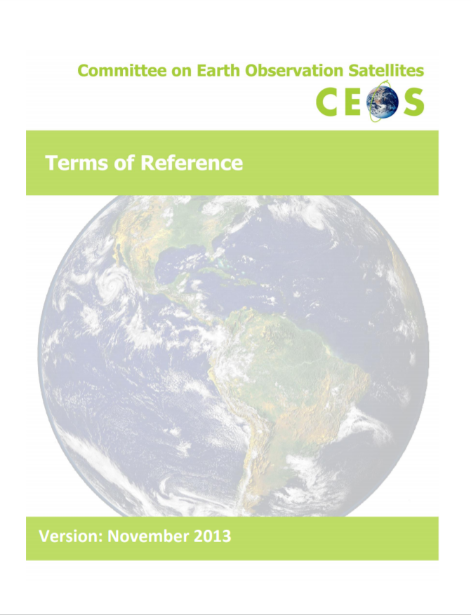
Governing Documents
There are four CEOS governing documents that primarily guide the work of CEOS:
The CEOS Terms of Reference define the mission and scope of CEOS activities. (November 2013)
Notes:
To ensure it remains a vital and relevant organization, CEOS initiated a self-study in 2011 to revisit its mission and international role in light of the evolving nature of Earth observation initiatives and the changing needs of the Earth observation user community. As a result of this self-study, CEOS now employs three documents to guide and conduct its work: CEOS Strategic Guidance document, which articulates the overarching long-term (7-10 years) purpose and goals of CEOS; a CEOS Governance and Processes document, which provides updated guidelines with regard to CEOS’s structure and operations, and the processes CEOS employs to achieve its goals; and a three-year rolling CEOS Work Plan, which sets forth near-term actions to achieve the goals outlined in the CEOS Strategic Guidance document. The CEOS Terms of Reference were amended and updated but have always been the guiding document of CEOS since its inception in 1984.
Future amendments of these documents will require review at a SIT Meeting and approval at subsequent Plenary Meeting.

Slide 6
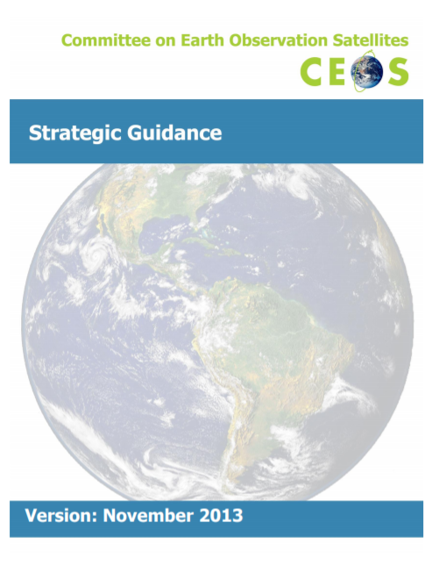
Governing Documents
The CEOS Strategic Guidance document articulates the overarching long-term (7-10 years) purpose and goals of CEOS. (November 2013)

Slide 7
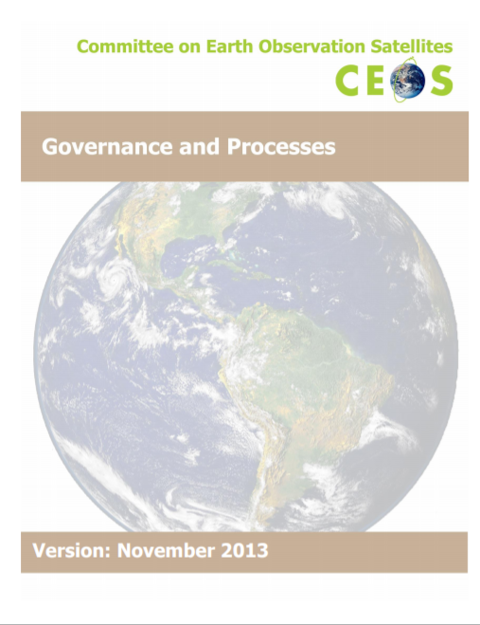
Governing Documents
The CEOS Governance and Processes document provides guidelines on the structure, operations, and processes CEOS employs to achieve its goals (~5 years). (November 2013)
Discussion Seed
Over the next 6 months, assess and make a determination at SIT Technical Workshop and Plenary if we need to update Governance and Processes Document.
Introduction and Background
Organizational Roles and Responsibilities
Decision-making Process
Major Meetings
Membership and Participation

Slide 8
Governing Documents
The CEOS Work Plan (3-year rolling) sets forth near-term actions to achieve the goals outlined in the CEOS Strategic Guidance document. (March 2018)
Realize the CEOS Work Plan
This is our agencies’ commitments to working as members of CEOS
Adjust VC and WG contributions based on results of questionnaire

Slide 9
Governing Documents
Other governing documents define the roles, responsibilities, and plans of the various CEOS leadership positions and organizational entities. These include:
Terms of Reference – CEOS Chair, Strategic Implementation Team (SIT) Chair, CEOS Secretariat, CEOS Executive Officer (CEO), CEOS Systems Engineering Office (SEO)
Process Papers – Working Group, Virtual Constellations, and New Initiatives

Slide 10
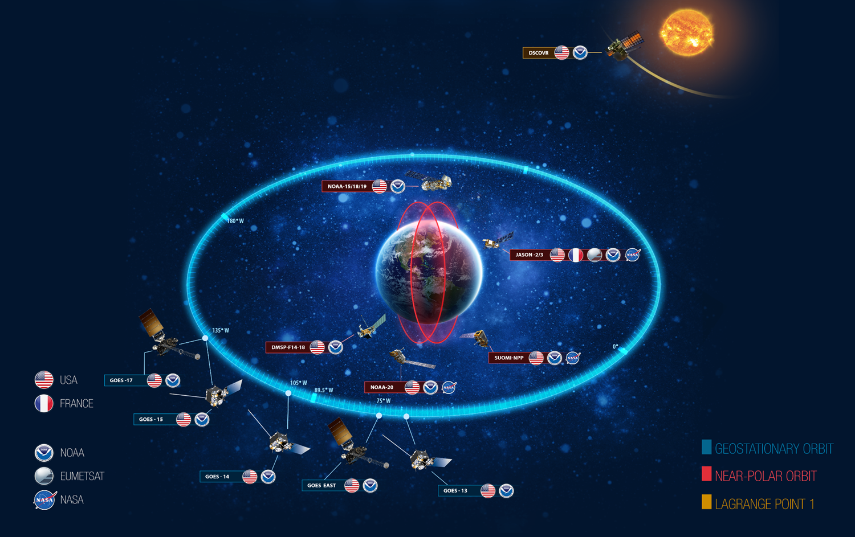
An Example – Greater Sum than Individual Parts
NOAA operates 18 satellites

Slide 11
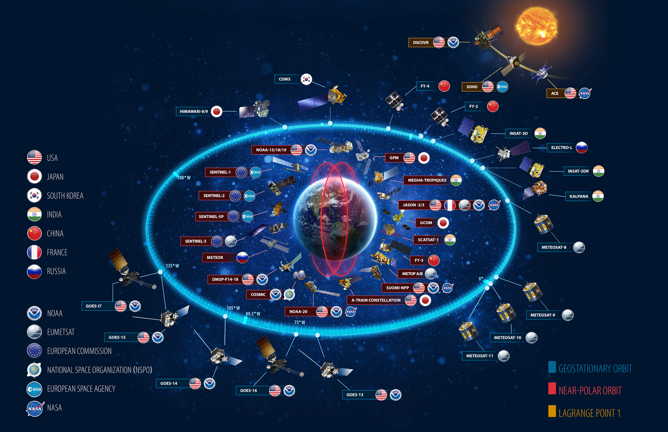
But this is how many satellites NOAA sees
through our partnerships with CEOS Agencies*
* And one non-CEOS Agency

Slide 12
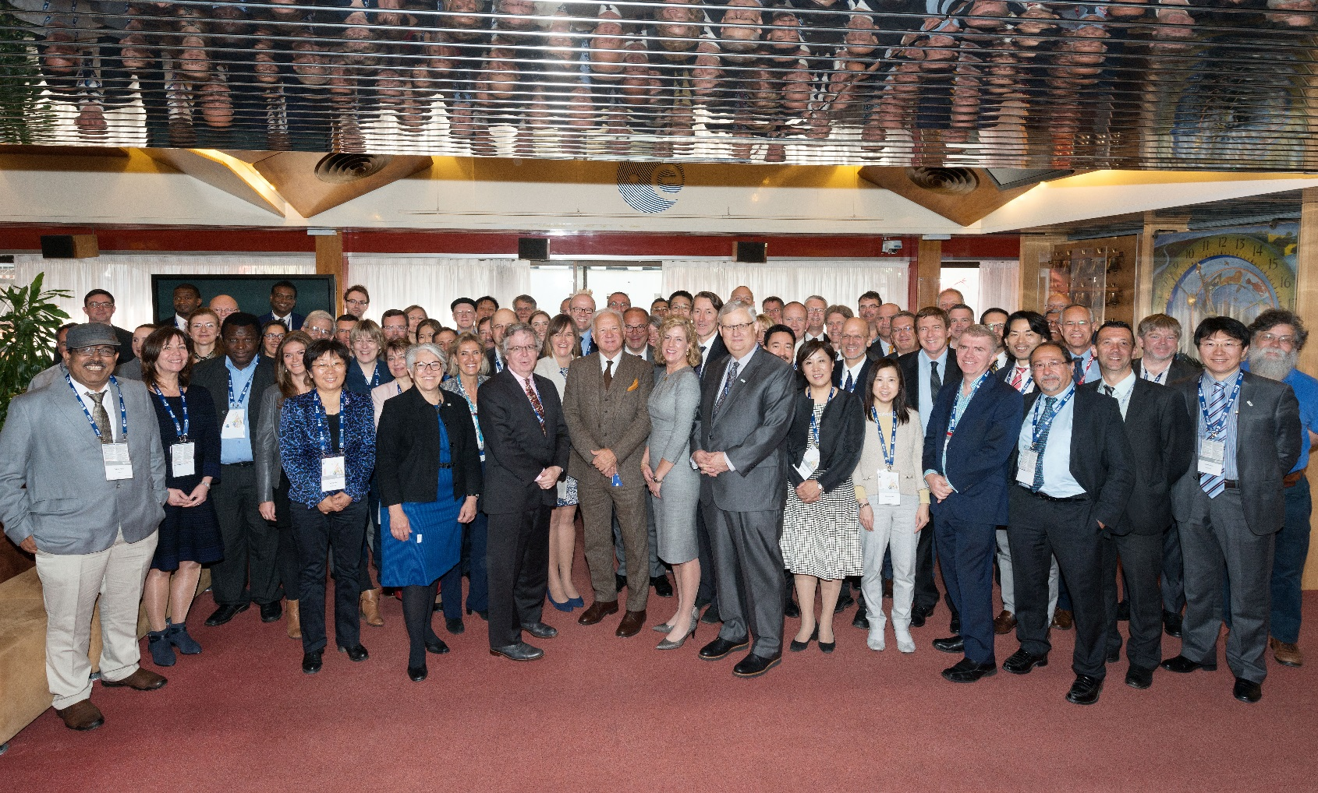
Plus, we are not just the Committee on Earth Observation Satellites but we are also a Community of Earth Observation Satellites

