Slide 1

NOAA Future Observing System Objectives
Committee on Earth Observation Satellites
Steve Volz, CEOS SIT Chair
National Oceanic and Atmospheric Administration (NOAA)
CEOS SIT-33
Session 1, Agenda Item 1.7
Boulder, CO, USA
24 – 25 April 2018

Slide 2
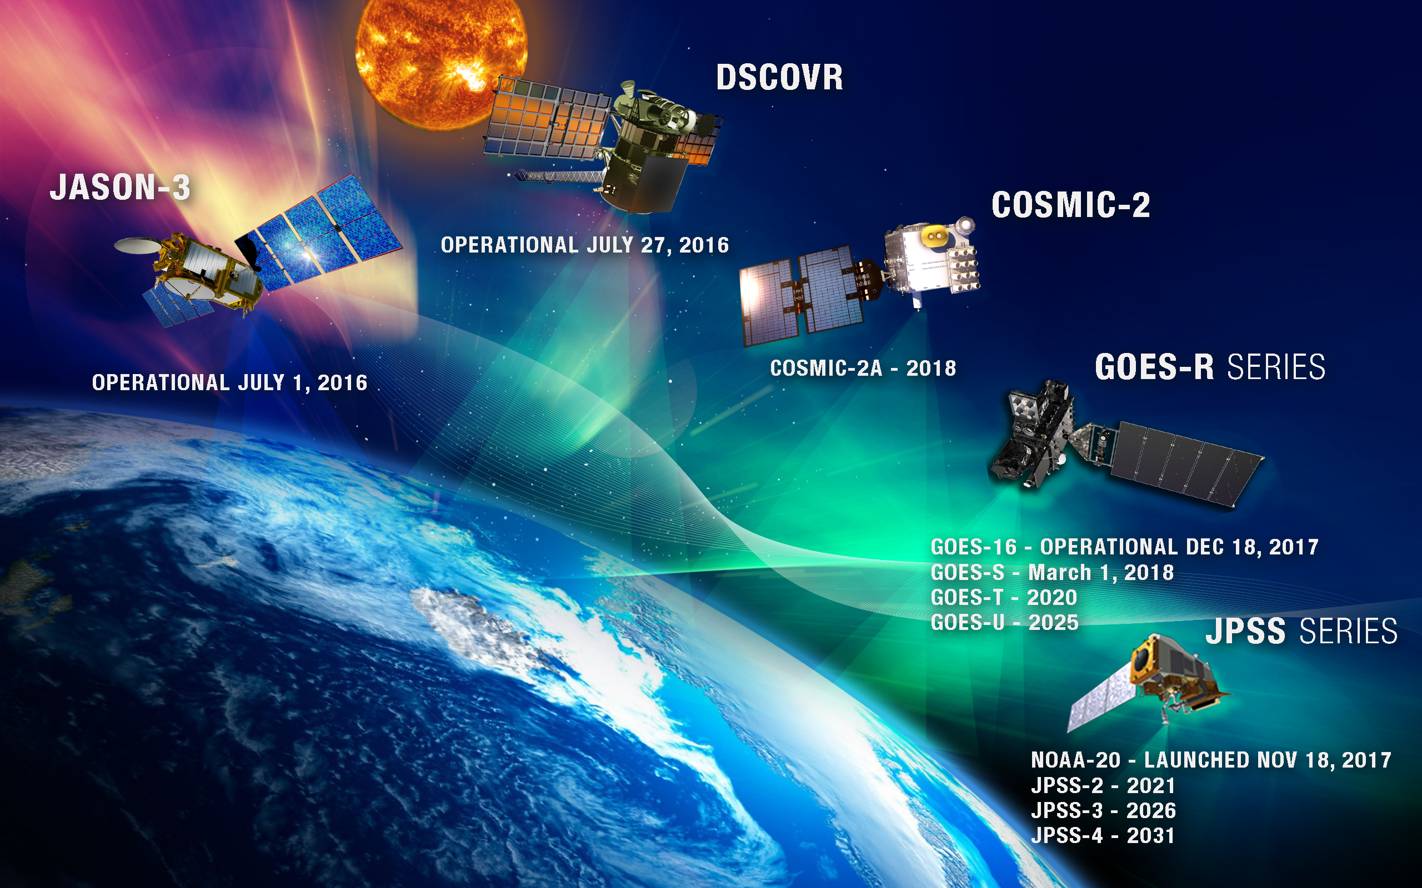
Committed NOAA Assets
Meet a portion of our system needs
SIT-33, 24-25 April 2018
2

Slide 3
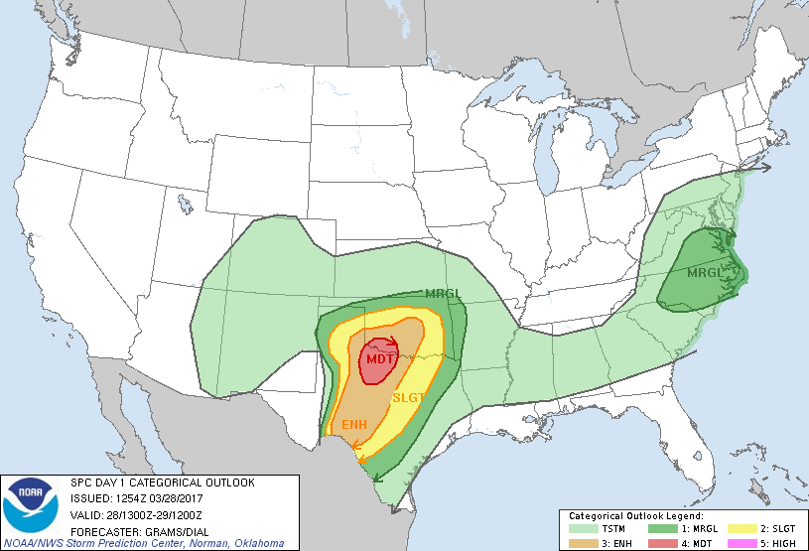

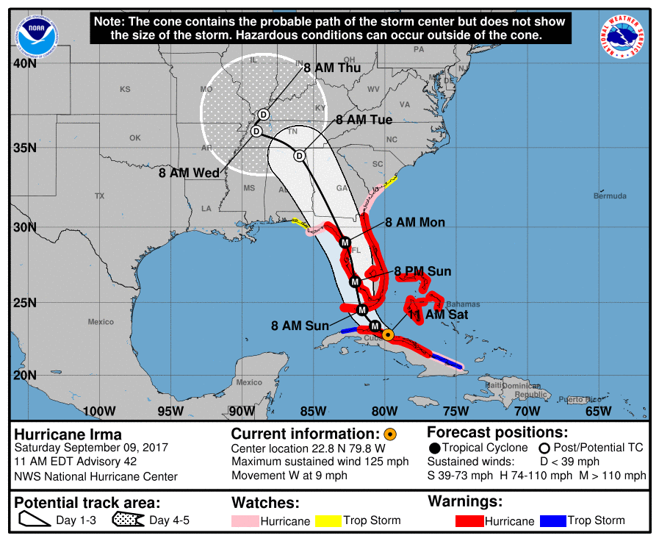
NOAA Architecture Study Intended to Inform New System Options
NOAA Satellite Observing Systems Architecture (NSOSA) study is examining NOAA’s future space segment architecture decisions
  Which observation functions should be allocated to which orbits?
  Should we retain the legacy architecture or seek major change?
  Which observation functions should be improved?
Addressing NOAA operational needs, from defined requirements
  Observations that result in warnings, watches, baseline weather and space weather forecasts, and ocean or fisheries actions
Scoped to address NOAA systems, with a knowledge and inclusion of partner contributions and relationships, and consideration of our joint partner responsibilities

Slide 4
Developing the Architecture for the Future
NOAA User Prioritized Requirements
Strategic
Priorities
National Weather Service
National Marine Fisheries Service
National Ocean Service
Oceanic and Atmospheric Research
Operational Considerations
(NOAA/DoD/ Met Partners)
Policies & Standards
Technology Opportunities
Instrument Capabilities Allocated to Orbits
Replenishment policies
Cost estimates
Technology roadmap
NSOSA Architecture Analysis
Pre-Phase A
Commercial Data/Services
Partner Sources
Program(s) of Record
NOAA Ground
Source Agnostic Data/Products

Slide 5
NSOSA Study Approach
Study is organized into 3 major lines of effort built around 3 major design cycles
  Three Lines: Value Model, Instrument Catalog, Constellation Synthesis
  Each design cycle does complete, end-to-end designs of multiple alternative architectures
  Scoring is based on how well all NOAA mission needs are met
Value Model Development
Score Alternatives
Instrument Catalog Development
Integration, Trades, Architecture Selection
Design and Cost Alternatives
Constellation Alternative Synthesis
Three full architecture cycles enable:
user engagement, learning, fine tuning
High-Value Alternative Architectures
SIT-33, 24-25 April 2018
Notes:
Build a 2030 Value Model with a trade-able range (from study threshold or “Walk-away” level to maximum effective)
Chose to write in terms of satellite observations and worked through the SPRWG
Also have a parallel effort based on a pre-existing NESDIS value model
Project cost/performance of cost-driving elements to 2030
For these satellites the instruments are the primary cost drivers
Generate and assess a wide range of alternative constellations, bracketing the projected budget level
Concentrate on selection of genericized instruments, their assignment to orbits, and the launch cadence required to reach desired availability levels

Slide 6
Architecture Designed Around Expected Assets
POR2025
2020
2025
2030
2035
2040
2045
2050
GOES
NSOSA Scope
JPSS
Sounding (μW, IR, RO)
Real Time Imaging
Ozone, Clouds, winds
Space Weather
COSMIC-2
DSCOVR/SWFO
Ocean Altimetry
MTG
EPS-SG
Sentinel
JMA Himawari
Radarsat
2028
GOES-S Flies Out
Assumed Partner Contibutions

Slide 7

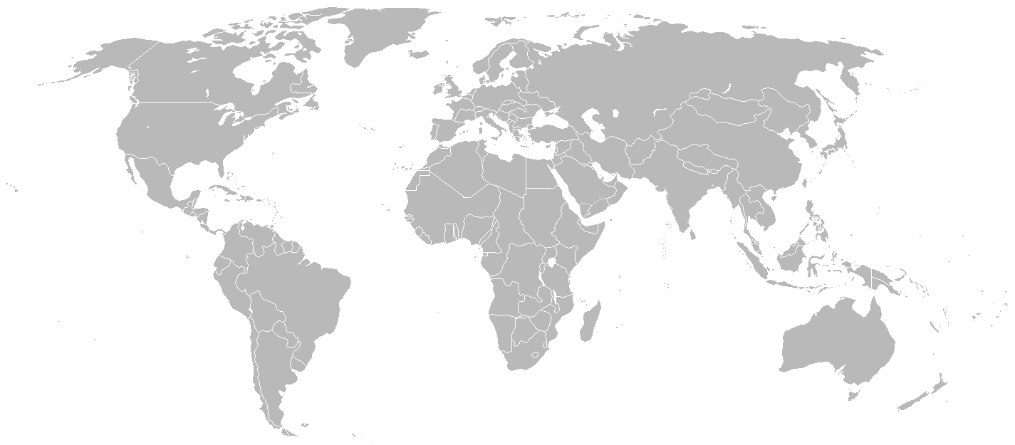






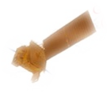



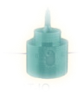
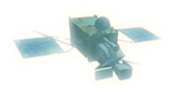


NOAA’s & Partners’ Legacy Constellation (and Architecture)
Regional RT from GEO, Government satellites
SENTINEL 3
JASON
JPSS-1 or 2
HIMAWARI
(JAPAN) 140° E
GEO-KOMPSAT
(SOUTH KOREA)
128° E
GOES-W
3rd Gen. (USA) 135° W
Radarsat
GOES-Spare
3rd Gen. (USA) 105° W
GNSS-RO
GOES-E
3rd Gen. (USA)
75° W
EPS-SG-A
EPS-SG-B
METEOSAT-IO
(EUMETSAT) 57.5° E
METEOSAT 3rd Gen. (EUMETSAT) 0°
SWFO – L1
Global coverage from polar SS and partners, all Government satellites
Mixed functions at L1, Government satellites
SIT-33, 24-25 April 2018

Slide 8
What is a Successful Architecture Analysis?
Inputs:
Sound understanding of current and projected future observing capabilities – Constellation Gap Analyses and Partner Agency strategic plans
Accurate assessment of instrument technologies
Educated guess of future commercial interests and capabilities
Outputs:
Provide discriminating choices and opportunities about the next generation constellation architecture for NOAA Systems
Support NOAA development of a clear vision/roadmap for the next generation, including actionable trade studies and demonstrations
Establish a robust analytic
capability to evaluate and
iterate opportunities
Examples of Upcoming Trades
Transition to hosting payloads
Give up some legacy measurements
Space weather collected differently
Cross-grade imagers
New NOAA LEO orbits (0530, crossing)

Slide 9

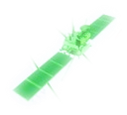
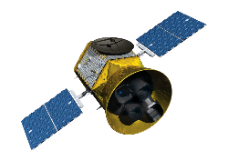
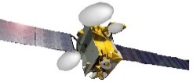
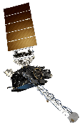

Tundra
Exemplar Possible Hybrid Architecture
GEO is mixed US Gov. satellites & hosted payloads
Partially disaggregated LEO systems
Mixed resolution payloads, update rates
SENTINEL
JASON
Sounder 1330
HIMAWARI
(JAPAN) 140° E
Hosted Imager West
GEO-KOMPSAT
(SOUTH KOREA) 128° E
Wind LIDAR
Radarsat
Hosted Instrument of Opportunity
Sounder 0530
Comprehensive SWX – L1
US Gov Center GEO
“SuperGOES”
Hosted Imager East
EPS-SG-A
EPS-SG-B
MTG-S
(EUMETSAT)
GNSS-RO Data Buys
Communications Service Buys
MTG-I
(EUMETSAT) 0°
Comprehensive SWX – L5
Tundra
Comprehensive space weather

