Slide 1
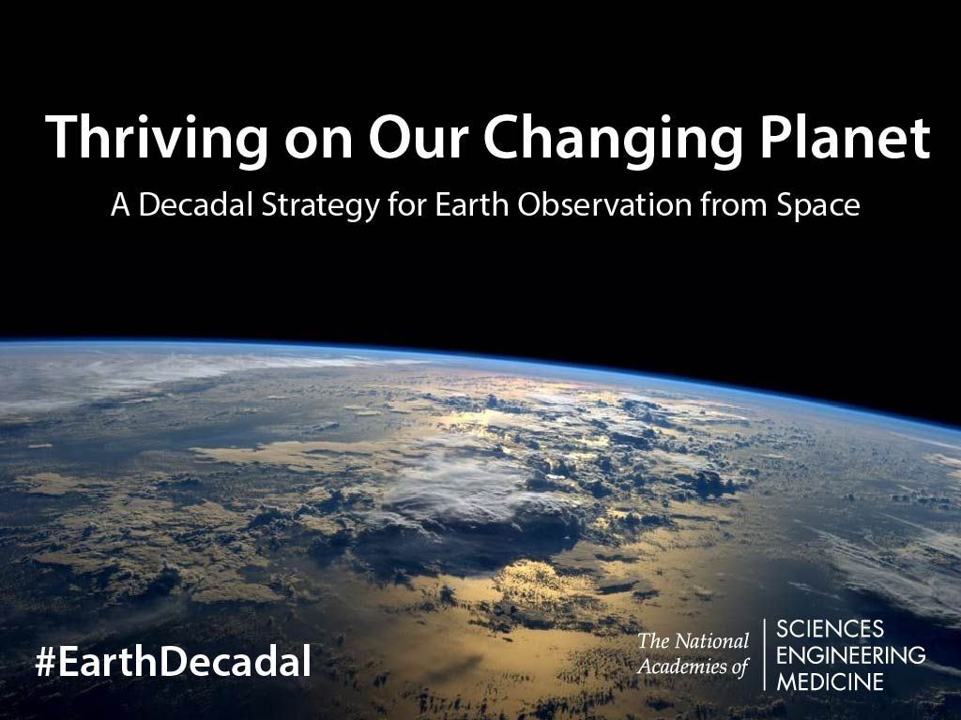
A report of the Decadal Survey for Earth Science and Applications from Space
Released: 5 January 2018
Report available at: http://www.nas.edu/esas2017

Slide 2
Quick Summary: Recommendations
2
SCIENCE & APPLICATIONS
Address 35 key science/applications questions, from among hundreds suggested. Those with objectives prioritized as most important fell into six categories:
Coupling of the Water and Energy Cycles
Ecosystem Change
Extending & Improving Weather and Air Quality Forecasts
Sea Level Rise
Reducing Climate Uncertainty & Informing Societal Response
Surface Dynamics, Geological Hazards and Disasters
1
VISION & STRATEGY
“Thriving on our Changing Planet”
OBSERVATIONS
Augment the Program of Record with eight priority observables:
Five that are specified to be implemented:
  Aerosols
  Clouds, Convection, & Precipitation
  Mass Change
  Surface Biology & Geology
  Surface Deformation & Change
Three others to be selected competitively from among seven candidates
Structure new NASA mission program elements to accomplish this
Methods for new NASA capabilities to be leveraged by NOAA and USGS
4
3
PROGRAMMATICS
CROSS-AGENCY
NASA
  Flight
  Technology
  Applications
NOAA
USGS

Slide 3
What We Were Asked to Do
OVERARCHING TASKS
Assess progress from 2007
Develop a prioritized list of top-level science and application objectives for 2017-2027
Identify gaps and opportunities in the programs of record at NASA, NOAA, and USGS
Recommend approaches to facilitate the development of a robust, resilient, and appropriately balanced U.S. program of Earth observations from space
GENERAL & AGENCY-SPECIFIC TASKS
Cross-Agency
  Enabling activities
  Partnerships & synergies
NASA
  Program balance and scope
  Ventures flight element
  Decision principles and measurement continuity
NOAA and USGS
  Non-traditional observation sources
  On-ramp of scientific advances
  Research-to-operations
  Technology replacement/infusion

Slide 4
Comparison to ESAS 2007
  Prioritization Method. Prioritize science and applications instead of missions
  Operational. NOAA’s operational system was not considered in this report
  Budget Resources. Align with planned budgets instead of aspirational
  Large Missions. Avoid having one recommended activity grow at expense of all others
  Innovation. Consider “new space” technology and business ideas
  Policy. Existence of recent high-level US government policy guidance regarding Earth observations
  International. Increased recognition of important role of international partners

Slide 5
Steering Committee
WALEED ABDALATI, University of Colorado Boulder, Co-Chair
WILLIAM B. GAIL, Global Weather Corporation, Co-Chair
STEVEN J. BATTEL, Battel Engineering, Inc.
STACEY W. BOLAND, Jet Propulsion Laboratory
ROBERT D. BRAUN, University of Colorado
SHUYI S. CHEN, University of Washington
WILLIAM E. DIETRICH, University of California, Berkeley
SCOTT C. DONEY, University of Virginia
CHRISTOPHER B. FIELD, Stanford University
HELEN A. FRICKER, Scripps Institution of Oceanography
SARAH T. GILLE, Scripps Institution of Oceanography
DENNIS L. HARTMANN, University of Washington
DANIEL J. JACOB, Harvard University
ANTHONY C. JANETOS, Boston University
EVERETTE JOSEPH, University of Albany, SUNY
JOYCE E. PENNER, University of Michigan
SOROOSH SOROOSHIAN, University of California, Irvine
GRAEME L. STEPHENS, Jet Propulsion Laboratory/Caltech
BYRON D. TAPLEY, The University of Texas at Austin
W. STANLEY WILSON, National Oceanic and Atmospheric Administration (ret.)
ANTONIO J. BUSALACCHI JR., NAE (Original Co-Chair - resigned from committee, 8/19/2015 -- 5/5/2016) UCAR
MOLLY K. MACAULEY [Deceased], (Member, 12/1/2015 -- 7/8/2016) Resources for the Future
National Academies
  Space Studies Board (lead)
  Board on Atmospheric Sciences and Climate
  Board on Earth Sciences and Resource
  Ocean Studies Board
  Polar Research Board
  Water Sciences and Technology Board

Slide 6
Panels
Global Hydrological Cycles and Water Resources
Co-Chairs: Jeff Dozier, UC Santa Barbara and Ana Barros, Duke University
The movement, distribution, and availability of water and how these are changing over time
Weather and Air Quality: Minutes to Subseasonal
Co-Chairs: Steve Ackerman, University of Wisconsin and Nancy Baker, NRL
Atmospheric Dynamics, Thermodynamics, Chemistry, and their interactions at land and ocean interfaces
Marine and Terrestrial Ecosystems and Natural Resource Management
Co-Chairs: Compton (Jim) Tucker, NASA GSFC and Jim Yoder, WHOI
Biogeochemical Cycles, Ecosystem Functioning, Biodiversity, and factors that influence health and ecosystem services
Climate Variability and Change: Seasonal to Centennial
Co-Chairs: Carol Anne Clayson, WHOI and Venkatachalam (Ram) Ramaswamy, NOAA GFDL
Forcings and Feedbacks of the Ocean, Atmosphere, Land, and Cryosphere within the Coupled Climate System
Earth Surface and Interior: Dynamics and Hazards
Co-Chairs: Dave Sandwell, Scripps and Doug Burbank, UC Santa Barbara
Core, mantle, lithosphere, and surface processes, system interactions, and the hazards they generate

Slide 7

The Decade Ahead
Thriving on our Changing Planet
A decade in which we find growing community and public recognition of:
Society’s broad reliance on Earth information to thrive
The growing challenge of understanding and predicting a moving target, as Earth change happens around us through natural and human influence

Slide 8
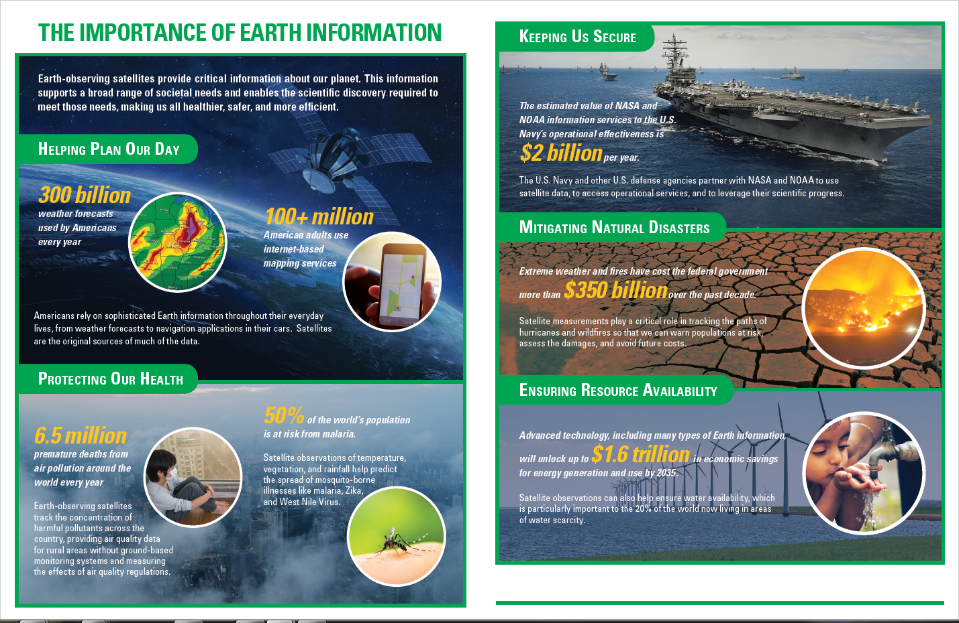
Earth Information is Increasingly
Critical to Thriving on our Planet
9

Slide 9
A Paradigm and Challenge of the decade
UNDERSTANDING SEA LEVEL RISE EXEMPLIFIES EARTH AS A SYSTEM OF INTERACTIONS
Prediction is the realm of Earth system science
Earth science and derived Earth information have become an integral component of our daily lives, our business successes, and society’s capacity to thrive. Extending this societal progress requires that we focus on understanding and reliably predicting the many ways our planet is changing.
ii) Earth System Science and Applications Paradigm
Changes to our planet are a result of processes that couple together in complex ways establishing Earth as a system. Predicting changes to the Earth system requires an integrated Earth system model and a more integrated systems approach to observing Earth
iii) Decadal Community Challenge
Pursue increasingly ambitious objectives and innovative solutions that enhance and accelerate the science/applications value of space-based Earth observation and analysis to the nation and to the world in a way that delivers great value, even when resources are constrained, and ensures that further investment will pay substantial dividends.

Slide 10
Path from Science & Applications to Observational Priorities
Blue: Science & Applications; Green: Observables

Slide 11
Recommended NASA Flight Program Elements
Designated. A new program element for ESAS-designated cost-capped medium- and large-size missions to address observables essential to the overall program and that are outside the scope of other opportunities in many cases. Can be competed, at NASA discretion.
Earth System Explorer. A new program element involving competitive opportunities for medium-size instruments and missions serving specified ESAS-priority observations. Promotes competition among priorities.
Incubation. A new program element, focused on investment for priority observation opportunities needing advancement prior to cost-effective implementation, including an Innovation Fund to respond to emerging needs. Investment in innovation for the future.
Venture. Earth Venture program element, as recommended in ESAS 2007 with the addition of a new Venture-Continuity component to provide opportunity for low-cost sustained observations.
Program of Record.
The series of existing or previously planned observations, which should be completed as planned. Execution of the ESAS 2017 recommendation requires that the total cost to NASA of the Program of Record flight missions from FY18-FY27 be capped at $3.6B.

Slide 12
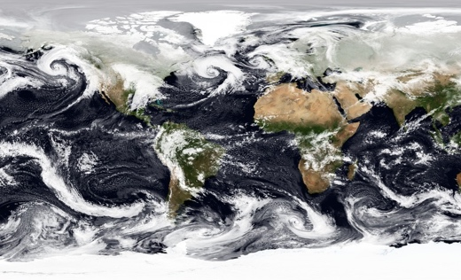
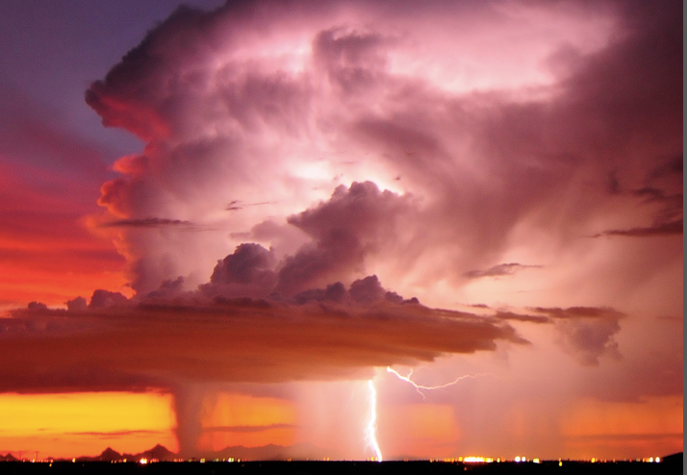
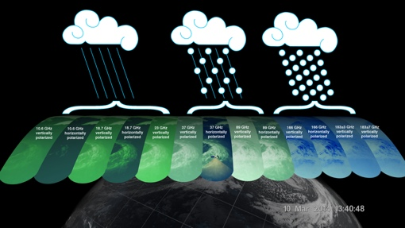

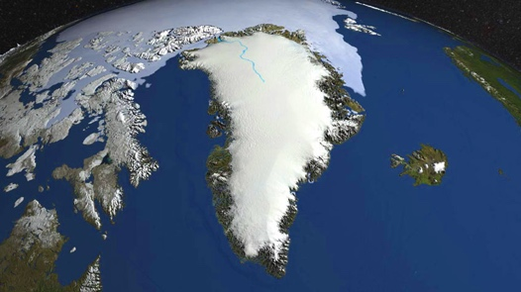
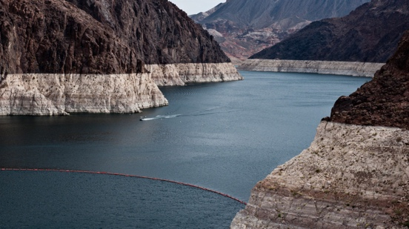
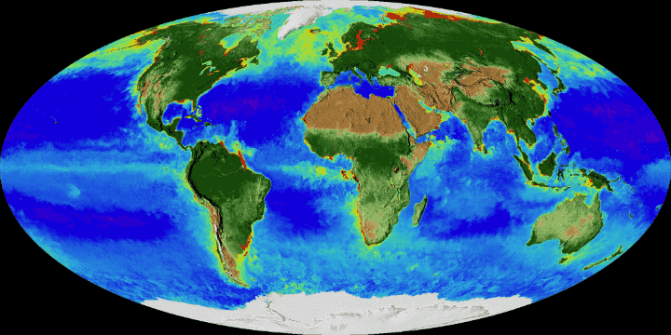
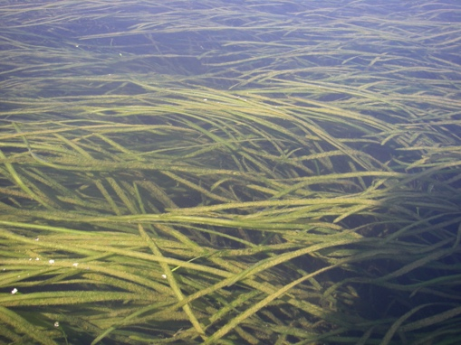
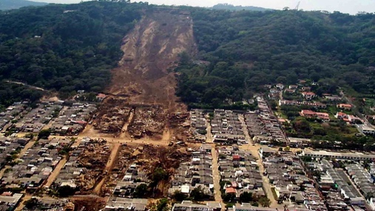
Anticipated Science/Applications Accomplishments
DESIGNATED Program Element
Candidate EXPLORER Program Element
Sources and sinks of CO2 and methane
Contributions of glaciers and ice sheets to sea level rise
Impacts of ocean circulation and exchange with atmosphere on weather and climate
Changes in ozone and other gases and impacts on health and climate
Snow amounts and melt rates and implications for water resources
Impact of changes in land cover and related carbon uptake on resource management
Transport of pollutants and energy between land, ocean, and atmosphere
Make-up and distribution of aerosols and clouds
Severe weather, convective storms
Impacts of changing cloud cover and precipitation
Growth or shrinkage of glaciers and ice sheets
Trends in water stored on land
Alterations to surface characteristics and landscapes
Movement of land and ice surfaces
Evolving characteristics and health of terrestrial vegetation and aquatic ecosystems

Slide 13
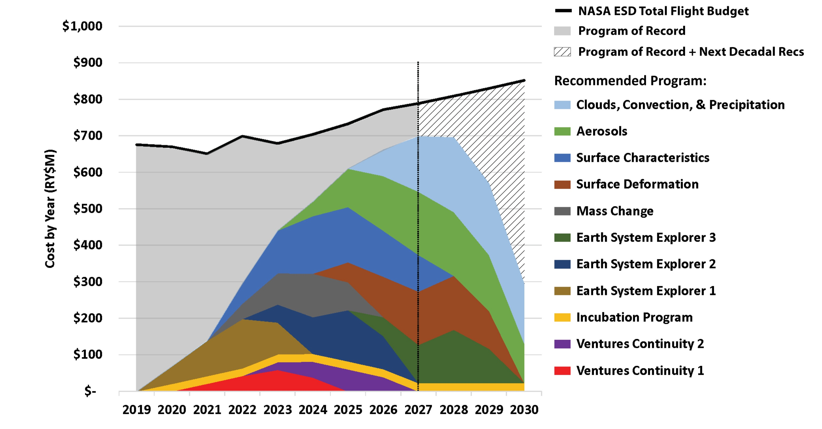
NASA Budget Compliance
Liens from last decade into this one are substantial
Very little flexibility to absorb funding challenges until mid decade
Committee sought to keep liens lower on next decade
  Allows more flexibility for next decadal survey
  Some carry over of programs into subsequent decade is required

Slide 14
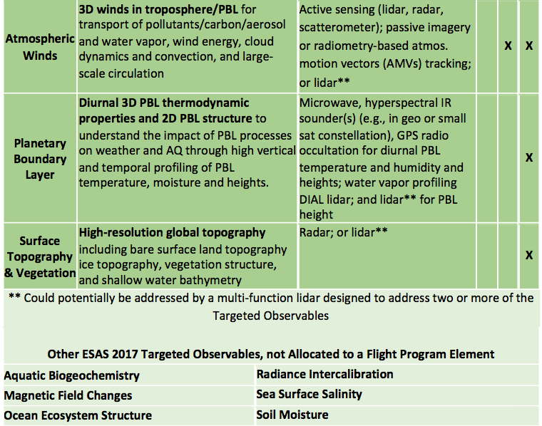
Recommended NASA Priorities: Incubation/Other

Slide 15
NOAA Observation System Opportunities

Slide 16
Partnerships
Finding 4C: NASA, NOAA, and USGS have successfully relied on international partnerships to enhance their programs. Partnerships potentially lower the overall cost to the U.S of space-based observations and enable more of this Decadal Survey’s priorities than could otherwise be achieved. In certain cases, current restrictions on potential international partnerships hinder access to observations and thus limit opportunities to reduce U.S. cost and/or enhance science and applications.
Recommendation 4.5: Because expanded and extended international partnerships can benefit the nation:
NASA should consider enhancing existing partnerships and seeking new partnerships when implementing the observation priorities of this Decadal Survey.
NOAA should strengthen and expand its already strong international partnerships, by a) coordinating with partners to further ensure complementary capabilities and operational backup while minimizing unneeded redundancy; and b) extending partnerships to the more complete observing system life-cycle that includes scientific and technological development of future capabilities.
USGS should extend the impact of the Sustainable Land Imaging (SLI) program through further partnerships such as that with the European Sentinel program.

Slide 17
Specific roles of international co-ordination and partnerships
The program of record
Many of the science and application priorities are addressed by the Program of Record (POR) and it is essential that these measurements continue to be supported. It is also essential that in addressing the ESAS priorities:
    We exploit the PoR evolving capabilities
    We consider what in the PoR needs augmenting (gaps & continuity )
International partnerships
Implementation of the Decadal Survey measurement priorities would benefit from :
    Building upon existing activities & partnerships
    establishing new international partnerships

Slide 18
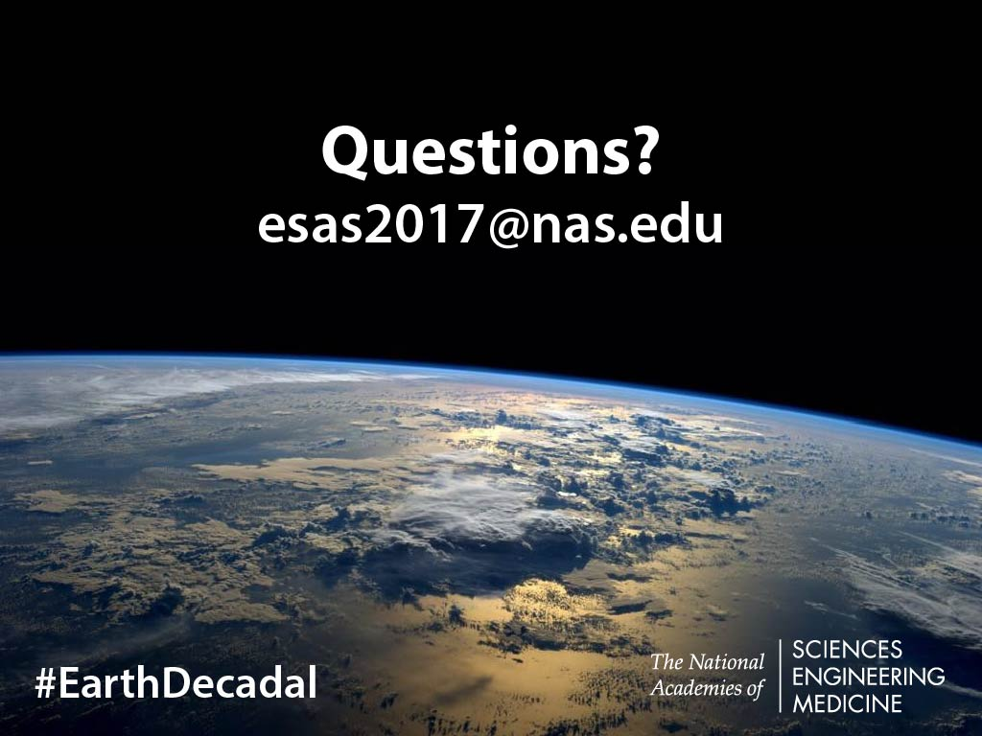
Thriving on our Changing Planet
A decade in which we find growing community and public recognition of: Society’s broad reliance on Earth information to thrive.
The growing challenge of understanding and predicting a moving target, as Earth change happens around us through natural and human influence
THANK YOU!

Slide 19
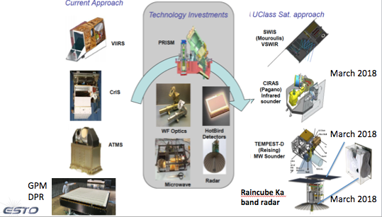
We can expect to see real advances in sensor innovation
May
May
plus others (e.g. PREFIRE,…)

Slide 20
Finding 4A: NASA, NOAA, and USGS applications-oriented programs have successfully transitioned remote-sensing-based research into applications of societal, economic, and operational value, but much more is both needed and possible. The transition has recognized barriers: a) conservatism by operational agencies that is often justified but may also make them slow to adopt advances; b) lack of early involvement in the research component of the research-to-applications process by operational agencies; c) a shortage of specific funds and well-defined responsibilities for ensuring the rapid and effective realization of applications
from research, and d) insufficient academic focus on the science of applications.
Recommendation 4.1: NASA, NOAA, and USGS should reduce barriers to applied uses of remote-sensing research and seek innovative ways to accelerate the transition of scientific research into societal benefits.

Slide 21
Recommendation 4.5: Because expanded and extended international partnerships can benefit the nation:
• NASA should consider enhancing existing partnerships and seeking new partnerships when implementing the observation priorities of this Decadal Survey.
• NOAA should strengthen and expand its already strong international partnerships, by a) coordinating with partners to further ensure complementary capabilities and operational backup while minimizing unneeded redundancy; and b) extending partnerships to the more
complete observing system life-cycle that includes scientific and technological development of future capabilities.
• USGS should extend the impact of the Sustainable Land Imaging (SLI) program through further partnerships such as that with the European Sentinel program.

Slide 22
Recommended NASA Priorities: Designated

Slide 23
Recommended NASA Priorities: Explorer

Slide 24
Recommended NASA Priorities: Incubation/Other

Slide 25
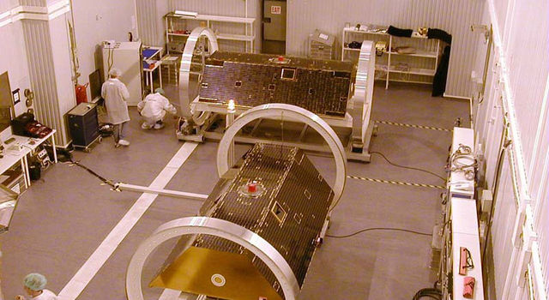
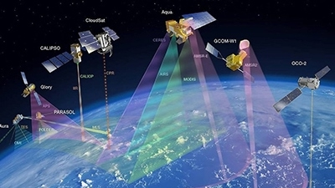

Anticipated Programmatic Progress
Programmatic implementation within the agencies will be made more efficient by:
Increasing program cost-effectiveness
Institutionalizing sustained science continuity
Enabling untapped interagency synergies
Improved observations will enable exciting new science and applications by:
Initiating or deploying more than eight new priority observations of our planet
Achieving breakthroughs on key scientific questions
Enhanced societal value will be provided to businesses and individuals from scientific advances and improved Earth information, such as:
Increased benefits to operational system end-users
Accelerated public benefits of science
New enabling data for innovative commercial uses

Slide 26

NASA Portfolio Balance
Earth Science research and analysis: maintain at approximately 24% of the ESD budget (22-26%)
  Includes 18% for openly competed research and analysis
  Includes approximately 3% each for computing and administration
Flight program (including Venture): maintain at 50-60% of the ESD budget
Mission operations: maintain at 8-12% of the ESD budget
Technology program: increase from current 3% to about 5% of the ESD budget
Applications program: maintain at 2-3% of the ESD budget

Slide 27
Programmatics - NASA
Rec 4.6 Apply decision rules (included) to maintain programmatic balance (programmatic balance was a high priority)
Rec 4.7 Small scope changes to applications & technology programs
Rec 4.8 Reevaluate Ventures structure at mid-term
Rec 3.3 Avoiding cost growth is critical to program’s success (capability and reliability are where the flexibility must be found)

Slide 28

Programmatics - NOAA
Rec 4.9 Make it easier to extend use of satellite data for NOAA purposes beyond weather
Rec 4.10 Further leverage US and international government partner observations, allocating budget as needed to do so
Rec 4.11 Be a leader in exploiting commercial observations
Rec 4.12 Establish with NASA a flexible framework to co-develop technology that will be used by NOAA

Slide 29

Programmatics - USGS
Rec 4.13 Ensure Landsat user needs continue to be understood and addressed
Rec 4.14 Constrain and reduce Landsat development cost
Rec 4.15 Leverage Landsat-related partnerships, including international complements

Slide 30
Summary of Top Science & Applications Priorities*
* Complete set of Questions and Objectives in Table 3.3

