Slide 1
Welcome to SIT-33
Committee on Earth Observation Satellites
Steve Volz, CEOS SIT Chair
CEOS SIT-33
Session 1, Agenda Item 1.1
Boulder, CO, USA
24 – 25 April 2018

Slide 2
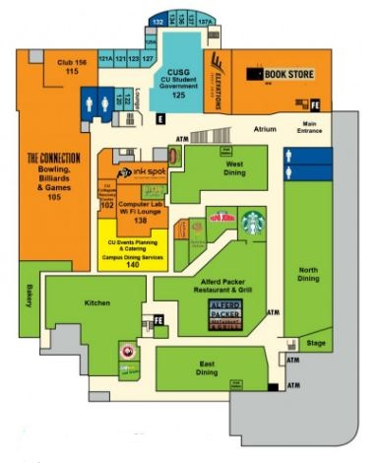
Emergency Exits

Slide 3
Coffee/Lunch

Slide 4
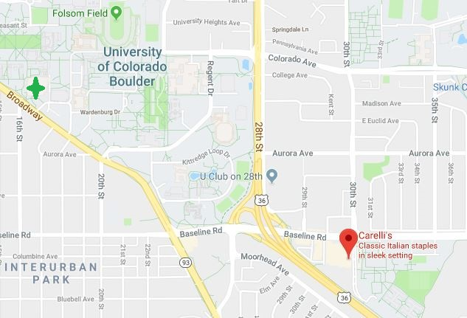
Reception: Carelli’s of Boulder
17:00
Address: 645 30th St, Boulder, Co 80303
Maps are available

Slide 5
Presentations
Any updated presentations must be submitted to Albert (AJ) during the break prior to your time slot. There will be no changes to presentations during the discussions.
Flash Drive or Albert.DeGarmo@NOAA.gov

Slide 6
Questions??
POC: Albert DeGarmo
Albert.DeGarmo@NOAA.gov
281 797 9720

