Slide 1
Carbon products: Calibration and validation approaches

Slide 2
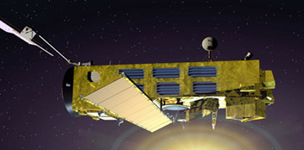
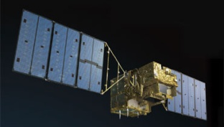
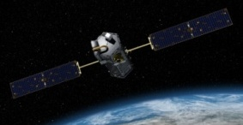
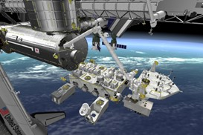
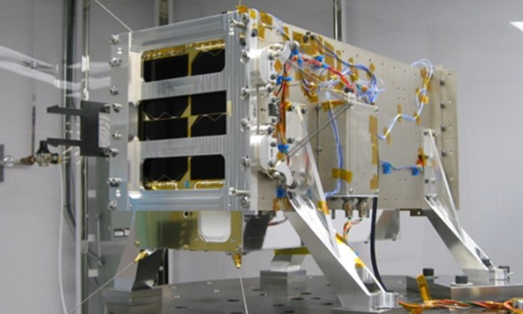
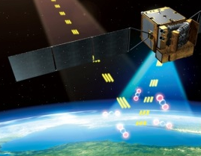
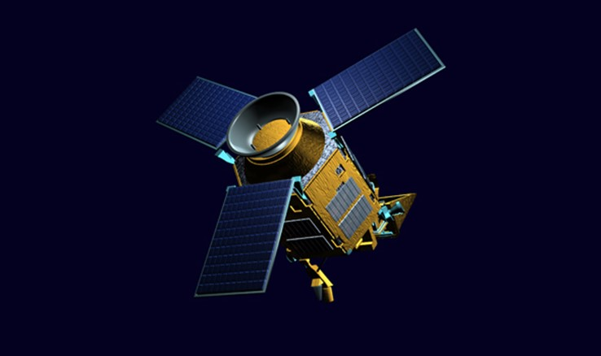
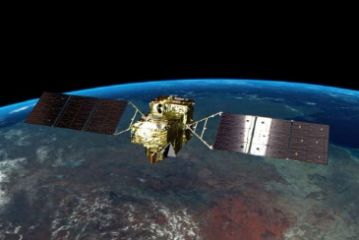
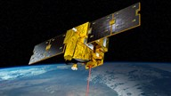
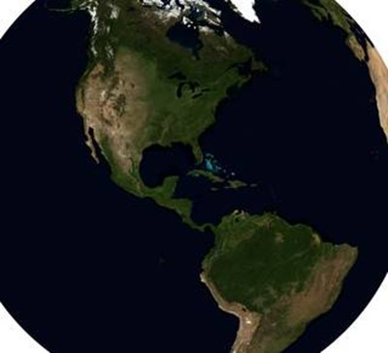
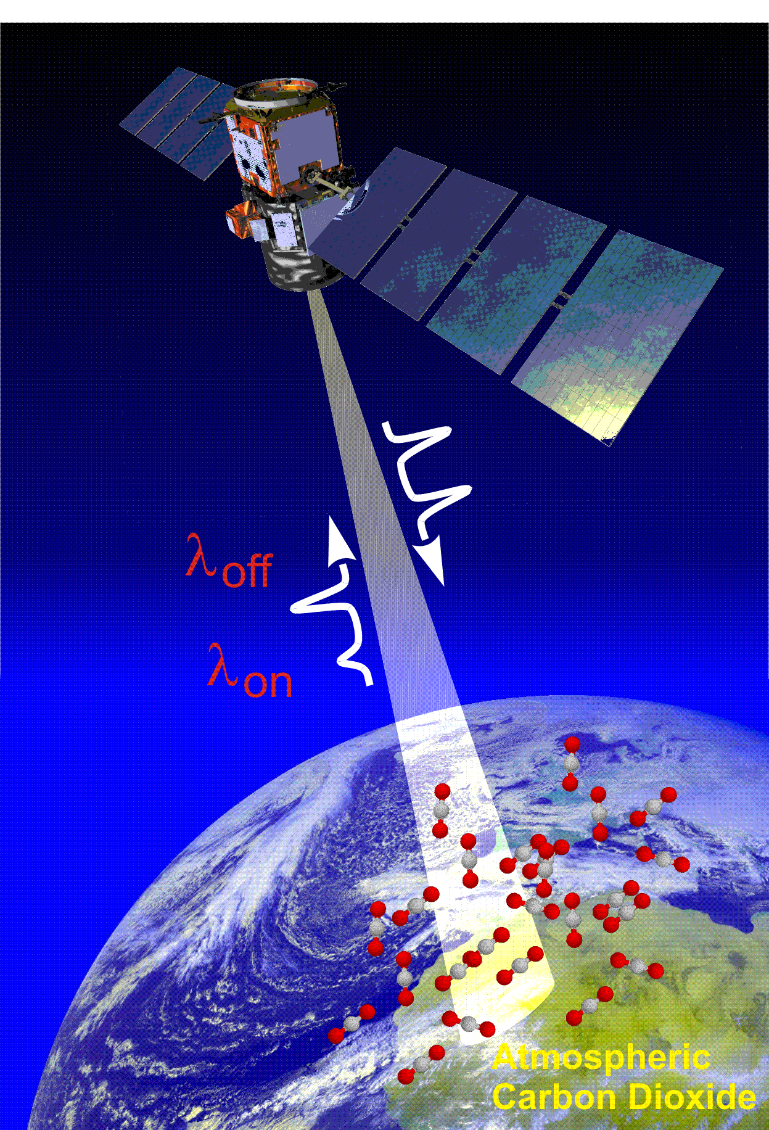
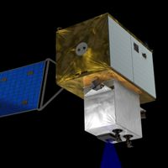
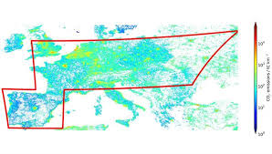
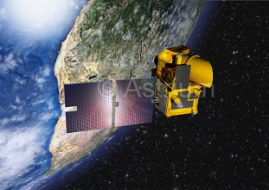
TANSO is the only FTS for GHG measurements from space
SCIAMACHY (2002 - 2012) | GOSAT (2009 - ) | OCO-2 (2014-) OCO-3 (2018) |  | GHGsat (2016-)
TanSat (2016-) | TROPOMI (2017-) | GOSAT-2 (2018-) | MERLIN (2020) | GeoCARB
MicroCarb (2020) | ASCENDS (2021) | CarbonSat (2022) | GOSAT-3 | G3E
 |  |  | Lab model test
2

Slide 3
International effort to demonstrate the effectiveness of satellite GHG observation.
Japanese GOSAT and US OCO-2 have different observation strategies.
TANSO-FTS onboard GOSAT has wide spectral coverage from SWIR to TIR and an agile pointing system at the expense of spatial context, while OCO-2 targets CO₂ with higher spatial resolution using imaging grating spectrometers.
Since the early phase of the two projects, both teams have worked in calibration and validation to demonstrate the effectiveness of satellite greenhouse gases observation.

Slide 4


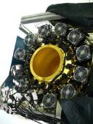
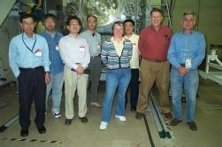
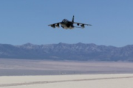
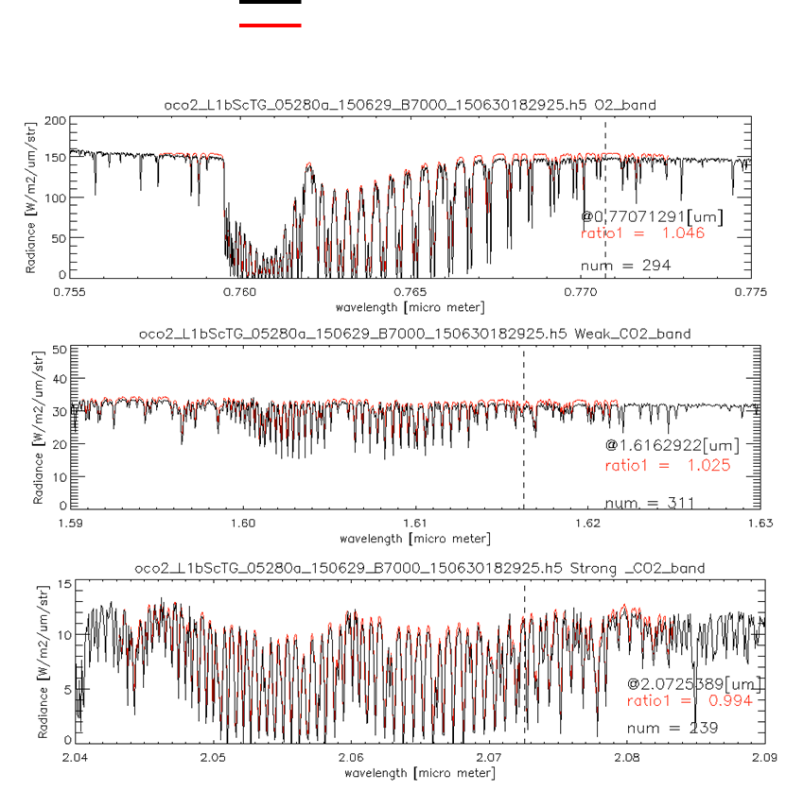
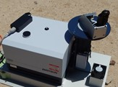
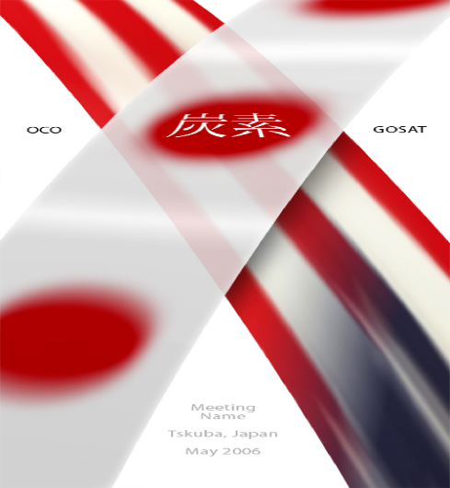
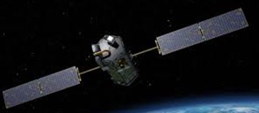
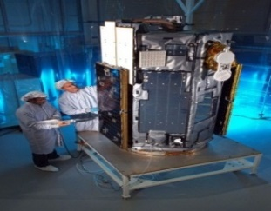
Inter-comparison between GOSAT and OCO-2
2008 2009 2010 2011 2012 2013 2014 2015 2016 2017
Radiometric calibration
Prelaunch
X-CAL
Annual Vicarious Calibration at the desert playa in Nevada
CO₂ & CH₄ profile
In situ CO₂ and CH₄ on AJAX
XCO₂ & XCH₄
Column with EM-27 FTS
Coincident Target
Retrieved Parameter
Comparison over match up points
Calibrated GOSAT and OCO-2 radiance spectra agrees within 5% for all bands.
Retreived XCO₂ bias is much less than 0.5ppm over match up observations points.
4

Slide 5
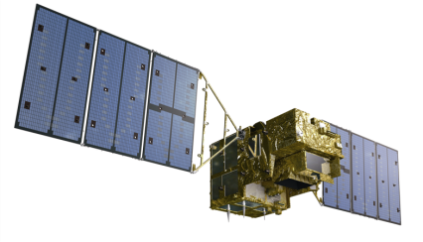
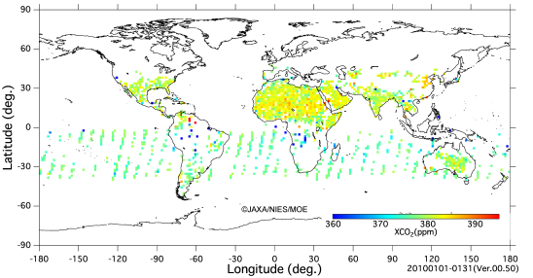
Calibration, Retrieval, and Validation
Common standards
Should be calibrated and validated in each level.
Measurement
H₂O
CH₄
CO₂
Level 1: spectra
Level 2: retrieved CO₂
GOSAT/TANSO-FTS and OCO-2 observe sunlight reflected from the Earth’s surface and retrieve atmospheric carbon dioxide (CO₂) with different observing geometries and ground track repeat cycles.
Most measured spectral radiances (Level 1) agree within 5% for all bands shared by the two instruments
Retrieved CO₂ densities also agree within +/- 4ppm (1%).
Level 1
Level 2

Slide 6
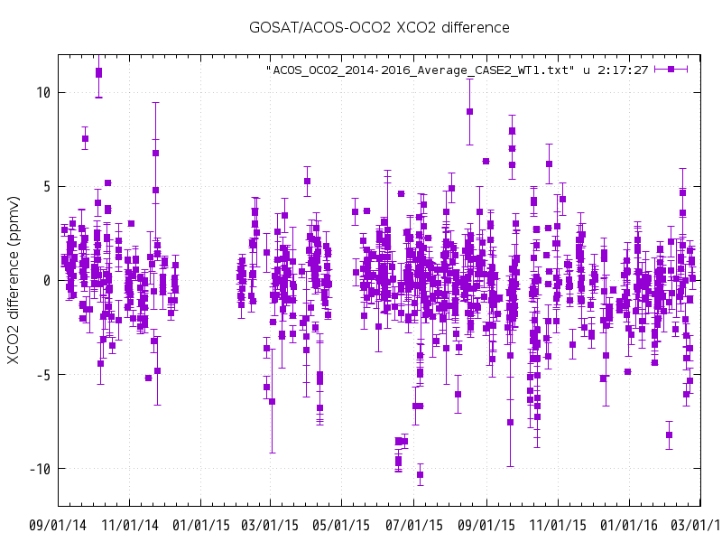

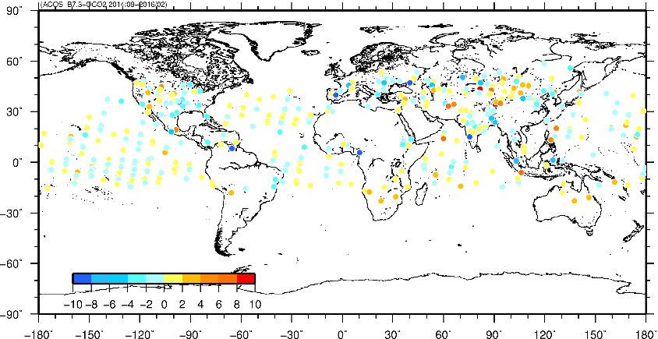
Intercomparison
GOSAT/ACOS –OCO2 Level 2 XCO₂
● Temporal : GOSAT – OCO2 time difference : +/- 1 hour
● Spatial : Select OCO2 data within
10.5 km GOSAT footprint
Sep2014
Feb2016
⊿XCO2 (ACOS-OCO2) error bar: ⊿XCO2 deviation within GOSAT-FOV
[Data period] 2014/09～2016/02 ; Level2 matchup : 715 points

Slide 7
Common Standards and Data for
Calibrations and Retrieval
 |  | Common standards and data | Notes
Calibration | Prelaunch | Cross-calibrate radiometers | Viewing common radiometric standard
 | Onboard | Solar data
 | Vicarious | CEOS site (RRV etc.) | Annual campaign
Retrieval Algorithm | Parameters | Molecular spectroscopy A priori model (Aerosol)
 | Input | Calibrated spectra at 0.76, 1.6, 2.0μm Observation geometry and condition | Level 1
 | Output | Retrieved column amount GHG Simultaneously retrieved parameters (aerosol optical depth, Solar-induced plant chlorophyll fluorescence (SIF)) | Level 2
Validation | Ground Site | High resolution spectrometer mobile spectrometer | TCCON
 | Air plane | In situ measured data | CONTRAIL etc.
 | Match up | Land type and Ocean | Viewing Common sites

Slide 8

Data products
Different satellite data are available from the same site
https://co2.jpl.nasa.gov/

Slide 9
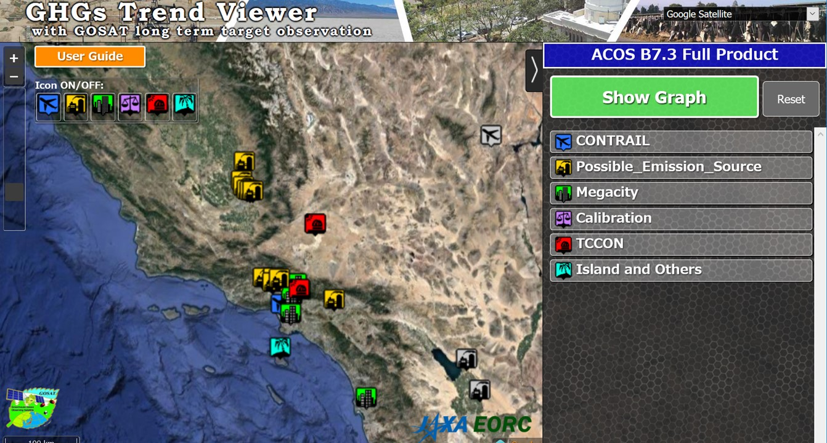
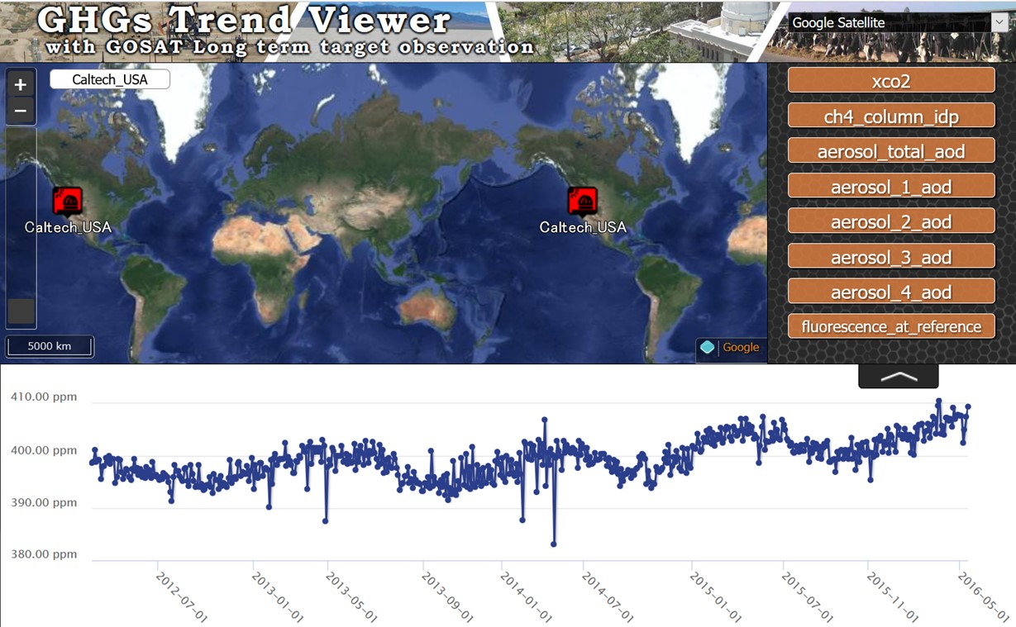
Long term data should be easy to use
CO₂, CH₄ ,4 Aerosol Optical Depth with type classification
Solar-induced plant chlorophyll fluorescence (SIF)
http://www.eorc.jaxa.jp/GOSAT/CO2_monitor/index.html

