Slide 1

WG Disasters Coordination Efforts
Committee on Earth Observation Satellites
Stéphane Chalifoux, CSA
Chair, Working Group on Disasters
SIT-32 Agenda Item # 32
CEOS Strategic Implementation Team
ESA Headquarters, Paris, France
26th -27th April 2017

Slide 2
Overview of the Presentation
WG Disasters Organizational Chart
High-level evaluation of CEOS thematic pilots: Floods, Seismic hazards, Volcanoes
- DRAFT Pilot final reports: Flood, Seismic Hazards and Volcano
ALOS-2 Data Usage in Support of CEOS DRM Pilots (Flood, Volcano, Seismic Hazards)
Geohazards Lab
- Geohazards Lab concept
GEO Geohazard Supersites and National Laboratories (GSNL)
- Supersite biennial report Hawaii
- San Andreas Fault Natural Laboratory
Notes:
.

Slide 3




Internal Organisation: Teams & Functions
CSA
WG Chair
(single person with secretarial support)
ASI
WG Vice-Chair (single person)
NOAA
Liaison to GEO Disaster SBA
(single person)
Liaison to User Communities
(one or two persons)
TBD
WGDisasters Experts
(more than 100 members)
NASA, USGS, GFZ & Unistra
NASA & NOAA
ESA & INGV
USGS & ASI
FLOODS
Thematic Team
(2 co-Leads + experts)
SEISMIC
RISKS
Thematic Team
(2 co-Leads + experts)
VOLCANOES
Thematic Team
(2 co-Leads + experts)
LANDSLIDES
Thematic Team
(4 co-Leads
+experts)
…
…
…
…
CNES & WB
Recovery Observatory Team (2 co-Leads + experts)
…
INGV
GEO Geohazard Supersites and Natural Laboratories (1 Lead + experts)
…
ESA
GEO-DARMA (Data Access for Risk Management) (1 Chair + experts)
…
Data Coordination Team (2 co-Chairs + 1 Representative per Space Agency .
Includes the former Supersite Coordination Team )
DLR & TBD
…

Slide 4
Flood Pilot – Accomplishments and Way Forward
Pilot Objectives | Accomplishments
Global Flood Dashboard, integrating existing systems | Requirements defined for distributed system, but not yet implemented operationally.
Three regional end-to-end pilots: Caribbean/Central America, Southern Africa, SE Asia | Strong success demonstrated in three pilot areas. Some examples of mature users funding value-adding.
Develop in-country capacity to access and integrate EO into operational flood management processes | Strong relationships established with regional partners.
Sustainability strategy:
Ad hoc approach for event-based monitoring successfully demonstrated – no continued activity planned;
Transition technical success of flood pilot to support multi-hazard Sendai implementation in context of GEO-DARMA;
Work through Global Flood Partnership to identify data needs and possible CEOS contribution for long- term flood records;
Work with WGCapD and AmeriGEOSS/AfriGEOSS to continue developing regional capacity development activities to support local operational flood monitoring using EO.
For more information and comments, please read the Draft Final Report

Slide 5
Flood Pilot – End User Benefits and Possible future CEOS role
End user benefits:
Caribbean/Central America: at RCCP (8 countries), models and observational capabilities (open data sets e.g. precipitation, Sentinel, Landsat) integrated into system now run in-country, operationally. Capability to integrate RADARSAT products.
Southern Africa: RCMRD (20 countries) running operational flood warning system including precipitation based flood forecasting and EO data for flood extent mapping using CEOS data sets. Model validation.
SE Asia: use of archived data (ALOS, RADARSAT, COSMO-SkyMed) to generate subsidence profiles for long-term trends in flood risk (Indonesia); For ADPC, SERVIR Mekong using open data sets to support regular flood monitoring at medium resolution
Other: work with US FEMA on Texas, Louisiana and Matthew floods (ALOS, COSMO-SkyMed, RADARSAT) – EO recognized as a critical component to flood response; sat derived vector map layers (transportable and compact) used operationally, combined with other data (e.g. housing). Huge potential benefit internationally. FEMA establishing EO capability, including in-house SAR processing.
Note: RCCP – Regional Climate Change Program; RCMRD – Regional Center for Mapping of Resources for Development (Kenya, 20 countries) ; ADPC – Asian Disaster Preparedness Center; SERVIR (https://www.nasa.gov/mission_pages/servir/index.html); FEMA – Federal Emergency Management Agency
Possible future CEOS role:
CEOS can play critical role as catalyst in emerging multi-hazard initiatives with flood components (e.g. GEO-DARMA) through renewed data contributions on user-led projects and with large multilateral donors (World Bank, World Food Programme);
On-going role for CEOS relating capacity building.

Slide 6
Seismic Hazards – Accomplishments and Way Forward
Pilot Objectives | Accomplishments
Support the generation of globally self-consistent strain rate estimates and map active faults | Feasibility of strain rate estimate calculation demonstrated over large area (Turkey) and several smaller test case areas; active fault mapping using VHR imagery also demonstrated.
Support GSNL in data access and exploitation | Geohazard Exploitation Platform (GEP) well-established, with 47 users. Proposal to move to Geohazards Lab for on-going support to data access and processing.
Develop and demonstrate advanced science products for rapid earthquake response [role of EO: observation of earthquakes with M>5.8]. Generate EO-based earthquake response products. | The Seismic pilot responded with rapid science products for 8 earthquakes with magnitude > 5.8 in 5 countries since November 2014. Uptake by operational end users in Greece and Italy.
Sustainability strategy:
Consolidate strain rate estimates and active fault mapping as planned fro global application;
Rapid science products could be generated on recurring basis and distributed through International
Charter (additional product for science agencies working with national civil protection agencies).
For more information and comments, please read the Draft Final Report

Slide 7
Seismic Hazards Pilot – End User Benefits and Possible future CEOS role
End user benefits:
High value benefit to geoscience centers and end users: users expressed need to continue activity and expand its objectives (e.g. strain rate and active fault mapping to be expanded on a global basis, earthquake response to expand to 10-12 events per year).
Pilot helped users analyze the impact of events and better support decisions.
21 publications, 2 presentations, 2 posters and 5 web-stories/articles stemming from pilot work.
Possible future CEOS role:
  Consolidate global strain rate and fault mapping work through continued data provision to achieve global map; develop a collaborative framework with geoscience centers to achieve adoption of technology by decision makers, establish a consensus methodology for product generation and reach decision makers;
  Demonstrate efficiency of EO-based monitoring methodologies as a complement to in-situ measurements;
  Develop regular rapid science product production in association with International Charter (for distribution);
  Expand at least 10-12 earthquake per year;
Support integrated geohazard processing capability through Geohazards Lab support.

Slide 8
Volcano Pilot – Accomplishments and Way Forward
Pilot Objectives | Accomplishments
Demonstrate feasibility of comprehensive monitoring on regional scale (Latin America) | Complete monitoring of entire zone with wide range of sensors (SAR, optical, thermal); demonstrated value of integrated approach; identified new volcanic activity in areas thought to be at rest; supported improved readiness with volcano observatories and civil protection agencies.
Multi-disciplinary, multi-platform monitoring of a few representative using GSNL supersites. | Achieved at Hawaii supersite, where intense, integrated monitoring allowed new product elaboration.
Specific study of a major eruption with significant regional or global impact. | No event on this scale during pilot period, but demonstrator activity at Fogo (Cape Verde) showed value of intense monitoring on opportunistic basis during heightened activity.
Sustainability strategy:
Consolidate existing Latin American monitoring to reinforce user capacity and ensure long- term data
analysis;
Extend to new areas of high priority (Indonesia, Philippines, Africa);
Implement global approach in 3 to 4 year timescale, using identified USGS VDAP (Volcano Disasters
Assistance Program) resources as starting point.
For more information and comments, please read the Draft Final Report

Slide 9
Volcano Pilot – End User Benefits and Possible future CEOS role
End user benefits:
Volcano Observatories: strong relationships developed with end users and new capacity developed for SAR processing in particular; volcano observatories in region now see integrated EO as key component to operational monitoring.
National civil protection agencies: agencies rely on observatories for information; improved warning and targeted monitoring (e.g. using EO to relocate ground sensors) through comprehensive EO monitoring demonstrates high value of EO data; many dangerous volcanoes that were previously un- monitored now monitored.
Possible future CEOS role:
Provide archived and new data to support consolidation of Latin American monitoring and extension to global monitoring with focus on high risk areas least monitored (e.g. Indonesia, Philippines, Africa);
Support capacity building and possibly tools for local technology transfer (e.g. Geohazards Lab for decentralized image processing);
Showcase results with global DRR leaders to identify long-term funding for global monitoring system.

Slide 10
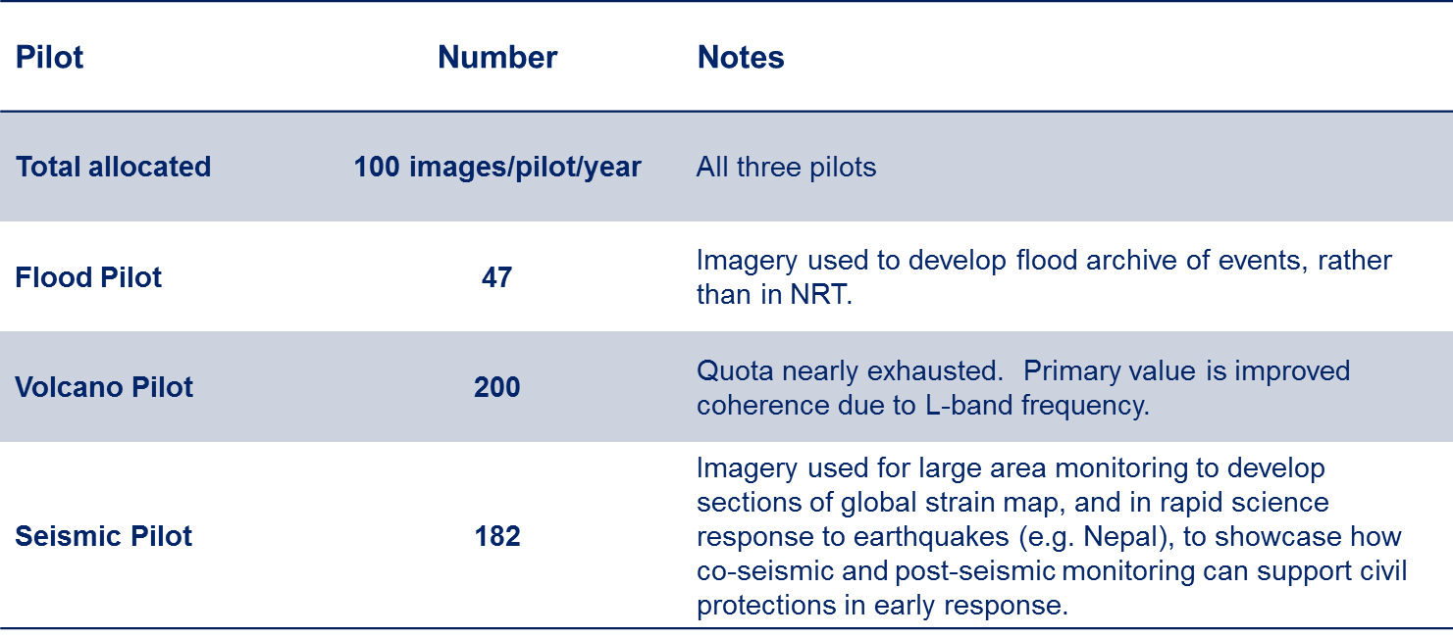
ALOS-2 Data Usage

Slide 11
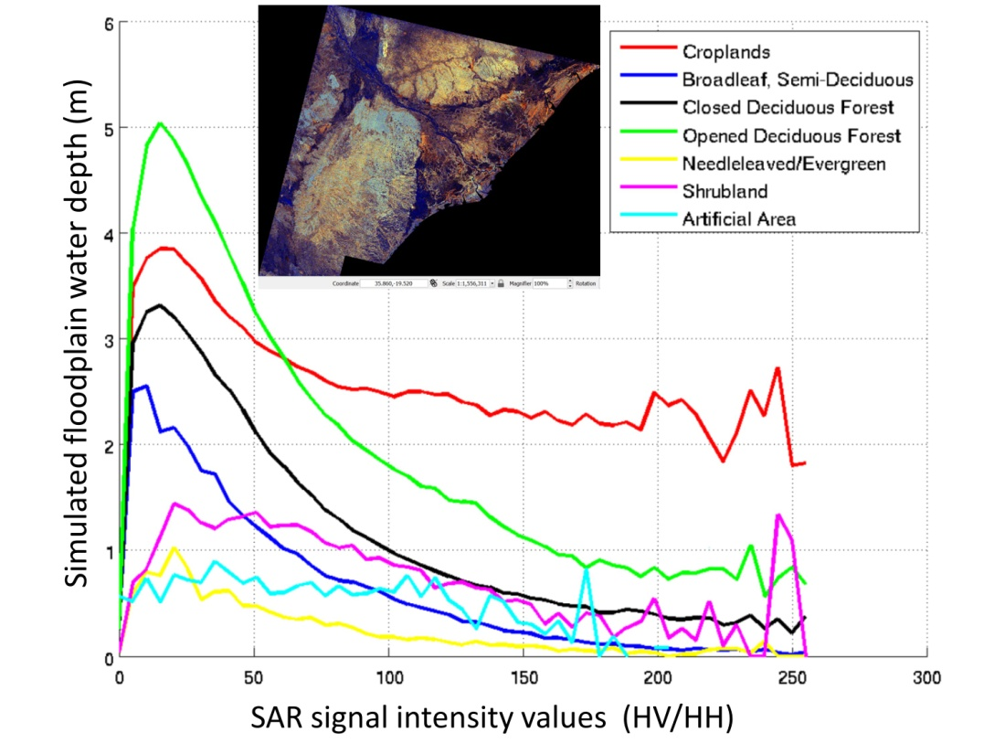
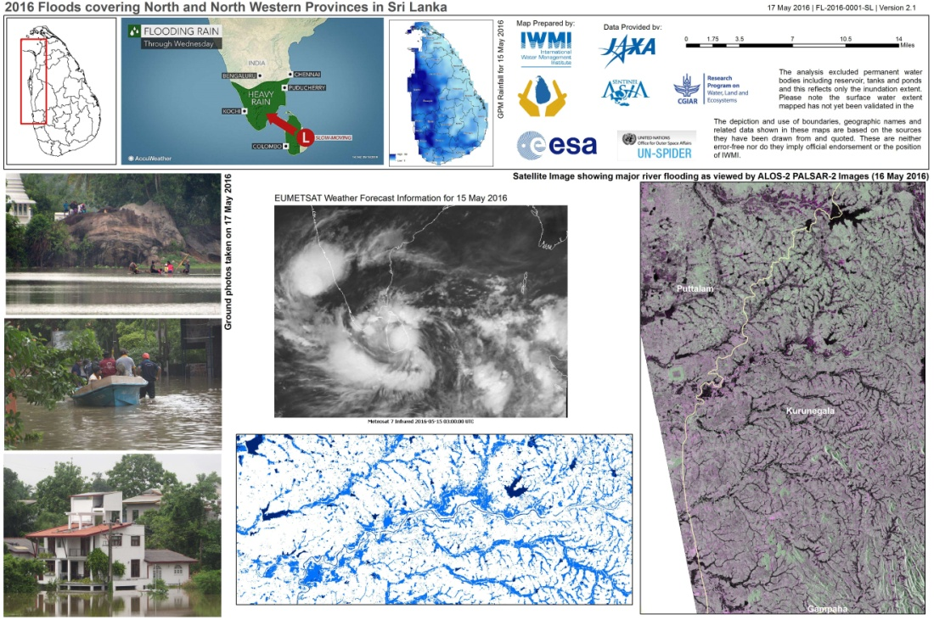
Flood Pilot PALSAR-2 Data Use
Examples of PALSAR data from other sources used by Pilot members:
Comparison of SAR signal compared to land cover and (modeled) inundation depth over Malawi, 14 January 2015 (figure courtesy G. Schumann, UCLA)
International Water Management Institute Flood Maps in NW Sri Lanka, 17 May 2016

Slide 12
Flood Pilot Use of ALOS-2 Data
The availability of timely ALOS L-band imagery during flood events in the sub-tropics and tropics especially enables the detection of flood waters under dense canopy and with different emerging vegetation types.
The polarization flexibility of PALSAR allows differentiation of different kinds of flooded surfaces (bare, vegetated, densely vegetation, forests) and makes detection from single flood imagery easier
The advantages noted of L-band are crucial to help improve current flood classification algorithms

Slide 13
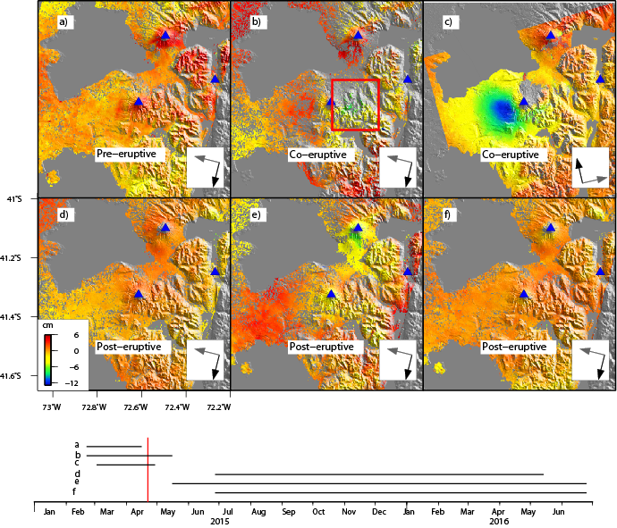
Volcano Pilot PALSAR Use at Calbuco, Chile
ALOS-2 interferograms are very coherent, excellent for assessing deformation associated with 2015 Calbuco eruption

Slide 14
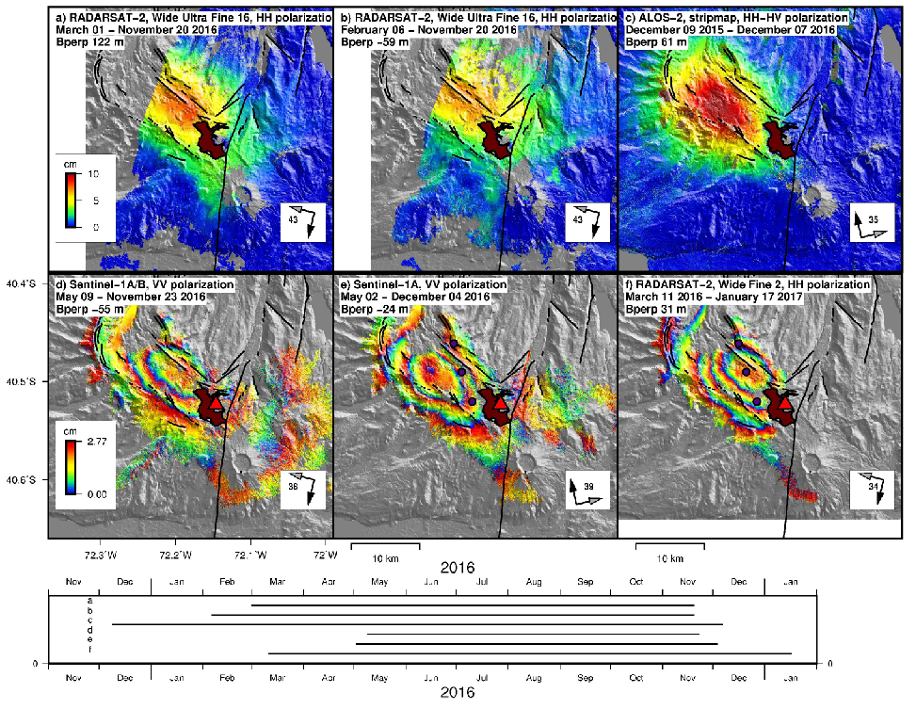
PALSAR-2 Use at Cordón Caulle Volcano, Chile (1/2)
L-band coherence makes a difference at Cordón Caulle.

Slide 15
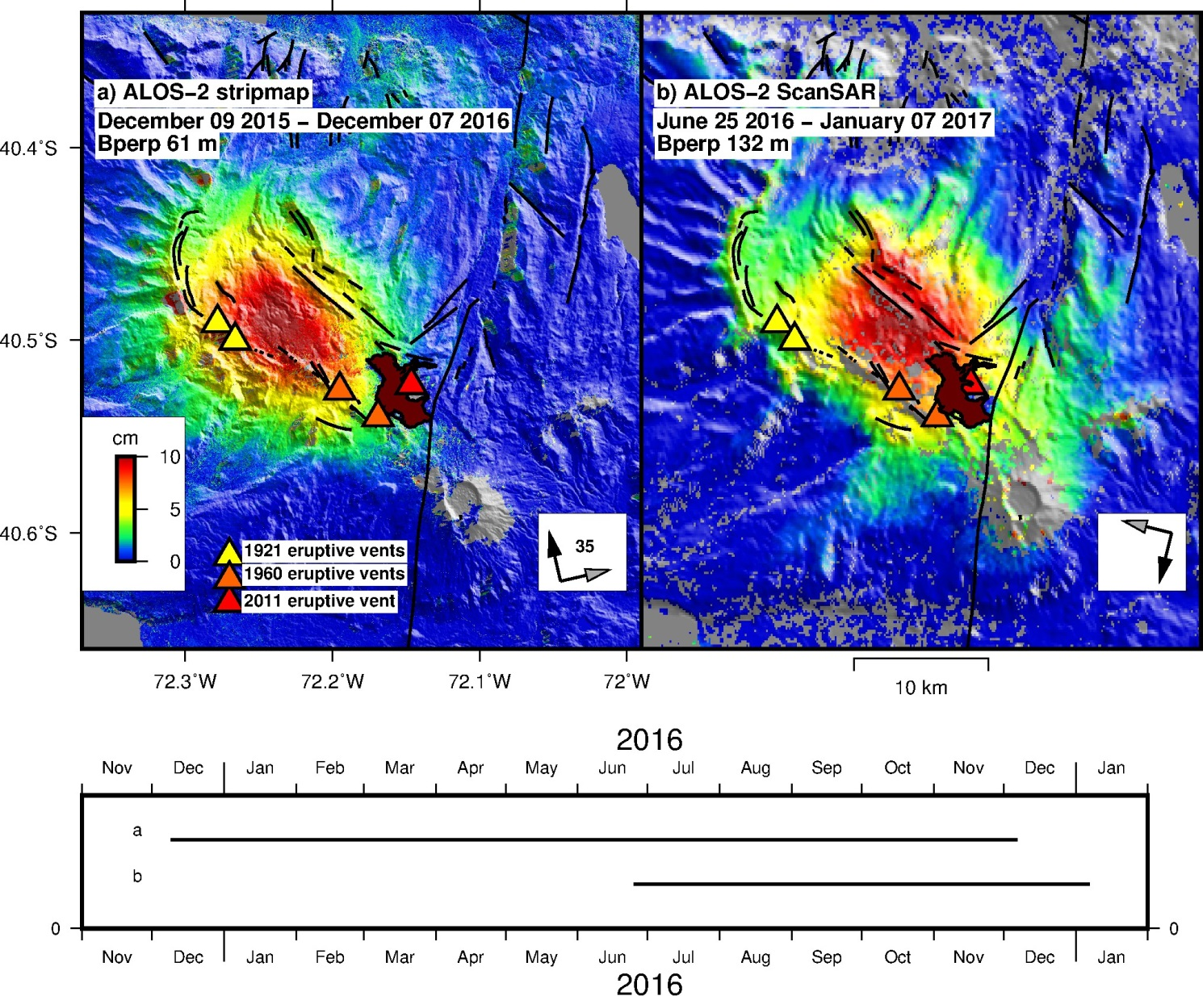
PALSAR-2 Use at Cordón Caulle Volcano, Chile (2/2)
ALOS-2 wide-swath vs. stripmap
Exceptional coherence!

Slide 16
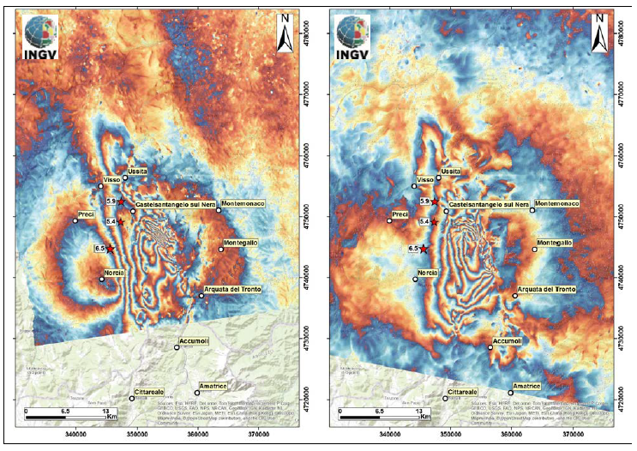
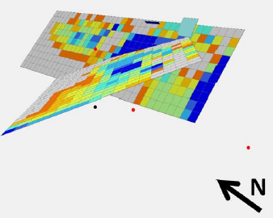
Italian EQs: Source model based on ALOS-2 interferograms
The source model (based on ALOS-2 unwrapped interferograms) for the October 26 and 30 events.
ALOS 2 L band data are fundamental to measure crustal deformation in vegetated areas, where other SAR sensors fail due to decorrelation. Most volcanic areas in the world occur in strongly vegetated areas and many fault zones too. Without ALOS-2 data, CEOS pilot scientists will simply not be able to map crustal deformation, and since in situ data (e.g. GPS) are still very scarce in many contexts, the lack of these data will delay the understanding of the earthquake and volcanic phenomena.

Slide 17
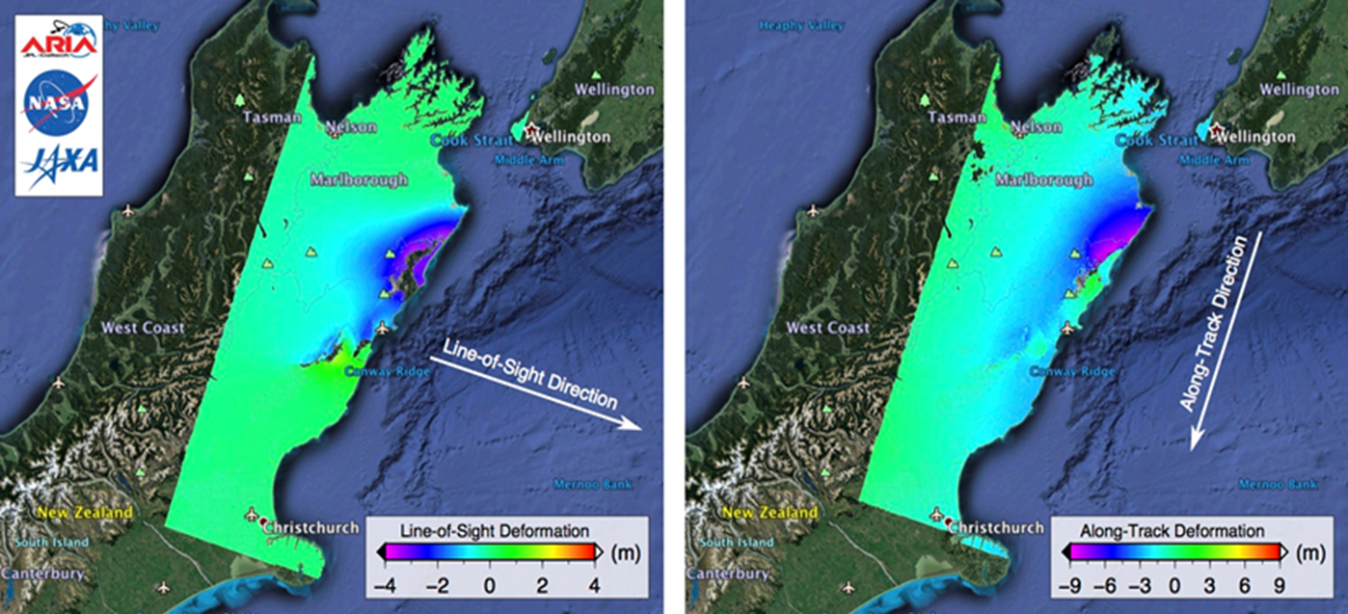
Kaikura (NZ) Earthquake: ALOS-2 interferograms generated by NASA JPL
ALOS-2 data were used for the generation of interferograms showing LOS and Along Track deformation.

Slide 18
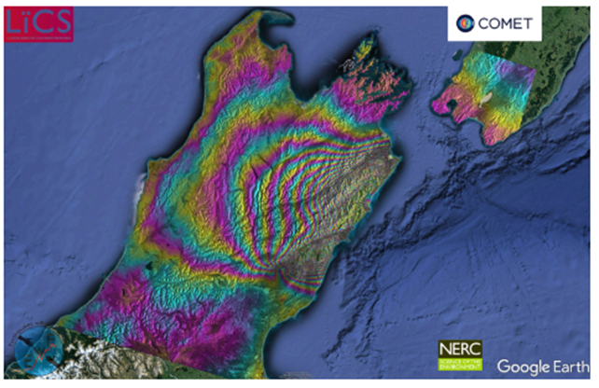
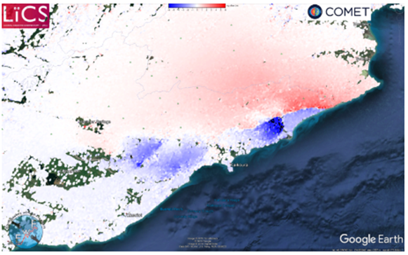
Kaikura (NZ) Earthquake: ALOS-2 and Sentinel -1 results generated by COMET
ALOS-2 interferogram from track 195 showing the coseismic displacement field after the 2016 New Zealand earthquake.
Coseismic Range Offsets from Sentinel-1 SAR data highlighting the fault trace and numerous fault segments.
Results were online 5 hours 27 minutes after satellite acquisition.

Slide 19
Summary: ALOS-2 Data
ALOS-2 PALSAR imagery offers only available L-band SAR imagery, with an extremely valuable global archive
L-band (with S-band) will be flown on upcoming NISAR mission so it is important to build capability to fully utilize L-band data
L-band imagery of unique value, especially in highly vegetated environments where C and X band have coherence issues
Even small volumes of L-band imagery used in conjunction with other imagery can help interpret results and improve understanding of science issues
CEOS pilot very thankful for JAXA’s valuable contribution
CEOS pilots showcase how technology can help reduce risk; future work will focus on priorities of the Sendai Framework and achieving Sustainable Development Goals, especially Goals 8, 11 and 15 (Economic Growth, Sustainable Cities and Life on Land):
  GEO-DARMA: multi-hazard risk reduction work in conjunction with regional development organizations, where value of L-band imagery can be highlighted for longer-term use outside of pilot context
  Recovery Observatory: high profile opportunity to showcase how L-band JAXA contribution can be used in major recovery context (Hurricane Matthew in Haiti), in project co-led by the World Bank
  For landslide activity monitoring ALOS-2 PALSAR L-band data are advantageous, because of the longer wavelength they are more robust against surface cover changes caused by vegetation growth / decline

Slide 20
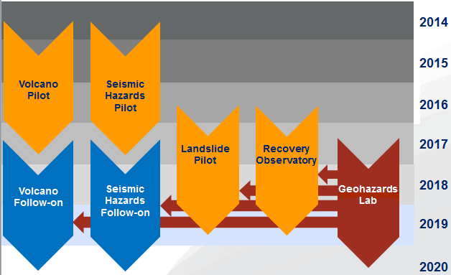
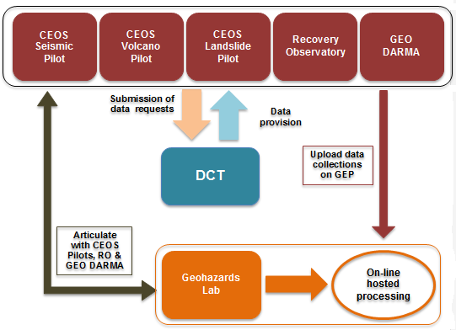
New activity proposed
– The Geohazards Lab
  Geohazards Lab
  New initiative proposed in the frame of CEOS
  Aims to address priorities of the Sendai Framework for Disaster Risk Reduction 2015-2030 using satellite EO
  Main goal: provide an EO processing & e-collaboration environment to exploit EO data to assess geohazards and their impact
  Concrete goals:
    achieve awareness and acceptance of EO based solutions with expert users and end users
    enable EO applications with massive volume and/or intensive processing,
    increase access to users in regions where it is difficult to download large EO data products while the results of Cloud based processing generally are much smaller files
    ensure the persistency of results and allow to share and transform processing chains
    reduce the cost of EO exploitation via the mutualization of resources
  Support and complement CEOS WG Disasters activities (on-going pilots, follow-on activities and the RO), the GSNL and GEO-DARMA
  While CEOS activities focus on provising data to users, the Geohazards Lab will complement these activities with additional EO processing. The contribution of the Geohazards Lab is not required for the CEOS activities to achieve their goals.
  Contributions and interest from CEOS agencies and partners:
    Space agencies: ESA, DLR, ASI and CNES,
    Users: CNRS-EOST, IPGP, COMET, ISTerre/IRD, CEO-YachayTech, NASA JPL, INGV, CNR-IREA, HUA.

Slide 21
A response to challenges
identified
  Based on lessons learnt from the Seismic Hazards pilot activity some challenges have been identified:
  many users aren't aware or cannot afford EO based solutions
  EO techniques need to be adopted by users (standards, norms)
  some new EO missions' data are large in volume
  some EO applications require complex or intensive processing
  some EO applications require to maintain, reprocess and compare EO based VA products
  the EO data and derived VA products are costly to generate for the objectives of the community (e.g. with regional/global coverage)
  As a contribution from ESA to the CEOS WG Disasters (seimic, volcano and landslides) the Geohazards Exploitation Platform has provided an EO processing and an e-collaboration environment. It has demonstrated benefits:
  support expert users from CEOS and the GSNL with hosted processing
  support users who aren't processing experts (black boxes)
  help users in regions with limited bandwidth (EO results versus large EO data files)
  optimise impact over time with the persistency of results (on-line publication of results)
  These concrete achievements from precursor platform activities are the basis for a broader joint approach with several space agencies.
  The Geohazards Lab is a new initiative to help the user community augment the impact of the CEOS WG Disaster activities. It is focused on geohazards (seismlic, volcano, landslides) and is intended to maximise how User needs are met with hosted processing and e-collaboration by:
  addressing the complexity and timeliness of massive volume processing
  finding more cost effective approaches to achieve greater geographic coverage
  raising awareness and share results with geoscience centers and end users
  supporting capacity development activities with on-line solutions
  work on standards and support consensus results generation

Slide 22
Landslide Pilot Data Plan: For Decision
Decision @ SIT-32
CEOS SIT-32 Action to WGDisasters: Prepare for approval the Geohazards Lab Concept.
Accept: CEOS Principals are asked to endorse the Geohazards Lab Concept. An implementation plan with specific contribution by space agencies will be presented for endorsement at Plenary in October.

Slide 23
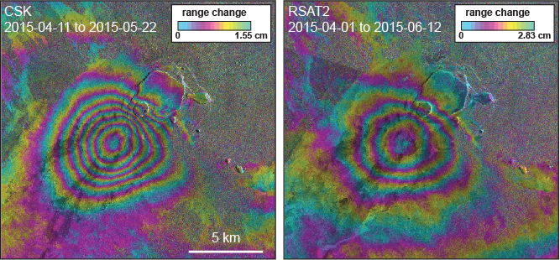
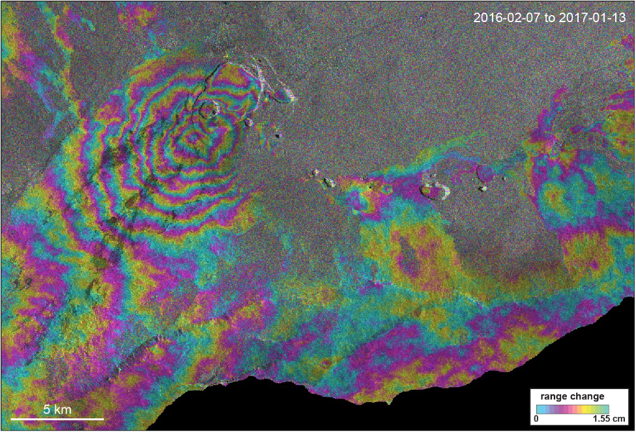
GEO Geohazard Supersites and Natural Laboratories (GSNL)
Supersite Periodic Review Process: Biennial report
Hawaii supersite endorsed in October 2012
Representative interferograms spanning the April 2015 inflation and May 2015 intrusion at the summit of Kīlauea Volcano from Cosmo-SkyMed (left) and RADARSAT-2 (right).
Quick facts:
Outreach: 13 peer reviewed journal articles in 2015-16
Dara used: ENVISAT, Sentinel, TerraSAR-X, Cosmo-SkyMed,
RADARSAT, ALOS, ASTER, Landsat, MODIS, EO-1
TerraSAR-X interferogram spanning February 7, 2016 to January 13, 2017 and indicating inflation centered in the south part of Kīlauea Caldera.

Slide 24
Supersite Periodic Review Process: For Decision
Decision @ SIT-32
Biennial report
Positive evaluations from Agencies with comments and remarks clarified by Supersite coordinator: Future data requests and results.
TerraSAR-X acquisitions every 11 days on 2 tracks (one ascending and one descending) covering the summit of Kīlauea Volcano.
Cosmo-SkyMed acquisitions as frequently as possible on two tracks (one ascending and one descending), with Mauna Loa imaged every 16 days on each track and Kīlauea’s summit imaged 2–3 times per 16 days on each track.
A new allocation of RADARSAT-2 of 200 scenes, which will be used to investigate past (since 2015) and future deformation of both Kīlauea and Mauna Loa.
Accept Hawaii Supersite Report (Permanent Supersite)

Slide 25
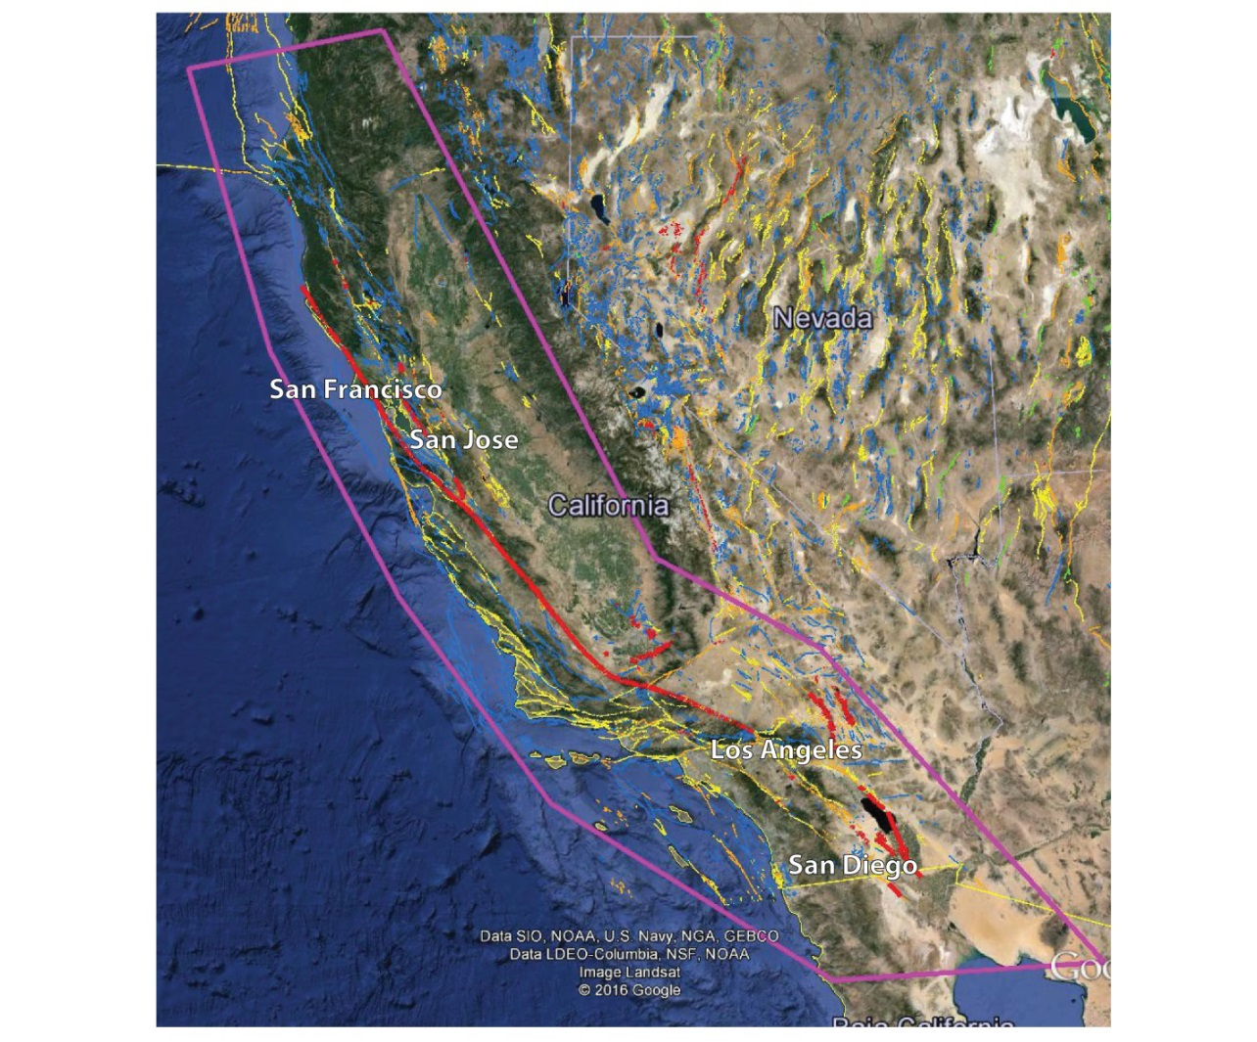
San Andreas Fault (SAF) Natural Laboratory Proposal
Faults that have been active in the last ~150 years are shown in bold red. Faults active in the Holocene and Pleistocene are orange. Other known faults that have been active in the Quaternary are shown in green, yellow and blue.

Slide 26
SAF Natural Laboratory Team
Supersite Point-of-Contact: Charles Wicks, U.S. Geological Survey, USA
Team:
Organized between several USA Academia – Institutes:
Jet Propulsion Lab, California Institute of Technology
University of Arkansas, University of Miami, Arizona State University, University of California (Berkeley), State University of New York at Buffalo, University of Wisconsin-Madison, University of California San Diego (SIO/IGPP), Appalachian State University, University of Colorado, Stanford University
International Scientific Community:
IREA-CNR (Italy)
Nanyang Technological University (EOS) in Singapore

Slide 27
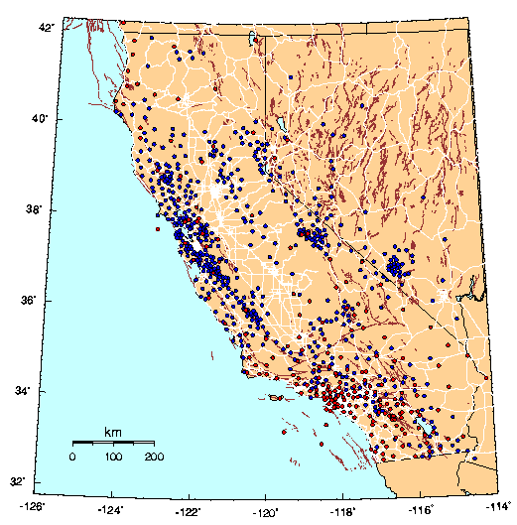
SAF Natural Laboratory Available In-Situ Data
Seismological data
Geodetic data
Maps and images
LiDAR
The instrumental infrastructure of the project partners covering the area of the San Andreas Fault system. California Integrated Seismic Network (CISN) short-period stations (blue) and broadband stations (red).

Slide 28
CEOS support to the San Andreas Fault Natural Laboratory
Indicative data resources committed
CEOS intends to support this Natural Laboratory with the following resources:
DLR | Up to 360 archive products + up to 360 new products for a period of 2 years (180 new acquisition per year) | TerraSAR-X
ASI | Up to 3800 archive products + up to 40 new products for a period of 2 years | COSMO-SkyMed
USGS | no quota as the data is freely accessible | Landsat
EC/ESA | no quota as the data is freely accessible | Sentinel-1, -2, -3

Slide 29
SAF Natural Laboratory: For Decision
Decision @ SIT-32
SIT-32 accepts the Natural Laboratory Proposal and agrees to support it by making available data according to the request in the proposal and up to the limits listed below.
SIT-32 requests that the Data Coordination Team (DCT) inform the PoC for the Natural Laboratory of this decision and the procedures of ordering and accessing the data

Slide 30
Decision @ CEOS SIT-32
Required decisions by SIT-32:
New Geohazards Lab
1. Endorsement: Geohazard Lab Concept (an implementation plan will be proposed for endorsement at Plenary)
GEO Geohazard Supersites and National Laboratories (GSNL)
2. Endorsement: Hawaii Supersite biennial report
3. Endorsement: San Andreas Fault Natural Laboratory

Slide 31
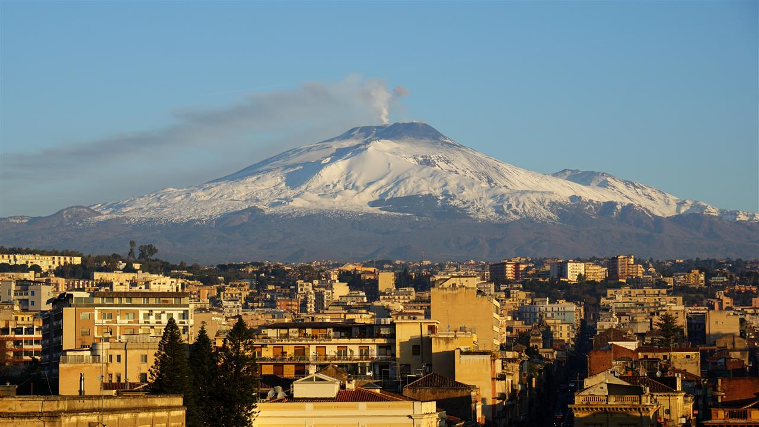
Thank You !!
10 injured in explosion on erupting Mount Etna volcano. Source: ABC News.
https://www.youtube.com/watch?v=MN9aZyNK8gw

