Slide 1

Committee on Earth Observation Satellites
Feasibility Study for an Aquatic Ecosystems Imaging Spectrometer
Ad-Hoc Working Group CEOS
Presented by A. Held & A.G. Dekker
CEOS-SIT ………. 2017

Slide 2
Scope of the Feasibility Study
Imaging Spectrometer for Aquatic Ecosystems
(excluding ocean colour)
The CEOS response to (GEOSS) Water Strategy developed under the auspices of the Water Strategy Implementation Study Team (WSIST) was endorsed by CEOS at the 2015 CEOS Plenary.
One Water Strategy recommendation is C.10 : A feasibility assessment to determine the benefits and technological difficulties of designing a hyperspectral satellite mission focused on water quality measurements:
The GEO Water Quality community (AquaWatch) proposed that alternative approaches, involving augmenting designs of spaceborne sensors for terrestrial and ocean colour applications to allow improved inland, near coastal waters and benthic applications, could offer a cost-effective alternative pathway to addressing the same science and societal benefit applications. Accordingly, this CEOS study will also analyse the benefits and technological difficulties of this option

Slide 3
Scope of the Feasibility Study
Imaging Spectrometer for Aquatic ecosystems
Three activities defined in this feasibility study:
A feasibility assessment of the benefits and technological difficulties of designing a hyperspectral satellite mission focused on inland, estuarine, deltaic and near coastal waters - as well as mapping macrophytes, macro-algae, seagrasses and coral reefs and shallow water bathymetry- at significantly higher spatial resolution than 250m.
To examine threshold and baseline observation requirements for sensors suitable for aquatic ecosystem to inform CEOS Agencies when considering the potential to add this application area to their mission designs.
That the GEO Water community define inland and near-coastal water quality and benthic habitat essential variables, including an assessment of relative priority, linked to defined economic, social and environmental benefits. This information would be of great value in informing investment decisions.

Slide 4
CEOS Team
“Feasibility Study Imaging Spectrometer”:
Lead: CSIRO - Arnold Dekker; Coordinator: DLR - Nicole Pinnel
Members: (for non-CEOS organisations the country is given)
CNES Marie-Jose Lefevre & Xavier Briottet
DLR Peter Gege, Harald Krawczyk, Bingfried Pflug, Birgit Gerasch
EOMAP Thomas Heege (Germany)
CNR Federica Braga, Claudia Giardino & Vittorio Brando (Italy)
NASA Kevin Turpie & Nima Pahlevan
CSA Martin Bergeron & Maycira Costa
USGS Thomas Cecere
WaterInsight Steef Peters (Netherlands)
TNO Andy Court (Netherlands)
(NSO) Mark Loos & Joost Carpaaij
(EC) Astrid-Christine Koch & Catharina Bamps
CSIRO Hannelie Botha & Antonio Robles-Kelly

Slide 5
CEOS Report Contents
“Feasibility Study Imaging Spectrometer”:
Table of Contents: Feasibility Study for an Imaging Spectrometer for Water Quality vs 3.0 20 April 2016
1. Background
1.1. Overview
1.2. Strategic direction for studying inland waters, coastal waters, benthos and shallow water bathymetry
  1.2.1. RS of Inland waters and variables
  1.2.2. RS Coastal and optically shallow waters
1.3. Introduction to the physics of light interaction in water bodies
1.4. Introduction to algorithms to derive information from RS data
1.5. Benefits to society / societal impacts
1.6. What we propose to do

Slide 6
CEOS Report Contents
“Feasibility Study Imaging Spectrometer”:
2. Science and Applications Traceability Matrix
2.1. Introduction to the science questions
2.2. Science question per application
  2.2.1. Inland waters
  2.2.2. Aquatic macrophytes in wetlands
  2.2.3. Estuarine, deltaic and lagoon waters
  2.2.4. Seagrass, coral reefs, kelp
  2.2.5. Shallow water bathymetry
2.3. Science and applications traceability matrix (inland waters & wetlands, estuarine, delta's and lagoons, seagrassess and coral reef, kelp, shallow water bathymetry)

Slide 7
CEOS Report Contents
“Feasibility Study Imaging Spectrometer”:
2.4. Determining the sensor requirements
  2.4.1. Bio-optical simulations of remote sensing reflectance and water leaving radiance
    2.4.1.1. Theory
    2.4.1.2.Spectral intervals and resolution
    2.4.1.3. Radiometric sensitivity (SNR , NEdL and NEdR)
  2.4.2. Top of atmosphere simulations (SNR , NEdL and NEdR)
  2.4.3. Spatial resolution and geometric accuracy requirement
  2.4.4. Temporal resolution requirements
  2.4.5. Atmospheric, adjacency effect and air-water interface correction requirements
  2.4.6. Summary of sensor specifications

Slide 8
CEOS Report Contents
“Feasibility Study Imaging Spectrometer”:
2.5. Suitability assessment of past, current and near-future earth observing sensors
2.6. Proposed modifications to planned future sensors to make them more suitable for (non-oceanic) aquatic ecosystems
  2.6.1.Modifications to planned land sensors
  2.6.2.Modifications to planned ocean colour sensors

Slide 9
CEOS Report Contents
“Feasibility Study Imaging Spectrometer”:
3. Instrument, platform and mission design considerations
3.1. LEO orbit sensors
3.2. Geostationary orbit sensors
3.3. Scanning time and coverage
3.4. Atmospheric and air-water interface corrections
  3.4.1. Aerosols
  3.4.2. Ozone and NO₂
  3.4.3. Water vapour
  3.4.4. Sun glint avoidance and mitigation strategies
  3.4.5. Polarization
  3.4.6. Adjacency effect

Slide 10
CEOS Report Contents
“Feasibility Study Imaging Spectrometer”:
3.5. Instrument artefacts
3.5.1. Straylight
3.5.2. Striping
3.5.3. Linearity response
3.5.4. Polarisation
3.6. Calibration and validation
  3.6.1. Pre-launch calibration and characterization
  3.6.2. Post-launch calibration and validation
3.7. Platform requirements incl. geometric stability
3.8. Ancillary data requirements
3.9. End-to-end simulation

Slide 11
CEOS Report Contents
“Feasibility Study Imaging Spectrometer”:
4. Aquatic ecosystem earth observation enabling activities
4.1. Introduction
4.2. Studies for algorithm development
  4.2.1. Atmospheric correction
  4.2.2. Air-water interface correction
  4.2.3. In water algorithms
  4.2.3.1. Optically deep waters
  4.2.3.2. Optically shallow waters

Slide 12
CEOS Report Contents
“Feasibility Study Imaging Spectrometer”:
4.3. In situ Instruments
  4.3.1. Spectroradiometers (AOP sensors) above and underwater
  4.3.2. IOP sensors
  4.3.3. Biogeochemical sensors
4.4. Sources of uncertainties
4.5. Field campaigns and priorities for calibration/validation research
4.6. Interdisciplinary science studies (data-data fusion, model-data fusion, model-data assimilation)
Summary, conclusions, recommendations
References
Appendix A: The forward bio-optical and atmospheric simulations

Slide 13
Current Status:
April 2016 Team created
May 2016 Contents established
June 2016: Self-nomination process chapter leads and co-authors
Sept. 2016 Summary presented at (CEOS-SIT) Oxford UK
Nov 2016 CEOS Plenary: Full draft approximately 80 % ready
April 2017 All information required (especially simulations of benthos-water column-airwater interface and atmosphere) written
May 2017 Editing to a draft report suitable for review

Slide 14
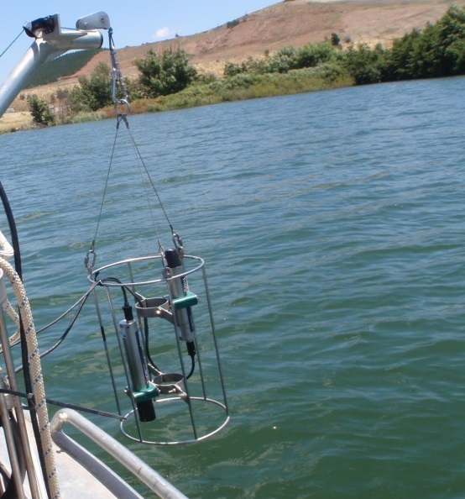
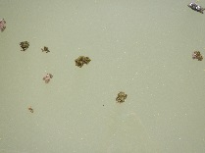

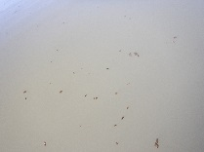
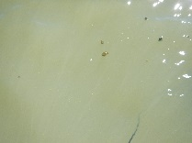
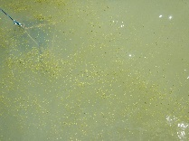
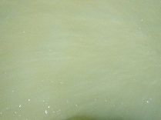
Inland waters: not so simple: land-water boundaries; lakes at -140 to 4500 m altitude
Reflectance

Slide 15
Spectral simulations example of high CDOM (&variable S) and medium Chl
Some interesting thoughts: how to determine a representative set of concentration ranges for inland waters and coastal waters globally?

Slide 16
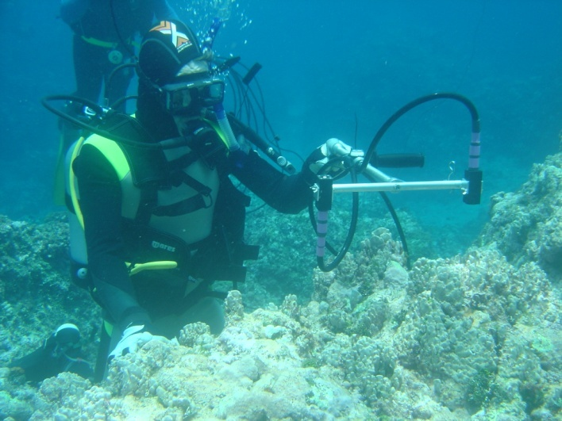
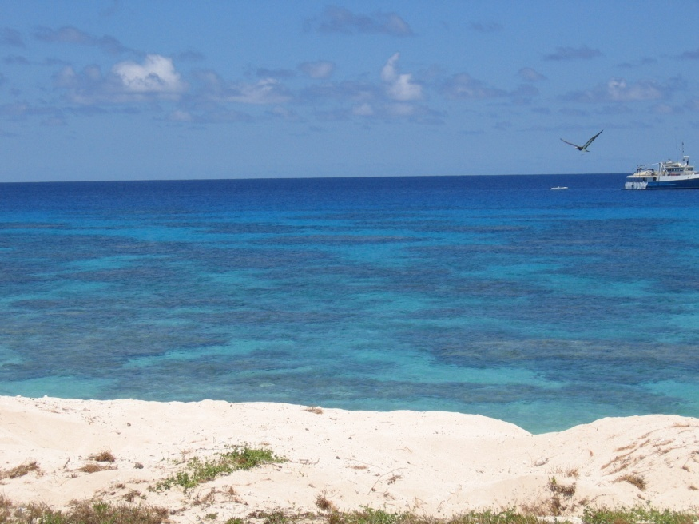
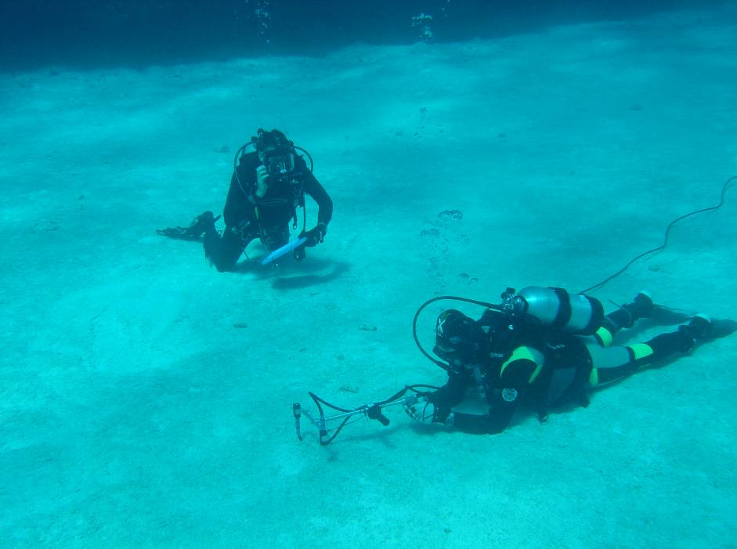
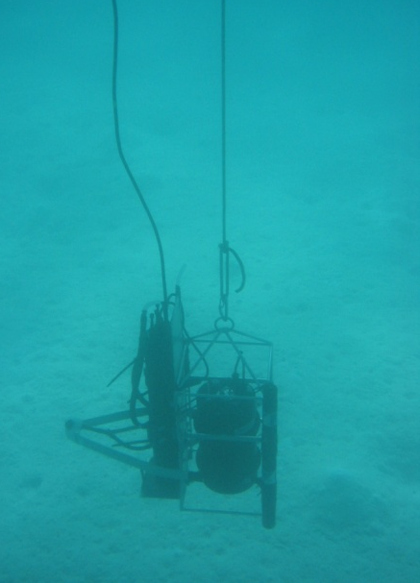
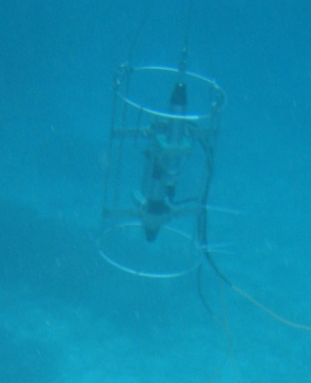
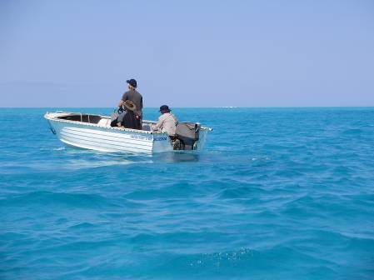
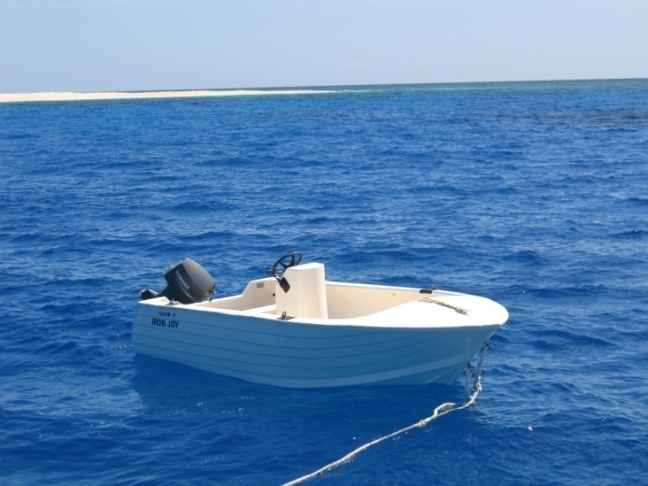
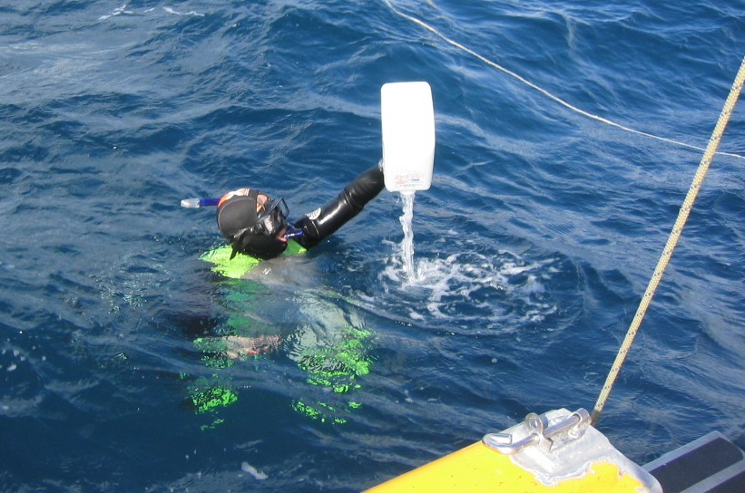
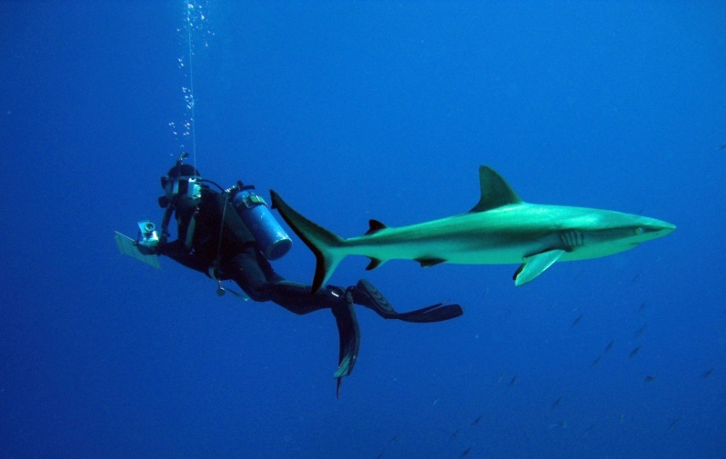
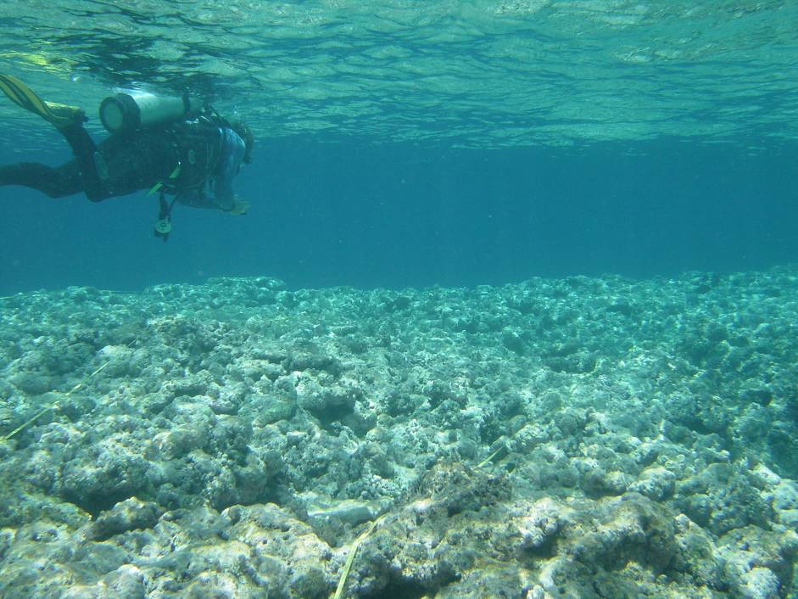
Examples of coral reef habitat and sampling
In situ substrate reflectance measurements (RAMSES)

Slide 17
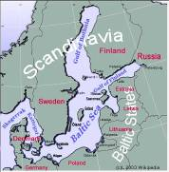
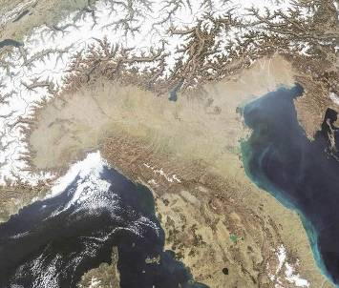
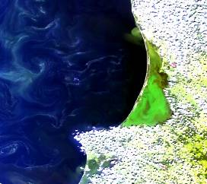
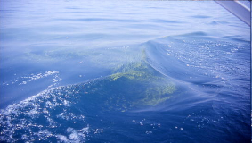
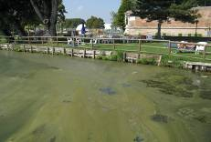
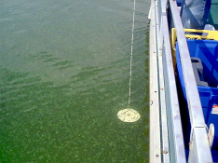
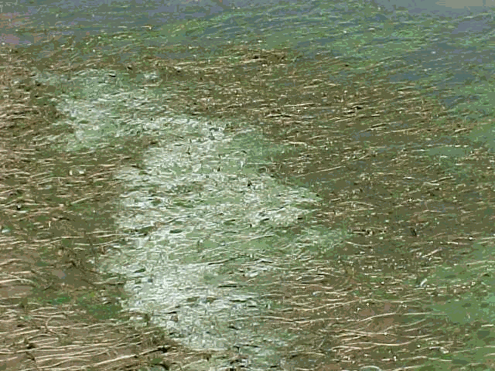
Study areas and potentially Harmful Algal Bloom types (courtesy C. Giardino CNR)
Curonian lagoon
Como
Idro
Garda
Italian lakes
Mantova
Trasimeno
Sporadic homogeneous blooms with vertical migration in oligo-meso trophic lakes
Frequent and intense heterogeneous bloom in hypertrophic lakes
Frequent homogeneous bloom in meso-eurtrophic lakes without scums
Frequent and intense homogeneous bloom in hypertrophic lakes with scums

Slide 18
Table 6.2.
Spatial resolution for inland waters
is a key driver for specifications
Ground sampling distance requirements showing resolvable size class and total cumulative number and area coverage of the world’s lakes (based on assumptions using Verpoorter et al. (2014) dataset).
(Courtesy E.L. Hestir. North Carolina State University)
Size Class | Required GSD* | % Total Area | Total number
≥ 10 km² | 1054 m | 44 | 25,976
≥ 1 km² | 333 m | 60 | 353,552
≥ 0.1 km² | 105 m | 80 | 4,123,552
≥ 0.01 km² | 33 m | 90 | 27,523,552
≥ 0.002 km² | 15 m | 100 | 117,423,552
*Calculated using a box of 3 x 3 pixels sufficient to resolve the specified lake size
Focus of current and future OC sensors
Focus of this study

Slide 19
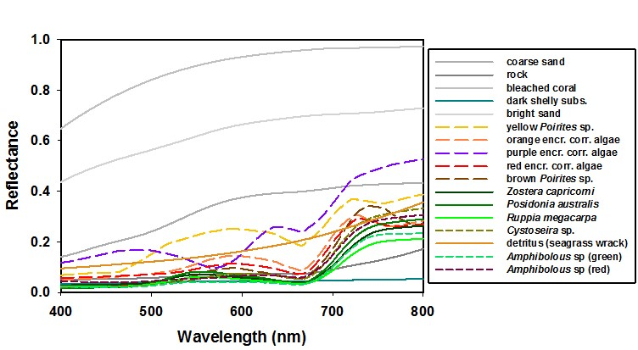
Substratum spectra: seagrass & coral reef environments used as parametrisation for simulations of Rrs

Slide 20
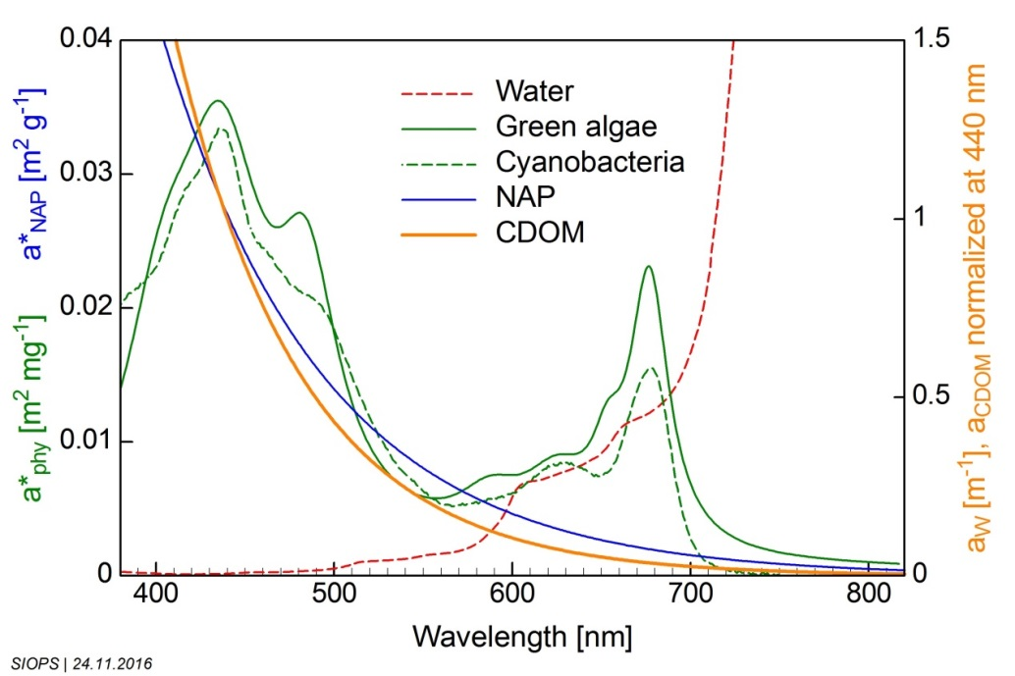
Input specific inherent optical property (IOP) data for Rrs simulations

Slide 21
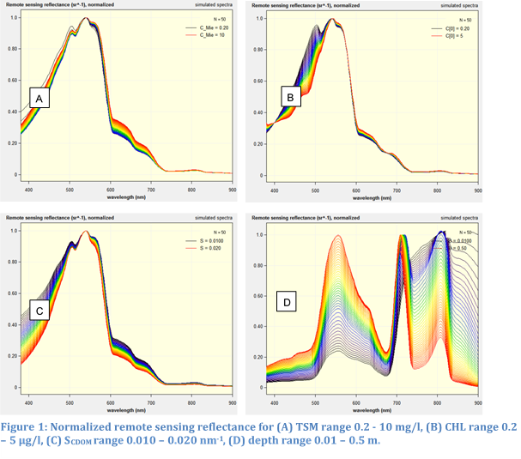
Simulation results Rrs (normalized) for a range of inland to coastal water types

Slide 22
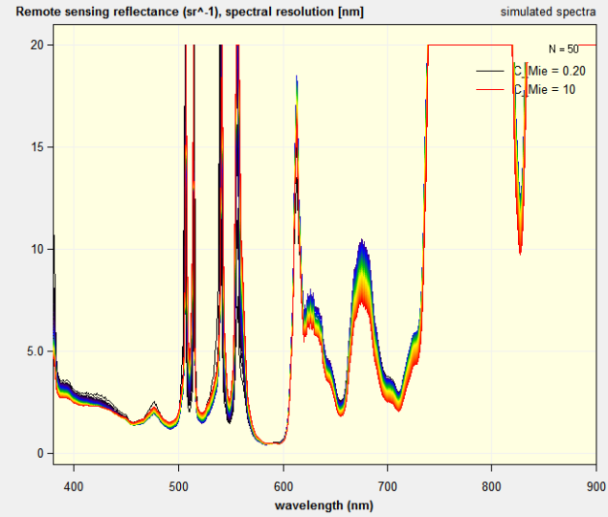
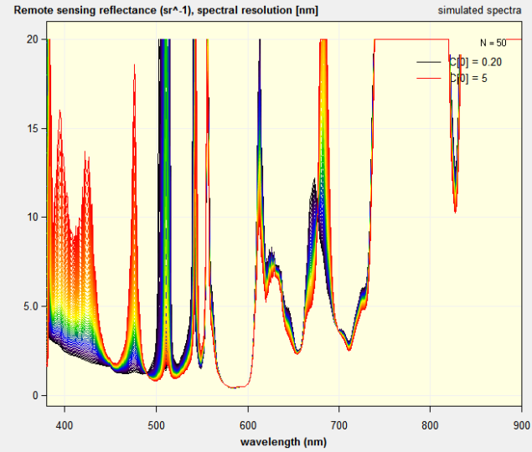
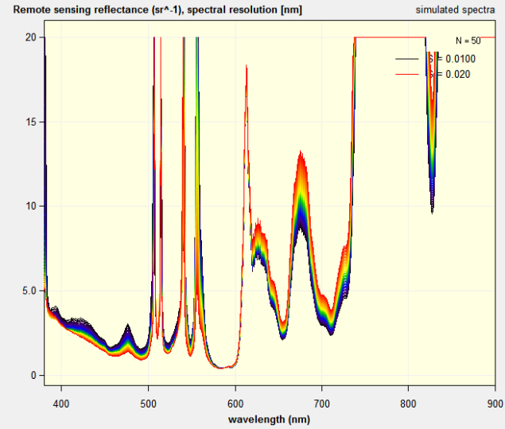
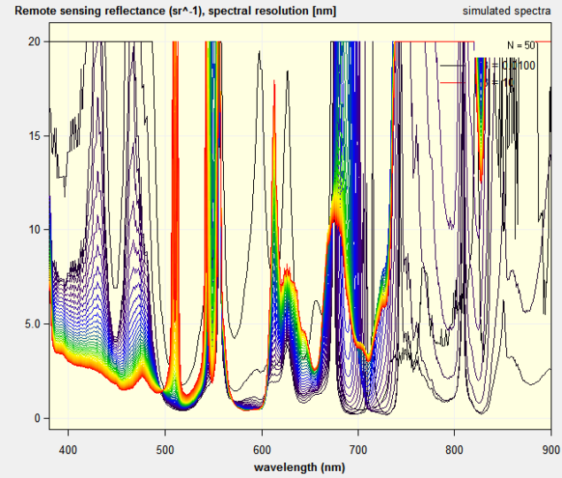
Simulation results of spectral resolution for a range of inland to coastal water types
(Y-axis is spectral resolution)
A
B
C
D
Figure 10: Spectral resolution for (A) TSM range 0.2 - 10 mg/l, (B) CHL range 0.2 – 5 µg/l, (C) S_{CDOM} range 0.010 – 0.020 nm⁻¹, (D) depth range 0.01 – 10 m.

Slide 23
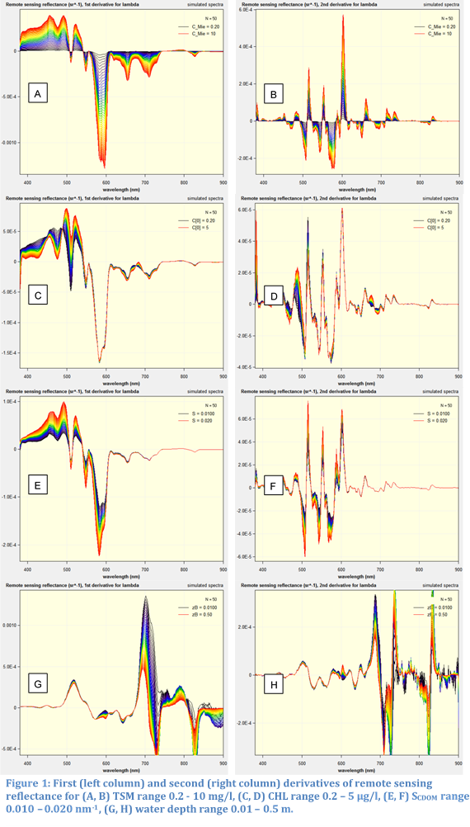
1st and 2nd derivatives of Rrs for a
range of inland to coastal water types

Slide 24
Spectral resolution (in 2.5 nm steps) required to resolve required variable concentration range reflectance: this varies from low to high concentrations

Slide 25
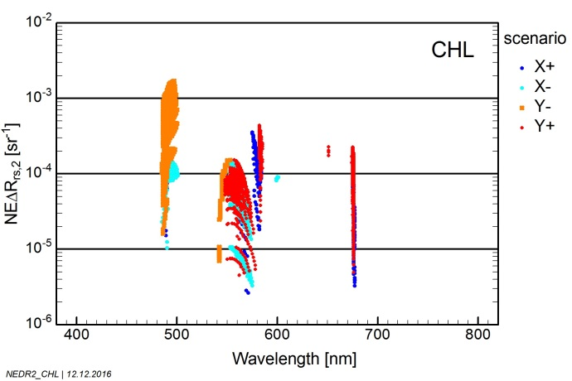
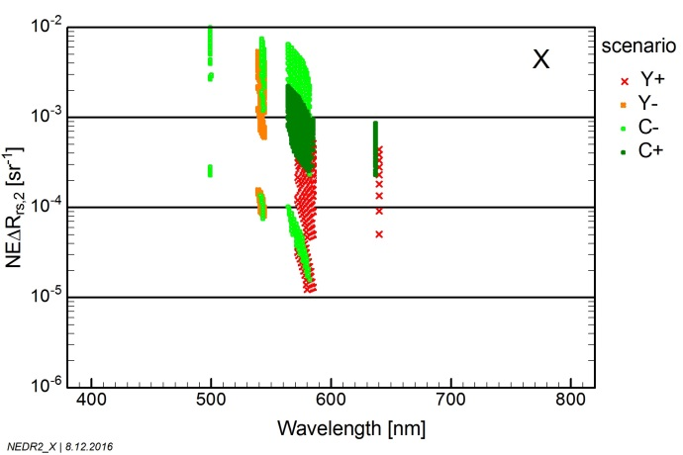
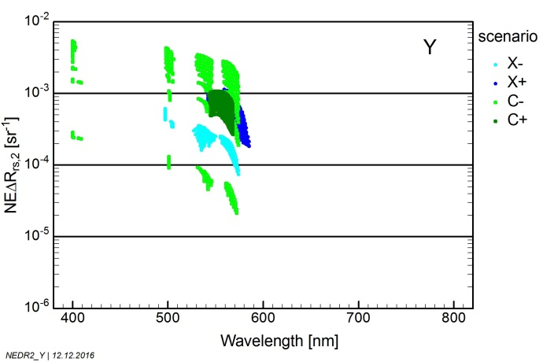
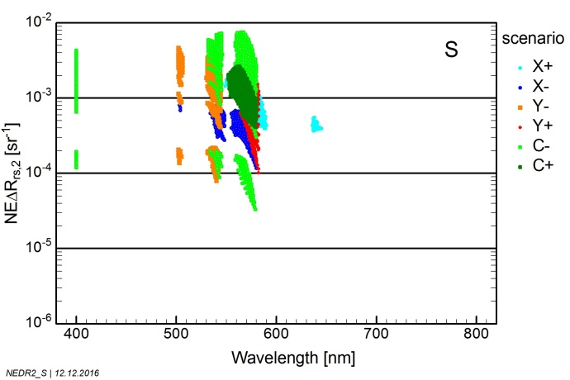
Simulations showing how spectral peaks shift with changing concentrations
(standard concentrations scenario)
Figure 35: Maximum change of R_{rs} for a 10% change of the parameter indicated top right for the standard scenarios.

Slide 26
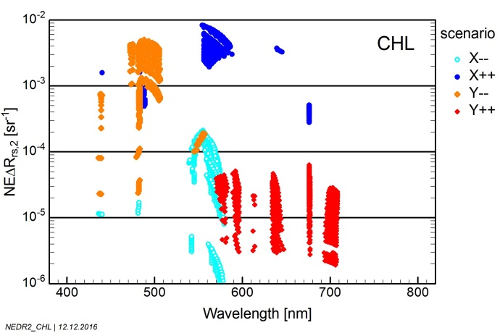
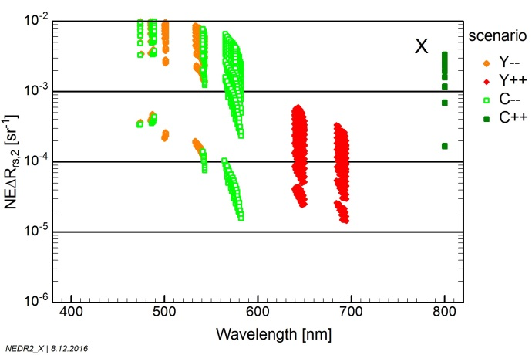
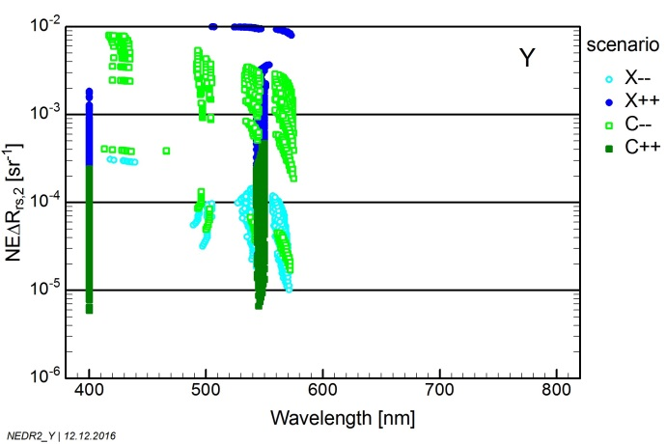
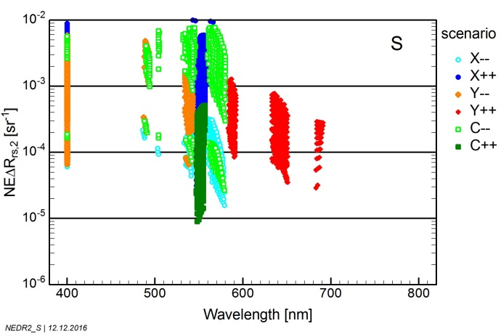
Simulations showing how spectral peaks shift with changing concentrations
(extreme concentrations scenario)
Figure 36: Maximum change of R_{rs} for a 10% change of the parameter indicated top right for the extreme scenarios.

Slide 27
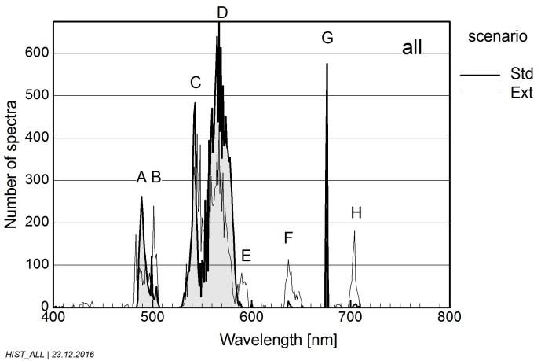
Possible augmentation bands to multispectral land sensors
Histograms of wavelengths of maximum: The histogram "all" is the sum of the histograms for CHL, CYA, TSM, CDOM and S(CDOM). The labels A to H indicate the most sensitive spectral regions.

Slide 28
Trade-off between spatial, spectral and radiometric resolution
The priority in specifications for an aquatic ecosystem imaging spectrometer (or many multi-bands sensor is:
Spatial resolution (as not getting a pure pixel avoids any measurement at all)
Spectral resolution (to discriminate between all the many variables)
Radiometric resolution: should be as high as possible given priorities 1 and 2
Temporal resolution (varies from once a season to hourly intervals) can be solved by LEO+GEO and /or constellations of LEO’s

Slide 29
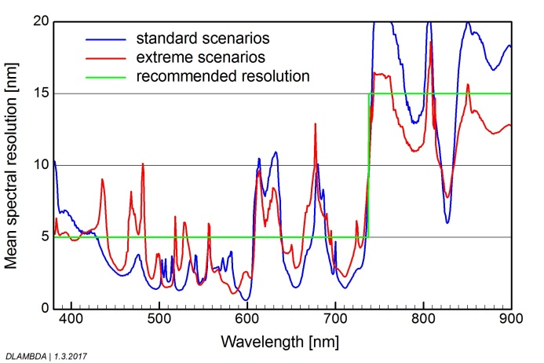
Summary of Results: spectral resolution recommendation based on simulations
the recommended spectral resolution of a hyperspectral sensor based on these simulations is 5 nm from 380 to 737 nm, and 15 nm from 737 to 900 nm.

Slide 30
Summary of Results: spectral bands & resolution recommendation based on essential bands from simulations and spectral pigment features from phytoplankton, macrophytes and other benthos
Center nm | FWHM nm | Application
+/- 385 | 6 | CDOM ; NAP
+/- 425 | 8 | CDOM ; Blue Chl-a absorption band reference band ; NAP
443 | 8 | Blue Chl-a absorption maximum
+/- 475 | 7 | Accessory pigments ; Blue Chl-a absorption band reference band ; NAP
+/- 490 | 8 | Chl band-ratio algorithm (in clear waters)
+/- 510 | 6 | Chl band-ratio algorithm (in clear waters) ; NAP ; red tide
+/- 542 | 8 | Suspended sediments ( as most algal pigments absorptions are low);
+/- 555 | 8 | Suspended sediments ( as most algal pigments absorptions are low); Cyanophycoerythrin
565 | 8 | Cyanophycoerythrin in vivo absorption maximum
+/- 583 | 8 | Phycoerythrin ;cyanophycocyanin reference band
624 | 8 | Cyanobacteria (specifically phycocyanin), suspended sediment,
+/- 640 | 16 | NAP, cyanophycocyanin reference band
655 | 3 | Chl-b
670 | 7 | Fluorescence line height (FLH) baseline; red chl-a absorption peak suitable for chlorophyll in highly turbid or CDOM rich water
676 | 7 | Chlorophyll in vivo absorption maximum; Fluorescence line height
683 | 3 | Chlorophyll fluorescence (FLH)band
+/- 700 | 8 | FLH baseline; HABs detection; NAP in highly turbid water; reference band for 2 or 3 band Chl-a algorithms
+/- 710 | 8 | FLH baseline; HABs detection; NAP in highly turbid water; reference band for 2 or 3 band Chl-a algorithms
+/- 748 | 9 | NAP in highly turbid water
Note that for the algal pigment absorption maxima we have included reference bands for the 3 band pigment absorption and fluorescence line height approaches. Physics based spectral inversion methods do not need these pigment reference bands. When the band center has a +/- sign it means that the wavelength center is not critical and may vary by about 5 nm.

Slide 31
Recommended spectral bands for atmospheric correction purposes as well as Non Algal Particulate matter concentration estimation.
+/- 730 | Sun and sky glint/NAP/atmospheric correction
+/- 740 | Sun and sky glint/NAP/atmospheric correction
+/- 750 | Sun and sky glint/NAP/atmospheric correction
+/- 770 | Sun and sky glint/NAP/atmospheric correction
+/- 865 | Atmospheric correction
1240 or 1238 | Atmospheric correction (MODIS or VIIRS)
1640 or 1600 | Atmospheric correction(MODIS or VIIRS)
2130 or 2257 | Atmospheric correction (MODIS or VIIRS)

Slide 32
Ground sampling distance requirements showing the resolvable river width class and cumulative number of total river reaches of the world’s rivers from Pavelsky et al. (2012) dataset.
River Reach Size Class (width) | Required GSD* | Total number of reaches | Percent of total reaches
≥ 1.5 km | 500 | 2,877 | < 0.1%
≥ 1 km | 333 | 8,483 | <1%
≥ 0.5 km | 167 | 35,420 | 1%
≥ 0.1 km | 33 | 382,466 | 12%
≥ 0.05 km | 17 | 766,303 | 24%
≥ 0.01 km | 3 | 2,576,452 | 81%
*Calculated using a box of 3 x 1 pixels sufficient to resolve the width of the river reach

Slide 33
Ground sampling distance requirements showing resolvable size class and total cumulative number and area coverage of the world’s lakes (based on assumptions using Verpoorter et al. (2014) dataset)
Size Class | Required GSD* | % Total Area | Total number
≥ 10 km² | 1054 m | 44 | 25,976
≥ 1 km² | 333 m | 60 | 353,552
≥ 0.1 km² | 105 m | 80 | 4,123,552
≥ 0.01 km² | 33 m | 90 | 27,523,552
≥ 0.002 km² | 15 m | 100 | 117,423,552
*Calculated using a box of 3 x 3 pixels sufficient to resolve the specified lake size

Slide 34
The minimum spatial resolution requirement for inland water bodies can be categorized in two bins.
A GSD of 300 m can observe the majority of the world’s lake surface area (but is a small fraction of the total number of lakes)
A sensor with a minimum GSD of 15-17 m would enable observations for ~25% of global river reaches and 90 to 100% of lakes 0.2 ha or larger.
The Sentinel-3 series of satellites has 22 spectral bands, high SNR and a GSD of 300m and is thus adequate for large lakes adequately.
The focus for new sensors should be around 5 to 8 nm spectral bands and a GSD of about 17 m, whilst a GSD of 30 m could be a compromise between costs and S:N

Slide 35
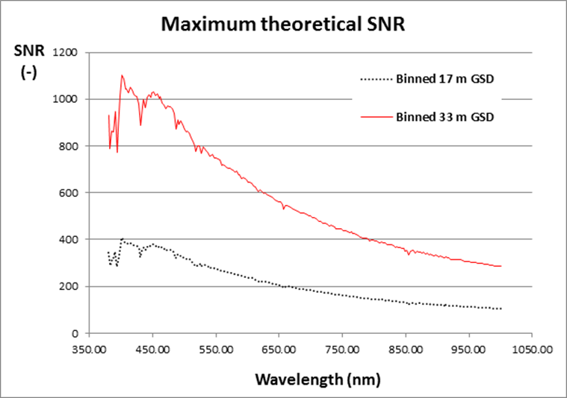
A simulation of achievable radiometric resolution within constraints of spectral and spatial resolution in terms of SNR ( By M. Bergeron CSA)
Raw GSD of 5.66 and 11 m binned (3 bins) to 17 and 33 m;
- Raw SSI of 2.66 nm binned (3 bins) to 8 nm;
- Assumes typical TOA radiance at 42 degrees SZA from Zia Ahmad (2012);
- a 30 cm aperture for the fore optics.

Slide 36
CEOS Report
“Feasibility Study Imaging Spectrometer”:
Society needs detection, assessment and monitoring of aquatic ecosystems (multiple UN SDG’s contain aquatic ecosystem variables SDG 6, 14 and 15 specifically).
Coral reefs, seagrasses, macro-algae, macrophytes (freshwater) could all possibly be measured with a fixed set of multispectral bands for each separate application
HOWEVER…..
When measuring optically active water constituents over large ranges (optically deep water case) and needing to measure the substratum/benthic spectra through a water column (optical shallow water case), there is not one specific multispectral band set that will be able to do it all- strong indication imaging spectrometry will be required.
HOWEVER…..
By augmenting planned land or ocean sensors spectrally or spatially, cost-effective solutions for observing aquatic ecosystems could be achieved.

Slide 37
Cost-effective enhancements to planned land sensors to make them much more suitable for inland and coastal water quality , submerged vegetation and benthic measurements.
As new versions for Landsat and Sentinel-2 are foreseen, a cost effective manner to enhance these sensors and make them much more useful for inland and near-coastal water remote sensing is to add a few spectral bands and to increase the spatial resolution where possible.
Sentinel-2 : if all 13 Sentinel 2 bands could be 10 m spatial resolution that would be a significant benefit for inland water remote sensing.
For S-2 and Landsat some extra spectral bands (8 to 10 nm wide) such as at the cyanophycocyanin and red chlorophyll a suitable wavelengths centered at 624 and 676 nm resp. would significantly enhance their suitability as global missions for inland and coastal water quality as well as submerged vegetation and benthos measurements.

Slide 38
CEOS Report
“Feasibility Study Imaging Spectrometer”:
Suggestions for improvements by CEOS members appreciated.
Arnold Dekker
Honorary Professor - Australian National University
Adjunct Professor - University of Queensland
Honorary Science Fellow - CSIRO
Director SatDek Ltd
arnoldgdekker@gmail.com
Mob: +61 (0) 419411338

