Slide 1
GEO Approach SDGs CEOS SIT-32 Barbara J. Ryan Director, GEO Secretariat April 26-27, 2017 Paris, France

Slide 2
History
GEO and its members helped include Earth observations references within the key UN 2030 Agenda document “Transforming our World: The 2030 Plan for Global Action”
GEO has participated in numerous events through 2016 and 2017 to raise awareness about roles of Earth Observation and geospatial to support the SDGs,
In January 2017 GEO participated in the UN World Data Forum, Cape Town
GEO has participated in the UN GGIM process including organizing side events at the UN Statistical Commission meetings in 2016 and 2017

Slide 3
GEO involvement in the SDG Process
At global level
Engaging GEO members to help deploy geospatial and Earth observations to support SDGs
Discovering cross-cutting information resources for multiple Goals and Targets
Engagement with the UN Statistical Division
Membership in the Working Group on Geospatial Information WGGI of the IAEG
Linkage with the indicator custodian agencies
At country level
Engagement of GEO Principals representing Members Countries, helping to establish national coordination mechanisms, involving entities and institutions with a role in the 2030 Agenda implementation
Notes:
Projects:
Federated approach: Other GEO tasks also relate to SDGs. GI-18 serves a coordination function - guidance, consistent approaches, quality standards
A series of pilot projects apply and test uses of Earth observations to support the assessment and tracking of the SDGs, including integration with national statistical accounts for the indicators.
Projects: Include efforts to support qualitative and quantitative evaluation on the benefits of Earth observations to enable societal benefits.
Some pilot project activities may focus on one country and address several SDG indicators; others may focus on a particular SDG indicator and apply it to several countries.
particular attention to the ability to scale a method to multiple nations or stakeholders on a regional or global scale
share smart practices and provide guidance, encouraging consistent approaches and quality standards
Capacity Building
draw on and contribute to GEO’s established capacity building activities and expertise
includes virtual and physical activities, such as trainings, webinars, joint projects, applied research, and workshops, among many other successful capacity building practices
Data and Information Products:
support GEO’s efforts to promote and encourage open data policies
Outreach:
creation and maintenance of a portfolio of materials, such as examples, stories, articles, and web features. For instance, a series of thematic examples can articulate how Earth observations relate to specific SDGs and can be integrated with traditional statistical approaches;

Slide 4
Partnerships
The Initiative pursues partnerships as a key element of the strategic implementation, leveraging knowledge, resources, and skills of partner organizations in collective support of the SDGs.
Engagement and partnership with other entities helps build processes, mechanisms, and human capacity to include Earth observations in national development plans and to integrate them with national statistical accounts to improve the measuring, monitoring and achievement of the SDGs.
Key organizations that the GI-18 Initiative will pursue partnerships with include the following, adding others over the course of the initiative, starting from a progressive engagement with the Indicators “custodian agencies”.
Sustainable Development Solutions Network
Global Partnership for Sustainable Development Data
UN Committee of Experts on Global Geospatial Information Management
International Institute for Sustainable Development
Notes:
Projects:
Federated approach: Other GEO tasks also relate to SDGs. GI-18 serves a coordination function - guidance, consistent approaches, quality standards
A series of pilot projects apply and test uses of Earth observations to support the assessment and tracking of the SDGs, including integration with national statistical accounts for the indicators.
Projects: Include efforts to support qualitative and quantitative evaluation on the benefits of Earth observations to enable societal benefits.
Some pilot project activities may focus on one country and address several SDG indicators; others may focus on a particular SDG indicator and apply it to several countries.
particular attention to the ability to scale a method to multiple nations or stakeholders on a regional or global scale
share smart practices and provide guidance, encouraging consistent approaches and quality standards
Capacity Building
draw on and contribute to GEO’s established capacity building activities and expertise
includes virtual and physical activities, such as trainings, webinars, joint projects, applied research, and workshops, among many other successful capacity building practices
Data and Information Products:
support GEO’s efforts to promote and encourage open data policies
Outreach:
creation and maintenance of a portfolio of materials, such as examples, stories, articles, and web features. For instance, a series of thematic examples can articulate how Earth observations relate to specific SDGs and can be integrated with traditional statistical approaches;

Slide 5
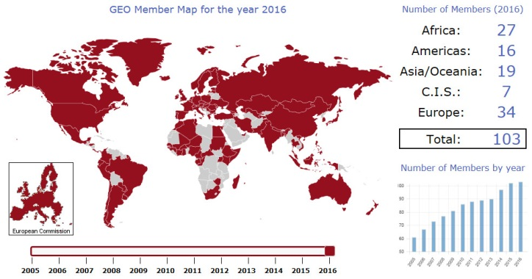
Resolve to strengthen & facilitate active participation of developing countries, including through Regional Initiatives – AfriGEOSS, AmeriGEOSS, AOGEOSS
AOGEOSS

Slide 6
Work Group on Geographical Information WGGI Work on Select Indicators
GEO leading on two WGGI selected indicator short papers – 6.6.1 and 15.3.1
Goal is to help identify & support methods using Earth observations that can be adopted by NSO’s for indicators
For 6.6.1 Earth observations for extent of water related ecosystems are available for helping to measure extent
For 15.3.1 the global community is working to develop methods with common definitions sufficient data resources

Slide 7
Goal 6.6.1
6.6.1 Percentage of change in water‐related ecosystems over time (% change/year)
SDG Goal 6, Ensure availability and sustainable management of water and sanitation for all;
Target 6.6 By 2020; protect and restore water-related ecosystems, including mountains, forests, wetlands, rivers, aquifers and lakes.

Slide 8
Components of Indicator 6.6.1
Resulting state/health of ecosystems (6.6.1.d)
Quality of water in ecosystems (6.6.1.c) = (6.3.2)
Spatial Extent of water-related ecosystems (6.6.1.a)
Quantity of water in ecosystems (6.6.1.b)

Slide 9
Method Will Include Data Analysis
Earth Observation – images and data describing the location and spatial extent of most water-related ecosystems are freely available at down to 10m resolution
There will be costs associated with the interpretation of the data at a country level, some ground based verification (i.e. ground truthing) data is necessary to ensure valid results
The approach used has to be cognizant of seasonal and temporary changes in extent so that long-term changes are reported
Analysis of both EO and ground-based data can be carried out periodically (i.e., 4 year intervals) to provide information used for local management and SDG report

Slide 10
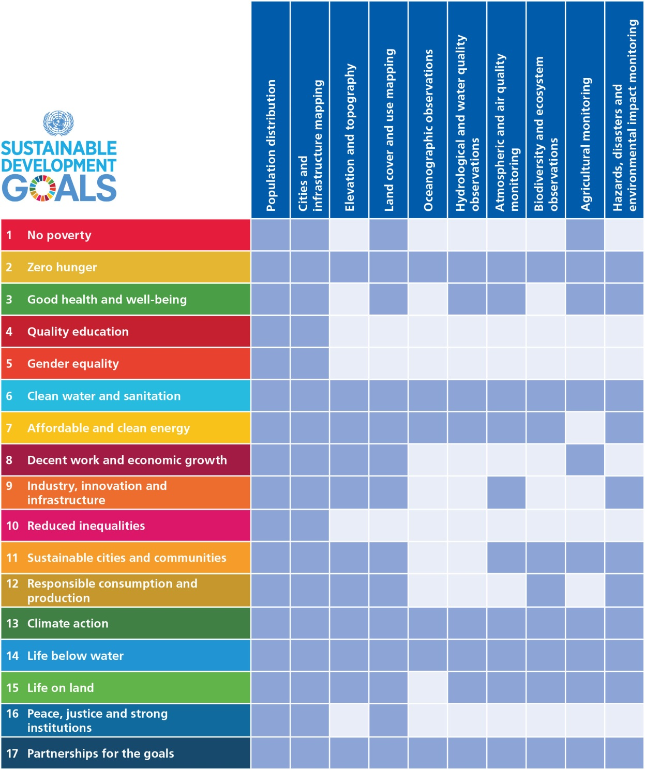
EO linkages with SDGs Goals, Targets, and Indicators
Alignments of the Goals with specific types of Earth observation and geospatial info “products”.
Notes:
Projects:
Federated approach: Other GEO tasks also relate to SDGs. GI-18 serves a coordination function - guidance, consistent approaches, quality standards
A series of pilot projects apply and test uses of Earth observations to support the assessment and tracking of the SDGs, including integration with national statistical accounts for the indicators.
Projects: Include efforts to support qualitative and quantitative evaluation on the benefits of Earth observations to enable societal benefits.
Some pilot project activities may focus on one country and address several SDG indicators; others may focus on a particular SDG indicator and apply it to several countries.
particular attention to the ability to scale a method to multiple nations or stakeholders on a regional or global scale
share smart practices and provide guidance, encouraging consistent approaches and quality standards
Capacity Building
draw on and contribute to GEO’s established capacity building activities and expertise
includes virtual and physical activities, such as trainings, webinars, joint projects, applied research, and workshops, among many other successful capacity building practices
Data and Information Products:
support GEO’s efforts to promote and encourage open data policies
Outreach:
creation and maintenance of a portfolio of materials, such as examples, stories, articles, and web features. For instance, a series of thematic examples can articulate how Earth observations relate to specific SDGs and can be integrated with traditional statistical approaches;

Slide 11
GEO and SDGs
SDG Initiative
Alignment of Earth Obs. and GEO to the 17 Goals, 169 Targets, and 230 Indicators
SDGs with most opportunities:

Slide 12
Way forward
Continue to develop SDG reporting national data ecosystems with in-country assessment and technical assistance
Provide both analysis and experience-based information on how Earth observations can efficiently bridge important societal benefit and policy areas
Through partnerships like the Global Partnership for Sustainable Development Data, pre-identify suites of GEO and development community data resources to quickly deploy for SDG reporting
Work with UN SDG Indicator “custodial agencies” to support monitoring methodologies with Earth observations.

Slide 13
Thank you !

