Slide 1

Ad hoc team on the Sustainable Development Goals (AHT SDG)
Committee on Earth Observation Satellites
Co-leads (CSA, CSIRO and ESA)
SIT-32 Agenda Item # 19
CEOS Strategic Implementation Team
ESA Headquarters, Paris, France
26th-27th April 2017

Slide 2
Title
Presenter Guidance
The SIT Chair Team asks that presenters allow for substantial time (> 50% of allocation) for discussion during SIT-32.
Materials should be clearly aligned with the SIT-32 agenda objectives, and formulated in collaboration with the SIT Chair Team contact prior to the submission deadline.
Reporting to support discussion is encouraged, but historical context and detailed reporting (e.g. review of past meeting dates) should be provided as pre-reading or in background slides.
Materials should be sent to george@symbioscomms.com and matthew@symbioscomms.com
  Documents for endorsement: no later than Monday 10th April
  Presentations: no later than Monday 17th April

Slide 3
Title
SIT Chair Team Contacts
Session | Contact | Session | Contact
1: Introduction | Ivan Petiteville | 7: Thematic | Stephen Ward
2: CEOS Plenary | Ivan Petiteville | 8: Climate | Pascal Lecomte
3: Partnerships | George Dyke | 9: VCs / WGs | Jean-Louis Fellous
4: FDA | Stephen Ward | 10: Copernicus | George Dyke
5: GEO | Ivan Petiteville | 11: Wrap-up | Ivan Petiteville
6: UN | Ivan Petiteville

Slide 4

CEOS and the UNSDGs
The 2030 Agenda for Sustainable Development
(UNSDGs, the UN Sustainable Development Goals)
GEO and CEOS role:
Identify where EO data can be useful to monitor AND help achieve UNSDGs
Notes:
For those who haven’t heard of the UNSDGs:
On September 25th 2015, countries adopted a set of goals to end poverty, protect the planet, and ensure prosperity for all as part of a new sustainable development agenda. Each goal has specific targets to be achieved over the next 15 years –
A set of indicators (more than 200) have been set up to provide a solid framework to the countries to monitor and report on the targets over the years.
The national statistical offices have been designated as responsible for the reporting to the UN Statistical Commissions (UNSC).
UNIVERSAL: governments, private sector, civil society, researchers, and developed and developing countries.

Slide 5


Sustainable data for sustainable development
The monitoring of the MDGs taught us that data are indispensable elements
of the development agenda.
Despite improvement, critical data for informed policy making on development are still lacking.
New technology is changing the way data are collected and disseminated.
Data should be open, easily accessible and effective for decision-­‐making.
A World That Counts: Mobilising the Data Revolution
for Sustainable Development, Nov. 2014
UN SG Independent Expert Advisory Group on data revolution for sustainable development
Global Action Plan for Sustainable Development Data launched at UN WDF and adopted at UNSC-48
modernizing NSOs is essential to achieving the 2030 SDGs.
Integrating geospatial and statistical data is a necessity.
First UN World Data Forum on Sustainable Development Data
15-18 January 2017
Cape Town,
South Africa.

Slide 6



The importance of EO data for the SDGs full realization
Transforming our World: The 2030 Plan for Global Action
Article 76:
… We will promote transparent and accountable scaling-up of appropriate public-private cooperation to exploit the contribution to be made by a wide range of data, including Earth observation and geo-spatial information, while ensuring national ownership in supporting and tracking progress.

Slide 7
Latest Assessment on where can Earth observations help?
Notes:
CEOS/GEO supports to the UNSDGs: direct and indirect measurements to support the monitoring
Contribute to monitor and help achieve the targets
EO, geospatial data, and derived information play insightful roles in monitoring targets, planning, tracking progress, and helping nations and stakeholders make informed decisions, that will contribute toward achieving the SDGs.
Combined with demographic and statistical data, these sources enable nations to analyze and model conditions, create maps and other visualizations, evaluate impacts across sectors and regions, monitor change over time in a consistent and standardized manner, and improve accountability.
A few areas where EO can help supporting SDGs:
Population distribution
Cities and Infrastructure mapping
Elevation and topography
Land cover and use mapping
Oceanographic observations
Hydrological and water quality observations
Atmospheric and air quality monitoring
Biodiversity and ecosystem observations
Agricultural monitoring
Hazards disasters and environmental impact monitoring

Slide 8





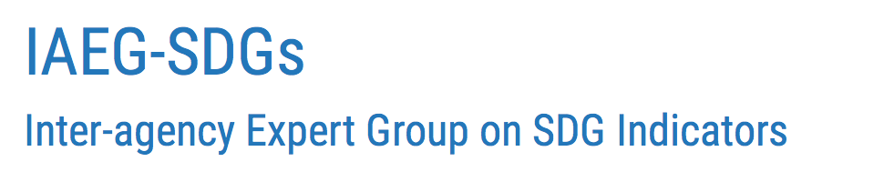
Key Stakeholders of UN SDGs
UNSG annual report on "Progress towards the Sustainable Development Goals"
UNDESA - UN Statistics Division (UNSD)
National Statistical Offices
National governments
and agencies
UN Custodian Agencies
UNEP
FAO
UN Habitat
Working Group on Geo-spatial Information (WGGI)
WHO
UNISDR
Working Group on Inter-linkages of SDGs
UNICEF
UNCCD
WB
OECD
Working Group on SDMX
UNSD
Notes:
HLPF = UN central platform for the follow-up and review of the 2030 agenda for sustainable development and the SDGs.
Secretary-General's annual report on "Progress towards the Sustainable Development Goals"
The United Nations Statistical Commission
established in 1947
highest body of the global statistical system.
It is is a Functional Commission of the UN Economic and Social Council (ECOSOC).
It brings together the Chief Statisticians from member states from around the world.
It is the highest decision making body for international statistical activities especially the setting of statistical standards, the development of concepts and methods and their implementation at the national and international level.
The UN Statistical Commission (UNSC) has the mandate for the development and and implementation of the Global Indicator Framework.
The Statistical Commission oversees the work of the United Nations Statistics Division (UNSD)
The United Nations initiative on Global Geospatial Information Management (UN-GGIM)
aims at playing a leading role in setting the agenda for the development of global geospatial information and to promote its use to address key global challenges.
It provides a forum to liaise and coordinate among Member States, and between Member States and international organizations.
The committee is mandated, among other tasks, to provide a platform for the development of effective strategies on how to build and strengthen national capacity on geospatial information.
In March 2015 at its forty-sixth session, the United Nations Statistical Commission created an Inter-agency and Expert Group on SDG Indicators (IAEG-SDGs), which is composed of representatives from a regionally-balanced group of Member States and includes regional and international agencies as observers
Proposed Global Indicator Framework for the SDG Goals and Targets submitted to UNSC-47 on 8-11 March 2016 for approval by UNSC.

Slide 9
IAEG-SDG, inside the UN system
IAEG-SDGs: Inter-agency Expert Group on SDG Indicators
  Created by the UN Statistical Commission
  Organizations are encouraged to talk to relevant Agencies,
  the “SDG indicators' custodian agencies" as identified in the IAEG-SDG document from their 5th meeting, December 2016: “Tier Classification for Global SDG Indicators”: https://unstats.un.org/sdgs/files/meetings/iaeg-sdgs-meeting-04/Tier%20Classification%20of%20SDG%20Indicators_21%20Dec%20for%20website.pdf
    3 different “tiers” levels according to the availability and maturity of data/methodologies – a work plan for Tier III is being implemented (https://unstats.un.org/sdgs/files/meetings/iaeg-sdgs-meeting-05/TierIII_Work_Plans_03_03_2017.pdf )
CEOS Agencies to contribute to the development of
the SDG indicators’ methodologies (for the most relevant indicators)
through GEO or with relevant ‘custodian’ agencies
Notes:
Inter-agency Expert Group on SDG Indicators: was established by the Statistical Commission at its 46th session to develop an indicator framework for the monitoring of the goals and targets of the 2030 Agenda for sustainable development at the global level, and to support its implementation.
Tier I: Indicator conceptually clear, established methodology and standards available and data regularly produced by countries.
Tier II: Indicator conceptually clear, established methodology and standards available but data are not regularly produced by countries.
Tier III: Indicator for which there are no established methodology and standards or methodology/standards are being developed/tested.

Slide 10


GEO/CEOS involvement in the
SDG process
GEO Initiatives on SDGs
(EO4SDGs)
CEOS Ad-hoc team on SDGs
Leads: NASA, JAXA, INEGI
Leads: CSIRO, CSA, ESA
GEO Sec, UN-GGIM, GPSDD, WHO, UNOOSA, ISPRS, CEOS, ESA, CSA, CSIRO, NOAA, US EPA, DK GST, SE SHMI, EARSC …
CEOS Sec and SEO, NASA, USGS, NOAA, ISRO, JAXA, GEO Sec …
UN Statistical Division
WG on Geo-spatial Information (WGGI)
UN Habitat
UNCCD
UNEP
UN
Custodian Agencies
National Statistical Offices

Slide 11
EO4SDGs: GEO initiative on SDGs
GEO Initiative on the SDGs “Earth Observations in Service of the 2030 Agenda for Sustainable Development” (EO4SDGs):
  Elaborate case studies at country level to showcase the value of EO data:
    Report co-written with CEOS and distributed at the 48th UN Statistical Commission (available on CEOS page under SDGs work)
  Participate in the new “Working Group on Geospatial Information” (WGGI) within IAEG-SDG (Inter-Agency Expert Group on SDGs):
    another report to be available soon
  Explore further partnerships with SDGs (eg Data4SDGs toolbox - modules to be developed)
  Other capacity building activities
CEOS is an active member of EO4SDGs
Programme Board: SDGs is one of the top 3 priorities (sub-group)

Slide 12




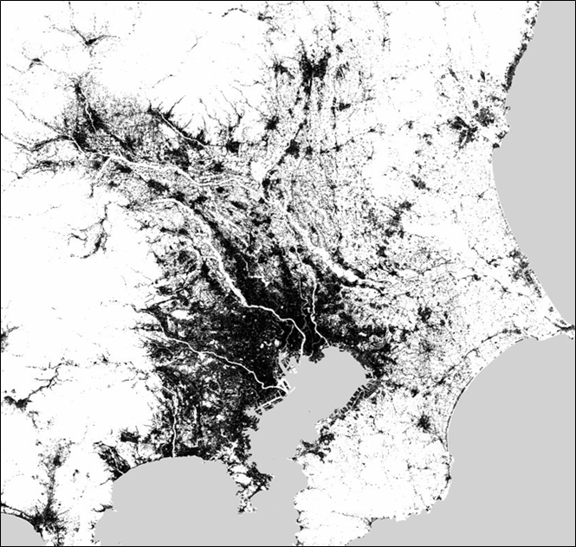






EO support to SDG implementation
Global Datasets
Methodo. Guidelines
Country Support
Capacity
Building
EO
Software
Toolboxes
EO Knowledge Hub
Custodian Agencies
NSOs
governments / agencies
Key Stakeholders
Access to global / regional datasets.
in the absence of or to complement and enhance, national data sources.
countries which face major difficulties in collecting national data
Support custodian agencies to develop method. guidelines to countries.
EO Best Practices.
Scientifically sound approaches.
Product validation.
Show Cases.
Targeted activities to support NSOs and ministries to report on SDG indicators.
Support country level efforts to apply EO to track, monitor and achieve SDGs.
Build capacity to exploit EO
Training courses
Training material on EO best practices
Mainly in developing and emerging economies
Critical mass of technical centers
Free of charge
Open source
Easy to use
EO Processing Toolboxes
(ESA SNAP)
Thematic Toolboxes
Knowledge sharing
Facilitate access to satellite data
Access to global / regional datasets
EO Best practices
Method. guidelines
Visualisation and Analysis tools
On-line processing
Toolboxes (e.g. Data Cube)
GUF
Toolbox

Slide 13



Global rising interest in the UNSDGs
Opportunity for CEOS agencies to work closely with external partners:
GEO – to support the EO4SDGs initiative
World Bank Group –with a ‘project/program’ approach rather than cross-cutting (ex Albania/NASA or Vietnam with Datacube?)
Foundations/Development banks – Gates, Rockefeller, Clinton?
Other global partnerships or institutes: IISD (International Institute for Sustainable Development), GPSDD (Global Partnership for Sustainable Development Data)
Does CEOS need/wish to be a member of GPSDD ?
UN Agencies to develop specific ‘indicators’ and monitoring guidelines (under UN Statistics) – eg CSIRO/UNCCD
National Statistics Offices (NSOs): a few CEOS Space & technical agencies being approached by their NSOs for advice to use EO in SDGs monitoring (Australia, South Africa, Japan, European countries…)
Notes:
CEOS strongly supports the GEO Initiative on UNSDGs:
- GEO is producing a report on “EO value for monitoring SDGs”, to be presented at the 48th UN Statistical Commission meeting in March 2017
Increased engagement of UN Agencies to develop specific ‘indicators’ and monitoring guidelines (under UN Statistics)
- CSIRO has been commissioned from UNCCD (UN Convention to Combat Desertification) to provide a ‘good practice guidance report’ for EO-based monitoring of indicator 15.3.1
=> Glenn Newnham (CSIRO) presentation
Selected CEOS Space & technical agencies being approached by their NSOs for advice to use EO in SDGs monitoring (Australia, South Africa, Japan, European countries)

Slide 14

Value of EO data for Official Statistics
  Significant opportunities for complementing and enhancing official statistics:
    Several sources of available satellite imagery data, free or commercial, from different EO satellites
    Various measurements collected about the land and land cover, water and atmosphere;
    Complement traditional sources (ground or socio-economic data) when there is a lack of data;
    Provide spatially and temporally denser information (on multiple scales, up to global);
    Improve frequency or richness of data;
    Save money on traditional methods (survey methods can be time-consuming and expensive);
    Allow consistent and comparable measurements across different countries and regions
Notes:
SDGs = opportunity for EO and official statistics to work together
A reminder here of the value of EO data, especially for official statistics:
+++: different sources or information to enable the measurement of various products,
An additional source of data to complement and verify traditional ones
Increase the frequency and richness of data (globally, in ‘no mans land’)
Provide consistent and comparable measurements across the globe
However the space agencies and EO organixations are aware of a few challenges that need to be overcome to increase the use of EO in official statistics:
Large and complex data
New or revised methods for a new language
New capacity to select, process the data
Data continuity to be ensured
Spatial information to be used with the suitable algorithms and models to create a valid derived product

Slide 15

Value of EO data for Official Statistics
Still, a few challenges …
  Large and complex data: necessary expertise, infrastructure and internet bandwidth;
  New statistical methods to be implemented;
  Capacity Building: NSOs to develop the capacity to select, access, process and apply the required data sources;
  Data continuity (long-term investment in countries frameworks);
  Only spatial, spectral, and temporal information which can be then related to indicators;
              - Identify the best algorithmic approach and statistical applications that are most suited to the use of EO data,
          - Criteria: organisational benefits, methods’ feasibility, and cost savings probability
Where can CEOS help to reduce the risks or gaps, and increase some capabilities?
Notes:
However the EO community is aware of many challenges that need to be addressed soon to improve the access of EO data of non-EO people

Slide 16
CEOS AHT SDGs:
Terms of Reference (ToR)
In the complex and evolving SDG environment,
the AHT SDG must
take stock of the UN processes in place for the SDG implementation and of the existing participants and stakeholders,
focus its activities around the unique role that CEOS should play as a coordination body of the Space community efforts to support the integration of satellite EO in support to the full realisation of the SDGs.
CEOS AHT will align its engagement with the UN SDG agenda mostly through GEO
(GEO Programme Board, GEO Engagement Strategy, GEO initiative EO4SDGs)
and on a case by case basis directly with the UN custodian agencies and
individual countries (through their NSOs and relevant ministries).

Slide 17
CEOS AHT SDGs:
Terms of Reference (ToR)
The AHT SDG will assess, showcase and promote EO contribution
to SDG targets and indicators.
CEOS AHT SDGs - ToR
Coordinate the efforts of CEOS agencies and communicate CEOS support to the SDG processes (use cases, communication materials, )
Provide a forum for sharing/communicating EO best practices in support to the SDGs.
Analyse new opportunities for satellite-based EO to support SDGs Targets and Indicators
Engage with other relevant authoritative stakeholders inside (IAEG-SDGs, WGGI, UN Custodians) and outside the UN system (GPSDD, IISD, WBG, Foundations, etc.)
Use CEOS assets and bodies to build user capacity at all levels of the UN SDGs implementation

Slide 18
CEOS AHT SDGs:
update & the way forward
CEOS Plenary (Brisbane, 2016) decided the creation of an ad hoc team on SDGs (AHT SDG) – today ~30 members (mailing list)
3 co-leads until next Plenary:
  Marie-Josée Bourassa (CSA) until SIT-32, then Satya Kalluri (NOAA)
  Marc Paganini (ESA)
  Alex Held (CSIRO)
Terms of Reference produced – available here - for endorsement at SIT
Implementation Plan prepared including key activities under 2 main axes:
  Supporting GEO and its EO4SDG initiative
  Initiating discussions directly with other partners especially UN custodian agencies and National Statistical Offices (bilateral)
Communications and Capacity Building activities
ToRs to be approved?
Call for volunteers for next year’s new co-leads ?
Any new activity or partnership to be initiated ?

Slide 19


THANK YOU FOR YOUR ATTENTION
THANK YOU FOR YOUR ATTENTION
For more information – CEOS contacts:
Marie-Josee Bourassa (CSA, co-lead of the AHT SDGs) marie-josee.bourassa@canada.ca
Marc Paganini (ESA, co-lead of the AHT SDGs) marc.paganini@esa.int
Alex Held (CSIRO, CEOS Chair 2016 & co-lead of the Ad hoc Team SDG) alex.held@csiro.au
And Flora Kerblat (CSIRO, AHT SDG) flora.kerblat@csiro.au
CEOS WEBPAGE on SDGs:
http://ceos.org/ourwork/ad-hoc-teams/sustainable-development-goals/

