Slide 1

CEOS Ad Hoc WG on GEOGLAM
Committee on Earth Observation Satellites
Selma Cherchali (CNES) & Brad Doorn (NASA)
SIT-32 Agenda Item # 12
CEOS Strategic Implementation Team
ESA Headquarters, Paris, France
26th-27th April 2017

Slide 2
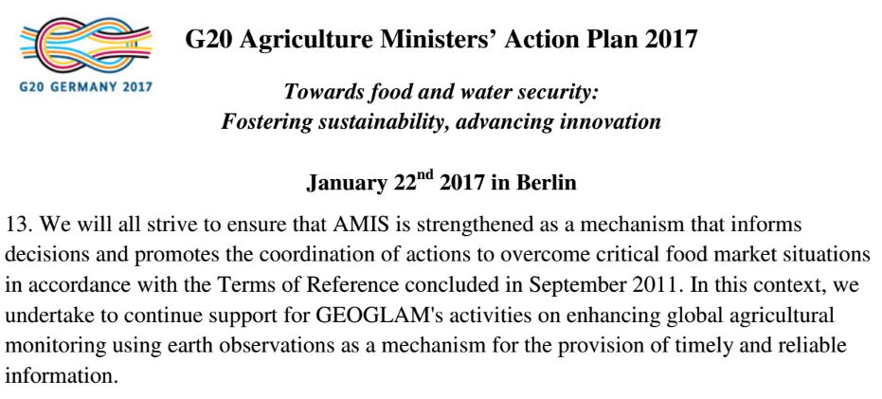
GEOGLAM Updates (1)
GEOGLAM-wide:
  Re-endorsement of GEOGLAM by G20 – Signaling greater support, strengthened political mandate
    EO for timely, reliable information
Regional Network Highlights:
  4-day GEOGLAM Latinoamerica Training planned for AmeriGEOSS Week, 31 July-4 August 2017 (Costa Rica)
  Launch of AfriGAM – joint contribution to AfriGEOSS and GEOGLAM
    Full day workshop on needs, priorities, and objectives in Uganda, October 2016
  GEOGLAM Latinoamerica & AfriGAM still in “ramp up” phase (need funding for coordination, implementation planning)
  Asia-RiCE SARI/LCLUC Workshop, Vietnam October 2016, and GEOGLAM/Asia-Rice Workshop at APGEOSS, Tokyo January 2017 (discussion about UN SDGs)

Slide 3
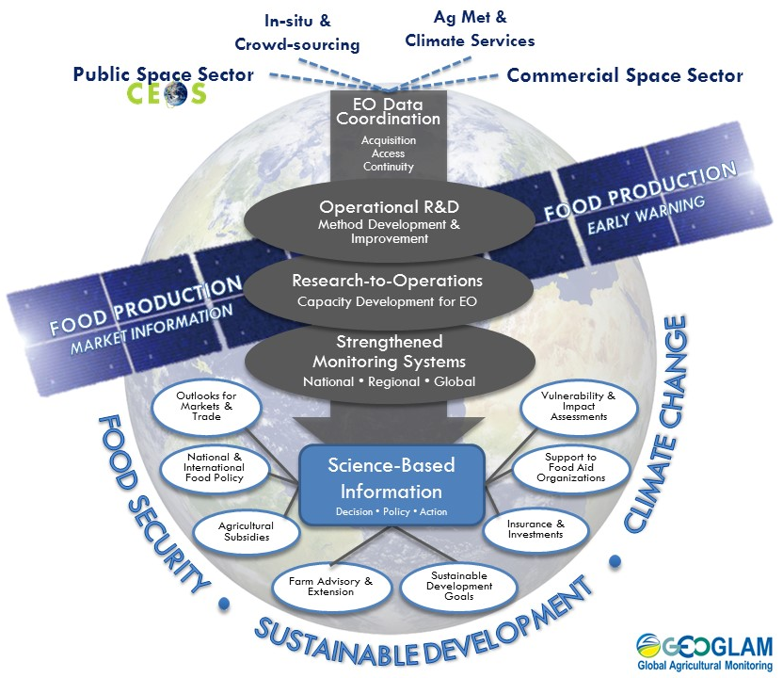
GEOGLAM Updates (2)
GEOGLAM’s New Workflow Diagram approved by GEOGLAM Advisory Committee
  Positions EO data coordination (inc. CEOS agency data) at the center of all activities, from R&D through operations
EO Data Requirements “reboot”
  Still in progress – emphasis on getting it “correct” rather than “quickly”
  Completion slated for Fall 2017 (contingent upon community meeting)

Slide 4
GEOGLAM Updates (3)
Asia-RiCE
  Upcoming Asia-RiCE related meeting (15 May 2017) focused on pre-operational data use (wall-to-wall) in Indonesia and Vietnam with Data Cube discussion and ALOS-2 ScanSAR data on-line access
  GEORICE contributing a Sentinel-1 Module to the Vietnam Mekong Delta Data Cube
RAPP
  Upcoming workshop at ESRIN (16-17 May) focused on integrating Sentinel-1 and -2 data for biomass estimation on rangelands
  RAPP Map (global monitoring system) officially launched (http://map.geo-rapp.org/) – Newsletter #5
  In-country validation work ongoing with RAPP partners (Argentina, Brazil, South Africa, Namibia, Mongolia…)
JECAM
  SAR Inter-comparison Experiment
    Agreement achieved between AAFC and CS;, imminent start
    Details to-be-discussed 28 June at Sen2Agri/SIGMA/JECAM meeting in Rome
    Crop Biophysical Variables – LAI, Biomass (McNairn, AAFC)
    Crop Type Mapping (Davidson, AAFC)
  Significant quantity of VHR optical data (Pleiades) provided (Nov 2016) (nearly 6000 km2)
Compendium of Best Practices from R&D Activities (Sen2Agri, SIGMA, JECAM)
  Inspired by GFOI MGD – to be scoped at 26-30 June 2017 (Rome)

Slide 5


GEOGLAM & the UN SDGs (1)
Contribution to the SDG 2 (end hunger, achieve food security and improved nutrition, and promote sustainable agriculture)
and strong links to other SDGs from 2 to 13, with more direct effects on clean water, climate action, life on earth, no poverty, and good health

Slide 6
GEOGLAM & the UN SDGs (2)
Some examples
Target 2.c
Adopt measures to ensure the proper functioning of food commodity markets and their derivatives and facilitate timely access to market information… in order to help limit extreme food price volatility
Target 2.a
Increase investment, including through enhanced international cooperation, in… agricultural research and extension services, technology development… to enhance agricultural productive capacity in developing countries.
Target 2.4
By 2030, ensure sustainable food production systems and implement resilient agricultural practices that increase productivity and production…
Target 13.3
Improve education, awareness-raising and human and institutional capacity on climate change mitigation, adaptation, impact reduction, and early warning.
Crop Monitor for
AMIS
GEOGLAM
JECAM
Asia-RiCE
SIGMA
GEOGLAM R&D
Crop Monitor for Early Warning
Capacity Dvlmpt

Slide 7
GEOGLAM & the UN SDGs (3)
GEOGLAM will continuously improve the accuracy of crop production outlooks and predictions that directly or indirectly help policy makers and agricultural stakeholders to provide sufficient quality crops with sustainable agriculture practices.
GEOGLAM needs to upgrade prediction models by integrating multiple time series satellite data with in-situ observations
The importance to address the whole added-value chain
  Multi-platform observations: we need satellite data (optical and SAR), meteorological data, in situ data, with standardized data and product definition and format
  Interoperable platform: required for integration and data assimilation in models, for simulation scenarios on climate change and on socio-economic aspects
  Innovation for crop models to assimilate the relevant AO and meteorological data. Innovation for models integrating socio-economic component for Decision Support Systems for scenarios of climate change, environment and socio-economic impacts at short and long term

Slide 8


GEOGLAM & the UN SDGs (4)
How to align GEO(GLAM) and CEOS efforts to contribute to the SDGs?
  Messaging, outreach, approach
  Goals
MONITORING FOR EARLY WARNING IN SMALLHOLDER SYSTEMS
R&D EFFORTS ON SUSTAINABLE AGRICULTURE
ENHANCING MONITORING IN COUNTRIES AT RISK OF FOOD INSECURITY; R&D TO SUPPORT
CROP MONITOR => TIMELY ACCESS TO MARKET INFORMATION TO REDUCE PRICE VOLATILITY

Slide 9
GEOGLAM & CEOS: Interactions
LSI-VC:
  Adapting GEOGLAM’s requirements development and evaluation process
    Tabular & spatial representation of common needs
      Where do we have critical gaps across MULTIPLE applications?
      Which observations have a high bang-for-their-buck return on investment?
      Acquisition planning for non-systematic sensors across multiple apps
      Future mission design & justification
    Tie-ins to ARD work → what standard pre-processed products have utility across multiple activities?
      A “common denominator” of sorts
  Joint LSI-VC, GEOGLAM, GFOI meeting planned September 6-8th
Increasing coordination with WGCapD
  Challenge: aligning GEOGLAM’s operational/institutional capacity development mandate with WGCapD’s priorities

Slide 10
GEOGLAM & CEOS: Priorities
Continued collaboration with LSI-VC, WGISS on data dissemination and access – ARD, Data Cube, etc.
Commercial engagement: topic being discussed amongst GEOGLAM Advisory Committee, will keep CEOS in the loop as that develops
Developing a plan for concretely contributing to the UN SDGs
Updated data requests/requirements pending the outcome of several key 2017 funding opportunities for GEOGLAM (in Europe, the USA, and China)
  This will determine where the next 3-5 years of work are taking place

Slide 11
Summary
Harmonizing, centralizing, “glue” functions:
    Coordinating Crop Monitors (AMIS, Early Warning, GEORICE)
    EO Data Coordination with CEOS: for R&D activities, baseline dataset generation, and developing/implementing community requirements
    Operational R&D (JECAM, Asia-RICE,...future framework US, Europe, China,…)
    Capacity Development coordination

Slide 12
BACKUP MATERIAL

Slide 13
Major Achievements
- Asia Rice -
Asia Rice team meeting was held at Asia Pacific Regional Space Agency Forum in Manila with ADB in November, 2016 and GEOSS-AP working group 5 was also held in January, 2017 in Tokyo
1. Rice crop area and growth monitoring
Techinical demonstration sites = one province (Chinese Taipei, India, Japan, Malaysia, Philippine, Thailand + Cambodia and Myanmar from 2016).
Regional area (wall-to-wall): Vietnam and top 10 rice production provinces in Indonesia
GEORIICE for Vietnam
ADB project for 4 countries – rice crop area estimation Innovative Data Collection Methods for Agricultural and Rural Statistics results sharing finished by November 2016 with holding regional workshop with on-line training course with INAHOR and ALOS-2 (this training course will be open in ADB from March, 2017)
L/X/C with optical integration usage study is going with JECAM for rice to estimate rice yield
Start to set up pre-operational service for rice crop growing monitoring using ALOS-2 ScanSAR on-line service, Sentinel and other satellites in Indonesia and Vietnam (as a suucessful result of wall-to-wall study by Asia Pacific Regional Space Agency Forum SAFE prototyping in Vietnam and Indonesia with ADB project). Especiall, for Vietnam, under the cooperation with CSIRO and VSNC, JAXA prepares ALOS-2 ScanSAR data on-line access as SAR ARD to CEOS Mekong Data Cube. CEOS Mekong Data cube will be plan to demonstarte at coming GEOSS-AP meeting this September.
2. Rice crop outlook using agro-met information derived from EO satellites such as GPM, GCOM-W, MODIS, Himawari
5 countries (Indonesia, Philipine, Thailand, Vietnam, Japan) from 2013 + Cambodia, Laos, Myanmar in cooperation with AFSIS
3. Capacity Building and training
Hold a workshop for rice crop growth and outlook monitoring using space technology to ASEAN countries (Vietnam, Lao, Thailand, Philippine and Indonesia) in cooperation with AFSIS in March, 2017

Slide 14
CEOS Mekong Data Cube concept (draft)
JAXA
GA/CSIRO
VNSC
Ground data
ALOS-2
GEORIICE
Mekong
Data Cube
(VNSC)
ScanSAR every 42 days
+ INAHOR software
Statistical info
MARD
ESA
Met info
Sentinel
MONRE
MODIS
Landsat
Analyzed info
Dual every 12 days
CSIRO
VNSC, VAST, MARD

Slide 15
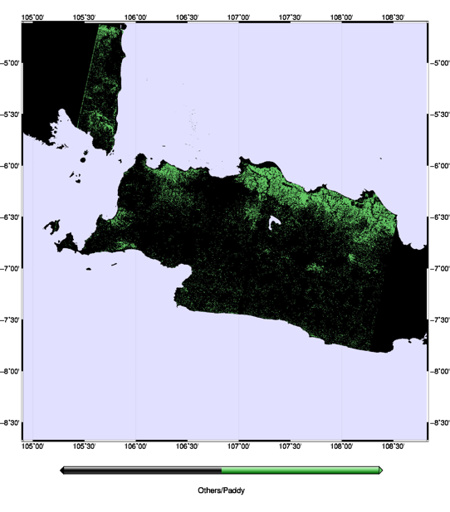
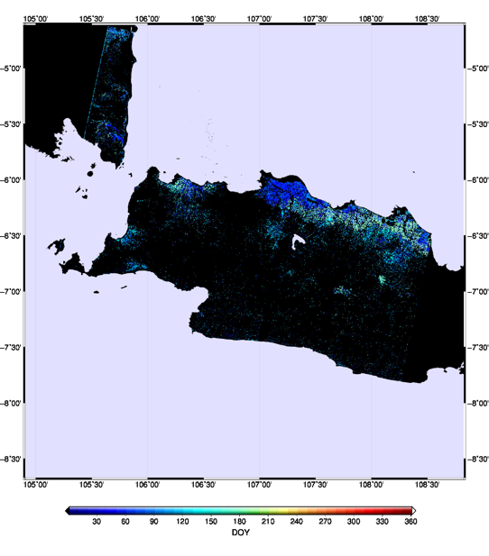
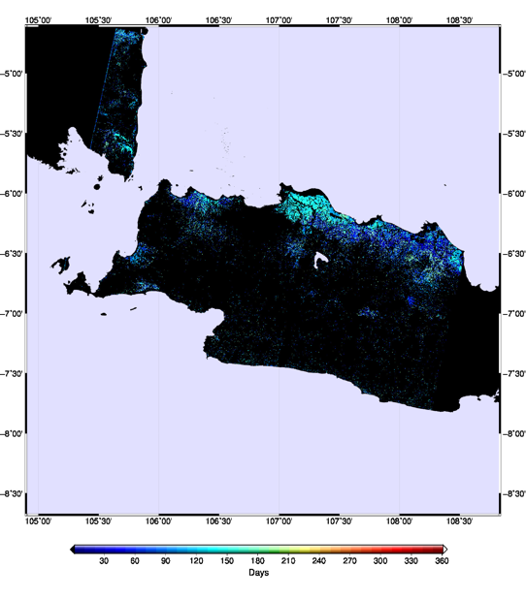
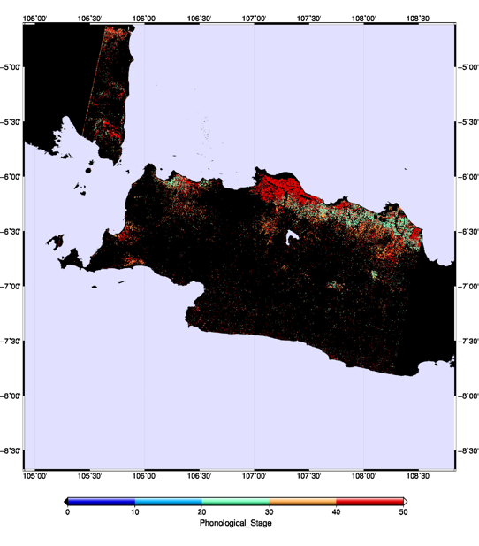


Rice Monitoring Products (example)
As of
22 Jul 2016
Planted Area
Planted Date
West Java, Indonesia
Plant Age
(Days since Planting)
Phenological Stage
Joint research with MoA, Indonesia

