Slide 1
GEO Framework Update and Outlook, including highlighting of GEO priorities
CEOS SIT-32
Barbara J. Ryan
Director, GEO Secretariat
April 26-27, 2017
Paris, France

Slide 2
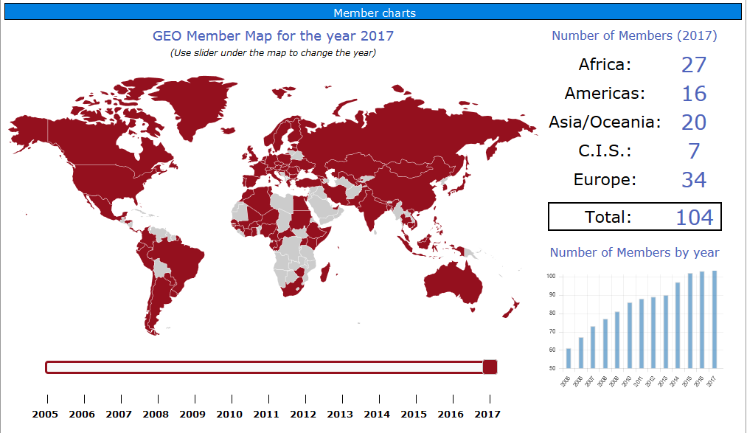
GEO partnership 104 Members

Slide 3
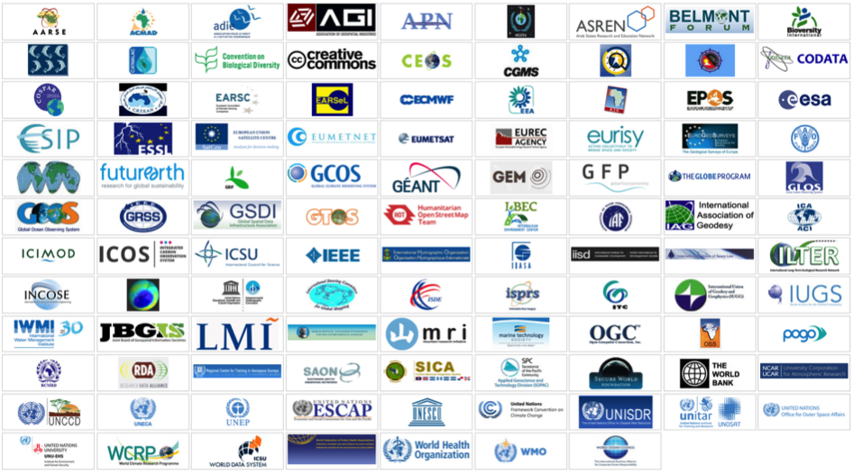
110 Participating Organisations

Slide 4
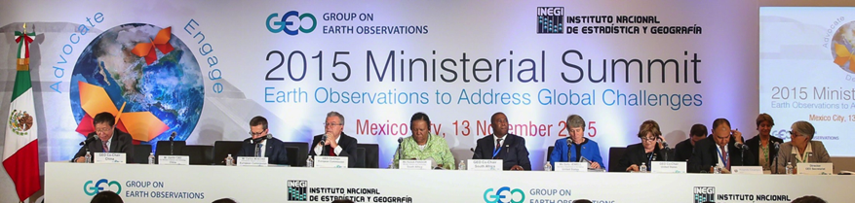
High level commitment to use EO for policy
Ministerial Declaration , GEO Plenary XII, Mexico City, 2015
“Affirm that GEO and its Earth observations and information will support the implementation of, inter alia, the 2030 Global Goals for Sustainable Development, the Sendai Framework for Disaster Risk Reduction 2015-2030, the United Nations System of Environmental and Economic Accounts, and the United Nations Framework Convention on Climate Change.”

Slide 5
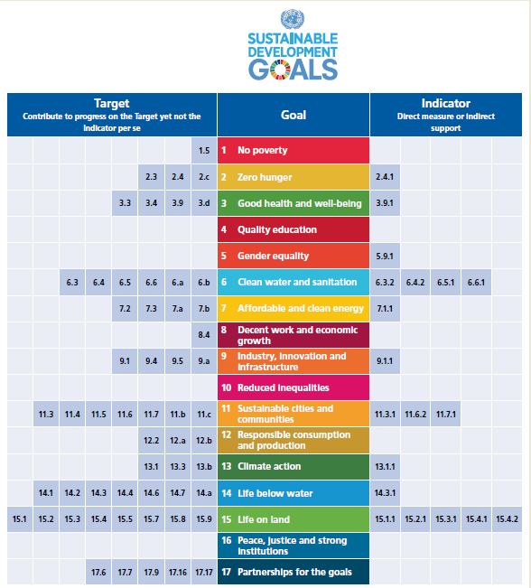
GEO support to the 2030 Agenda
EO to support the 2030 Agenda.
GEO represented on Inter-Agency Expert Group of the UN Statistics Division.
GEO is the Earth Observation Anchor Partner to the Global Partnership for Sustainable Development Data.

Slide 6

EO4SDG Case Studies
GEO integrates use of EO data into the methodology of measuring and achieving SDG Indicators.
This brochure (March 2017) gives graphic illustrations of the types of EO data sets and images available for improved policy and decision-making.

Slide 7
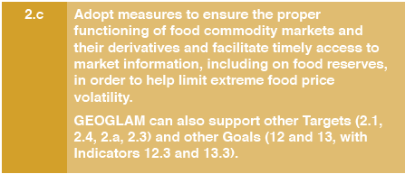
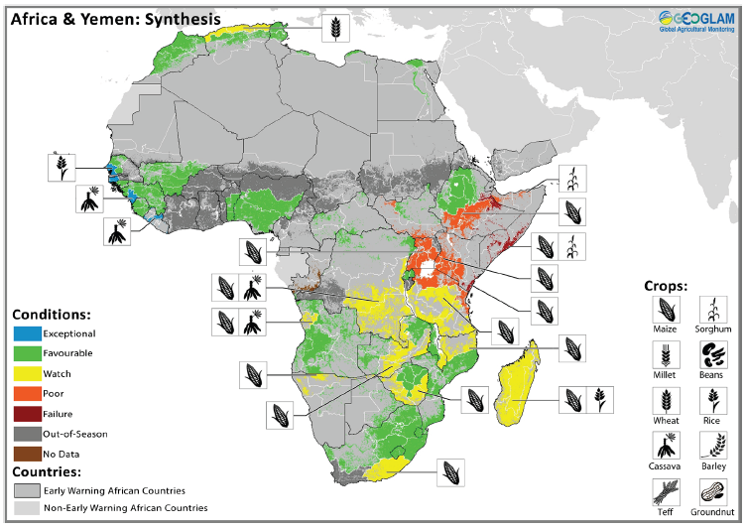
Goal 2 informed by GEO’s Agricultural Monitor

Slide 8
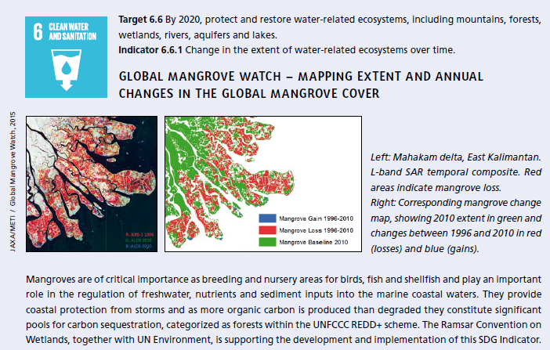
Goal 6 informed by The Ramsar Convention

Slide 9
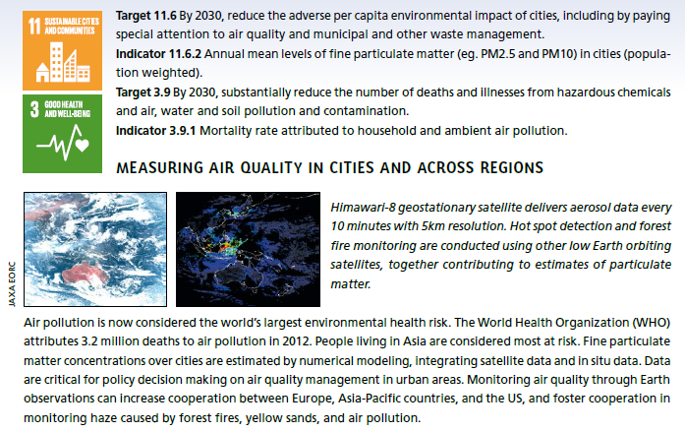
Goals 11 & 13 informed by aerosol data

Slide 10
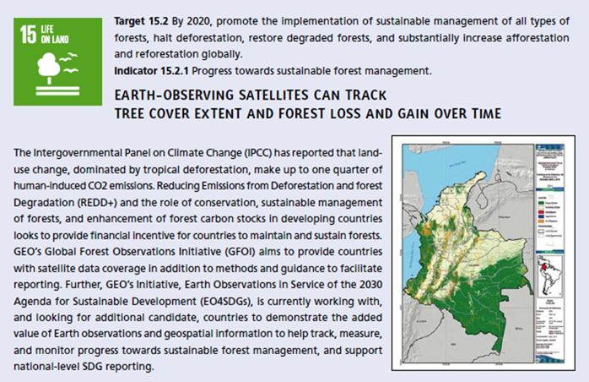
Goal 15 achieved through GFOI

Slide 11
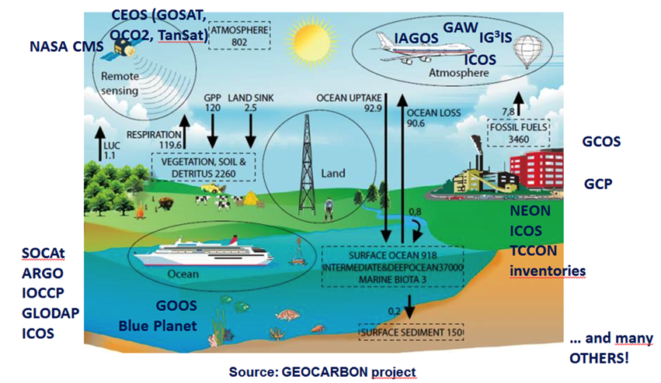
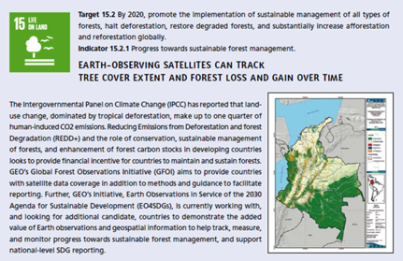
Paris Agreement national reporting supported by GEO’s Carbon and GHG Initiative

Slide 12


Responding to the Paris Agreement
Article 4 and Article 13 – National Reporting
Reported five-yearly by parties, successive reductions in emissions
Using existing methods and guidance; not validation
Article 5 Mitigation
Knowledge of evolution of sinks and sources
Article 7 Adaptation
(7.6) Strengthening cooperation,
(7.7c) Research, systematic observation
Article 10 Technology Transfer
& Article 11 Capacity Development
Article 14 Global stocktaking
in the light of equity and the best available science: 2023, 2028…
Article 15 Compliance
Policy needs reliable GHG-related information

Slide 13
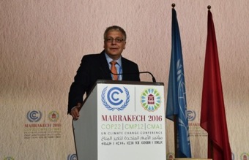
Informing policy agendas
Presented to Parties at UNFCCC SBSTA-44, Bonn (19 May 2016)
Presentation at UNFCCC COP-22 Earth Info Day (10 Nov 2016)
Werner Kutsch, Director ICOS, presenting the GEO Carbon and GHG Initiative
Upcoming Events:
Presentation UNFCCC SBSTA-46, Bonn (10 May 2017)
Organisation of a Side-Event at COP-23, Bonn

Slide 14

COP-23 Side Event
UNFCCC IPC (Sep 2016) endorsed GEO to have independent eligibility to apply for side events and exhibits at future UNFCCC sessions
ExCom Action 39.9: Secretariat to work with key partners (e.g. UNFCCC, IPCC, CEOS, GCOS, ICOS, etc.) to design a Side-Event at COP-23
Content to be defined with partners → Task Force
Possible topics include:
  Carbon and GHG observations to support the implementation of the Paris Agreement
  Help for countries in their national reporting
  Role of (satellite) observations in the Refinement of the IPCC Guidelines

Slide 15

The Sendai Framework
GEO’s Data Access for Risk Management (GEO DARMA) is building a synergy Framework for the Integration of Earth Observation Technologies into Disaster Risk Reduction.

Slide 16

UN Convention on Biological Diversity
The UN Convention on Biological Diversity (CBD) Aichi Targets can be measured by countries with support from the GEO Biodiversity Observation Network (GEO BON) Initiative for biodiversity observations.

Slide 17
Coordinating Terrestrial Observations
13 March 2017: Half Day Strategy Session ESA/ESRIN, Frascati - organized by GEO, ICSU and GCOS
~12 participants including CEOS, CMCC, ESA, GCOS, GEO, GOFC-GOLD, ICSU, ISCC,UNEP (unable to attend: DLR, FAO, JRC, UNESCO-IOC)
Meeting purpose:
  Address the gap in coordination of terrestrial observations
  Develop overall strategy
Outcomes:
  Concept note for a suggested coordination approach
  Agreement to organise a workshop in 2017

Slide 18
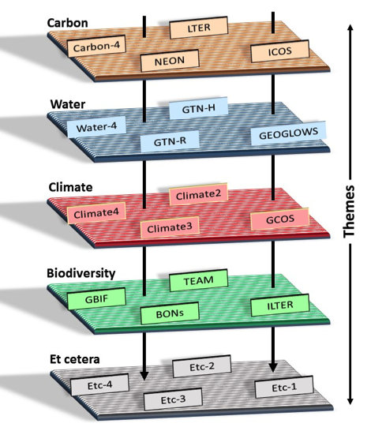
Suggested coordination approach
Many thematic areas already have a variety of related observing networks, yet coordination is limited
Coordination across themes is typically even more limited
Fortunately, some coordination does already exist and can provide a starting point for expansion

Slide 19
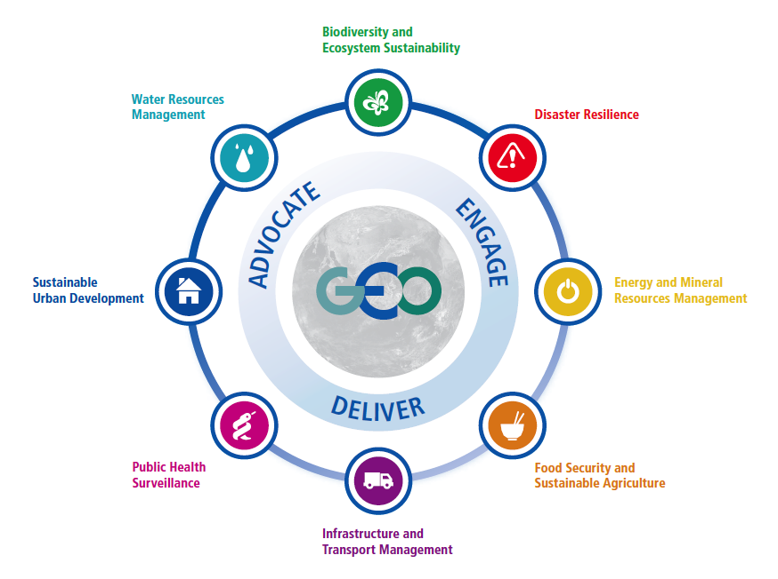
Societal Benefit Areas

Slide 20



GEO Flagships
GEO Biodiversity Observation Network (GEO BON)
GEO Global Agriculture Monitoring (GEOGLAM)
The Global Forest Observations Initiative (GFOI)
Global Observation System for Mercury (GOS4M)

Slide 21



GEO Regional Initiatives
AfriGEOSS
AmeriGEOSS
Asia Oceania GEOSS
(AO-GEOSS)

Slide 22
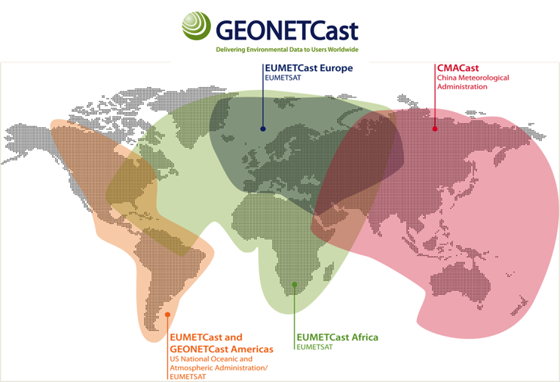
New stations
deployed throughout
the system
(around 20 per month)
Shared user management
between EUMETCast
& CMACast
for users of exchanged data
Broadcast bandwidth increased in Europe (DVB-S2 service) to accommodate new satellites & products

Slide 23
GEO Initiatives
Data Access for Risk Management (GEO-DARMA)
The GEO Carbon and GHG Initiative (GEO-C)
GEO Cold Regions Initiative (GEO CRI)
The Global Ecosystem Initiative (GEO ECO)
Global Network for Observations and information on Mountain Environments (GEO-GNOME)
GEO Global Water Sustainability (GEOGLOWS)
Geohazard Supersites and Natural Laboratories (GSNL)
GEO Human Planet Initiative (GEO HPI)
GEO Vision for renewable ENERgies (GEO-VENER)
GEO-Wetlands

Slide 24
GEO Initiatives cont.
GEOSS-EVOLVE
Global Drought Information System (GDIS)
GEO Global Urban Observation and Information
Global Wildfire Information System (GWIS)
Oceans and Society – Blue Planet
Earth observations in Service of the 2030 Agenda for Sustainable Development

Slide 25
GEO Foundational Tasks
GEOSS Development and GCI Operations
Advancing GEOSS Data Sharing Principles
GEOSS Common Infrastructure (GCI) Operations
GEOSS In Situ Earth Observation Resources
GEOSS Satellite Earth Observation Resources
GEONETCast Development and Operations
User Needs and Gaps Analysis
Community Development
Capacity Building coordination
Secretariat Operations
Management and Support
Communication and Engagement
Monitoring and Evaluation

Slide 26
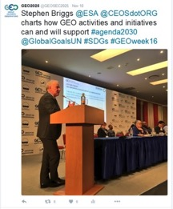
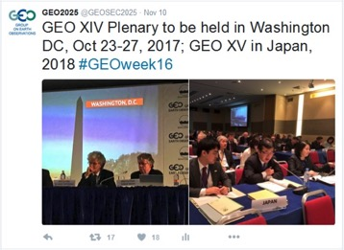
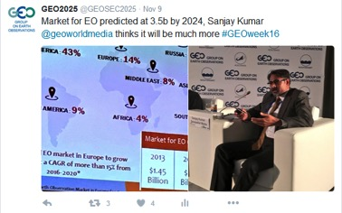
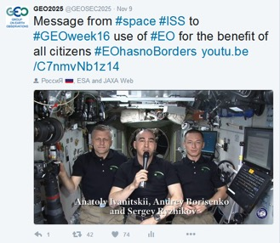
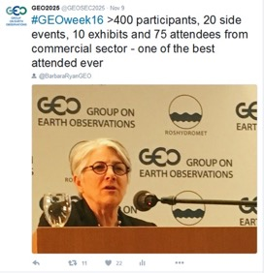
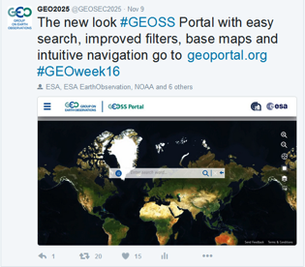
GEO XIII Plenary: Commercial Sector Panel,
SDG support and a new look GEOSS Portal

Slide 27
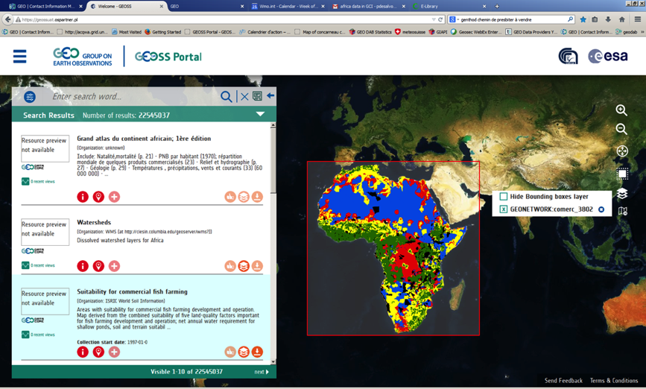
Visualize, download data from GEOSS Portal

Slide 28
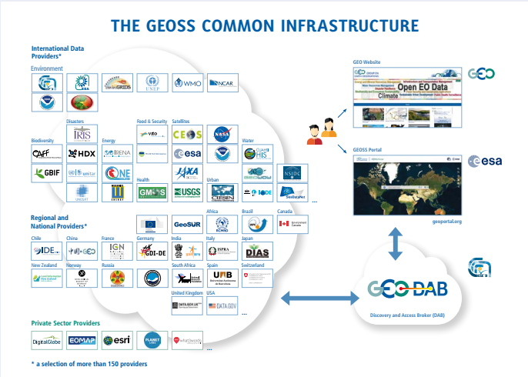
GEOSS Common Infrastructure (GCI)

Slide 29
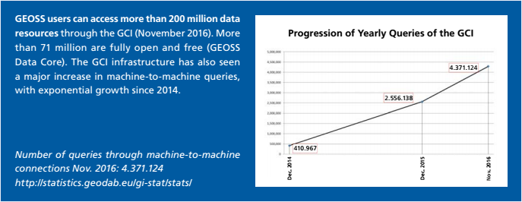
GEOSS Common Infrastructure (GCI)

Slide 30
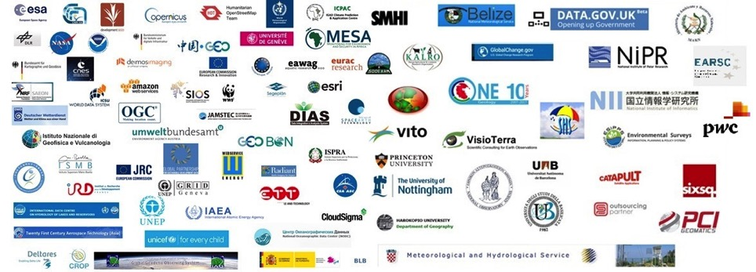
GEO Data Providers Workshop
April 20-21, Florence
93 organizations participated
Hosted by CNR, ESA and GEO Secretariat
Sponsored by Amazon webservices and development seed

Slide 31


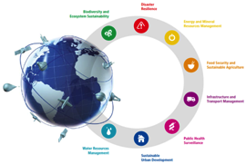
Challenges
  Data access
    Broad, open data policies are needed for global monitoring and transparency
  Interoperability
    Data discoverability and access through federated systems
  Downstream services
    Applications and information are needed to make data useful for decision-makers

Slide 32
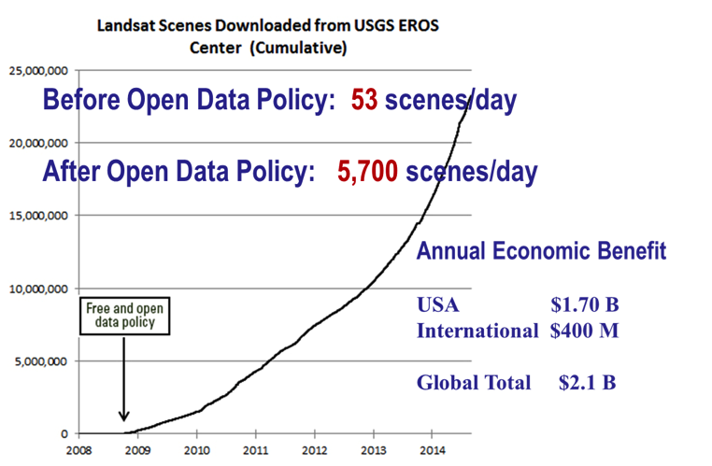
GEO promotes broad open data policies using strong economic arguments

Slide 33
Thank you !

Slide 34
Back ups

Slide 35
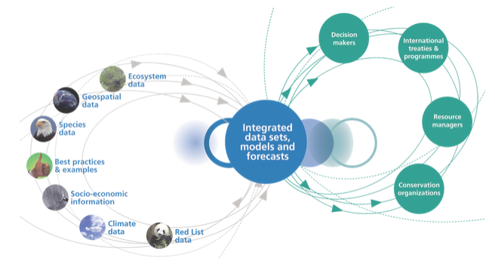
GEO BON – monitoring biodiversity change in support of policy

Slide 36

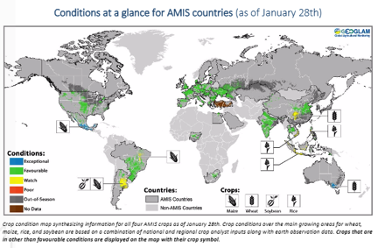
GEO GLAM – leveraging Earth observations for a food-secure world
Crop monitor for Early Warning
Crop monitor for AMIS

Slide 37

GFOI: measuring and monitoring forest and terrestrial carbon
Through the work of its partners, GFOI supports REDD+ countries to develop their national forest monitoring systems and associated emissions measurement, reporting and verification (MRV) procedures.
Reducing
Emissions from
Deforestation and forest
Degradation
+ Conservation and Sustainable Development

Slide 38

GOS4M: Global Earth Observation System for Mercury – in support of policy and science
Aims to increase the availability and quality of EO data and information to contribute to the understanding of the cycling of mercury released to the global environment, harmonize metadata production and develop advanced services in support of the Minamata Convention

Slide 39
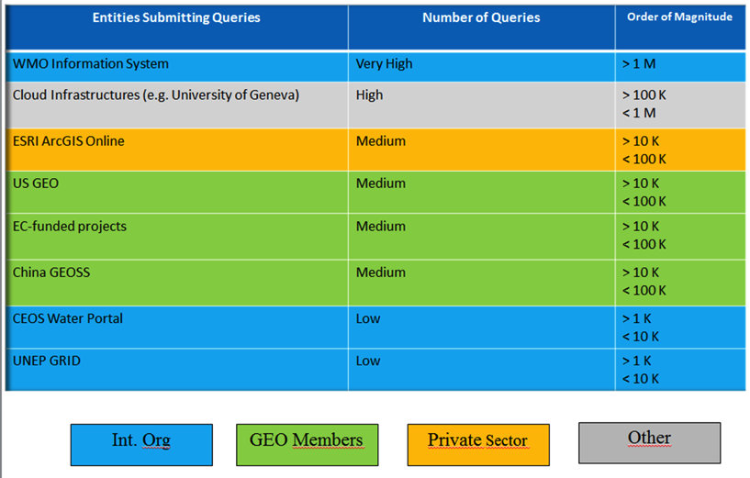
GEOSS main users 2016

