Slide 1

Logistics
Committee on Earth Observation Satellites
ESA
SIT-32 Agenda Item # 1
CEOS Strategic Implementation Team
ESA/HQ, Paris, France
26th-27th April 2017

Slide 2
Logistics (1/4)
LUNCH
Hosted lunch for SIT-32 participants at Canteen.
Daily lunch tickets will be distributed during morning coffee break.
CANTEEN & BAR
Floor -1
COFFEE, TEA AND WATER
At each coffee break, outside the Plenary room.
TRAVEL OFFICE, ATM machine and INFIRMARY:
Ground floor next to Main Reception

Slide 3
Logistics (2/4)
SECURITY
Attendees are requested to wear their magnetic badge at any time, inside ESA HQ building.
Due to high level of security, on-site circulation is restricted; visitors must be accompanied by security staff.
On 27 April, Participants are required to present again a valid Id at ESA Security Office (entrance of ESA HQ) to receive a magnetic badge.

Slide 4
Logistics (3/4)
SECURITY ADVICE
Expect heightened security and travel disruption in Central Paris. Comply with all directives issued by security forces.
Security alerts can prompt closures or evacuations of transport hubs and services. Don’t stand to close to SIT Chair …
Report any suspicious behavior or suspect packages to Authorities
TRANSPORTATION
Taxi on demand at reception desk

Slide 5
Logistics (4/4)
GROUP PHOTO
Today, during the morning coffee break
WIFI
Individual Wifi access code provided to each participant
WORKING ROOM
Room B301 (3rd floor) available to all CEOS participants, on 26 - 27 April
SUPPORT
Contact Carmen (Carmen.Comparetto@esa.int, tel: +39 3392460669) or Veronique Eliet (Veronique.Eliet@esa.int, tel: xxxx extension)

Slide 6
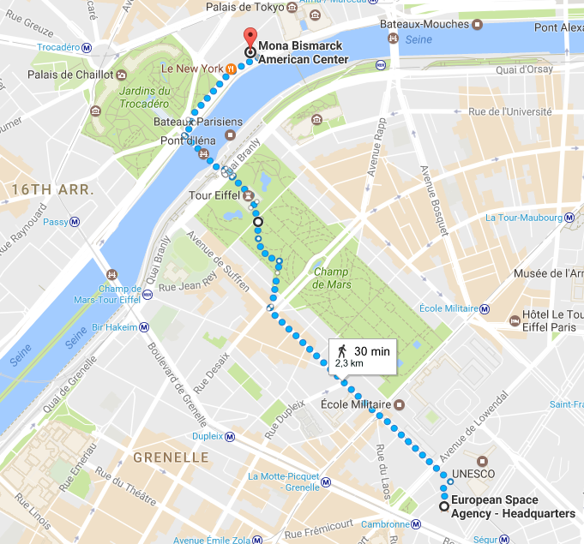
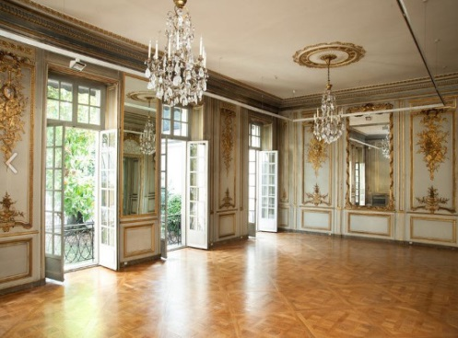
SIT-32 Social event
Tonight, guided tour of Mona Bismarck American Centre at 19:00 (7 pm), followed by a hosted dinner.
Dress code: casual
Address: 34 Avenue de New York, near the Jardins du Trocadero
Access:
Walking distance from ESA HQ: 2,3 km (1.4 mile).
Underground (“metro” in French) from Cambronne station (line 6, direction Charles de Gaulle Etoile), get out at the Trocadero station and then walk 750 m (0.5 mile).

