Slide 1
CEOS Information Systems Survey
Committee on Earth Observation Satellites
I. Petiteville
SIT-32 Agenda Item #35
CEOS Strategic Implementation Team
ESA Headquarters, Paris, France
26th-27th April 2017

Slide 2
Background
The CEOS Database and SEO teams conducted a user survey in 2016 covering:
EO Handbook: http://www.eohandbook.com/
CEOS Database: http://database.eohandbook.com/
COVE: http://www.ceos-cove.org/
CEOS Data Policy Portal: http://www.ceos-datapolicy.org/
29 responses received
45% from space agencies
21% government other than space agency
21% university
10% NGO and International Organisation
None identified from industry

Slide 3
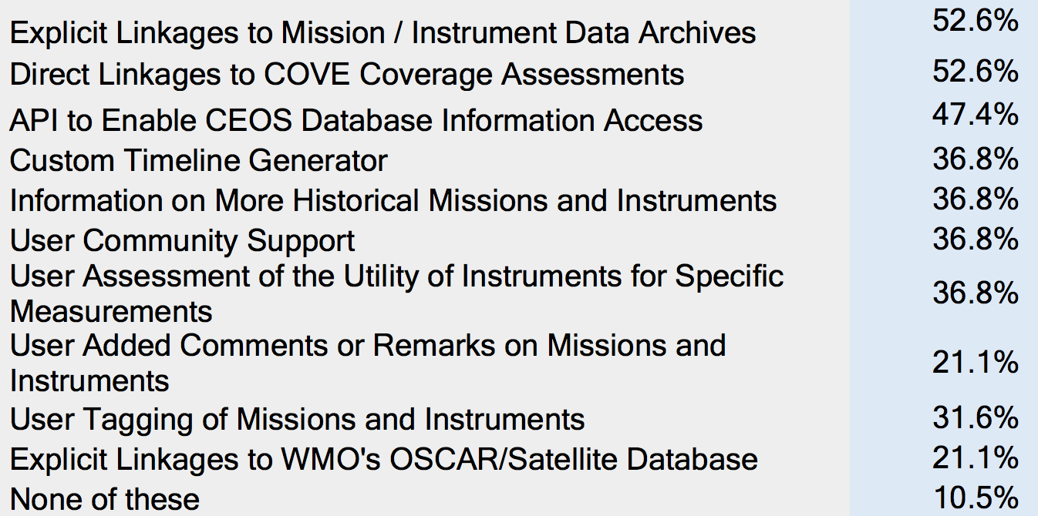
Feature Requests

Slide 4
Top Three Requests
Explicit Linkages to Mission / Instrument Data Archives
Could be accomplished by leveraging tools provided by WGISS
e.g. CWIC, OpenSearch, FedEO
This was investigated a couple of years ago, but tools still in early development – have matured.
Next Steps
Investigate the potential to include information from these tools in the mission and instrument profiles and implement some trial links if feasible.
Better highlight current data repository links in the database.

Slide 5
Top Three Requests
Direct Linkages to COVE Coverage Assessments
Discussed with the CEOS SEO team in the past, and would be desirable.
COVE does have an API which have trailed on the MIM website
Currently also have links to COVE from some mission profiles (to COVE landing page only).
Next Steps
Take another look at the COVE API to see if this could be leveraged to partially address MIM user interests

Slide 6
Top Three Requests
API to Enable CEOS Database Information Access
Use cases include using information in the Database for gap analyses (LSI-VC, SEO), and support to FDA implementation (machine-to-machine communications)
CEOS DB, SEO and WGISS coordinating on draft Rational, Use Cases, and Implementation Approach document
Posted on the SIT-32 website for information
Next Steps
A pilot API will be implemented this year for testing and evaluation.

Slide 7
2017 Work Plan Highlights
May-June: Annual database survey cycle to be initiated.
May-June: Assess implementation options for ‘top three’ priorities.
In addition to the regular annual cycle of minor enhancements
June-July: Implement trial CEOS DB API based on approach agreed with SEO and WGISS.
Q3/Q4: API feedback and evaluation
September-October: Regular cycle of database update release as well as release of enhancements implemented.

Slide 8
Questions?
https://www.theguardian.com/news/gallery/2017/apr/18/best-photos-of-the-day-german-snow-and-french-campaigns#img-1

