Slide 1
Sentinel-2 Status Update
Current state of USGS EROS Inventory
Tiles generated: As of March 06, 2017 1,130,881
Total size of tiles: As of March 06, 2017 444.94 Tb
Files (Bundles or Tiles) successfully downloaded: 653,846 (345.15 Tb)
International Hub: 637,627
Scientific Hub: 16,219
Data Ingest Statistics
Product Files (Bundles or Tiles) Loaded: 651,697
ESA Software Version 02.01: 12,031
ESA Software Version 02.02: 1,293
ESA Software Version 02.04: 638,373
Unique Sentinel-2A Users On Earth Explorer Oct 2016-Feb 2017 15,172

Slide 2
Product Download Statistics
Files successfully downloaded: 653,846 (345.15T)
International Hub: 637,627
Scientific Hub: 16,219
Processing Version 02.01 and newer: 651,629 (3.30T)
Processing version prior to 02.01: 2,217
Product Files (Bundles or Tiles) Downloaded Mar-2017: 29,615
Feb-2017: 111,258
Jan-2017: 99,130
Dec-2016: 135,102
Nov-2016: 125,266
Oct-2016: 123,380
Sep-2016: 7,158
Aug-2016: 8,298
Jul-2016: 14,639
Files yet to be pulled: 40,828
International Hub: 2
Scientific Hub: 40,826
Processing Version 02.01 and newer: 40828
Processing Version prior to 02.01: 0
Total Files on ESA Data Hubs: 694,674
International Hub: 637,629
Scientific Hub: 57,045

Slide 3
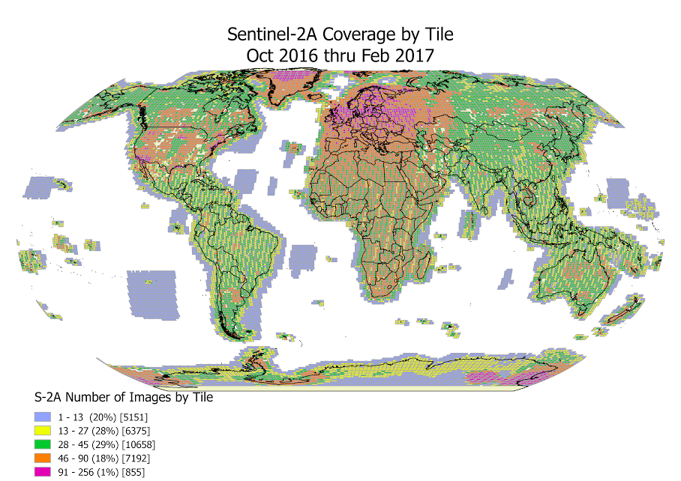

Slide 4
