Slide 1
Copernicus Sentinel Data Uptake and Application
Committee on Earth Observation Satellites
SIT Chair Team
SIT-32 Agenda Item #33 and #34
CEOS Strategic Implementation Team
ESA Headquarters, Paris, France
26th-27th April 2017

Slide 2
Session Outline
Review of SIT Chair objective and process
SIT-31 session outcomes
Space and Ground Segment Status (I Petiteville and P Counet)
Space Strategy for Europe (also known as SS4E) (10 min) (A Koch)
Inputs from CEOS Initiatives (VCs, WGs, AHTs etc.) on Access and Uptake of Sentinel Data in CEOS

Slide 3
Process
ESA SIT Chair Team Objective
“Ensure full access to, and exploitation of Copernicus Sentinel data;”
Response Template Circulated to CEOS Agencies Covering:
Intended purpose/use – primary use and data needs.
Acquisition – feedback on acquisition planning.
Discovery and Access – data access channels and issues.
Application – information needs, products, and processing
Input to be shared with Copernicus Mission Managers
Open discussion under item #34 seeded by 3-4 ‘highlighted’ submissions each with 1-2 minutes to speak to their inputs

Slide 4
Progress Since SIT-31
Since SIT-31 have added two units and Sentinel-3 data products
February 2016: Sentinel-3A
April 2016: Sentinel-1B (joins 1A)
March 2017: Sentinel-2B (joins 1A)
Ground segment partnerships opened up
Sentinel-1 archive mirror at ASF (2016)
Sentinel-2 archive mirror at EROS (2016)
Australian ground segment deployed (mid-2016)
Significant mirror archives on Google Cloud / Earth Engine (S1, S2), and AWS (S2)
Ivan and Paul to report further on progress in the Copernicus Space and Ground Segments

Slide 5
SIT-31 Session Recap
Recall - the main points from the same session at SIT-31 (April 2016):
Overall, the session was positive and encouraging, with the positive response to, and uptake of Copernicus Sentinel recognised
Some issues data access via SciHub were reported. Specifically around dropped, incomplete, empty, or corrupt downloads, and data product issues were identified by users in relation to: file naming, metadata content, duplication of scenes, etc. Improvements have been made, but download and product issues still being reported and resolved.
Plans to increase data distribution capacity were welcomed (e.g., via international/national mirror sites, the Collaborative Ground Segment). Access to SciHub/APIHub through scripting (OData, OpenSearch) was desired. US and Australian mirrors have helped to distribute user demand.
It was clear that there is a demand for the supply of higher-level products (e.g., ARD) or the tools to produce them. A prompt and unified approach to surface reflectance products was desired. Sentinel-1 and -2 standard products being planned / developed; tools being exercised.
Notes:
Note brief progress update in green under each.

Slide 6
SIT-31 Session Recap
Some domain-specific suggestions were also noted at SIT-31:
The Copernicus REDD+ Service should strongly encourage its use in applying Sentinel data in National Forest Monitoring Systems. Copernicus land service dev continues; REDD+ focused products remain TBD
Increased dual-polarization acquisitions of Sentinel-1 should be used to build up a dense systematic C-band data archive over the pan-tropics.
Increased SAR agricultural coverage was encouraged – these acquisitions should be coordinated with other SAR instruments to support multi-frequency analyses.
Have built to 12-day global dual-pol coverage, with 6-day in some areas, and target of 6-day for tropics.
10m fused Sentinel-2/Landsat-8 products (cross-calibrated, georeferenced time series) were desired for medium and small agricultural field studies. Being developed, and a focus of the case study of the USGS CEOS Chair MRI initiative.

Slide 7
Copernicus Space and Ground Segment Status
Committee on Earth Observation Satellites
I Petiteville, P Counet
SIT-32 Agenda Item #33
CEOS Strategic Implementation Team
ESA Headquarters, Paris, France
26th-27th April 2017

Slide 8
Space Strategy for Europe
Committee on Earth Observation Satellites
A Koch
SIT-32 Agenda Item #33
CEOS Strategic Implementation Team
ESA Headquarters, Paris, France
26th-27th April 2017

Slide 9
Copernicus Sentinel Data Uptake and Application – Agency Inputs
Committee on Earth Observation Satellites
SIT Chair Team
SIT-32 Agenda Item #33 and #34
CEOS Strategic Implementation Team
ESA Headquarters, Paris, France
26th-27th April 2017

Slide 10
Inputs Received
Agencies
NASA/CEOS SEO
NOAA
ISRO
GA/CEO
INPE/Brazil
SANSA/South Africa
Agencia Espacial Mexicana
GFOI/SDCG
USGS
Other
Google Earth Engine
Amazon Web Services
Sinergise

Slide 11
Highlighted Inputs
Overall feedback is very positive, instrument quality is high, and data utility is very strong.
For the purposes of discussion highlighting some specific cases
USGS - Sentinel utalisation and management
SEO - Data Cubes and ARD
GFOI/SDCG - Application of data
GA/CEO - experience with Australian Copernicus hub
Each followed by discussion

Slide 12
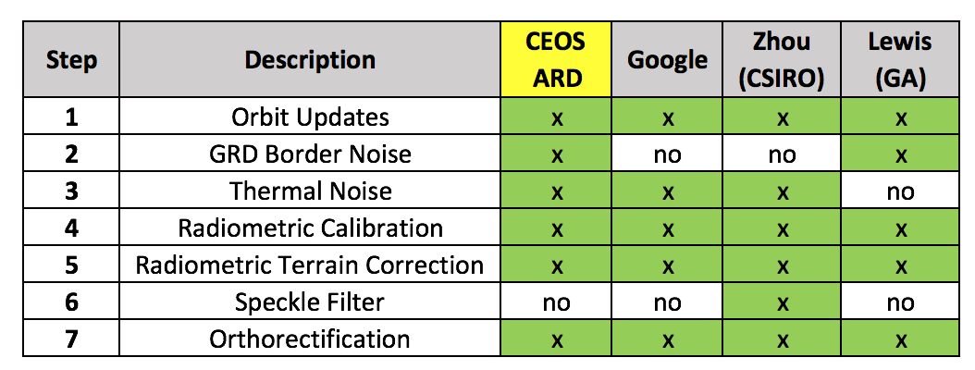
CEOS SEO
Sentinel-1
Getting the data is not an issue – defining the ARD is the issue.
Uncertainty about certain processing steps.
For Data Cube use:
Have an S-1 ingestor and have combined S-1, ALOS and Landsat in the Vietnam Data Cube.

Slide 13
CEOS SEO
Sentinel-2
USGS now have a complete mirror archive
Key question: how do we get ARD?
Uncertainty about the atmospheric correction algorithm and other "add on" processing (e.g. NBAR, terrain, solar illumination) steps.
For now, the Open Data Cube project has requested processed S-2 data (using Sen2Cor) for Vietnam and Colombia. This will allow early testing of ingestion code and interoperability with other datasets.
Common desire:
Need open source algorithms for S-1 and S-2 to support user applications.
Goal is to convert the code into Python and connect them to the Data Cube API.
Will greatly enhance the use of Sentinel data.

Slide 14
GFOI/SDCG
Key issues that GFOI/SDCG see as important for ESA/EC action to optimise Copernicus data from the Sentinel series for forest monitoring use and users:
Some users continue to report difficulty with downloads from the SciHub, in some cases this is access and they download via ASF and EROS. In some cases its file issues (e.g. empty). We note that CEOS FDA strategy is taking steps to address some of the ‘Global Data Flows’ Report recommendations and we encourage ESA/EC to engage actively in this strategy since it may address some of these issues around the volume, velocity and variety of data. These include the ARD and FDA Pilots. Specific issues being worked and resolved as they arise.
GFOI users continue to request Analysis Ready Data and we encourage ESA/EC to continue taking steps to provide this for Sentinel-2 in particular. As free and open data, this would require a free and open path for users all the way to the SR/ARD product and not require user purchase of proprietary IP for any atmospheric correction. Discussions ongoing.
We ask ESA/EC to prioritise provision of Sentinel ARD for the CEOS FDA Pilots, including the Vietnam Data Cube. This can only promote awareness and uptake of Copernicus globally. Data support to Vietnam Data Cube will be provided.

Slide 15
GFOI/SDCG
The LSI-VC-3 meeting made significant strides towards convergence on SAR ARD definitions for CEOS. We encourage ESA/EC to continue to take active leadership and support in this area given the value of the S-1 dataset. Definitions being progressed, but remain open for discussion.
SDCG would like to promote an Early Warning capability for GFOI and to see S-1 and S-2 data flow regularly to any demo system to show the value of Copernicus. We ask ESA/EC to support this specifically. Early discussions supportive.
Forest monitoring countries should be able to make best use of Landsat and Sentinel-2 interchangeably and without significant complications. The USGS initiative to address this in 2017 is very welcome and we ask that ESA/EC and USGS work to characterise issues like geo-registration of Sentinel data in the Data Cube to ensure best results for the ARD initiative. The engagement of an ESA Co-Chair in the CEOS FDA team is most welcome and engagement on the working progress would help accelerate technical issues. Will be pursued once Global Reference Image is completed in early 2018.

Slide 16
Discussion
Intended purpose/use – primary use and data needs.
Acquisition – feedback on acquisition planning.
Discovery and Access – data access channels and issues.
Application – information needs, products, and processing
Other points?

