Slide 1

AC-VC – GHG Constellation
Committee on Earth Observation Satellites
Report to CEOS SIT
April 2017
David Crisp (JPL/Caltech)
AC-VC GHG Lead

Slide 2
CEOS Carbon activity
-History and Background
GEO Carbon Report developed in June 2010 by team led by Ciais et al. (GCP).
CEOS Strategy for Carbon Observations from Space–written in response to above, completed in March 2014 –Wickland et al.
Deliveries:
  Merged CARB AI 16+18: AC-VC to support the organization of yearly IWGGMS (FMI (Helsinki, Finland) on 6-8 June 2017
  Merged CARB AI 17+19+23: AC-VC will prepare a white paper within 2 years
  CARB AI 20: AC-VC will write a Technical Note within 2 years

Slide 3
14 February 2017 Letter from the CEOS SIT
In February 2017, the AC-VC received a formal request from the CEOS Chair, Frank Kelly
  Included specific guidance on the content of the GHG White Paper
  Requests interim reports be provided at forthcoming CEOS SIT meetings, SIT Technical Workshops, and the 2017 CEOS Plenary
  Requests a final report to be provided at the 32nd CEOS Plenary to be held in the 4th quarter of 2018
  Invited CGMS asking them to nominate, if they wish, additional people to participate in development of the report

Slide 4
Mandate for Satellite Carbon report content, undertaken by AC-VC
Based on existing requirements, define the key characteristics of a global architecture for carbon (CO₂, CH₄) measurements from space.
Consider observational needs for both composition and fluxes, natural and anthropogenic
Include known plans and considerations from space agencies worldwide in overall system architecture to ensure global consistency of design
Incorporate potential observations from both GEO and LEO potential missions in an optimal system, and consider optimal acquisition strategies across the system including orbits, equator crossing times, sensor characteristics etc.
Include instrument on-orbit calibration and geophysical validation aspects
Build on work already undertaken by AC-VC in response to the CEOS Carbon Strategy
Provide a reference architecture against which individual agencies can develop their plans to optimise joint implementation.
Report at Plenary 2017, with interim report SIT (April 2017)

Slide 5
Scope of the White Paper
Define the key characteristics of a global architecture for carbon (CO₂, CH₄) measurements from space
The CEOS perspective
  Facilitate coordination of ongoing efforts by member agencies
  Focus on calibration and validation of space-based data and products
  Emphasize value of an open data policy and common product formats
  Foster use of space-based greenhouse gas (GHG) observations
  Consolidate data requirements for next-generation GHG satellites

Slide 6
Chapter 1: Need for space-based measurements of CO₂ and CH₄

Slide 7
Need for space-based measurements of CO₂ and CH₄
Verifying fossil fuel emission inventories and their time evolution
  Review origin, content, and limitations of present GHG inventories
  New requirements from UNFCCC Paris agreement (e.g. “global stocktaking”)
  Summarize challenges of discriminating and quantifying anthropogenic emissions in context of natural carbon cycle
Monitoring and predicting changes in the natural carbon cycle associated with climate change and human activities
  Deforestation, degradation, fire
  Changes in CO₂ and CH₄ associated with drought, temperature stress, melting permafrost

Slide 8
Supporting success of post-COP21 actions to reduce climate-disrupting GHG emissions (IG³IS Perspective)
Develop a sound-scientific, measurement-based approach that:
reduces uncertainty of national emission inventory reporting,
identifies large and additional emission reduction opportunities, and
provides nations with timely and quantified guidance on progress towards their emission reduction strategies and pledges (Nationally Determined Contributions, NDCs)
Contribution from satellite community
Improved national inventory reporting by making use of atmospheric measurements for all countries –Satellite observations can help with “closing the budget” by measurement over ocean and over areas with poor data coverage
  requires reduced uncertainty
Adapted from Decola et al. October 2016 AC-VC Meeting

Slide 9
Elements of a space based top-down GHG monitoring system
Measurements of CO₂ and CH₄ from a constellation of satellites with the accuracy, precision, resolution, coverage, and continuity needed to detect and quantify emission sources and natural sinks on local (10 km x 10 km) to national (500 km x 500 km) scales over the globe
Measurements of proxy gases (CO, NO₂) and solar induced chlorophyll fluorescence (SIF) from a constellation of satellites to facilitate attribution or sources and sinks
Precise, accurate, ground- and aircraft base measurements of atmospheric CO₂, CH₄, for validating the space based concentrations and fluxes with respect to internationally recognized standards
Ground-based measurements of key isotopes (i.e. ¹⁴C) and proxy gases (CO, NO₂, ethane) for source attribution
Modeling architecture for deriving CO₂ and CH₄ fluxes from the space based and ground based observations

Slide 10
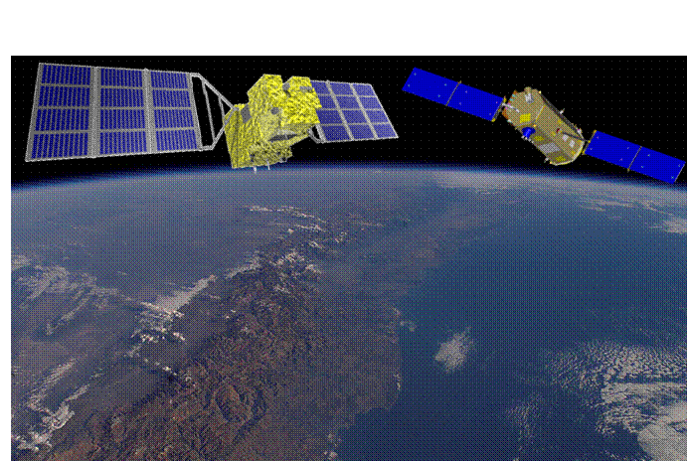
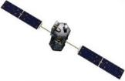
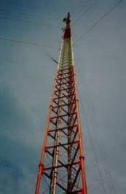

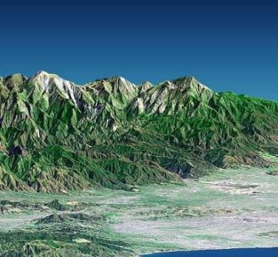
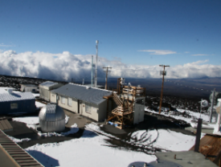
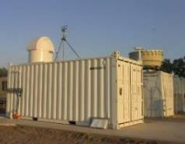
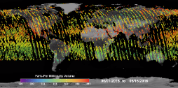
Deriving column-averaged CO₂ and CH₄ dry air mole fractions from measurements of reflected Sunlight
Record spectra of CO₂ , CH₄, and O₂ absorption in reflected sunlight
Retrieve variations in the column averaged CO₂ and CH₄ dry air mole fractions [X_{CO2}, XCH₄] over sunlit hemisphere
Validate measurements against available standards to ensure X_{CO2}, X_{CH4} accuracy
Initial Surf/Atm
State
Radiative Transfer Model
GOSAT and OCO-2
Revised Surf/Atm State
Instrument
Performance Model
Inverse Model
Tower
Aircraft
Flask
FTS
X_{CO2}

Slide 11
The Promise and Challenge for Space Based GHG Measurements
Spatial coverage
  Observations over both land and ocean
Temporal resolution and sampling
  Hourly sampling needed to resolve diurnal cycle and plumes
  Daily to weekly sampling needed to resolve CO₂ weather
  Monthly measurements required over multiple years to resolve seasonal and inter-annual variability in CO₂
Spatial resolution and sampling
  Sensitivity to point sources scales with area of footprint
  Small measurement footprints enhance sensitivity to point sources and reduce data losses due to clouds
Primary Challenge: Precision and accuracy
  High precision required to resolve the small (0.2-0.3%) variations in CO₂ and CH₄ associated with sources and sinks
  High accuracy essential to avoid regional-scale biases

Slide 12
Chapter 2: Existing space-based
GHG Satellites and near term plans

Slide 13
Existing space-based GHG Satellites and near term plans
Past: SCIAMACHY: 2002-2012 – first NIR/SWIR X_{CO2}, X_{CH4}
Existing GHG satellites: GOSAT, OCO-2, and TanSat
  Evolution of measurement capabilities: precision, accuracy, resolution, coverage, data availability
  Progress toward a constellation: cross calibration of measurements and cross validation of products against internationally recognized standards
Near-term Missions: S5P, Gaofen 5, Sentinel 5p, Feng-Yun 3D, GOSAT-2, OCO-3, MERLIN
Missions in formulation: MicroCarb, GeoCarb, GOSAT-3, GHG Sentinels

Slide 14
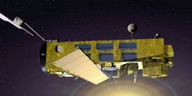
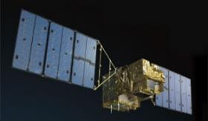
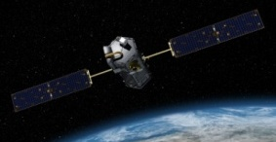
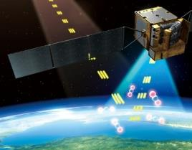
Remote Sensing of CO₂ using Reflected Sunlight: The Pioneers
SCIAMACHY (2002-2012) – First sensor to measure O₂, CO₂, and CH₄ from reflected NIR/SWIR sunlight
  Regional-scale maps of X_{CO2} and X_{CH4} over continents on seasonal time scales
GOSAT (2009 - ?) – First Japanese GHG satellite
  FTS optimized for spectral coverage (O₂, CO₂, CH₄)
  High spectral resolution over broad spectral range yields high sensitivity to CO₂, CH₄, and chlorophyll fluorescence
OCO-2 (2014 - ?) – First NASA satellite designed to measure O₂ and CO₂ with high sensitivity, resolution, and coverage
  High resolution imaging grating spectrometer with agile pointing (glint, nadir, target), small (< 3 km²) footprint and rapid sampling (10⁶ samples/day)
TanSat (2016-?) - First Chinese GHG satellite
  Uses same O₂ and CO₂ bands and similar orbit as OCO-2
  Cloud & Aerosol Imager: 0.38, 0.67, 0.87, 1.38 and 1.61μm channels

Slide 15
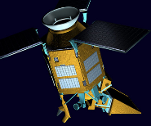
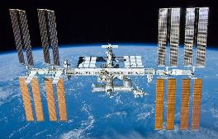
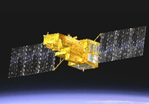
Remote Sensing of CO₂ and CH₄: The Next Generation
Gaofen 5 (2017) - 2nd Chinese GHG Satellite
  Spatial heterodyne spectrometer for O₂, CO₂, and CH₄
Sentinel 5p (2017) - Copernicus pre-operational Satellite
  TROPOMI measures O₂, CH₄ (1%), CO (10%)
  7km x 7 km resolution, daily global coverage
Feng Yun 3D (2018) – Chinese GHG satellite on operational meteorological bus
  GAS FTS for O₂, CO₂, CH₄, CO, N₂O, H₂O
OCO-3 (2018) – NASA OCO-2 spare instrument, on ISS
  First solar CO₂ sensor to fly in a low inclination, precessing orbit
GOSAT-2 (2018) – Japanese, High precision CO₂, CH₄, CO
  Improved precision (0.5 ppm), spatial resolution, and range of ocean glint observations expected to improve coverage

Slide 16
Future GHG Satellites
CNES MicroCarb (2020) – high sensitivity at low cost
  Imaging grating spectrometer for O₂ A, O₂ ¹Δ_{g,} CO₂
  ~1/2 to 1/3 of the size, mass (< 200 kg) of OCO-2, with similar sensitivity in 4.5 km x 9 km footprints
CNES/DLR MERLIN (2021) - First CH₄ LIDAR (IPDA)
  Precise (1-2%) X_{CH4} retrievals for studies of wetland emissions, inter-hemispheric gradients and continental scale annual CH₄ budgets
NASA GeoCarb (2022) – First NASA GEO GHG satellite
  Imaging spectrometer for XC_{O2}, XC_{H4}, X_{CO} and chlorophyll fluorescence
  Stationed above 85° E for North/South America

Slide 17


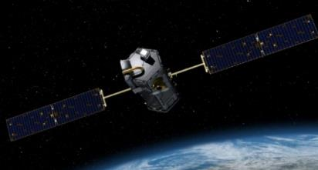


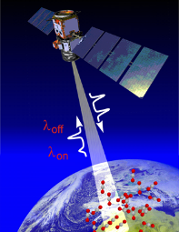
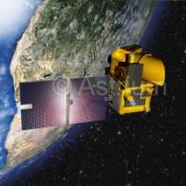
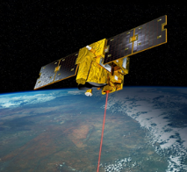
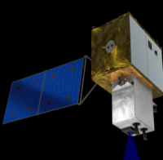
Evolving Carbon Measurement Capabilities
EnviSat SCHIAMACHY
TanSat Successfully Launched on 22 Dec 2016
NASA Earth Ventures GeoCarb Selected
CNES MicroCarb Approved for Implementation
PAST
2002-2012
GOSAT
OCO-2
TanSAT
PRESENT
2009 …
2014 …
2016 …
Gaofen 5
Sentinel 5p
GOSAT-2
OCO-3/ISS
NEAR FUTURE
2017
2017
2018
2018
MicroCarb
MERLIN
GeoCarb
GOSAT-3
Sentinel #
ASCENDS
LATER
2020
2021
2022
2023
2025
202X…

Slide 18
Chapter 3: Integrating diverse Missions into a Virtual Constellation

Slide 19
Moving Forward from “Science” to “Operational” GHG Missions
All of the existing and planned GHG missions are “science” missions, designed to identify optimal methods for measuring CO₂ and CH₄, not “operational” missions designed to deliver policy relevant GHG products focused on anthropogenic emissions
  With the exception of SCIAMACHY, Sentinel 5p, and GeoCarb, these are “sampling” missions, rather than GHG “mapping” or “imaging” missions
GHG imaging missions are needed to quantify emissions from compact sources including cities and large power plants
  GOSAT and OCO-2 measurements clearly show that compact sources can be detected and quantified if they are captured within a footprint, but their plumes are more difficult to quantify downwind of the source
  These two satellites sample < 10% of the surface area of the Earth each month, and only 10% of their samples are sufficiently cloud free to retrieve full-column estimates of X_{CO2} and X_{CH4}

Slide 20
Advantages of GHG Constellations
A multi-satellite GHG constellation could
Exploit the benefits of observations from low Earth orbit (LEO), geostationary orbits (GEO), and Highly Elliptical Orbits (HEO) vantage points
Reduce revisit times in the presence of clouds
Improve spatial coverage without requiring very broad swaths that
  Are technically difficult and expensive to implement, and will limit sensitivity (spectral resolution, SNR, low scattered light …)
  Introduce larger atmospheric path lengths at the edges the swath that are more likely to be contaminated by clouds
Collect coincident observations of proxies (CO, NO₂, SIF) to facilitate the interpretation of the measurements
Provide resiliency to the loss/degradation of individual satellites
Facilitate data quality improvements through cross calibration and cross validation
Partnerships will help realize these objectives

Slide 21
Benefits of LEO Observations
High spatial resolution imaging observations from broad-swath instruments on LEO platforms
Can collect measurements over nearly the entire globe at high spatial resolution at weekly to monthly intervals
Use a single sensor, reducing sensor-to-sensor calibration biases
Allows “glint” observations for adequate signal over ocean
Platforms in LEO orbits facilitate the combined use of passive spectrometers and active LIDAR measurements
Passive sensors provide high spatial resolution and coverage across the sunlit hemisphere
Active sensors complement these measurements with sampling of high latitudes and the night side
A combination of passive and active LEO sensors can reduce bias spatially-coherent biases, which affect the sensors differently
Principal disadvantage of LEO platforms
relatively long repeat cycles (weeks)

Slide 22
Benefits of GEO Observations
Continuous imaging of X_{CO2} and X_{CH4} from GEO platforms
Captures spatial and temporal context, resolving transport, boundary conditions and local sources and sinks
Resolves emissions from localized sources in the context of CO₂/CH₄ “weather” and synoptic variability (clouds, fronts)
Explicitly resolves variations in X_{CO2}, X_{CH4}, SIF from dawn to dusk
Reduces temporal sampling bias – does not miss flux events
GEO platform disadvantages:
Clouds limit coverage beyond ± 50° of sub-satellite point
  Observations from satellites in Highly Elliptical Orbits (HEO) would provide high time resolution coverage of high latitudes
Glint observations extremely limited, precluding observations over oceans
Multiple satellites needed to cover major continents
  Places additional demands calibration and validation capabilities

Slide 23
Benefits of integrating data across the evolving constellation
Even for the existing GHG science missions, there are numerous benefits of integrating data across the constellation
  Improving coverage in the presence of clouds
  Covering more of the day-lit portion of the diurnal cycle
  Maintaining data continuity if one satellite is lost
Coordinating measurement capabilities during mission formulation
  Trade-offs in precision, accuracy, resolution, coverage
  Maximizing benefits of LEO, GEO, and HEO vantage points
Cross calibration of measurements
  Pre-launch calibration measurements using common standards
  On orbit calibration (on-board, astronomical, and vicarious)
Cross validation of retrieved CO₂ and CH₄ concentrations
  Current role of TCCON and aircraft
  Future needs

Slide 24
Collaborative CAL/VAL activities needed to integrate data sets across a constellation
Pre Launch:
  Cross calibration of pre-launch radiometric standards
  Exchange of gas absorption coefficient and solar databases
  Retrieval algorithm development/intercomparison
  Validation system development (TCCON, aircraft, models)
  Multi-Satellite OSSE’s – what do you gain with truly coordinated observations
Post Launch:
  Cross calibration of solar/lunar/Earth(vicarious: RRV+?) observations
  Including exchange of solar and lunar (ROLO) standards
  Cross validation: TCCON, aircraft validation campaigns
  Continued retrieval algorithm development/intercomparisons
  Intercomparisons of flux inversions

Slide 25
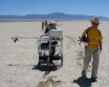
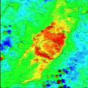
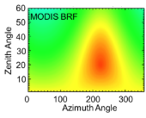
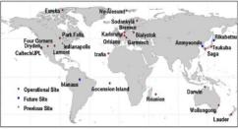
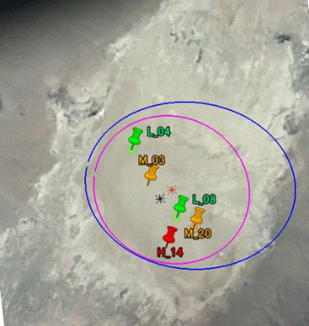
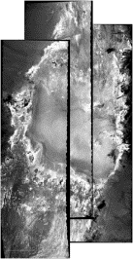

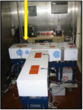
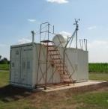
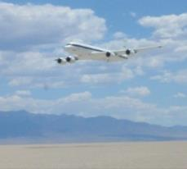

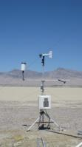



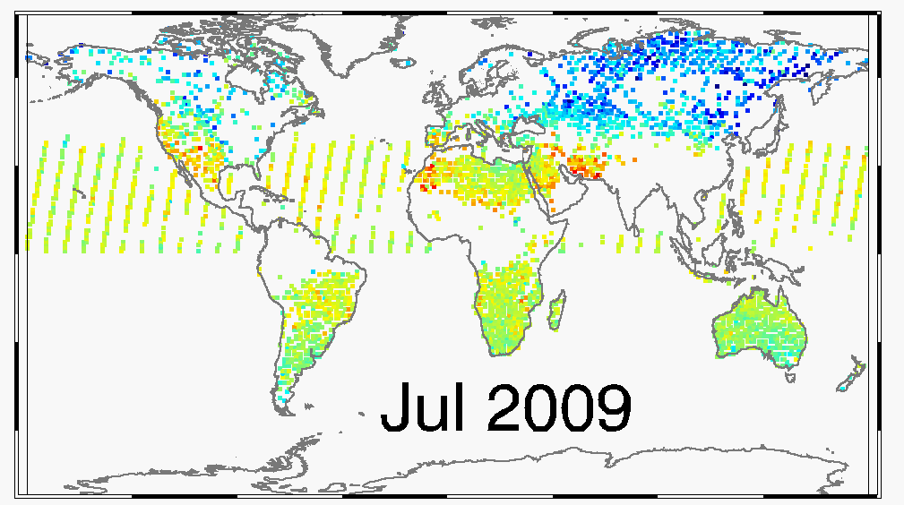

Example: The GOSAT/OCO-2 Cal/Val program
Vicarious Calibration
Retrieval Algorithm
Cross Validation
GOSAT CAI
Forward Radiative Transfer Model
Spectra + Jacobians
Instrument Model
Spectral+Polarization
Inverse Model
Compare obs. & simulated spectra
Update State Vector
not converged
ACOS GOSAT B3.5
ACOS GOSAT B7.3
NASA DC-8
AMES AJAX
?
LSPEC
converged
OCO-2 v7
AERONET

Slide 26
Chapter 4: Lessons Learned from GOSAT and OCO-2

Slide 27
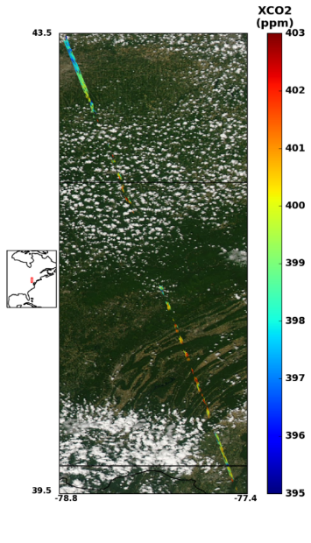
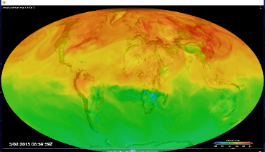
Lessons learned from GOSAT and OCO-2 CO₂ and CH₄ Measurements
High spatial resolution (footprint area < 4 km²)
  Critical for quantifying emissions from compact sources
    X_{CO2} anomaly associated with a given CO₂ injection is inversely proportional to the area of the footprint
  Critical for gathering data in the presence of patchy clouds
Imaging rather than sampling the CO₂ and CH₄ field
  Critical for tracking emission plumes and resolving anthropogenic emission sources from the natural background
High resolution transport models for flux inversion
  Critical for quantifying at the scale of cities
  Needed for resolving anomalies associated with CO₂/CH₄ “weather” from local sources and sinks
Proxies such as SIF, CO, and NO₂ may be needed for attribution
OCO-2 track through patchy clouds in NE U.S.
GEOS-5 XCO2 Weather

Slide 28
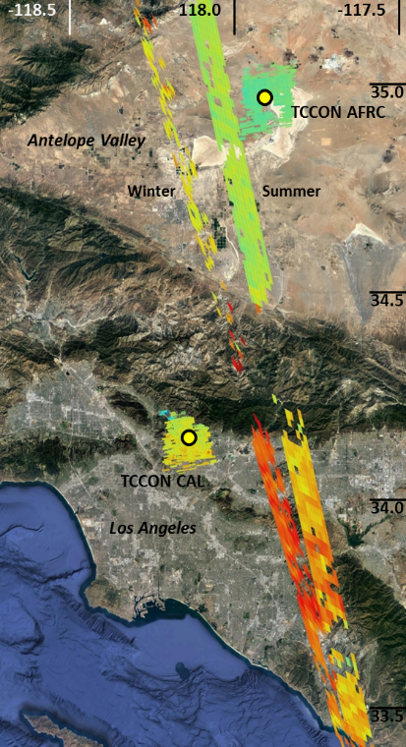
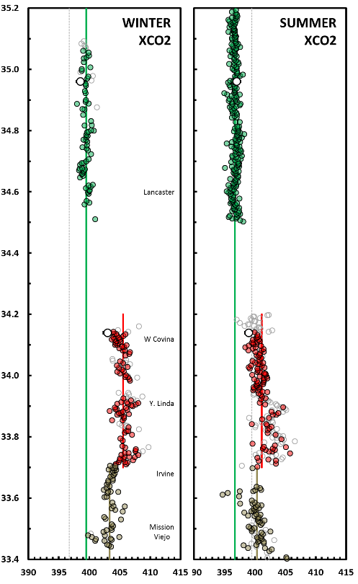
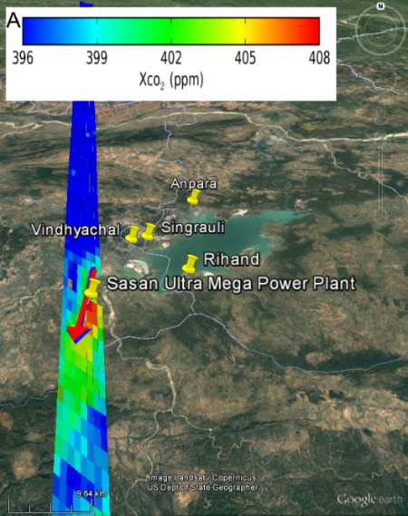

High precision and coverage needed to characterize compact sources
4.4 ppm
6.1 ppm
drawdown counters emissions
Direct OCO-2 overpasses or close flybys clearly detect emission plumes from individual, moderate sized power plants, yielding flux accuracies of 8 to 50% [Nassar et al. 2017].
50km
Los Angeles Basin
Winter and summer OCO-2 tracks across the Los Angeles basin and the Antelope Valley to the north of the San Gabriel mountains show X_{CO2} anomaly across the megacity [Schwandner et al, Submitted 2017] .

Slide 29
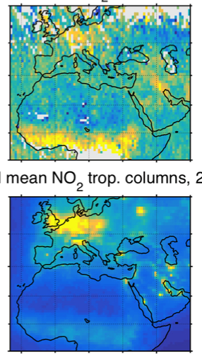
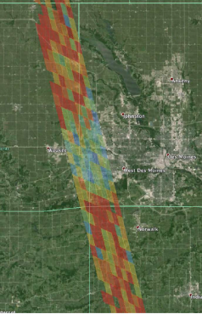
Proxies and other Coincident measurements needed
OCO-2 X_{CO2} Anomalies
Proxies useful for CO₂ emissions source attribution:
  CO traces both moderate (biomass burning) and high temperature (fossil fuel) combustion
  NO₂ traces high temperature (fossil fuel) combustion
  SIF traces spatial distribution of CO₂ uptake by the land biosphere
What proxies are needed for discriminating CH₄ sources?
OMI NO₂ Anomalies
OCO-2 SIF is more intense over corn fields than over Des Moines, Iowa
[Frankenberg et al., 2016]
OCO-2 X_{CO2} and OMI NO₂ anomalies over Europe (fossil fuel combustion) but not over central Africa (biomass burning) [Hakkarainen et al., GRL 2016]

Slide 30
Open Data Policy and Common Cal/Val Standards: Recommendations
Apply best practices (lessons learned) for spectrometer calibration, characterization, and validation
  Share calibration/characterization plans and invite cross participation in reviews of such plans
  Develop longer term recommendations for common post-launch cal/val strategies (e.g. cal/val instrumentation round-robins, joint vicarious calibration campaigns, joint airborne campaigns)
Radiometric consistency
  Pre-launch: highest priority is per-instrument calibration/characterization as completely as possible (common absolute radiance calibration is secondary)
  Post-launch: (eg LEO vicarious intercalibration, lunar calibration, solar calibration)
Sharing and consistency of data products (format, content, metadata)
  Share specification documents
  Share instrument characterization/calibration databases and Level 1-b data, in a common format, to allow wide application of algorithms to all datasets
  Identify and produce common constellation data products (may differ from standard products)
Consistency in retrieval algorithms
  Cross participation in ATBD reviews
  Jointly improve retrieval algorithms by conducting inter-comparisons on common spectra
Consistency of laboratory spectroscopy
Support scientific collaboration among teams
Adapted from Atmospheric Composition Constellation Meeting ACC-11, Frascati, Italy, 28-30 April 2015

Slide 31
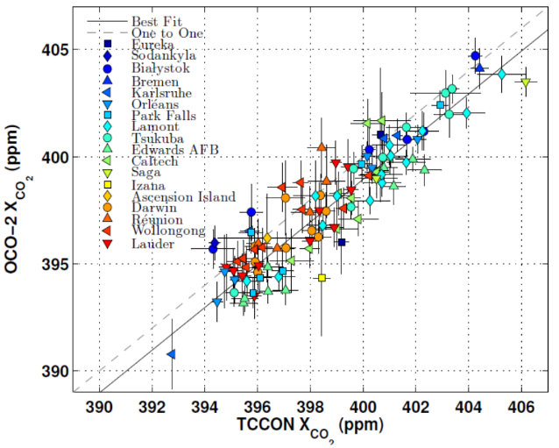
Validating space-based measurements against international standards
GOSAT and OCO-2 data were validated against the Total Column Carbon Observing Network (TCCON)
TCCON is validated against the WMO standards profiles from in situ instruments on aircraft
Other standards, including aircraft campaigns (HIPPO, ACT-America, Atom) also used
These validation methods may have to be expanded to support future observations from LEO, GEO and HEO platforms
Example of comparisons between OCO-2 and a wide array of TCCON stations. After applying a bias correction, the global bias is reduced to < 0.5 ppm and the station-to-station biases reduced to ~1.5 ppm

Slide 32
Chapter 5: Deriving GHG Constellation Requirements

Slide 33
Tools for deriving Constellation measurement requirements
Efforts to trace requirements on the space based CO₂ and CH₄ concentration measurements to the desired improvements in inventories use numerical models of increasing sophistication:
  Signal detection experiments use carbon tracer transport models (CTTMs) to simulate atmospheric the impact of atmospheric transport on GHG concentration changes associated with specified changes in surface fluxes (i.e. doubled CO₂ emissions from East Asia or CH₄ injections from a broken pipeline or melting permafrost)
  End-to-end Observational System Simulation Experiments (OSSEs) combine CTTMs with remote sensing retrieval models and instrument models to assess observing system and retrieval algorithm trade in “realistic” conditions
  Flux inversion experiments using existing space-, aircraft-, and ground based data provide an end-to-end test of accuracy, precision, resolution, and coverage of existing observing systems for a wide range of conditions

Slide 34
Challenges in deriving Constellation Measurement Requirements
All 3 approaches need improvements to derive requirements for a constellation of satellites for anthropogenic GHG measurements
  Signal Detection experiments provide insight into sensitivity, resolution, and coverage needs as a function of source/sink scale, but provide no information about correlated errors or systematic biases
  OSSEs are good for identifying impact of random errors in concentration or transport or limitations of coverage, but are generally not adequate for assessing the impact of systematic biases in transport or measured concentration
  Flux inversion experiments show that spatially-dense space based data pose special problems
    Limitations in coverage and biases in transport and measured concentration can all introduce significant uncertainties in fluxes
    These sources of uncertainty play different roles in local (city scale), national (500 km x 500 km), and global scale flux inversion experiments

Slide 35
A path forward for defining Constellation requirements
While existing studies have identified a number of challenges in defining traceable measurement requirements, they have also indicate that different approaches can be combined to define different requirements
  Signal detection experiments provide insight into the amplitude of X_{CO2} and X_{CH4} anomalies associated with persistent flux changes and their dependence on wind speed at local to global scales
  Realistic, end-to-end OSSEs are adequate for assessing flux uncertainties associated with different sensor precision, resolution, and coverage in the presence of realistic transport
  Flux inversion experiments combining data from in situ, TCCON, GOSAT and OCO-2 are being validated against “withheld data” (from aircraft or surface stations) to provide insight into the impact of biases in concentration measurements and transport

Slide 36
Existing Space-based GHG Measurement Requirements
To monitor anthropogenic emissions on the scale of medium sized countries (e.g. France), we need to
Resolve and discriminate anthropogenic emissions from contributions from the natural biosphere and ocean
“Image” the majority (~80%) of Earth’s surface at high spatial resolution on hourly (cities) to weekly (natural biosphere) intervals
A number of international organizations have recommended requirements on space-based GHG measurement precision, accuracy, resolution, coverage, and repeat frequency
Examples: GEO Carbon Strategy Report (Ciais et al. 2010)
CEOS Strategy for Carbon Measurements from Space
GCOS (4ppm, 10 km, 3-hour repeat cycle)
Many of these requirements were recorded before space based GHG measurements were providing useful constraints on the carbon cycle

Slide 37
Requirements from GEO Carbon Strategy Report
The next generation of GHG satellite measurements needs to provide high accuracy measurements of CO₂ and CH₄ with high spatial resolution (1-2 km) to observe and attribute surface fluxes and, to minimize cloud contamination.
A daily repeat-frequency is required.
  Lower repeat cycles are valuable but clearly lose information on the variability of surface fluxes, whether natural or anthropogenic in origin.
Continuity of the time series of space-based planetary boundary layer CO₂ and CH₄ measurements, ideally in a GHG-satellite constellation.
  managed within the international system of operational meteorological satellites or by a dedicated organization.
A strategy for easy access to GHG satellite observations should be developed.
A coordinated planning effort towards the next generation of a constellation of GHG satellite observations is also required.

Slide 38
Requirements from CEOS Strategy for Carbon Observations from Space
A coordinated constellation of passive and active X_{CO2} and X_{CH4} remote sensing instruments in Low Earth Orbit (LEO), with
  retrieved, single-sounding measurement accuracy of 0.1 to 0.2% for X_{CO2} and X_{CH4}
  Spatial resolution of 1-2 km
  Temporal sampling yielding daily coverage of the entire globe.
A coordinated constellation of passive X_{CO2} and X_{CH4} remote sensing instruments in geostationary orbit (GEO)
  To cover all longitudes at a spatial resolution of 1-2 km
  Retrieved, single sounding measurement accuracy of 0.1 to 0.2% for X_{CO2} and X_{CH4} over continents
  Temporal sampling interval of 20 minutes to 1 hour.
These missions should be considered in the context of the added value to be derived from coordinated mission planning and associated data compilation activities (spaceborne and in situ/aircraft) both in the future and by exploiting archive data.

Slide 39
Chapter 6: Candidate Constellation Architectures

Slide 40
A Candidate Constellation Architecture
Can the the coverage, resolution, and precision requirements would be to fly a constellation that incorporates
3 (or more) satellites in low Earth orbit (LEO) with
  A broad (~200) km swath with a mean footprint size < 4 km²
  A single sounding random error near 0.5 ppm, and vanishing small regional scale bias (< 0.1 ppm) over > 80% of the sunlit hemisphere
  One (or more) satellites carrying ancillary sensors (CO, NO₂, CO₂ and/or CH₄ Lidar)
A constellation with 3 (or more) geostationary satellites
  Monitor diurnally varying processes (e.g. rush hours, diurnal variations in the biosphere)
  Stationed over Europe/Africa, North/South America, and East Asia

Slide 41
Chapter 7: Conclusions

Slide 42
Conclusions
Space-based remote sensing observations hold substantial promise for future long-term monitoring of greenhouse gases
  These measurements will complement existing ground-based data with increased spatial coverage and sampling density
Over the next decade, a succession of missions with a range of CO₂ and CH₄ measurement capabilities will be deployed in LEO
  Include near polar, sun synchronous orbits with morning and afternoon mean local times, and low inclination, precessing orbits (OCO-3/ISS)
  Because there is little overlap between the missions, each one is a critical link in a chain that must be successfully deployed to ensure a continuous climate data record.
Combining measurements from LEO and GEO would also be valuable for studying the diurnal cycles of CO₂ and CH₄
Much greater benefits could be realized if these missions could be coordinated and their data products can be combined

Slide 43
Milestones for GHG White Paper Development
25-28 April: CEOS SIT, Paris, France
  Present a report on the GHG White Paper progress and plans
6-8 June: IWGGMS-13, Helsinki, Finland
  AC-VC participation in Organizing Committee and opportunities to enlist participation in GHG White Paper among space-based GHG measurement and modeling communities
11-16 June: GHG report to the CGMS-45, Jeju Korea
  Opportunity to solicit input on GHG White Paper from operational agencies
28-30 June: CEOS VC-AC, CNES HQ, Paris, France
  Breakout session to harmonize mission requirements (GEO, GCOS, CEOS)
  Finalize GHG White Paper outline and writing assignments
21-25 August, ICDC10, Interlaken, Switzerland
  First drafts of all chapters due
11-14 September, 2017 SIT Technical Workshop, Frascati, Italy
  Present a report on the GHG White Paper scope and contents

