Slide 1
Space Agency Response to the GCOS IP
Pascal Lecomte - WGClimate Chair
April 27th, 2017
SIT-32 Agenda Item 28a

Slide 2
Outline
Targeting a 20-30 pages document
Broad Context (10-15 pages)
“Soft Actions” and Cross cutting actions
Calibration , Validation, Assessment, Data integration and Intercomparison.
Detailed Implementation (6-9 pages)
Terrestrial (2-3 pages - Grouped in meta-Actions)
Oceanic (2-3 pages - Grouped in meta-Actions)
Atmospheric (2-3 pages - Grouped in meta-Actions)
Meta-response to the Product Requirement Table (3 pages)
Support the feed back process to GCOS
Annex-1 Responses to detailed Actions – Coordinated Action Plan

Slide 3
Broad Context (10-15 pages)
Observations for Adaptation, Mitigation and Climate Monitoring
Climate Services
Climate Indicators
Links to other UN conventions and STGs
Earth System Cycles
Capacity Building
Detailed Implementation – Cross cutting Actions

Slide 4
Detailed Implementation (6-9 pages in total)
Mission Continuity and new missions
Product evolution
Product generation and intercomparison
Reprocessing needs
Validation, metadata
Capacity Building

Slide 5
Annex-1 Responses to detailed Actions – Coordinated Action Plan
Non by SBSTA Delivery - By February March 2018.
A table was created to indicate for each of the 201 actions if it is: Broad, Atmospheric, Oceanic, Terrestrial, related to a specific CDR (then should be picked up the Gap Analysis), non Space. It also indicate merged actions, or actions to be addressed by WGCV.

Slide 6
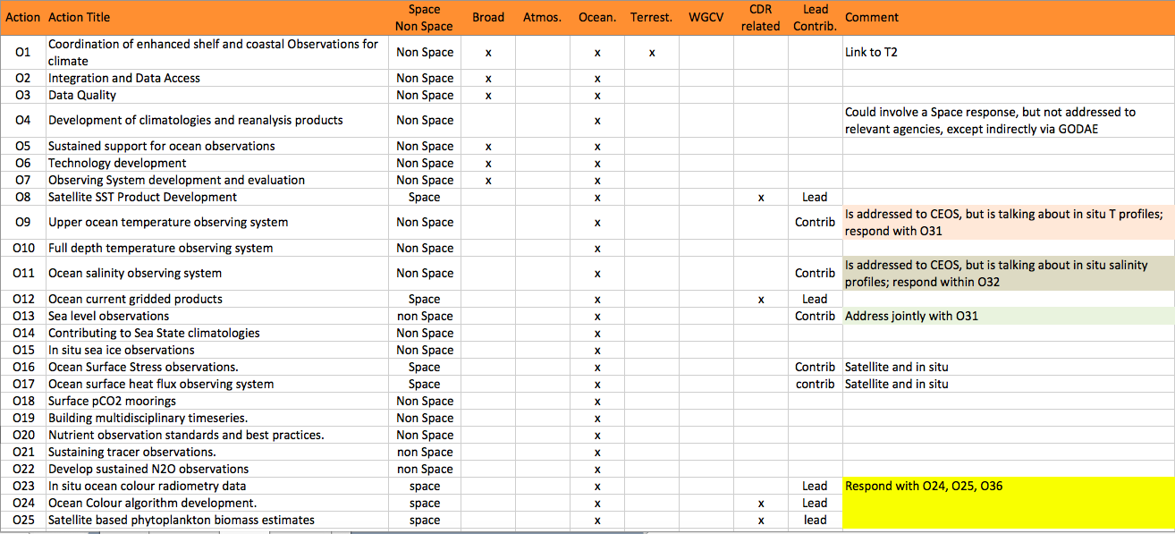
Action Table (Ocean Domain)

Slide 7
Writing Team
Broad Context
Pascal Lecomte (ESA)
Jörg Schulz (EUMETSAT)
Robert Husband (EUMETSAT)
Mark Dowell (EC)
Atmospheric Chapter – Stephan Bojinski (WMO)
Oceanic Chapter – Chris Merchant (UKSA)
Terrestrial Chapter – John Dwyer (USGS)
Plus 20 people from CNES, NASA, DLR, INPE, DWD, NOAA, EUMETSAT, JAXA and ESA

Slide 8
Space Agency Response to GCOS IP
07/02/2017 1st Face to Face meeting
13/04/2017 Writing Team teleconference
25/04/2017 CEOS SIT (Paris – France)
10/05/2017 SBSTA – Status report (Bonn – Germany)
12/06/2017 CGMS plenary (Seoul – Korea)
01/08/2017 Gap Analysis report ready
11/09/2017 2nd Face to Face meeting (Frascati – Italy)
12/09/2017 WGClimate #8 (Frascati - Italy)
13/09/2017 CEOS SIT Workshop (Frascati – Italy)
01/10/2017 Coordinated Action Plan
06/10 2017 Draft response sent to SBSTA
18/10/2017 CEOS plenary (Rapid City – USA)
06/11/2017 COP-23 (Bonn – Germany)

