Slide 1
GCOS Status and Outlook
Committee on Earth Observation Satellites
C. Richter, GCOS Secretariat, c/o WMO
SIT-32 Agenda Item 27
CEOS Strategic Implementation Team
ESA Headquarters, Paris, France
26th-27th April 2017

Slide 2
NEW Implementation Plan
You can download finally the English edited version!
Also available: French translation of Exec Summary

Slide 3
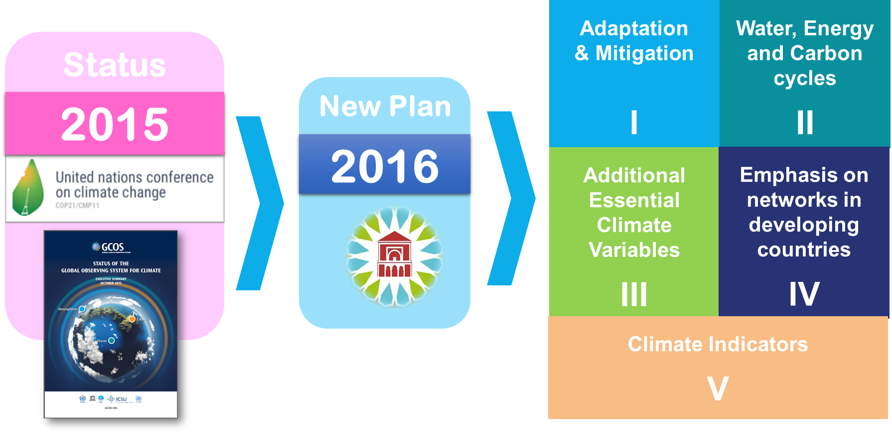
NEW Implementation Plan
19 / CP.22
(Decision 19,
COP-22, Marrakech, Morocco)

Slide 4
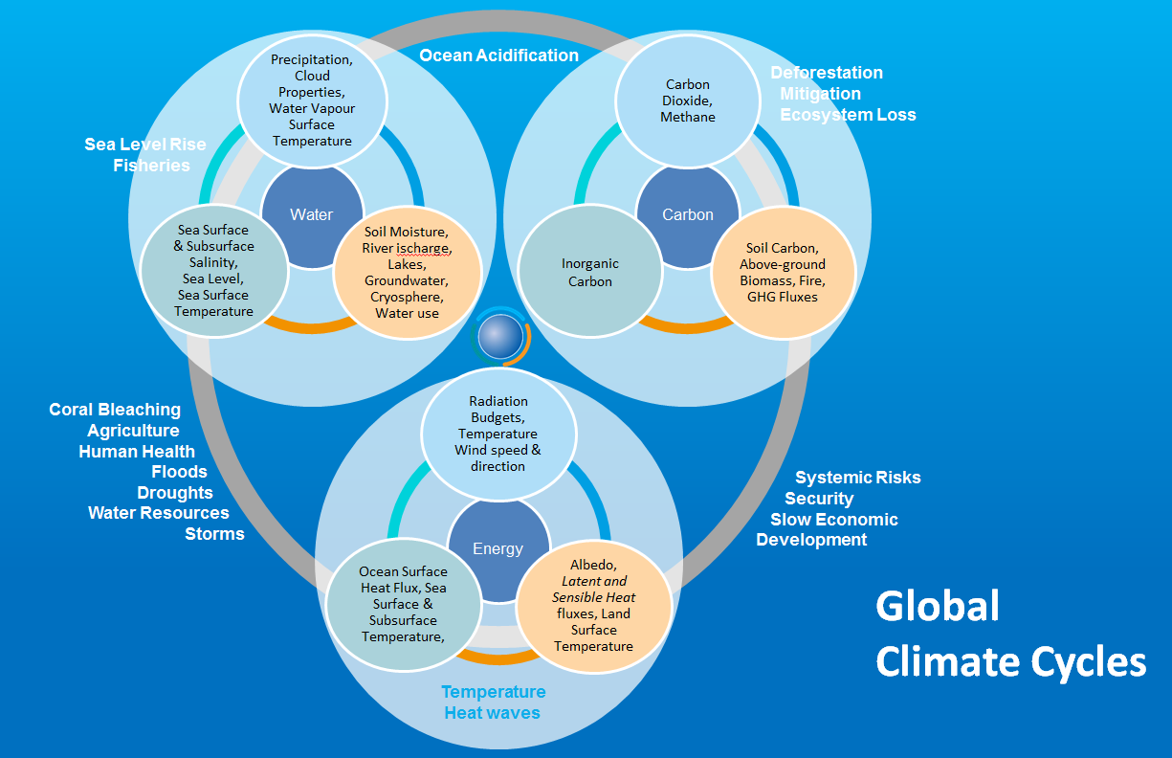
NEW: Closing Budgets

Slide 5
Role of GCOS Science Panels
Main Objectives:
Assessing the current state of the global observing system for climate, and identifying its gaps and inadequacies and designs to ensure long-term monitoring;
Advocating and promoting the establishment and enhancement of the systems required to provide long-term and consistent data; securing the implementation of designated GCOS networks;
Promoting the transfer and accessibility of data to the user community.
Identifying measurable key variables that control the physical, biological and chemical processes affecting climate, and are indicators of climate change;
Coordinating activities with other global observing systems, panels and task groups to ensure the consistency of requirements with overall programmes.
Responsible for overseeing “their” actions
Panels have flexibility in how to do this BUT there should be consistency in the outputs and timeline
Lead by B. Sloyan (CSIRO) &
J. Wilkin (Marine Sciences, U Rutgers)
Lead by W. Wagner (Remote Sensing, Geo,
TU Vienna)
Lead by K. Holmlund (EUMETSAT) &
P. Jones (CRU, U East Anglia)

Slide 6
Key Science Panel Activities
1: Adequacy
Review adequacy and availability of ECV monitoring (G11,12 &13)
Use existing systems where they are available
Need an annual process
Need to involve other actors
CEOS/CGMS WGClimate is doing this for satellite data records
ECV Inventory
May need to consider capacity development needs
2: Requirements
Routinely maintain, review and revise list of ECV product requirements (G10)
3-year process (to be ready for update of Implementation Plan)
Extensive public consultation and review
Links to adaptation and mitigation needs and regional activities
3: Progress
Monitor progress on implementing actions in Implementation Plan
An annual process for the panel
Need to allocate responsibilities for each ECV

Slide 7
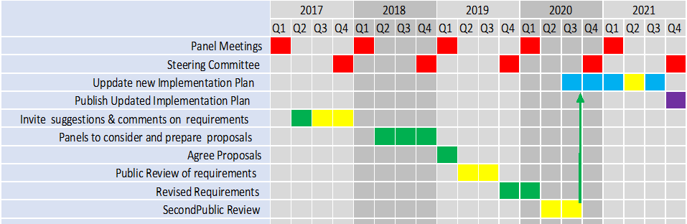
Work Plan for 2017 - 2021

Slide 8
Atmospheric Observation Panel for Climate (AOPC-22) outcomes of relevance to CEOS :
1. Radiosondes: Study the impacts on obtaining higher altitude for radiosondes, flexible launch time and keeping the original data from radiosondes:
Missing radiosondes have a massive impact on reanalysis
Radiosondes have very significant impact for NWP in the troposphere and stratosphere with stratospheric radiosonde observations especially important for tropical wind forecast performance.
Radio occultation compensates for temperature but not for wind.
2. Clouds:
Need for observing cloud profiles from space over several decades with a vertical resolution better than 30m
Developing a strategy to observe water vapor profile from space in the tropical boundary layer with a vertical resolution of 100m
3. Lightning: New ECV.
4. GSRN (Global Surface Reference Network): Co-located reference quality measurements will provide a valuable data set for the calibration and validation of satellite observations.
Task teams are being set up for further studies.

Slide 9
Ocean Observations Panel for Climate (OOPC-20) outcomes of relevance to CEOS :
1. Sea Surface Temperature, Sea Ice:
Advocate for continuity of satellite passive microwave observation of SST and sea ice.
2. Ocean Surface Stress:
Form a project to work with modelling and observing communities to estimate the effect of small-scale convective cells on the discrepancy between satellite and in-situ wind measurements in rainy regions
Engage IOVWST to improve consistency of rain flagging
Encourage NWP centers with coupled assimilation capabilities to implement dynamically consistent account for ocean surface current effects on wind stress retrievals, and test impacts of Tropical Moored Array winds
Engage CEOS to encourage greater international data sharing (particularly the China HY Series)
3. Heat Fluxes:
Articulate a strategy for coordinated air sea fluxes observations
4. Boundary Currents/Shelf Interactions:
Form a Boundary Current/Shelf Sea Interaction Task Team
5. Ocean Change detection:
Develop proposal for ocean Temperature/Heat Content and Salinity/Freshwater Content Review.
DOOS engage with OSTST (Ocean Surface Topography Science Team) to explore synergy in DOOS design of pressure measurements to complement satellite altimetry/gravity/geodesy missions

Slide 10
Terrestrial Observation Panel for Climate (TOPC-19) outcomes of relevance to CEOS:
1 Evaporation from land should be an ECV
Latent and sensible heat fluxes
Products derived from a basket of other parameters
Confirmation by steering committee in September
2 Satellite observations may help fill large gaps in reporting in situ observations of rivers and lakes
poor or even no reporting of parameters such as river discharge, lake height and area in some areas
3 Consistency between ECV products (e.g. Albedo, LAI, FAPAR, Land surface temperature) needs to be assured
these are physically related and the products should reflect this
4 Copernicus will deliver many ECVs on a guaranteed long-term basis
several space agencies also provide products
5 GCOS Surface Reference Network being led by AOPC would support satellite observations by providing high quality ground observations

Slide 11
New: Possible historic climate indicators
Topic | Headline Indicator | Baseline | Subsidiary Indicators
Temperature and Energy | Global surface temperature | Pre-industrial temperatures | Top-of-the-atmosphere energy balance
 | Ocean Warming: 0-2000m | data from 1970 onwards | 0-700m ocean warming – has the advantage of a much longer time series.
Atmospheric composition | Atmospheric CO2 (ppm) | Pre-industrial | Methane, N2O, hydrogenated greenhouse gases
Oceans | Sea Level Rise | 1870 | Ocean Acidification
Cryosphere | Arctic and Antarctic Sea Ice Extent separately | 1980 | Arctic and Antarctic sea ice extent
 | Area of land covered by snow and ice, for the N and S Hemispheres | 1980 (selected for consistency with the sea ice) | Snow and ice anomaly trackers
Extremes | Heatwaves
 | Extreme Rainfall
 | Drought
Land Use / Vegetation | To be further discussed
Current status of discussion after GCOS panel discussions (April 2017)

Slide 12
Programme Planning 2017 - 2021
Alignment with IPCC AR6
WG I: April 2021
WG III: July 2021
WG II: October 2021

