Slide 1
GEO AquaWatch Update
Committee on Earth Observation Satellites
Emily Smail
AquaWatch Secretariat (UMD/NOAA)
SIT-32 Agenda Item 22
CEOS Strategic Implementation Team
ESA Headquarters, Paris, France
26th-27th April 2017

Slide 2
About GEO AquaWatch
History
AquaWatch (previously referred to as the GEO Water Quality Community of Practice or the GEO Inland and Near-Coastal Water Quality Working Group) emerged from a 2007 GEO Inland and Nearshore Coastal Water Quality Remote Sensing Workshop.
In 2015, the group drafted a 10-year strategic plan for developing water quality assessment data and information products.
In 2016, GEO AquaWatch established a Secretariat, formally established working groups and identified near-term projects and priorities.

Slide 3
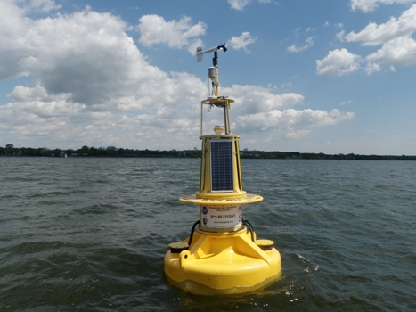
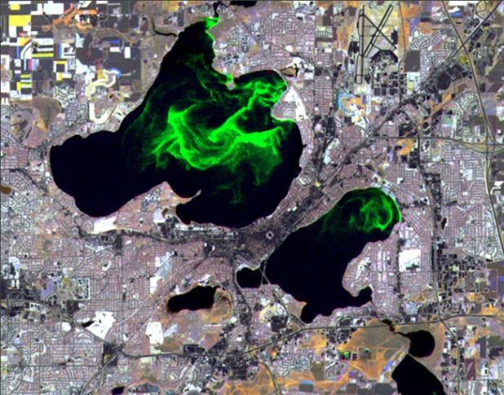
About GEO AquaWatch
The AquaWatch Mission
To improve water quality in coastal and inland waters through more effective monitoring, management and decision making.
The AquaWatch Goal
To develop and build the global capacity and utility of Earth Observation-derived water quality data, products and information to support water resources management and decision making.
Chesapeake Bay Buoy – NOAA Image
Lakes Mendota & Monona -University of Wisconsin SSEC image

Slide 4
About GEO AquaWatch
AquaWatch Objectives
Facilitate effective partnerships between the producers, providers and users of water quality data, products and information.
Improve analysis and integration of in situ and remote sensing water quality data.
Develop and deliver fit-for-purpose water quality products and information services.
Support technology transfer and access to water quality data products and information.
Advocate for increased capacity for and use of water quality information for decision making.

Slide 5
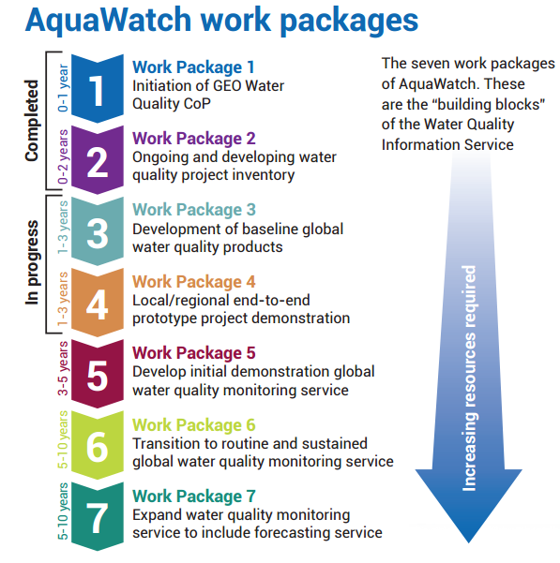
Current Activities
The Water Quality Information Service
Develop international operational water quality information systems based on Earth observation with a focus on the developing world, leveraging and transferring capabilities of developed nations

Slide 6
Current Activities
Work Packages 3 and 4
Work package 3: AquaWatch has begun the development of an NTU turbidity product, a Secchi disk depth product, a diffuse attenuation coefficient product, and a surface reflectance product. Absorption and scattering information will also be included where appropriate for added value and product comparability. The product will be done at three resolutions – 1 km, 300 m and 100 m. The product will be coherent globally at the 1 km level, continent or country level at 300m and regional “zoom-in” at the ≤100 m level.
Work package 4: AquaWatch is currently producing a booklet highlighting the functionality of prototype projects that products that include in situ data, remote sensing data and modeling. The booklet will be used to educate potential end users about available functionality and spur interest and funding for the development of new AquaWatch prototype projects.

Slide 7
Near term & Future Activities
Near term
Launch new website
Submit Implementation Plan to GEO for AquaWatch to be an Initiative in the GEO Work Programme
Publish booklet and continue work on turibidy/SDD product suite
2017 – 2019
Support and collaborate with other GEO groups on water quality project needs (GEOGLOWS, EO4SDGS, GEO Blue Planet, GEO Wetlands, GEO BON, Regional GEO groups)
Continue to build on work package 3 and 4, initiate 5 and 6
Populate formal Steering Committee and build Working Groups
Work to increase engagement and begin capacity building activities

Slide 8
AquaWatch and CEOS
Linkages
CEOS has representation in GEO AquaWatch management and working groups
The work of the CEOS Virtual Constellations (especially the Ocean Color Radiometry Virtual Constellation, OCR-VC) and Working Groups has and will continue to support the work of AquaWatch
CEOS tools and services, including the CEOS Water Portal, will likely be utilized and integrated into future AquaWatch products
Moving Forward
Increased participation of CEOS in GEO AquaWatch Working Groups
CEOS representation in the GEO AquaWatch Steering Committee
Continued support of GEO AquaWatch activities

Slide 9
Questions?

