Slide 1

UN-WCDRR: CEOS support to the Sendai Framework
Stéphane Chalifoux, CSA
Chair, Working Group on Disasters
SIT-32 Agenda Item # 20
CEOS Strategic Implementation Team
ESA Headquarters, Paris, France
26th -27th April 2017
Committee on Earth Observation Satellites

Slide 2
Overview of the Presentation
Major earthquakes struck central Italy
Haiti Recovery Observatory
- Status Overview
- First mission to Haiti and feedback
- Management
GP-STAR contribution
- WG on Volcanoes
- UN Global Platform, Cancun, Mexico

Slide 3
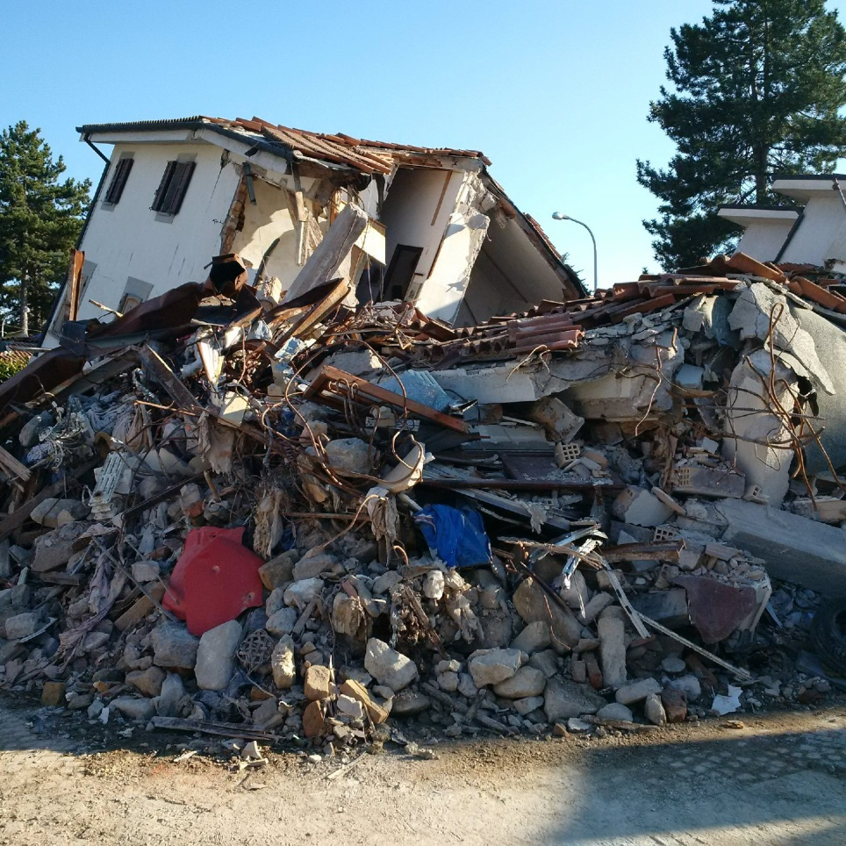
Recent CEOS Activities in Support of DRM: Central Italy Earthquake Response
Major earthquakes struck central Italy:
- August 24, 2016, a 6.0 magnitude earthquake.
- October 30, 2016, a 6.5 magnitude earthquake.
- January 18, 2017, many seismic events
occurred ranging from 5.0 to 5.5 magnitude.
Seismic pilot Obj. C has been triggered to
generate rapid science products to support
response.
In addition to the search and rescue and to the population assistance activities, many technical activities are carried out to support the civil protection management of this first emergency phase.
INGV: Seismic monitoring, ground deformation monitoring with GPS/InSAR (with IREA-CNR), seismic source modeling. Provision of scientific-technical support to the Civil Protection.
Copernicus Emergency Management Service (EMS): 3 activations.

Slide 4

Recent CEOS Activities in Support of DRM: Central Italy Earthquake Response
During the post-emergency phase, one of the aims of Civil Protection activities is to guarantee permanent reduction in the risk of landslide reactivation and restoration of basic social functions.
In this framework, the contribution of satellite SAR is twofold:
assessment of residual movements after the occurrence of a slope failure;
identification of safe areas for relocation with the support of geomorphological analysis.
Good example of what can be done with CEOS data by scientists supporting emergencies, when the data are rapidly provided!

Slide 5
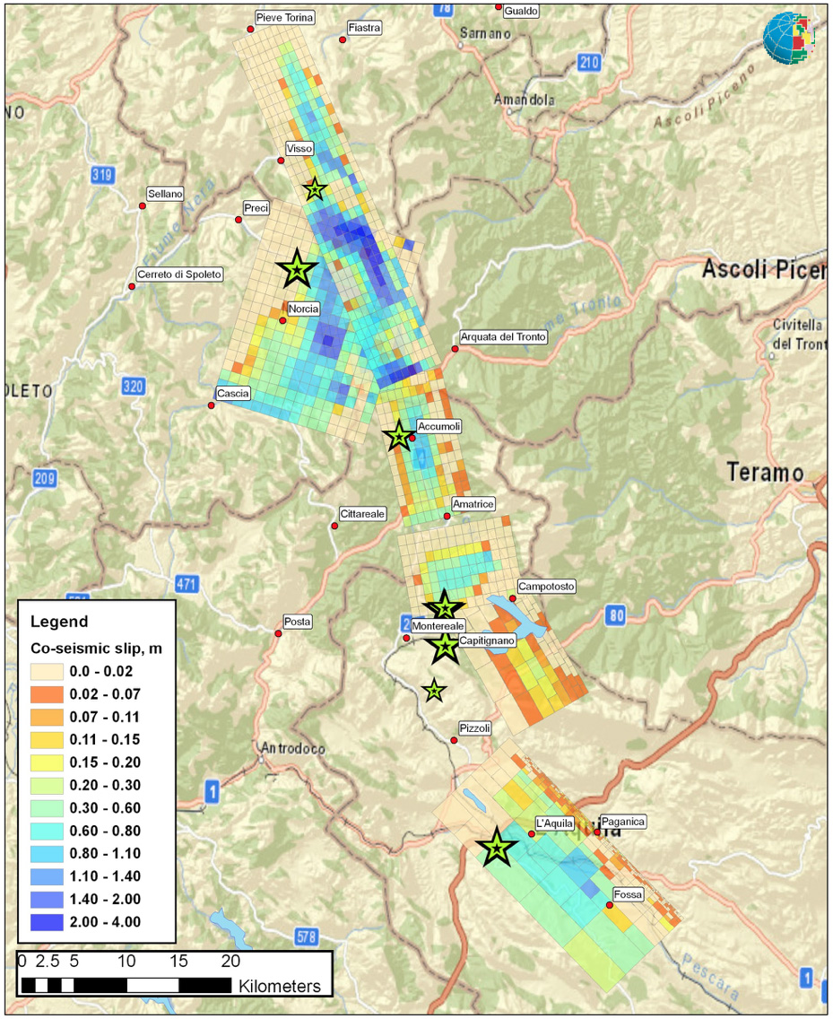

Recent CEOS Activities in Support of DRM: Central Italy Earthquake Response
Source models from INSAR and GPS data
InSAR data are used to generate models of the seismic ruptures, continuously updated during the seismic sequence.
This information is provided by INGV to the Civil Protection in support of the situational awareness.
The 50 km long fault system ruptured in smaller segments, reducing the impact.
If it had ruptured in one big earthquake the damage would have been much larger.
INGV

Slide 6
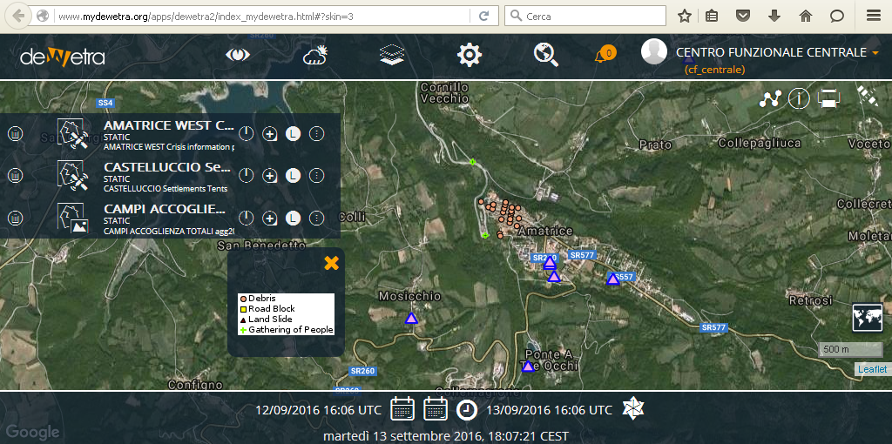
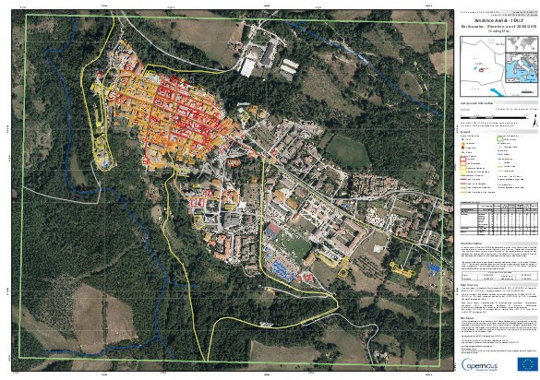

Recent CEOS Activities in Support of DRM: Central Italy Earthquake Response
MAPS AND CRISIS LAYERS

Slide 7
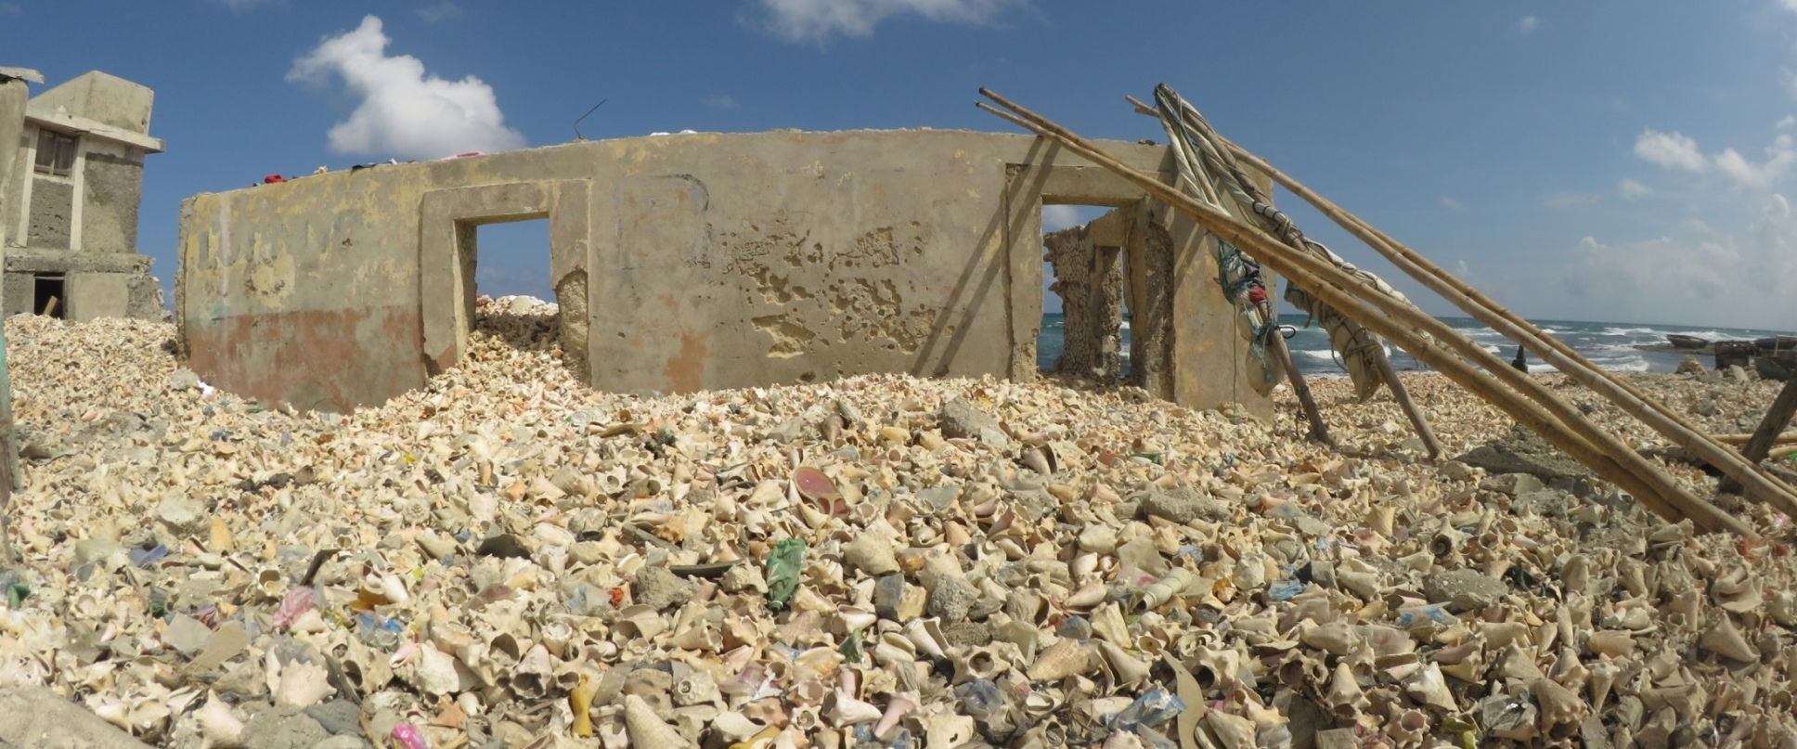
Recovery Observatory Status Overview
House full of seashell
  Triggering of the RO decided by CEOS Chair in consultation with CEOS Principals, December 22, 2016, after significant impact of Hurricane Matthew in Southwest Haiti (October 2016);
  Sendai framework: Support Priority for Action 4 “Enhancing disaster preparedness for effective response, and to «Build Back Better» in recovery, rehabilitation and reconstruction

Slide 8
RO Status Overview
Infrastructure
Product definition, image requirements
Lessons
learned
RO Haiti Triggering
12/22/16
Early RO evaluation
2015 2016 2017 2018 2019 2020
jfmamjjasond jfmamjjasond jfmamjjasond jfmamjjasond jfmamjjasond jfmamjjasond
PDNA
Today
Hurricane Matthew
in Haïti
10/04/16
Malawi, Nepal
Demonstrators
Missions to Haiti
(2 to 3 per year)
1st
31 Jan – 3 Feb
Workshop
Week of 29 May
PDNA: Post-Disaster Needs Assessments

Slide 9
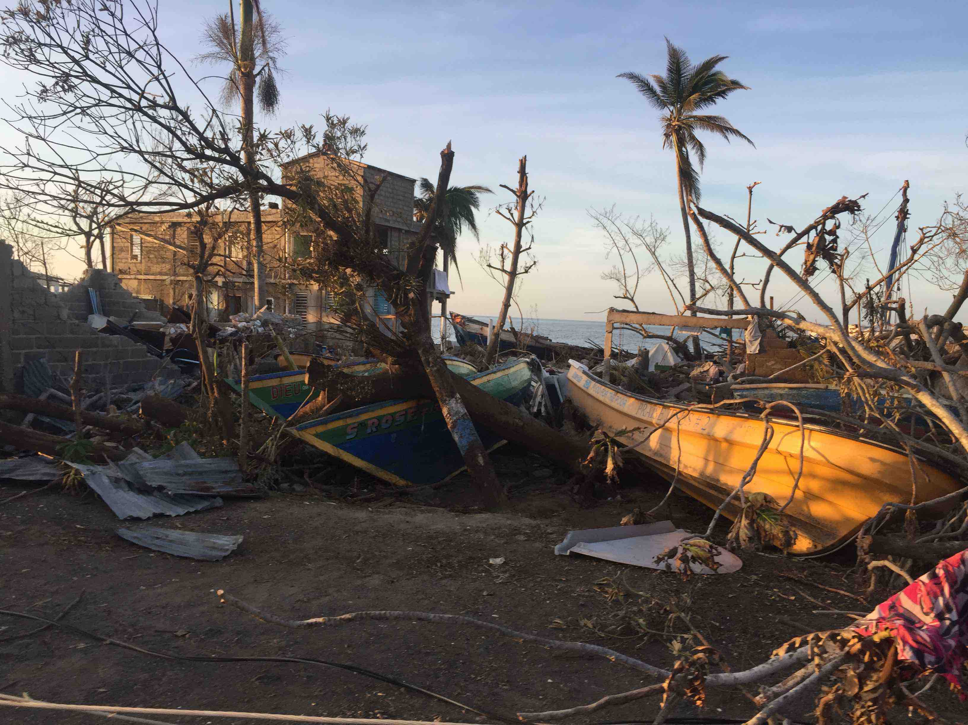

Hurricane Matthew – Haïti 2016
Evaluation des Besoins Post Désastre
Post Disaster Needs Assessment
PDNA

Slide 10
Potential RO Partners, Users, Practitioners
National government users :
3 early partners : CNIGS, CIAT, ONEV
Other desired partners : ministries (planning, interior, agriculture, finance…)
Academia: universities and institutes (UEH, UniQ, UNDCayes, ENS...)
CEOS agencies :
Italy (ASI), China (CAS), France (CNES), Europe (ESA), Japan (JAXA), USA (NASA, NOAA, USGS) - Possibly Germany (DLR), Canada (CSA). Open to others…
DRM stakeholders and donor bodies :
WB, GFDRR, UNDP, EU, UNEP, UNOPS, WHO, UN Habitat, UNOOSA,…
NGO, crowdsourcing and collaborative associations :
Potentiel 3D, OSM, ……
International scientific community:
CIMH, CIMA, INGV, CIRAD, CESBIO, ….

Slide 11
Mission to Haiti
(Jan/Feb 2017)
Joint CNES-GFDRR mission on behalf of RO to establish partnership with RO users and stakeholders and develop consensus on user needs for the RO.
Consultations:
CNIGS
CIAT
ONEV
Ministere de la planification
UNDP
UNEP
WHO (World Health Organization)
IOM (International Organization for Migration)
Delegation of European Union
Open Street Map/3D Potential
Univ Notre-Dame des Cayes, UniQ (Quisqueya), UEH, ENS

Slide 12
Feedback from consultations (1/2)
Strong support for RO concept
Desire to link RO to existing tools and platforms for increased synergy: HaitiData.org, KAL-Haiti, RASOR, new ONEV environmental information service
Role of local champions
  CNIGS technical implementation and leadership
  CIAT user needs coordination
  Ministry of planning linkages to national and local recovery efforts
  ONEV linkages to environmental and eco-system monitoring
Strong interest of universities and research communities

Slide 13
Feedback from consultations (2/2)
Area to be extended to the three administrative units
Main application areas :
  Agriculture and food security
  Forests and protected areas
  Coastal zone monitoring and coastal settlements
  Population displacement and rural settlements
  Road networks and accessibility
  Landslides and water system monitoring (river bed and river discharge monitoring)
Baseline pre and immediately post event; update every six months over AoI; hotspots with more detailed, more frequent coverage; thematic applications led by theme leaders (e.g. Environment- ONEV); reactive update after future events.

Slide 14
ROOP Preliminary Product List 1/2
Baseline mapping | Pre-event baseline landcover map of area of interest
 | After event baseline map showing categories of damage over AoI Update with schools and health centres and road network
Housing | Progress of housing reconstruction (routine product) 1 or 2 years only?
 | Population displacement monitoring product (routine product)
Transport | Status of critical transportation points (input to Rural Access Index) (routine product)
Agriculture | Agricultural change assessment (science product)
Health | Vector-based disease risk product (science product)

Slide 15
ROOP Preliminary Product List 2/2
Environment | Status of regeneration, deforestation and human impacts (and other parameters?) in protected areas (routine product)
 | Coastal zone monitoring with focus on reefs (reef health) and coastline (sedimentation, river discharge, coastline change) – (science product)
 | Integrated watershed monitoring (science product)
 | Ground movements: landslide (base map and update after major met events or seismic event) and fault mapping (science product)
 | Evolving hazards – change detection map of high risk vulnerable areas ; flooding after new met events (science product)

Slide 16
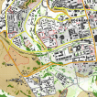
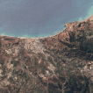
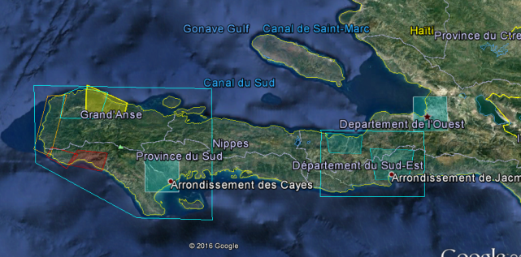
RO Baseline :
Pre/Post Matthew
An HR cover of the entire AOI, few VHR on zoom before and after Matthew
(Optical and SAR)
Archive Existing data :
TerraSAR-X, Spot, Landsat, WV, ALOS-2,
RADARSAT-2, Pléiades, Drones images
Action : Discuss Archive Data quota
with CEOS RO partners
Charter activation for Matthew in Haiti
ROSCOSMOS- Resurs p
ROSCOSMOS- Kanopus v
CNES - Pléiades
CSA – RADARSAT-2
Action : Charter- CEOS agreement

Slide 17
Timeline
To June 2017 – RO Establishment
Discussion of MOUs with Haitian users and partners,
Solicitation of new partnerships (especially for value-adding)
Establishment of IT infrastructure with charter images, baseline pre/post-event
Development of capacity building plan
First User workshop in Haiti to provide further input to the ROOP and finalise the RO baseline.
June to fall 2017 – RO Commissioning
Incorporating the first products into the RO and ensuring easy access;
Animating the user forum;
Encouraging and promoting RO use.
First “early evaluation”, with a report to RO Steering Committee
To end 2021 (est.) – RO Steady-state Operations
Ensure IT updates, engage in capacity building activities, generate regular products, report on RO annually to stakeholders and partners
Preparation of closure, including evaluation and legacy strategies.

Slide 18
Proposed Haiti RO Management
Haiti RO will set up a Project Team, made up of local stakeholders, international DRM community, value adders, academia, and CEOS satellite community. All RO contributors and users are de facto members of Project Team. All ROOT members invited to join.
Haiti RO Steering Committee (SC) to be made up of Haiti champions CNIGS, CIAT and ONEV, together with GFDRR/WB, and UNDP as representatives of the international community, and two or three volunteers ROOT CEOS agencies.
Haiti SC to meet via teleconference once every three months to oversee RO development and address issues that arise, and face to face as required.
Day-to-day management of RO to be undertaken by project team on a decentralized basis (project leadership by CNIGS; technical project management support by CNES).

Slide 19
GP-STAR
Global Partnership on Space Technology Applications for Disaster Risk Reduction (GP-STAR)
Support the implementation of the Sendai Framework for Disaster Risk Reduction 2015-2030
- Fostering the use of Space-based Technologies and Applications and Earth observation in the context of the Sendai Framework
- Providing advice to governments, organizations, and projects on the use of space technologies and applications in disaster risk reduction efforts, and the provision of relevant publications
- Partnership shall integrate international, regional and national organizations involved in space science and technologies, Earth observation, disaster risk reduction and civil protection

Slide 20
GP-STAR
Chair: Mexican Space Agency
Co-Chair: Disaster Management Center Government of Sri Lanka
The following Working groups have been established in December 2016
Name of Working Group | Sendai framework component | Members
“Cancun”: Preparation of GP-STAR side event, including brochure, fact sheets and GP-STAR web page, for Global Platform Session Cancun, Mexico 2017 | All | GEO, UN-SPIDER, DMC-SL, ISPRS (tbc), IWG-SEM, CEPREDENAC, AEM
Volcanos (tbc) | Priority 1 | DLR, CEPREDENAC, CEOS (tbc), GEO POs (tbc), ISPRS (tbc)
Droughts | Priorities 1 and 4, global targets and indicators | DMC-SL, IWMI, UNCCD, WMO, CNE-DR, ESCAP, ZFL UniBONN , ISPRS (tbc), GEO POs (tbc), UNU-EHS
Sand and dust storms | Priorities 1 and 4 | UNCCD, WMO (tbc), NDRCC (tbc), SDIM (tbc), ISA –Iran (tbc), UN-SPIDER, ISPRS (tbc)
Tsunami | Global targets and indicators | Tohoku University, MMAF-Indonesia, Sentinel Asia, UN-SPIDER, GEO, ISPRS (tbc)
Flood | Priorities 1 and 4, global targets and indicators | IWMI, IWG-SEM, Sentinel Asia (tbc), DMC-SL, CNE-DR, GEO POs (tbc), CEOS (tbc), EC [DG-JRC, COPERNICUS] , DLR (tbc), WMO, UNCCD

Slide 21
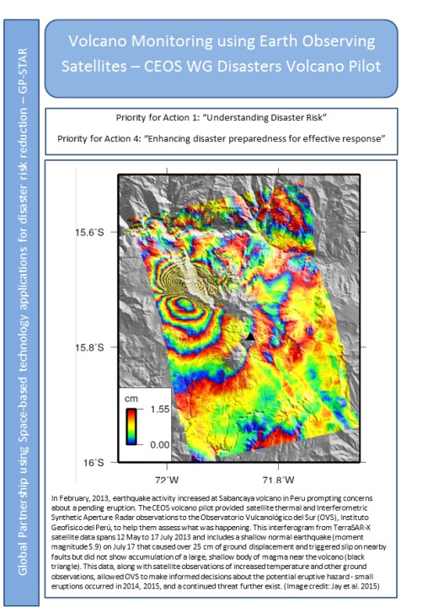
GP-STAR
WGDisasters contribution:
  GP-STAR Meetings and Website
  Volcanoes WG (fact sheet)
  Floods WG
  Special events
GP-STAR side event at the Global Platform for Disaster Risk Reduction meeting in May 2017, organized by The United Nations Office for Disaster Risk Reduction.

Slide 22
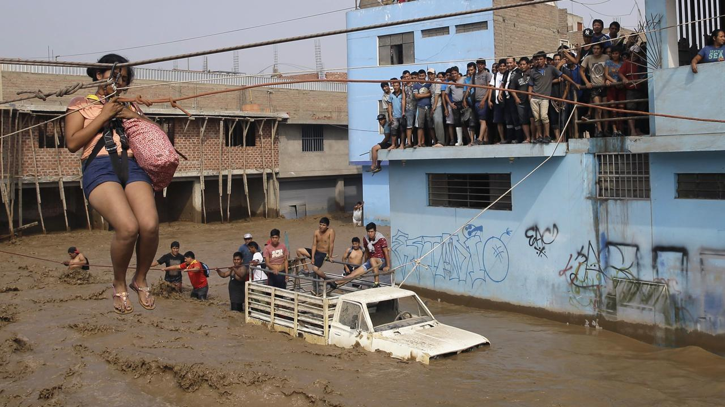
Thank You !!
Peru Floods Leaves Thousands Homeless (19 03 2017 ). Source: GONEWS.
https://www.youtube.com/watch?v=qpNwP__j4Os

