Slide 1
UN-WCDRR Process Update and CEOS Way Forward
Committee on Earth Observation Satellites
I.Petiteville (ESA, CEOS WGDisasters)
SIT-32 Agenda Item #20
CEOS Strategic Implementation Team
ESA Headquarters, Paris, France
26th-27th April 2017

Slide 2
Session objectives
GEO-DARMA
Recall GEO-DARMA Principles
Report on current status on GEO-DARMA
A multi-M$ initiative …

Slide 3
Expectations After Sendai
Growing awareness of decision makers and key stakeholders on the need to use ALL data sources (in-situ, remote sensing, socio-economic, models,…) for taking better- informed disaster risk reduction decision and resilience measures.
Need for sustained end-to-end solutions with involvement of ALL relevant actors from data / information providers down to final end users.

Slide 4
Follow-on Actions After Sendai
“Sendai Framework for Disaster Risk Reduction 2015-2030”:
For 1st time in 20 y, explicit references to satellite EO.
UN ISDR requested concrete follow-on actions from both CEOS & GEO.
Some on-going disaster-related activities initiated by space agencies (CEOS or non-CEOS) before Sendai, address some recommendations from the Sendai Framework.
After Sendai, CEOS WGDisasters & GEO SEC developed a new GEO initiative GEO-DARMA directly linked to Sendai Framework. Endorsed at last GEO Plenary (Nov. 2016).
as per SDGs, linked to indicators and to targets.

Slide 5
GEO-DARMA Concept Phase
Data providers (e.g. Space agencies) not fully aware of DRR priorities & user needs ….
Support from knowledgeable bodies sought for independent assessment of DRR priorities / community needs for 2015-2030:
At regional level, 2 or 3 independent and authoritative regional institutions such as World Bank, GFDRR, UNESCAP, UNISDR, UNDP, UNOOSA, RCMRD, others, …
Three initial regions: South-East Asia, Latin America & Caribbean, Southern Africa)
Identification of hazards affecting most of the countries in the region that require regional and multi-country involvement.
e.g. highest human and economic losses or transboundary risks
Identification of 1st set of countries within the region that are ready to actively participate in future projects at the very beginning.

Slide 6
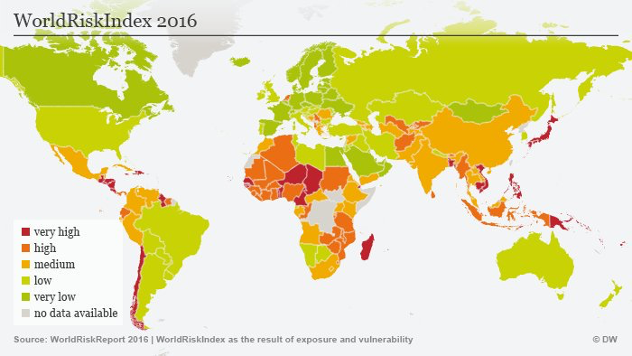
World Risk Index 2016

Slide 7
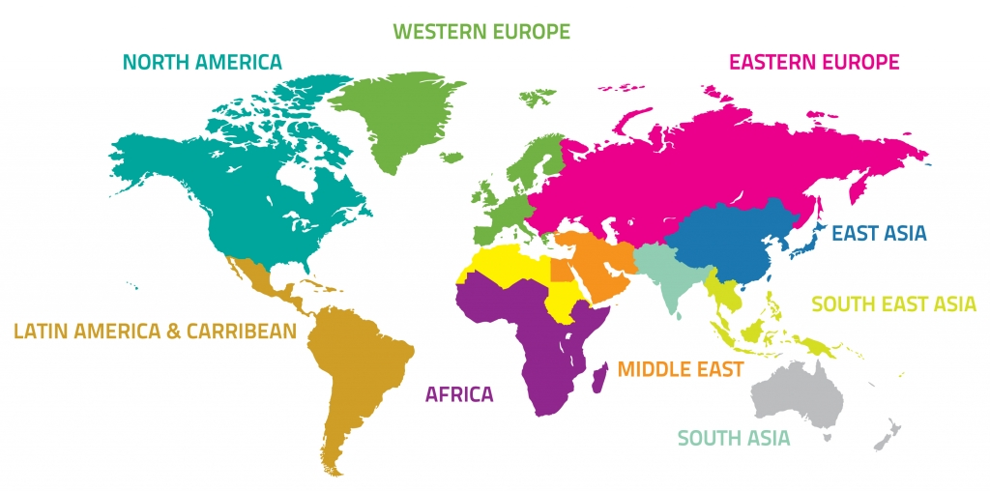
GEO-DARMA – Just an Example !
Identification of users needs and DRR priorities per region
For each region:
Types of hazards,
DRR Issues to be solved,
Initial countries

Slide 8
GEO-DARMA Prototype Phase
1. Realistic assessment of recommendations / user needs) from Regional Institutions, given resources from the potential actors (e.g. data providers, value-added information providers, ..).
2. Define and implement possible prototype projects at country level to address recommended priorities;
2 to 3 per region
Close iterations with end users.
Maximum reuse of existing initiatives / activities (operational, research, capacity building) e.g. CEOS Disaster Pilots, SERVIR, Copernicus EMS
3. Progressive extension of solutions to neighboring countries where applicable.
4. If “successful” prototype project and if strong request from end users to continue → Assess of resources needed to transition to operation (e.g. identification of donors)

Slide 9
GEO-DARMA – Just an Example !
Prototype projects – progressive extension to neighbouring countries

Slide 10
GEO-DARMA Governance
a Steering Committee
High level persons, representing International Organisations, Financial Institutions, end-User Communities, Scientific communities, National Disaster Management Agencies, National Resource Management Agencies, ….
All continents represented.
a Technical Committee.
Project teams
similar to CEOS Pilot teams: one per project. To be set up at end of Concept phase

Slide 11
Where do we stand ?
GEO-DARMA in GEO 2017-2019 WP; endorsed at 2016 GEO Plenary
Steering committee being assembled with major stakeholders:
e.g. GFDRR (Global Facility for DRR ; lead by WB) or UNESCAP (UN Economic and Social Commission for Asia and the Pacific)
10% of WB’s annual budget is allocated to disaster management
GFDRR already cooperates with CEOS WGDisasters in RO
8 members confirmed so far (out of 12 expected)
Related to the Future Partnerships with Banks and UN system
GEO-DARMA workshop (25 May) at GPDRR (22-26 May 2017).
Meetings with individual Regional Institutions during Summer 2017.
Opportunity to take stock of current CEOS Pilots.
Could be an opportunity to extend the current Pilots with new objectives.

Slide 12
Work Flow – Concept Phase
(KO to 8 Mo)
Work Logic – Conceptual Phase (KO – M8)

Slide 13
Proposed GEO-DARMA Steering Committee Members (in bold confirmed)
Francis Ghesquiere, Head, GFDRR (lead by WB)
Michael Szoenyi, Group Head of Flood Resilience, Zurich Insurance group
Ronald Jackson, Executive Director, Caribbean Disaster and Emergency Management Agency (CDEMA)
Mohammed Ibrahim, Principal programme officer, ECOWAS Commission
Tiziana Bonapace, Director ICT and DRR, UNESCAP
Faisal Djalal, Chairperson, Asia-Pacific Alliance for Disaster Management
Peeranan Towashiraporn, Capacity Development Specialist, Asian Disaster Preparedness Center (ADPC)
Ivan Petiteville, GEO-DARMA PoC, CEOS / ESA
Mamadou Toure, Founder and Chairman, Africa 2.0 Foundation
Joseph Tocco, Chief Executive, Americas, XL Catlin
DG-GROW, European Commission
Irene Céspedes, General Director, Regional Center for Disaster Information for Latin America and the Caribbean (CRID)

Slide 14
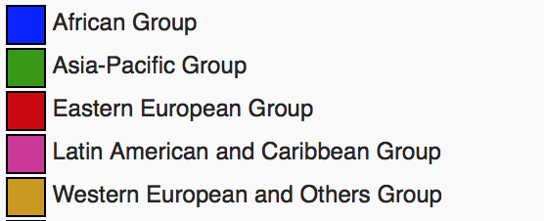
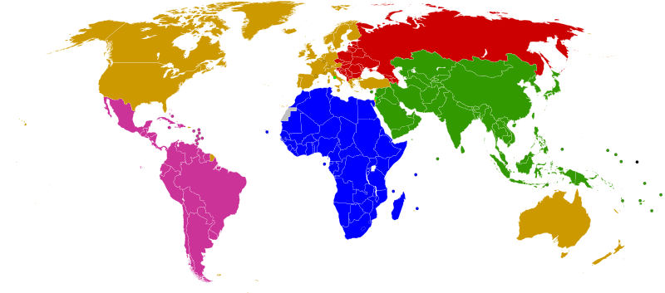
GEO-DARMA Potential Regional Institutions
.
ASEAN
ADRC
SDMC (SAARC)
UNESCAP
APEC
LAS
PIFS
Asia-Pacific
Africa
Latin America
Caribbean
SADC
LAS
ECOWAS
CILSS
IGAD
UNECA
CDEMA
CEPRELAC
INDM (OAS)
CAPRADE
CRID
ECLAC
International: consider regional processes and programmes of World Bank, GFDRR, UNDP, UNEP, UNESCO, UNISDR, across all regions, especially in areas where there is no regional organisation (e.g. Central Asia)

Slide 15
GEO-DARMA Kick-Off Workshop
& Steering Committee meeting
Organized on 25 May, during the 2017 Global Platform for Disaster Risk Reduction (GPDRR, 22-26 May, 2017):
Most important international forum dedicated to the disaster risk reduction agenda. Every 2 year.
Organized by United Nations Office for Disaster Risk Reduction (UNISDR).
+ 5,000 participants expected, including Policy Makers and Disaster Risk Managers.
GPDRR: first opportunity for international community to review global progress on the implementation of the Sendai Framework for Disaster Risk Reduction (2015).

Slide 16
Using satellites to save the world …
B.Gates and P.Omidyar (Ebay) will fund the Radiant Earth project
A powerful digital platform to:
Harness the avalanche of data sent from satellites each day - and make it freely available for humanitarian and environmental causes (e.g. planning and management of issues
© 2017 Reuters
such as land tenure, global health, sustainable development, food security and disaster response. )
Foster more informed decision-making about the Earth's resources.
Find ways to combine and analyze Earth data and imagery and offer it free of charge in formats that do not require specific expertise to understand.”
Any potential opportunity for CEOS, GEO, Copernicus, …?
http://www.reuters.com/article/us-technology-satellites-humanitarian-idUSKBN1661KH

Slide 17
Thank you
For more information see http://ceos.org/ourwork/workinggroups/disasters/geo-darma/

