Slide 1
World Cover 2017 Conference
Committee on Earth Observation Satellites
S. Briggs
SIT-32 Agenda Item # 18
CEOS Strategic Implementation Team
ESA Headquarters, Paris, France
26th-27th April 2017

Slide 2
World Cover 2017 Conference
Round table conclusions

Slide 3
World Cover 2017 Round table conclusions
Agreed that a wider collaborative initiative bringing together worldwide expertise desirable, possibly through a GEO Initiative
Retain also individual initiatives, including those delivering single-issue thematic maps (water, tree cover, urban, …)
Need for land cover classification schemes to be relevant to specific problem areas: no single scheme will satisfy all needs
Nevertheless a generic classification could be of use to a wide range of service areas in societal areas such as SDGs
Need for consistency in approach, some near real time mapping capacity, more penetrating analysis of accuracy assessment than simple comparisons
Generic land cover clearly important for biodiversity and ecosystem analysis, but care needed to ensure correct typology of classification schemes
Transparency of results and validation, sharing of validation data is important
Be wary of crowd-sourced validation data
Commercial sector capable and willing to deliver, in particular, tailored services on land cover and analysis
NEED CAREFUL DIALOGUE WITH USERS TO UNDERSTAND THEIR INFORMATION NEEDS AND POTENTIAL TO SATISFY THEM

Slide 4
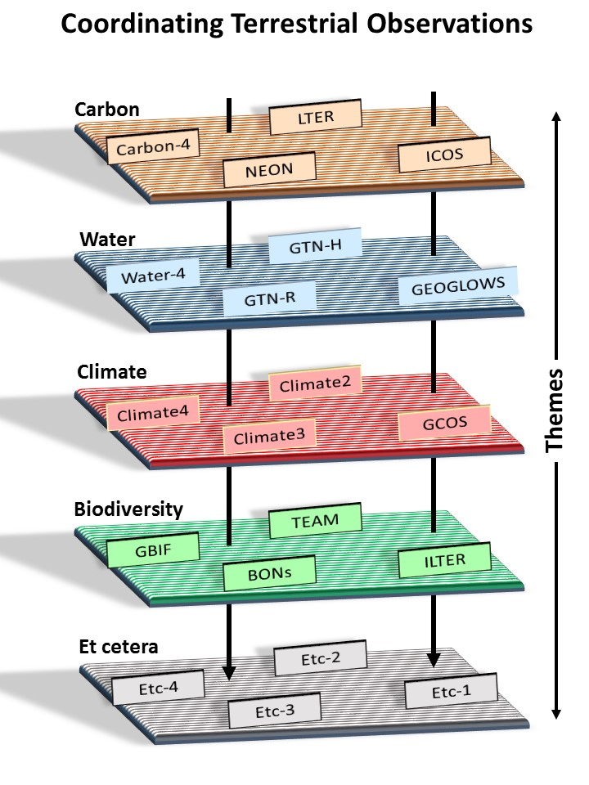
Terrestrial observations discussion ESRIN 13/3/17
Participants:
GEO* (Chair), ESA, UNEP, ICSU*, GCOS*, WMO, GOFC/GOLD, EC-JRC
Objective:
Reconstruction of framework for future Terrestrial Observations
Outcome document (in draft):
Coordinating Terrestrial Observations for Sustainable Development:Thoughts to Facilitate a Path Forward
*Co-ordinators

Slide 5
Draft Outcomes
Coordination goals and approaches for consideration
1) Goals (Acquisition):
Shared sites and co-location of observations (e.g., integrated site system)
Shared site database and/or meta-database
Identify and fill gaps
Eliminate overlaps (or extract more value from them)
Coordinated observing methods and protocols (standards)
2) Goals (Delivery):
Harmonized parameter formats and units (standards)
Harmonized systems with increased interoperability
Improved data discovery and access of related cross-theme and cross-system observations
3) Approaches for consideration (General):
Agree on an overall framework within which terrestrial observation systems collectively operate (e.g., analogous to the Framework for Ocean Observations)
4) Approaches for consideration (Specific):
Create thematic working groups for within-theme discussion
Focused workshops, online forums, discussions
Clear identification of benefits to users (how does coordination help them fulfill their mission)
Create cross-theme discussion mechanisms

