Slide 1
GEO Blue Planet Update
Committee on Earth Observation Satellites
Emily Smail
GEO Blue Planet Secretariat (UMD/NOAA)
SIT-32 Agenda Item 17
CEOS Strategic Implementation Team
ESA Headquarters, Paris, France
26th-27th April 2017

Slide 2
About GEO Blue Planet
Oceans and Society: Blue Planet is an Initiative within the Group on Earth Observations
GEO Blue Planet’s mission is to:
advance and exploit synergies among the many observational programmes devoted to ocean and coastal waters;
to improve engagement with a variety of users for enhancing the timeliness, quality and range of services delivered; and
to raise awareness of the societal benefits of ocean observations at the public and policy levels.

Slide 3
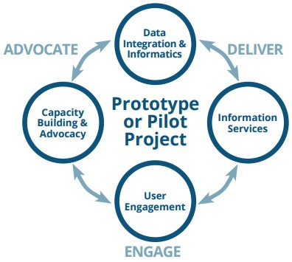
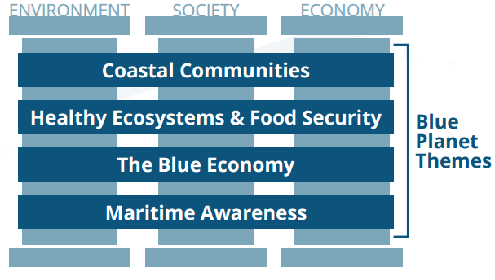
About GEO Blue Planet
Components
Themes
Notes:
OECS is the Organisation of Eastern Caribbean States

Slide 4
Current Activities
Populating a new Advisory Board and expanded the Steering Committee
Planning a Blue Planet symposium in College Park, MD
Notes:
Symposium speakers include:
Craig McLean (NOAA), Christopher Corbin (UNEP), Dick Feely (NOAA), Werner Kiene (Marine Stewardship Council), Rashid Sumaila (University of British Columbia), Martin Le Tissier (Future Earth Coasts), Claire Jolly (Head, Ocean Economy Group, OECD), Dail Rowe (Weather Predict Consulting Inc.), CMD Ruth Lane (North American Ice Center), Okalik Eegeesiak (Chair of the Inuit Circumpolar Council), James Movick (Pacific Islands Forum Fisheries Agency)

Slide 5
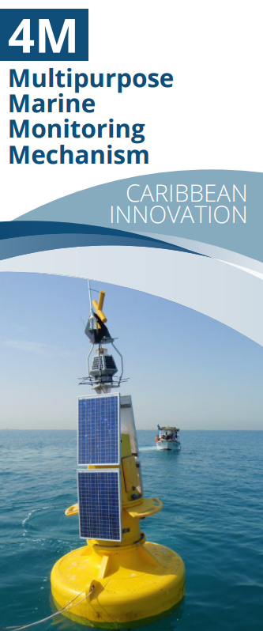
Current Activities
4M – Multipurpose Marine Monitoring Mechanism
Project concept (for implementation in Barbados and Grenada) currently being developed by UNDP Barbados and the OECS, IOCARIBE-GOOS and GEO Blue Planet
4M will work to support Caribbean SIDS by:
Providing technology for effective monitoring of the marine environment
Increasing capacity for marine data collection and analysis
Improving access to real-time data in the region
Increasing data sharing in the region
Establishing a data platform for Caribbean SIDS
Notes:
OECS is the Organisation of Eastern Caribbean States

Slide 6
Current Activities
GEO Blue Planet and the UN Sustainable Development Goals
Contributed to side event on ocean observing at the February preparatory meeting UN Oceans Conference
Members of the GEO Blue Planet network will participate in the UN Oceans Conference in June
GEO Blue Planet is working on a proposal to NASA to fund a workshop in the Caribbean titled: “Implementing and Monitoring the Sustainable Development Goals in the Caribbean: The Role of the Ocean”
Notes:
Side Meeting title: “Building partnerships for Integrated Ocean Observing and Information in support of the implementation of SDG 14”. Emily Smail was a speaker at the side event on behalf of Blue Planet.
SDG Caribbean workshop will be hosted by the minister of St. Vincent

Slide 7
Near term & Future Activities
Near term
Work with EOS Data Analytics, Inc. on demonstration projects related to ocean and coastal observing
Host the GEO Blue Planet Symposium
2017 – 2019
Build and engage working groups
Secure funding for implementation of 4M
Identify and begin work on additional prototype/pilot projects
Work to increase engagement and begin capacity building activities
Advocate for sustained ocean and coastal observations

Slide 8
Blue Planet and CEOS
Linkages
CEOS is a founding partner of GEO Blue Planet
Paul DiGiacomo is designated as the CEOS Blue Planet Expert
Steve Volz has been invited to represent CEOS on the Advisory Board
GEO Blue Planet seeks to support CEOS with identifying observation requirements/priorities for ocean-related services
Moving Forward
Participation of CEOS in GEO Blue Planet Working Groups
Continued support of GEO Blue Planet activities
Participation in the upcoming symposium and 2018 symposium

Slide 9
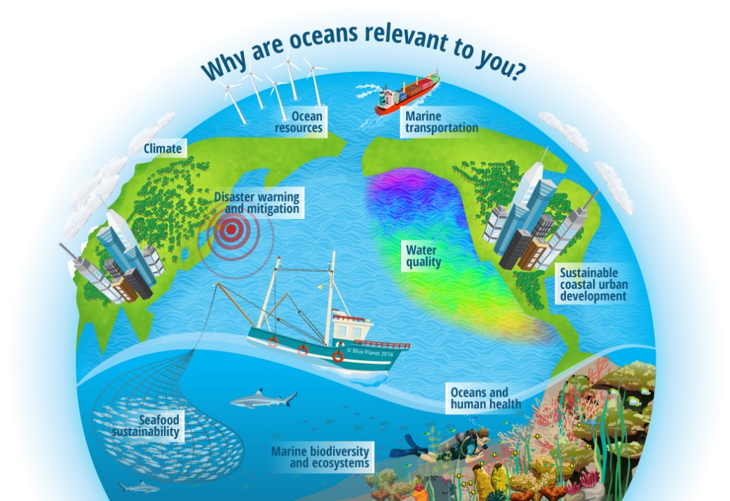
Questions?

