Slide 1
CEOS Ad Hoc WG on GEOGLAM
Committee on Earth Observation Satellites
Selma Cherchali (CNES) & Brad Doorn (NASA)
SIT-32 Agenda Item # 16
CEOS Strategic Implementation Team
ESA Headquarters, Paris, France
26th-27th April 2017

Slide 2
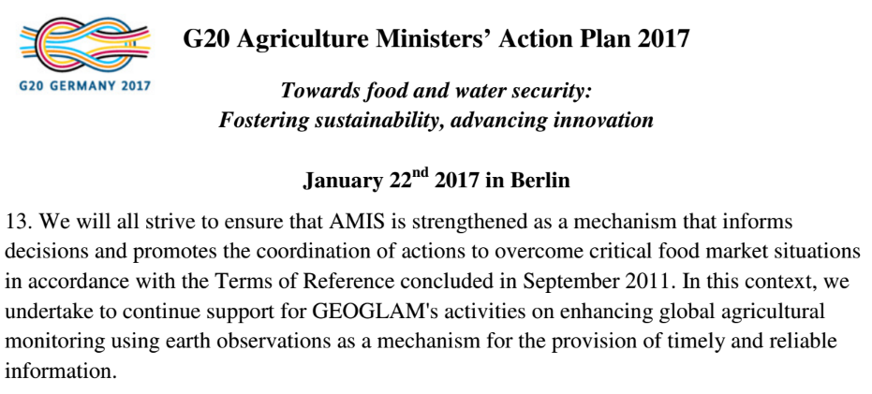
GEOGLAM Updates (1)
GEOGLAM-wide:
Re-endorsement of GEOGLAM by G20
Signaling ever greater support, strengthened political mandate
EO for timely, reliable information
Regional Network Highlights (strengthen & coordinate with global network):
4-day GEOGLAM Latinoamerica Training during AmeriGEOSS week 2016 (June, Colombia); another being planned for AmeriGEOSS Week, 31 July-4 August 2017 (Costa Rica)
Launch of AfriGAM – joint contribution to AfriGEOSS and GEOGLAM
Full day workshop on needs, priorities, and objectives in Uganda, October 2016
GEOGLAM Latinoamerica & AfriGAM still in “ramp up” phase (need funding for coordination, implementation planning)
Asia-RiCE SARI/LCLUC Workshop, Vietnam October 2016, and GEOGLAM/Asia-Rice Workshop at APGEOSS, Tokyo January 2017 (discussion about UN SDGs)

Slide 3
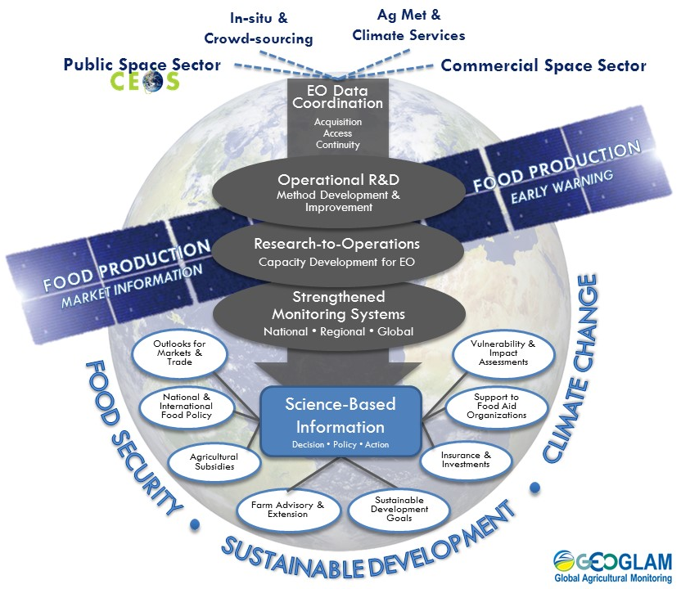
GEOGLAM Updates (2)
GEOGLAM’s New Workflow Diagram approved by GEOGLAM Advisory Committee
Positions EO data coordination (inc. CEOS agency data) at the center of all activities, from R&D through operations
EO Data Requirements “reboot”
Req’s from 2012-2014 still excellent quality
Reboot = more products, more detail (in situ), updated science from R&D activities
Still in progress – emphasis on doing it well rather than doing it soon
Completion slated for Fall 2017 (contingent upon community meeting)

Slide 4
GEOGLAM Updates (3)
Asia-RiCE
Upcoming Asia-RiCE related meeting (15 May 2017) focused on pre-operational data use (wall-to-wall) in Indonesia and Vietnam with Data Cube discussion and ALOS-2 ScanSAR data on-line access
GEORICE contributing a Sentinel-1 Module to the Vietnam Mekong Delta Data Cube
RAPP
Upcoming workshop at ESRIN (16-17 May) focused on integrating Sentinel-1 and -2 data for biomass estimation on rangelands
RAPP Map (global monitoring system) officially launched (http://map.geo-rapp.org/) In-country validation work ongoing with RAPP partners (Argentina, Brazil, South Africa, Namibia, Mongolia…)
JECAM
SAR Inter-comparison Experiment
Agreement achieved between AAFC and CS;, imminent start
Details to-be-discussed 28 June at Sen2Agri/SIGMA/JECAM meeting in Rome
Crop Biophysical Variables – LAI, Biomass (McNairn, AAFC)
Crop Type Mapping (Davidson, AAFC)
Minimum validation datasets for crop monitoring led by Argentina
Nearly 6000 km² of VHR optical data (Pleiades) provided (Nov 2016)
Compendium of Best Practices from R&D Activities (Sen2Agri, SIGMA, JECAM)
Inspired by GFOI MGD – to be scoped at 26-30 June 2017 (Rome)
GEOGLAM IT Meeting (“All Hands”)
Hosted by AMIS, Rome – 19-21 June 2017

Slide 5
Why Agriculture Matters to Sustainable Human Development
Food production and distribution are at the intersection of multiple metrics of human livelihoods:
Goal 1: Poverty, nearly 40% of global workforce works in agriculture; 75% in poorest countries (FAOSTAT)
Goal 2: Sufficient, reliable food availability, access, utilization as population increases
Goal 3: Health and well being, early warning of food shortages can mitigate human mortality & reduce risk
Goal 6: Water, balanced access to and use of water, potable and safe non-potable (e.g. for irrigation); water partitioning and filtration
Goal 12: Responsible production, improved agricultural practices can increase sustainable usage of natural resources; monitoring of production can help mobilize policies to reduce post-harvest losses
Goal 13: Climate change, agriculture can help mitigate, while at the same time change climate change and instability threatens food production in most vulnerable areas
Goal 15: Sustainable agricultural production practices to prevent land degradation
Earth observations can provide synoptic, objective, timely and repeatable information to fill in knowledge gaps
Efforts to link GEOGLAM with SDGs because EO fulfills priorities: strong national, regional and global political mandate

Slide 6
GEOGLAM & the UN SDGs:
Some examples
Target 2.c
Adopt measures to ensure the proper functioning of food commodity markets and their derivatives and facilitate timely access to market information… in order to help limit extreme food price volatility
Target 2.a
Increase investment, including through enhanced international cooperation, in… agricultural research and extension services, technology development… to enhance agricultural productive capacity in developing countries.
Target 2.4
By 2030, ensure sustainable food production systems and implement resilient agricultural practices that increase productivity and production…
Target 13.3
Improve education, awareness-raising and human and institutional capacity on climate change mitigation, adaptation, impact reduction, and early warning.
Crop Monitor for
AMIS
GEOGLAM
JECAM
Asia-RiCE
SIGMA
GEOGLAM R&D
Crop Monitor for Early Warning
Capacity Dvlmpt

Slide 7
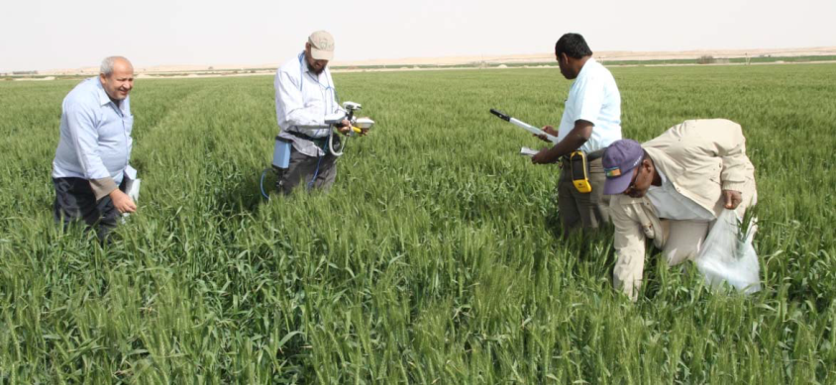
Example for SDG Target 2.4:
By 2030, ensure sustainable food production systems and implement resilient agricultural practices that increase productivity and production…
GEOGLAM is…
Coordinating international research & development activities on finding pathways toward long-term sustainable agriculture.
Enhancing capacity to assess interannual variability in cultivation practices and their impacts on cropland productivity and on the environment.
Investigating sustainable cropland management practices.
Fostering South-South transfer through capacity development workshops and partnerships.

Slide 8
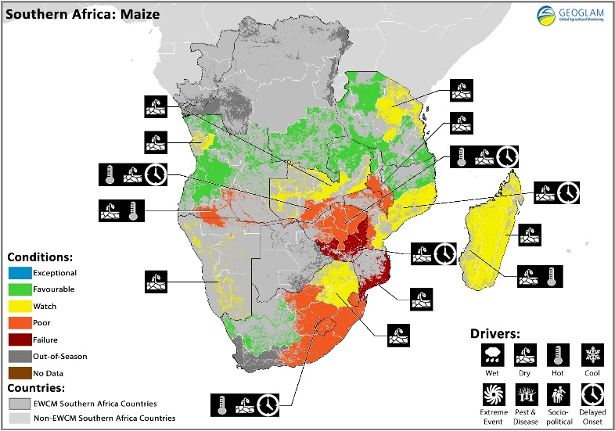
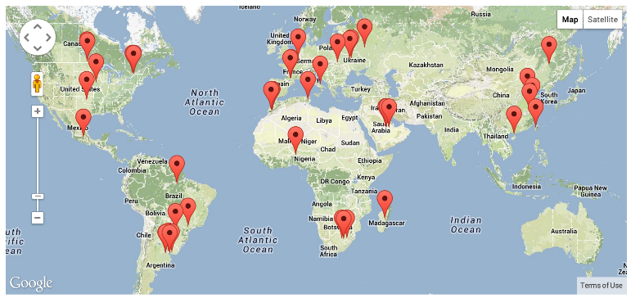
Example for SDG Target 2.a
2.a
Increase investment, including through enhanced international cooperation, in rural infrastructure, agricultural research and extension services, technology development and plant and livestock gene banks in order to enhance agricultural productive capacity in developing countries, in particular least developed countries.
GEOGLAM is…
Facilitating international coordination and collaboration around improving early warning of crop failure & strengthening food security.
GEOGLAM is…
Linking agricultural research sites & sampling frame under a global framework
GEOGLAM’s Early Warning Crop Monitor
Monthly international consensus reporting on productivity outlooks in developing countries

Slide 9
Earth Observation & the SDGs: Challenges
Communication Challenge: SDG metrics to date have been defined primarily by the statistical community. Little direct interaction between GEOGLAM and the SDG’s at the global, regional or national level.
At best the uptake of EO by statisticians has been slow, at worst EO is seen as a threat to long standing approaches
Little understanding about what EO can offer, need for open dialogue, GEO can facilitate
Current State: Metrics are largely qualitative assessments of growing conditions based on science based agro-climate and remote sensing information integrated with human observation. Works well for the purpose they were designed, but will it work for SDG’s?
Need for more quantitative metrics
Need for more capacity to forecast yield and create accurate measures of acreage (production)
Beyond the SDG’s there is a need for solutions to hunger. This will require information on agriculture state and change, and ultimately reliable forecasting to support proactive decision making
Notes:
Leverage connections with agricultural statistics agencies – show the ways we are already contributing (AAFC, MARS, AAFC)

Slide 10
GEOGLAM, CEOS, and the SDG’s:
Moving Forward
Short Term: Leveraging existing activities, create change metrics on the state of growing conditions (extent, severity and type)
June GEOGLAM Implementation Team (19th-21st) and JECAM (28th) Meetings
Medium Term: Step up R&D for the development of quantitative metrics
Yield Forecasting
Crop bio-physical metrics (phenology, LAI, Biomass, etc)
Increased temporal and spatial resolution
Early season crop acreage estimates
Monitoring smallholder farming systems
Longer Term: Strengthen international cooperation and identify institutional homes for activities
Accelerate the Research-Development-Operations continuum
Discussion point: How to align GEO, GEOGLAM, and CEOS efforts to contribute to SDGs? – messaging, outreach, approach…

Slide 11
GEOGLAM & CEOS: Interactions
LSI-VC:
GEOGLAM has already been engaging with LSI-VC
Benefits to adapting GEOGLAM’s requirements development and evaluation process
Tabular & spatial representation of common needs
Where do we have critical gaps across MULTIPLE applications?
Which observations have a high bang-for-their-buck return on investment?
Acquisition planning for non-systematic sensors across multiple apps
Future mission design & justification
Tie-ins to ARD work → what standard pre-processed products have utility across multiple activities?
Joint LSI-VC, GEOGLAM, GFOI meeting planned September 6-8th
WGCapD:
GEOGLAM representation at WGCapD annual meeting (March 2017); WGCapD seeking to enhance coordination with GEOGLAM.
Opportunity to align GEOGLAM’s operational/institutional capacity development mandate with WGCapD’s priorities and activities

Slide 12
Summary
Harmonizing, centralizing, “glue” functions of GEOGLAM Secretariat
Current program coordinator (French Min Ag) secondment ending Sep 2017
Seeking new secondee(s)
Coordinating Crop Monitors (AMIS, Early Warning); EO Data Coordination with CEOS (R&D activities, baseline dataset generation, and developing/implementing community requirements); Operational R&D (JECAM, Asia-RICE…); Capacity Development coordination
GEOGLAM & CEOS: Priorities
Continued collaboration with LSI-VC, WGISS on data dissemination and access – ARD, Data Cube, etc.
Updated data requests/requirements pending the outcome of several key 2017 funding opportunities for GEOGLAM (in Europe, the USA, and China)
This will determine where the next 3-5 years of work are taking place
Developing a plan for concretely contributing to the UN SDGs
In consultation with CEOS

Slide 13
BACKUP MATERIAL

Slide 14
Major Achievements - Asia Rice -
Asia Rice team meeting was held at Asia Pacific Regional Space Agency Forum in Manila with ADB in November, 2016 and GEOSS-AP working group 5 was also held in January, 2017 in Tokyo
1. Rice crop area and growth monitoring
Techinical demonstration sites = one province (Chinese Taipei, India, Japan, Malaysia, Philippine, Thailand + Cambodia and Myanmar from 2016).
Regional area (wall-to-wall): Vietnam and top 10 rice production provinces in Indonesia
GEORIICE for Vietnam
ADB project for 4 countries – rice crop area estimation Innovative Data Collection Methods for Agricultural and Rural Statistics results sharing finished by November 2016 with holding regional workshop with on-line training course with INAHOR and ALOS-2 (this training course will be open in ADB from March, 2017)
L/X/C with optical integration usage study is going with JECAM for rice to estimate rice yield
Start to set up pre-operational service for rice crop growing monitoring using ALOS-2 ScanSAR on-line service, Sentinel and other satellites in Indonesia and Vietnam (as a suucessful result of wall-to-wall study by Asia Pacific Regional Space Agency Forum SAFE prototyping in Vietnam and Indonesia with ADB project). Especiall, for Vietnam, under the cooperation with CSIRO and VSNC, JAXA prepares ALOS-2 ScanSAR data on-line access as SAR ARD to CEOS Mekong Data Cube. CEOS Mekong Data cube will be plan to demonstarte at coming GEOSS-AP meeting this September.
2. Rice crop outlook using agro-met information derived from EO satellites such as GPM, GCOM-W, MODIS, Himawari
5 countries (Indonesia, Philipine, Thailand, Vietnam, Japan) from 2013 + Cambodia, Laos, Myanmar in cooperation with AFSIS
3. Capacity Building and training
Hold a workshop for rice crop growth and outlook monitoring using space technology to ASEAN countries (Vietnam, Lao, Thailand, Philippine and Indonesia) in cooperation with AFSIS in March, 2017

Slide 15
CEOS Mekong Data Cube concept (draft)
JAXA
GA/CSIRO
VNSC
Ground data
ALOS-2
GEORIICE
Mekong
Data Cube
(VNSC)
ScanSAR every 42 days
+ INAHOR software
Statistical info
MARD
ESA
Met info
Sentinel
MONRE
MODIS
Landsat
Analyzed info
Dual every 12 days
CSIRO
VNSC, VAST, MARD

Slide 16
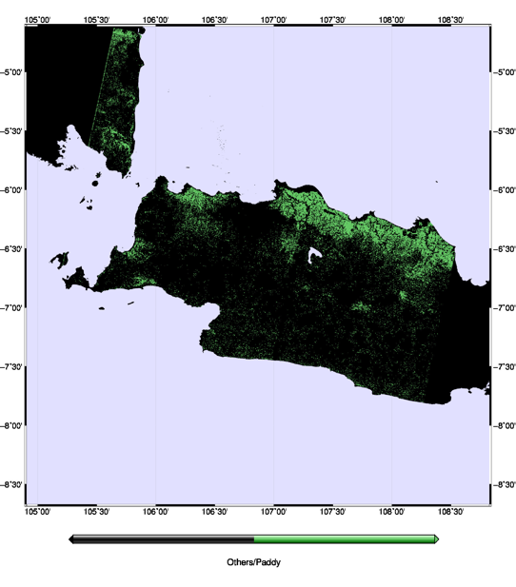
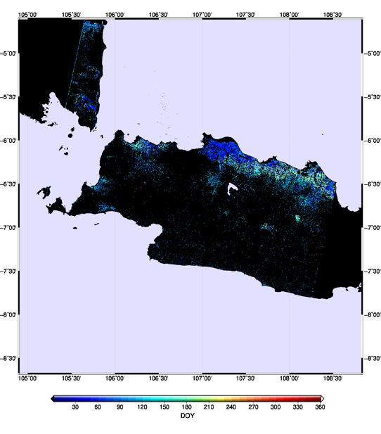
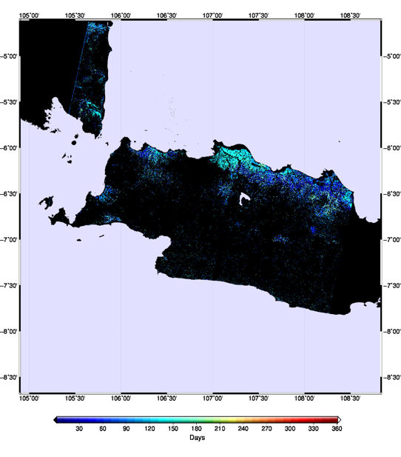
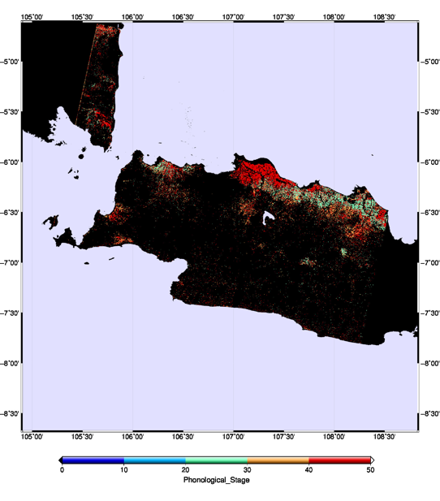
Rice Monitoring Products (example)
As of 22 Jul 2016
Planted Area
Planted Date
West Java, Indonesia
Plant Age (Days since Planting)
Phenological Stage
Joint research with MoA, Indonesia

