Slide 1
GFOI
Committee on Earth Observation Satellites
Stephen Ward, CEOS Alternate Lead for GFOI
SIT-32 Agenda Item # 15
CEOS Strategic Implementation Team
ESA Headquarters, Paris, France
26th -27th April 2017

Slide 2
GFOI STATUS OVERVIEW April 2017
CEOS Lead: Masanobu Shimada for JAXA, Stephen Ward, SDCG EXEC for CSIRO/NASA
SDCG Co-Chairs: Frank Martin Seifert (ESA) and Gene Fosnight (USGS)

Slide 3
Coordination and management
Leads:
USA: Doug Muchoney (USGS, Chair) Evan Notman & Sylvia Wilson (USAid, USGS)
Norway: Henrik Fliflet on leave, Maarten van der Eynden (NICFI)
Australia: Anthony Bennie (DOTE, Chair) [Australian funding ends 2016]
CEOS: Masanobu Shimada with Stephen Ward alternate (JAXA, CSIRO/NASA)
FAO: Anssi Pekkarinen
Phase 2 allows for new Leads
Office:
Staffed since Feb 16 (Australia and Norway $$)
Funding outlook extended to the end of 2017 whilst Phase 2 is being finalized
Phase 2 definition close to conclusion – strong country emphasis

Slide 4
Space Data – where are we up to?
Sentinel-2B seals the global coverage … multiple core data streams in operation and ensuring the necessary EO data supply for the next decades
Emphasis turns to data uptake and application – consistent with Phase 2
Global Data Flows to be addressed – volume, velocity and variety of data a major challenge. CEOS FDA developing coordinated strategy
Pilot activities continuing – Data Cube for Colombia and now Vietnam
SDCG SEC support from Australia ended Nov 2016: 2017 fill-in cover provided by CSIRO and NASA
Based on countries’ requests SDCG pursuing inclusion of Early Warning as GFOI activity – possible basis for the long-promised cooperation with WRI/GFW
Considerable effort in ensuring Phase 2 design consistent with CEOS goals and role in GFOI – and exploring practical activities
SDCG R&D (Element-3) development support by JAXA. All SDCG agencies now actively contributing EO data to GFOI R&D Programme
Rationalisation of GFOI in CEOS structure: upcoming LSI-VC, GEOGLAM, SDCG trial meeting at ESRIN in Sept 2017

Slide 5
Methods and Guidance (MGD)
REDDcompass launched in April 2016 and has established a strong user base
MGD Edition 2.0 released October 2016
French and Spanish versions completed April 2017
MGD Advisory Group under new Chair Maria Sanz-Sanchez
New CEOS representative on MGD Advisory Group needed
Communications and Assessment Readiness Level (CARL) framework
for progressive development of new technologies towards operational levels and hence applicability for capacity building activities
framework for how the GFOI components can interact
for consultation at Plenary
CEOS agencies supporting REDD+ related projects should promote application of the GFOI MGD by the countries involved

Slide 6
Capacity Building
GFOI enabled stronger coordination on Capacity Building between FAO (UN-REDD), SilvaCarbon, GOFC-GOLD and World Bank
UN-REDD now the REDD+ team within FAO (diversified funding). New focus is on 14 priority countries of Norway and less so the 64 UN-REDD countries, also more and more involved in FCPF implementation
SilvaCarbon continuing to implement full work plan until September 30 2018. Significant USAid funding uncertainty (broadly)
SilvaCarbon partnering with other USG capacity building programs to leverage capacity and funds. For example SERVIR
Proposing a GFOI CB Summit (donors, CB partners, and selected countries) ICIMOD – Kathmandu, Nepal - Sep 2017

Slide 7
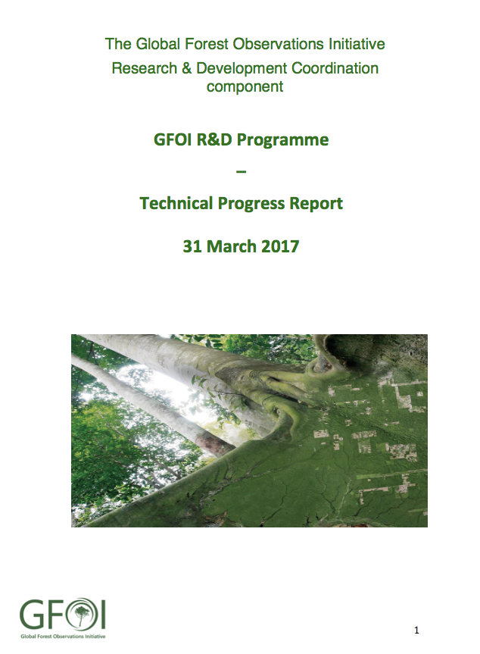
R&D Coordination
Successful R&D science meeting Nov. 2016 in The Hague (see report: www.gofcgold.wur.nl/sites/gofcgold-gfoi_sciencemeeting2016.php)
ESA volunteered continuity of coordination funding for the R&D Coordination component for the next 3 years
New R&D Coordination Work Plan for 2017-2019 prepared
SDCG Element-3 Strategy updated (available at SIT-32 www or CEOS.org/SDCG)
R&D Programme Technical Report released (available at GFOI.org/RD)
Discussion with EC ongoing to address GFOI R&D (coordination and specific actions) in a future call of the Horizon 2020 Initiative

Slide 8
Key points for CEOS
GFOI Review recognized the success in coordinating systematic data acquisition, ensuring for the first time global coverage of land remote sensing
Phase 2 focus is country engagement - caution over structures and processes
GFOI Plenary country focus a success for MGD/CB
“Thanks for all the data, we’ll take it from here”…..?
CEOS and agencies have more to learn by staying close to users
2018 Plenary in Colombia, a more advanced country and CEOS heritage
Proposed a GFOI ALERT demo (Early Warning) at Plenary
In response to requests from several countries
Inclusion in MGD
Strong interest from WRI/GFW (who are heavily optical)
Vietnam Cube and Colombia Cube demos
Unique C/L/X/S? band and optical inter-comparison to reduce FAR
‘One last try’ with FAO: SEPAL – CUBE collaboration
Integrate FAO interactive interface with CEOS Data Cube (no GEE dependence)

Slide 9
Outlook
SDCG emphasis turns from systematic acquisition to data uptake and application – ARD and Data Cube concept are key to success
Funding pressures will impact component capacity across the board
Strong central support for GFOI Office, with an increased role for coordination of components and partners
Phase 2 focus is on country engagement where capacity building is key. This has opportunities and challenges – in particular CEOS needs to be part of effective partnerships for country engagement, with capacity building

