Slide 1
GEO Framework Update and Outlook, including highlighting of GEO priorities CEOS SIT-32 Barbara J. Ryan Director, GEO Secretariat April 26-27, 2017 Paris, France

Slide 2
GEO partnership 104 Members

Slide 3
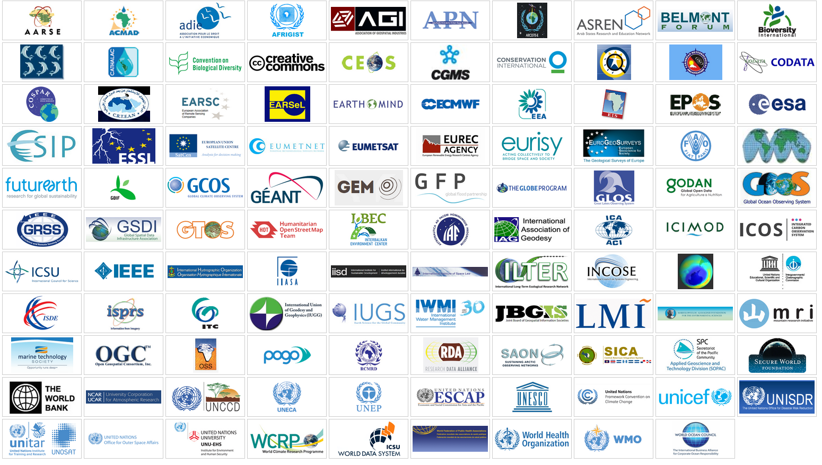
GEO partnership 109 Participating Organizations

Slide 4
High level commitment to use EO for policy
Ministerial Declaration , GEO Plenary XII, Mexico City, 2015
“Affirm that GEO and its Earth observations and information will support the implementation of, inter alia, the 2030 Global Goals for Sustainable Development, the Sendai Framework for Disaster Risk Reduction 2015-2030, the United Nations System of Environmental and Economic Accounts, and the United Nations Framework Convention on Climate Change.”

Slide 5
GEO support to the 2030 Agenda
EO to support the 2030 Agenda.
GEO represented on Inter-Agency Expert Group of the UN Statistics Division.
GEO is the Earth Observation Anchor Partner to the Global Partnership for Sustainable Development Data.

Slide 6
EO4SDG Case Studies
GEO integrates use of EO data into the methodology of measuring and achieving SDG Indicators.
This brochure (March 2017) gives graphic illustrations of the types of EO data sets and images available for improved policy and decision-making.

Slide 7
Goal 2 informed by GEO’s Agricultural Monitor

Slide 8
Goal 6 informed by The Ramsar Convention

Slide 9
Goals 11 & 13 informed by aerosol data

Slide 10
Goal 15 achieved through GFOI

Slide 11
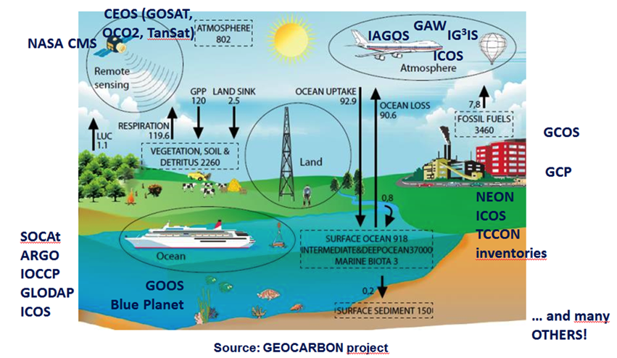
Paris Agreement national reporting supported by GEO’s Carbon and GHG Initiative

Slide 12
Responding to the Paris Agreement
Article 4 and Article 13 – National Reporting
Reported five-yearly by parties, successive reductions in emissions
Using existing methods and guidance; not validation
Article 5 Mitigation
Knowledge of evolution of sinks and sources
Article 7 Adaptation
(7.6) Strengthening cooperation,
(7.7c) Research, systematic observation
Article 10 Technology Transfer
& Article 11 Capacity Development
Article 14 Global stocktaking
in the light of equity and the best available science: 2023, 2028…
Article 15 Compliance
Policy needs reliable GHG-related information

Slide 13
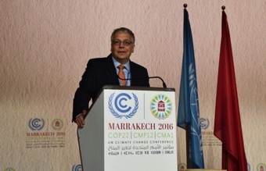
Informing policy agendas
Presented to Parties at UNFCCC SBSTA-44, Bonn (19 May 2016)
Presentation at UNFCCC COP-22 Earth Info Day (10 Nov 2016)
Werner Kutsch, Director ICOS, presenting the GEO Carbon and GHG Initiative
Upcoming Events:
Presentation UNFCCC SBSTA-46, Bonn (10 May 2017)
Organisation of a Side-Event at COP-23, Bonn

Slide 14
COP-23 Side Event
UNFCCC IPC (Sep 2016) endorsed GEO to have independent eligibility to apply for side events and exhibits at future UNFCCC sessions
ExCom Action 39.9: Secretariat to work with key partners (e.g. UNFCCC, IPCC, CEOS, GCOS, ICOS, etc.) to design a Side-Event at COP-23
Content to be defined with partners → Task Force
Possible topics include:
Carbon and GHG observations to support the implementation of the Paris Agreement
Help for countries in their national reporting
Role of (satellite) observations in the Refinement of the IPCC Guidelines

Slide 15
The Sendai Framework
GEO’s Data Access for Risk Management (GEO DARMA) is building a synergy Framework for the Integration of Earth Observation Technologies into Disaster Risk Reduction.

Slide 16
UN Convention on Biological Diversity
The UN Convention on Biological Diversity (CBD) Aichi Targets can be measured by countries with support from the GEO Biodiversity Observation Network (GEO BON) Initiative for biodiversity observations.

Slide 17
Societal Benefit Areas

Slide 18
GEO Flagships
GEO Biodiversity Observation Network (GEO BON)
GEO Global Agriculture Monitoring (GEOGLAM)
The Global Forest Observations Initiative (GFOI)
Global Observation System for Mercury (GOS4M)
GOS4M

Slide 19
GEO Regional Initiatives
AfriGEOSS
AmeriGEOSS
Asia Oceania GEOSS
(AO-GEOSS)

Slide 20
GEO Initiatives
Data Access for Risk Management (GEO-DARMA)
The GEO Carbon and GHG Initiative (GEO-C)
GEO Cold Regions Initiative (GEO CRI)
The Global Ecosystem Initiative (GEO ECO)
Global Network for Observations and information on Mountain Environments (GEO-GNOME)
GEO Global Water Sustainability (GEOGLOWS)
Geohazard Supersites and Natural Laboratories (GSNL)
GEO Human Planet Initiative (GEO HPI)
GEO Vision for renewable ENERgies (GEO-VENER)
GEO-Wetlands

Slide 21
GEO Initiatives cont.
GEOSS-EVOLVE
Global Drought Information System (GDIS)
GEO Global Urban Observation and Information
Global Wildfire Information System (GWIS)
Oceans and Society – Blue Planet
Earth observations in Service of the 2030 Agenda for Sustainable Development

Slide 22
GEO Foundational Tasks
GEOSS Development and GCI Operations
Advancing GEOSS Data Sharing Principles
GEOSS Common Infrastructure (GCI) Operations
GEOSS In Situ Earth Observation Resources
GEOSS Satellite Earth Observation Resources
GEONETCast Development and Operations
User Needs and Gaps Analysis
Community Development
Capacity Building coordination
Secretariat Operations
Management and Support
Communication and Engagement
Monitoring and Evaluation

Slide 23
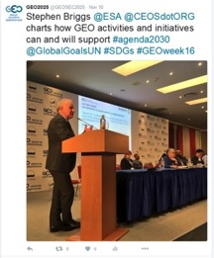
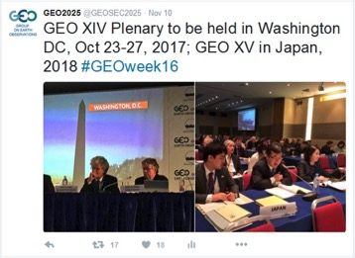
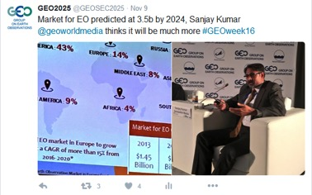
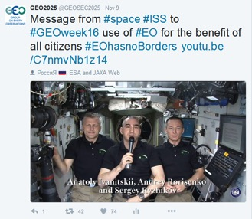
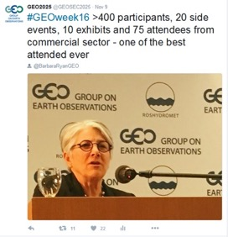
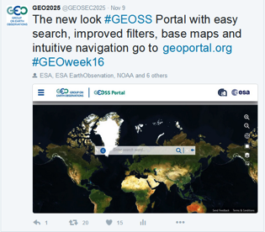
GEO XIII Plenary: Commercial Sector Panel, SDG support and a new look GEOSS Portal

Slide 24
Visualize, download data from GEOSS Portal

Slide 25
GEOSS Common Infrastructure (GCI)

Slide 26
GEOSS Common Infrastructure (GCI)

Slide 27
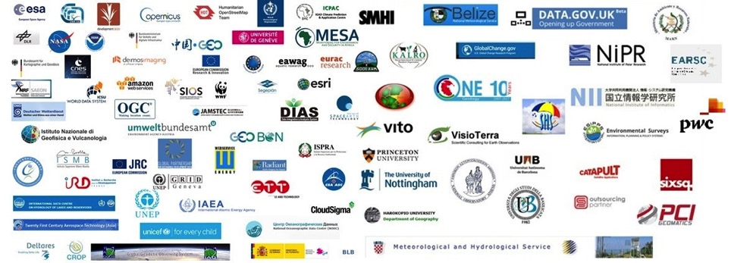
GEO Data Providers Workshop April 20-21, Florence
93 organizations participated
Hosted by CNR, ESA and GEO Secretariat
Sponsored by Amazon webservices and development seed

Slide 28
New stations
deployed throughout
the system
(around 20 per month)
Shared user management
between EUMETCast
& CMACast
for users of exchanged data
Broadcast bandwidth increased in Europe (DVB-S2 service) to accommodate new satellites & products

Slide 29
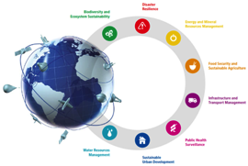
Challenges
Data access
Broad, open data policies are needed for global monitoring and transparency
Interoperability
Data discoverability and access through federated systems
Downstream services
Applications and information are needed to make data useful for decision-makers

Slide 30
GEO promotes broad open data policies using strong economic arguments

Slide 31
Thank you !

Slide 32
Back ups

Slide 33
GEO BON – monitoring biodiversity change in support of policy

Slide 34
GEO GLAM – leveraging Earth observations for a food-secure world
Crop monitor for Early Warning
Crop monitor for AMIS

Slide 35
GFOI: measuring and monitoring forest and terrestrial carbon
Through the work of its partners, GFOI supports REDD+ countries to develop their national forest monitoring systems and associated emissions measurement, reporting and verification (MRV) procedures.
Reducing
Emissions from
Deforestation and forest
Degradation
+ Conservation and Sustainable Development

Slide 36
GOS4M: Global Earth Observation System for Mercury – in support of policy and science
Aims to increase the availability and quality of EO data and information to contribute to the understanding of the cycling of mercury released to the global environment, harmonize metadata production and develop advanced services in support of the Minamata Convention

Slide 37
GEOSS main users 2016

