Slide 1
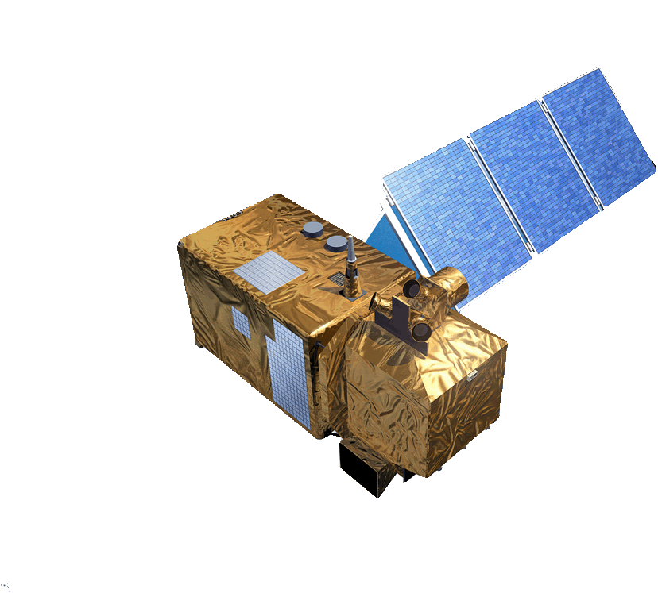


Earth Observation for Sustainable Development
In partnership with International Financing Institutions
Stephen Coulson
Directorate of Earth Observation Programmes, ESA/ESRIN, April 2017

Slide 2
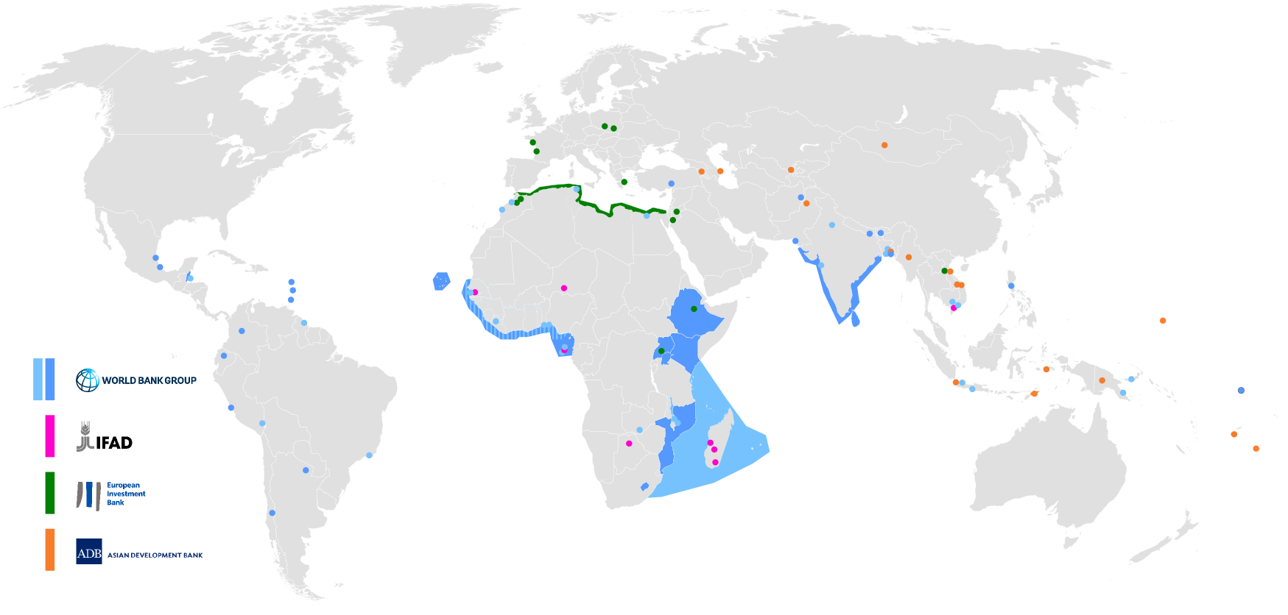
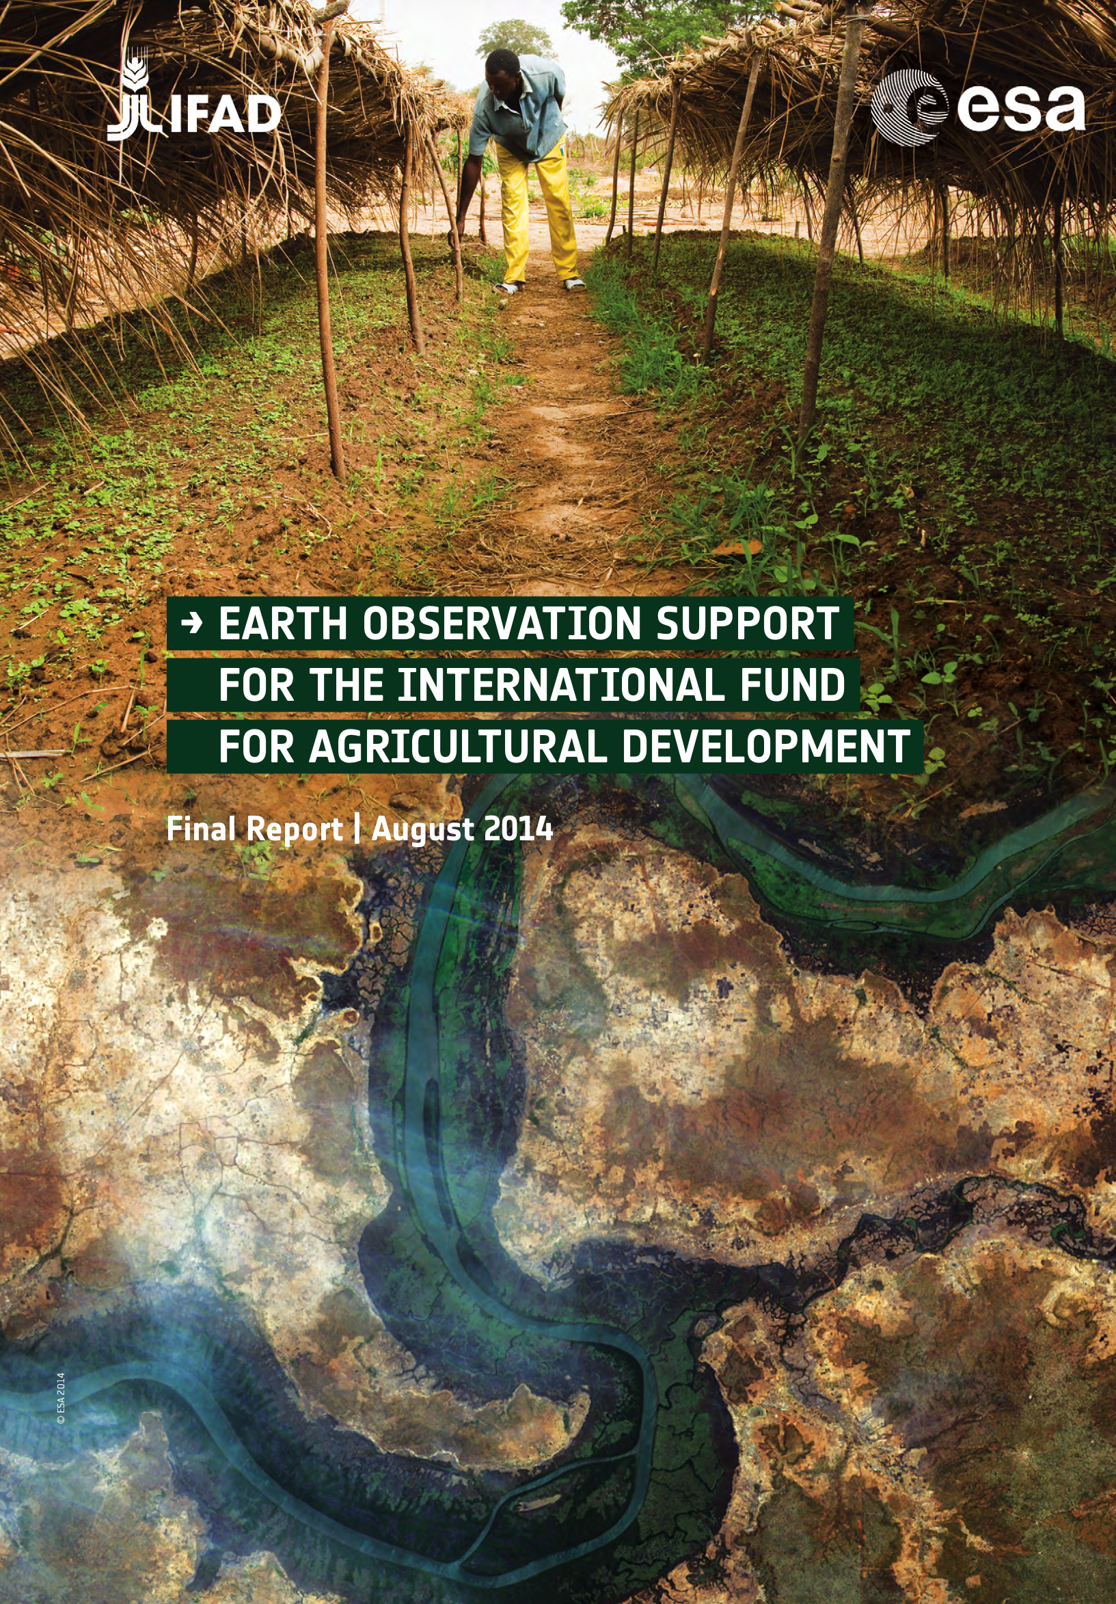

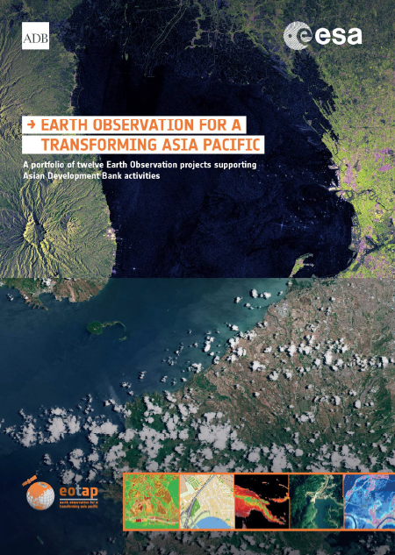
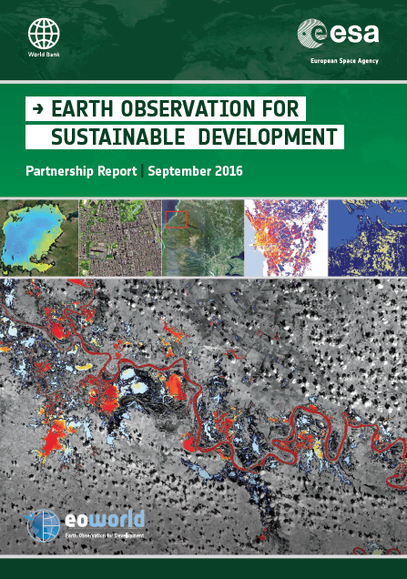
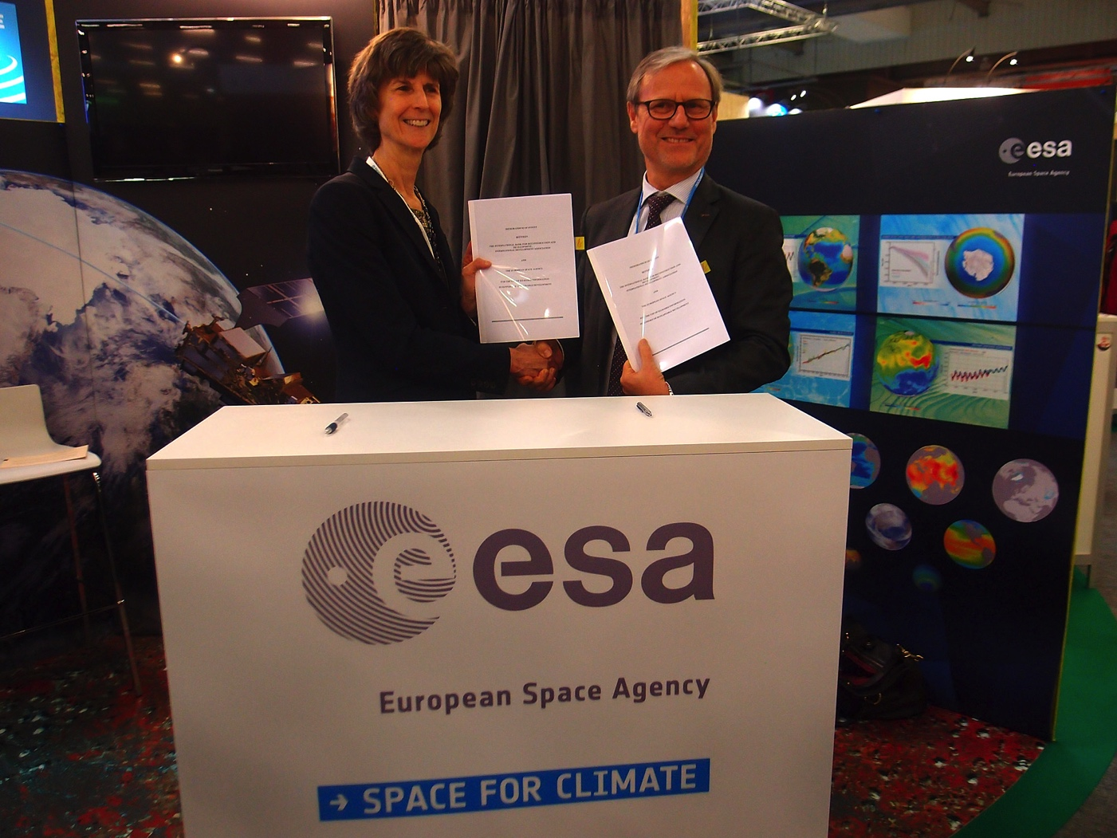
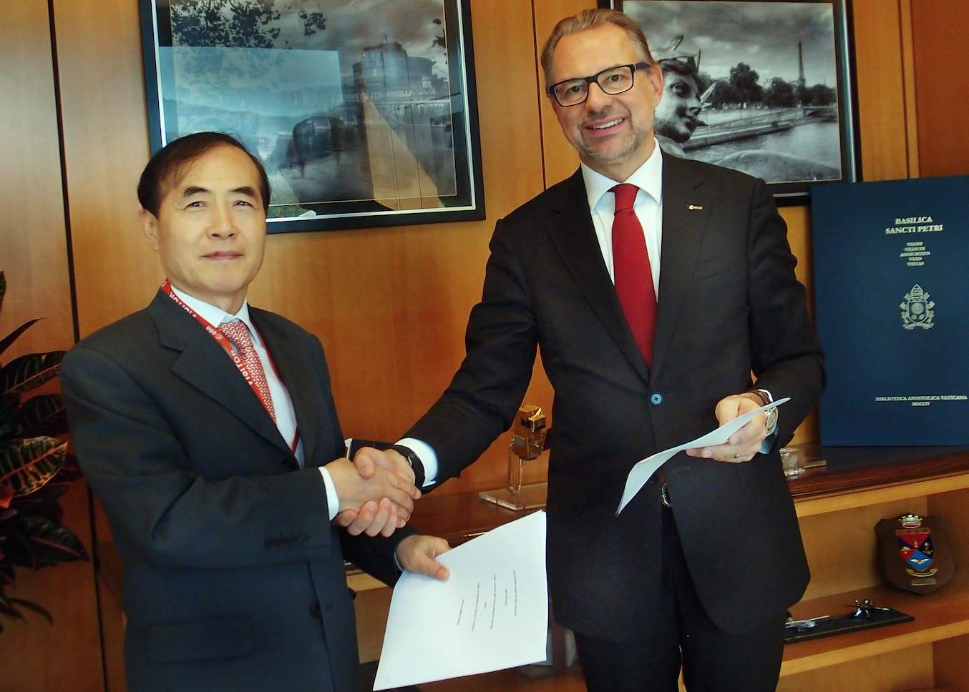
Initial Phase : Raised interest of IFIs in EO
During period 2010 -2015
        65+ small-scale demonstrations of EO-derived environmental information in the implementation of Official Development Assistance (ODA) projects; MoUs signed.
Asian Development Bank, Nov 2016
World Bank, Dec 2015

Slide 3
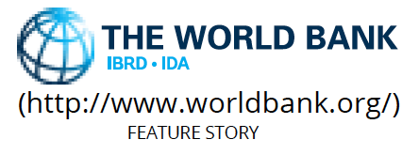
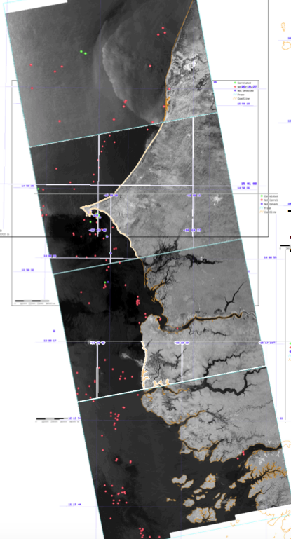
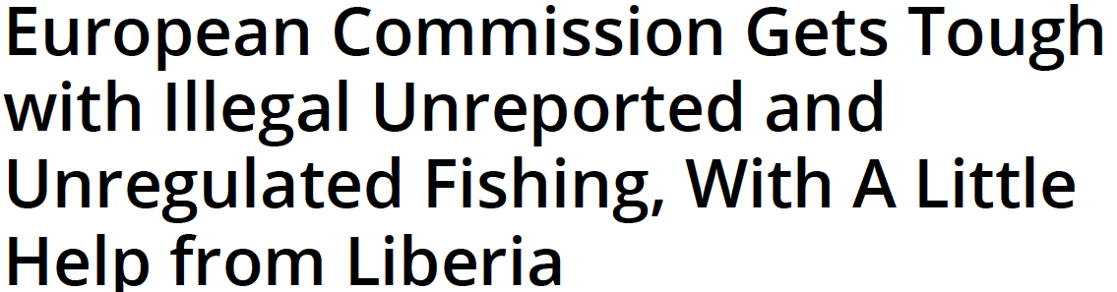

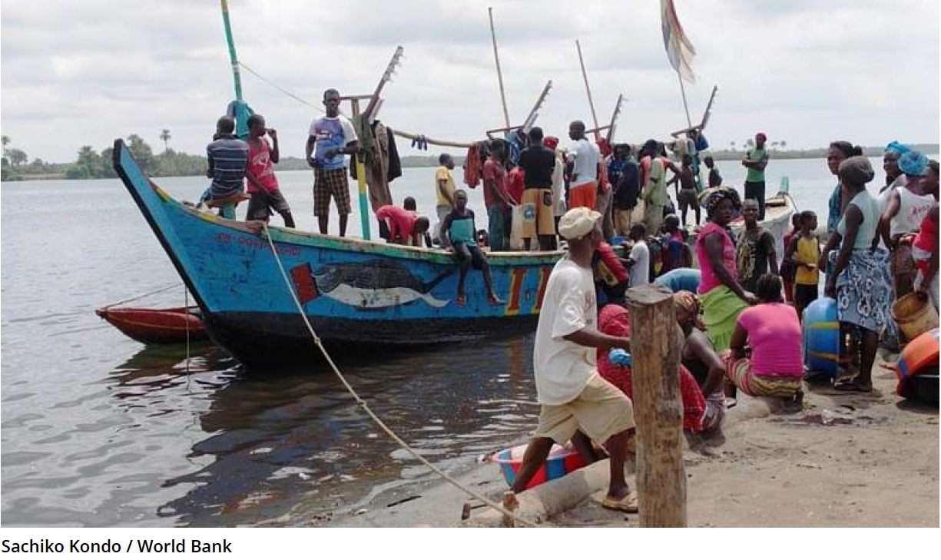
Example : World Bank project : Illegal fishing
First use of Sentinel 1 data for fisheries protection in developing countries (West Africa).

Slide 4





International Financing Institutions (IFIs):
How could they use EO ?
Information Drivers
Information Uses
Green Growth
  Environmental impact / sustainability of economic development investments
Climate Resilience / Proofing
  Long-term durability of development investments
Natural Capital Valuation
  Economic valuation of Ecosystems for National and Global accounting (GDP)
Open Development
  Increasing drive towards transparency in knowledge resources
In support directly to Programs / Projects
  concept definition, planning, implementation
  close-out and remission
  as part of capacity-building in developing countries
In support of Monitoring & Evaluation (M&E) methodologies
  as best-practice to harmonize M&E tools:
    Feasibility
    Environmental Impact Assessments
    Audits
    SDG Indicators / Reporting
In support of policy & planning
  sectorial analyses,
  country development planning

Slide 5
Growing use of IFI financial resources for procurement of EO-based information
Initial set of ESA-financed projects (total cost of 2.7 M€) have generated directly EO procurements by mainly GEF, World Bank & IFAD for additional activities:
  7 M $US (approved & allocated)
  (forest management, urban extent, land degradation, smallholder agriculture)
  10-14 M $US (in planning)
  (Great Green Wall Sahel & W. Africa, sustainable cities, food security, climate resilience, landscape assessment W. Africa)
In addition, frequent examples recent (2015) of use of EO in in 17-20 IFI projects, occurring independently of ESA demonstration activities.
Longer-term ‘What-If ?’ scenario for systematic use of EO in of ALL IFI projects leads to ROM figures for annual procurement of EO-based information as (2014 projects pipeline WB, ADB, IADB, AfDB):
  40-50 M€/yr for projects preparation (0.1%)
  140-280 M€/yr for projects implementation (1-2%)
Spin-off commercial procurement from clients in the developing countries (both government and private sector), as a result of the business networking, presence and contacts made (EO Asian Market only):
  450 M$ (2012), -> 1,500 M$ 2022
  European share was 45 M€ (2012)
  Realistic to grow to 100 M€ ?

Slide 6
Geographic distribution of ‘What If ?’ scenario (i.e. EO in ALL IFI projects; WB, ADB, IADB, AfDB)

Slide 7
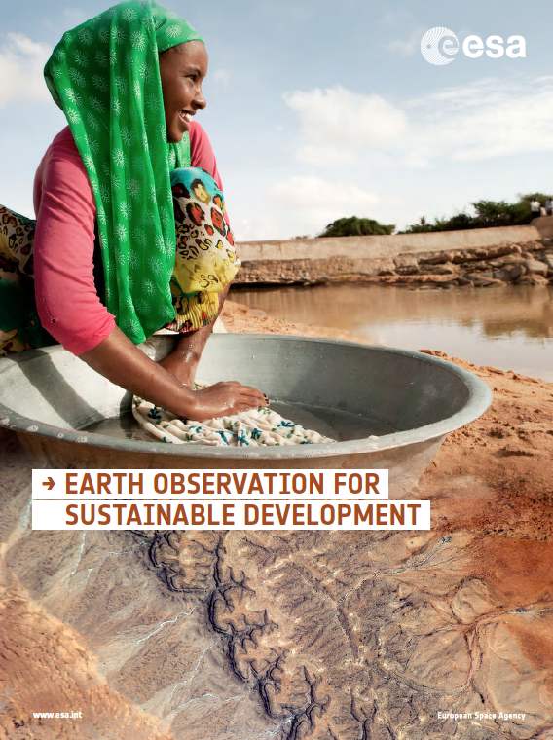



Longer-Term Vision : Transfer EO into ODA (next ~ 8 years)
Phase 1 (25 M€, 3 years, in EOEP-5) : Consolidate Requirements, Engage Stakeholders (IFIs & Client States) via regional demonstrations of EO for 10 specific thematic areas
Phase 2 (65 M€, 5 years, EW element, C-MIN19) : Mainstream & Transfer EO into operational working processes & financing of ODA as ‘best-practice’ source of environmental information in Environmental Safeguards Systems (ESS) and Monitoring & Evaluation methodologies, SDGs of highly relevant.

Slide 8
Phase 1 : Consolidation of Requirements
Implementation : Activities
Phased approach; Set-up phase (1st year) followed by Large-scale regional demonstrations (next 2 years),
Phase A : Strategic Planning & Stakeholder Engagement
  Engage IFI’s and key stakeholders in IFI client states,
  Define mechanisms for sustainable transfer of EO and define common actions to address issues across the project life-cycle,
  Elaborate and prepare the EO demonstrations required (European data access, service specifications, support tools, capacity-building).
Phase B : Service Demonstration & Transfer Preparation
  Develop EO service clusters, and execute/scale-up EO service demonstrations,
  Connect to existing international networks and development support initiatives,
  Implement cooperative training and capacity building, both within IFI (for project preparation) and IFI Client countries (project implementation); priorities : SE Asia, LAC, Africa,
  Prepare the sustainable transfer of EO services into routine working practices of large scale ODA programmes and projects.

Slide 9
EOEP-5 Block 4: EO for Sustainable Development
10 Large-Scale Activities in remaining high-priority thematic domains to consolidate Requirements & Engage Stakeholders (IFIs & Client States) via regional demonstrations of EO, (each contract 2 M€, 3 years)
2016 (started) : Agriculture, Urban, Water Resources
2017 (ITT June) : Marine Resources & Coastal Environment, Disaster Risk Mitigation & Reduction, Fragile & Conflict States, Climate Resilience & Proofing.
2018 (ITT June) : Energy & Extractives, Forest Management, Ecosystems Services,
EO for SDGs for in-depth review of the SDG Global Indicator Framework, assess potential use of EO in SDG targets, showcase EO for a few of SDG Indicators country-level demonstration in partnership with the National Statistical Office (1 contract, 400 K€, Q2)
EO ‘Walk-in Clinic’ for rapid-response, small-scale exploratory uses of EO information in Bank projects/activities (1 contract 2 M€, 3 years, ITT 2017), pre-qualified EO information suppliers, 2-3 competing consortia for EO service provision (40 K€ Euro max units).
EO for Environmental Safeguards policies, Monitoring & Evaluation Methodologies, Environmental Impact Assessments (1 contract, 500 K€, 1.5 years, ITT Q1 2018).

Slide 10
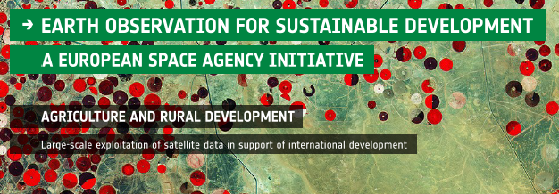
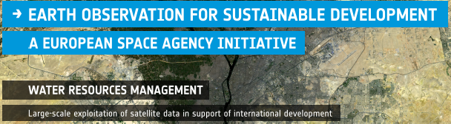

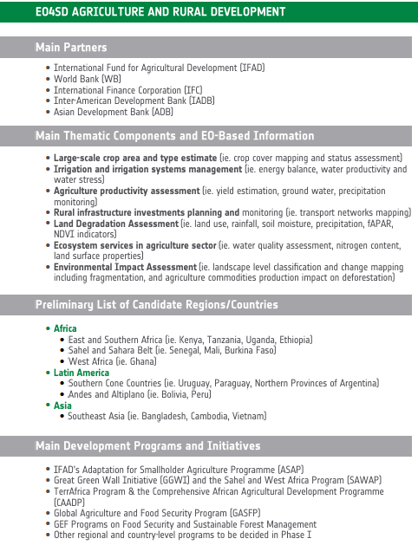
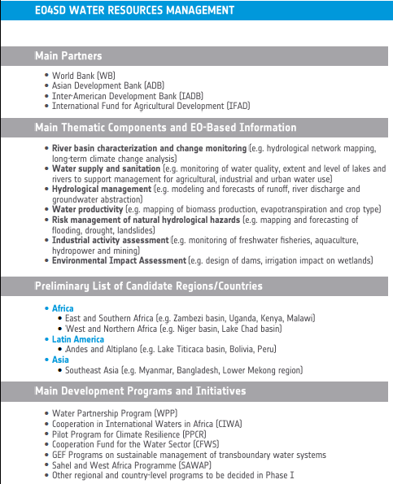
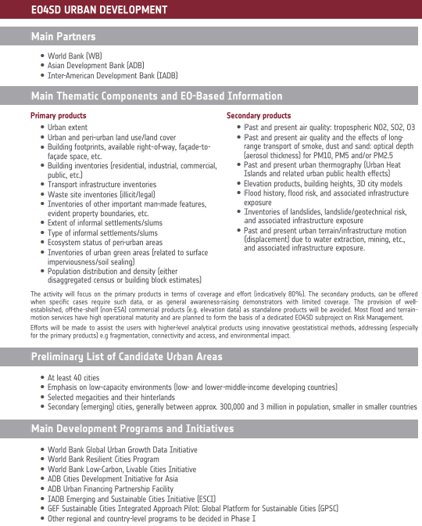
Agriculture, Urban, Water
Partners / Products / Programmes

Slide 11
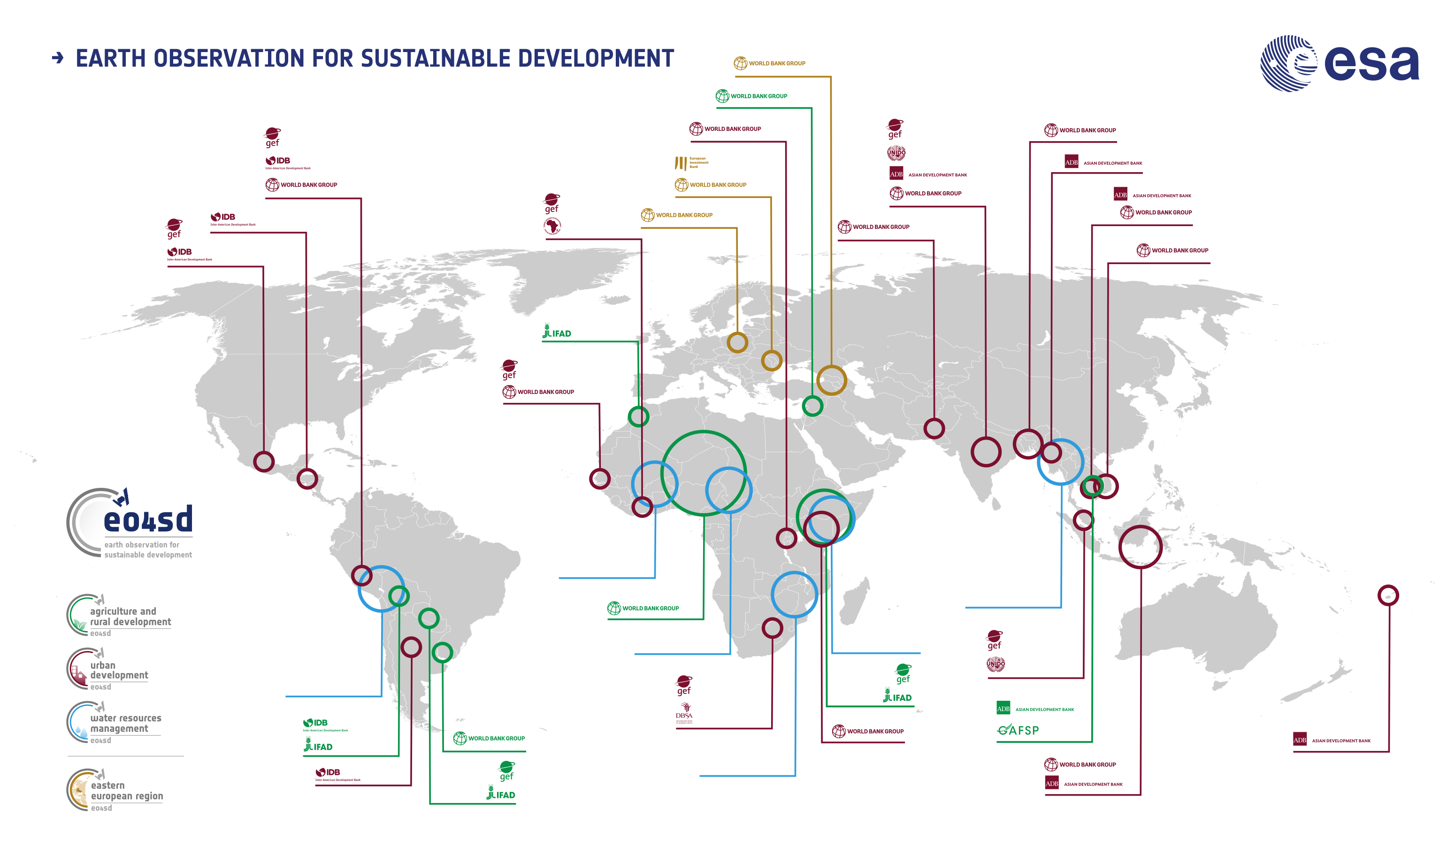
Agriculture, Urban, Water
Regions / Countries
Notes:
Budget is between 3.5 and 4.5 billion Euro each year.
We work with programmes. We're not an administration, we're an agency. Every three years every member state sends a minister to decide which program each country will put money into.

Slide 12

Take-Home Messages……..
Official Development Assistance (ODA) is a sector of huge (and long-term) economic activity with increasing attention on environmental sustainability (green growth) and climate change (resilience, proofing) of the (mainly large infrastructure) investment projects to promote ecnonmic growth in developing countries,
Earth Observation can deliver key environmental information that supports the definition, planning, implementation, monitoring and assessment of many (not all) major projects and programmes.
Europe has world-leading capabilities in Earth Observation (both ESA and national EO missions) and a highly skilled and experienced EO information services industry. WB and ADB recently signed long-term, strategic cooperation agreements with ESA.
-> Significant opportunity to take EO to a new, highly relevant user community; CEOS and GEO can be key.
Notes:
Budget is between 3.5 and 4.5 billion Euro each year.
We work with programmes. We're not an administration, we're an agency. Every three years every member state sends a minister to decide which program each country will put money into.

Slide 13
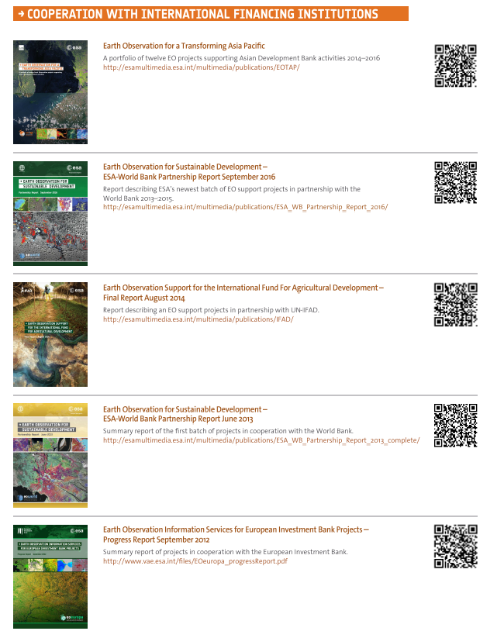
        Thank You !
        and ….
        For further information.

