Slide 1
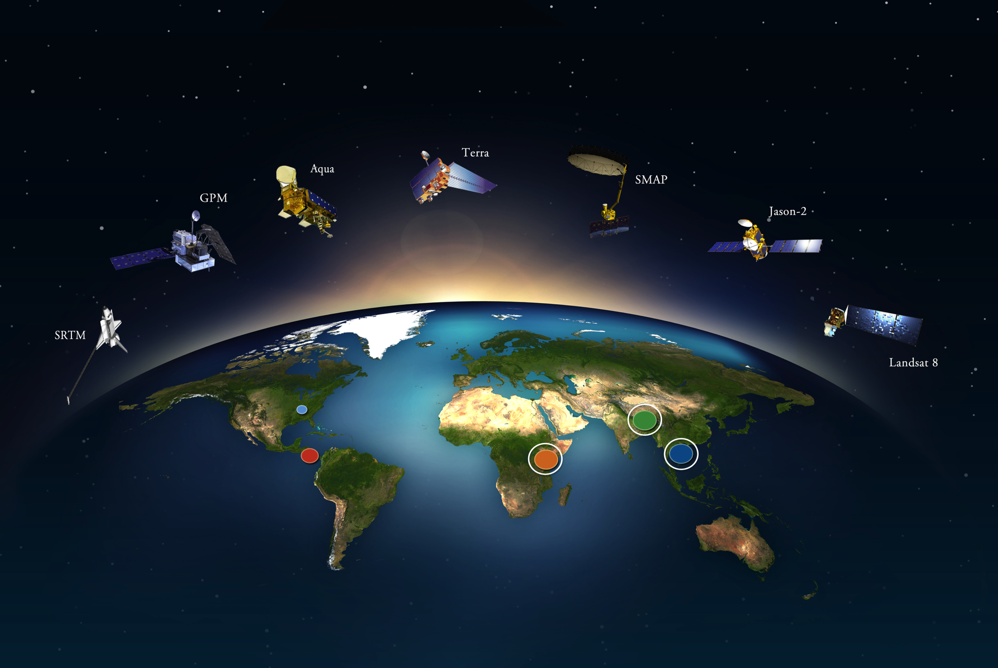
SERVIR is a joint development initiative of NASA and USAID, in partnership with leading
regional organizations around the globe, to help developing countries use information provided by
Earth observing satellites and geospatial technologies to address
Food Security, Water and Disasters, Weather and Climate, and Land Use/Land Cover Change.
.

Slide 2
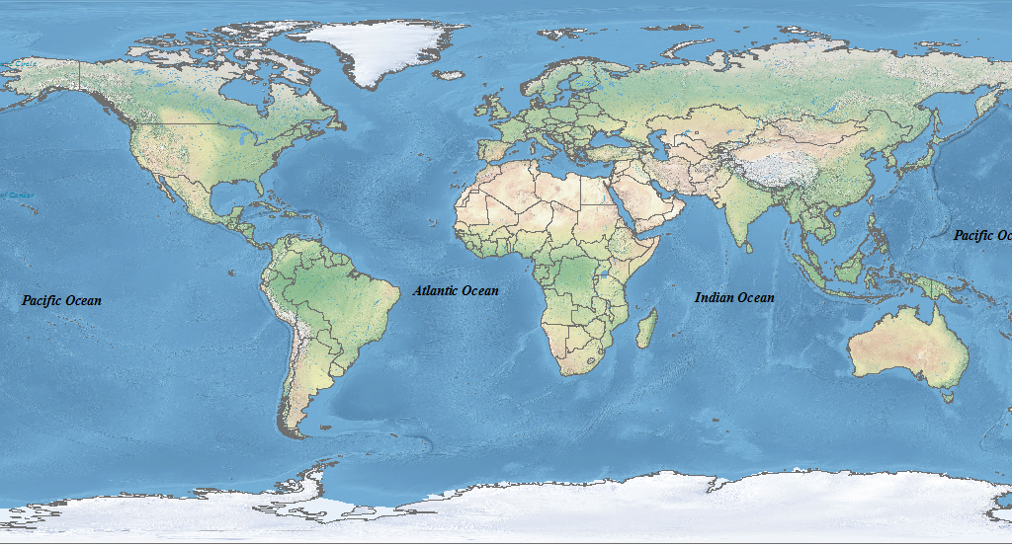
The SERVIR Hub Network
SERVIR Global
SERVIR Central Asia (2018)
SERVIR Hindu Kush Himalaya
SERVIR
Mekong
SERVIR West Africa
SERVIR Amazonia (2017)
SERVIR Eastern & Southern Africa

Slide 3
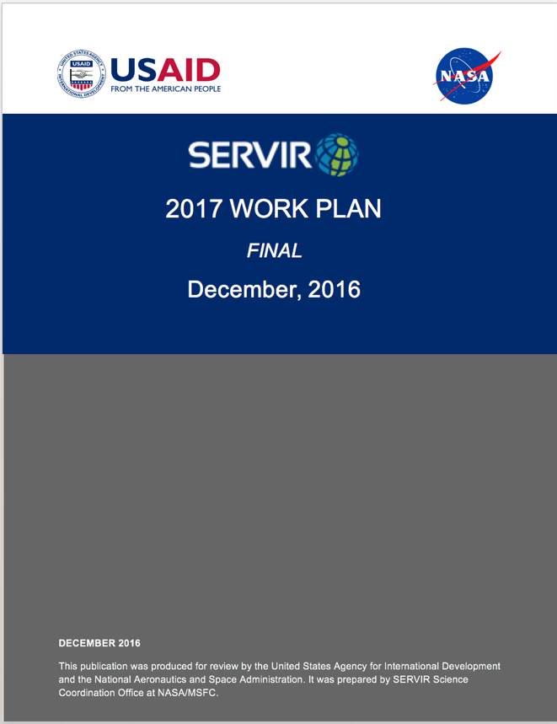
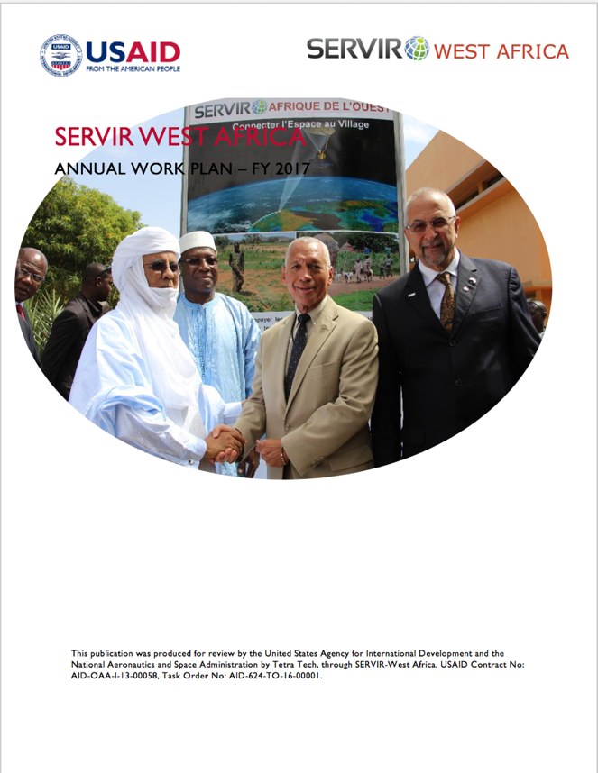
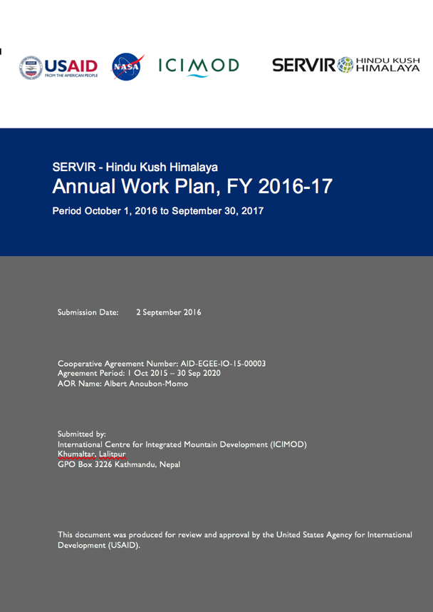
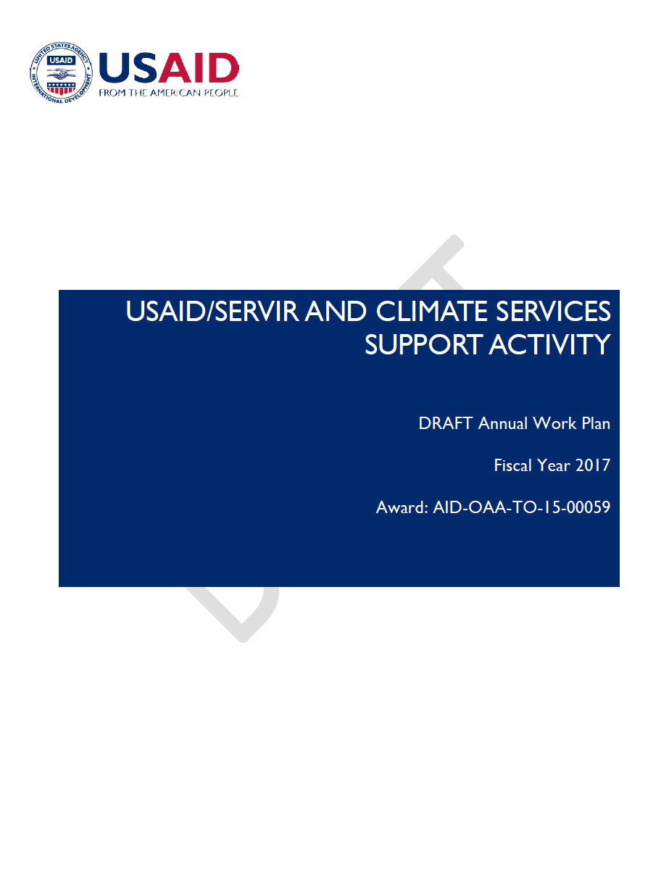
Harmonized Work Plans

Slide 4
SERVIR Theory of Change
Goal: Improved economic, social, and environmental resilience for developing countries
Objective: Increased use of Earth observation information and geospatial technologies in development decision-making
IR2. Improved capacity of analysts and decision-makers to use Earth observation information and geospatial information technologies
IR3. Improved awareness of and access to geospatial data, products, and tools
IR4. Increased provision of user-tailored geospatial data, products, and tools to inform decision-making
IR1. Improved capacity of hubs to function as regional service providers

Slide 5
A Complex, Yet Synergistic Structure of Many Partners
USAID Missions
West Africa Regional
East Africa Regional
Nepal Bilateral
Asia Regional
West Africa
Eastern & Southern Africa
Hindu Kush Himalaya
Mekong
SERVIR Hubs
UMD-CP
Columbia U
SDSU
U of OK
U of Houston
BYU
UCSB
JHU
GSFC, JPL, MSFC
USFS
USGS
Support Team
Applied Sciences Team
Joint SERVIR Program Committee
Washington
E3 Climate Change Program
SERVIR SCO
Capacity Building Program
Private Sector Partners
DigitalGlobe
Esri
Google
Reduce poverty, build resilience
Working on data-dependent issues in data-scarce places
International field offices and partners in 70+ countries
Provide societal benefit from space
Extensive research and applied sciences portfolio
Constellation of Earth observing satellites, all data free and open

Slide 6
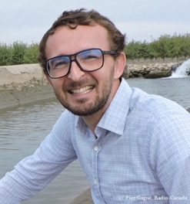
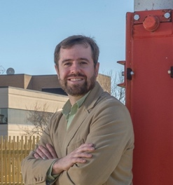
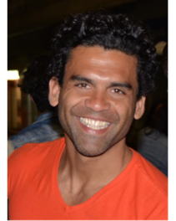
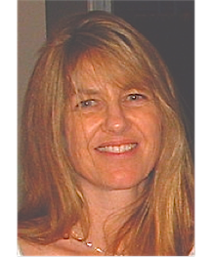
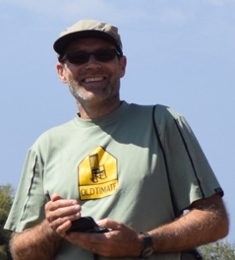
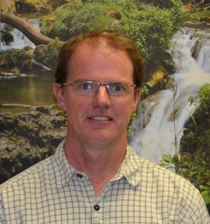
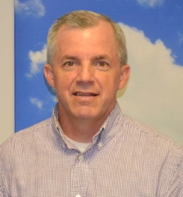
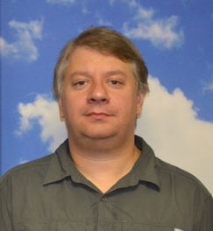
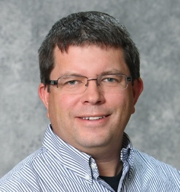
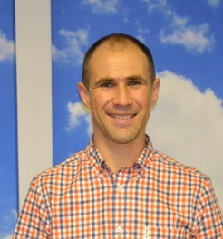
SERVIR Applied Sciences Team (ROSES 2015)
Inbal Becker-Reshef
University of Maryland,
College Park
John Bolten
NASA Goddard Space Flight Center
Cédric David
NASA Jet Propulsion Laboratory
Patrick Gatlin
NASA Marshall Space Flight Center
Augusto Getirana
NASA Goddard Space Flight Center
Alessandra Giannini
IRI, Columbia University
Stephanie Granger
NASA Jet Propulsion Laboratory
Niall Hanan
New Mexico State University
ROSES 15 A.44 SERVIR Applied Sciences Team announced 30 June 2016
16 new projects - co-led by US scientists and hub scientists
Innovative selection process to ensure hub involvement in projects and that pressing regional are met
The projects include:
Water Resources: Advances the flood forecast capabilities of water departments in SERVIR regions
Agriculture and Food Security: Enhances capabilities of drought monitoring and agricultural forecasts for agriculture ministries in SERVIR regions
Land Use and Land Use Change: Builds capacity of hubs and ministries to quantify carbon stock changes
Weather and Climate: Enables inclusion of latest seasonal and longer term forecasts in regional decision making
Sean Healey
US Forest Service, Rocky Mountain Research Station
Yang Hong
University of Oklahoma, Norman
Hyongki Lee
University of Houston
Jim Nelson
Brigham Young University
Peter Potapov
University of Maryland,
College Park
Shrad Shukla
University of California,
Santa Barbara
Michael Wimberly
GISc Center of Excellence,
South Dakota State University
Ben Zaitchik
Johns Hopkins University

