Slide 1
30th CEOS Plenary
Committee on Earth Observation Satellites
CSIRO, CEOS Chair
SIT-31 Agenda Item #15c
CEOS Strategic Implementation Team
ESA/ESRIN, Frascati, Italy
20th April 2016

Slide 2
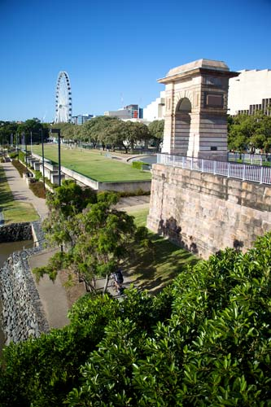
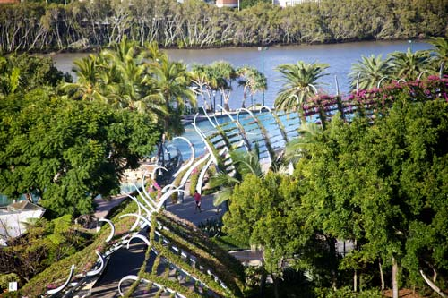
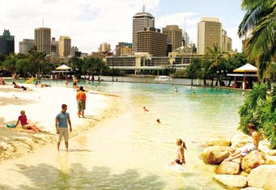
30th CEOS Plenary
1st to the 2nd of November 2016 at the Brisbane Convention & Exhibition Centre (BCEC) in Brisbane, Australia
Side meetings will be held on the 30th (if necessary) and 31st of October
Appreciate applications for agenda time to be made well in advance

Slide 3
30th CEOS Plenary
All participants are encouraged to begin making visa and travel arrangements
Block hotel bookings:
Rydges Southbank
Book CEOS rate via: http://www.rydges.com/customised-web-page/ceos/
Mantra Southbank
Book CEOS rate via: http://bookings.ihotelier.com/bookings.jsp?groupID=1611537&hotelID=11365
More information and booking links:
http://ceos.org/meetings/30th-ceos-plenary/

Slide 4
CEOS ‘Townhall’ Event & Panel Discussion
3rd of November
In collaboration with Geoscience Australia and University of Queensland
Please consider your participation when making travel arrangements
Details will be announced and made available on the CEOS Plenary website in due course

Slide 5
30th CEOS Plenary
More information: http://ceos.org/meetings/30th-ceos-plenary/
Any questions? Please contact: caroline.bruce@csiro.au
We look forward to seeing you in Brisbane!

