Slide 1
Developing G7 ocean initiative
Committee on Earth Observation Satellites
Albert Fischer, GOOS, IOC/UNESCO
SIT-31 Agenda Item #15 (AOB)
CEOS Strategic Implementation Team
ESA/ESRIN, Frascati, Italy
19th-20th April 2016

Slide 2
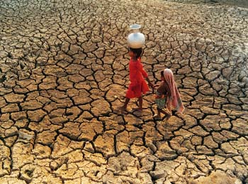
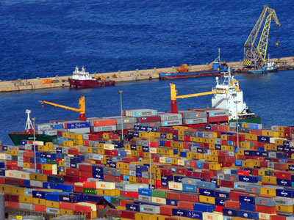
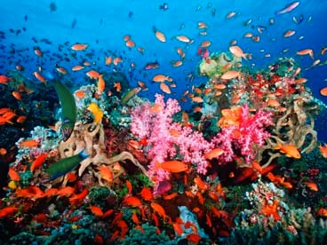
GOOS themes Climate, services, ocean health
Notes:
Information from the ocean, and therefore sustained observations of the ocean, are needed to inform decision-making in a number of different areas of key importance to human well-being.
A changing climate is in fact a changing ocean, as 90% of the energy accumulated in the climate system since 1971 is in the ocean, and 30% of human-emitted carbon has ended up on the ocean, causing ocean acidification. Accurately projecting the future path of climate change and monitoring whether our mitigation efforts are avoiding dangerous change requires sustained and extended deep ocean observations, as does the provision of climate information on shorter time scales, such as the El Niño forecasts so important for agriculture, water management, and disaster risk reduction.
On shorter time scales, sustained ocean observations underpin early warning for ocean-related hazards at the coast, improved medium-term weather forecasts, and forecasts that can improve the safety and efficiency of the maritime economy.
We are developing models of how human impact on the oceans may be having adverse impacts on ocean ecosystems, and the basic ecosystem services of coastal protection, food security, and tourism that enable coastal livelihoods and the blue economy. Our understanding here is still evolving through research, and makes leaps when we have sustained ocean observations to validate our theories.
GOOS therefore contributes to each of the four high level objectives of the IOC’s Member States: Healthy ocean ecosystems, Early warning for ocean hazards, Resiliency to climate change and variability; and Enhanced knowledge of emerging issues.

Slide 3
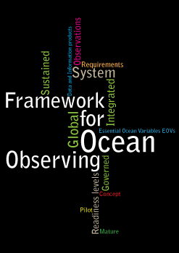
Framework for Ocean Observing A simple system
Input
(Requirements)
Output
(Data &
Products)
Process
(Observations)
Notes:
GOOS at the global level as a program delivers strategic oversight, coordination, and evaluation of the sustained ocean observing system for these three themes: climate, services, and ocean health. The program is helping to coordinate a wide range of efforts by national and regional research and operational agencies, entraining a wide range of voluntary effort.
Since the publication by IOC in 2012 of the Framework for Ocean Observing, a growing community has been working using the same interoperable language of developing observing requirements for societal benefit, identifying Essential Ocean Variables or EOVs based on feasibility and impact, coordinating ocean observing networks through standards and the sharing and promotion of best practices, developing readiness to observe new EOVs in a globally sustained way, and developing coordinated and interoperable data management streams that feed different information generation mechanisms.
We first published this Framework for Ocean Observing in English; we have had it in Chinese thanks to the efforts of the State Oceanic Administration, and we now plan to translate it into other languages to maximize its uptake in the ocean observing community.

Slide 4
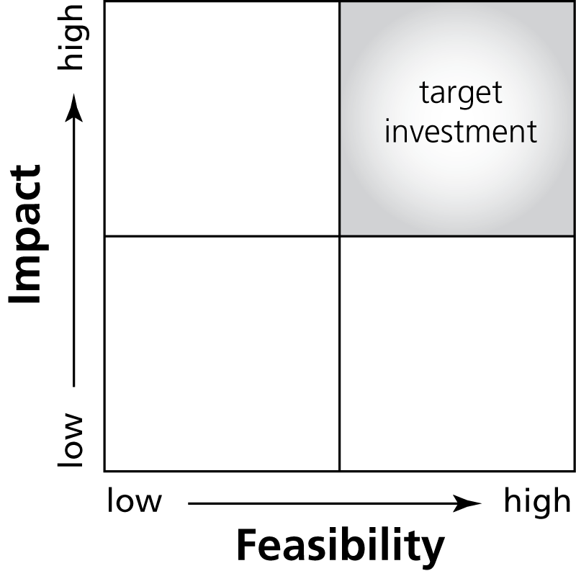
Driven by requirements, negotiated with feasibility Essential Ocean Variables
We cannot measure everything, nor do we need to
basis for including new elements of the system, for expressing requirements at a high level
Driven by requirements, negotiated with feasibility
Allows for innovation in the observing system over time
Notes:
A key idea in the Framework is the definition of Essential Ocean Variables, which some overlap with other types of essential variables that have been defined, such as Essential Climate Variables defined by GOOS and GCOS, Essential Variables defined by WMO for weather forecasting, and Essential Biodiversity Variables that are being defined by GEOBON (although largely focused on terrestrial variables).
The idea is that for the key societal and scientific drivers of sustained ocean observations, we cannot measure everything, nor do we need to. Essential Ocean Variables should respond to these high-level drivers, related to climate, to understanding and managing ecosystem services, to conserving biodiversity, to managing living marine resources, to safety and protection of life and property at sea and on the coasts.
Aligning the coordination processes of the observing system on variables, rather than by platforms or observing techniques, stays truer to the natural system which we are trying to observe, while allowing for innovation of observing techniques over time as technology and capability develop.
The definition of an EOV must be driven by these requirements, but be rooted in reality, its measurement must be feasible. We may not be ready to measure all EOVs, but this assessing and encouraging the development of readiness is also a part of the Framework.

Slide 5
EOVs and readiness level CONCEPT PILOT MATURE *also ECV
Physics
Sea State*
Ocean surface vector stress*
Sea Ice*
Sea level*
SST*
Subsurface temperature*
Surface currents*
Subsurface currents*
SSS*
Subsurface salinity*
[Heat flux/ radiation*]
Biogeochemistry
Oxygen*
Inorganic macro nutrients*
Carbonate system*
Transient tracers*
Suspended particulates
Nitrous oxide*
Carbon isotope (¹³C)
Dissolved organic carbon
Ocean colour*
Biology and Ecosystems
Phytoplankton* biomass and productivity
HAB incidence
Zooplankton diversity
Fish abundance and distribution
Apex predator abundance and distribution
Live coral cover
Seagrass cover
Mangrove cover
Macroalgal canopy cover
March 2016

Slide 6
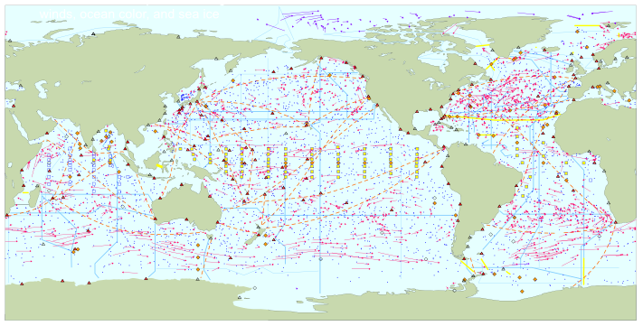
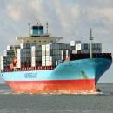
Total in situ networks
66%
Dec 2015
continuous satellite measurements of sea surface temperature, height, winds, ocean color, and sea ice
100%
Surface measurements from volunteer ships (VOS)
250 ships in VOSclim pilot project
100%
Global drifting surface buoy array
ice buoys
5° resolution array: 1250 floats
40%
Tide gauge network (GLOSS committed)
Fast data
300 real-time reporting gauges
Slow/no data
GPS
37%
XBT sub-surface temperature section network
37000 XBTs deployed
100%
Argo profiling float network
3° resolution array: 3200 floats
70%
Global time series network
71%
Global tropical moored buoy network
62%
Repeat hydrography and carbon inventory
(Planned)
87 combined sites
125 moorings planned
Full ocean survey in 10 years
Representative Milestones
100%
Original goal for full implementation by 2010
System % sustained, of initial goals
30
34
40
45
48
55
56
59
60
62
62
62
62
62
63
66%
2000
2001
2002
2003
2004
2005
2006
2007
2008
2009
2010
2011
2012
2013
2014
2015

Slide 7
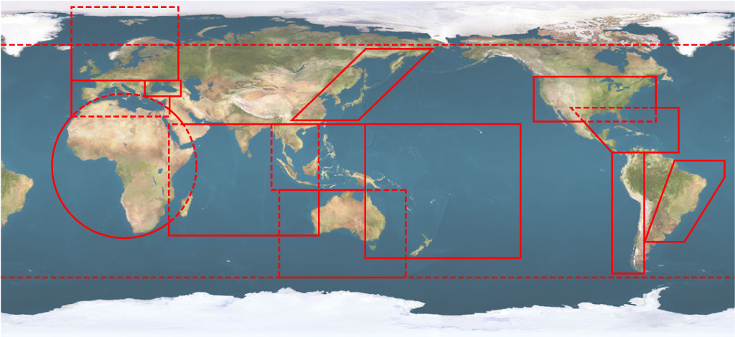
GOOS Regional Alliances and collaborating regional observing systems
SAON
EuroGOOS
Black
Sea
GOOS
NEAR-GOOS
US IOOS
MONGOOS
IOCARIBE-GOOS
GOOS-Africa
SEAGOOS
PI-GOOS
IOGOOS
GRASP
OCEATLAN
IMOS
SOOS
Notes:
At the regional level, the GOOS Regional Alliances in the past few years have been active in mapping their own priorities and capabilities, sharing experiences, and in the past year have embarked in an extensive review of their modeling needs and capacities.
The next GOOS Regional Forum will take place in September in Greece, alongside a forum for high-frequency coastal radar observing networks. We are working hard to make this a good opportunity to develop projects for bilateral and multilateral activity: in improving observations, in addressing organizational challenges, and building local capacity.
The regional development of GOOS is an area with a lot of activity, but scope for far more, and I particularly welcome your guidance and ideas on the projects that IOC Member States wish to contribute to in this area.

Slide 8
G7 oceans background
G7 in 2015 considered two issues under “Future of the Seas and Oceans”: research on marine litter and on environmental impacts of deep sea mining.
Also agreed that a step change in approach is required if we are to address the challenges our seas and oceans face. Committed to developing proposal for G7 May 2016 (Japan) to better predict, manage and mitigate future changes in the seas and oceans and their impacts on the environment and on human societies.
G7 Expert Working Group on “Future of the Oceans and Seas” held 8-9 March 2016, Southampton, UK

Slide 9
G7 oceans: ’big science’ with a purpose
Sound international framework to provide international access to the data and produce regular authoritative assessments of the state of the ocean, in order to:
Make sense and improve projections of global and regional-scale long-term change and variability
Sustaining the productive capacity of ocean ecosystems under increasing human pressure
Sustainable use of marine ecosystem services
Increasing resilience of human population and economic infrastructure to marine-related disasters

Slide 10
A more effective adaptive management loop for the ocean

Slide 11
A value chain

Slide 12
Potential recommendations
Will be confirmed only in May when G7 Science & Technology Ministers meet (15-17 May 2016, Tsukuba) and at the G7 Summit (26-27 May 2016, Ise-Shima)
Enhanced global sustained ocean observing system
Improved and resourced World Ocean Assessment
Promote data and information sharing, using GEOSS data infrastructure
Strengthen collaborative approaches to managing regional seas, including developing sustained observing capacity
Streamline legal access for marine scientific research in areas under national jurisdiction (starting with G7)
Engage commercial shipping industry in ocean observation
[Still under discussion!]

Slide 13
Potential CEOS role
Provides additional motivation and possibly momentum for GEO Blue Planet / development of flagship(s):
Along with SDGs, Sendai Framework for DRR, operational ocean services, UNFCCC, GEO Societal Benefit Areas
Sustained ocean observations (space and in situ, global regional and local) are a foundational component
Reminder that we would like CEOS leadership engaged in an interim Board for GEO Blue Planet, putting in place a permanent Board focused on strategy and a Technical Steering Committee dealing with implementation, as Blue Planet evolves along with GEO and in response to user needs.

