Slide 1
Copernicus Sentinel Data Uptake and Application
Committee on Earth Observation Satellites
USGS
SIT-31 Agenda Item #14
CEOS Strategic Implementation Team
ESA/ESRIN, Frascati, Italy
19th-20th April 2016

Slide 2
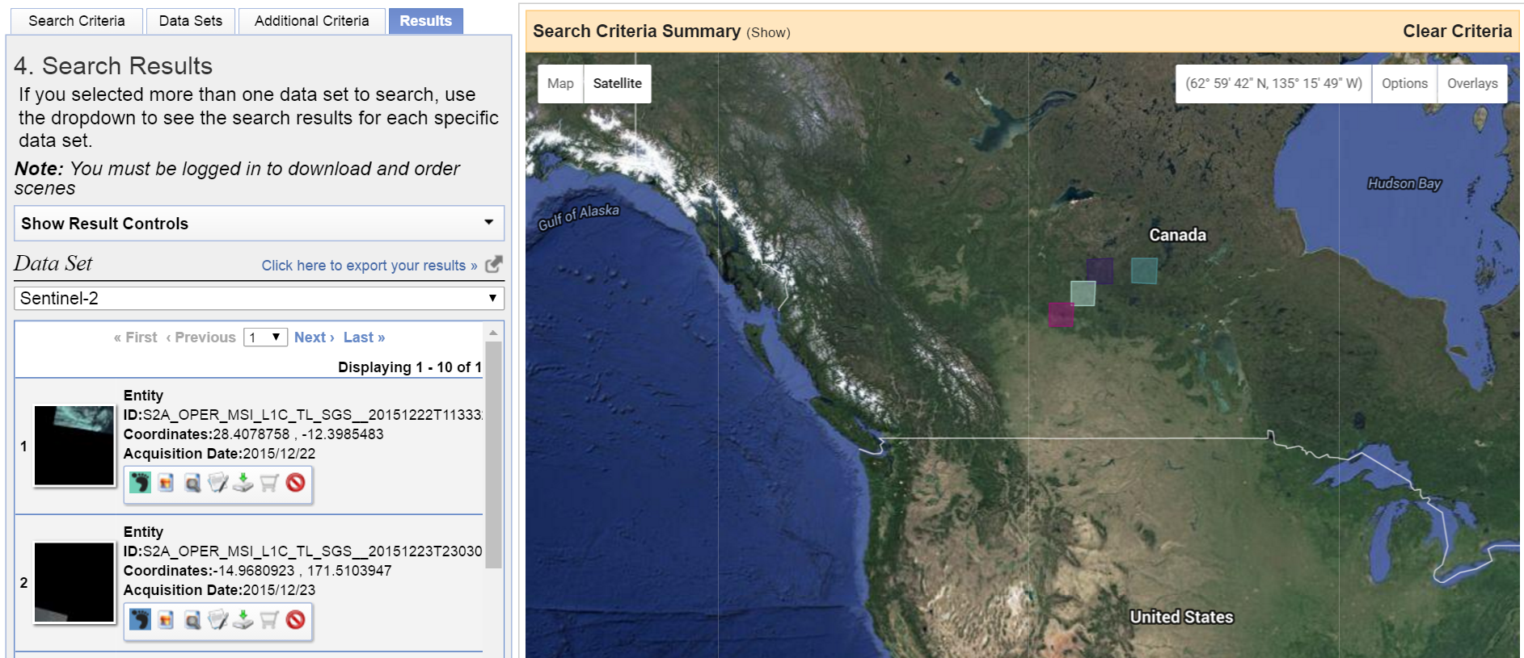
USGS Sentinel 2A Statistics
(as of 14 April 2016)
Product Bundles Hosted on ESA Scientific Hub 23,368
Product Bundles Downloaded by USGS 4,837
Looking forward to Sentinel 2A data availability on ESA International Hub (April 2016) and GÉANT network (May 2016)
Product Bundles Processed by USGS to Tiles/Browse 4,837
Tiles/Browse Available on USGS Earth Explorer 60,081
http://earthexplorer.usgs.gov/
L1C Tiles Distributed by USGS 2,834
Full Resolution Browse (FRB) Distributed by USGS 3,795
USGS ground control improvement phase added to make the Landsat control more consistent with the Sentinel-2 global reference image (GRI)
More information:
http://eros.usgs.gov/sentinel-2

Slide 3
USGS Sentinel 2A Coverage Map
(as of 14 April 2016)

