Slide 1

Outline of presentation
Copernicus Space Component
Overview, deployment plan and status
Copernicus Contributing Missions Data Access
Sentinels Data Access @ ESA
Sentinels Data Access @ Eumetsat
Copernicus Services Component
Overview, deployment plan and status
Access to Copernicus Services
Copernicus Programme and cross-cutting user uptake actions

Slide 2
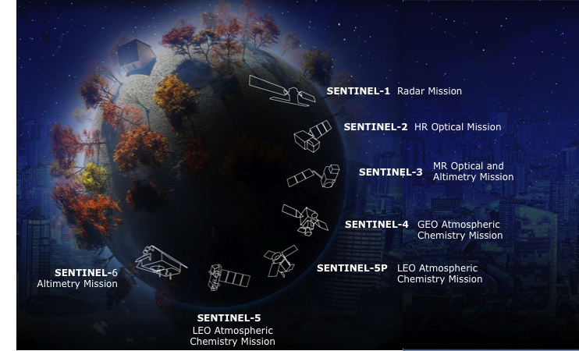

Sentinel missions

Slide 3

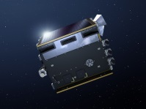
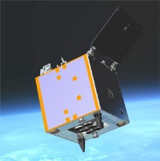
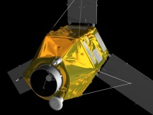
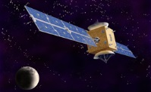
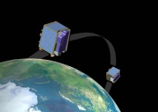
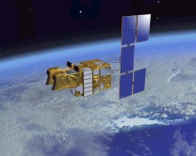
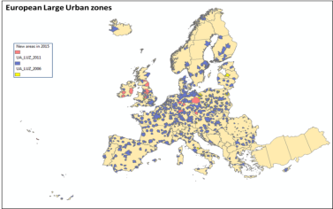
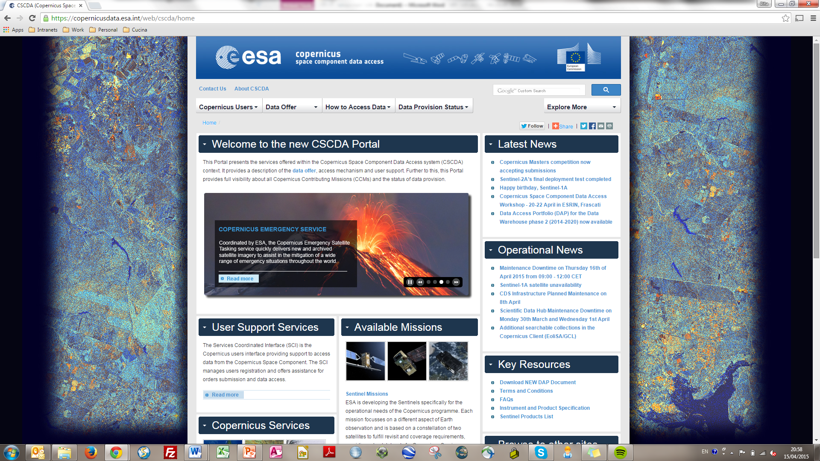
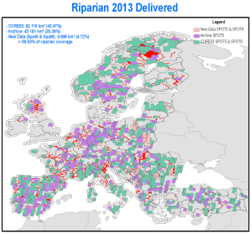
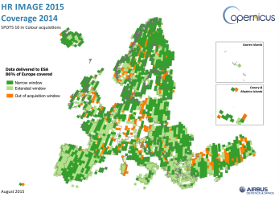
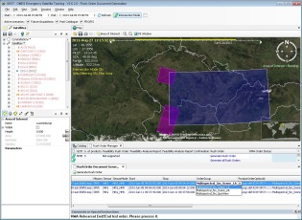
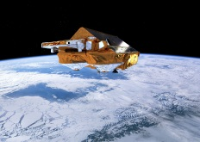
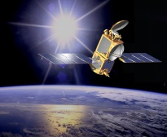
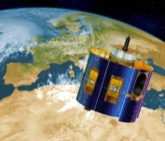
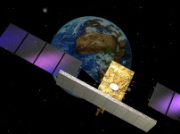
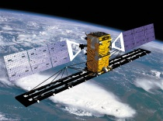

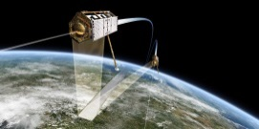
Access to Copernicus Contributing Missions
https://spacedata.copernicus.eu
Notes:
Available today or planned at European, national and international level
Developed for other purposes but making important data available for Copernicus
List not exhaustive (+ Seosar, SPOT-6/-7, TanDEM-X, EnMAP, Venμs, Altika, Deimos2, etc. )… will evolve based on service requirements and mission availabilities

Slide 4
Sentinels constellation deployment schedule

Slide 5
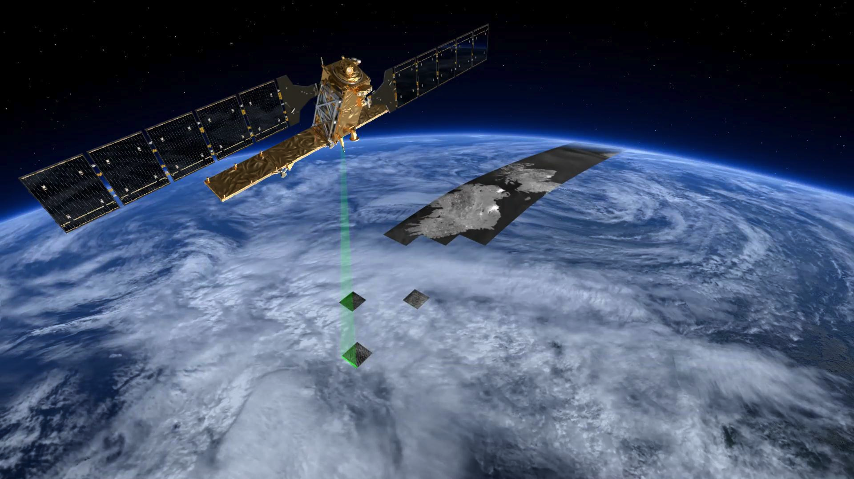
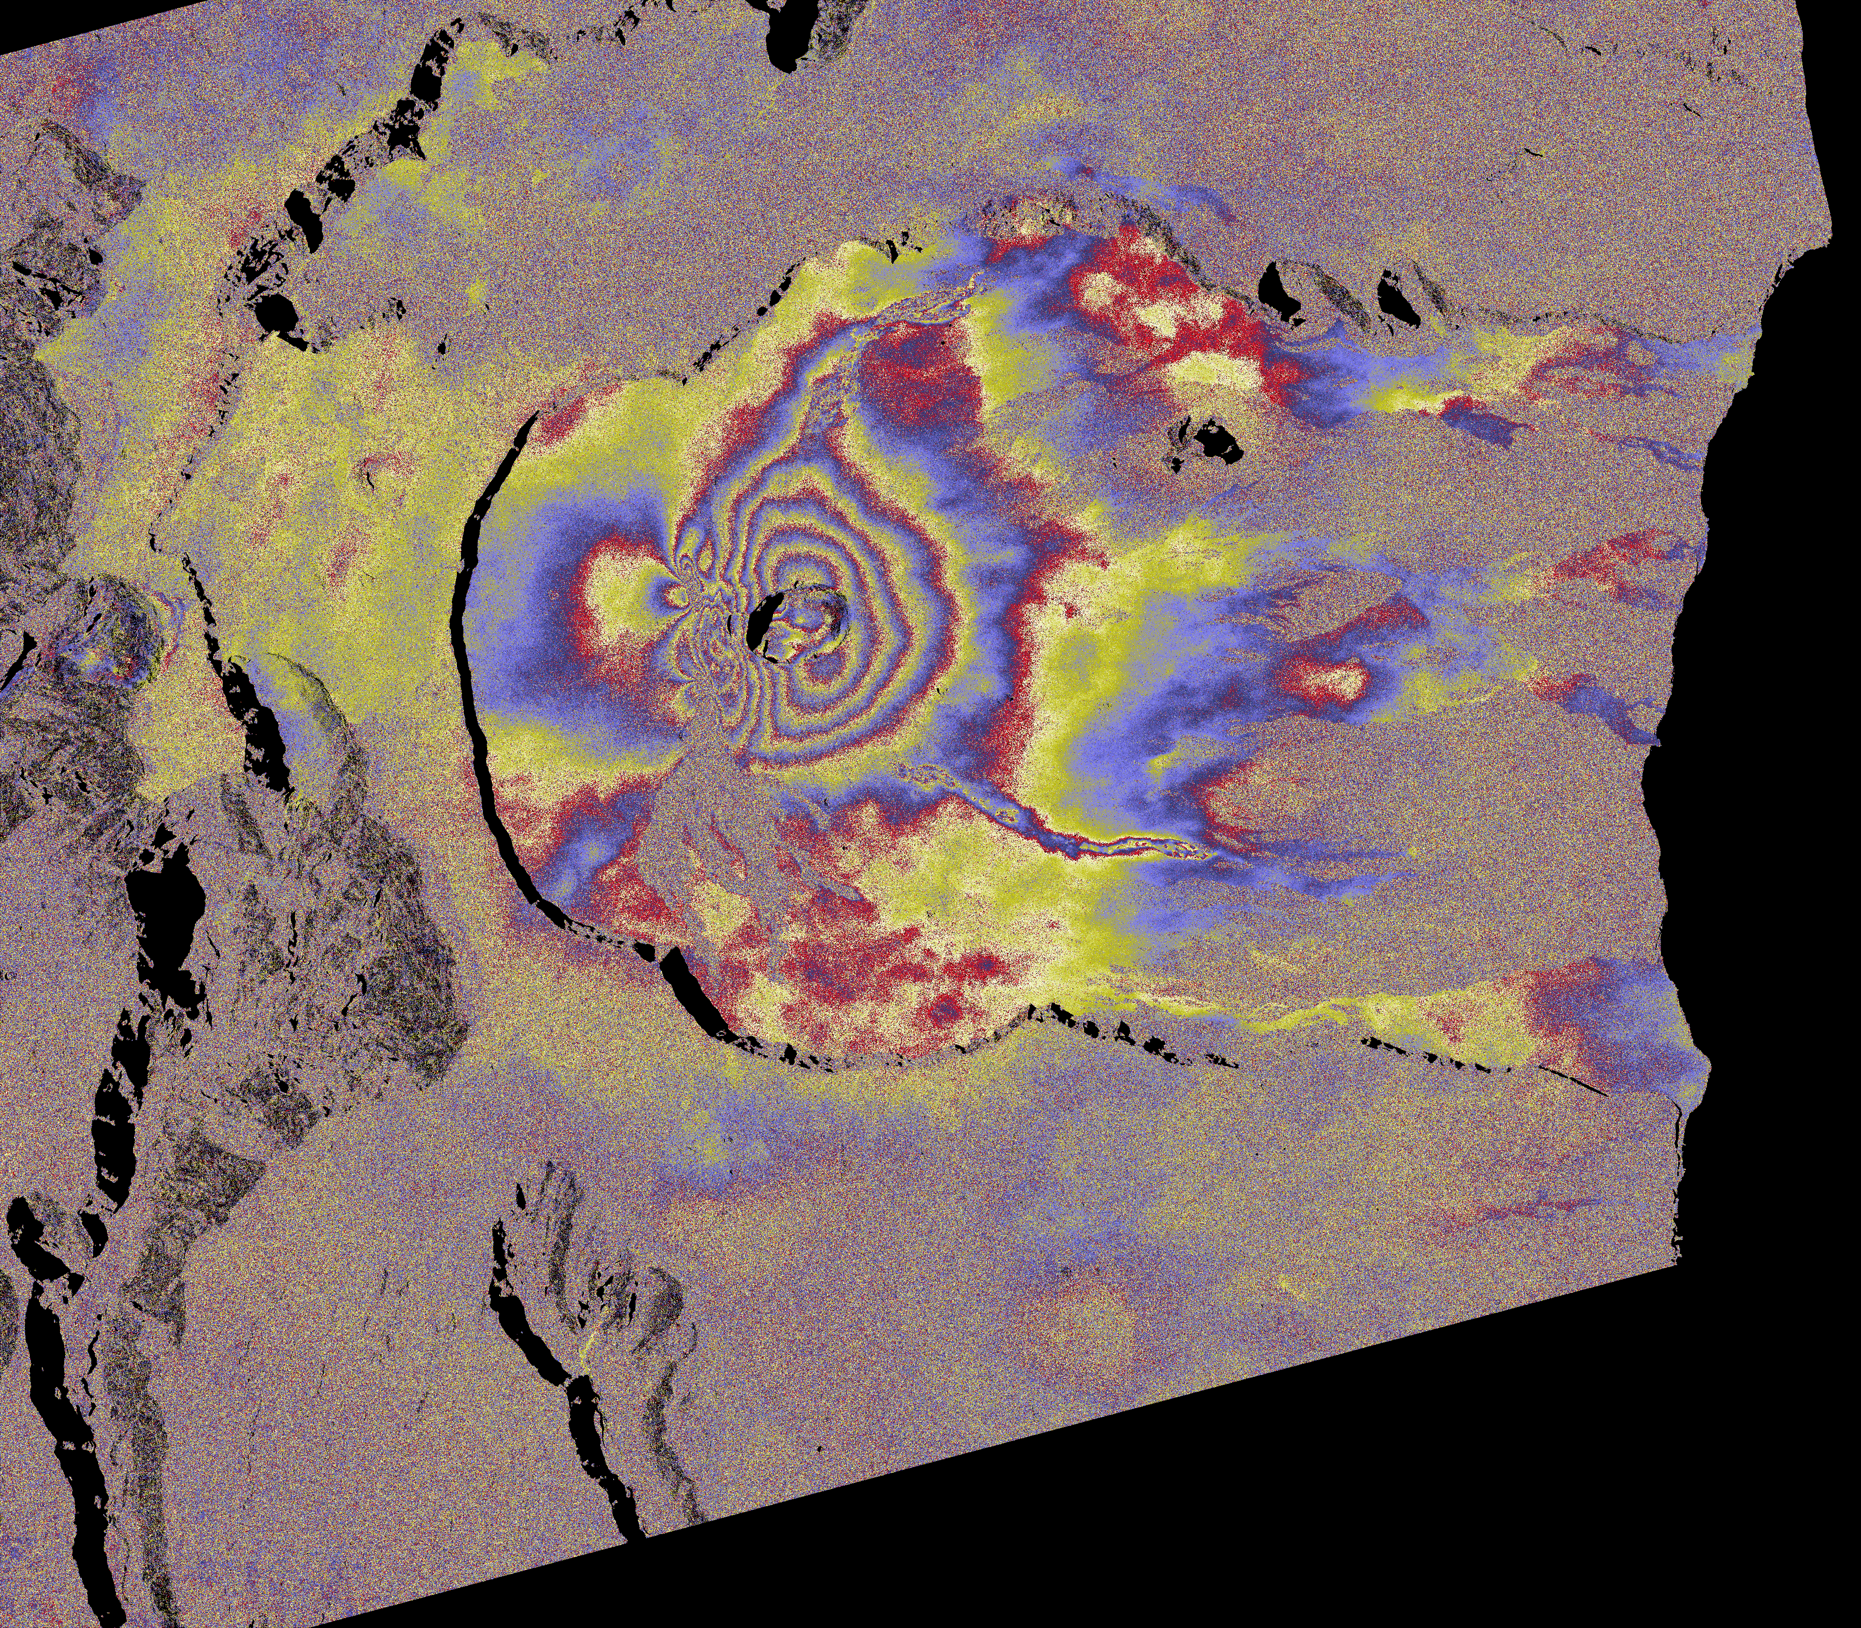
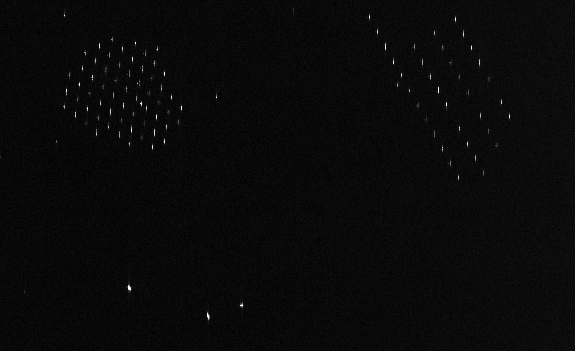
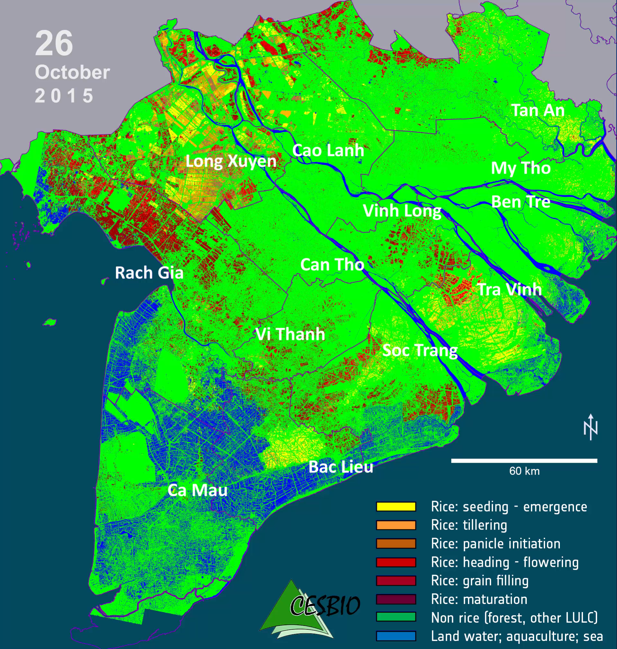
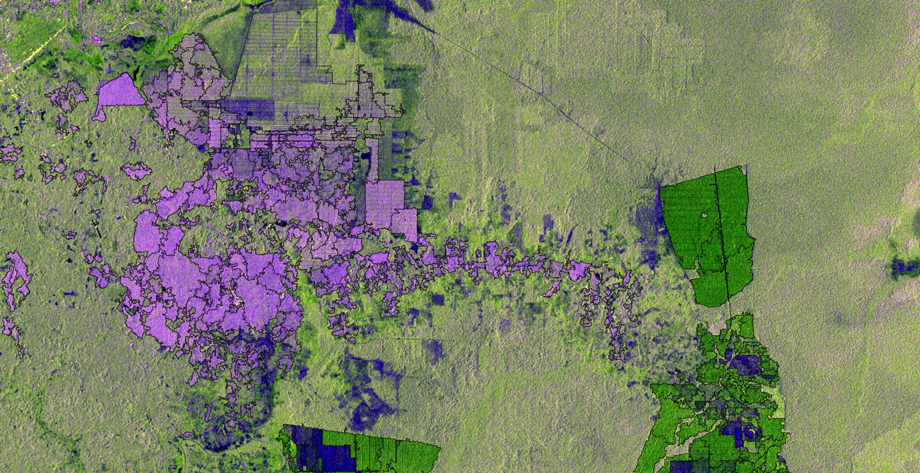
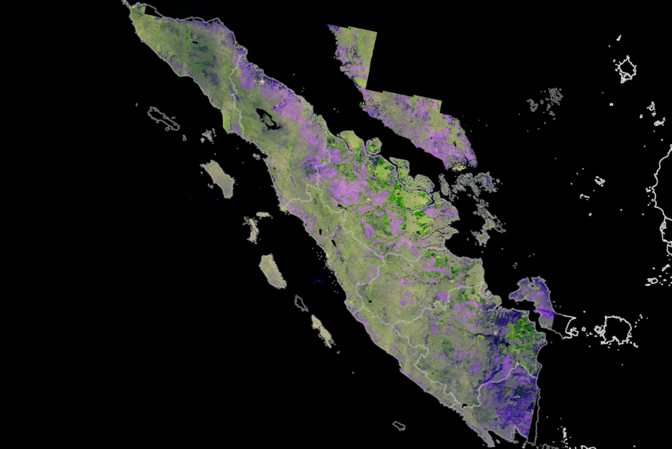

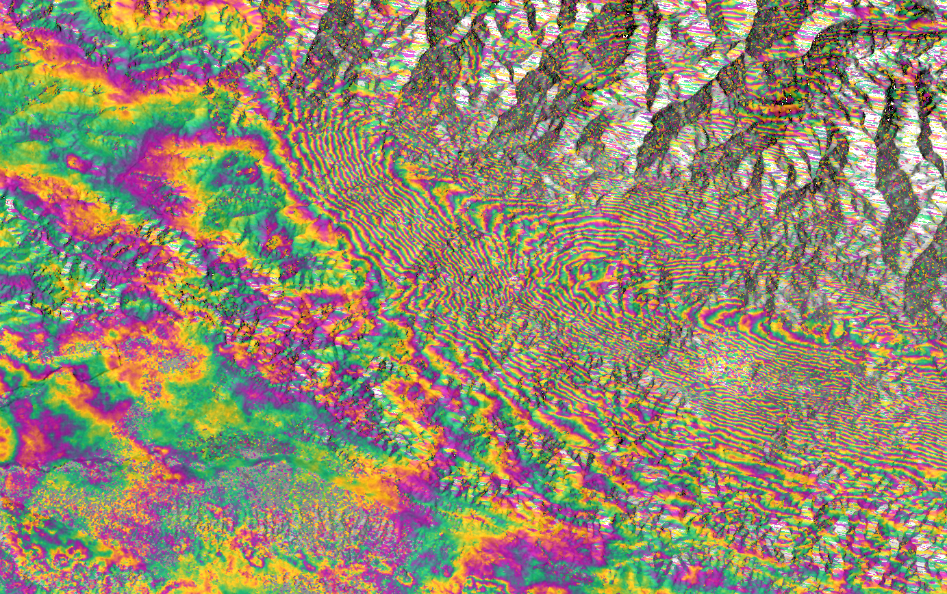
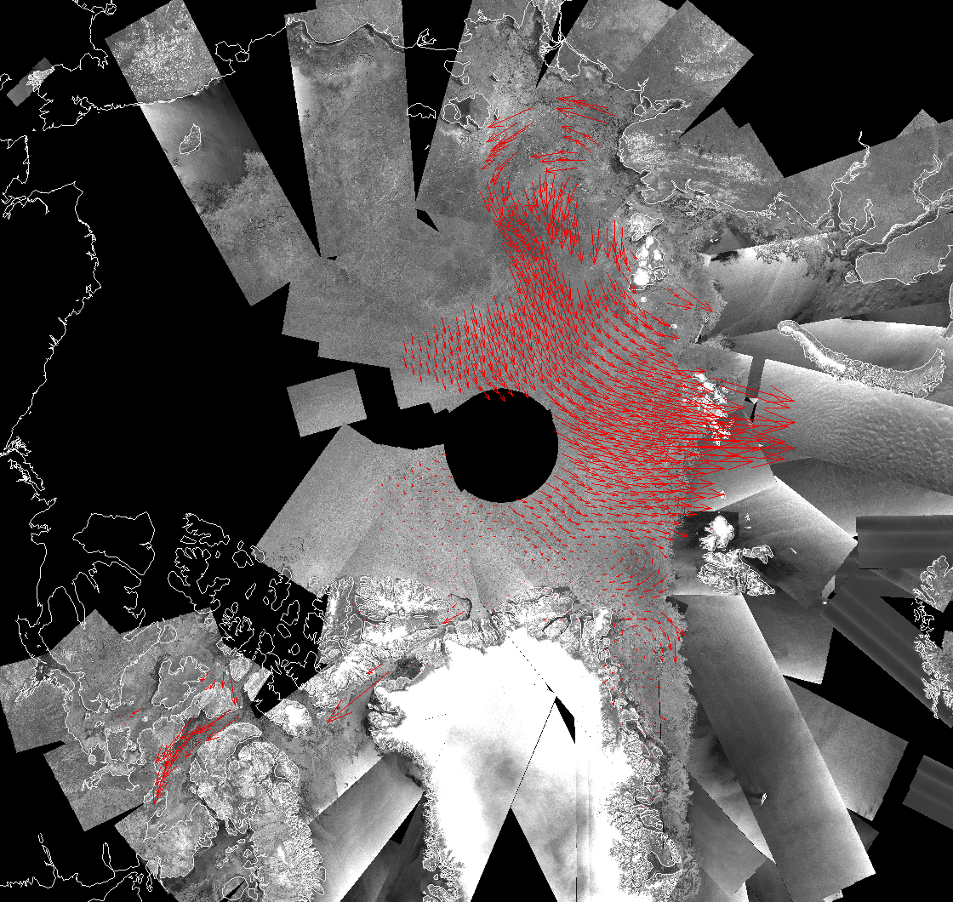
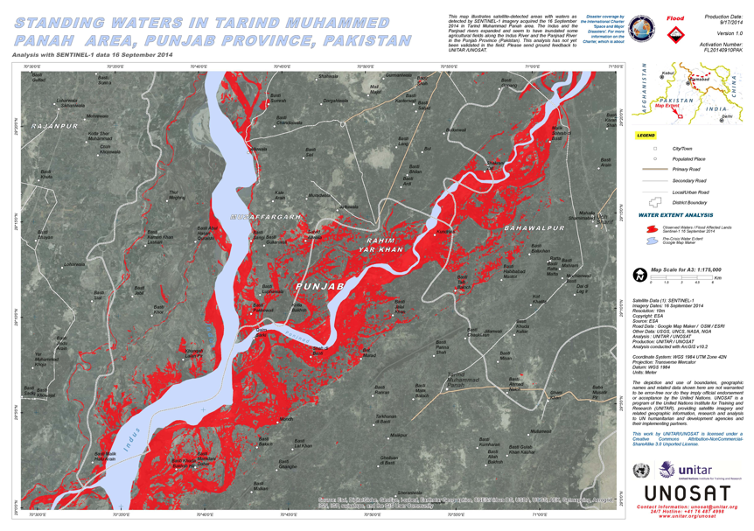

Sentinel–1 Mission
Eruption of Le Piton de la Fournaise, August 2015,
Windfarms off the Dutch coast
Sentinel-1A launched on April 3, 2014
Nepal Earthquake, 25 April 2015
Ice drift over the Arctic
Sentinel-1B to be launched on April 22, 2016
Pulp
plantations
Oil palm estates
Volcano deformation.
Courtesy of JL. Froger, OPGC © Contains modified
Copernicus Sentinel data (2015)/OPGC
Oil palm
smallholders
Kathmandu
© Contains modified Copernicus Sentinel data (2015)
/Norut/PPO.labs/COMET-ESA SEOM INSARAP study
Constellation of 2 satellites in the same orbit, embarking a C-band SAR
6 days repeat cycle at Equator (with 2 satellites) with daily coverage of high priority areas, e.g. in the European Arctic for sea-ice and iceberg monitoring
Applications include: Marine, Ice and Land Monitoring, Maritime surveillance, ground motion monitoring, disaster management support such as floods mapping
Contains Copernicus Sentinel data (2015)/Processing by SarVision
© Contains modified Copernicus Sentinel data (2015)/DTU
© Copernicus Sentinel data (2015)
Link to Sentinel-1 Web Pages

Slide 6
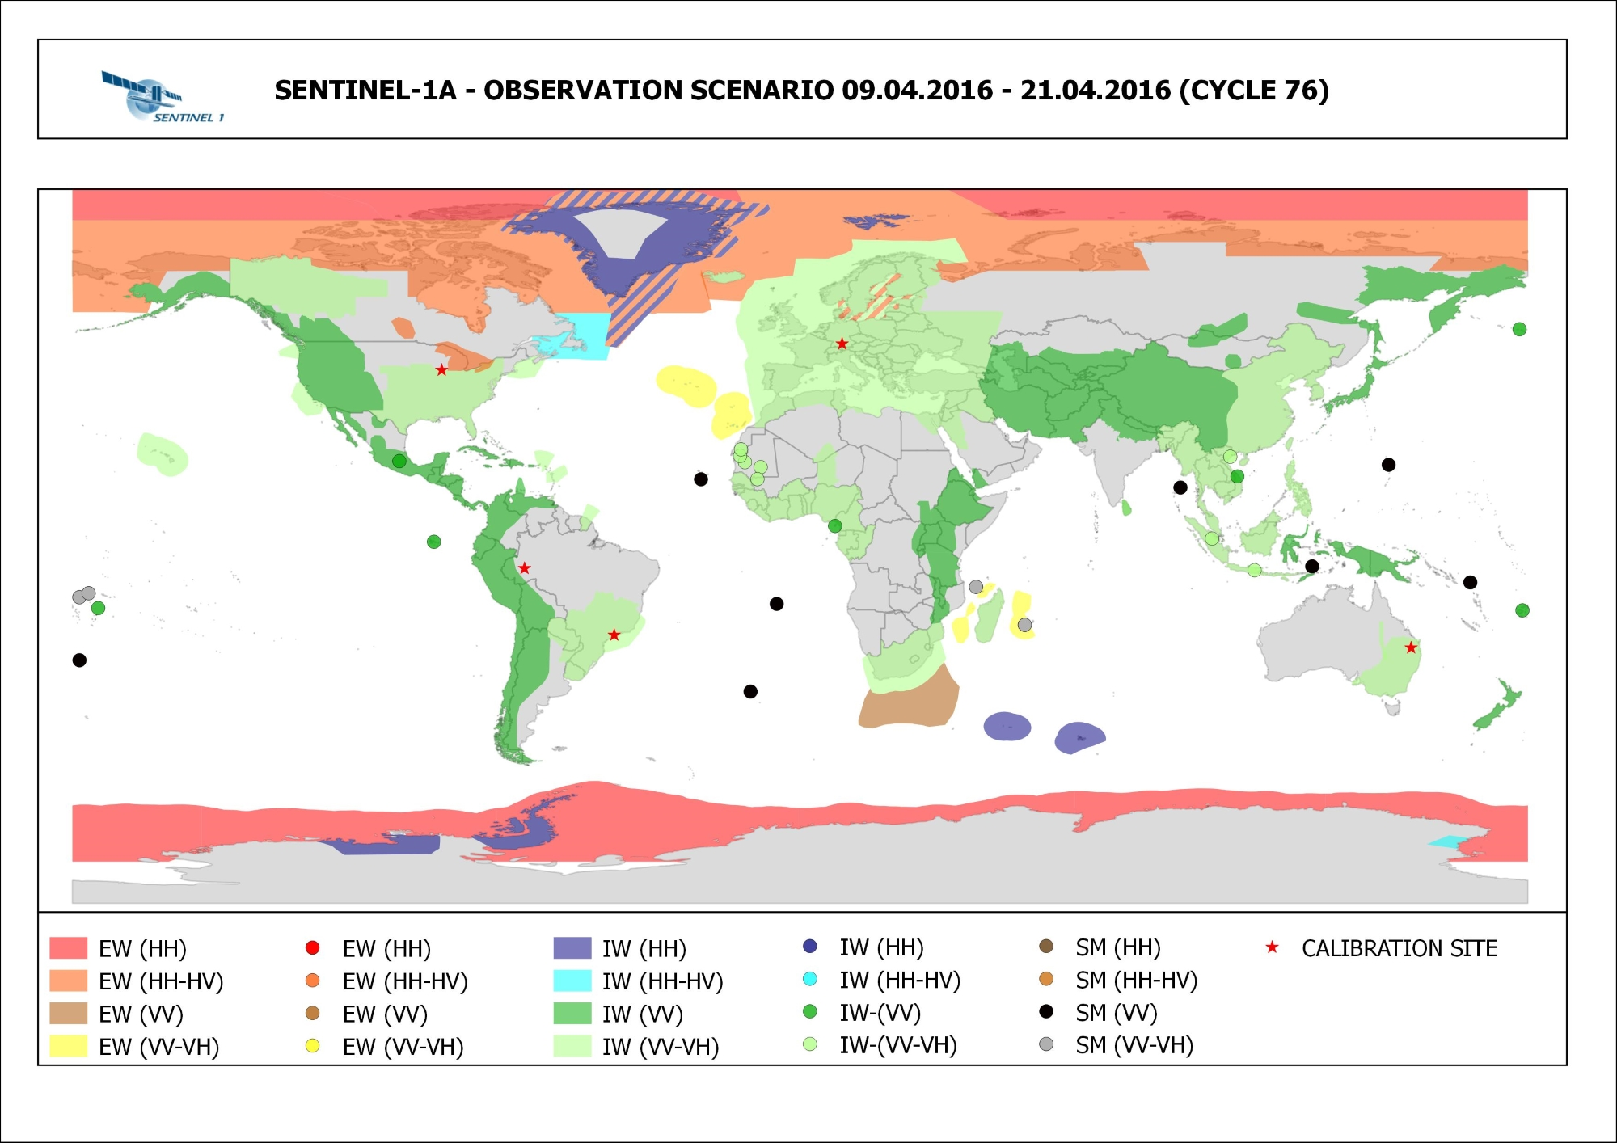
Sentinel-1 mission operations
Baseline pre-defined mission observation scenario making optimum use
of the SAR duty cycle within the technical constraints of the overall system.
Acquisition plan regularly published on https://sentinels.copernicus.eu/
All acquired data automatically processed to a set of core products and made available to users

Slide 7
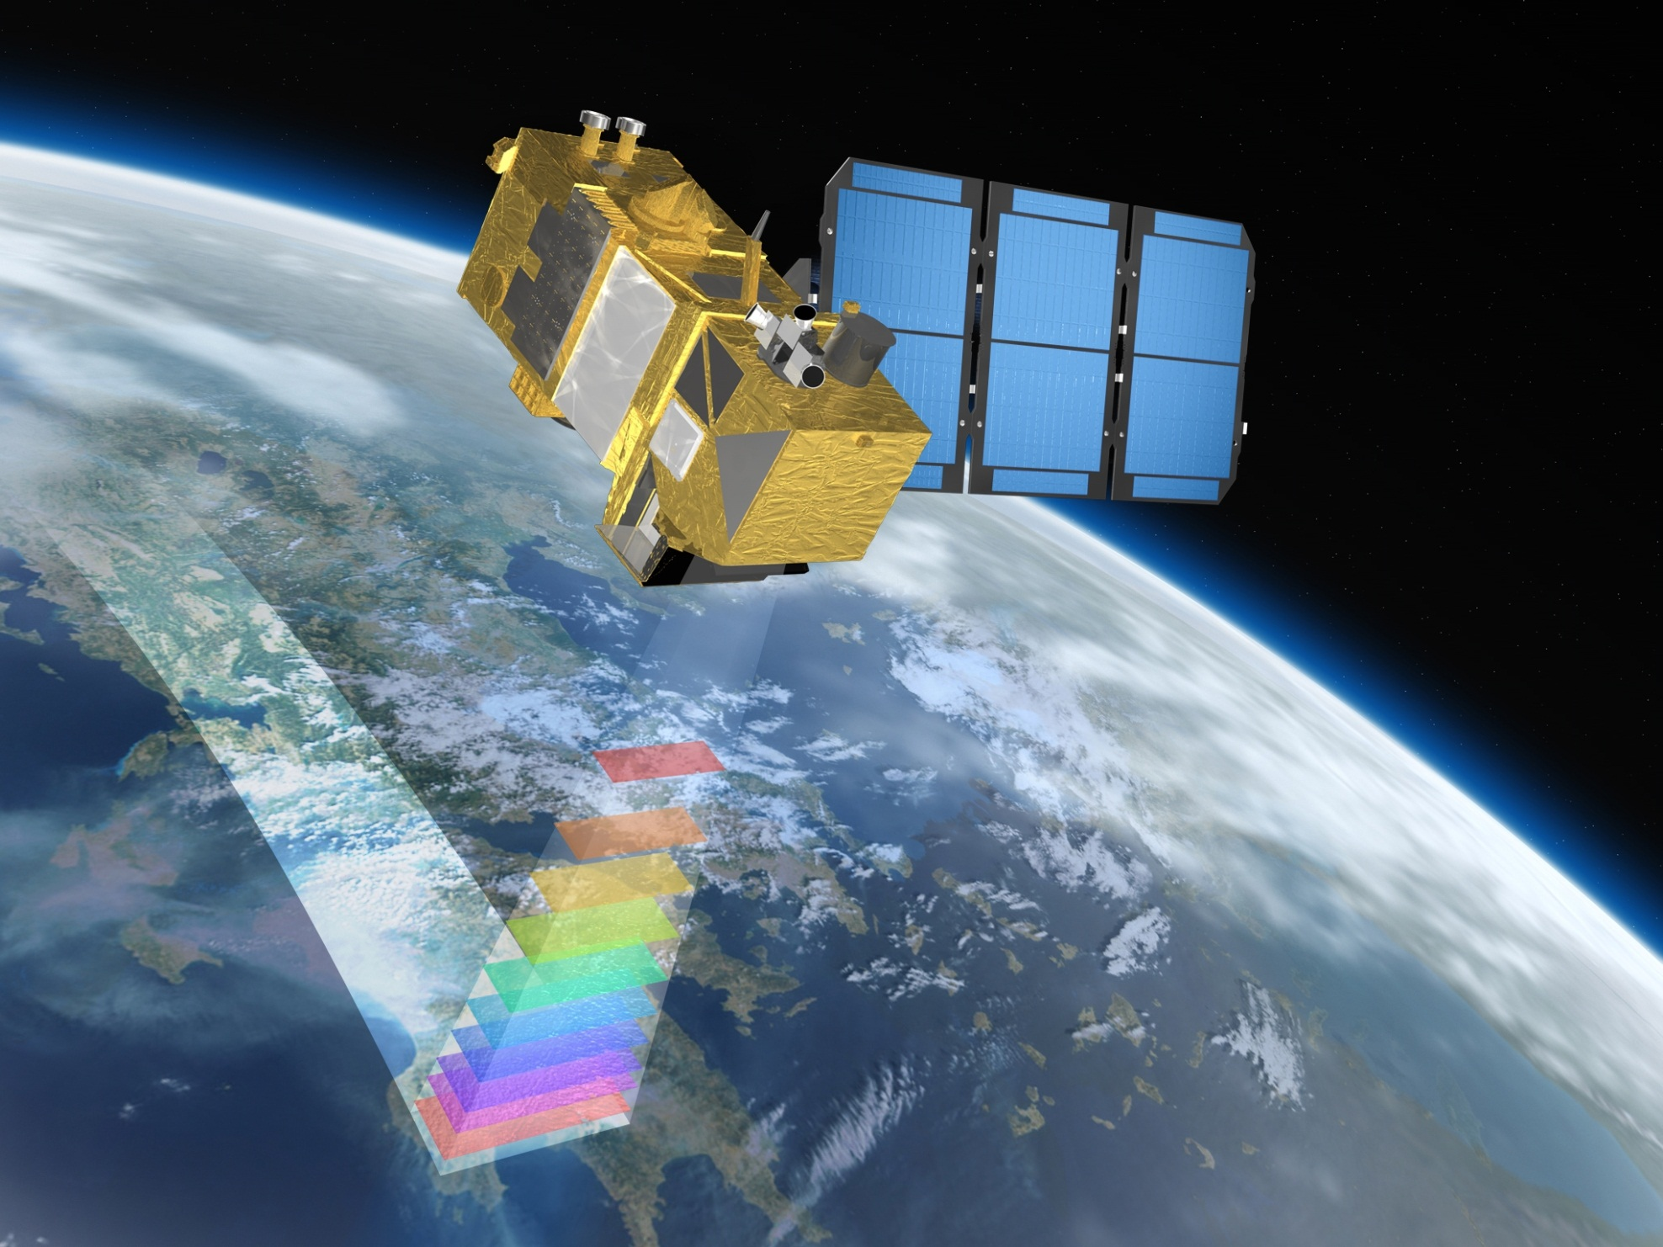
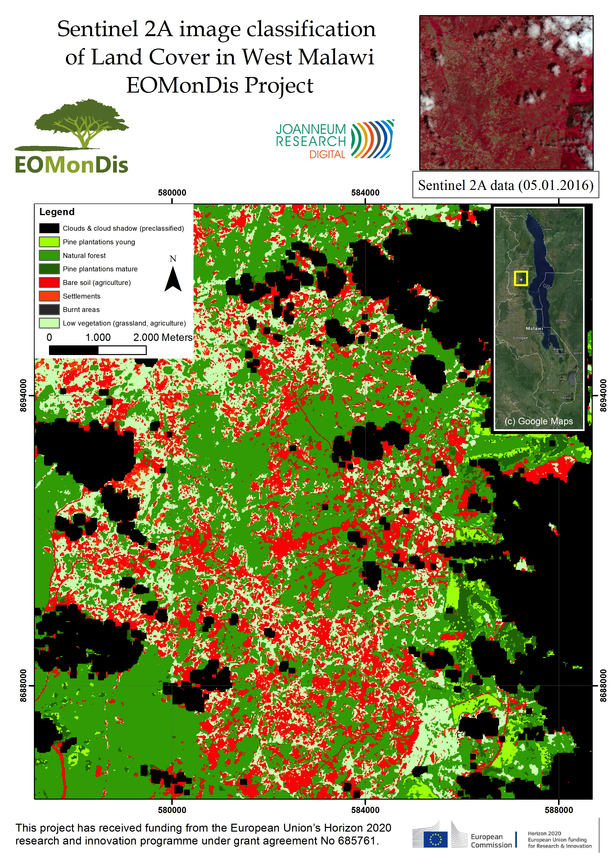
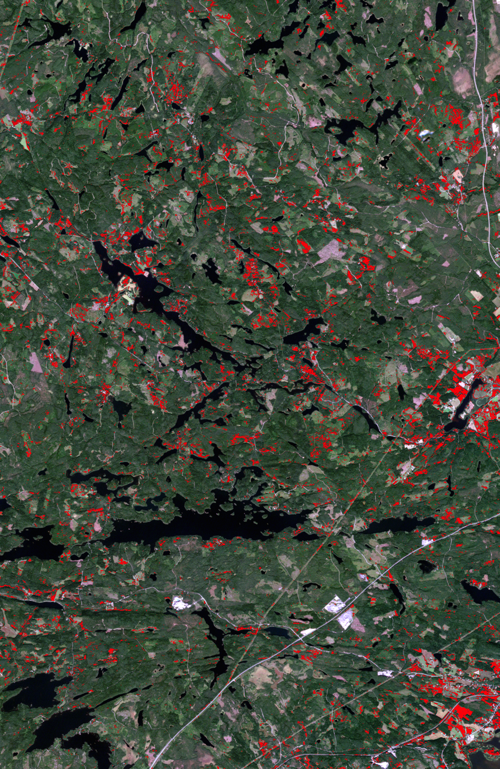

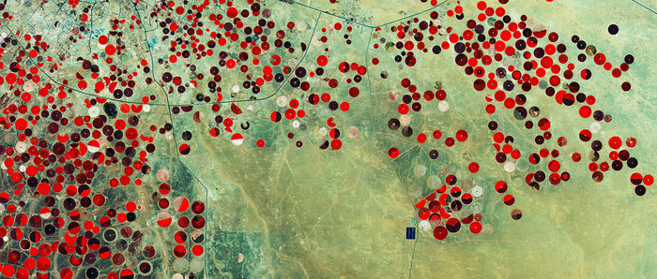
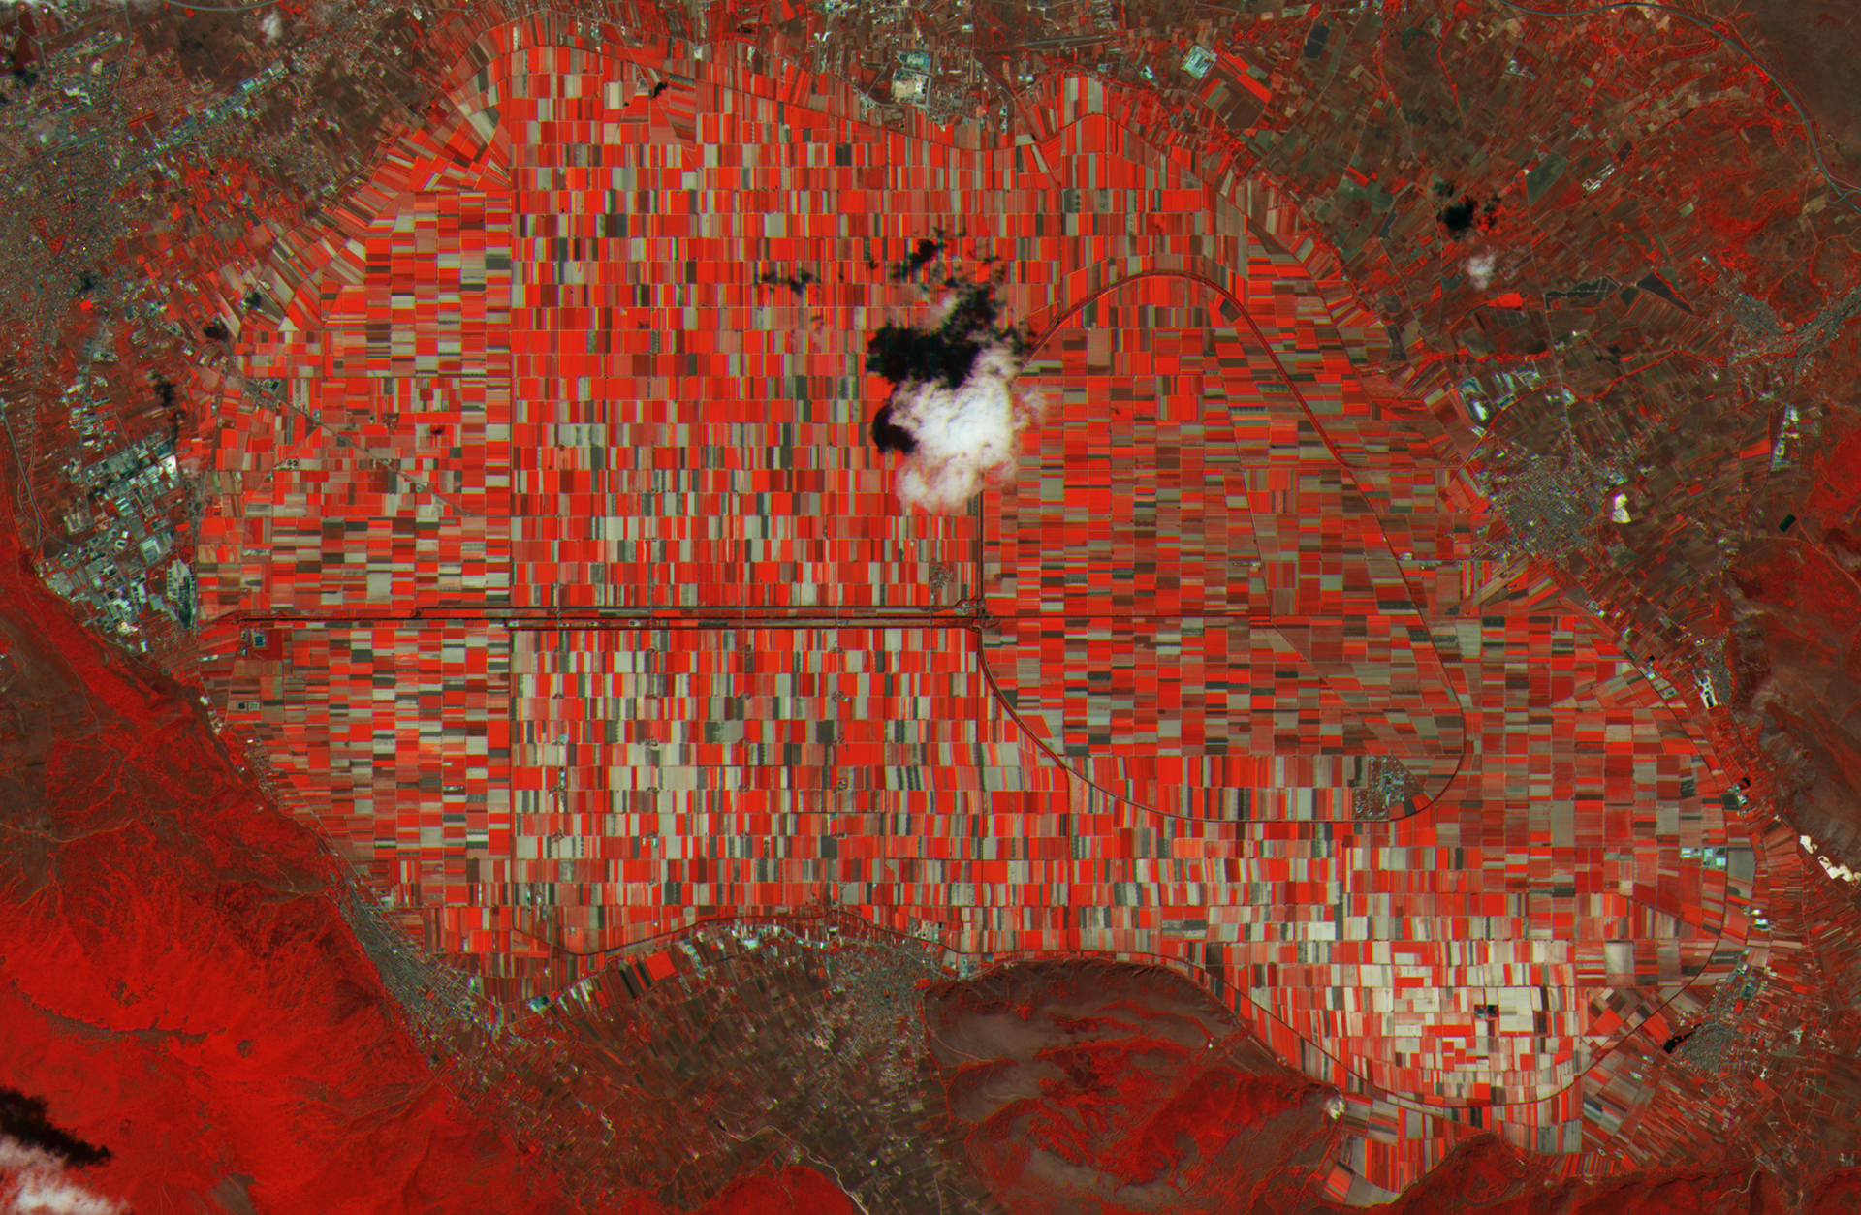
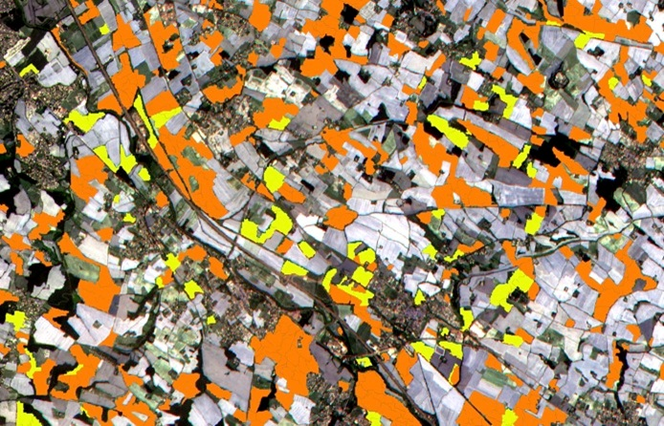
Sentinel–2 Mission
Sentinel-2A launched on June 23, 2015
Constellation of 2 satellites in the same orbit, embarking a super-spectral imager in the VIS, NIR & SWIR (13 bands)
Very wide swath (290km) coupled with high-resolution (10m)
5 days repeat cycle at Equator (cloud free) with 2 satellites
Applications focus on land monitoring
Contains Copernicus Sentinel data (2015)/ESA
Contains Copernicus Sentinel data (2015)/ESA
Sunflower
Monitoring forest regeneration in Finland based on Sentinel-2
Maiz
Link to Sentinel-2 Web Pages
Contains modified Copernicus Sentinel data (2015)/ESA/University of Louvain/CESBIO

Slide 8
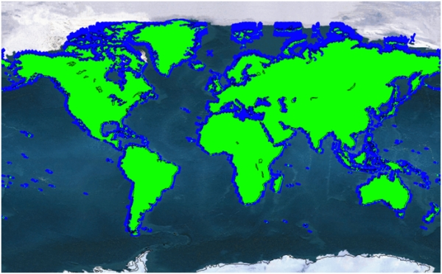
Sentinel-2 operations
Sentinel-2 target coverage at full operation
Sentinel-2 operations ramp-up according to https://sentinel.esa.int/web/sentinel/missions/sentinel-2/operations-ramp-up-phase
All acquired data automatically processed and made available to users

Slide 9
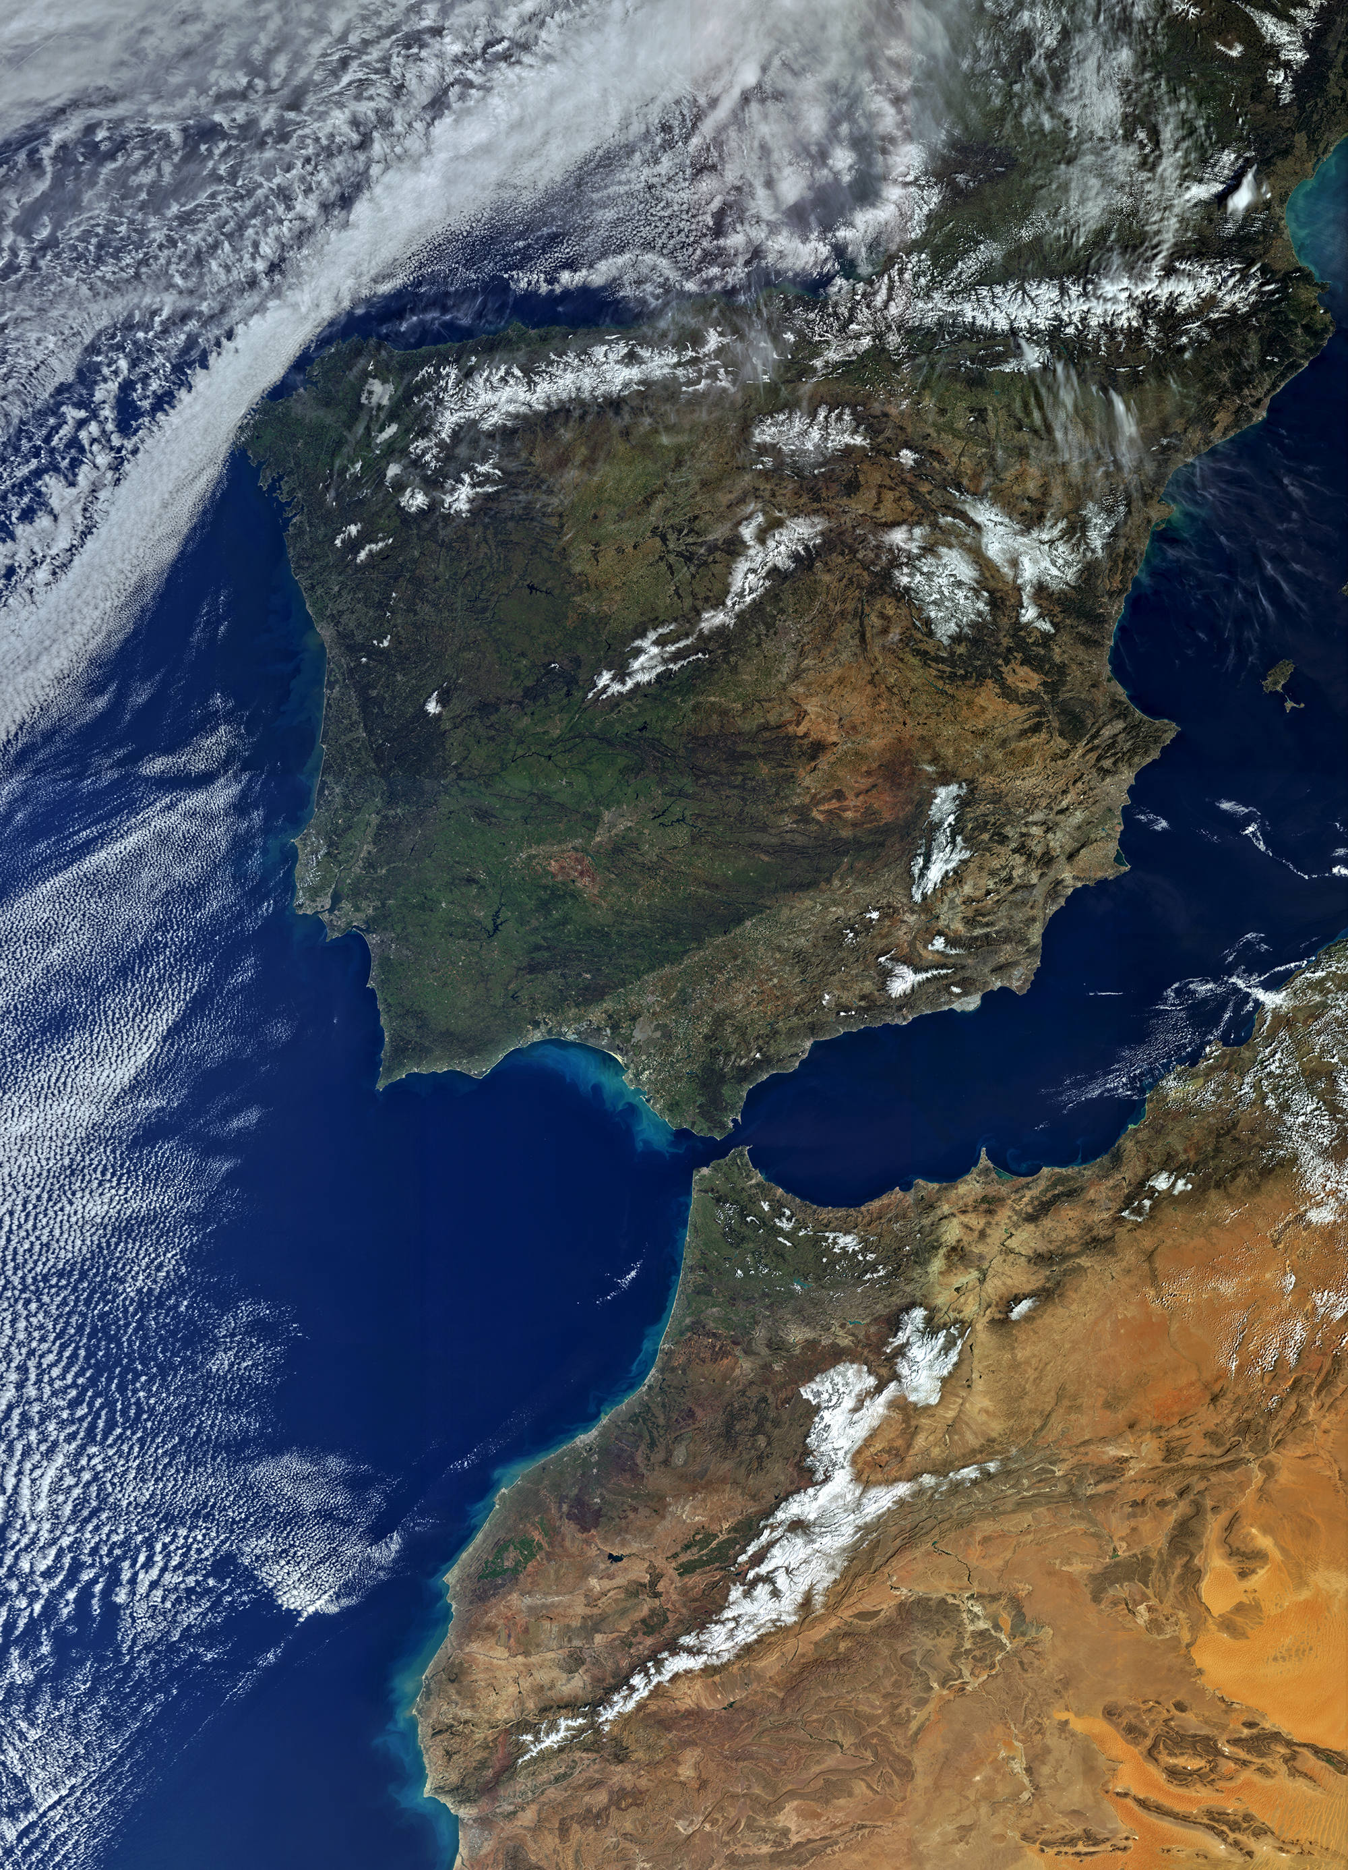
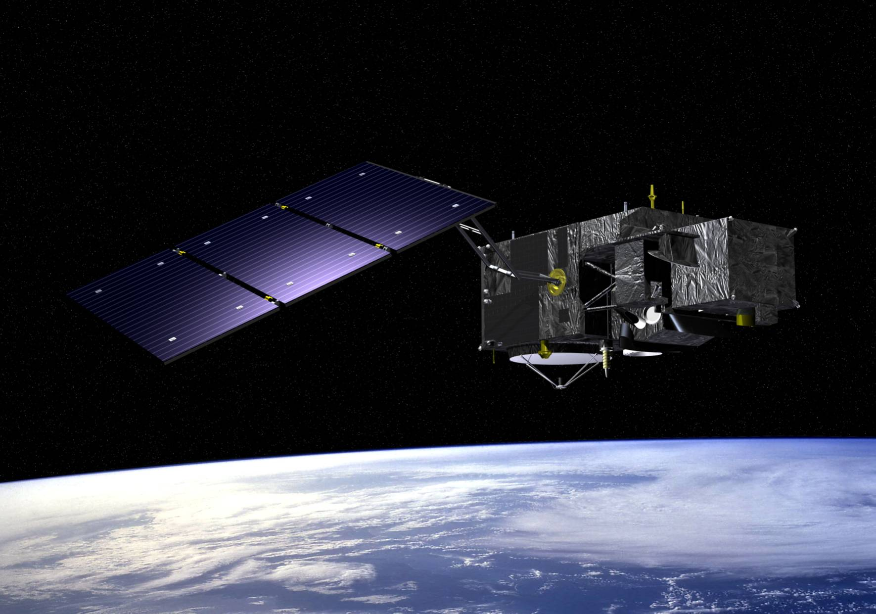
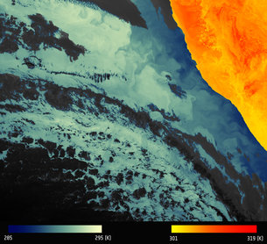
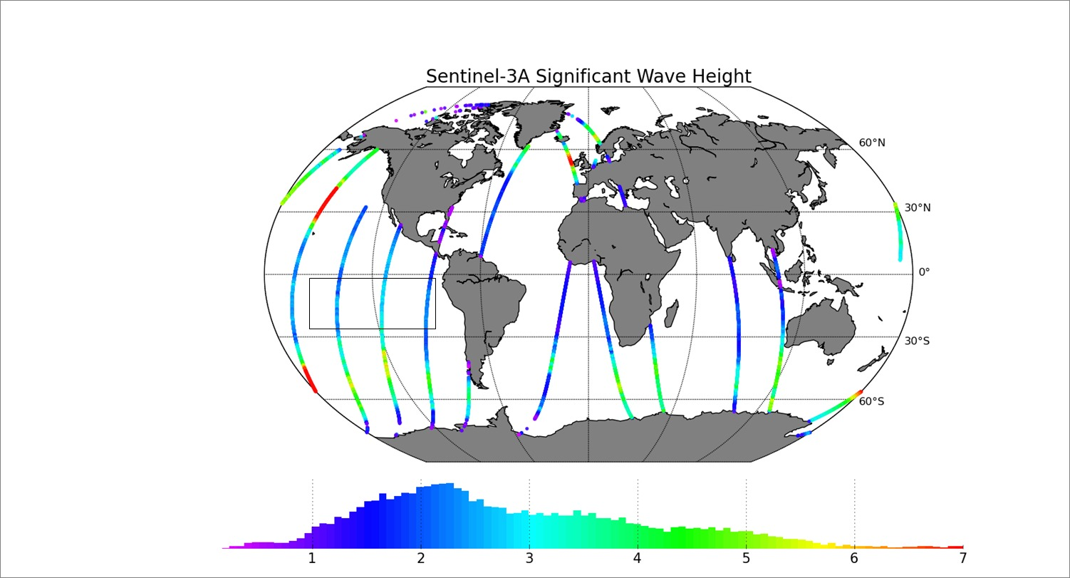
Sentinel–3 Mission
Sentinel-3A launched on February 16, 2016
Constellation of 2 satellites in the same orbit, embarking optical and topography packages (in continuation of Envisat)
27 days repeat cycle for the topography package, less than 3 days for OLCI and less than 2 days for the SLSTR with 2 satellites
Applications include sea and land colour (bio-geochemistry), sea and land surface temperature, sea-surface and land-ice topography
Operated in cooperation with Eumetsat

Slide 10
Sentinel-3 preparation to operations
Instruments switched-on progressively as from February 29
Commissioning on-going
Instruments calibration
Reference sets of core products to be released to validation team/ expert users
In addition, sample core products will be released to all users as early as possible for familiarisation
After IOCR (July/August)
Gradual ramp-up of operations
Release of L1 pre-qualified core products
Progressive release of level 2 pre-qualified core products

Slide 11
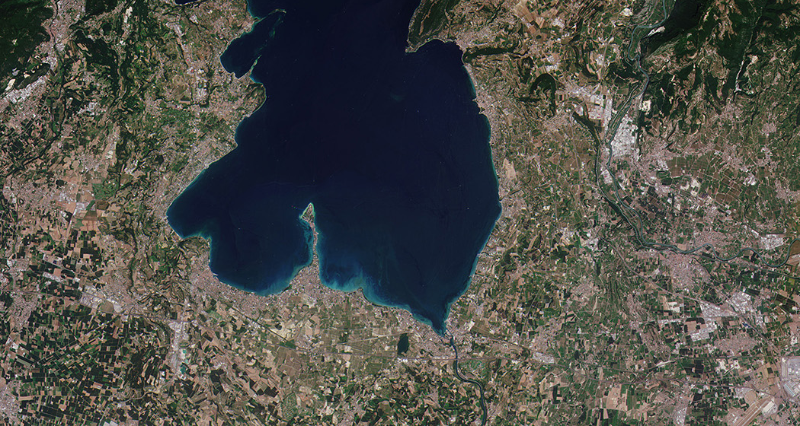
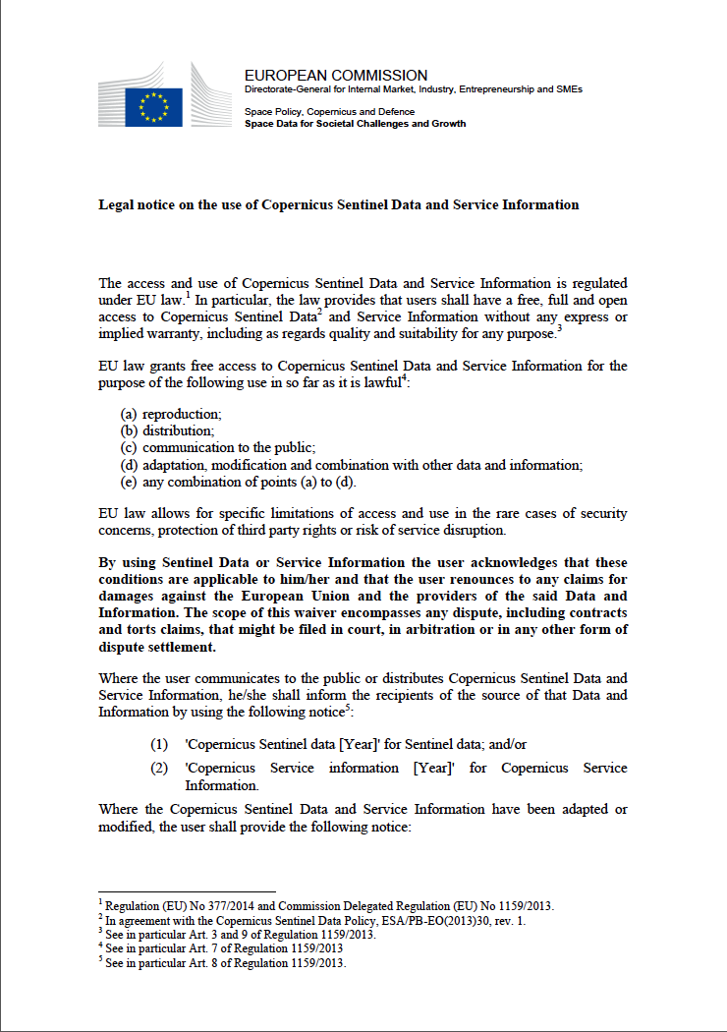
Sentinel data
Sentinel data are available:
  Open and free
  Over very long term
  Systematically, in an operational fashion
©Copernicus Sentinel data 2015

Slide 12
Sentinel data access @ ESA
ESA is delivering Sentinel products on a 24/7 basis both in Near Real Time (3hrs from sensing ) and Non Time Critical (within 24 hrs) to all users
ESA data access system is ensuring that at any point in time any user has access to all available Sentinels core products irrespective of their ‘age’
All users have free access to all Sentinels data, including most recent products as well as full Long Term Archives
  Data download is via terrestrial network featuring two separated and fully redundant outputs each of 10 Gbps bandwidth
  This includes a dedicated connection to the academic network (GEANT/Internet2)

Slide 13

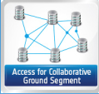


Sentinel data access @ ESA
Online access to all Sentinel products via dedicated data hubs
  Detailed product descriptions at sentinels.copernicus.eu
Open access data hub at scihub.copernicus.eu
  Users can self register online and get free access to ALL products
Additional data access hubs deployed to provided tailored services to specific users, e.g. EU/ESA Member States, International Partners

Slide 14
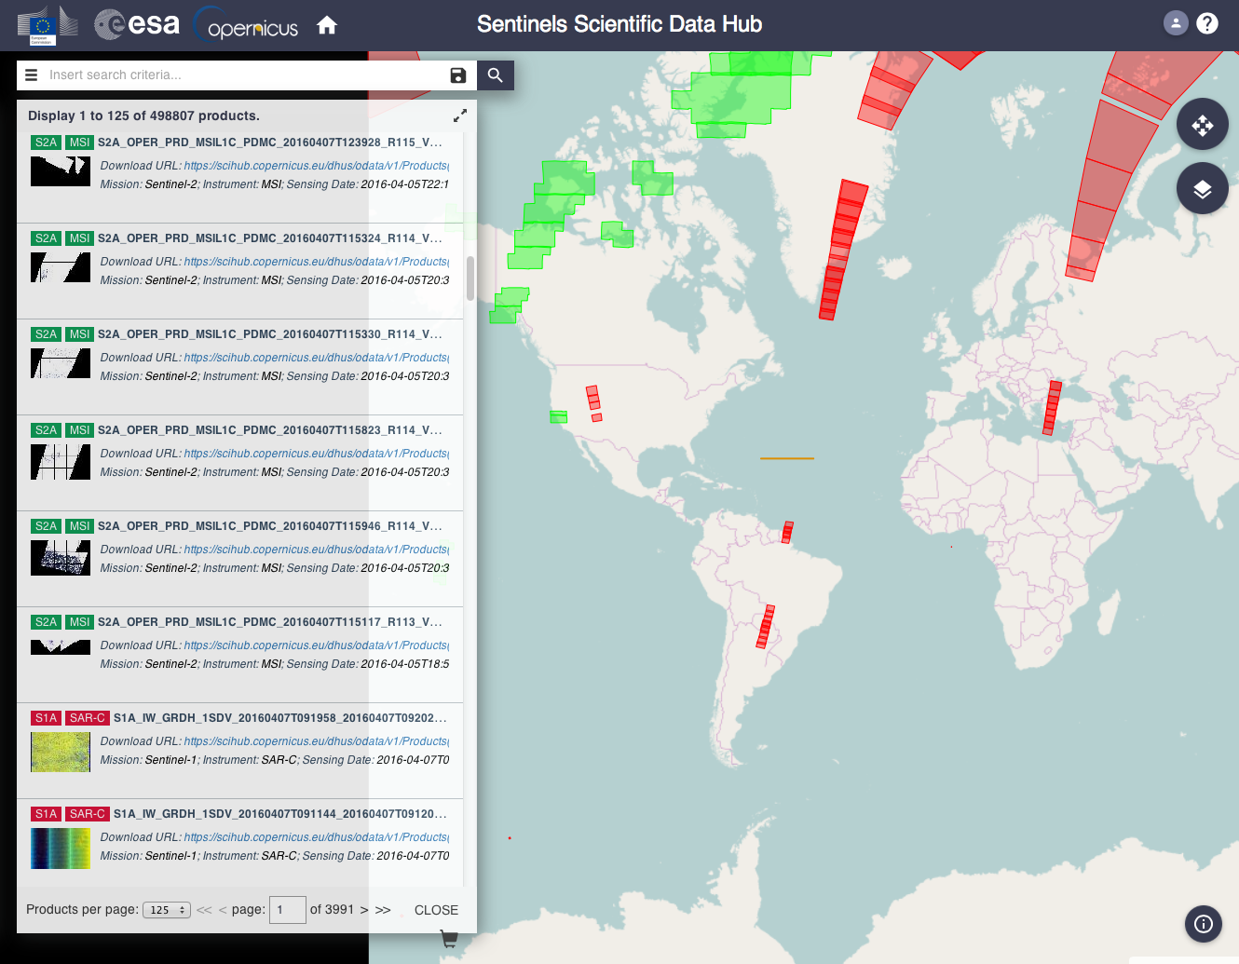
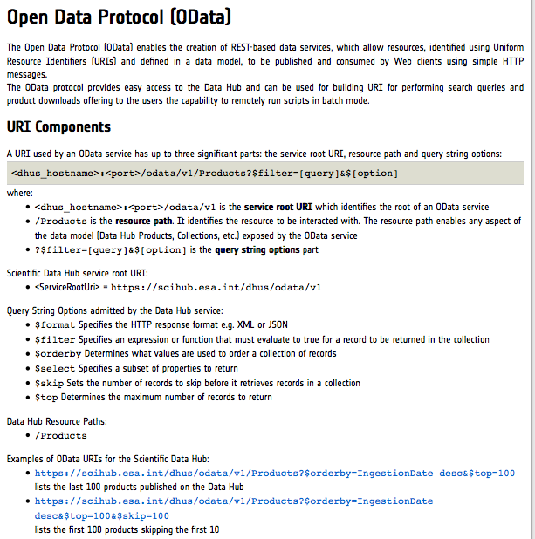
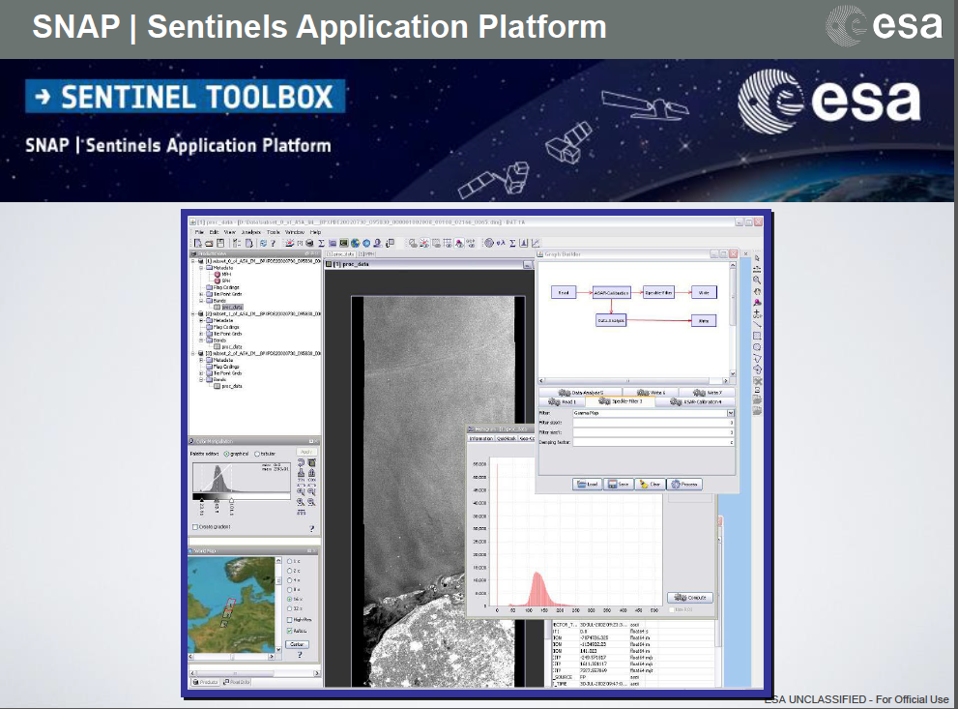
Sentinel data access tools @ ESA
APIs interface: scripting for automatic data selection and download
SNAP Sentinel toolbox
Data Hub Web graphic Interface http://scihub.copernicus.eu
Data Hub Server available as open source software
https://github.com/SentinelDataHub/DataHubSystem.
Sentinel Toolbox available as open source software https://github.com/senbox-org

Slide 15
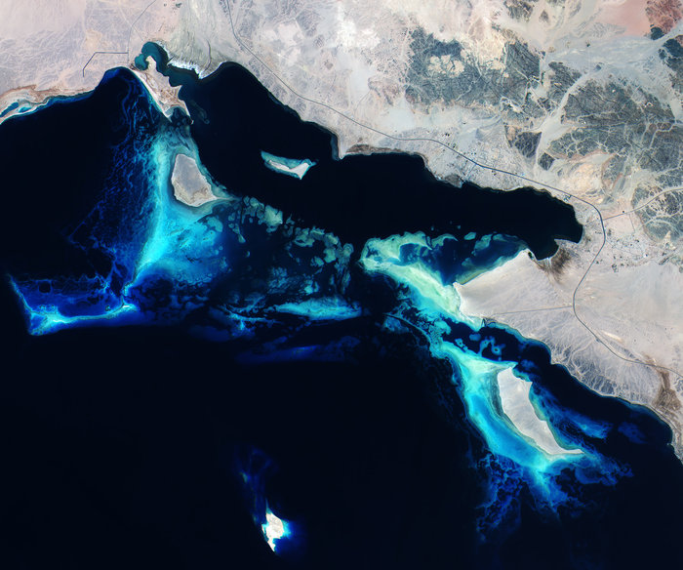
Data access stats from the open and free data hub
https://scihub.copernicus.eu
> 500,000 products available
> 30,000
Registered users
4 Million
products downloaded
> 4,7 PByte
Data volume
downloaded
Statistics at April 7, 2016
Copernicus Sentinel data (2015)

Slide 16
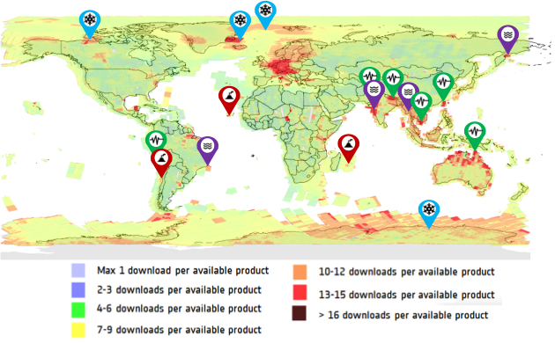
Sentinels products
Heatmap
In 2015 an average of 3 TB of products
was generated daily
By end 2016 it is projected that this figure will increase to more than 6 TB a day
In 2015: on average each product was downloaded 10 times
In 2015: 30 TB of products have been disseminated on average a day
It is projected that by end 2016
100 TB of products will be disseminated daily

Slide 17
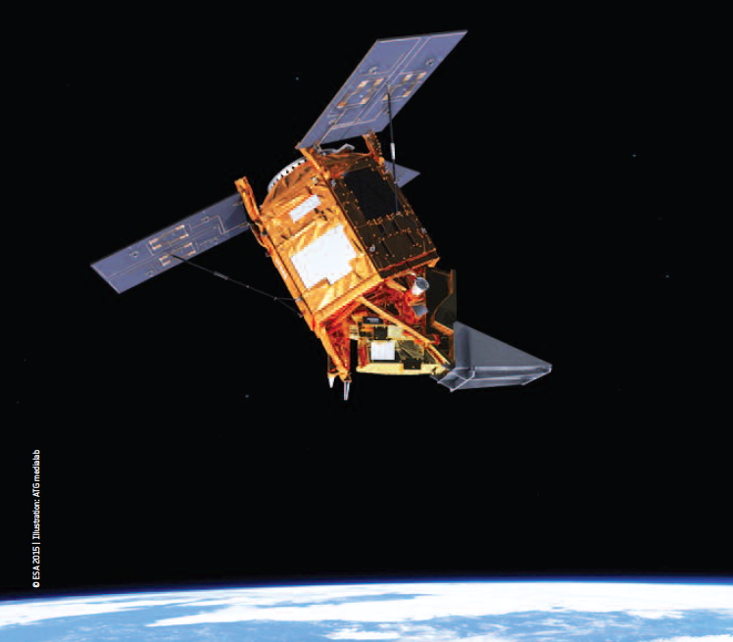
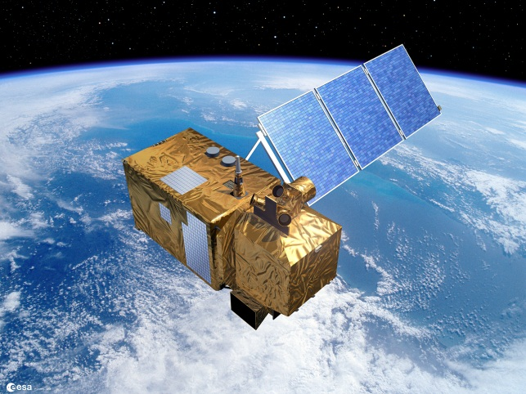

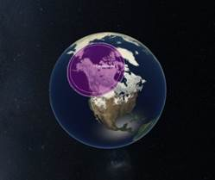


Sentinels Mission Management
2016 Outlook
SENTINEL-5P
Launch: October
SENTINEL-2A
End of Operational Qualification Phase: July
SENTINEL-1B
Launch: 22 April
SENTINEL-3A
Launched 16 February
Commissioning on-going
4th X-band Station
September: service start in Inuvik
EDRS-Sentinel downlink
May: service start
European Data Relay System
EDRS-A Launch: January
Commissioning on-going
Notes:
A

