Slide 1

Committee on Earth Observation Satellites
Passive Microwave Radiometer Constellation
for Sea Surface Temperature
SST-VC
SIT-31 Agenda Item 13
CEOS Strategic Implementation Team
ESA/ESRIN, Frascati, Italy
19th-20th April 2016

Slide 2
Overview
Use of Passive Microwave Radiometers (PMW) for SST retrievals is an essential component of global constellation of SST sensors.
Provides temperature of ocean under clouds, not possible from infrared sensors, albeit with poorer spatial resolution.
Particularly important in high-latitude regions and in areas of extensive and persistent cloud cover or in case of a large volcanic event.
Currently there are risks and gaps identified in constellation, therefore continuity and redundancy of PMW for SST is sought.

Slide 3
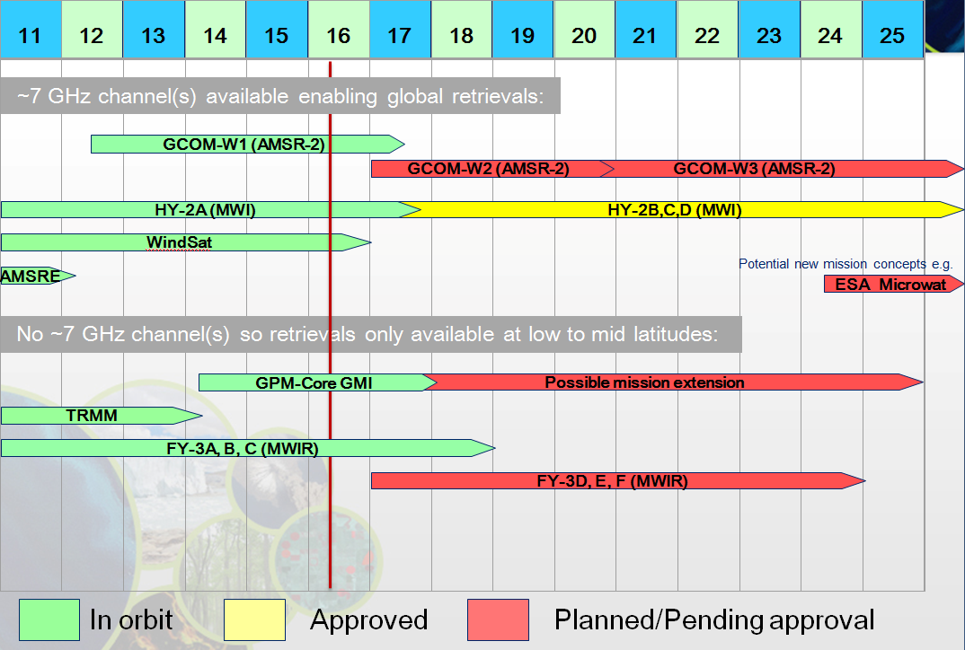
Passive Microwave Radiometer constellation for Sea Surface Temperature
Notes:
Global retrievals (with 6-7GHz channel):
There is no follow-on plan to GCOM-W1 AMSR2 by JAXA at present. However, it is understood that discussions on a potential follow-on mission will be accelerated in Japan in 2016.
There is a 6.6 GHz channel on the NSOAS HY-2 series, and ROSCOSMOS are planning to add a 6.9 GHz channel to future Meteor series (maybe 2020 onwards). HY-2A has a 6.6 GHz channel. More coordination with China would be beneficial to work on scientific and calibration issues leading to possible sharing of data. This will also be pursued in GHRSST context.
AMSRE mission has finished.
Two letters of intent have been received by ESA to the Earth Explorer 9 (EE9) call that propose missions that can retrieve SST from passive microwave instruments in the 2024 timeframe if selected. Extensive studies conducted by ESA on the Microwat concept (a multi-frequency passive microwave radiometer operating in C- and X-bands) highlighted the importance of flying an EE9 type SST mission in tandem with METOP-SG as one of the METOP-SG satellites will carry a scatterometer (SCA) and the second a microwave radiometer (MWR) providing a suite of higher frequency channels. Such an approach maximises the opportunity to work in synergy and provide the best SST and sea ice edge information in the polar regions as well as SST from a global perspective.
Low to mid latitudes (no 6-7GHz channel):
If GMI continues well, it is thought that the mission may be possible up to 2026. There are limitations, as the radiometer is not able to provide measurements at high latitudes or cool SSTs, since it is in a high inclination orbit and only has a 10.65 GHz channel but not in the 7GHz range. However, the mission does provide an important climate PMW SST bridge, at least in the Tropics where it measures.
The Chinese FY-3 series with MWRI (Microwave Radiation Imager) has a 10.7 GHz channel allowing warmer SST retrievals, but there is no 6.9 GHz channel so accurate retrievals < 12˚C, typically pole-ward of ~40˚ latitudes, are not possible. More coordination with China would be beneficial to work on scientific and calibration issues leading to possible sharing of data.

Slide 4
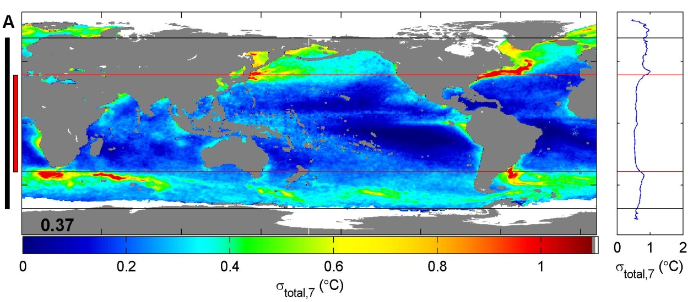
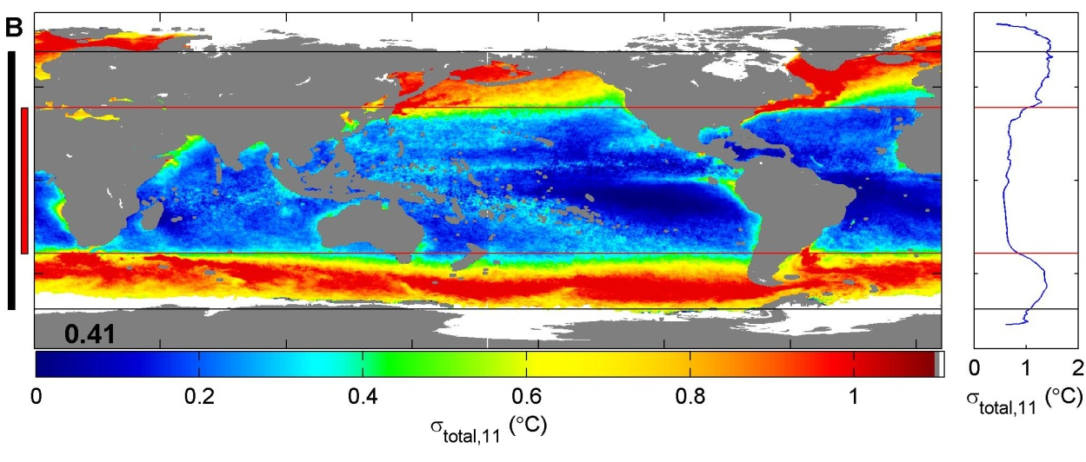
The benefit to SST retrievals using ~7GHz and ~11GHz channels
Standard deviation of differences between AMSR-E and Reynolds SST for top (7GHz AMSR-E SST) and bottom (11GHz AMSR-E SST).
Map using 11GHz demonstrates significant errors above 40 degree latitude for both hemispheres, due to decreased sensitivity to colder SST at 11 GHz.
Importance of 6-7GHz channel at high-latitudes.
From Gentemann et al. (2010).
Notes:
Coverage of TMI indicated in red on left side of figure.
Coverage of GMI indicated in black.
The PMW retrieval algorithm was developed for AMSR-E using the same methodology, but
-Including all channels. This is the 7GHz algorithm referenced above.
-Excluding 6.9 GHz from retrieval. This is the 11GHz algorithm referenced above.
STD shown by the colour, and the latitudinal dependence on right side. Large increases in error for 11GHz algorithm above 40deg latitude because that is where most temps < 12C exist.

Slide 5
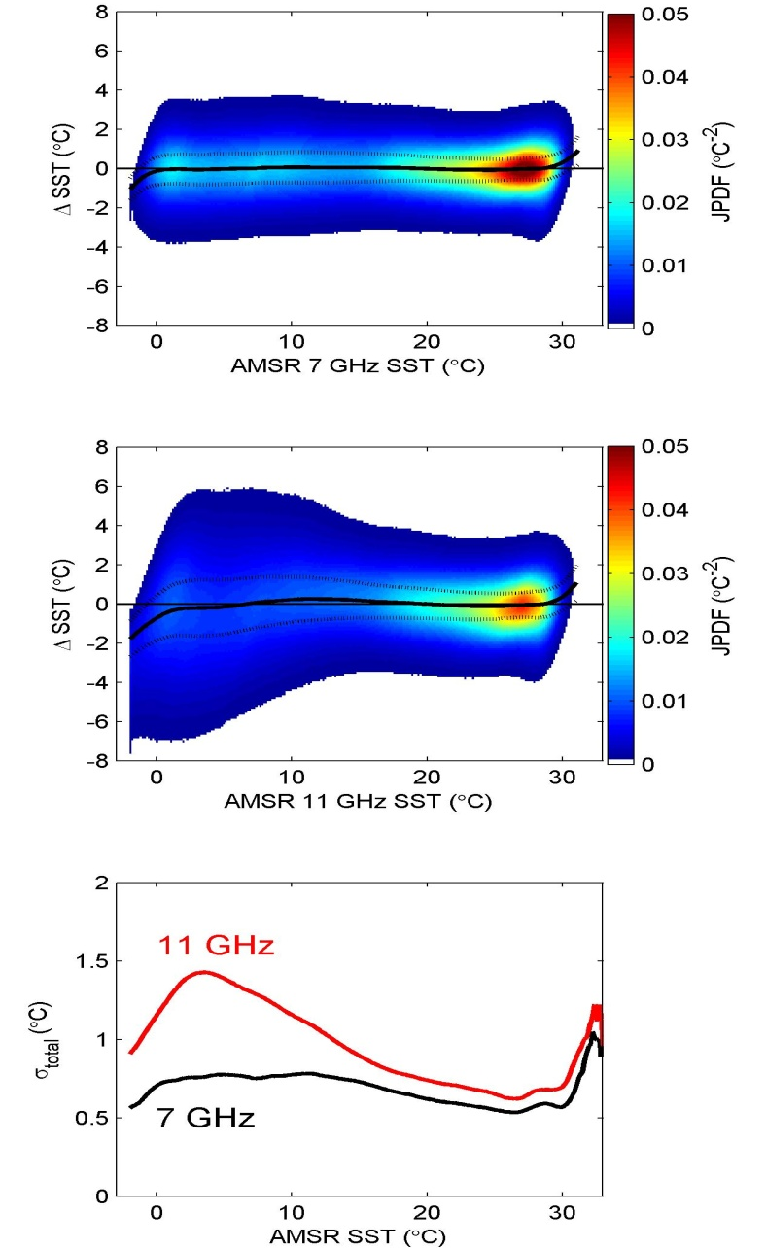
Importance of 6-7GHz for SST
AMSR-E minus Reynolds SST as a function of 7 GHz SST (top) and 11 GHz SST (bottom).
Increased differences between the two retrievals at cooler temperatures.
7 GHz SST retrieval gives much more stable differences for all temperatures.
From Gentemann et al. (2010).

Slide 6
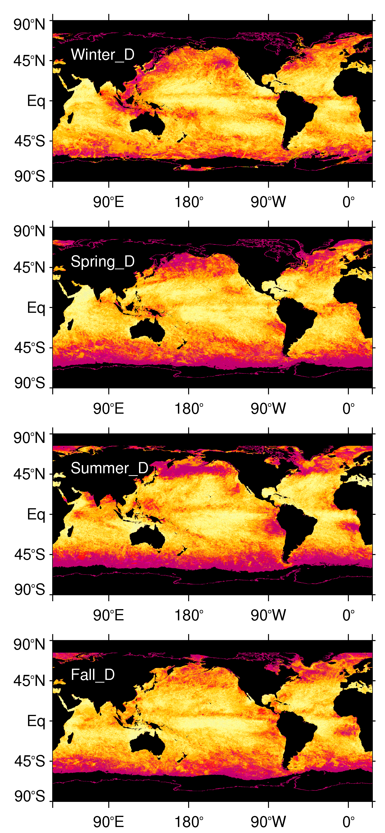

Cloud cover limitations on infrared SST
Maximum cloud persistence (days) from MODIS v6 daytime cloud mask data (seasons relate to Northern Hemisphere; D indicates daytime part of each orbit).
Highlights regions where infrared SST retrievals are prevented due to persistent cloud cover.
Regions where 11GHz are not accurate and infrared not possible due to cloud are highly correlated.
Emphasizes need for 6-7GHz channel.
From Lui and Minnett (2016).

Slide 7
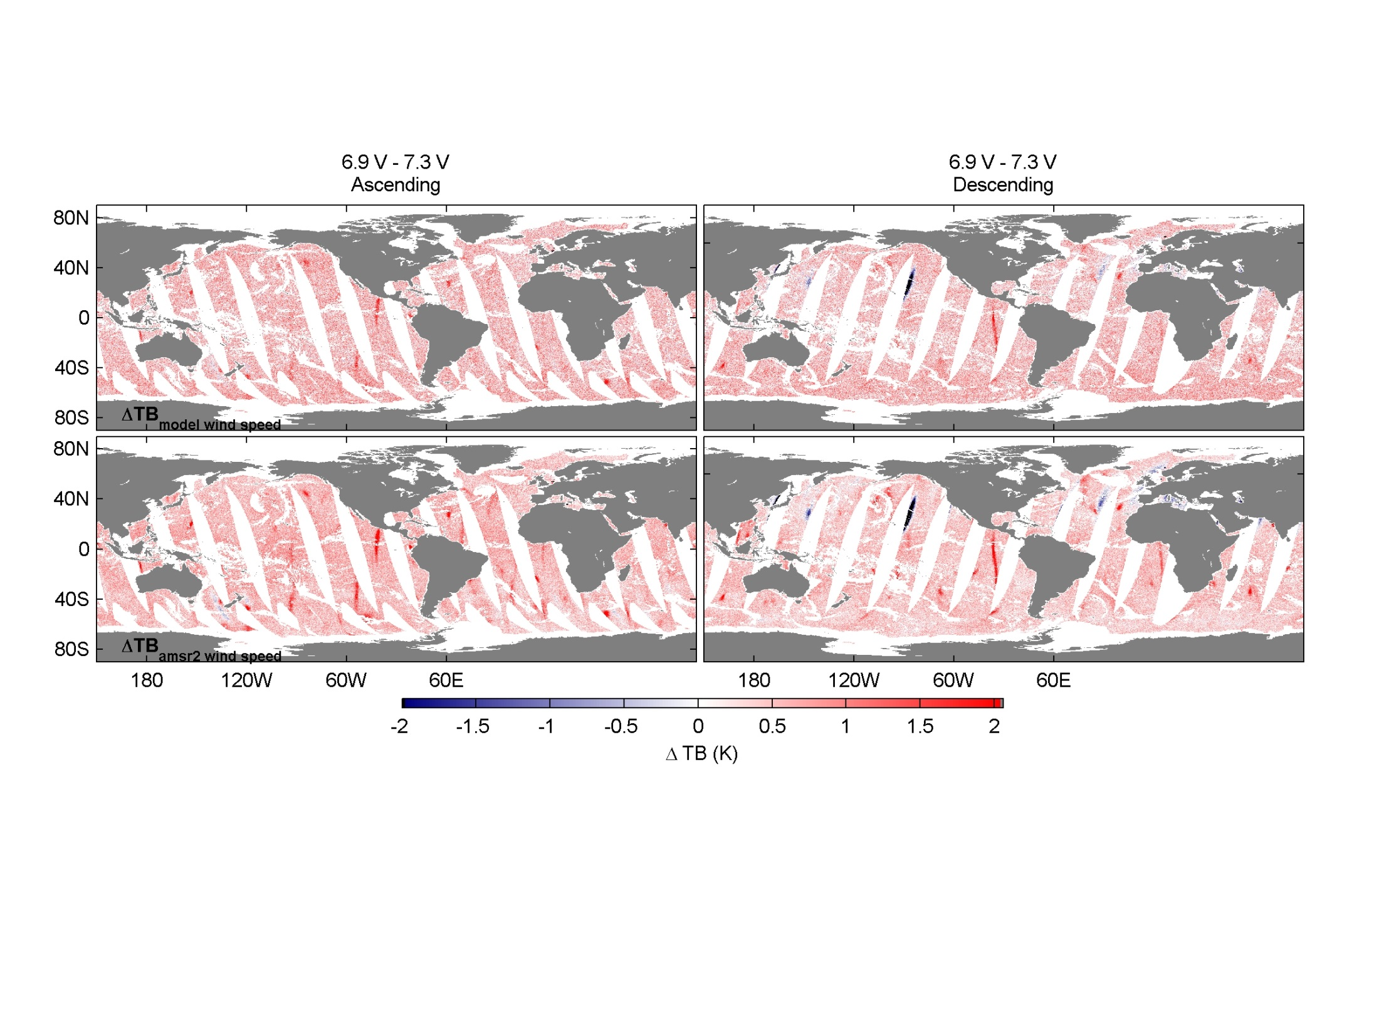
Radio Frequency Interference
Double difference of brightness temperature minus radiative transfer model simulated brightness temperatures, TB6.9-RTM6.9 – (TB7.3-RTM7.3), showing the many vertical red streaks where satellite-satellite RFI is affecting SST retrievals.
Presently the only method for removing these contaminated SST retrievals depends on having both 6.9GHz and 7.3GHz channels (from Gentemann et al (2015)).
Notes:
Geostationary RFI also an issue, but fairly well understood and can be removed. The satellite-satellite RFI is a significantly more subtle problem.

Slide 8
Summary
Uncertain future for PMW SSTs, especially at high latitudes where the PMW SSTs provide valuable through-cloud data in the region where the climate is changing most rapidly.
The current outlook means there is a high risk of a gap, particularly for SSTs using the ~7GHz channel.
The GHRSST science team meeting will be in Qingdao in June 2017 and should facilitate closer collaboration with China on the HY-2 and FY-3 series towards PMW SST capabilities. There is a need to work together on lower level data to ensure sensors are well calibrated and to tie in to existing records.
Presentation to CGMS-44 planned for 7th June 2016. For example the operational availability of PMW data from HY-2 and in the future from Meteor is a CGMS consideration.

Slide 9
Request
Given the current risk to the current and continued PMW constellation for SST and the need for a redundant capability of PMW with ~7 GHz, CEOS is requested to coordinate and encourage its agencies to ensure the continuation of the existing capability and to facilitate the coordination of agencies to ensure continuity and redundancy of PMW for SST.

Slide 10
References
Gentemann, C.L., Meissner, T., & Wentz, F.J. (2010). Accuracy of Satellite Sea Surface Temperatures at 7 and 11 GHz. IEEE Transactions on Geoscience and Remote Sensing, 48, 1009-1018.
Liu, Y., & Minnett, P.J. (2016). Sampling errors in satellite-derived infrared sea-surface temperatures. Part I: Global and regional MODIS fields. Remote Sensing of Environment, 177, 48-64.
Expanded list of mission related papers is given in the position paper.

