Slide 1

Committee on Earth Observation Satellites
Synthesis report on current activities, achievements and plans of WGs & VCs
Assembled by Jean-Louis Fellous
On behalf of SIT Chair Team
SIT-31 Session 8 – Agenda Item 13
CEOS Strategic Implementation Team
ESA/ESRIN, Frascati, Italy
19th-20th April 2016

Slide 2
Working Group on Information System and Services (WGISS)
Committee on Earth Observation Satellites
Prepared by Andy Mitchell (NASA) and Mirko Albani (ESA)

Slide 3

WGISS Recent Achievements & On-going Activities
March 14th to 18th the WGISS-41 and WGCV-40 meetings were jointly held in Canberra, AU.
  Discussions centered around ways in which they might help ensure a cohesive life-cycle for satellite Earth observation data, from its proper calibration and validation to its discovery, access, and analysis. Both WGs agreed to address their Carbon Action Items jointly by developing a process based on a work break-down structure which allows the management of priorities and resources while highlighting areas of collaboration.
WGISS is supporting the creation of guidelines/standards on Data Cubes and on Analysis-Ready Data (ARD) to address the CEOS Chair initiative on the study of future data access and analysis architectures.
  Hosting a 1-2 day(s) "Future Data Architecture" Workshop during WGISS-42 in September 2016.
  WGISS is documenting their efforts in Big Data and Cloud Computing for the FDA Study Report.
Both the CWIC and FedEO have implemented the CEOS OpenSearch interface and are jointly providing access to over 2,300 collections and 76+ millions granules of EO mission data standard interfaces.

Slide 4
WGISS Recent Achievements & On-going Activities (cont’d)
Recovery Observatory Infrastructure ready for a triggering by CEOS Disasters WG. In operational use by the KalHaiti project in CNES.
WGISS Water Portal Project was successfully completed. The operation of the portal was transferred to Tokyo University on April 1st.
Data Stewardship: Persistent Identifiers (PI) Best Practice is being updated. Implemented the new procedure for a Data Purge Alert that was endorsed at the Plenary. Finalizing the WGISS Glossary of Terms. Investigating the benefit of developing a CEOS-recommended metadata model.
WGISS is hosting a series of Technology Exploration Webinars (including topics on Big Data, High Performance Computing (HPC) and Cloud Computing
WGISS is supporting the 2016 CEOS EO Handbook in updating the MIM Instrument/Measurement pages with links to agency’s data access portals for the mission data.

Slide 5
WGISS Contributions to GEO
WGISS has been added as a contributor to the 2016 GEO Work Program Foundational Task GD-7 Subtask 2 ‘GCI Development’ and GD-2 ‘GCI Operations’.
As contributors, WGISS will:
  Continue to advocate for CEOS agency mission data to be contributed to the implementation of the GEOSS via the WGISS interoperable systems and standards. As more CEOS data providers adopt WGISS supported standards (e.g. OGC CSW 2.0.2 and CEOS OpenSearch Best Practices) these data providers holdings will be made discoverable via IDN, CWIC, and FedEO.
  Maintain the website titled ‘Connected data assets’ to provide up-to-date metrics for IDN, CWIC and FedEO.
  Contribute to this activity through the WGISS Technology Exploration Interest Group which serves as a forum for the exchange of technical information and lessons-learned about current and trending software technologies, services, and other internet-based software technologies.

Slide 6
Working Group on Calibration and Validation (WGCV)
Committee on Earth Observation Satellites
Prepared by Albrecht von Bargen (DLR) and Kurtis Thome (NASA)

Slide 7
WGCV-40 Plenary Achievements and status
Topical sessions on Atmosphere, Land surface, Carbon action items, CEOS Chair initiatives, validation metrics
Interaction with SST-VC, IOCCG / OCR-VC, LSI-VC, a.o.
Set-up of ad hoc team for terminology definition
Joint meeting with WGISS
Carbon, Future Data Architecture, LSI-VC
Subgroup reports & Agency update reports from 15 agencies
(membership between stable and growing)
ToRs draft and WGCV work plan layout discussed
Goal: Results will be documented in WGCV two-pagers
Notes:
The achievements of WGCV can be briefly described by the outcomes of WGCV 40 in Canberra:
In contrast to the long trip, the attendance was absolutely high; BoM could be welcomed as new, JAXA as renewed member, ISRO and ANGKASA participated remotely (travel expenses trouble!)
The meeting outline was changed by having focused the usual reporting of agencies and subgroups to updates and action items and introducing several topical sessions such as written above under 1.
A special focus was also set to the interaction with other CEOS entities (T. Cecere’s visit was highly appreciated) which becomes more and more “working level” status: items with those entities are discussed with clear focus and related action items to be solved in conjunction with those entities
Having different discussions, it turned out that here is also a need to collect the terminology definitions (e.g. validation metrics) which are distributed over different groups in WGCV, and agree about I one comprehensive WGCV document. This shall provide basic information also to other CEOS entities.
A fruitful meeting with the above mentioned foci brought us to minuted results. WGCV and WGISS agreed that Carbon AI-38 (assigned to WGISS) will be analyzed by WGCV and WGISS to set-up a proper tasking
Last day was reserved for internal business with main focus on the discussion on the ToRs draft. A final agreement was achieved and the final draft is currently under circulation for approval at coming CEOS plenary. In conjunction the CEOS WGCV work plan will be totally revised during summer time: action items, deliverables on all levels (CEOS, WGCV, WGCV sub-groups) will be part as a rolling plan to be updated with each meeting (finally). Deliverables / results shall be in the future documented as small documents in WGCV format (1-10 pages, depending of content)

Slide 8
WGCV Contributions to CEOS Work Plan 2015
Action Status: Closed: 8 / Open: 4 / Delayed: 2 out of 12 in total
Delayed:
  CV-1 – web-site update: concept in study
  CV-3 – Workshop in on-ground calibration & performance characterization (such workshop successfully implemented for SAR, under organization for optical sensors)
Open
  CV-4 – Self-analysis interaction with VCs/WGs (due end 2016)
  CV-9 – Implementation of RADCALNET (due end 2016)
Work plan update 2016: two task teams (ACIX, Cloud Masking)
most (many) additional new will be contained in Carb-8
Notes:
Status of CEOS work plan 2015 close-out
WGCV is in the lucky situation to have finalized/closed 8 deliverables demonstrating the huge amount of work carried out (however, other haven’t been part)
Two deliverables are delayed but not seen as an real fault: The WGCV secretariat is now working on the web outreach concept and will discuss with all different partners (the web outreach of WGCV is distributed on four different web sites/portals) a comprehensive approach taking into account the need of maintenance, sustainability etc.,
Workshop regarding on-ground calibration and sensor performance had been successfully settled between SAR subgroup and ESA last year at ESTEC, but must be also settled for optical sensors. It is in focus of WGCV but will be delayed.
The only open deliverables are fully in schedule! Chair and Vice-Chair will deliver a report about interaction with other VCs and WGs; RADCALNET is coming into the beta phase within this year!
In the upcoming work plan only two deliverables had been mentioned but those include a lot of work, because they are dedicated to two task teams. One ACIX, is carrying out a dedicated comparison of Atmospheric corrections (approved with a “Go” during WGCV 40) another is related to a comparison of different cloud masking schemes (and its applications) (approval in September)
Many other deliverables will come within CARB-8: sub-tasks in the Carbon action items!

Slide 9
WGCV Main issues and obstacles
Challenge: New activity definitions in CEOS vs. WG basic activities
Typical top-down vs. bottom-up situation
“Best-effort” approach works well bottom-up when
  Motivation of large (science) community exists (see subgroups)
  Resources are bundled in win-win situation
CEOS new activities highly “top-down” ingested (Carbon, etc.)
  Need is well understood by WGCV
  Thorough process to be established to “translate into WG terms”
WGCV worked out a process to handle the competitive situation / supported by WGISS during joint meeting (see also Carbon session)
Notes:
What is a main issue we do observe:
It is a real challenge for the WG to be faced with number of growing ad hoc initiatives / studies and the activities of other VCs/WGs which also “defines” activities in context of WGCV
In a simple picture I can be seen as a competitive situation between a “Top-down” (CEOS plenary initiates and requests WGs to act on) and a “bottom-up” approach (several communities, mostly science, serve the needs of the WGCV: Those are highly motivated by the visibility and the platform which CEOS provides. Since they bring their own resources, they usually like to define their own….)
CEOS WGCV does understand and agrees the needs of the new studies there is a lot of importance behind and it can also move forward the activities of WGCV but only in that case if it is “translated in WGCV terms” so that it fits well (in best case both sides needs: CEOS and scientists working on their specific topic taking into account priority and selection criteria why to do now.).
CEOS WC worked hard on a process how to handle such a situation. We like to draw the attention of the SIT plenary to such a process “model”, because it shows not only value for the specific case as for Carbon but for many others. [Hint: I, Albrecht talked about with Mark to present some slides about,]. We like to make clear that WGISS fully agree with us and works with us n the some model on CarbonAction item 38.

Slide 10
WGCV Governance and meetings
Personal changes
  Subgroup LPV lead
    Chair: Miguel Román (NASA/GSFC)
    Vice-chair: Fernando Camacho (EOLAB/CGLS)
  Subgroup SAR Vice-chair: Bruce Chapman (NASA/JPL)
Dates and places of forthcoming meetings
  CEOS WGCV # 41 hosted by JAXA in Tokyo, Sep 5-7, 2016
  in conjunction with Subgroup SAR meeting (Sep 7-9, 2016)
  Subgroup LPV: aside ESA Living Planet Symposium May 2016
  Subgroup MWSG: IGARSS 2016 (the week before)
  Subgroup IVOS: IGARSS 2016 (the week after)
Notes:
The last slide shall inform the SIT plenary about changes in personal:
We thank the institutions behind the persons which contribute with their funding (substantial in case of NASA!)
I am also proud on our subgroups: They are ready to have their meetings. SAR will be in conjunction with the coming plenary; the others are surround major meetings like IGARSS

Slide 11
Working Group Disasters
Committee on Earth Observation Satellites
Prepared by Stéphane Chalifoux
WG Disasters Chair et al.

Slide 12
Accomplishments/Activities since 29th WG Disasters Plenary
WG Disasters Plenary meeting held in Bonn, 8-10 March. Achievements from pilots and sub-groups discussed and reviewed.
Data Coordination Team - Supports several activities, including the GSNL, continue providing support to request and access data from space agencies.
New members: Research Centre for Earth Operative Monitoring from Russian Federal Space Agency, National Remote Sensing Centre from India and Agence Gabonaise d'Études et d'Observations Spatiales.
Outreach: Side event at the 2016 Understanding Risk (UR) Forum in May, Turkey called: ‘Satellite data for enhanced risk management and reduction - innovative technologies and future applications’ to promote outputs and results of the WG activities, and to strengthen collaboration with key stakeholders.

Slide 13
Accomplishments/Activities since 29th WG Disasters Plenary
Flood Pilot – Mississippi River flood forecast and impact products through U. of Maryland Global Flood Monitoring System and Dartmouth Flood Observatory, and NASA ALOS-2 flood maps (Jan 2016):
  Feedback from Federal Emergency Management Agency was very positive. Progress on regional dashboards in Caribbean and Southeast Asia.
Seismic Pilot – Demonstrated value of EO-based science products for response over Nepal, Chile and Lefkada (Greece) earthquakes
  The Geohazards Exploitation Platform (GEP) is successfully being exploited by scientists as an environment for virtualized and federated processing of EO data; GEP now provides access also to COSMO-SkyMed data; performed first Cloud based processing to support hazard mapping (Chile).
Volcano Pilot – Demonstrated value of EO data on individual volcanic systems, with results from numerous locations that have been communicated to local volcano observatories
  Collected feedback and specific needs from users in Costa Rica, Guatemala, Colombia, Peru, Ecuador, and Chile; on going integration between visible/thermal and SAR; work in progress to achieve systematic arc-wide monitoring of volcanoes in Latin America; developing plan for sustained monitoring.
Notes:
Backup information:
Seismic Pilot – Begun effort for global strain rate mapping using radar interferometry and for improved fault mapping using both optical & radar; demonstrated value of advanced science products for rapid earthquake response; tested the Geohazards Exploitation Platform (GEP) as a new processing environment for virtualized and federated processing of EO data; performed first Cloud based processing using spaceborne SAR to support hazard mapping (Chile EQ - 09/2015); agreed priority acquisition strategies with main contributing EO missions (in particular Sentinel-1); gathered data collections from CEOS and GSNL contributors (in particular VHR radar data) and organised data access through the GEP.

Slide 14
Accomplishments/Activities since 29th WG Disasters Plenary
Landslide Pilot – 1st team meeting held with some 30 participants. Developing Implementation Plan and data requests for Plenary.
Recovery Observatory – World Bank/GFDRR has become co-chair of Oversight Team.
  Working session held December 2015 in Washington with World Bank, GFDRR and UNDP.
  Demonstrator activity defined early 2016. Proposed focus area in Malawi March to June 2016. Mission to Malawi late March 2016 – Government of Malawi (DoDMA) to fully support recovery demonstrator. Sub-group on data licensing created to address commercial licensing issues.
GSNL – New proposal for Greek Supersite is under review by the SAC
  San Andreas fault and Southeast Asia (Indonesia/Philippines) Supersite proposals still under preparation. Good demonstration of EO data value during Iceland eruption.
GEO-DARMA – Sub-group will be formed within WG Disasters, and secretariat being organised.
  Proposal being reworked and approach to partners to begin.

Slide 15
Committee on Earth Observation Satellites
Working Group on Capacity Building and Data Democracy (WGCapD)
Prepared by Jane Olwoch (SANSA)

Slide 16
Objectives of WGCapD
Increase access to data, products, and tools and ability to use them through targeted training workshops;
Build awareness of new mission datasets, and how to use them within the context of existing datasets;
Support CEOS WGs and VCs on their own capacity building initiatives;
Improving communications and coordination between Agency and WG/VC/WGCapD capacity building and education activities as well as related international activities such as the GEOCAB Portal. This will include close collaboration with UNOOSA and other UN agencies to support needs in emerging space agencies.

Slide 17
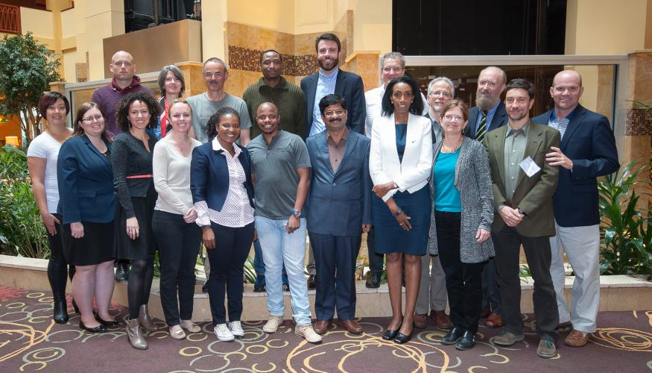
WGCapD Recent Achievements
WGCapD 5th Annual Meeting hosted by the CEOS Systems Engineering Office (SEO) in Hampton, Virginia, USA from Wednesday, March 30, 2016 to Friday, April 1, 2016.
Completed first
phase of the Survey
of Capacity Building
activities in CEOS,
Capacity Building
Summit and draft
document on
Capacity Building
Best Practices

Slide 18
WGCapD 2016 Activities
CB-4: Contribute to Capacity Building Portal (GeocabPortal). Populate the Capacity Building Portal. This portal aims at increasing the awareness of the Capacity Building Inventory across CEOS and GEO.
CB-11: Build awareness and demonstrating the value and applications of EO targeting teachers, students and practitioners in major conferences. The first of these is an event during the Living Planet Symposium (ESA and DLR) in 2016 and SANSA at ISRSE (2017).
CB-13: Continue exploration and providing of appropriate E-learning courses in relevant applications.
CB-15: Survey of CEOS Capacity Building activities and a task report on capacity Building in CEOS + Document on best practices in Capacity building.
CB-16: SAR Training Workshops. Two planned SAR data access and basic processing training workshops. Financial support provided (20,000 Euros from the ESA Copernicus Office, $5, 000 from UNOOSA) for the two workshops, one in Zambia and other in Gabon (both dates to be confirmed).

Slide 19
Ocean Surface Vector Winds- Virtual Constellation (OSVW-VC)
Committee on Earth Observation Satellites
Prepared by Julia Figa (EUMETSAT) and
Paul Chang (NOAA)

Slide 20
OSVW-VC Related Meetings
Last OSVW-VC meeting in conjunction with the IOVWST meeting held May 19-21, 2015 in Portland, Oregon, USA
  Summarized current status of OSVW-VC, presented reviewed ToRs, and posed several questions:
    Is the current constellation sufficient? (temporal sampling, spatial resolution, complementary measurements), should a constellation minimum capability be defined? – Should continuity and new measurement capability be identified separately? -> OSVWC-VC recommendation (next slide) and the elaboration of a capability requirements document
    What are the priorities of the OSVW community (i.e., IOVWST)? -> Elaboration of data standards, but no resources available
    Is there any particular advocacy/actions from the OSVW community that would be helpful for the space agencies? -> scatterometer/AMSR-3 capability in GCOM-W2
High Winds Workshop conducted as follow-up to IOVWST working group recommendation December 9-10, 2015 at NHC in Miami, FL, USA
ISRO ScatSat-1 prelaunch meeting held October 28-29, 2015 at SAC in Ahmedabad, India.
  Participation included personnel from ISRO, EUMETSAT, NOAA, NASA and KNMI. ScatSat-1 planned for a July 2016 launch with a similar open and timely access data policy as OSCAT on OceanSat-2
ESA/EUMETSAT Scatterometer science conference held February 2-4, Noordwijk, The Netherlands, confirmed as above the need for data standards
Next OSVW-VC meeting will be held in conjunction with the IOVWST meeting May 17-19, 2016 in Sapporo, Japan

Slide 21
OSVW-VC: CEOS Action Plan
VC-1: List of Relevant Datasets from VCs (Q4 2016)
  No progress since last technical workshop
VC-14: Vision for an OSVW Constellation (Q4 2016)
  The International Ocean Vector Winds Science Team (IOVWST) meeting held in 2015 strongly recommended: (1) at least three scatterometers in orbits designed to roughly meet the WMO requirements, and, (2) one instrument in a non-sun-synchronous orbit to help with the diurnal cycle, better sampling at mid-latitudes, and to improve inter-calibration. It has been proposed that a User Requirements Document is elaborated. An interim report will be prepared for the next IOVWST meeting to be held in Q2 2016.
VC-15: OSVW Standards and Metrics (Q4 2016)
  Cal/Val methods will be addressed by the IOVWST Climate Working Group and a definition of a CF compliant basic set of netCDF standard variable names is ongoing within the IOVWST Data Standards Working Group (led by the JPL colleagues at the PODAAC)
  The need and benefit for standardization is recognized, but the resources to coordinate a data and format standards document (as was done for GHRSST) are currently not available within the IOVWST and here there could be an opportunity for the agencies to provide support.

Slide 22
OSVW-VC: CB activities and issues
Planned capacity building activities
Marine forecaster satellite training courses being led by EUMETSAT
  Mediterranean (Croatia hosting) – October 10-14, 2016
  South Africa – December 12-15, 2016
  At this time there is no anticipated need for WGCapD involvement
Issues
Need to continue to advocate for open and timely data access commitments from China and Russia for their planned OSVW missions
Encourage JAXA and ISRO to continue pursuing a joint scatterometer and AMSR-3 sensor package for the GCOM-W2 mission – great benefit to the OSVW and earth observation communities.
Standardization of data, formats and the representation of measurement uncertainty may benefit from additional resources supporting the IOVWST work

Slide 23
Land Surface Imaging - Virtual Constellation (LSI-VC)
Committee on Earth Observation Satellites
Prepared by Jennifer Lacey (USGS),
Bianca Hoersch (ESA) and
Adam Lewis (Geoscience Australia)

Slide 24
LSI-VC – Status
Organization and Meetings
  Initial telecon of LSI-VC was held in December with monthly telecons thereafter
  LSI-VC-1, first face-to-face meeting, was held at ESA ESRIN 22-24 February 2016
  Regularly scheduling monthly LSI-VC meetings and bi-weekly co-Lead meetings
  LSI-VC-2 is being tentatively planned for July 20-22 at NASA Ames
Main Issues/Obstacles
  None at this time

Slide 25
LSI-VC – Accomplishments and Activities
Successful first meeting of the renewed LSI-VC
Met with SDCG for GFOI – valuable exchange of ideas to help guide LSI-VC’s initial direction. Discussed ARD and the SDCG’s Global Data Flows Study
Survey and short report on the tools/processes used by large space agencies to manage multiple different requirements and stakeholders in the operation of their space infrastructure (or indeed any complex, high in demand systems
  Results already presented in Session on Thematic Observing Strategies
Defined an initial LSI-VC Work Plan consisting of five task areas, which include a number of sub-tasks.
  Increase the visibility of land surface imaging data holdings;
  Identify gaps in/opportunities for acquisition planning in support of the CEOS Carbon Strategy;
  Define intercomparable Analysis-Ready Data (ARD) products within the context of land surface imaging;
  Engage in the implementation of trial data cubes;
  Long-term LSI-VC strategy and vision.

Slide 26
LSI-VC – CEOS Work Plan Status
LSI-VC Work Plan Tasks are defined around the CEOS WP Tasks – see WP for further details
Objective/Deliverable | Status
VC-23: Identify gaps in/opportunities for acquisition-planning in support of the CEOS Carbon Strategy | ESA leading a review of the parameters set out in the CEOS Carbon Strategy. A statement of the satellites applicable to each (based on the guidance in the report) will be compiled.
VC-24: Define intercomparable Analysis-Ready Data (ARD) products within the context of land surface imaging | LSI-VC anticipates a paper that draws out the high level principles that characterize ARD. SEO have initiated work on this drawing input from across CEOS, as well as USGS. LSI-VC are working with SEO to integrate efforts
VC-25: Increase the visibility of land surface imaging data holdings | SEO are preparing reports for LSI-VC on some of the technical barriers to visibility of data holdings, e.g., accessible meta-data
VC-26: Pilot approaches to conducting integrated assessments of gaps/opportunities in asset usage | Results from initial survey presented for discussion at SIT-31 (Session 7)
VC-27: Develop a roadmap for the routine production of intercomparable ARD | Work on this has not commenced. A key step toward a meaningful roadmap will be CEOS agency commitment to the concept of ARD
VC-28: Establishing enhanced collaboration on wetlands and inland waterway monitoring | No progress

Slide 27














LSI-VC – Team Members
Kevin Gallo
Kim Holloway
Kurt Thome
Matt Steventon
Patrice Henry
Paul Briand
Rajeev Jaiswal
Stephen Ward
Stuart Phinn
Takeo Tadono
Tom Cecere
Zoltan Szantoi
Adam Lewis*
Bianca Hoersch*
Jenn Lacey*
Alan Belward
Albrecht von Bargen
Bimal Bhattacharya
Brian Killough
David Jarrett
Gene Fosnight
George Dyke
Jeff Masek
*Denotes co-chair
SEO
SEO

Slide 28
Committee on Earth Observation Satellites
Sea Surface Temperature - Virtual Constellation (SST-VC)
Prepared by Anne O’Carroll (EUMETSAT) and Ken Casey (NOAA)

Slide 29
SST-VC Achievement
VC-1: Regional/Global task sharing activities continue. 81 GHRSST (Group for High Resolution SST) products now in archive.
New ISRO member welcomed October 2015.
Satellite Oceanography User Workshop, Melbourne, 9-11th November 2015
  https://www.ghrsst.org/ghrsst/Meetings-and-workshops/satellite-oceanography-user-workshop/
Possible SST-VC presentation to IOVWST in Sapporo, May 2016

Slide 30
SST-VC Current activities
VC-19: First draft of white paper in progress
  To include next generation SST Virtual Constellation, including necessary on-orbit assets, measurement methods (MW and IR, Geo and Polar), climate/NWP applications, fiducial reference measurements, and data management systems.
    Dual view IR reference solved by S-3 SLSTR (launch Feb 16)
    Complete geo latitudinal coverage -> ISRO and hopefully CMA
  First draft ready by beginning of May to allow review by the SST-VC and final discussions at the next SST-VC meeting #5 on 10th June 2016, Washington DC.
Constellation
  SST-VC position paper prepared on Passive Microwave radiometer constellation for SST.
  Seeking continuation and redundancy of PMW with 6-7GHz channel(s)
    This topic will be discussed separately

Slide 31
Committee on Earth Observation Satellites
Ocean Surface Topography - Virtual Constellation (OST-VC)
Prepared by Philippe Escudier (CNES) and
Hans Bonekamp (EUMETSAT)

Slide 32
OST-VC recent achievements
Meetings
  The OSTST (Ocean Surface Topography Science Team) international meeting, Reston (VA, USA), October 20-23, 2015
    Provided updates on the status of Jason-2/3 missions
    Held splinter meetings on systems performance (orbit, measurements, corrections), altimetry data products, science outcomes, and outreach
      In addition to the analysis of data from the Topex/Poseidon-Jason series, data analyses from other international missions bringing reciprocal benefits were welcomed.
Missions
  Two recent successful launches represent major milestones for the future of the Ocean Surface Topography constellation :
    Jason-3 (US-Europe) launched January 17, 2016
    Sentinel 3-A (European mission in the framework of the Copernicus program) launched February 16, 2016.
      As soon as they are declared operational, these two new satellites will extend the current OST constellation

Slide 33
OST-VC current status
Jason-2 will be moved into an interleaved orbit with Jason-3
Saral/Altika (India-France)
  In operation, 3 years nominal lifetime mission reached end of February 2016, beginning a two-yr extended mission
CryoSat (ESA)
  Dedicated to ice topography measurement, but providing a valuable complementary ocean surface topography mission
HY-2 (China, with French contribution)
  Operations suspended
Jason-3 and Sentinel 3-A
  Under validation, will soon become operational
In this new configuration, the requirements expressed in the CEOS OST-VC requirement document will be met

Slide 34
On-going activities, status of actions
The OSTST is being renewed
  NASA Announcement of Opportunity (AO) released in Feb 2016
  CNES/EUMETSAT International AO to be released in May
  Joint team selection announcement by end 2016
Forthcoming meeting
  Ocean Surface Topography Science Team meeting, to be held in La Rochelle, France, 31 October - 4 November
  An OST-VC meeting is planned during this event
    Specific item to be addressed :
      Catalog of Cal/Val infrastructure
      Steps towards a new generation of OST-VC to support high resolution oceanography. This topic will be addressed in a special presentation later in this session

Slide 35

Precipitation Virtual Constellation (P-VC)
Committee on Earth Observation Satellites
Prepared by Riko Oki (JAXA) and
Steven Neeck (NASA)

Slide 36
Recent achievements, on-going activities
VC-16: P-VC Data Portal and links to CEOS Water Portal (CLOSED)
  PVCDP has been released and is deployed at http://pvcportal.pps.eosdis.nasa.gov.
  Further refinement is continuing including resolution of firewall issue and the addition of partner data sets.
VC-17: Support to ECV precipitation parameters
  The GPM constellation has remained stable with full observational capabilities. Next scheduled additions are JPSS-1 and Metop-C in 2017 and 2018, respectively (Deliverable #1).
  P-VC members submitted white papers on a combined Cloud and Precipitation Processes mission concept and an End-to-End Water Cycle mission concept to the U.S. 2017 NRC Decadal Survey team in response to a recent RFI (Deliverable #1).
Cross-Calibration Working Group met at UCF.
  The focus remains on improving passive microwave radiometer inter-calibration (Deliverables #2, #3, #4, and #5).

Slide 37
Recent achievements, on-going activities (cont’d)
PPS/MOS continued to produce and distribute all GPM Standard Data Products and specialized NRT products (IMERG, GSMaP) to public users.
  The IMERG NRT version is currently available with 4-5 hour latency with plans to reduce this to 3-4 hour latency.
  Reprocessing of GPM Standard Data Products to V4 has begun (Deliverables #2, #3, #4, and #5).
Multi-month OLYMPEX Ground Validation Campaign in the U.S. Pacific Northwest was completed in February.
  This was the 7th and final major GPM field campaign. (Deliverable #2).
PMM Science Team selections were completed.
  The 60 research proposals selected included activities in multi-satellite inter-calibration, algorithm development, and flood and landslide applications areas. Japanese PMM Science Team selections were also completed and 41 research proposals were selected (Deliverables #2, #3, and #4).

Slide 38
Recent achievements, on-going activities (cont’d)
VC-18: Programs for improvement of global precipitation products
  PPS began producing a GIS translation of the IMERG multi-satellite data product distinguishing surface rain and frozen precipitation in addition to total precipitation GIS product.
  P-VC is supporting the CEOS Disasters Working Group in a new Landslide Pilot in addition to its support to the Flood Pilot.
VC-22: Response to precipitation-related aspects of CEOS Strategy for Water Observations from Space
  P-VC members are developing responses (e.g. Huffman et al./White Paper prospectus, Ferraro et al./CGMS-44 and 8th IPWG side meetings, post-GPM study report to WSIST Water Constellation FS study team).
Issue: Concern remains regarding microwave radiometer (GCOM-W2/W3, DMSP FO) and precipitation radar continuity. NASA TROPICS cubesat constellation and JAXA post-GPM study suggest alternative technology paths (No SIT Chair action requested)

Slide 39
Atmospheric Composition Constellation (ACC-VC)
Committee on Earth Observation Satellites
Prepared by Claus Zehner (ESA),
Jassim Al-Saadi (NASA) and
Ben Veihelmann (ESA)

Slide 40
ACC-VC – Recent achievements, on-going activities, and status of actions in the CEOS Work Plan
VC-2 – “Total ozone dataset validation and harmonization”
  2015 deliverable completed 2015-Q2 on total ozone (peer-reviewed papers on inter-comparison results, European and USA long term data sets – e.g.: http://www.esa-ozone-cci.org/?q=node/160, http://acd-ext.gsfc.nasa.gov/Data_services/merged/).
  New deliverable for 2017-Q4 to produce peer-reviewed papers on nadir profile inter-comparisons and long term (1979-now) combined (US-Europe) total ozone data sets
VC-3 – “Air Quality (AQ) Constellation coordination”
  http://ceos.org/document_management/Virtual_Constellations/ACC/Documents/ACC_White-Paper-A-Geostationary-Satellite-Cx-for-Observing-Global-AQ-v4_Apr2011.pdf
  A new document is now being prepared to define geophysical validation needs for the AQ constellation, deliverable Q2-2017.

Slide 41
ACC-VC – Recent achievements, on-going activities, and status of actions in the CEOS Work Plan
VC-5 – “Greenhouse Gas Constellation coordination”
  2015 deliverable initiating coordination completed 2015-Q2.
  Continuing as an on-going VC activity, with specific deliverables TBD based on developments since CEOS-Strategy-for-Carbon-Observations-from-Space report
Main issues/obstacles
  6 individual Carbon tasks were initially reassigned to ACC as Action Items/Deliverables.
    Some of these tasks can be implemented (e.g. organize international Workshops, work together on improved algorithms, etc.) and some cannot (e.g. establish a GHG Constellation in space) – such a task can only be supported by ACC
    During 2016 the GHG subgroup within ACC will develop a tractable scope for specific deliverables (likely to be a subset of the original 6) and work with SIT chair to help identify a path forward for the other tasks.
The ACC/GHG Constellation membership will be expanded (e.g. TanSat, Microcarb, MERLIN, EC activity on an CO₂ mission) during 2016

Slide 42
ACC-VC – Future meetings
ACC-12 Meeting will be held in Seoul, Korea, in the week of October 10, 2016.
  Hosted by Korea National Institute of Environmental Research
  This will be the first ACC meeting held outside Europe or US!

Slide 43
Ocean Color Reflectance
Virtual Constellation (OCR-VC)
Committee on Earth Observation Satellites
Prepared by Paul DiGiacomo (NOAA),
Paula Bontempi (NASA) and
Craig Donlon (ESA)

Slide 44
OCR-VC – Final status of previous Work Plan actions
VC-7: Agency mapping exercise complete; IOCCG has reviewed and is finalizing.
VC-8: Overall Blue Planet Implementation plan DELIVERED 15 April 2016; active CEOS engagement, including leadership and participation in the 3rd Blue Planet Symposium to be held in the U.S. in Spring/Summer 2017
VC-9: Moving forward w/modular implementation; gaps/challenges exist
VC-10: Water Quality CoP created; implementation plans now being formulated
Also: IOCCG Phytoplankton Functional Types and Polar Seas Reports being printed
Also: Sentinel-3A successfully launched 16 Feb 2016 - first of four Ocean and Land Colour Imagers providing a sustained operational OCR (w/VIIRS) capability to 2030. Complemented by four Sentinel-2 instruments that also have a significant contribution to coastal OCR (S2A was launched June 2015 and S2B will launch later in 2016)

Slide 45
OCR-VC Issues for CEOS-SIT
Ready access to L0 or L1A ocean color radiometry data remains a challenge and item of significant concern for the OCR-VC.
  CEOS-SIT, at the OCR-VC’s request, sent out a letter in July 2015 to those agencies that (plan to) have ocean color missions requesting they consider distribution of Level 0 and Level 1A mission data.
  Formal replies were (only) received from ESA and NOAA (note that NASA already fulfills this requirement), and via email from CNES. The NOAA and CNES responses were in the affirmative regarding access to these data; ESA indicated there was no plan or resources to deliver these data (NB: CEOS-SIT to follow up with EC please as per ESA guidance).
OCR-VC would be most appreciative if all relevant CEOS agencies could respond as to their plans/intentions regarding access to L1A (really as close to L0 as feasibly possible) ocean color data, and more so that this general issue is discussed during SIT/Plenary to advance free, open, routine and timely data exchange of these data.

Slide 46
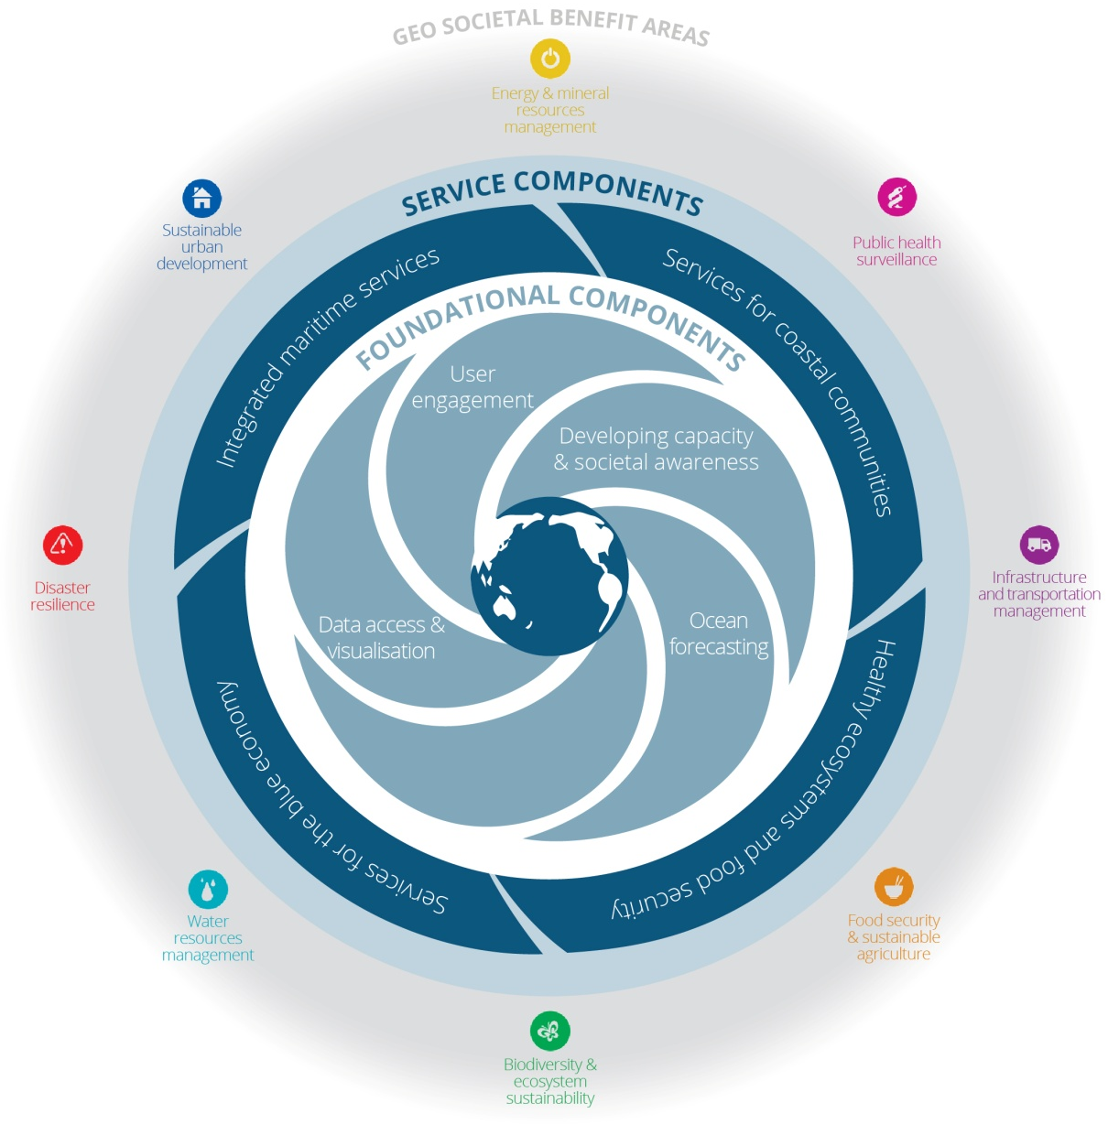
OCR-VC role in GEO Blue Planet
The OCR-VC (participation, expertise, data, products et al.) will play a significant role in the GEO Blue Planet Initiative, cross-cutting its Foundational as well as Service Components (Session #4)

Slide 47
THANK YOU
FOR YOUR ATTENTION
AND PATIENCE!

