Slide 1
Requirements handling – trade-off for acquisition planning
Committee on Earth Observation Satellites
B. Hoersch/ESA for LSI-VC (inputs from ESA, NASA, CSA, USGS)
SIT-31 Agenda Item #11b
CEOS Strategic Implementation Team
ESA/ESRIN, Frascati, Italy
19th-20th April 2016

Slide 2
LSI-VC#1, Action 2-1: Objective of this Survey
Lead a survey of tools or systems in use within CEOS agencies for multiple requirements reconciliation and management *
Present the results at SIT-31 in the form of a short report and presentation.
This is currently limited to the identification of tools however the context is that as CEOS is being asked to take on an increasing number of requests, there needs to be a way for CEOS to assess the full spectrum of existing requests to help us understand the scale of requests and the resources required.
*for existing missions, excluding future missions in this first instance

Slide 3
Participants to the initial Survey
ESA, slides 8-13: Sentinel-1, Sentinel-2
NASA, slides 14-19: ASTER, EO-1
CSA, slides 20-24: Radarsat-2
USGS, slides 25-30: Landsat-7, -8(/-9)
…etc. (NOAA indicated delivery after SIT, others are encouraged to contribute)

Slide 4
Structure, per Agency
Relevant Missions
User categories & general priority schemes
Tools & software for requirements handling
Process description
Results & Information sharing with user community

Slide 5
Priority schemes comparison
ESA: Sentinels | NASA: ASTER | NASA: EO-1 | CSA: RS2 | USGS: Landsat
Spacecraft safety (incl. calibration) | Spacecraft maneuvers | Spacecraft maintenance | Spacecraft health | Space craft safety/orbit maintenance
Emergency Observation (Copernicus Emergency - Security, other) | Emergency/Disaster/Urgent Observations | Mission Science Office National Emergency | National security Emergencies | Charter/Emergency special requests
 |  |  | Image quality and calibration | Calibration
Baseline Obs Scenario Copernicus Services National Other | Individual science/user requests: ASTER team, field work Large monitoring requests (e.g., glacier monitoring or volcano monitoring) Global mapping background acquisitions (reset every 3-5 years) | Priority Science Long term requests Large area mapping Requests from JPL, generally for volcanic activity Optimizing orbit use - lower priority MSO if orbit free (e.g. biodiv.) Requests from the general public | Time Critical Request Non-Time Critical Request Background mission request | United States Coordinated Field Campaigns Day-lit land descending Mid/low Latitudes (54 degrees N to 54 degrees S) Ocean and night special requests Day-lit land ascending High Latitude Day-lit land descending special requests

Slide 6
Timelines comparison
 | ESA: Sentinels | NASA: ASTER | NASA: EO-1 | CSA: RS2 | USGS: Landsat
Consulta-tion intervals | 6 months to once a year typically consultation, or event-driven in case of major changes | Constant via database | Constant via database (only until discontinued) | Canadian Government: submitted to Government order desk monthly Other/commercial: daily/sub-daily | LTAP (long-term) plus special requests (short-term)
Turn-around time | Nominal: 3 to 6 months typically from submission of requirements to definition of the observation plans Ad-hoc special request (priority dependent) | Approximately 2-3 weeks | Approximately 2-3 weeks | Depends on user: few hours to month(s) | Nominal: long-term Ad-hoc special request (priority dependent)
Length of nominal ahead planning before revision | One to few cycles ahead (12/24 for S1, 10 for S2, rolling | 27 hours of selected target lists Daily schedule updates for cloud forecast | Weekly selected target lists Daily schedule updates for cloud forecast | Few hours to month(s) | LTAP with 24h-adaptation: < 725 images per day possible: all candidates scheduled. > 725 candidate scenes, then images excluded as a function of cloud cover prediction and long term cloud cover statistics
Length of re-planning | Typically ½ - 1day for replanning for S1, typically 1 week for S2, exceptionally 2-3 days for e.g. emergency | 24-36 hours for time-critical events (e.g., disasters) | 1-3 days for time-critical events (e.g., disasters) | Few hours | Daily

Slide 7
For Reference
Details per Agency and Mission in the following slides

Slide 8
Agency#1: European Space Agency

Slide 9
1. Relevant Missions (= not systematically acquiring)
Sentinel-1A (1B)
C-SAR, 3 April 2014 (22 Apr 2016), 7.25years each,
Main application domains requiring trade-off: tectonics, volcanoes, landslides, subsidence, agriculture, forestry, maritime surveillance, emergency, security, ice sheets, glaciers, permafrost & snow, icebergs, lake ice, sea state etc
Main constraint leading to the need for trade-off: 4 different SAR modes, SAR duty cycle, download constraints incl. QRT or NRT needs
Sentinel-2A (2B) – mostly during ramp-up Phase
MSI, 23 June 2015 (Q1/2017), 7.25years each
Main application domains requiring trade-off: agriculture, vegetation, forestry, land use, land cover and change, coastal regions/shallow waters, glaciers, snow, ice, icebergs, emergency, etc.
Main constraint leading to the need for trade-off: acquisition/downlink capacity during ramp-up Phase (before systematic acquisitions), later systematic acquisitions over land

Slide 10
2. User categories & general priority scheme
Based on Copernicus Regulation, GSC Programme Declaration, and the EU-ESA Copernicus Agreement
It is used for managing the few potential conflicting user needs for accessing Sentinel missions’ resources
It is expected that most of the potential conflicts can be solved by appropriate planning of shared resources among the Sentinels two-spacecraft constellation
1 (first priority) Spacecraft safety
2 Emergency Observations (no specific priority is applied among the items of the list below):
- Copernicus Emergency Management Service
- Copernicus security services
- Other cases as defined above, handled through the mission management.
Baseline observation scenario
Copernicus service use: Copernicus service providers, responding to the Copernicus governance, consisting of all “Copernicus services” approved by the European Commission
National utilisation by Participating States in accordance with the Copernicus Regulation and the GMES Space Component Programme Declaration and by the following EU institutions: European Parliament, European Council, Council of European Union, European Commission, European External Action Service (EEAS)
Other use: Cooperation agreements between EU and international partners, scientific use, other use
https://sentinels.copernicus.eu/documents/247904/351367/Sentinel+High+Level+Operations+Plan

Slide 11
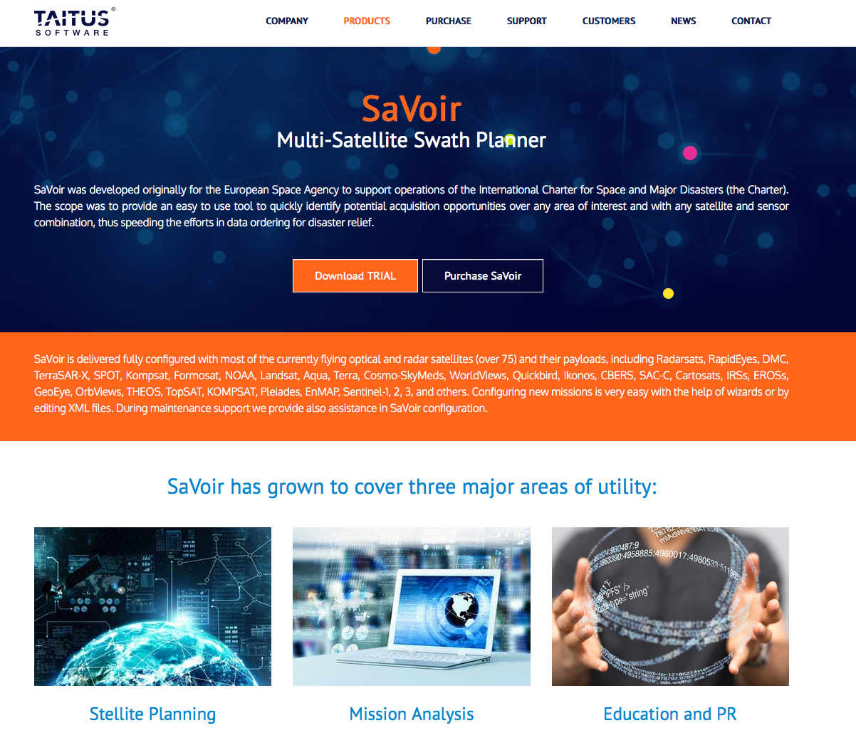
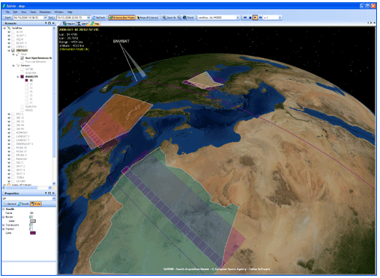
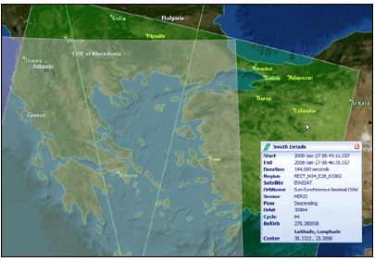
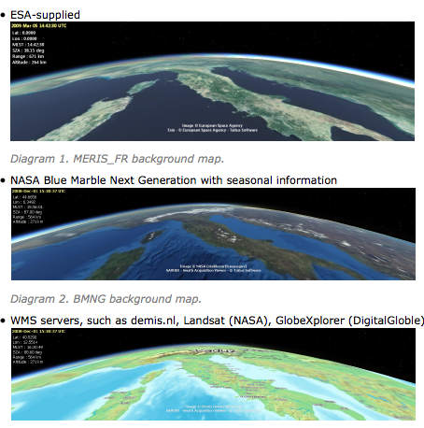
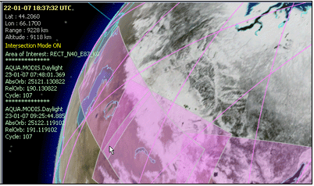
3. Tools for requirements handling: Sentinels
Software based on SaVoir, developed under ESA contract by Taitus, IT
Proprietary software
Free trial version (30 days)
http://www.taitussoftware.com/products/applications/savoir-multi-satellite-swath-planner/

Slide 12
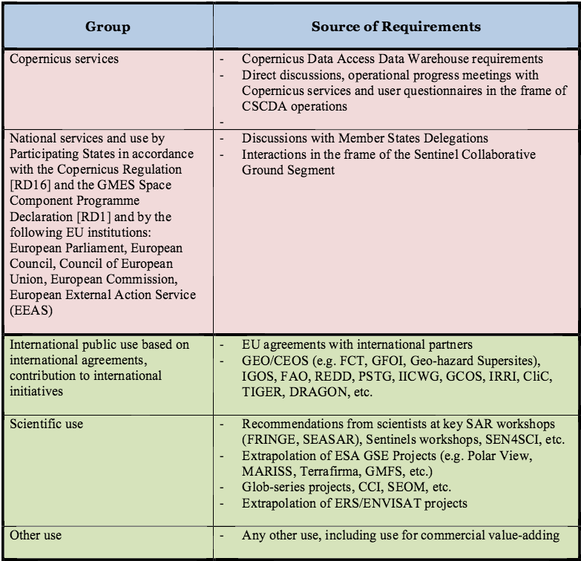
4. Process description
Collection of requirements:
The consultation of the European Commission and ESA/EU Member States on both the collection of observation requirements and the resulting observation plans is planned to take place once a year typically, or as needed in case of major changes
A time interval of 3 to 6 months indicatively is necessary between the submission of requirements and the effective definition of the observation plans, in order to perform the necessary analyses, simulations and optimisation in the use of mission resources. The approval mechanism with the Commission is based on the following principles:
before issuing a new version of the HLOP and/or a baseline observation scenario update, ESA submits the draft of the document to the Commission for review and endorsement
on request by the Commission, ESA will support the presentation of HLOP updates to the relevant Copernicus boards (e.g. User Forum, Committee, Ground Segment Task Force)
the gradual extension of the observation scenario during the ramp-up phase (in line with the increasing operational capacity), as well as day-to-day routine changes during full operations (e.g. due to technical reasons) will be done at the discretion of ESA.
→ https://sentinels.copernicus.eu/documents/247904/351367/Sentinel+High+Level+Operations+Plan

Slide 13
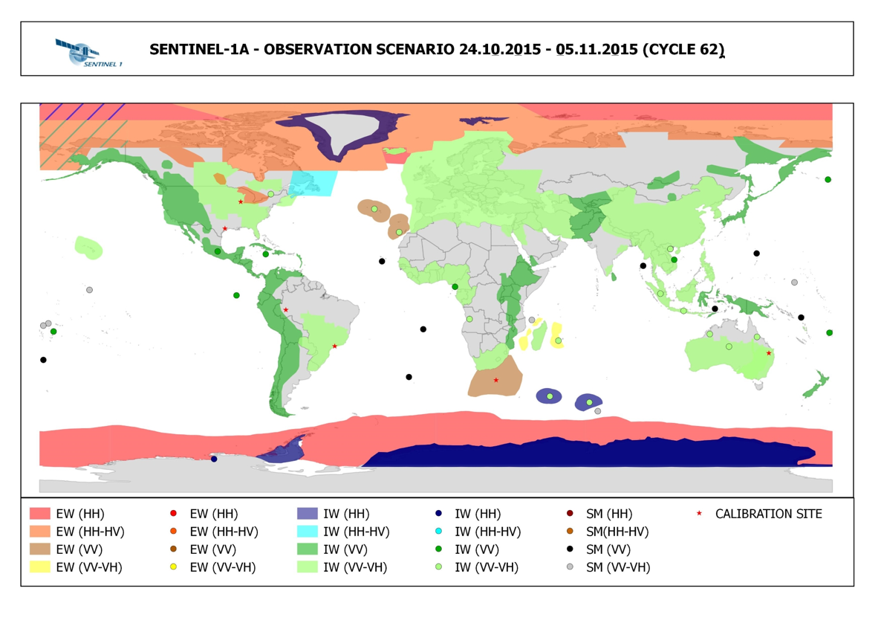
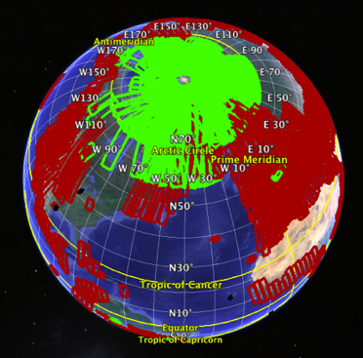
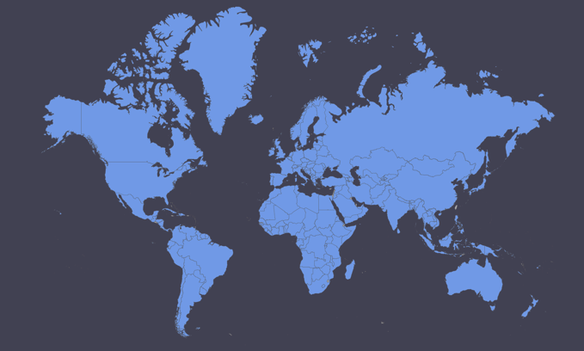
5. Results & Information sharing with user community:
Sentinels
Sentinel-1 observation scenario regularly published online:
https://sentinels.copernicus.eu/web/sentinel/missions/sentinel-1/observation-scenario
Sentinel-1 acquisition segments regularly published online:
https://sentinels.copernicus.eu/web/sentinel/missions/sentinel-1/observation-scenario/acquisition-segments
Sentinel-2 observation scenario is fixed (for routine Phase):
https://sentinel.esa.int/web/sentinel/user-guides/sentinel-2-msi/revisit-coverage
(during ramp-up Phase, a reduced observation is executed at e.g. 20-30 days interval, see below)
Sentinel-2 observation plan is published online ahead of every repeat cycle at: https://sentinels.copernicus.eu/web/sentinel/missions/sentinel-2 /observation-scenario
→ https://sentinels.copernicus.eu/documents/247904/351367/Sentinel+High+Level+Operations+Plan

Slide 14
Agency#2: National Aeronautics and Space Administration

Slide 15
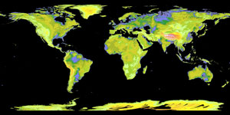
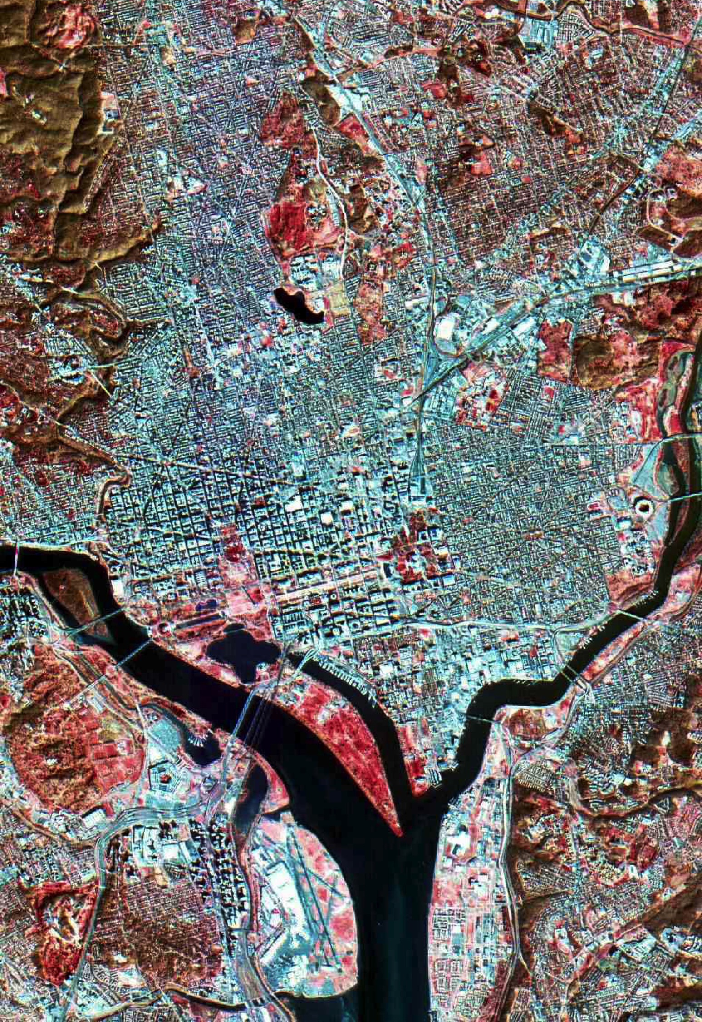
1. Relevant Missions (= not systematically acquiring)
Advanced Spaceborne Thermal Emission and Reflection Radiometer (ASTER)
VNIR-SWIR-TIR imager aboard the Terra platform (1999-present)
Cooperative effort between Japan (METI) and U.S. (NASA)
Main applications involve geologic mapping (reflective , emissive), land surface temperature, geologic hazards, ecosystem properties, glacier dynamics, and global Digital Elevation Model (DEM) generation
Main constraint leading to the need for trade-off: ASTER has an 8% memory duty cycle, so every day a schedule is created to determine which scenes will be acquired.
http://asterweb.jpl.nasa.gov
Earth Observing – 1 (EO-1)
Two imaging instruments
Advanced Land Imager (ALI) - VNIR-SWIR pushbroom multispectral imager prototype for Operational Land Imager (OLI) on Landsat 8
Hyperion - VNIR-SWIR hyperspectral imager
Launched as a technology demonstration mission in 2000 through the NASA New Millennium Program
EO-1 is scheduled for decommissioning in 2016-2017
Main applications involve ecological applications and vegetation physiology, geologic mapping, and disaster response
Main constraint leading to the need for trade-off: scheduling conflicts and satellite maintenance may affect instrument availability and there are no guarantees of acquisition. This is a low volume satellite and only one scene per path may be acquired.
https://eo1.gsfc.nasa.gov/new/extended/index.html

Slide 16
2. User categories & general priority scheme
ASTER
Several categories of data acquisition requests are defined as follows, in order of priority:
Spacecraft maneuvers (orbit corrections, debris avoidance, calibration maneuvers) that override image acquisitions
Individual science/user requests - coordination with field campaigns gets preference; who the requester is also gets consideration (ASTER team members are first)
Large monitoring requests (e.g., glacier monitoring or volcano monitoring)
Global mapping background acquisitions (reset approximately every 3-5 years)
EO-1
The EO-1 process for data acquisition, prioritization, and scheduling generally follows the following list, in order of priority:
Mission Science Office (MSO)
National Emergency and Disaster Response Requests
High Priority Science Collects (to support ground and aerial campaigns)
Long term requests for repeated observations and time series are prioritized by seasonality requirements
Large area mapping - requests for consecutive or overlapping imaging
Sensor Web requests from JPL, generally for volcanic activity monitoring
Optimizing orbit use - lower priority MSO scenes are scheduled if an orbit is free (e.g. areas with high biodiversity)
Requests from the general public via the USGS Data Acquisition Requests (DAR) at http://eo1.usgs.gov/dar/instructions

Slide 17
3. Tools for requirements handling
ASTER
The ASTER Ground Data System (GDS) contains software (the ASTER Scheduler) which chooses between different observing alternatives for each small increment of time, in a manner designed to maximize the science return over a time period of a day.
The Scheduler reads all active Data Acquisition Requests (DARs) and Science Team Acquisition Requests (STARs) in the ASTER GDS in order to do this.
Its scheduling algorithm uses a prioritization function to rank the alternative observing modes (and non-observing instrument modes) for each time-step.
The output schedule can be modified by changing the Scheduler’s input parameters; the ASTER Science Team is responsible for choosing these input parameters.
The latest global cloud-cover forecast from NOAA is used as input by the Scheduler each day, when generating the One Day Schedule. These data are used in the prioritization function to increase the fraction of ASTER images which are sufficiently free of clouds to meet the requirements of ASTER users.
ASTER has a custom tool that allows last-minute changes to the daily schedule to respond to urgent requests, natural hazards, etc.
EO-1
Normal imaging operations are controlled by an autonomous on-board scheduling system in concert with an autonomous ground version that mirrors the on-board system. The combination of systems is collectively known as the Autonomous Sciencecraft Experiment (ASE). The ground version screens and sorts all requests by priority and generates the onboard goals/targets for uplink to the spacecraft scheduling system.
The ASE system selects targets, S-band command and telemetry capture contacts, and X-band downlinks for the next week automatically based on the target priorities of three sets of inputs in addition to satellite constraints and other engineering activities that need to occur during the next week.
An artificial intelligence engine is used within ASE to generate a selected target list, which is produced for review by personnel at the three input sources. Any individual changes are ingested and the contacts for the next week are finalized with the Near Earth Network Services teams.
On a daily basis, the active requests are sorted into a tasking queue, based on in-view feasibility and a cloud score based on the latest global cloud-cover forecast from NOAA.

Slide 18
4. Process description
ASTER
Users enter their requests through an online Data Acquisition Request (DAR) tool at http://asterweb.jpl.nasa.gov/NewReq.asp.
The DARs are reviewed by a committee of ASTER scientists and NASA HQ personnel.
The daily schedule is constructed using a custom software program that prioritizes ~3000 possible daily data acquisitions to make a one-day schedule.
ASTER has a custom tool that allows last-minute changes to the daily schedule to respond to urgent requests, natural hazards, etc.
More information on the ASTER Scheduling Process can be found at http://asterweb.jpl.nasa.gov/schedule.asp
EO-1
A user enters a Data Acquisition Request (DAR) to provide the information necessary to schedule an acquisition over their area of interest. A new DAR is required for each area or data range.
A user can contact the EO-1 Mission Science Office (MSO) at NASA GSFC and request research acquisition(s).
The general public can
Request acquisitions at http://eo1.usgs.gov/dar/instructions to submit a Data Acquisition Request (DAR).
Obtain the overpass predictions at http://eo1.usgs.gov/acquisition.
The MSO coordinates image collections with the goal to optimize the use of EO-1 for scientific purposes. For example, the MSO can facilitate the requests for short term acquisitions over targets of high interest, large aerial coverage requiring multiple adjacent scenes, repeated coverage, and/or resolve scheduling conflicts.
More information on EO-1 Operational Scheduling can be found at https://eo1.gsfc.nasa.gov/new/OpsMetrics.

Slide 19
5. Results & Information sharing with user community
ASTER
Requesters are sent updates on the status of their requests and acquisition success
ASTER has an online calendar on ASTERWEB site that is constantly updated at http://asterweb.jpl.nasa.gov/gettingdata/calendar.asp
All ASTER data products are now available at no charge to all users at http://asterweb.jpl.nasa.gov/data.asp
EO-1
Weekly selected target lists are posted at https://eo1.gsfc.nasa.gov.
Daily schedules are shown on a map at http://geobpms.geobliki.com/sched.
Acquisition possibilities can be evaluated directly by the general public at http://geobpms/geobliki.com.
Priorities/schedules are shared or are discussed directly by the MSO with the requestor.
All users can setup and submit criteria for scene acquisition notification as well as to to search and download acquired data at http://earthexplorer.usgs.gov and http://earthexplorer.usgs.gov/subscription/submit

Slide 20
Agency#3: Canadian Space Agency

Slide 21
1. Relevant Missions (= not systematically acquiring)
Radarsat-2
C-SAR, December 14, 2007,
Main application domains: Sea ice mapping and ship routing, iceberg detection, marine surveillance for ship and pollution detection, agricultural crop monitoring, disaster monitoring and mapping (flood, landslides, subsidence), forestry, geological mapping, mine monitoring, land use mapping, wetlands mapping, topographic mapping.
Constraint leading to the need for trade-off:
Private-Public Partnership
Commercial vs public/scientific use
> 20 imaging modes
Maritime vs land applications

Slide 22
2. User categories & general priority scheme
MDA is responsible for planning the mission and in particular the planning of system operations.
Two categories of users:
Commercial users
Canadian Government Users
Operational and scientific applications
The priority scheme:
Spacecraft health
National security
Emergencies
Image quality and calibration
Time Critical request
Non-Time Critical Request
Background mission request
Canadian Government operational imaging request falls within the category 5. Scientific applications, international collaborations (CEOS, GEO, etc .) , and others are mainly in category 6.

Slide 23
3. Tools for requirements handling
Commercial End Users are directed to MDA's customer services
Canadian Federal Government Departments and Agencies end users are using the Government order desk services
Order tool: The RADARSAT-2 acquisition planning tool
This tool allows users to view existing data as well as potential acquisitions.
MDA provides the RADARSAT-2 Acquisition Planning Tool software.
Users can search the RADARSAT-2 archive independently and make preliminary assessments for the data acquisitions they require.
Catalogues of available RADARSAT-2 data are available to end-users either locally, through the Acquisition Planning Tool, or by Internet through NEODF-CAT, the National Earth Observation Data Framework web page at Natural Resources Canada.

Slide 24
4. Process description
Canadian Government users:
- Image acquisition planning:
- Annual and seasonal for operational applications
- Seasonal or time specific for scientific applications and collaborative projects (national and international)
- Data ordering submitted to Government order desk on monthly basis.
- Image request process through EMOC (Enhanced Management of Orders and conflicts)
- Data acquisition plan
- Image acquisition, processing and archiving

Slide 25
Agency#4: United States Geological Survey

Slide 26
1. Relevant Missions
• Landsat 7
• ETM+, Operational since 15 April 1999, Expected life : Fuel constrained; anticipated decommissioning in 2020-2021
• Main application domains requiring trade-off: agriculture, vegetation, forestry, land use, land cover and change, coastal regions, evapotranspiration, emergency, etc.
• Physical constraints: on-board memory/downlinks and duty cycle constraints limit optimal imaging to continental land masses below 72 degrees latitude (row 9); images are rejected as a function of cloud cover
• Landsat 8 (Landsat 9 launch date 2021)
• OLI/TIRS, Operational since 18 March 2013, Expected design life 5 years OLI and 3 years TIRS; Fuel: 12+ years
• Main application domains requiring trade-off: agriculture, forestry, land use, land cover and change, coastal regions/shallow waters, snow/ice, emergency, evapotranspiration, fire, etc.
• Physical constraints: downlinks; images are rejected as a function of cloud cover

Slide 27
2. User categories & general priority scheme
Priority scheme for Landsat 7 & 8 Long Term Acquisition Plan
Priority | Originator/category
1 | Space craft safety/orbit maintenance
2 | Charter/Emergency special requests
3 | Calibration
4 | United States
5 | Coordinated Field Campaigns
6 | Day-lit land descending Mid/low Latitudes (54 degrees N to 54 degrees S)
7 | Ocean and night special requests
8 | Day-lit land ascending High Latitude
9 | Day-lit land descending special requests
The primary Landsat mission is to monitor day-lit vegetated land processes.
To meet that goal the land scenes are prioritized to optimize acquisitions over land surfaces.
Sufficient margin exists to image beyond the core mission to acquire snow/ice, open water and night images.

Slide 28
3. Tools for requirements handling: Landsat
Programmatic Requirements Effort:
USGS Land Remote Sensing Program’s “Requirements, Capabilities and Analysis for Earth Observations (RCA-EO)”
User needs driven business management process to address mission priorities, and incorporate evolving Earth observing technology
NOAA/USGS partnership for infrastructure development and data sharing
Focus on value tree, user requirements, and Earth Observation capabilities
Supporting and benefitting from the OSTP National Earth Observation Assessment 2016
Collaborating with DOI and other civil agencies in assessing their needs
Interested in potential collaborations – Australia, ESA/EU, CEOS, …,
1) Value Tree Information (VTI) – Organizational program of Earth observing input and capabilities mapped to the organization’s goals and objectives
Agency Strategic Plan Mission Areas, Goals, Strategies..
2) User Requirements, Elicited System Agnostic
Topography
Land Use/Land Cover
Precipitation/Temperature
Streamflow rate
Soil Moisture
…
Science Strategy Goals
Key Products and Services Example:
Future Water Availability Studies
3) Earth Observing Capabilities tied to requirements for gap analysis
Current and Future Earth Observing Capabilities
Earth Observation Requirements Evaluation System (EORES) – database and analysis system

Slide 29
4. Process description
Collection of imaging requirements:
Changes to the Long Term Acquisition Plan are coordinated through the Landsat Calibration and Validation Team, Landsat Science Team, and the Mission Management Office.
All changes to the Long Term Acquisition Plan are modeled to determine impact on acquisitions prior to release.
Special Requests are submitted to the Landsat Data Acquisition Manager via email Off-nadir requests are submitted with a formal off-nadir policy
Science off-nadirs are evaluated by the USGS Landsat Project Science office
Emergency requests request expedited approval through Landsat Project and EROS Center management
The Landsat Multi-mission User Portal is under development to support special request submission, approval, and presentation of results to the user community.
Special Request Type | Description
Emergency/priority nadir | Charter and other emergency requests
Emergency/priority off-nadir | Emergency response and limited science (Arctic/Antarctic)
Ground Look Calibration | Calibration/validation requests
Individual User Requests | Small high priority requests day-lit land field campaigns, ocean or night
Science Campaigns | Large usually low priority requests that require modeling before approval

Slide 30
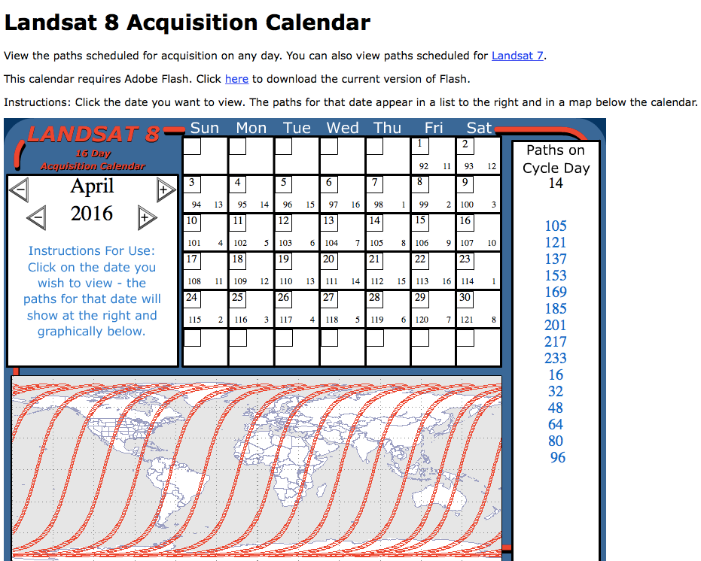
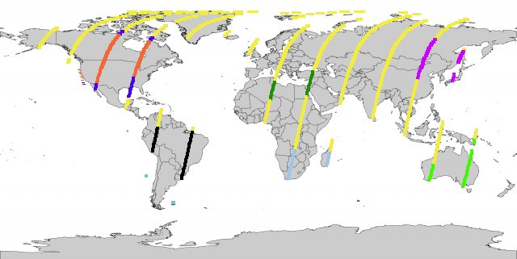
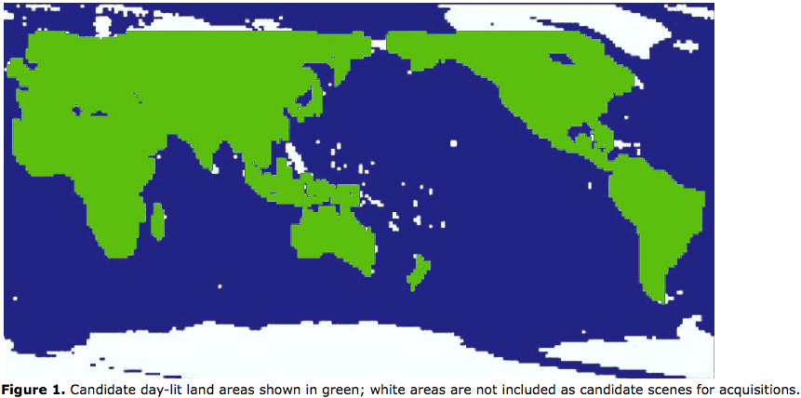
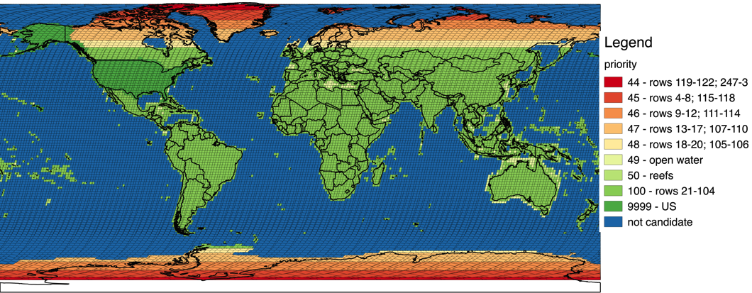
5. Results & Information sharing with user community:
Landsat
Landsat acquisition website
http://landsat.usgs.gov//tools_acq.php
Long Term Acquisition Plans
http://landsat.usgs.gov//LTAP8.php http://landsat.usgs.gov//tools_da_LTAP.php
Lat/long to WRS-2 Path/Row converters and maps
http://landsat.usgs.gov//tools_csf.php
Next day Acquisitions
Landsat 7 Continental Acquisition Strategy
Landsat 8 Acquisition Strategy

