Slide 1
WCDRR and CEOS DRM activities
Committee on Earth Observation Satellites
Stéphane Chalifoux, WG Disasters Chair
SIT-31 Agenda Item # 7
CEOS Strategic Implementation Team
ESA/ESRIN, Frascati, Italy
19th-20th April 2016

Slide 2
World Conference on Disaster Reduction and Recovery (WCDRR) – Sendai, Japan
WCDRR – Over 6,500 delegates attended the intergovernmental and multi-stakeholder events; over 40,000 attended the public forum; 187 States officially represented; over 25 Heads of State, Vice Presidents, and Heads of Government as well as 100 participants at ministerial level.
Sendai Framework (SF) – adopted for 2015-2030 period; 3 explicit references to satellite EO and several articles relying on the use of remote sensing data e.g. to produce regular up-to-date risk maps; strong emphasis on monitoring risk reduction progress.
CEOS & WCDRR:
Active and visible role in Preparatory Committee work;
Two public presentations and several informal ones during side meetings with key stakeholders;
Active participation to 3 Working Sessions (out of 30);
IGNITE stage presentation on pilots and RO;
Two CEOS booths (brochures, poster) hosted by JAXA;
~ 1000 copies of CEOS EO Handbook distributed;
E-course (video) with UNITAR.
Notes:
The IGNITE Stage is a special venue where WCDRR participants are allowed 15 minutes to present a disaster risk reduction topic, project or initiative.

Slide 3
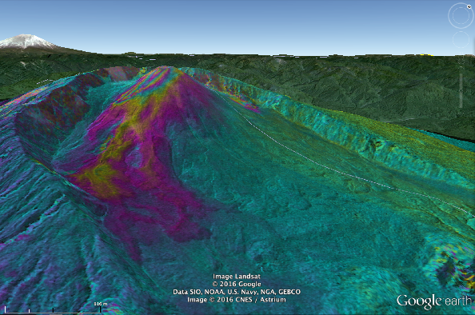
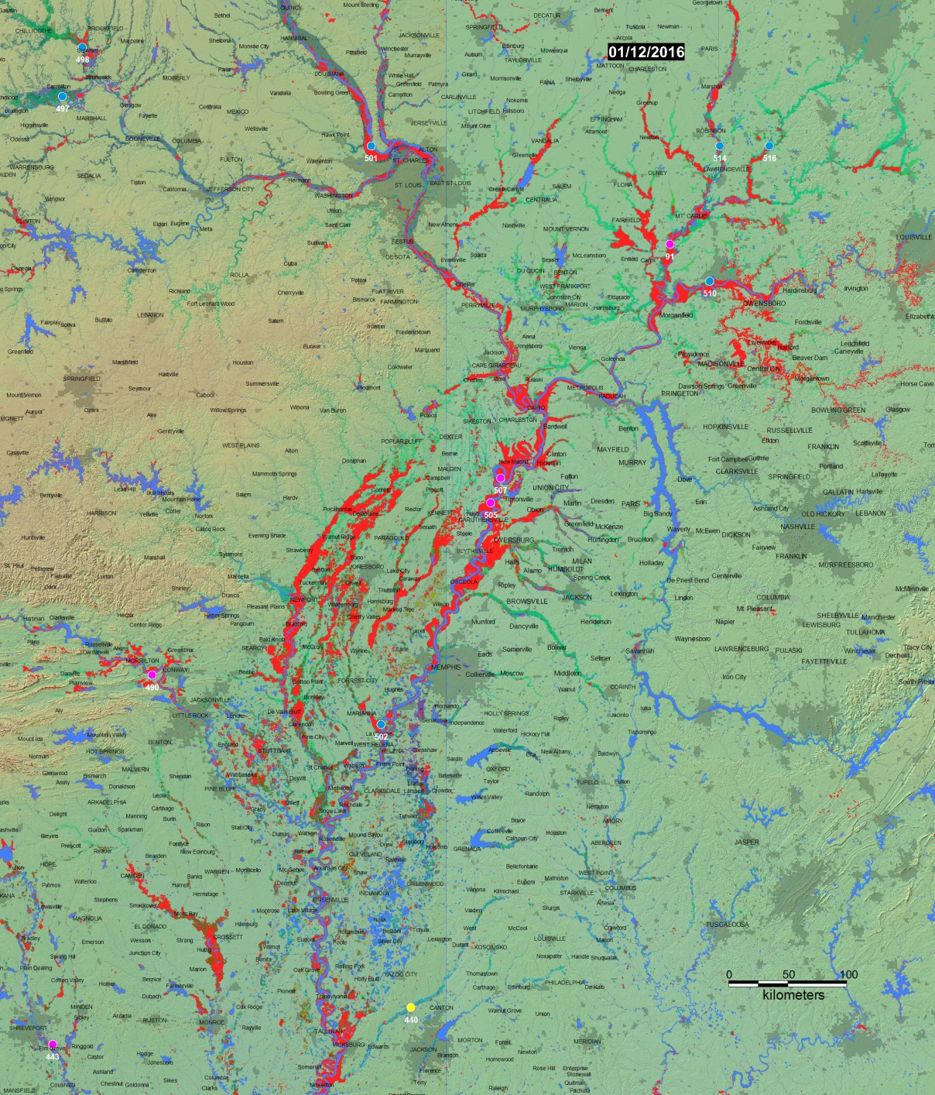
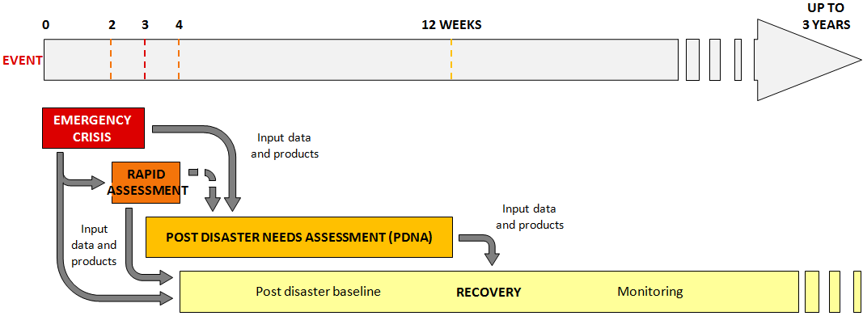
CEOS Disaster Risk Management Pilots
Three thematic pilots (floods, seismic hazards, volcanoes) approved April 2014 to run until end 2017.
Recovery Observatory approved November 2014 – demonstrator with World Bank/GFDRR and Government of Malawi began March 2016.
Fourth thematic pilot on landslides approved November 2015.
Pilots and RO meaningfully demonstrate how satellite EO contributes to DRM, but are not focussed on Sendai Framework (SF) monitoring or SF priorities.
Photos: Brackenridge Mississippi Floods (DFO), TSX data on Reventador, ISTerre (visco-elasticity in Tibet) ,

Slide 4
CEOS Flood Pilot
Leads: NASA, NOAA
Key users/stakeholders: National disaster management agencies, hydrological departments, river commissions, regional and national met organisations.
Achievements: Regional flood “dashboards” in Caribbean, Southern Africa and Mekong; capacity development in Southern Africa.
Issues: Linkages of regional and global activities, using specific flood events followed at high resolution to validate global systems; approach for sustainability of long-term monitoring pre, during, and post-flood.
WCDRR linkage: Floods most prevalent disaster globally; compelling satellite-based approach would offer major step forward.
Notes:
Flood Pilot Objectives
Demonstrate effective application of EO to the full cycle of flood management at all scales by:
Objective A: Integrating information from existing NRT global flood monitoring / modeling systems into a Global Flood Dashboard;
Objective B: Delivering EO-based flood mitigation, warning, and response products and services through regional end-to-end pilots in:
Caribbean/Central America (focus on Haiti)
Southern Africa (inc. Namibia, South Africa, Zambia, Zimbabwe, Mozambique, and Malawi);
Southeast Asia (focus on lower Mekong Basin and Java)
Objective C: Encouraging at least base-level in-country capacity to access EO and integrate it into their operational systems and flood management practices

Slide 5
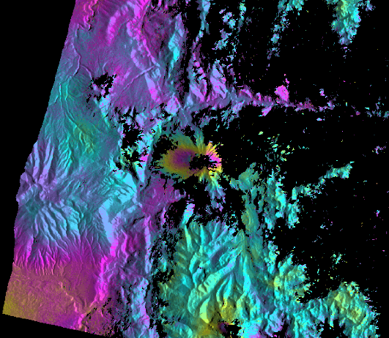
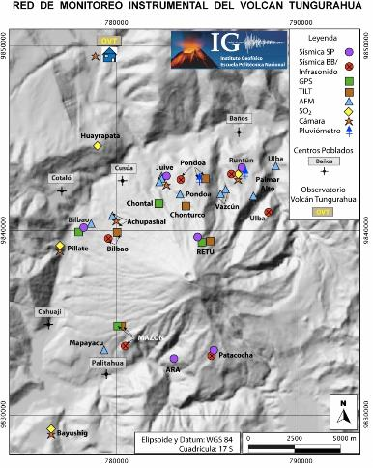
CEOS Volcano Pilot
Leads: USGS, ASI
Key users/stakeholders: National volcano observatories, national civil protection agencies, Washington and Buenos Aires VAACs.
Achievements: Demonstrated value of on-going SAR monitoring and integration of various satellite observations to achieve a complete integrated picture.
Issues: Transfer of lessons learned to sustainable monitoring in Latin America and a vision for global monitoring of Holocene era volcanoes.
WCDRR linkage: Pilot demonstrates clear, measurable ability to reduce risk, but requires global application.
RADARSAT-2 observations lead to new monitoring stations being installed
Notes:
Overall Volcano Pilot Objectives
Demonstrate the feasibility of integrated, systematic and sustained monitoring of Holocene volcanoes using space-based EO;
Demonstrate applicability and superior timeliness of space-based EO products to the operational community for better understanding volcanic activity and reducing impact and risk from eruptions;
Build the capacity for use of EO data in volcanic observatories in Latin America as a showcase for global capacity development opportunities.
Three main components:
Demonstration of systematic monitoring in Latin America;
Development of new products using monitoring from Geohazard Supersites and Natural Laboratories initiative
Showcase monitoring benefits for major eruption during 2014–2016
A Volcanic Ash Advisory Center (VAAC) is a group of experts responsible for coordinating and disseminating information on atmospheric volcanic ash clouds that may endanger aviation.

Slide 6
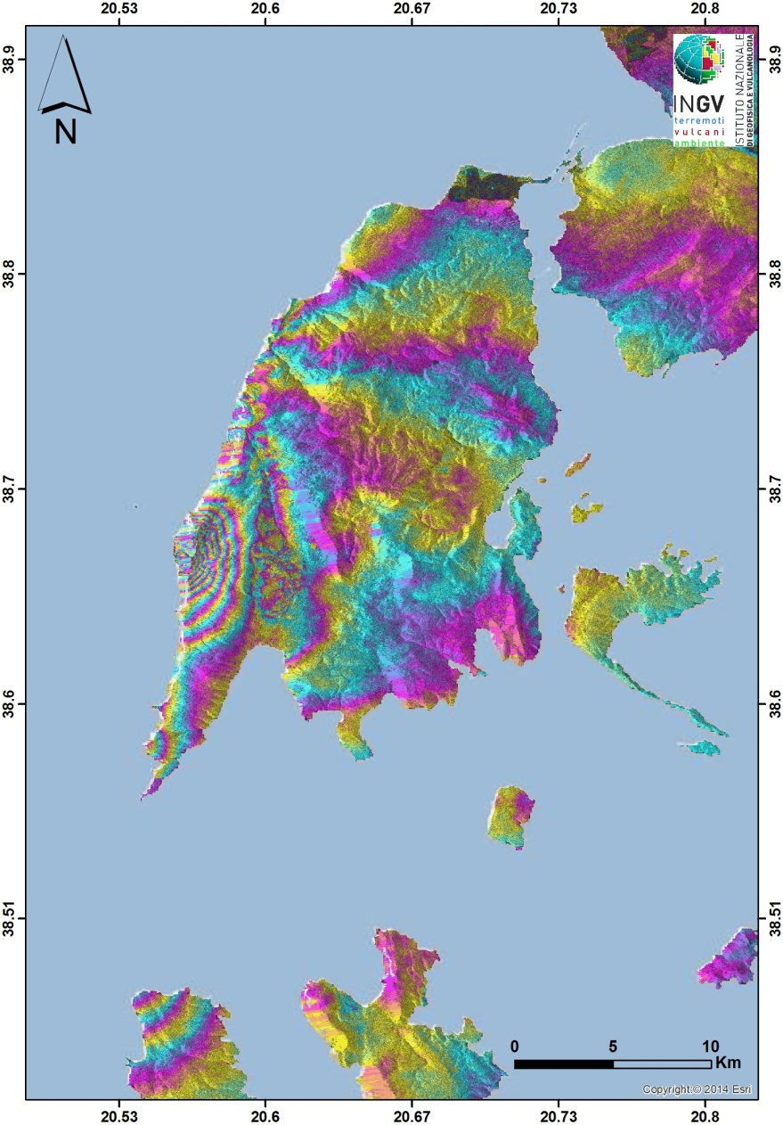
CEOS Seismic Hazards Pilot
Leads: ESA, INGV (Italy)
Key users/stakeholders: National civil protection agencies, science/geohazard agencies in affected countries.
Achievements: Begun effort for global EO-based strain map; demonstrated value of rapid satellite-based science products after events for improved fault mapping and hazard understanding; integrated CEOS satellite data in Geohazards Exploitation Platform.
Issues: Transition from hazard to risk; challenge of integrating science into operational environment.
WCDRR linkage: Pilot shows science can improve hazard understanding; needs closer linkage to WCDRR, possibly through GSNL.
Notes:
Seismic Hazards Pilot Objective
Support the generation of globally self-consistent strain rate estimates and the mapping of active faults at the global scale by providing EO InSAR and optical data and processing capacities to existing initiatives, such as the iGSRM
[role of EO: wide extent satellite observations]
Support and continue the Geohazard Supersites and Natural Laboratories (GSNL) for seismic hazards and volcanoes
[role of EO: multiple observations focused on supersites]
Develop and demonstrate advanced science products for rapid earthquake response.
[role of EO: observation of earthquakes with M>5.8]

Slide 7
CEOS Recovery Observatory (RO)
Leads: CNES, GFDRR
Key users/stakeholders: National government of recovery area (demonstrator – Malawi); World Bank, GFDRR, UNDP, UNOSAT.
Achievements: Working partnership developed with GFDRR to deliver framework for satellite-based recovery planning and assessment; demonstrator Malawi 2016.
Issues: Critical role of value-adding contributions still to be developed for long-term RO; legacy strategy in country relies on strong national involvement; CEOS long-term strategy to be evaluated after 1st RO.
WCDRR linkage: RO strong tool to promote resilient recovery; requires plan for broader, more systematic application.
Notes:
RO Objectives
Demonstrate in a high-profile context the value of using satellite Earth Observations to support Recovery from a major disaster:
near-term (e.g. through a demonstrator working on recovery planning and monitoring); and
long-term (e.g. major recovery planning and implementation, estimated to be about 3 to 5 years).
- Establish institutional relationships between CEOS and stakeholders from the international recovery community.
- Work with the recovery community to define a sustainable vision for increased use of satellite Earth observations in support of recovery.
- Foster innovation around high-technology applications to support recovery.
The Global Facility for Disaster Reduction and Recovery (GFDRR) is a global partnership that helps developing countries better understand and reduce their vulnerabilities to natural hazards and adapt to climate change. Working with over 400 local, national, regional, and international partners, GFDRR provides grant financing, technical assistance, training and knowledge sharing activities to mainstream disaster and climate risk management in policies and strategies. Managed by the World Bank, GFDRR is supported by 34 countries and 9 international organizations.
United Nations Development Programme (UNDP) works, helping to achieve the eradication of poverty, and the reduction of inequalities and exclusion. We help countries to develop policies, leadership skills, partnering abilities, institutional capabilities and build resilience in order to sustain development results.
UNITAR’s (United nations Institute for training and Research) Operational Satellite Applications Programme - UNOSAT
UNOSAT is a technology-intensive programme delivering imagery analysis and satellite solutions to relief and development organisations within and outside the UN system to help make a difference in critical areas such as humanitarian relief, human security, strategic territorial and development planning. UNOSAT develops applied research solutions keeping in sight the needs of the beneficiaries at the end of the process.

Slide 8
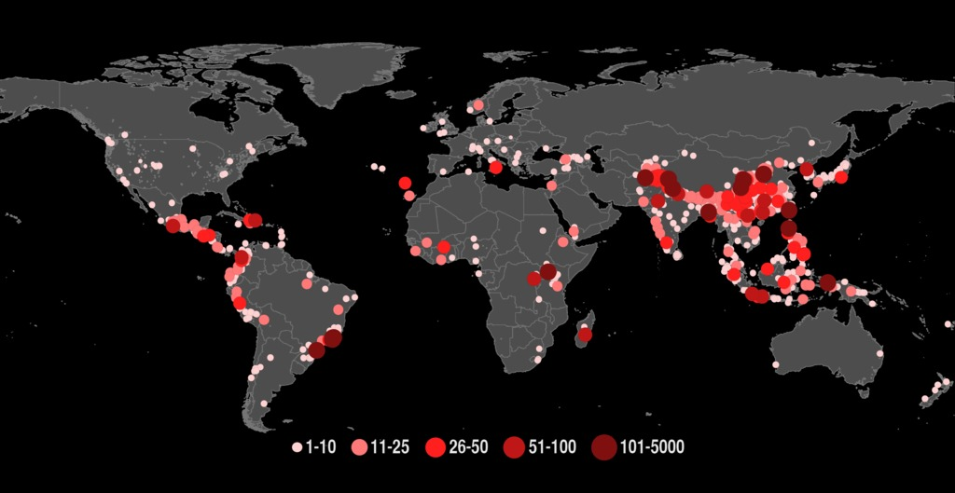
CEOS Landslide Pilot
Fourth thematic pilot on landslides approved at last Plenary
Leads: NASA, others being identified.
Key users/stakeholders: National civil protection agencies.
Achievements: Large team of partners and stakeholders assembled – approximately 30 active partners.
Issues: Development of Implementation Plan; attribution of satellite data quota, determination of focus areas to demonstrate successful monitoring and develop long-term strategy.
WCDRR linkage: Not established.
Landslides with fatalities from a global landslide catalog of rainfall-triggered events 2007-2013 (Kirschbaum et al. 2015)
Notes:
Proposed Landslide Pilot Goal and Objectives
Proposed Goal:
To demonstrate the effective exploitation of Earth observations (EO) data and technologies to detect, map and monitor landslides and landslide prone hillsides, in different physiographic and climatic regions.
To apply satellite EO across the cycle of landslide disaster risk management, including preparedness, situational awareness, response and recovery with a distinct multi-hazard focus on cascading impacts and risks.
Proposed Objectives:
Objective A:
Establish effective practices for merging different Earth Observation data (e.g. optical and radar) to better monitor and map landslide activity over time and space.
Objective B:
Demonstrate how landslide products, models or services can support disaster risk management for multi-hazard and cascading landslide events.
NOTE OBJ C deleted at Bonn meeting:
(Objective C:
Exploit the experience, data, and lessons learned from ongoing pilots (i.e., seismic hazards, floods, volcanoes).)
Objective D:
Engage and partner with data brokers and end users to understand user and service requirements, user expectations, and to get feedback through the activities described in objectives A-C.

Slide 9
CEOS DRM Pilots – Seed questions for discussion
REVIEW. Pilots will be reviewed by Plenary in October 2017 – what are the expectations of CEOS for pilot reporting? Are there any specific concerns or interests?
SUSTAINABILITY. Pilots are on-track to achieve significant success in some areas – what is the CEOS vision for sustainability of successful activities within or outside CEOS?
PARTNERS. Pilots have formed strong partnerships with organizations outside CEOS (GFDRR/World Bank, UNDP, Universities) – how should CEOS encourage continuity of these relationships outside the pilot activity?
WCDRR and SF. What is the best mechanism to directly link positive pilot outcomes to sustainable services tied to SF implementation?

Slide 10
UN Stakeholder participation in pilots
Thematic pilots:
Keiko Saito, GFDRR, Washington, DC (flood pilot).
Emily Niebuhr, WFP, Rome, Italy (flood pilot).
David Farrell, CIMH (WMO affiliated), Bridgetown, Barbados (flood pilot).
Irena Pavlova, UNESCO, Paris, France (landslide pilot).
Recovery Observatory:
Joe Leitmann (Head of Recovery, Team co-chair), Tahir Akbar, and Keiko Saito, GFDRR, Washington, DC
Chiara Mellucci and Jeannette Castro, UNDP, New York, NY
Einar Bjorgo and Olivier Vandamme, UNOSAT, Geneva, Switzerland
Ayaz Parvez, World Bank, Washington, DC
Francis Nkoka, World Bank, Lilongwe, Malawi
Notes:
The World Food Programme (WFP) is the food assistance branch of the United Nations and the world's largest humanitarian organization addressing hunger and promoting food security.
The Caribbean Institute for Meteorology and Hydrology (CIMH) for 43 plus years has been the primary training and education facility for meteorological personnel in the Caribbean. CIMH has resigned itself to not only training but also in the involvement in collative projects that would benefit the local and regional community. The Institute was designated as a Regional Meteorological Training Centre by the World Meteorological Organisation (WMO) in 1978 in recognition of the high standard of its training programmes.

