Slide 1
UN WCDRR Disaster Risk Reduction
Committee on Earth Observation Satellites
Organization ESA
SIT-31 Agenda Item # 7
CEOS Strategic Implementation Team
ESA/ESRIN, Frascati, Italy
19th-20th April 2016

Slide 2
CEOS Strategy for 3rd UN WCDRR
Goal: Foster use of satellite EO in DRR (in all DRM phases)
Objectives:
Demonstrate the significant added-value of satellite EO to DRR (all DRM phases), to WCDRR participants.
“Satellite EO” to be incorporated in “Sendai Framework for DRR 2015-2030”
Create opportunities for future partnership to get additional resources, and/or political backup (at least blessing !)
Issue: Most of DRM community incl. UN agencies present in Sendai, not aware of remote sensing.

Slide 3
CEOS Strategy for 3rd UN WCDRR (cont’)
Strategic actions to achieve that objectives:
Several single-hazards and multi-hazards pilot projects initiated as proofs of concept:
Involvement of key stakeholders: UNDP, UNOSAT, World Bank/GFDRR, Copernicus EMS Risk and Recovery, WFP, UNESCO and GEO .
Lobbying before and during Sendai:
National governments:
Japan Cabinet Office and several others during Sendai Framework negotiation meetings in Geneva;
International organizations:
World Bank/GFDRR, UNISDR, UNESCAP, UNOSAT / UNITAR, UNOOSA.

Slide 4
Follow-on Actions After Sendai
“Sendai Framework for Disaster Risk Reduction 2015-2030”:
For 1st time in 20 y, explicit references to satellite EO.
UN ISDR requested concrete follow-on actions to both CEOS & GEO.
Ongoing space agencies’ disaster-related activities (CEOS or non-CEOS) address several recommendations from the Sendai Framework.
CEOS & GEO SEC developed a new GEO initiative GEO-DARMA, endorsed with whole GEO 2016 WP (GEO Plenary, end 2015).
GEO-DARMA based on cooperation between international organisations incl. UN agencies

Slide 5
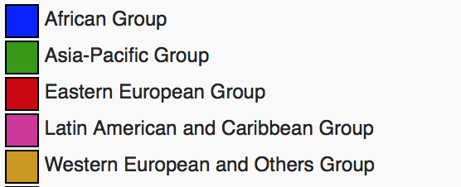
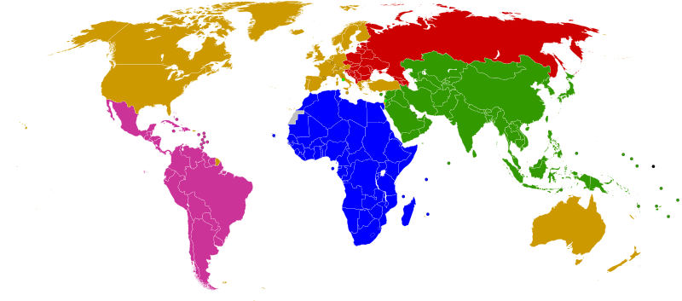
GEO-DARMA Partnership Approach
.
AP
ASEAN
ADRC
SDMC (SAARC)
UNESCAP
APEC
LAS
PIFS
Af
SADC
LAS
ECOWAS
CILSS
IGAD
UNECA
LAC
CDEMA
CEPRELAC
INDM (OAS)
CAPRADE
CRID
ECLAC
International: consider regional processes and programmes of GFDRR, UNDP, UNEP, UNESCO, across regions and in areas where there is no regional organisation (e.g. Central Asia
Notes:
Figure above shows world broken down by UN regions.
As of May 2014, the 193 UN member states are divided into five regional groups:[1]
the African Group, with 54 member states
the Asia-Pacific Group, with 53 member states
the Eastern European Group, with 23 member states
the Latin American and Caribbean Group (GRULAC), with 33 member states
the Western European and Others Group (WEOG), with 28 member states, plus 1 member state as observer.
Proposed initial focus of GEO-DARMA: African Group, Asia-Pacific Group and Latin American and Caribbean Group.
For each region, identify the critical regional organizations and relevant regional processes of leading global organizations involved in DRR
Approach the key organisations to identify priorities for SF implementation where satellite-based monitoring can play critical role
Jointly identify work programme for satellite contributions to existing priorities, or in some cases new initiatives

Slide 6
Follow-on Actions After Sendai
(cont’)
Issues:
Competition between UN agencies to gain more responsibilities and resources after the renegotiations of treaties in 2015 (WCDRR, SDG, COP21).
Participation of UN system in GEO is still a challenge
Space EO coordination role from CEOS, may be claimed by some other organizations, even without having the required competences / resources.
“Disaster Resilience” not covered at GEO SEC

Slide 7
Way Forward
Participation of international / regional organisations during GEO-DARMA Concept Phase is absolutely necessary.
Full cooperation of relevant UN Agencies in GEO-DARMA may be hindered if one non-CEOS agency is strongly opposed.
GEO-DARMA should avoid any major opposition coming from inside the UN or from other major non-UN international organisations.
Constructive attitude: Either propose potential roles, in-line with competences & resources of various actors or get acknowledgment.
Involvement of UN agencies could be facilitated by earlier GEO-UN discussions (if successful !! ).
Past experience shows the importance to discuss the participation of stakeholders via individual / personal contacts.
Notes:
In addition on GEO-DARMA, ESA intends to set up some contractual support from a DRM expert to compensate the lack of expertise at GEO SEC since the departure of Francesco Gaetani.

