Slide 1

Land Imagery Data
Architectures
Committee on Earth Observation Satellites
ESA SIT Chair Team/ CEOS Chair Team / SEO
SIT-31 Agenda Item 9
CEOS Strategic Implementation Team
ESA/ESRIN, Frascati, Italy
19th-20th April 2016

Slide 2
Trends & observations
Many emerging users of EO data use land surface imagery as a core data set for many purposes: SDGs, agriculture, forestry, biodiversity, water resources, urban, climate adaptation and mitigation, health etc. etc.
They are often unsophisticated users but represent a large constituency especially in the emerging sectors and in important policy areas – they are a shallow, but very large user pool.
But.. data size/complexity remain significant obstacles to uptake of CEOS agency data. Data volumes are increasing and traditional data access and exploitation are not convenient or easy for new (or old!) users
‘Internet giants’ are now very active and are changing expectations of users in relation to data uptake and application

Slide 3
Obstacles to uptake.. and solutions
Data size and complexity remain obstacles to uptake by national agencies and by major international programmes (more and better data create more and bigger problems!)
Some initial CEOS and CEOS Agency efforts - examples:
  USGS Analysis Ready Data (ARD) Strategy for Landsat
  GA/CSIRO Data Cube concept, and USGS partnership
  SDCG Global Data Flows study
  CEOS Chair Future Data Architectures AHT
  Multiple pilot activities by SEO (SDMS, Data Cube)
More effort required for government EO data to realise its potential as user-valued information & users are demanding convenient, cheap and easy access to data – or else they do not use it.

Slide 4
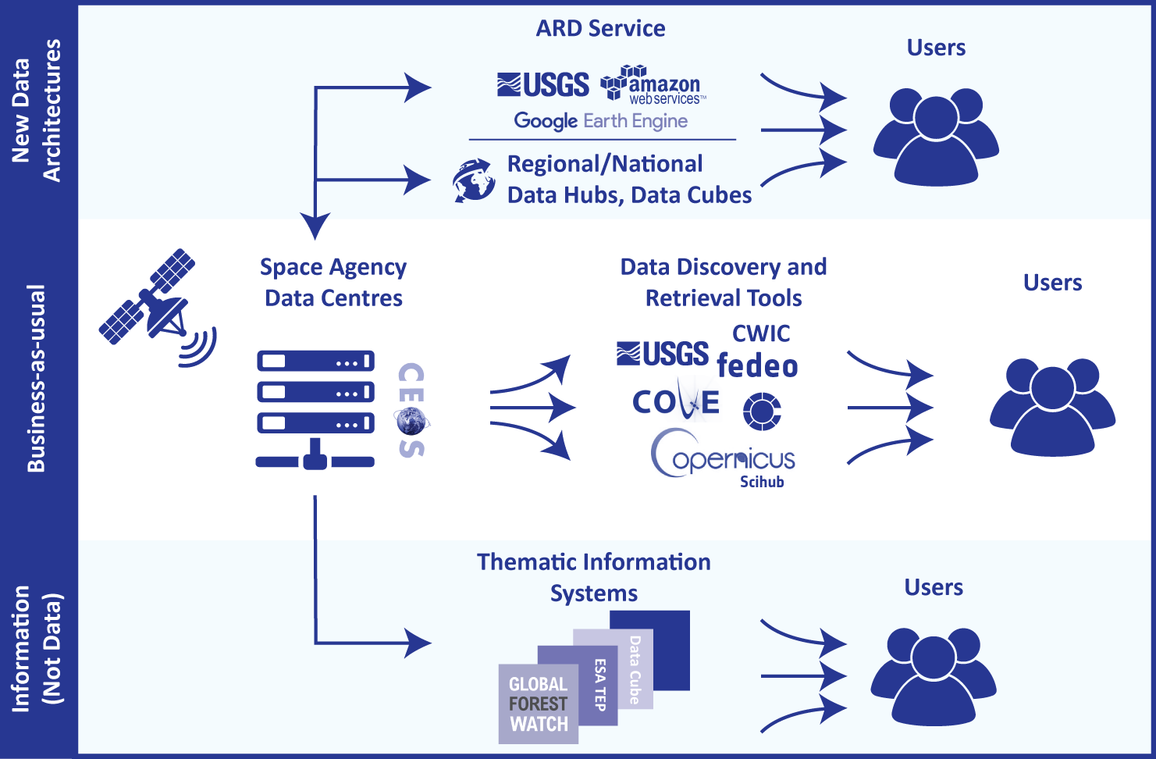
New data architecture examples
Moving less data, more information
Investment in ARD
Move data closer to users (hubs, cloud) for less infrastructure
Commercial costs
~$1M PB/year vs. ~$125k PB/year regional server (e.g. Sentinel on Australian NCI
Significant promise in addressing capacity building obstacles

Slide 5
New data architectures & players
Internet giants (e.g. Amazon, Google) are engaging in provision of EO data (CEOS agency data and/or their own sources) for major societal challenges. Data availability and ease of access make these sources a common choice for users.
Some strategic relationships already established for forestry and REDD+ applications (eg Google-FAO, Amazon-FAO, Global Forest Watch..) using CEOS agency data via commercial suppliers
New architectures and players are removing obstacles to data uptake with advanced cloud storage and processing capabilities. User expectations of space agency data provision are changing as a consequence

Slide 6
New data architectures & players
Discussion topic #1: Given the increasing activity of commercial cloud storage and processing players (such as Amazon and Google) in the uptake and application of CEOS agency missions, what should be the reaction of CEOS agencies? How can agencies take advantage of their entry into the game?
Discussion topic #2: How will government programmes co-exist with these trends? What is the impact on the nature of agency ground segments? Do we need novel partnerships with commercial sector?
Noting: SDCG Global Data Flows report, Future Data Architectures Team report (CEOS Plenary 2016), Recent AWS Grant to CEOS

Slide 7
Obstacles to uptake.. and solutions
Removal of obstacles seen as fundamental to the impact of government EOS programmes on societal challenges
A number of fundamental solutions already in train and require consideration by SIT and a top-down CEOS strategy for optimal results
Discussion topic #3: Analysis Ready Data has potential to support CEOS data uptake efforts. SEO has started a draft ARD description document to support effective coordination and standardisation efforts at this early stage. Should CEOS establish a strategic and top-down approach to ARD – supporting SEO activity and building on it?
Noting: SEO’s draft ARD description document. Ad-hoc Team on AHT report is in progress

Slide 8
New priorities and resources
Much of the work exploring new data architectures and removal of obstacles is reliant on the SEO capacity
SEO has brought essential prototyping development activity
A new geometry and very demanding of SEO
Discussion topic #4: If we wish to pursue with SEO, how might CEOS agencies further support the lead of the CEOS SEO to seize the opportunities ahead?
Noting: Data Cube 3yr Work Plan in progress

