Slide 1

The UN Sustainable Development Goals (SDGs) Process
Committee on Earth Observation Satellites
CSA and CSIRO
SIT-31 Agenda Item 6
CEOS Strategic Implementation Team
ESA/ESRIN, Frascati, Italy
19th-20th April 2016

Slide 2


1- UN SDGs
Transforming our World: The 2030 Agenda for Sustainable Development
The UN is creating a set of global goals, the Sustainable Development Goals (SDGs) to become the focus agendas around the world during the 2015-2030 period.
These goals were developed following extensive consultations and will apply to the whole world.
The UN Sustainable Development Summit in September 2015 adopted the post-2015 development agenda, including the SDGs.
Indicator framework defines
  what is to be monitored,
  who will carry it out and
  how it will it be done

Slide 3

1- UN SDGs
Transforming our World: The 2030 Agenda for Sustainable Development
17 goals, 169 targets, ~230 indicators
Where EO data can help (most obvious/direct use) ?
Implementation is a challenge
International and national priority setting is unavoidable

Slide 4

1- UN SDGs
EO & Geo-spatial information resources for SDG monitoring
But if you think broader (‘areas’) of potential collaborative work… EO satellite data can actually be used as resources for each goal or target
Source: GEO “Supporting Official Statistics in Monitoring the SDGs”, March 2016 – document presented at the 47th UN Statistical Commission in NYC

Slide 5







1 – UN SDGs
Example of use of EO for
SDG monitoring
GOAL 6 “Ensure availability and sustainable management of water and sanitation for all”
TARGET 6.6
“By 2020, protect and restore water-related ecosystems, including mountains, forests wetlands, rivers, aquifers and lakes. “
INDICATOR 6.6.1
Percentage of change in the extent of water-related ecosystems
over time
% of change in wetlands extent over time can be measured globally by earth observation based monitoring of wetlands looking at land-use, land-cover, vegetation cover, inundation frequency, biodiversity

Slide 6
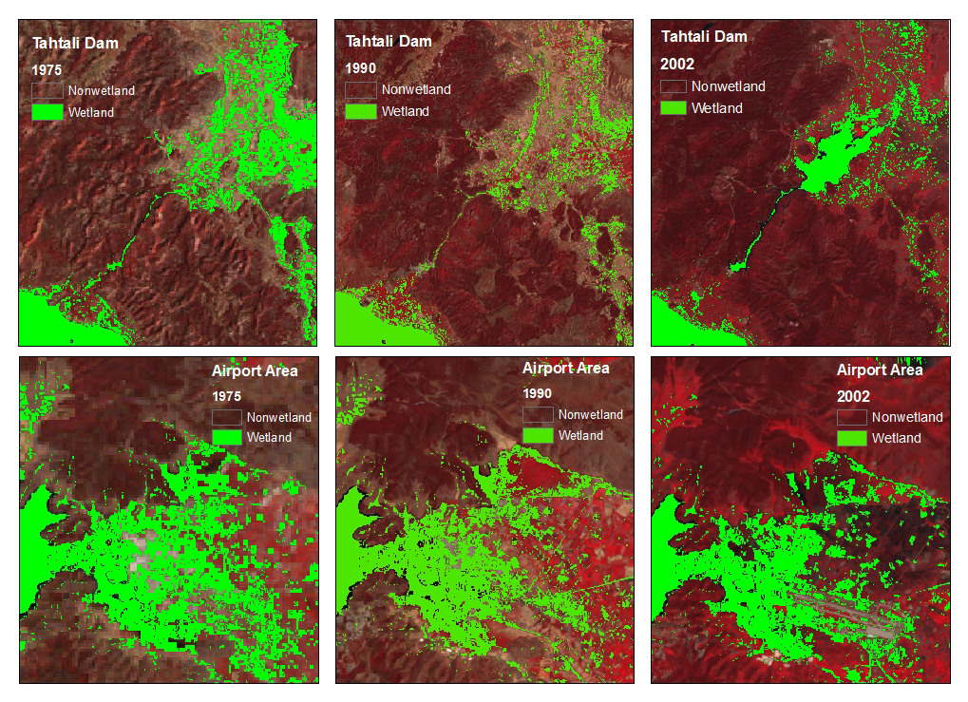
1 – UN SDGs
Example of use of EO for
SDG monitoring
Multi-temporal Wetland Identification and Delineation products (Landsat 1975, 1990, and 2002) for exemplary sites between Izmir and Bodrum (upper part: region around Tahtali Dam; lower part: Bodrum airport area).
http://www.earthzine.org/wp-content/uploads/2011/12/Figure-3.jpg

Slide 7
1- UN SDGs
Most recent News
8-11 March 2016, NY (USA): 47th UN Statistical Commission (UNSC)
  GEO organised a side-event on Geospatial information and EO (with UN CGIM)
CEOS supported the event (collaboration in writing a 4-pager leaflet)
  11 March 2016, NY (USA): the UNSC agreed, "as a practical starting point”, with the global indicator framework proposed by the Inter-Agency and Expert Group on Sustainable Development Goal Indicators (IAEG-SDGs)… noting that the indicators are "subject to further technical refinement”
  More time to work and enhance the potential role of EO satellite data to help monitoring the UNSDGs

Slide 8
1- UN SDGs
Most recent News
IAEG-SDGs
  3rd meeting of the IAEG-SDGs in Mexico (30 March-1 April): creation of a geospatial information subgroup
  Most updated SDG indicators list (24 March 2016): “Provisional Proposed Tiers for Global SDG”:
    Tier I: Indicator conceptually clear, established methodology and standards available and data regularly produced by countries.
  Tier II: Indicator conceptually clear, established methodology and standards available but data are not regularly produced by countries.
  Tier III: Indicator for which there are no established methodology and standards or methodology/standards are being developed/tested.
  http://unstats.un.org/sdgs/files/meetings/iaeg-sdgs-meeting-03/Provisional-Proposed-Tiers-for-SDG-Indicators-24-03-16.pdf

Slide 9
1- UN SDGs
CEOS Past and Current Actions
  CEOS followed GEO actions (GI 18)…
    CEOS principals attended the side event at GEO-XII Plenary in Mexico (Nov 2015): documents on CEOS website: http://ceos.org/documents/#elf_l1_VU5TREcvU0RHX01lZXRpbmdzL0dFTyBYSUkgUGxlbmFyeV9NZXhpY29fMTExNQ
    GI-18: GEO initiative on SDGs includes CEOS members (regular international teleconferences with GEO and UNGGIM)
  CEOS to stay well informed on the UNSDGs process:
    CSIRO (A. Held) participated in a UNCCD Expert meeting on a land indicator (15.3) in Washington
    CEOS agencies are building strong partnerships with their national statistical agencies (CSIRO with the Australian Bureau of Statistics, ABS – for the GWG on BigData)
    CEOS followed carefully the 47th UNSC and communicated accordingly (Twitter/FB/emailing principals)
    CEOS website (document management): creation of a specific location to store all relevant documentation on UNSDGs: http://ceos.org/documents/#elf_l1_VU5TREc

Slide 10
The UN SDGs process : SIT-31 SDGs side-meeting outcomes
Key recommendations
Align with GEO initiative (GI-18) to coordinate wider EO community efforts
Prepare communication strategy and materials:
  work with selected partners to develop compelling cases – e.g. connect with Australian representatives already engaged
  a dedicated CEOS webpage with harmonized examples => CEOS to create a template for agencies to promote SDG examples
Pursue (incl via GEO) partnerships with World Bank/Asia Development Bank and other global financial institutions interested in investing in programs to monitor SDGs (e.g. via DataCube projects)
Monitor EO-related capacity building initiatives and needs through WGCapD
Develop an engagement plan for Plenary endorsement

Slide 11
The UN SDGs process : SIT-31 SDGs side-meeting outcomes
Engagement pathways:
Many stakeholders (CEOS, GEO, UN organisations, private sector, …) are still figuring out how to best engage in the process
National statistics bureaus are the custodians of the official statistics responding to the indicators
EO and geospatial voices will be stronger if channeled through a strong and united voice.
UN GGIM is a key stakeholder, working from inside the UN and sharing the same interests
Recommendation: CEOS should engage through GEO SDG Initiative

Slide 12
The UN SDGs process : SIT-31 SDGs side-meeting outcomes
Building the case for the use of space-based EO for SDG monitoring:
CSIRO is part of the Global Working Group on Big Data for Official Statistics (under UN Statistical Commission)
Inter Agency Expert Group on SDGs is creating a subgroup group on geospatial information
World Band and Development Banks are starting to support initiatives in developing countries
GEO Initiative on SDGs to develop :
  data and information products
  A portfolio of projects conceive, develop, test, validate and deploy uses of EO, including integration with national statistical accounts for the indicators.
Recommendation:
work with selected partners to develop compelling cases – e.g. connect with Australian representatives already engaged
reinforce partnerships with World Bank/Asia Development Bank AND other global financial institutions interested in investing in programs to monitor SDGs (e.g. via Datacube projects)

Slide 13
The UN SDGs process : SIT-31 SDGs side-meeting outcomes
Outreach and awareness
GEO initiative will develop a portfolio of activities and events
Recommendation: CEOS should use its platforms to disseminate and broadcast
Building Capacity
Inter-Agency Expert Group on SDGs is creating a subgroup group on capacity building
GEO Initiative on SDGs to support institutions to build capabilities directly with the SDG methods and more broadly with accessing and applying EO.
Recommendation: WGCapD to monitor capacity building initiatives and provide recommendations to Plenary

Slide 14


GI-18: Draft Implementation Plan
Initiative Goals
Goal I: Earth observations contribute in novel and practical ways to support achievement of the SDGs.
Goal II: Increase skills and capabilities in uses of Earth observations for SDG activities and their broader benefits.
Goal III: Broaden interest and awareness of Earth observations support to the SDGs and social, environmental, and economic benefits.
Each Initiative Goal has associated objectives. Examples:
Produce effective methods for five Goals by 2018 and eight Goals by 2020.
Engage 50 countries in trainings on rolling three-year average.
Issue annual awards in 2017-2020 on uses of Earth observations for SDGs.
GI-18 Initiative

Slide 15
GI-18: Draft Implementation Plan
Implementation Mechanisms
(done in conjunction with existing GEO efforts)
GI-18 Initiative
Projects:
A portfolio of projects conceive, develop, test, validate and deploy uses of Earth observations to support the tracking of and reporting on the SDGs, including integration with national statistical accounts for the indicators.
Capacity Building:
Activities provide support to institutions and individuals in the ideation, development, and implementation of methods, building capabilities directly with the SDG methods and more broadly with accessing and applying Earth observations.
Data and Information Products:
Activities advancing the provision, access, discoverability, and applicability of Earth observations and geospatial information for use with the SDGs.
Outreach and Engagement:
A portfolio of activities and events to promote the consideration and adoption of Earth observations for the SDGs by nations and stakeholders.

Slide 16
Annexes

Slide 17
The UN SDGs process
CEOS strategic directions ?
UN 2030 Agenda provides a great opportunity for CEOS to promote use of satellite EO data for measuring, monitoring and achieving SDGs
Continue working with GEO (to formulate pilot projects in selected countries, to influence and demonstrate the power of monitoring SDG with satellite EO) – clear CEOS involvement (get CEOS logo on materials prepared?)
Connect with their respective national government delegation to the UN Statistical Commission and IAEG-SDG members in particular, to define role of satellite EO for SDG indicator monitoring.
Support and attend relevant SDGs events, on geospatial information when possible to continue influencing the process
Create or reinforce partnerships with
  key UN partners (UN-GGIM, UNOOSA?)
  World Bank/Asia Development Bank AND other global financial institutions interested in investing in programs to monitor SDGs (via Datacube projects?)

Slide 18
The UN SDGs process
CEOS strategic directions ?
CEOS to encourage any national partnership between a space agency and its national statistical office (i.e. CSIRO and ABS)
Identify a few (3 or 4) GOALS or TARGETS (broader than indicators) as examples where EO can be directly useful (with existing and practical case studies), and promote them
Start linking Datacubes projects and the potential for National Statistical Offices to use it to monitor SDGs?
Develop a clear CEOS strategy and messages to facilitate consistent communication within national ecosystems
Analyse how space-based EO can support the implementation of the indicators
Develop capacity building strategy and material, in support of the significant implementation challenge national statistical offices will face

Slide 19
The UN SDGs process :
Topics to be debated at SIT
CEOS own work or only support other global initiatives (such as GI-18 at GEO) ?
“SDGs in CEOS”: a task team to be implemented within CEOS? Or cross-cutting WG and VC?
  WG Climate/WGCapD: to include SDGs in their work plan?
CEOS to support special events (GEO/IAEG SDGS/UN)? If yes how?
CEOS to develop a brochure/leaflet with key case studies (existing) related to some SDGs?
CEOS short-term (2016) / long-term visions?
  Continue influencing to promote the use of EO satellite data at global and national levels?
  Start doing/producing something? I.e.: is it necessary to work on a detailed table on applicability of EO data for EACH indicator, or focus on goals/targets where CEOS can surely bring something
AOQ ??

Slide 20
The UN SDGs process :
SDGs Timeline – events
http://sd.iisd.org/events/ = all events linked to the UN SDGs
March, 2016: Approval of Indicator Framework as a “starting point”
Sept 2016: 3rd Conference on Big Data: CSIRO (A. Dekker) likely to attend and represent CEOS
July, 20-21, NYC (UN headquarters): High-Level Political Forum on Sustainable Development (HLPF 2016)
Sept, 21-22, NYC (Columbia University): 2016 International Conference on Sustainable Development
March 2017, 48th UN Statistical Commission: Endorsement of the Indicator framework = another year to influence the indicators
June 2017, Fiji: High-Level UN Conference to Support the Implementation of SDG 14 (co-hosted by governments of Fiji and Sweden)

Slide 21

Thank you for your attention and support for the 2030 Agenda for Sustainable Development….
CEOS has a key role to play to highlight the importance of geospatial and Earth Observation satellites data
Marie-Josee Bourassa (CSA), CEO
Alex Held (CSIRO), Chair 2016
Flora Kerblat (CSIRO), Chair team 2016

Slide 22
ANNEXES
  CEOS ACTIONS – post SIT
  CEOS to continue working on the UN SDGs and showing examples of the use of EO satellite data, and promote the UN SDGs process…
  e.g. A.Dekker at a national conference in Melbourne, CSS Symposium, March 2016…. (slides to follow)

Slide 23





Other example of use of EO for SDG monitoring: GOAL 15
GOAL 15
“Protect, restore, and promote sustainable use of terrestrial ecosystems, sustainably manage forests, combat desertification, and halt and reverse land degradation and halt biodiversity loss.”
TARGET 15.2
“By 2020, promote the implementation of sustainable management of all types of forests, halt deforestation, restore degraded forests and substantially increase afforestation and reforestation globally“
INDICATOR 15.2.2
Net permanent forest lost
Land cover (time series) to be monitored , such as the global initiative GFOI (to foster the sustained availability of observations for national forest monitoring systems)

Slide 24
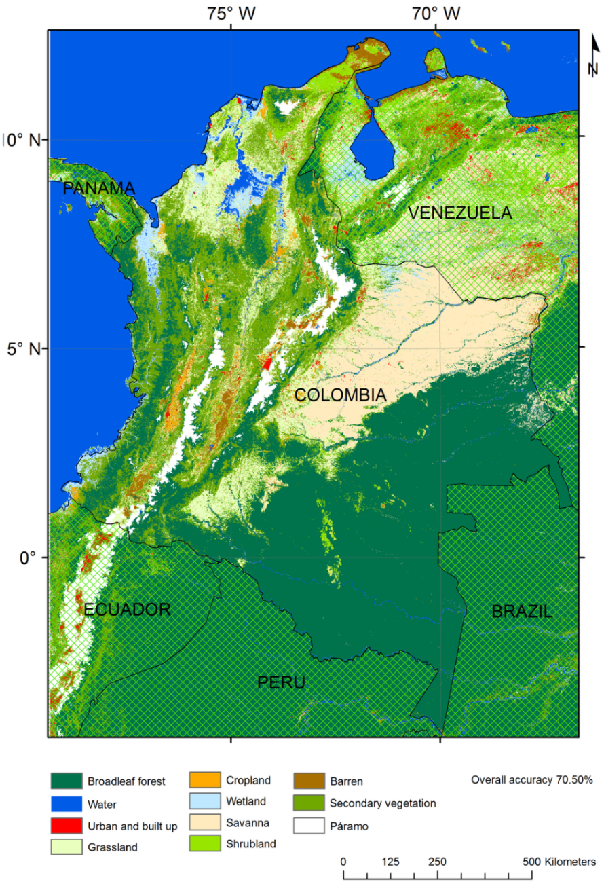
Other example of use of EO for SDG monitoring: GOAL 15
Land cover map for Colombia using 2011 ± 2 years of MODIS NDVI and surface reflectance MOD13A1 data, filtered for low-quality observations and adding elevation (TS-F-C2-E)
http://www.mdpi.com/2072-4292/7/12/15833/htm

