Slide 1
GEOGLAM Strategic Issues for EO Data Coordination
Committee on Earth Observation Satellites
Selma Cherchali (CNES) & Brad Doorn (NASA) co-leads, CEOS Ad Hoc WG for GEOGLAM
SIT-31 Agenda Item #
CEOS Strategic Implementation Team
ESA/ESRIN, Frascati, Italy
19th-20th April 2016

Slide 2
Relevant News
GEOGLAM responded to CEOS' request for high-level guidance via our external Advisory Committee (AC), upon which the CEOS Chair sits.
AC recommendation: Working with CEOS to coordinate satellite data is of the highest priority for GEOGLAM.
Free & open access
End-users (decision makers) vs. intermediate (remote sensing) analysts
In November, GEOGLAM is refreshing its G20 mandate:
Monitoring major production zones
An enhanced focus on food security and smallholder systems (small fields, complex landscapes)
Alignment with global development agenda
GEOGLAM has begun coordinating with CEOS WGCapDev
Initiated coordination around development of SAR training modules
Notes:
Lead with an ongoing statement – first goal is more free and open access to data. Package SAR within that (rather than leading with it).
Making a point – this is the group that could have a major impact on food security.
What is the residual cost on acquiring some S1 data for agriculture? – not much, could be a huge impact
If you’re putting a capability up there, if you aren’t fully exploiting it, you’re wasting capability
Then could say, “We do have requirements out there that could be met” – ask CEOS, how do we go about having them actually met?
Mention that we do HAVE specific requirements that need CEOS intervention (put it in a positive tone)

Slide 3
Strategic Issue #1:
Improving data access and utilization
GEOGLAM needs sustained access to analysis-ready coarse, moderate, and high resolution data including both optical and SAR, with supporting data services/dissemination systems.
GEOGLAM’s enhanced focus on food security requires SAR & fine resolution optical data – both in R&D and national/regional monitoring contexts (sampled basis).
What are the challenges? Data coverage & access for national-level needs; systematic processing of analysis ready data; access to restricted datasets; R&D activities for value-added products; dataset cross-calibration
What are the opportunities? Expanding the base of users; expanded use of multiple, interoperable datasets; cross-cutting impact for other global initiatives(e.g. water sustainability); ground validation data networks
What is the expectation? With proper planning and coordination, CEOS endorsements support will result in enhanced use and impact of EO datasets for global agriculture monitoring.
Notes:
I think we should be prepared to explain what “national/regional monitoring contexts” means. Some will see high resolution and national/regional monitoring and assume blanket coverage is needed. I think there is an opportunity with GEOGLAM datasets that we may be able to utilize moderate and coarse scale analyses from CEOS space agencies to stratify and intelligently sample regional/national AO’s to capture small fields. We should discuss this further in our side meetings.
AKW reply (4/4/2016) → good point. It is used here to indicate that these are nationally driven requirements for national statistics generation (as opposed to broad brush global scale monitoring requirements). It doesn’t mean blanket wall-to-wall, however it will mean some sampling of finer resolution data (as per the requirements table).

Slide 4
Data Requirements Submission Tool
GEOGLAM Requirements well-established and documented (cf. Plenary 2012, 2013, 2014, 2015)
GEOGLAM will begin targeting national level analyses in 2016.
Beginning with Asia-RiCE
Continuing with Ukraine and Argentina
Data Requirements Submission Tool:
Allows GEOGLAM intermediate users to self-report requirements for additional satellite data, when they are ready.
New acquisition requests & access to archival data
Provides enhanced communication of requirements from the national/regional level to the GEOGLAM and CEOS.
Strategic Issue #1a:
Fulfilling GEOGLAM Data Requirements
For analysis-ready data

Slide 5
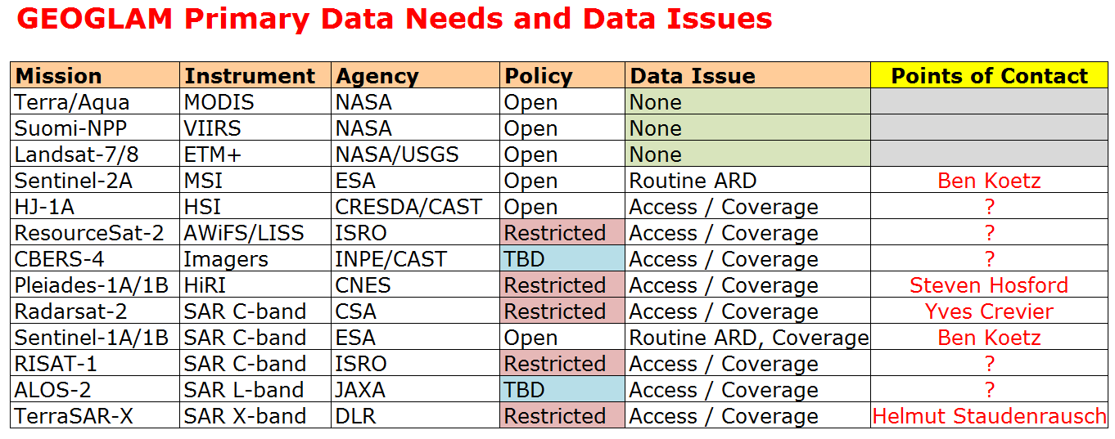
Strategic Issue #1a:
Fulfilling GEOGLAM’s Data Requirements
We already have replies to the Data Requirements Submission Tool:
Highlighting value of & need for coordinated acquisitions (optical+SAR)
PoC | Missions & Modes | Location | When? | Frequency | Max Cloud | Purpose
Natalia Kussul | L8, S2 | Ukraine | March-October | Weekly | 20% | Crop type classification, crop state monitoring, yield forecasting
 | Spot 5 | Kiev Region (Ukraine) | March-October (priority Apr-Jul) | Weekly | 10-20% | Crop classification, crop state monitoring, biomass mapping
 | Sentinel-1 | Ukraine | March-October | Weekly |  | Crop classification
What is the mechanism for requesting future acquisitions?
From near-term (3-18 months) and long-term (mission planning)
CEOS Ad Hoc? Direct to Space Agencies? Other? (coordination team?)
What is the mechanism for requesting archival data (already acquired)?
What is the feedback mechanism from CEOS/space agencies to GEOGLAM, for data requests?
Notes:
The last point is really asking, “if requirements are well-vetted and within the already endorsed GEOGLAM data requirements… what expectation can GEOGLAM have that their requirements will be met?” This will really help with a) further methods development; b) operationalization of methods (institutional buy-in)

Slide 6
Strategic Issue #1b:
Analysis Ready Data for GEOGLAM
There is a lot of interest in using Sentinel-1 and Sentinel-2 data, among other high quality CEOS data
One barrier to EO data adoption is overwhelming pre-processing load
Time
Expertise
Download volume (e.g. eMODIS model)
Storage space
Common theme across all SBAs – need for analysis ready data
Efforts underway to define “ARD” by thematic area (with SEO)
We are tracking GEOGLAM intermediate user needs via Data Request Submission Tool, users can identify their “data readiness level”
Example: Level 1: You have the desire and capacity to analyze the satellite data, but lack the capacity to download, store, and/or preprocess data for use. Therefore, a data services solution is desired to manage any data.

Slide 7
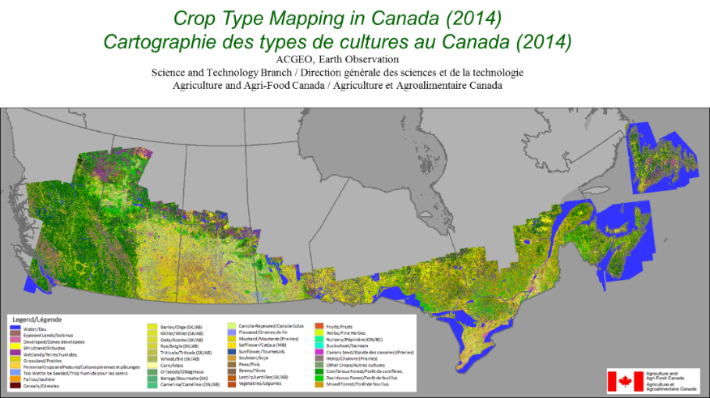
Strategic Issue #2: Promoting SAR data for agricultural monitoring
“The Power of Synthetic Aperture Radar for Global Agricultural Monitoring” (Document for reference on CEOS Ad Hoc WG Website)
Properly configured SAR has been demonstrated scientifically to be as useful for agricultural monitoring as optical data
So, why is SAR underutilized operationally for agriculture?
Infrequent acquisition over agricultural areas
Poor coverage of agricultural areas
Lack of assured data continuity
Lack of pre-processing to “Analysis Ready Data”
Lack of SAR expertise (training needed)
How can
CEOS help?
Preparing for a data rich future
Radarsat-2 is used operationally by AAFC

Slide 8
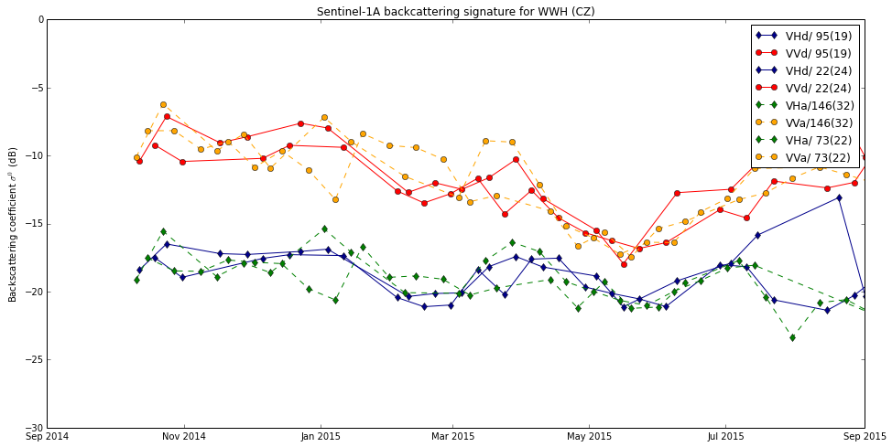
Sentinel-1 Acquisitions for GEOGLAM
Very dense time series of Sentinel-1A over Europe (50+ per season over Europe)
Sentinel-1B acquisitions needed over non-Europe regions – opportunity!
Guido Lemoine (EC JRC)
Areas highly impacted by clouds
focus for SAR acquisition! Whitcraft et al. (2015)
Notes:
The chart on the left is from Guido Lemoine, JRC - A time series of extracted sigma_0 (backscattering coefficient) for a (single) winter wheat field in central Czech Republic, which is covered by 2 ascending and 2 descending relative orbits of Sentinel-1A. This has led to 97 observations over less than one year, translating to much denser coverage than 30 observations expected by the 12 days revisit alone. Note that many areas in Europe are covered by 3, rather than 4, relative orbits, meaning 50 to 60 observations, though that is still more than that which is required to monitor agriculture. This allows for within-season monitoring, which can inform food policy!
SO – WE COULD USE SENTINEL-1B ACQUISITIONS ELSEWHERE
The 2nd image (map) shows the number of months for which there is a failure in capabilities of existing moderate spatial resolution optical remote sensing to meet EO data requirements for agriculture monitoring, due to persistent cloud coverage during important periods of the agricultural growing season. This analysis shows two thresholds of acceptable cloud coverage: < 5% cloudy. These are the areas and times which would benefit greatly from SAR acquisition. (Whitcraft et al., 2015).
4/5/2016 → WE COULD ADD THE CZECH REPUBLIC CROPLAND MAP HERE (IF IT IS READY AND PUBLISHABLE IN TIME FOR SIT) – A GREAT SUCCESS!

Slide 9
How can CEOS help?
Establish mechanisms and processes for meeting GEOGLAM requirements:
Facilitating GEOGLAM access to SAR, duty-cycle limited, or restricted datasets
Continued user demand for free & open datasets
Pre-processing into analysis-ready data products (example of S2 and S1 data)
Developing data services solutions to efficiently distribute and manage data, such as SDMS and Data Cube solutions
Increase EO data utilization by non-traditional users, especially in countries with poor internet connection, computational power, EO-utilization
WGCapD training and capacity development with GEOGLAM
Consider Data Cube options, further develop “analysis ready data” framework
Facilitate access to data in support of generating improved baseline datasets (crop masks and crop calendars)
Increasing COVE tool archive links to support archive analyses
Establishing mechanism to secure data for 3-5 year updates
Engage GEOGLAM in mission planning stages

Slide 10
Backup Slides

Slide 11
The GEOGLAM Initiative
Group on Earth Observation Global Agricultural Monitoring Initiative
Established in 2011 by G20 to provide timely, accurate, and actionable information on crop production…
…by improving the international community’s capacity to utilize EO data for agricultural monitoring at national, regional, and global levels
Seeking re-endorsement, November 2016
Implementation Team
Advisory Committee
GEOGLAM is a system of systems
Community Centric Dynamic Implementation
Responding to intergovernmental and national end-user needs
Harmonizing, centralizing, “glue” functions (GEOGLAM Secretariat):
Coordinating Crop Monitors (AMIS, Early Warning): consensus crop conditions
EO Data Coordination with CEOS: for R&D activities, baseline dataset generation, and developing/implementing community requirements
Operational R&D (JECAM, Asia-RICE)
Capacity Development coordination
Systems
Systems
Systems
Notes:
Acknowledging they want to keep GEOGLAM background to a minimum, this short refresher primes for the rest of the presentation (original endorsement; structure of organization; system of systems approach)

Slide 12
GEOGLAM’s
Data Requirements Submission Tool (1/3)
What? A mechanism for GEOGLAM community members to communicate their space-based EO data needs
Forward looking (new) data needs
Backward looking (archival) data needs
…so that GEOGLAM can work with CEOS and space agencies to meet GEOGLAM’s needs
Why? The first step in a pipeline to request and obtain space-based EO data for agricultural monitoring applications (e.g. crop conditions, crop yield forecasting & estimation, cropland & crop type mask, crop calendars) – coordinated data for GEOGLAM.
A request ≠ a guarantee of fulfillment
Who?
Requests from: Remote sensing analysts who participate in GEOGLAM who need support in discovering, requesting, and/or obtaining space-based EO data
Requests to: CEOS, the CEOS Ad Hoc Working Group for GEOGLAM, and the space agencies
12
Notes:
From Brad/Selma: Good description, but we think a short description with a description of either preliminary results/example responses/etc would provide the SIT a real sign of action, especially as it pertains to the last bullet and the idea of really impacting CEOS requests/processes.
From Alyssa (3/1/2016) → Survey is ready. Will be deployed in the end of the month, after I announce it to the Crop Monitor communities on the next call. There may be some responses by SIT, cannot guarantee. Put some screen-caps of the survey on the next slide.

Slide 13
GEOGLAM’s Data Requirements
Submission Tool (2/3)
Which Data?
New Acquisitions: any mission currently operational from a civil space agency
Archival Data: a few missions currently available, working to expand (see next slide)
Free & Open Datasets:
Landsat 5 (1985 – 2012)
Landsat 7 (1999 – Present; 2003 – Present SLC-off era)
Landsat 8 (Feb 2013 – Present)
Sentinel 2A (Jun 2015 – Present)
Sentinel 1A (Apr 2014 – Present)
Restricted Datasets: (fee-based, or use-restricted; requiring CEOS intervention)
SPOT 5 (May 2002 – 2015)
SPOT 4 (1998 – 2013)
SPOT 3 (1993 – 1997)
SPOT 2 (1990 – 2009)
Pleiades (2011 – Present)
Radarsat-2 (fine quad, ScanSar) - (December 2007 – Present)
ALOS-1 (2006 – 2001)
TerraSar-X (2007 – Present)

Slide 14
GEOGLAM’s
Data Requirements Submission Tool (3/3)
How?
Step 1: Submit requests here: https://goo.gl/dmV87v
Which data (spectral/spatial resolution), when, where, how frequently?
For what purpose?
Do you need help with downloading, storing, or pre-processing data?
Step 2: GEOGLAM Secretariat & CEOS Ad Hoc WG evaluate submissions
For archival data requests – we search the metadata archives to see what exists, then submit requests to agencies
For new acquisition requests – we evaluate capabilities to meet requirements, and request acquisition plan modifications to accommodate them
CEOS to respond with support via:
a) COVE tool analyses of archival and future data availability; b) Adjustments of CEOS acquisition plans to accommodate needs; c) CEOS support in pursuing restricted datasets; d) CEOS development & prototyping of data services
When to submit requests?
Starting now, only when you are ready and willing to use the data
Data readiness definitions:
Level 1: You have the desire and capacity to analyze the satellite data, but lack the capacity to download, store, and/or preprocess data for use. Therefore, a data services solution is desired to manage any data.
Level 2: You have the desire and capacity to download, store, preprocess, and analyze satellite data, but require CEOS intervention to do so (including: mode selection, coverage expansion, license assistance, etc.).
Level 3: You have the desire and capacity to download, store, preprocess, and analyze satellite data, but you require NO intervention on the part of CEOS (no new acquisition requests or aid in securing archival datasets).

Slide 15
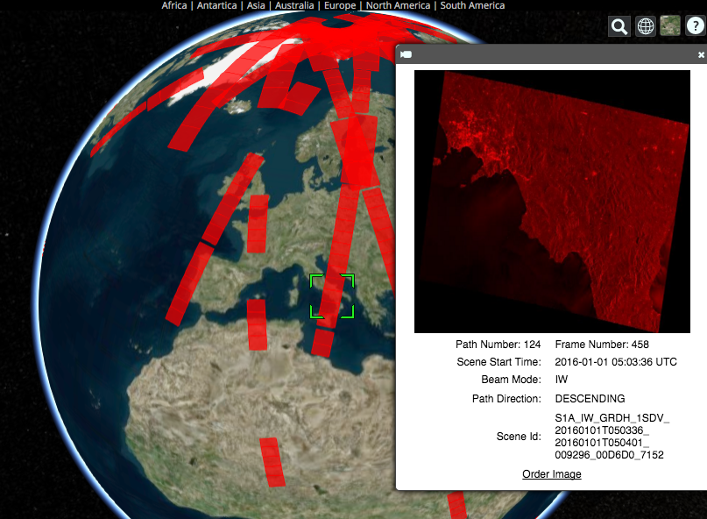
Recent COVE News
January 2016: Changed from Google Earth to Cesium for globe interface
Added New Missions: Sentinel-1A/2A, CBERS-4, RCM 1-3 (notional), FY-3C, PROBA-V, TET-1.
Added New Overlays: Landsat/Sentinel constellation revisit performance, Global Phenology (2001/2014 monthly NDVI Min/Max)
Increased Data Archive Links: Landsat, SPOT, Pleaides, Radarsat-2, ALOS-1, TerraSAR-X, Sentinel-1A (new), and Sentinel-2A (coming soon).
Example of COVE connection to the Sentinel-1A data archive. COVE now shows actual acquired data locations, quick-look images, and links to order the data.

Slide 16
GEOGLAM Data Services Status of Prototype Projects
Asia-RiCE (POC: Shin-Ichi Sobue) – The SEO is working with Asia-RiCE to enhance the cloud-based storage and processing tool. The system is hosting Radarsat-2 data (from CSA) and runs the INAHOR processing tool. Performance has improved with a move of the Amazon cloud server to Singapore.
Asia-Rice has recently expressed a desire for national coverage of cropland extent for Thailand, Vietnam, and Indonesia, which may expand the requirements of the system. The SEO plans to support the Asia-RiCE services through 2016.
JECAM (POC: Ian Jarvis) – The SEO is working with JECAM to develop requirements and plans for a storage and processing tool to support a SAR intercomparison study. Due to the need to host restricted datasets, JECAM is obtaining donated cloud-based computing resources from Microsoft. Once ready, the SEO will install all required data and software to allow full use of the system for SAR processing.
Test Sites: Ukraine, Belgium, South Africa, Argentina, Germany, Canada Datasets: Radarsat-2, TerraSAR-X, and other optical datasets.
16
Notes:
We suggest that we add other “new” tasks such as (RAPP, SIGMA, EWCM) and delete the word “prototype.” We suggest we add some highlights/key events that GEOGLAM impacted or were an impact on GEOGLAM of the previous year, including the Sentinel data agreement. More than 1 slide is probably needed.

Slide 17
Ground Validation from JECAM & GEO-Rice
A point to be fuller developed during the side meeting on the 21st, and presented at CEOS Plenary
Involvement of JECAM Sites in LPV
Nest the JECAM sites under the Land Product Validation (LPV) site network
[this idea needs more development and will be discussed at the side meeting on 21st April]

Slide 18
Archival Data Requests
Level 2 User: Natalia Kussul, Space Research Institute NAS Ukraine and SSA Ukraine
Missions | Modes | Location | Time Periods | Frequency | Max Cloud | Purpose
SPOT 5 |  | Kiev Region (Ukraine) | March-October; 2010-Present (priority April-July) | Weekly | 20% | Crop state assessment, crop classification, LAI/FAPAR mapping
SPOT 4 |  | Kiev Region (Ukraine) | March-October; 2013-Present | Weekly | 20% | Crop state assessment, crop classification, LAI/FAPAR mapping
Landsat 4-7 |  | Ukraine | March-October; 2010-Present | Weekly | 20% | Crop type classification, crop state monitoring, yield forecasting
Sentinel-1 | All Available | Ukraine | March-October; 2013-Present | Weekly |  | Crop classification
Radarsat-2 | All Available | Kiev Region (Ukraine) | March-October; 2013-Present | Weekly |  | Crop state assessment, crop classification

Slide 19
New Acquisition Requests (alter acq. Plans)
Level 2 User: Natalia Kussul, Space Research Institute NAS Ukraine and SSA Ukraine
Missions & Modes | Location | Time Periods | Frequency | Max Cloud | Purpose
L8, S2 | Ukraine | March-October | Weekly | 20% | Crop type classification, crop state monitoring, yield forecasting
Spot 5 | Kiev Region (Ukraine) | March-October (priority Apr-Jul) | Weekly | 10-20% | Crop classification, crop state monitoring, biopar mapping (LAI, FAPAR)
Sentinel-1 | Ukraine | March-October | Weekly |  | Crop classification

Slide 20
Ground data collection for Asia-Rice
A general ground data collection scheme is usually designed for a diversity of agricultural
scenes and applied to various satellite data. However, for rice monitoring within Asia-Rice,
the ground data should be compatible with the use of SAR data, which are the main
data source in these cloud-covered regions
The ground data collection scheme depends on the objective pursued:
Ground data for validation of rice area map
Ground data for analysis of the SAR measurements (method training)
Ground data for estimating rice biophysical variables
Ground data for crop growth modelling
Ground data for radar backscatter modelling
The sampling design can follow JECAM sites guidelines. The sampling density depends on the spatial distribution of rice crop species, calendar and field management (sowing, irrigation..). For validation of rice map, about 100 fields of rice and other LULC at each of the sampling regions identified with historical data (for ex, 5 sampling regions of 60x60 km in the 290x290 km Sentinel-1 frame of the Mekong Delta)
For the other objectives, the field size need to be large enough for SAR analysis (uncertainties
of σ°) e.g. for S1 with 20 m resolution, fields of width > 40 m and area > 0.5 ha . Observation and measurements of plant phenological stage, plant height, plant biomass, LAI, water layer thickness or soil moisture, meteorological data
For modelling, additional information needed: chemical/natural input, soil type..for (4), detailed description of rice plants (5)

Slide 21
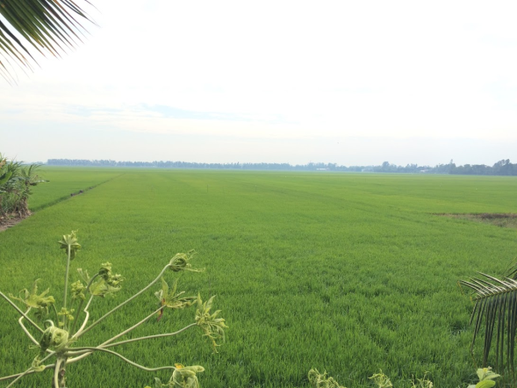
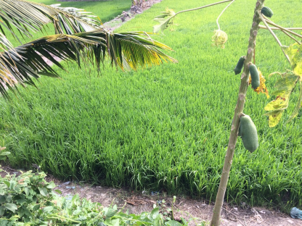
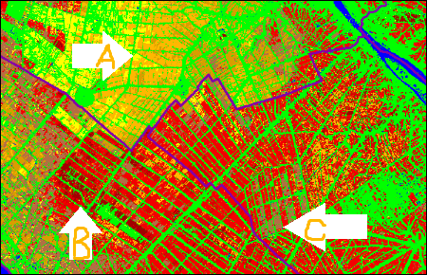
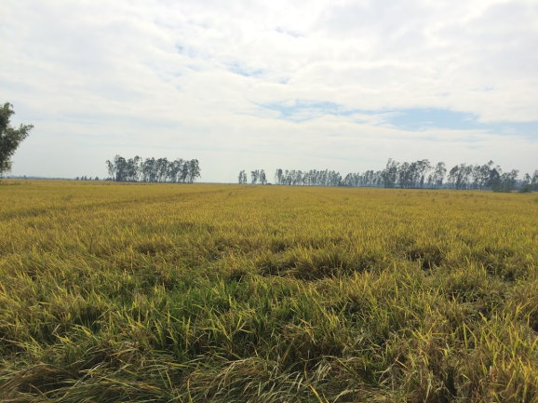
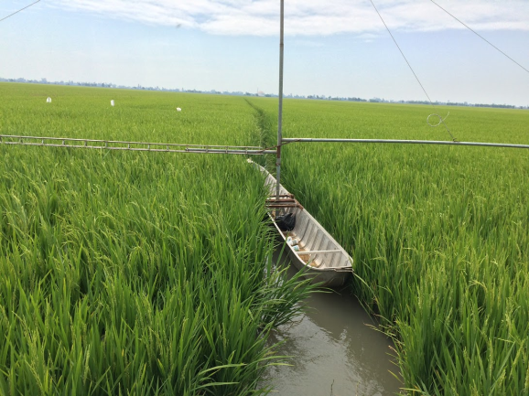
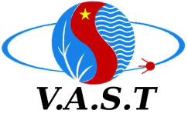
An Giang
Validation of rice development stage
estimated by Sentinel-1 data
The Mekong River Delta, 30 January 2016
Kien Giang
Can Tho

