Slide 1

Oceans and Society: Blue Planet
Committee on Earth Observation Satellites
GEO Blue Planet Initiative
Paul DiGiacomo, CEOS Blue Planet Expert
SIT-31 Agenda Item 5
CEOS Strategic Implementation Team
ESA/ESRIN, Frascati, Italy
19th-20th April 2016

Slide 2
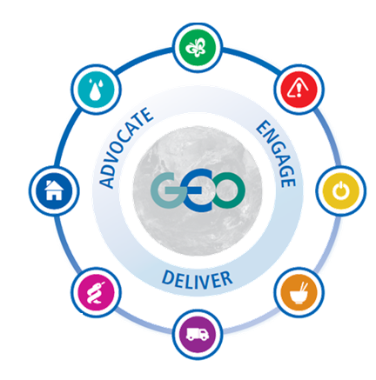
GEO Societal Benefit Areas
Biodiversity and Ecosystem
Sustainability
Water Resources
Management
Disaster
Resilience
Sustainable Urban
Development
Energy and Mineral
Resources Management
Public Health
Surveillance
Food Security and
Sustainable Agriculture
Infrastructure and
Transportation Management
Figure courtesy GEO Secretariat
Notes:
GEO has focused on societal benefit areas impacted/supported by Earth obs. Historically the ocean domain was much less visible than land and atmosphere, despite the fact that Oceans affect all the societal benefit areas of GEO. “Oceans and Society: Blue Planet” was created in 2011 primarily to raise the visibility of oceans within GEO and to demonstrate the impact of oceans and ocean observations on all GEO SBAs. The role of Blue Planet is to facilitate communication between these programmes. The ultimate goal is to integrate and explore synergies. Blue Planet does not seek to duplicate or compete with work that is already being done. Rather it seeks to raise the visibility of existing programmes and add value to them.

Slide 3
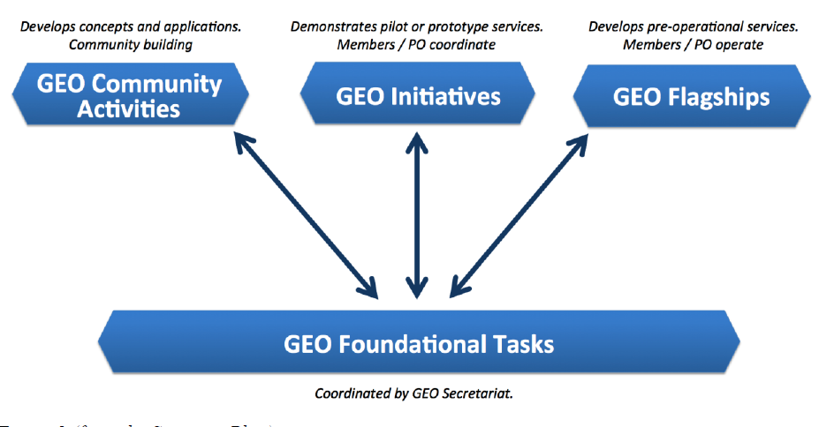
GEO Activities
Figure courtesy GEO Secretariat
Notes:
Blue Planet will be a GEO Initiative that coordinates ocean observing actions towards a common goal of increasing the visibility of ocean observing and serves as an “incubator” for GEO Flagships.
GEO Initiatives allow Members and Participating Organizations to coordinate their actions and contributions towards a common objective within an agreed, yet flexible framework. They develop and implement prototype services according to GEO priorities and have identified committed resources to a certain extent. GEO Initiatives may, for example, demonstrate technical feasibilities through pilot services, or serve a user need.
GEO Flagships allow Members and Participating Organizations with a policy-relevant mandate to spin-up a dedicated operational service serving common needs and/or well-defined user groups. They develop and implement near-operational services according to GEO priorities and are fully resourced. GEO Flagships may operate for as long as they are able to generate sufficient impact to attract support for their activities. Once they reach a mature, operational stage, they may be taken up by operational organizations (e.g. GEO Participating Organizations), for their continued operation over the long term.
GEO Community Activities allow stakeholders to cooperate flexibly in a bottom-up fashion and with a low initiation cost. They can include a broad variety of activities with varying degrees of coordination. GEO Community Activities may, for example, define user needs, explore new frontier applications or demonstrate technical possibilities, or agree on specific observation or analysis protocols and data exchange.
GEO Foundational Tasks allow GEO to implement selected, often enabling, tasks to achieve GEO Strategic Objectives. These include coordination actions, gap analyses, the implementation of technical elements for accessing GEOSS, and other routine operations of the GEO Secretariat. Thus, they provide important support functions to Flagships, Initiatives, and Community Activities.
Source: GEO 2016 transitional work programme: https://www.earthobservations.org/documents/work_programme/geo_2016_work_programme.pdf

Slide 4
Blue Planet: GEO Initiative & Incubator of GEO Flagships
GEO Activities
Figure courtesy GEO Secretariat
Notes:
Blue Planet will be a GEO Initiative that coordinates ocean observing actions towards a common goal of increasing the visibility of ocean observing and serves as an “incubator” for GEO Flagships.
GEO Initiatives allow Members and Participating Organizations to coordinate their actions and contributions towards a common objective within an agreed, yet flexible framework. They develop and implement prototype services according to GEO priorities and have identified committed resources to a certain extent. GEO Initiatives may, for example, demonstrate technical feasibilities through pilot services, or serve a user need.
GEO Flagships allow Members and Participating Organizations with a policy-relevant mandate to spin-up a dedicated operational service serving common needs and/or well-defined user groups. They develop and implement near-operational services according to GEO priorities and are fully resourced. GEO Flagships may operate for as long as they are able to generate sufficient impact to attract support for their activities. Once they reach a mature, operational stage, they may be taken up by operational organizations (e.g. GEO Participating Organizations), for their continued operation over the long term.
GEO Community Activities allow stakeholders to cooperate flexibly in a bottom-up fashion and with a low initiation cost. They can include a broad variety of activities with varying degrees of coordination. GEO Community Activities may, for example, define user needs, explore new frontier applications or demonstrate technical possibilities, or agree on specific observation or analysis protocols and data exchange.
GEO Foundational Tasks allow GEO to implement selected, often enabling, tasks to achieve GEO Strategic Objectives. These include coordination actions, gap analyses, the implementation of technical elements for accessing GEOSS, and other routine operations of the GEO Secretariat. Thus, they provide important support functions to Flagships, Initiatives, and Community Activities.
Source: GEO 2016 transitional work programme: https://www.earthobservations.org/documents/work_programme/geo_2016_work_programme.pdf

Slide 5
Goal of Blue Planet
The goal of the Blue Planet Initiative is to bring together and leverage existing Earth observation (EO) and user engagement work in marine and coastal environments to enable informed decisions and sustained Earth observations and information.
User needs
Data
Products
Information
Knowledge

Slide 6
Blue Planet Objectives
Objective 1: Provide foundational support to the Earth observing community by bringing together the numerous and diverse ocean, coastal and inland water observation organisations and programmes
Objective 2: Identify gaps in user needs and develop end-to-end services (i.e. support the development of GEO flagship services)

Slide 7
Blue Planet Structure

Slide 8
Blue Planet Components
Foundational Components
Service Components
User Engagement
Services for coastal communities
Sustained Ocean Observations
Healthy Ecosystem and Food Security
Ocean Forecasting
Services for the Blue Economy
Data Access and Visualization
Maritime Services
Developing Capacity and Societal Awareness
Notes:
The aim of foundational components is to increase coordination of existing ocean observations programs, enhance links to users, and increase visibility of ocean observing. The aim of service is to develop end-to-end services designed to meet user needs. Services will fill identified gaps in user needs and will not duplicate efforts.

Slide 9
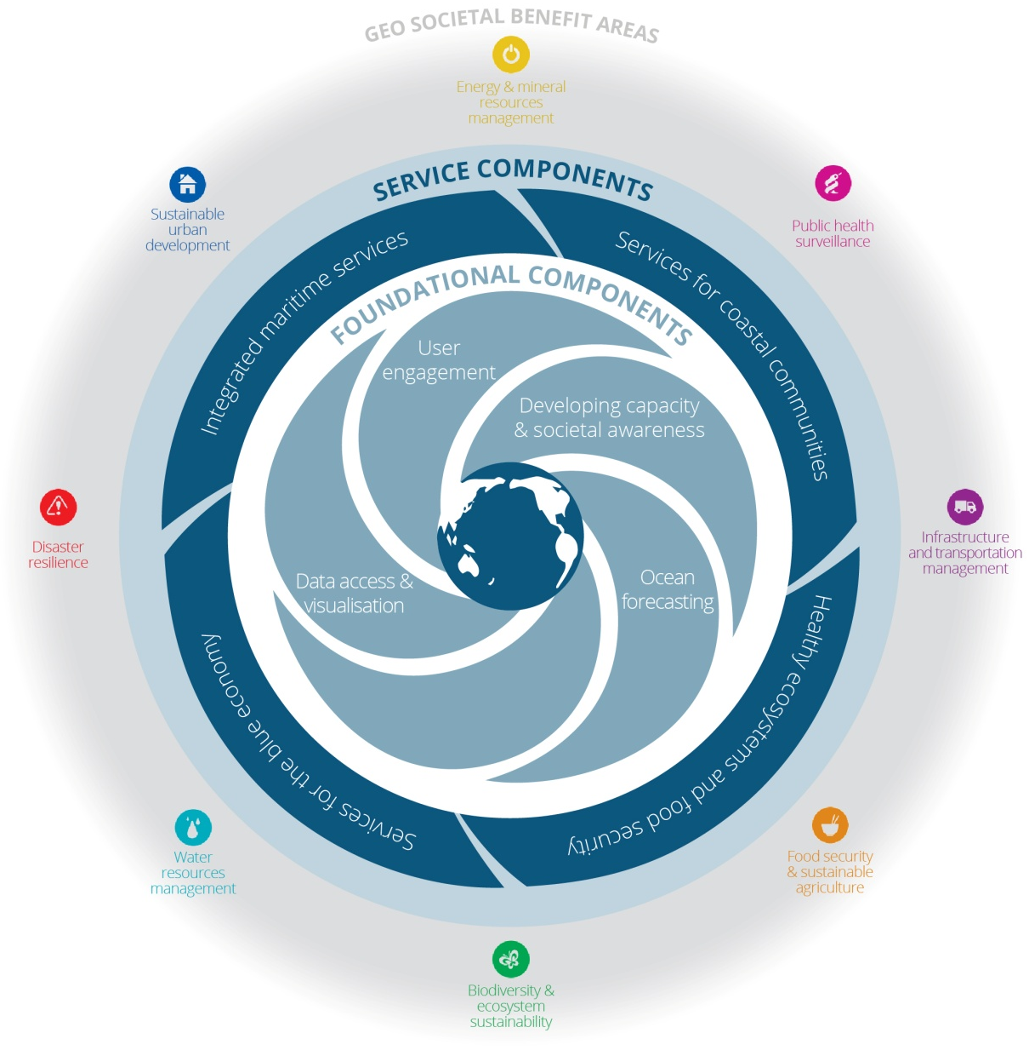
Blue Planet Conceptual Diagram

Slide 10
Blue Planet – Next Phase
Next year
Strategic communications and engagement
Establish management structure and build Blue Planet community
Update Implementation Plan
Next 3 years
Increase communication and coordination within the ocean observing community
Increase communication with the ocean observing community and end users
Begin development of end-to-end services

Slide 11
Engagement strategy developed
Board formulated
Technical Steering Committee formulated
Implementation Plan reviewed and updated
3rd Blue Planet Symposium
Component working groups formulated
Earth Life support system book produced
Implementation plan updated
Coastal zone report prepared
Service Component workshops
Component flagship services identified
2020 – 2023 Implementation plan produced
4th Blue Planet Symposium
Service components begin development of flagship services
Increase communication with the ocean observing community and end users
Increase communication and coordination within the ocean observing community

Slide 12
Blue Planet will add value by:
Enabling and expediting collaboration among the EO community;
Providing additional exposure and visibility to existing EO programmes;
Building on and adding to GEOSS infrastructure;
Improving connections between the EO community and users of EO-derived products, information and knowledge;
Promoting communication with decision makers and the general public on societal benefits of EOs;
Producing new EO services; and
Providing a framework to enable comprehensive world ocean assessments.

Slide 13

Questions?

