Slide 1
GEO Framework Update and Outlook
31st CEOS SIT Meeting
Barbara J. Ryan
Director, GEO Secretariat
19 April 2016
Frascati, Italy

Slide 2
GEO Vision
To realize a future wherein decisions and actions, for the benefit of humankind, are informed by coordinated, comprehensive and sustained Earth observations and information.

Slide 3
GEO Objectives
Improve and Coordinate Observation Systems
Advance Broad Open Data Policies/Practices
Foster Increased Use of EO Data and Information
Build Capacity

Slide 4
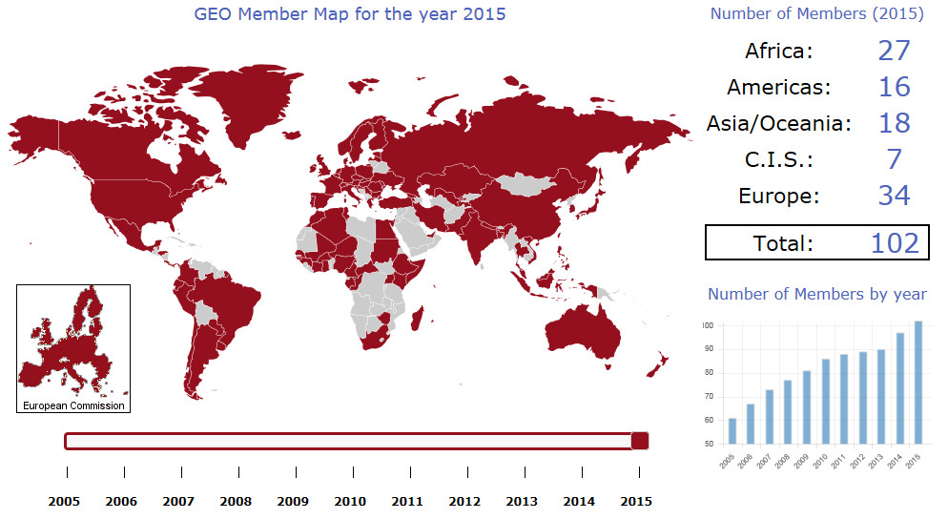
102 GEO Members

Slide 5
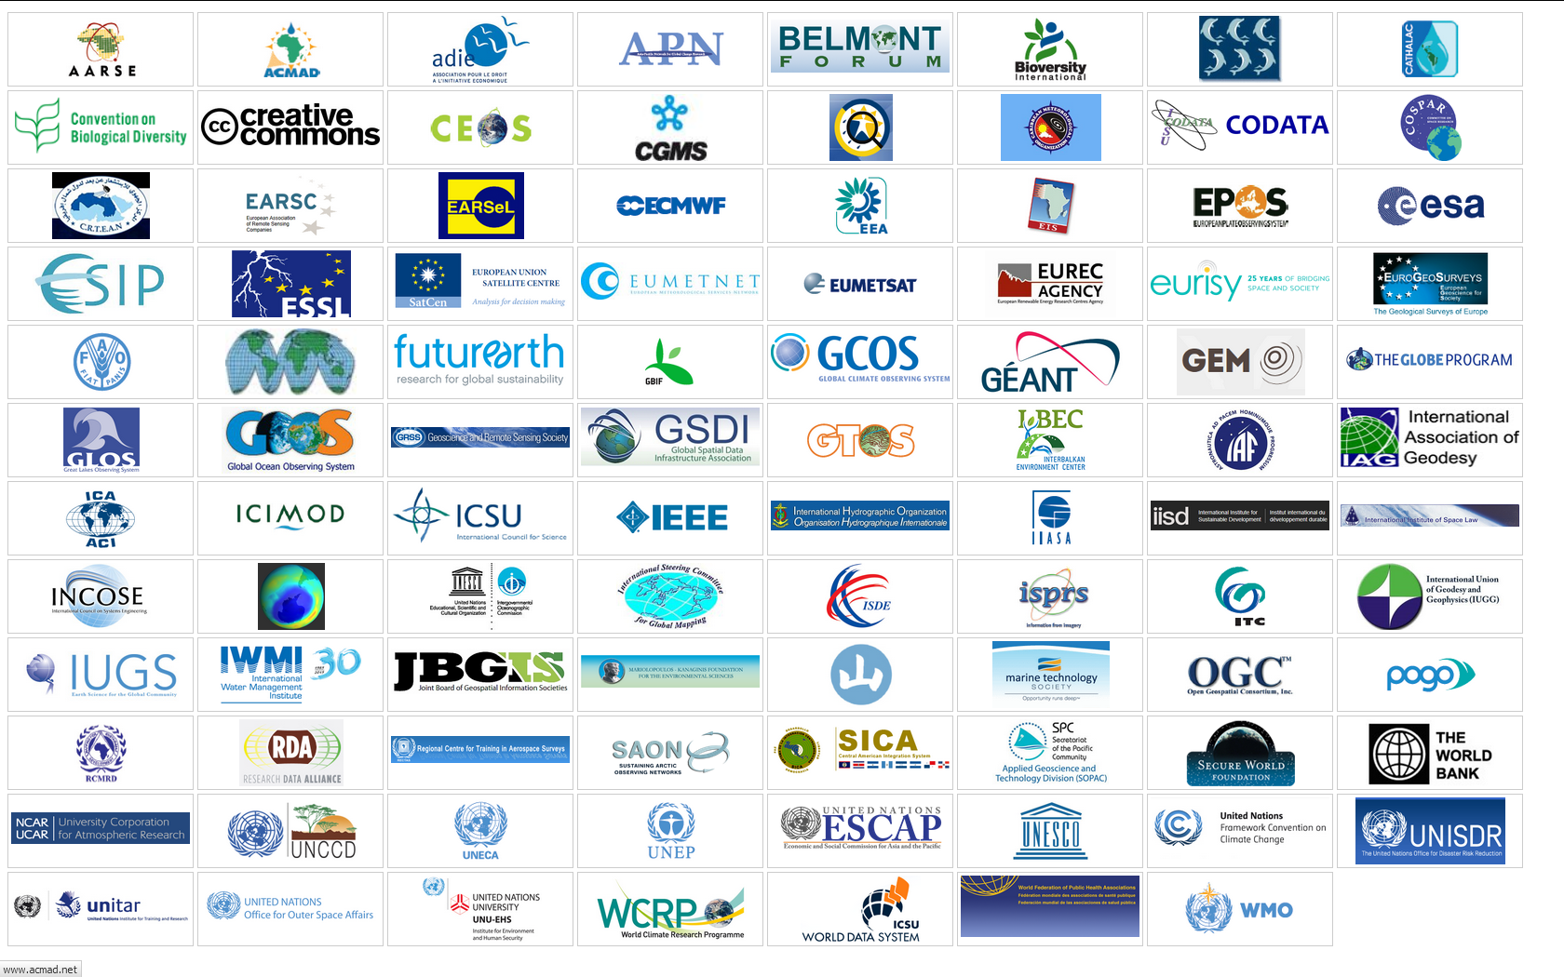
95 Participating Organizations

Slide 6
Unique Time in GEO’s History
Transition to next decade 2016-2025
Recognition of GEO’s convening power – Members, POs, Development Banks, Foundations, emerging Private Sector
Evolution & Recognition of Policy Mandates
New Strategic Plan with new programmatic mechanisms – community activities, foundational tasks, initiatives and flagships

Slide 7

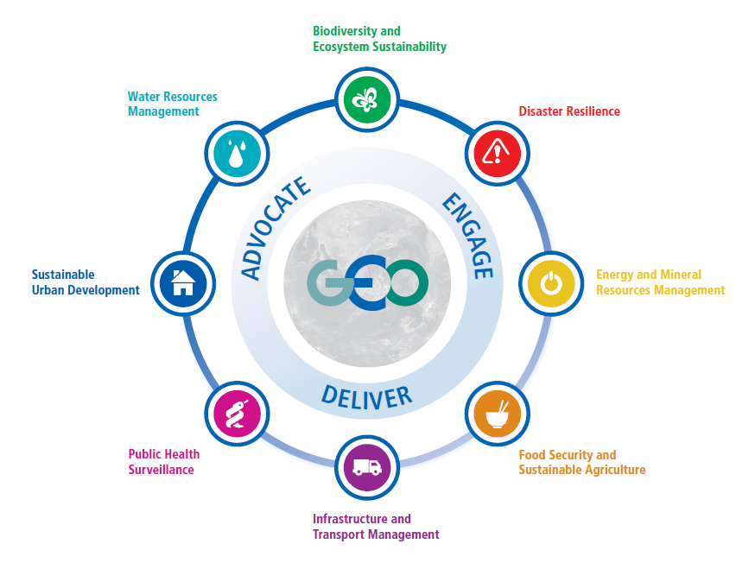






Societal Benefit Areas

Slide 8
GEO 2016 Work Programme
Transitional Work Programme for 2016
3-Year Work Programmes 2017-19, 2020-22 and 2023-25
      Inputs from GEO Members, Participating Organizations, and the GEO Community at large
      Reviewed and further developed by the GEO Programme Board for alignment with the priorities of GEO Members and Participating Organizations, identifies resource commitments by GEO Members and Participating Organizations, and recommends approval to GEO Plenary

Slide 9
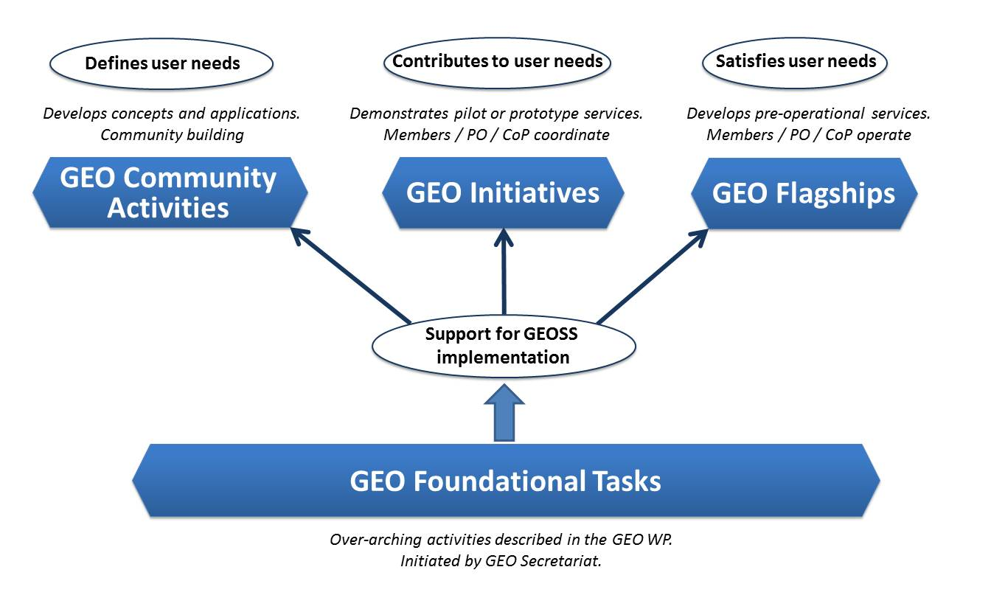
Four Types of GEO Activities

Slide 10



SBAs, Community Activities and Initiatives
SBA | GEO Initiatives |  | Community Activities
 | GI-02 | GEOBON-Global Biodiversity Observation (GEO BON) | CA-29 | Using Geospatial Data to Identify and Monitor Ecosystem Service and Track in a Natural Capital – Ecosystems Accounts Framework
 | GI-03 | GFOI Global Forest Observation Initiative | CA-30 | Harmful Algal Bloom (HAB) Early Warning System
 | GI-14 | GECO: the GEO Global Ecosystem Initiative | CA-31 | For Global Mangrove Monitoring
 | GI-15 | GEO-GNOME Initiative: GEO Global Network for Observation and information in Mountain Environments
 | GI-08 | GEO Geohazard Supersites and Natural Laboratories (GSNL) | CA-23 | Space and Security
 | GI-09 | Global Wildfire Information System | CA-26 | Towards Chinese tsunami mitigation system under GEO framework
 | GI-16 | GEO-DARMA = Data Access for Risk Management (to support the implementation of Sendai framework). | CA-27 | Foster Utilization of Earth Observation Remote Sensing and In Situ Data for All Phases of Disaster Risk Management (new-CEOS)
 |  |  | CA-28 | Global Flood Risk Monitoring
 | GI-10 | EO data and renewable energies | CA-06 | EO data and mineral resources (Includes Impact Monitoring System for Geo-Resource Exploration and Exploitation)
 |  |  | CA-25 | Africa Global-scale Geochemical Baselines for mineral resource and environmental management: Capacity-building phase

Slide 11




SBAs, Community Activities and Initiatives
SBA | GEO Initiatives |  | Community Activities
 | GI-01 | GEOGLAM-Global Agricultural Monitoring and Early Warning
 | GI-04 | Global Observing System for Mercury and Persistent Pollutants | CA-07 | Integrated Water-cycle Products and Services - Overall coordination
 | GI-12 | Integrated Information Systems for Health (Cholera, Heat waves) | CA-14 | GEO Water Quality
 | GI-13 | Integration of Methods for Air Quality and Health Data, Remote Sensed and In-Situ with Disease Estimate Techniques | CA-18 | Water Cycle Integrator (WCI)
 |  |  | CA-19 | E2E Water Indicators
 |  |  | CA-22 | Linking water tasks with wider societal benefit areas and the post-2015 global development framework
 | GI-17 | Global Urban Observation and Information | CA-24 | Earth Observation in Cultural Heritage documentation
 | GI-21 | Human Planet Initiative

Slide 12

SBAs, Community Activities and Initiatives
SBA | GEO Initiatives |  | Community Activities
 | GI-11 | Information Services for Cold Regions | CA-07 | Integrated Water-cycle Products and Services - Overall coordination
 | GI-20 | GEO Global Water Security (GEOGLOWS) | CA-08 | Water Vapor and Clouds (Aerosol & Precipitation)
 |  |  | CA-09 | Precipitation
 |  |  | CA-10 | Evapotranspiration (and Evaporation)
 |  |  | CA-11 | Soil Moisture
 |  |  | CA-12 | River Discharge
 |  |  | CA-13 | Groundwater
 |  |  | CA-14 | GEO Water Quality
 |  |  | CA-15 | Water Cycle Capacity Building
 |  |  | CA-16 | Global Drought Information System (GDIS)
 |  |  | CA-17 | GEO Great Lakes Activity
 |  |  | CA-18 | Water Cycle Integrator (WCI)
 |  |  | CA-19 | E2E Water Indicators
 |  |  | CA-20 | EartH2Observe
 |  |  | CA-21 | Total Water Prediction: Observations Infrastructure
 |  |  | CA-22 | Linking water tasks with wider societal benefit areas and the post-2015 global development framework

Slide 13
GEO Initiatives not associated with one SBA
GI-05 | Global Carbon Observation and Analysis System | Climate
GI-06 | Reinforcing engagement at regional level: AfriGEOSS for Africa | Regional coordination
GI-19 | AmeriGEOSS (new)
GI-22 | Asia-Oceania GEOSS –Asia-Oceania regional comprehensive earth observation application system
GI-07 | Ocean and society - Blue Planet
GI-18 | GEO and SDGs. EOs role in providing support to countries in achieving SDGs and in defining and monitoring the associated indicators.

Slide 14
Community Activities not associated with one SBA
CA-01 | Global Land Cover
CA-02 | Land Cover for Africa
CA-03 | Access to model data in GEOSS | Climate
CA-04 | Strengthen collaboration between GEO and GFCS
CA-05 | TIGGE (Thorpex Interactive Grand global Ensemble) evolution into a Global Interactive Forecast System (GIFS)
CA-32 | Research Data Science Summer Schools | Capacity Building
CA-33 | Building capacity for Forest Biodiversity in Asia and the Pacific Region
CA-34 | Multi-source Synergized Remote Sensing Products and Services | Support to GEOSS

Slide 15
Foundational Tasks – Current List
GD | GEOSS Development and GCI Operations
GD-01 | Advancing GEOSS Data Sharing principles
GD-02 | GCI Operations (including access to Knowledge)
GD-03 | Global Observing and Information Systems (new) (includes systems like WIGOS. GCOS; …. And reference datasets)
GD-04 | GEONETCast Development and Operations
GD-05 | GEOSS satellite Earth Observation Resources (includes advocacy for continuity)
GD-06 | GEOSS in situ Earth Observation Resources (includes inclusion of citizens’ observatories) (includes advocacy for continuity)
GD-07 | GCI Development (includes development of Data Management guidelines)
GD-08 | SBAs processes: Systematic determination of user needs / observational gaps
GD-09 | Knowledge Base development
GD-10 | Radio-frequency protection
GD-11 | Utilization of Communication Networks
CD | Community Development
CD-01 | Capacity Building coordination
CD-02 | Reinforcing engagement at national and regional level
CD-03 | Assess the benefits from EOs and of their socio-economic value
SO | Secretariat Operations
SO-01 | Management and Support
SO-02 | Communication and Engagement
SO-03 | Monitoring and Evaluation
SO-04 | Resources Mobilization

Slide 16
GEO Activities -- Number by Category
Community Activities | 33
GEO Initiatives | 20
Foundational Tasks | 18
TOTAL | 71
Most Current SBAs Are Addressed

Slide 17

Transforming Our World: The 2030 Plan for Global Action - Article 76: “We will promote transparent and accountable scaling-up of appropriate public-private cooperation to exploit the contribution to be made by a wide range of data, including Earth observation and geo-spatial information, while ensuring national ownership in supporting and tracking progress.”

Slide 18



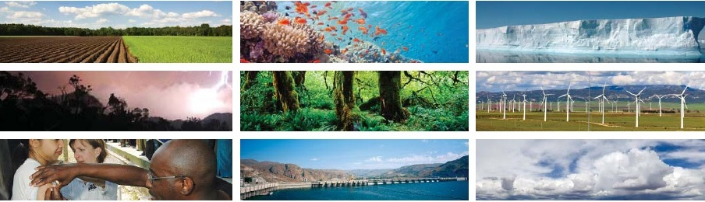

Geospatial Information and Earth Observations: Supporting Official Statistics in Monitoring the SDGs
UNSC Statistical-Geospatial Integration Forum
United Nations • 7 March 2016
Session III. Geospatial and Earth Observations Data as Inputs to the Indicators
Lawrence Friedl
USA / NASA
Notes:
Geospatial and Earth Observations Data as Inputs to the Indicators
47th Session of the United Nations Statistical Commission
Statistical-Geospatial Integration Forum
Geospatial Information and Earth Observations:
Supporting Official Statistics in Monitoring the SDGs
Monday 7 March 2016
10:00am – 1:00pm,
Conference Room 4 (CB), United Nations, New York

Slide 19
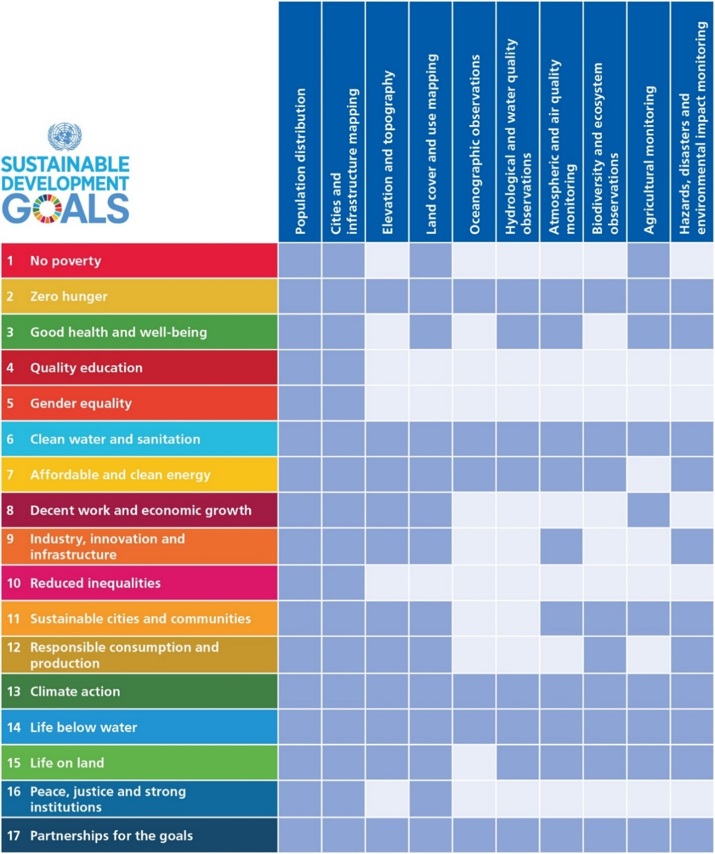
Earth Observations and
Geospatial Information
Support to SDGs
Direct measures of some Indicators and indirect support to others.
Contribute to progress on the Targets, which will show up in the Indicators.

Slide 20

UNFCCC COP21
Subsidiary Body for Scientific and Technological Advice (SBSTA)
30. The SBSTA recognises the importance of: GEO, including its implementation plan for GEOSS; collaboration between GEO and GCOS; and of capacity building on systematic observation, inter alia, to enable developing countries to apply climate observations for impact assessment and preparation for adaptation. The new GEO Strategic Plan 2016-2025 establishes three Strategic Objectives – Advocate, Engage, Deliver – and emphasizes climate change and its impacts as a cross-cutting area, and strengthens the societal benefit areas making them more focused on the needs of society to support processes under the UNFCCC, the UN Sendai Framework for Disaster Risk Reduction, the SDGs and other UN agencies.

Slide 21
G20 Meeting of Agricultural Ministers
Action Plan on Food Price Volatility and Agriculture
Paris, France, June 2011
32. In order to improve crop production projections and weather forecasting, with the use of modern tools, in particular remote sensing tools, we decide to launch, via the Group on Earth Observation, an international voluntary network of agricultural production monitoring based on geoinformation. This “Global Agricultural Geo-Monitoring Initiative” will be a useful input for AMIS concerning the provision of more accurate crop forecasts data.

Slide 22

G7 Science Ministers
"We recognise that the sharing of Earth observation data and information will strengthen science, knowledge, and decision-making in the areas discussed today and in others. We intend to continue to work together through the intergovernmental Group on Earth Observations (GEO) to enable policy makers to better address these environmental, health, and socio-economic challenges."

Slide 23
Multilateral Agreements, cont.
  26th African Union Summit adopted mandate/reference to AfriGEOSS -- South Africa and GEO Secretariat collaboration
  UNCCD request for assistance to support development of indicators for SDG Target on Land Degradation Neutrality

Slide 24

GEOSS Implementation requires:
Data Sharing Principles
Full and Open Exchange of Data
Data and Products at Minimum Time delay and Minimum Cost
Free of Charge or Cost of Reproduction
Notes:
See slide text

Slide 25

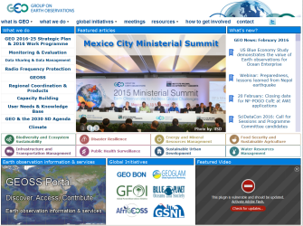









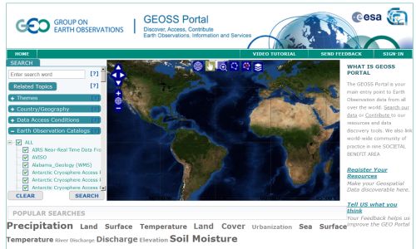














































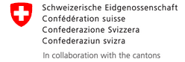


Climate/Weather
Cryosphere
GEO
Website
International Providers
Biodiversity
Disasters
GEO
Website
Energy
Geology/Soil
GEOSS
Portal
Environment
Health
Ocean
Satellites
Discovery and
Access Broker (DAB)
Water
Regional & National Providers
Australia
Brazil
Canada
Chile
China
France
Germany
Japan
Italy
New Zealand
Norway
Private sector providers
Switzerland
USA
Russia
South Africa
Spain
…
… more than 100 public providers…

Slide 26
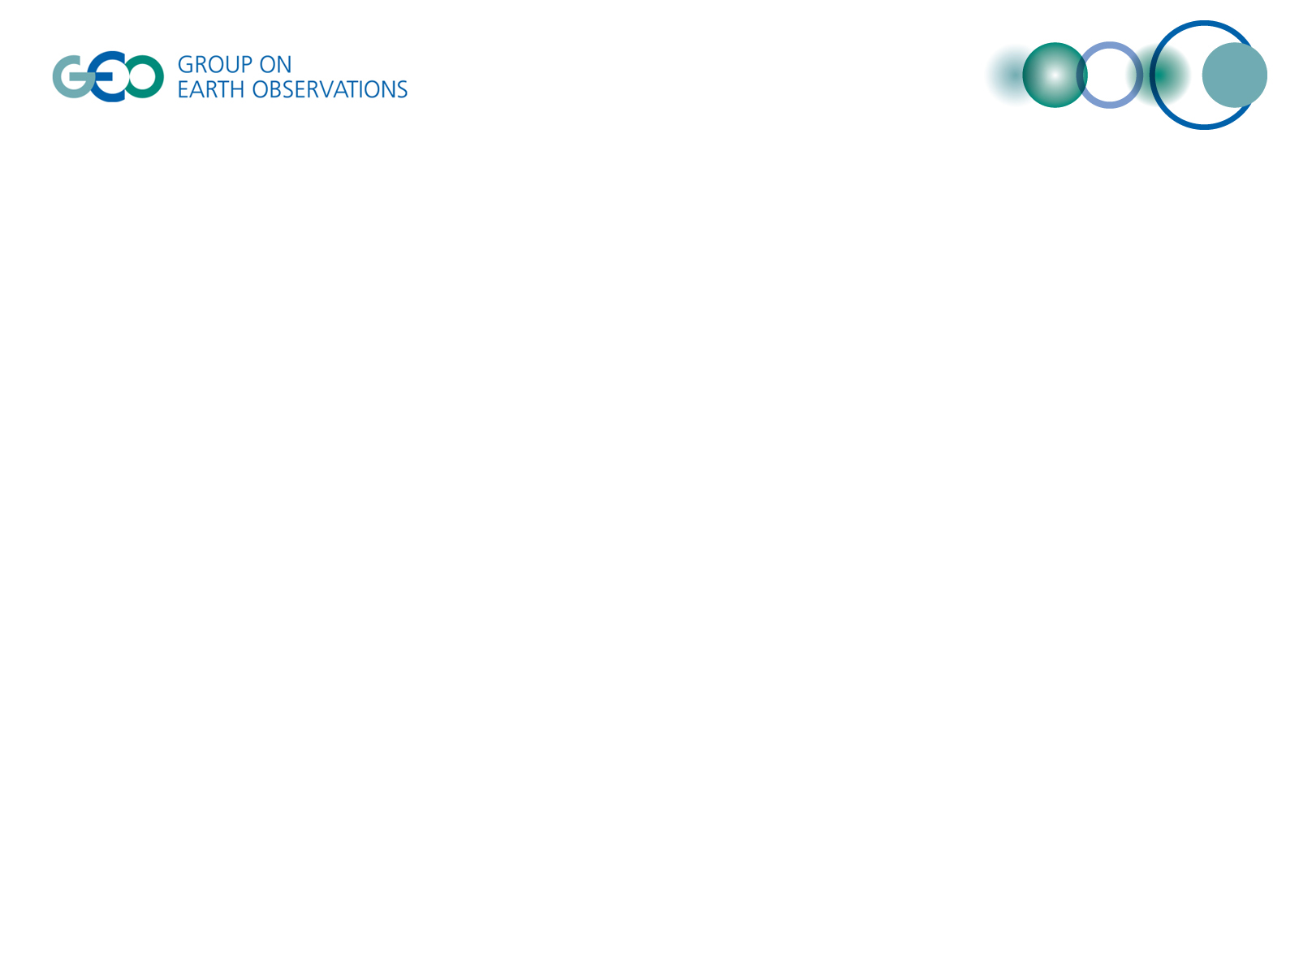
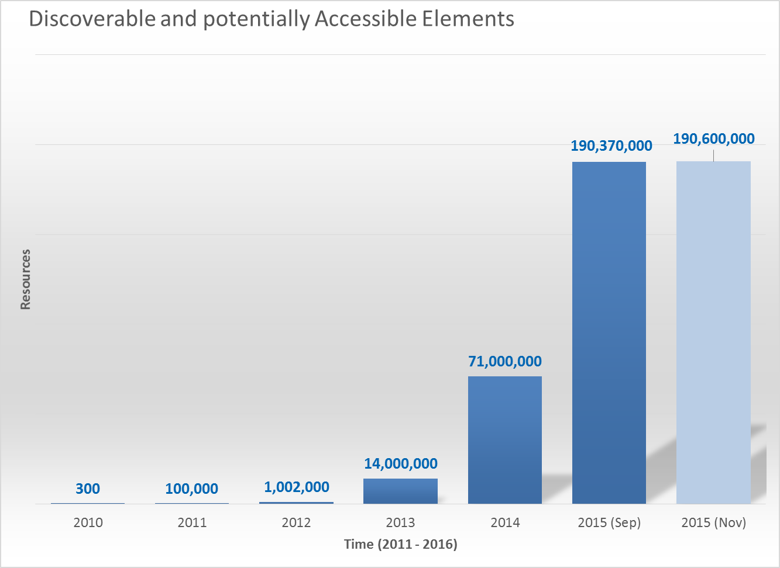
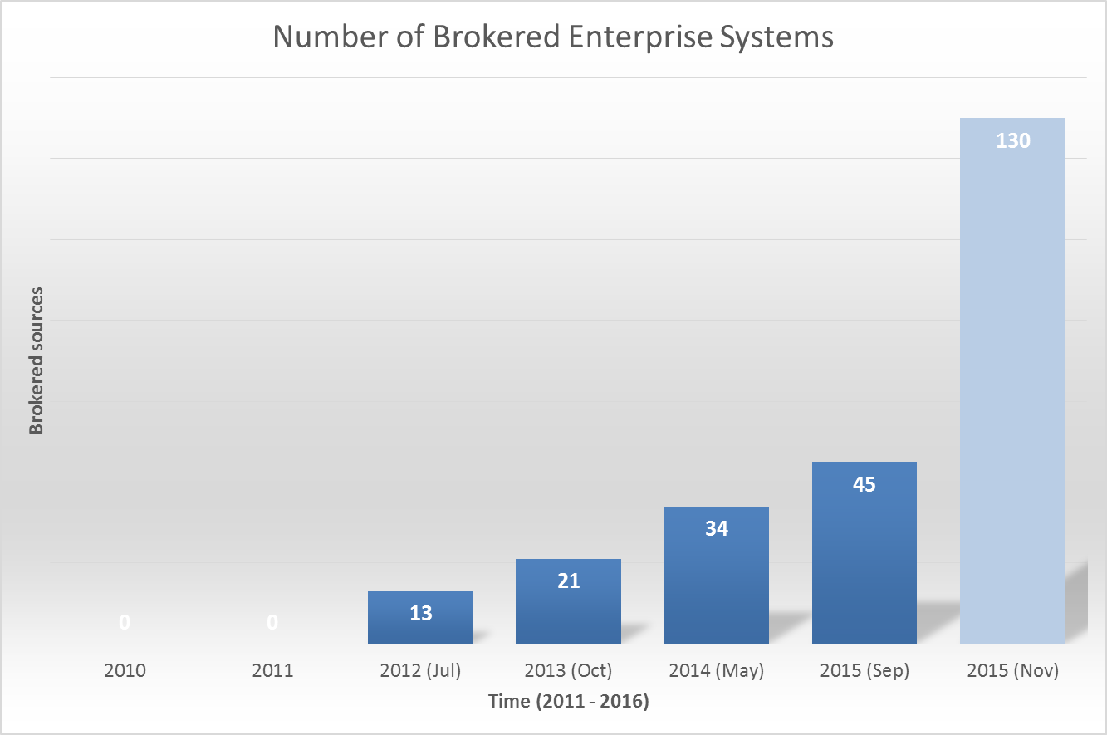
GCI Providers Evolution and Statistics
Introduction of the Brokering approach
Introduction of the Brokering approach

Slide 27



Brokering Organizations

Slide 28
GEO-UN Roundtable – 7 March 2016
Develop synergies between Earth observations and official/national statistics – identifying a common “language” or standards
Training and capacity building in Earth observation applications (e.g. BON-in-a-Box, or an EO App Store)
Develop a GEO Wetlands initiative – learn from/build upon the existing ESA/JAXA/Ramsar collaboration
Time travel – reaching back into archival data to create data layers of change over time (i.e., data cubes)
Sponsored by Swiss Federal Government, 16 UN and International Organizations, Representatives of Executive Committee, Programme Board and Secretariat

Slide 29
Countries have borders;
Earth observations don’t.
Barbara J. Ryan
Director, GEO Secretariat
Adapted from NY Times
September 2015

Slide 30

GEO Work Programme Symposium
2-4 May 2016
Geneva
GEO-XIII Plenary
9-10 November
St. Petersburg
Barbara Ryan – bryan@geosec.org
Osamu Ochiai – oochiai@geosec.org
www.earthobservations.org

