Slide 1

Strategic Partnerships
Committee on Earth Observation Satellites
ESA SIT Chair Team
SIT-31 Agenda Item 4
CEOS Strategic Implementation Team
ESA/ESRIN, Frascati, Italy
19th-20th April 2016

Slide 2
Purpose of discussion
Take stock of trends and future directions – so that CEOS can best serve needs of its membership and support future role of government EO programmes in service of society
Identify opportunities and challenges that need strategic attention
Accommodate the arising much broader need for geospatial data, non-expert users with policy-oriented problems, not historical expert science users
Consider, if necessary, allocation of resources to reflect these and set priorities for 2 years of ESA SIT Chairmanship
Refer to the Discussion Paper – please read it.

Slide 3

Evolution of CEOS Partnerships for EO data uptake and benefits
80s
mid 90s
mid 00s
mid 10s
late 10s?
Major science programmes as Associates: WCRP, IGBP etc
Major users gradually introduced as Associates – WMO, GCOS, FAO…
Broadened with thematic studies/alliances under IGOS-P umbrella – effective in establishing requirements and observing strategies in major areas
Alliances merged into GEO (2003+). Decreasing prominence of Communities of Practice
New relations with thematic science communities via VC mechanism
Mature partnership with GCOS in support of UNFCCC/Parties
IGOS tradition continued via new CEOS Water, Carbon Strategies
Extended reach to individual govts and key intermediaries through thematic GEO programmes like GFOI and GEOGLAM – bringing CEOS and agencies closer to linking space data with societal benefits
Common role for UN agencies but complex in some cases
GEO role evolving, and hence CEOS partnerships
Much broader, less sophisticated user base for especially land surface imagery: users more policy and issue driven
Financing institutions becoming important partners (WB, ADB,..)_

Slide 4
CEOS Members and Associates
ASSOCIATES
Australian Bureau of Meteorology (BOM)
Belgian Federal Science Policy Office (BELSPO)
Canada Centre for Mapping & Earth Observation (CCMEO)
Crown Research Institute (CRI), New Zealand
Earth Systems Science Organisation (ESSO), India
South African Council for Scientific and Industrial Research
(CSIR)/Satellite Applications Centre (SAC)
Gabonese Agency for Space Studies and Observations (AGEOS)
Global Climate Observing System (GCOS)
Geoscience Australia (GA)
Global Geodetic Observing System (GGOS)
Global Ocean Observing System (GOOS)
Global Terrestrial Observing System (GTOS)
Intergovernmental Oceanographic Commission (IOC)
International Council for Science (ICSU)
International Geosphere-Biosphere Programme (IGBP)
International Ocean Colour Coordinating Group (IOCCG)
International Society of Photogrammetry and Remote Sensing
(ISPRS)
Malaysian National Space Agency (ANGKASA)
Mexican Space Agency (AEM)
Norwegian Space Centre (NSC)
Swedish National Space Board (SNSB)
United Nations Economic and Social Commission for Asia and the
Pacific (ESCAP)
United Nations Educational, Scientific and Cultural Organization
(UNESCO)
United Nations Environment Programme (UNEP)
United Nations Food and Agriculture Organization (FAO)
United Nations Office for Outer Space Affairs (UNOOSA)
World Climate Research Programme (WCRP)
World Meteorological Organization (WMO)
MEMBERS
Agenzia Spaziale Italiana (ASI)
Canadian Space Agency (CSA)
Centre National d’Etudes Spatiales (CNES), France
Centro para Desarrollo Tecnólogico Industrial (CDTI), Spain
China Center for Resources Satellite Data and Applications (CRESDA)
Chinese Academy of Space Technology (CAST)
Comisión Nacional de Actividades Espaciales (CONAE), Argentina
Commonwealth Scientific & Industrial Research Organisation (CSIRO),
Australia
Deutsches Zentrum fürLuft-und Raumfahrt (DLR), Germany
European Commission (EC)
European Organisation for the Exploitation of Meteorological Satellites
(EUMETSAT)
European Space Agency (ESA)
Geo-Informatics and Space Technology Development Agency (GISTDA),
Thailand
Indian Space Research Organisation (ISRO)
Instituto Nacional de Pesquisas Espaciais (INPE), Brazil
Japan Aerospace Exploration Agency/Ministry of Education, Culture, Sports,
Science, and Technology (JAXA/MEXT)
Korea Aerospace Research Institute (KARI)
National Aeronautics and Space Administration (NASA), USA
National Oceanic and Atmospheric Administration (NOAA), USA
National Remote Sensing Center of China (NRSCC)
National Satellite Meteorological Center/Chinese Meteorological Administration
(NSMC/CMA)
National Space Agency of Ukraine (NKAU)
National Space Research Agency of Nigeria (NASRDA)
Netherlands Space Office (NSO)
Russian Federal Space Agency (ROSCOSMOS)
Russian Federal Service for Hydrometeorology and Environmental Monitoring
(ROSHYDROMET)
South African National Space Agency (SANSA)
Scientific and Technological Research Council of Turkey (TÜBITAK)
United Kingdom Space Agency (UKSA)
United States Geological Survey (USGS)
Vietnam Academy of Science and Technology (VAST)
ASSOCIATES
Australian Bureau of Meteorology (BOM)
Belgian Federal Science Policy Office (BELSPO)
Canada Centre for Mapping & Earth Observation (CCMEO)
Crown Research Institute (CRI), New Zealand
Earth Systems Science Organisation (ESSO), India
South African Council for Scientific and Industrial Research
(CSIR)/Satellite Applications Centre (SAC)
Gabonese Agency for Space Studies and Observations (AGEOS)
Global Climate Observing System (GCOS)
Geoscience Australia (GA)
Global Geodetic Observing System (GGOS)
Global Ocean Observing System (GOOS)
Global Terrestrial Observing System (GTOS)
Intergovernmental Oceanographic Commission (IOC)
International Council for Science (ICSU)
International Geosphere-Biosphere Programme (IGBP)
International Ocean Colour Coordinating Group (IOCCG)
International Society of Photogrammetry and Remote Sensing
(ISPRS)
Malaysian National Space Agency (ANGKASA)
Mexican Space Agency (AEM)
Norwegian Space Centre (NSC)
Swedish National Space Board (SNSB)
United Nations Economic and Social Commission for Asia and the
Pacific (ESCAP)
United Nations Educational, Scientific and Cultural Organization
(UNESCO)
United Nations Environment Programme (UNEP)
United Nations Food and Agriculture Organization (FAO)
United Nations Office for Outer Space Affairs (UNOOSA)
World Climate Research Programme (WCRP)
World Meteorological Organization (WMO)

Slide 5
Trends & observations
Evolving partnerships over three decades, evolving configurations
Reduced involvement of science programmes in CEOS Plenaries
  Not necessarily negative
Reduced participation of UN and other user agencies in CEOS Plenaries (also in projects/activities?) - due to positive effect of creation of GEO?
Development banks also active but EO often not central to financial support even when fundamental. Have very important potential role to play.
Non-expert users with policy-oriented problems, not historical expert science users, becoming increasingly interested parties. Strong policy background (SDGs, UN Conventions etc.)
‘Internet giants’ are also active and changing expectations of users
Increasing emphasis on ‘user-facing’ data uptake and application
  Thematic WGs (climate, disasters), GEO Projects, Ad-hoc Teams
Data size/complexity remain significant obstacles to uptake of CEOS agency data, some solutions emerging

Slide 6
Proposed discussion topics
Should, and if so how might, CEOS establish a more systematic interaction and integration of UN agency and CEOS agency activities in areas of common interest? Is this the role for GEO in establishing a more strategic geometry for EOS programmes and the UN system? Is this the best route for CEOS?
How could CEOS work through GEO to achieve greater strategic integration of political & financial support for our data uptake initiatives, including with international donor bodies such as World Bank, regional development banks? How can we ensure both the success in relation to UN Agencies of GEO, and CEOS’ role in it?

Slide 7
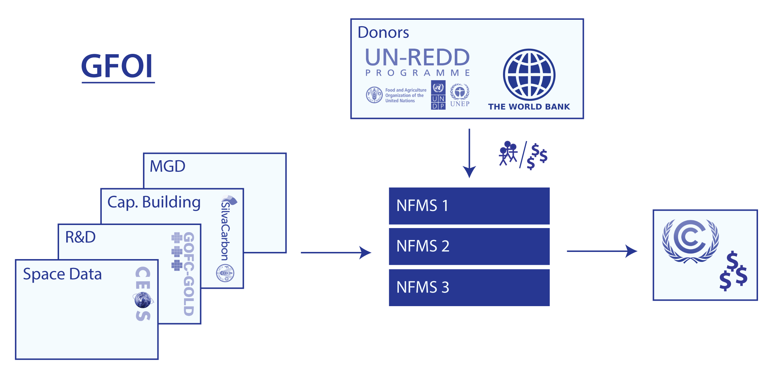
User-facing activities
New geometries with implications for resources
Space agencies require 3rd parties for effective user engagement – often including UN agencies

Slide 8
User-facing activities
GEO-DARMA:
  Competition between UN agencies to gain more responsibilities and resources after the renegotiations of treaties in 2015 (WCDRR, SDG, COP21).
  Participation of UN system through GEO is still a challenge
  Space coordination role from CEOS, may be claimed by other organizations, even without having the required competence, authority or resources.
  “Disaster Resilience” not covered at GEO in GEO-DARMA
Significant interaction between CEOS and UN agencies – CEOS not universally welcome even where EOS is acknowledged as crucial
Existence of GEO has not (yet?) necessarily helped in this

Slide 9
GCOS - Example of non-GEO Partnership
Not necessarily good or bad – different model, outside GEO ambit
Link to UNFCCC (and others)
Long and successful history
Ongoing development of Implementation Plans, Satellite Supplements.
Strong interaction of CEOS Agencies through GCOS mechanisms (Terrestrial/Ocean/Atmosphere Boards, Steering Committee)
Strong programmatic contributions e.g. ESA CCI/CCI+

Slide 10
Sustainable Development Goals
CEOS and GEO bodies and agencies active
Good example of mutual support
Good co-operation
Two means of access to discussion
Example of potential for both routes of cooperation via GEO and direct, for example ESA active in technical development of indicators for particular goals (desertification…)

Slide 11
Hence multiple potential models and routes
Independently as space agencies alone
  GCOS and UNFCCC
  WMO…...
Via GEO
  GFOI
  GEOGLAM
  Many other small and large tasks in GEO WP.
Using both vehicles GEO and Agency programmes in CEOS:
  SDGs
  International finance institutions
    E.g. bilateral ESA and NASA programmes with WB, JAXA programmes with ADB, etc.

Slide 12
User-facing activities
Should, and if so how might, CEOS establish a more systematic interaction and integration of UN agency and CEOS agency activities in areas of common interest? Is this the role for GEO in establishing a more strategic geometry for EOS programmes and the UN system? Is this the best route for CEOS?
Noting:
  COP21 follow up
  Successful GEO models of GFOI/GEOGLAM
  SDG exploration
  Successful model of CEOS-GCOS relationship (paper)
  Data giants beginning to have direct agreements with UN agencies (often supplying CEOS agency data in some format)

Slide 13
Development bank partnerships
Space agency EOS programmes often not properly reflected in own government development aid activities
Substantial funding is being applied to areas where CEOS seeks to contribute: forests, food security, disasters…including by international development banks
Indvidual agencies do have bilateral activities in this direction (ESA-WB, JAXA-ADB, NASA/SERVIR-WB etc)
How could CEOS work through GEO to achieve greater strategic integration of political & financial support for our data uptake initiatives, including with international donor bodies such as World Bank, regional development banks? How can we ensure both the success in relation to UN Agencies of GEO, and CEOS’ role in it?

