Slide 1
Title
Name Organization CEOS SIT-28 Meeting
Hampton , Virginia, USA Date

Slide 2
Contents
Information & discussion
Update on GFOI for information
Issues for attention of CEOS
2014 Global Baseline Data Acquisitions implementation report
2015 Update Endorsement
Decision
Endorsement of the SDCG 3-Year Work Plan
Endorsement of the SDCG Element-3 Strategy (for R&D data)
Information & discussion
2015 Outlook
Future of the Ad-hoc SDCG

Slide 3
General update on GFOI

Slide 4
Update on GFOI
Condensed version of the Prezi delivered by Stephen Briggs

Slide 5
Progress since SIT-29
Period of instability:
New Lead personnel: Australia, Norway, FAO (3/5 leads) in mid-2014
Transfer of PO from GEOsec to FAO slow and not complete
2nd GFOI Plenary held in Sydney (Mar 2015)
to ensure component coordination (Leads, MGD, SDCG, R&D, Capacity Building)
Helped re-establish foundations of GFOI
Involvement of Clinton Initiative, DE, (UK)
Propose to have further plenary in early 2015 (ESRIN tbc)
Very successful GFOI side event at Lima CoP
Concerns expressed at SIT/CEOS 2014 mainly resolved
Wider participation in GFOI excellent
SEO continues to be a strength of GFOI

Slide 6
Progress since SIT-29
Methods and Guidance translated into French & Spanish
Methods and Guidance portal in development – intended to be the focus for GFOI country engagement
2015 update of the Global Baseline Data Acquisition Strategy and the Space Data Services for GFOI.
Continued Capacity Building workshops by SilvaCarbon

Slide 7
Wider issues for attention
Role of GEO in relation to the UN system has not been negotiated at a high level - individual initiatives like GFOI and GEOGLAM having to establish support each time
Same issue for World Bank: major projects in developing countries often (almost always?) have WB involvement in some form
Future SIT/CEOS topic: Developing the GEO-UN relationship
GFOI needs to become THE place for coordination of space data in support of forest monitoring – please ensure your national activities and plans are aware and connected
Important to broaden delivery mechanisms/implementation agencies for REDD+, supported by GFOI

Slide 8
2014 Global Baseline Data Acquisitions Implementation Report

Slide 9
Your Ad-hoc SDCG for GFOI
SDCG Exec:
Co-chairs: USGS (Gene Fosnight), ESA (Frank Martin Seifert), NSC (Ake Rosenqvist – still supporting), but one Co-chair position vacant
SEC: Govt. Australia (Stephen Ward, George Dyke & Matthew Steventon)
Participation of:
ASI – Anna Rita Pisani
CNES – Steven Hosford
CONAE – Laura Frulla (not lately)
CSA – Yves Crevier
DLR – Helmut Staudenrausch
GEOSEC – Osamu Ochiai (not lately)
GFOI Office – Simon Eggleston (closed since 31 Jan 2015)
INPE – Ivan Barbosa ➔ Julio d’Alge
JAXA – Masanobu Shimada (retiring) ➔ Nobuyoshi Fujimoto
NASA/SEO – Brian Killough
Changes since SIT-29 in Green

Slide 10
Global Strategy: Context & Process
Coordination of satellite data supply is fundamental to GFOI objectives and supports all countries’ participation in reporting
CEOS Strategy for GFOI has 3 Elements, coordinated by SDCG:
Element 1: A baseline, coordinated global data acquisition strategy involving a number of ‘Core data streams’ that can be used free-of-charge and openly for GFOI purposes. This will involve global, systematic and sustained wall-to-wall acquisitions of forested areas
Element 2: Coordinated strategies for national data acquisitions including historical coverage characterization, impartial data needs assessment, and data delivery.
Element 3: Data supply in support of the GFOI R&D activities, including in support of: the science studies assisting the development and evolution of the Methods and Guidance document for GFOI

Slide 11
Baseline 2014: Objectives Reminder
Promote the systematic and sustained wall-to-wall acquisition of Space Data of forested areas
Aims to provides the default consistent time-series of forest observation data for all countries without specific technical requirements, heritage or data preference
Guarantee the minimum consistent, quantitative, and wall-to-wall forest observation data necessary for all interested countries to engage in MRV development in support of UNFCCC reporting
Remove Slide to reduce overall number

Slide 12
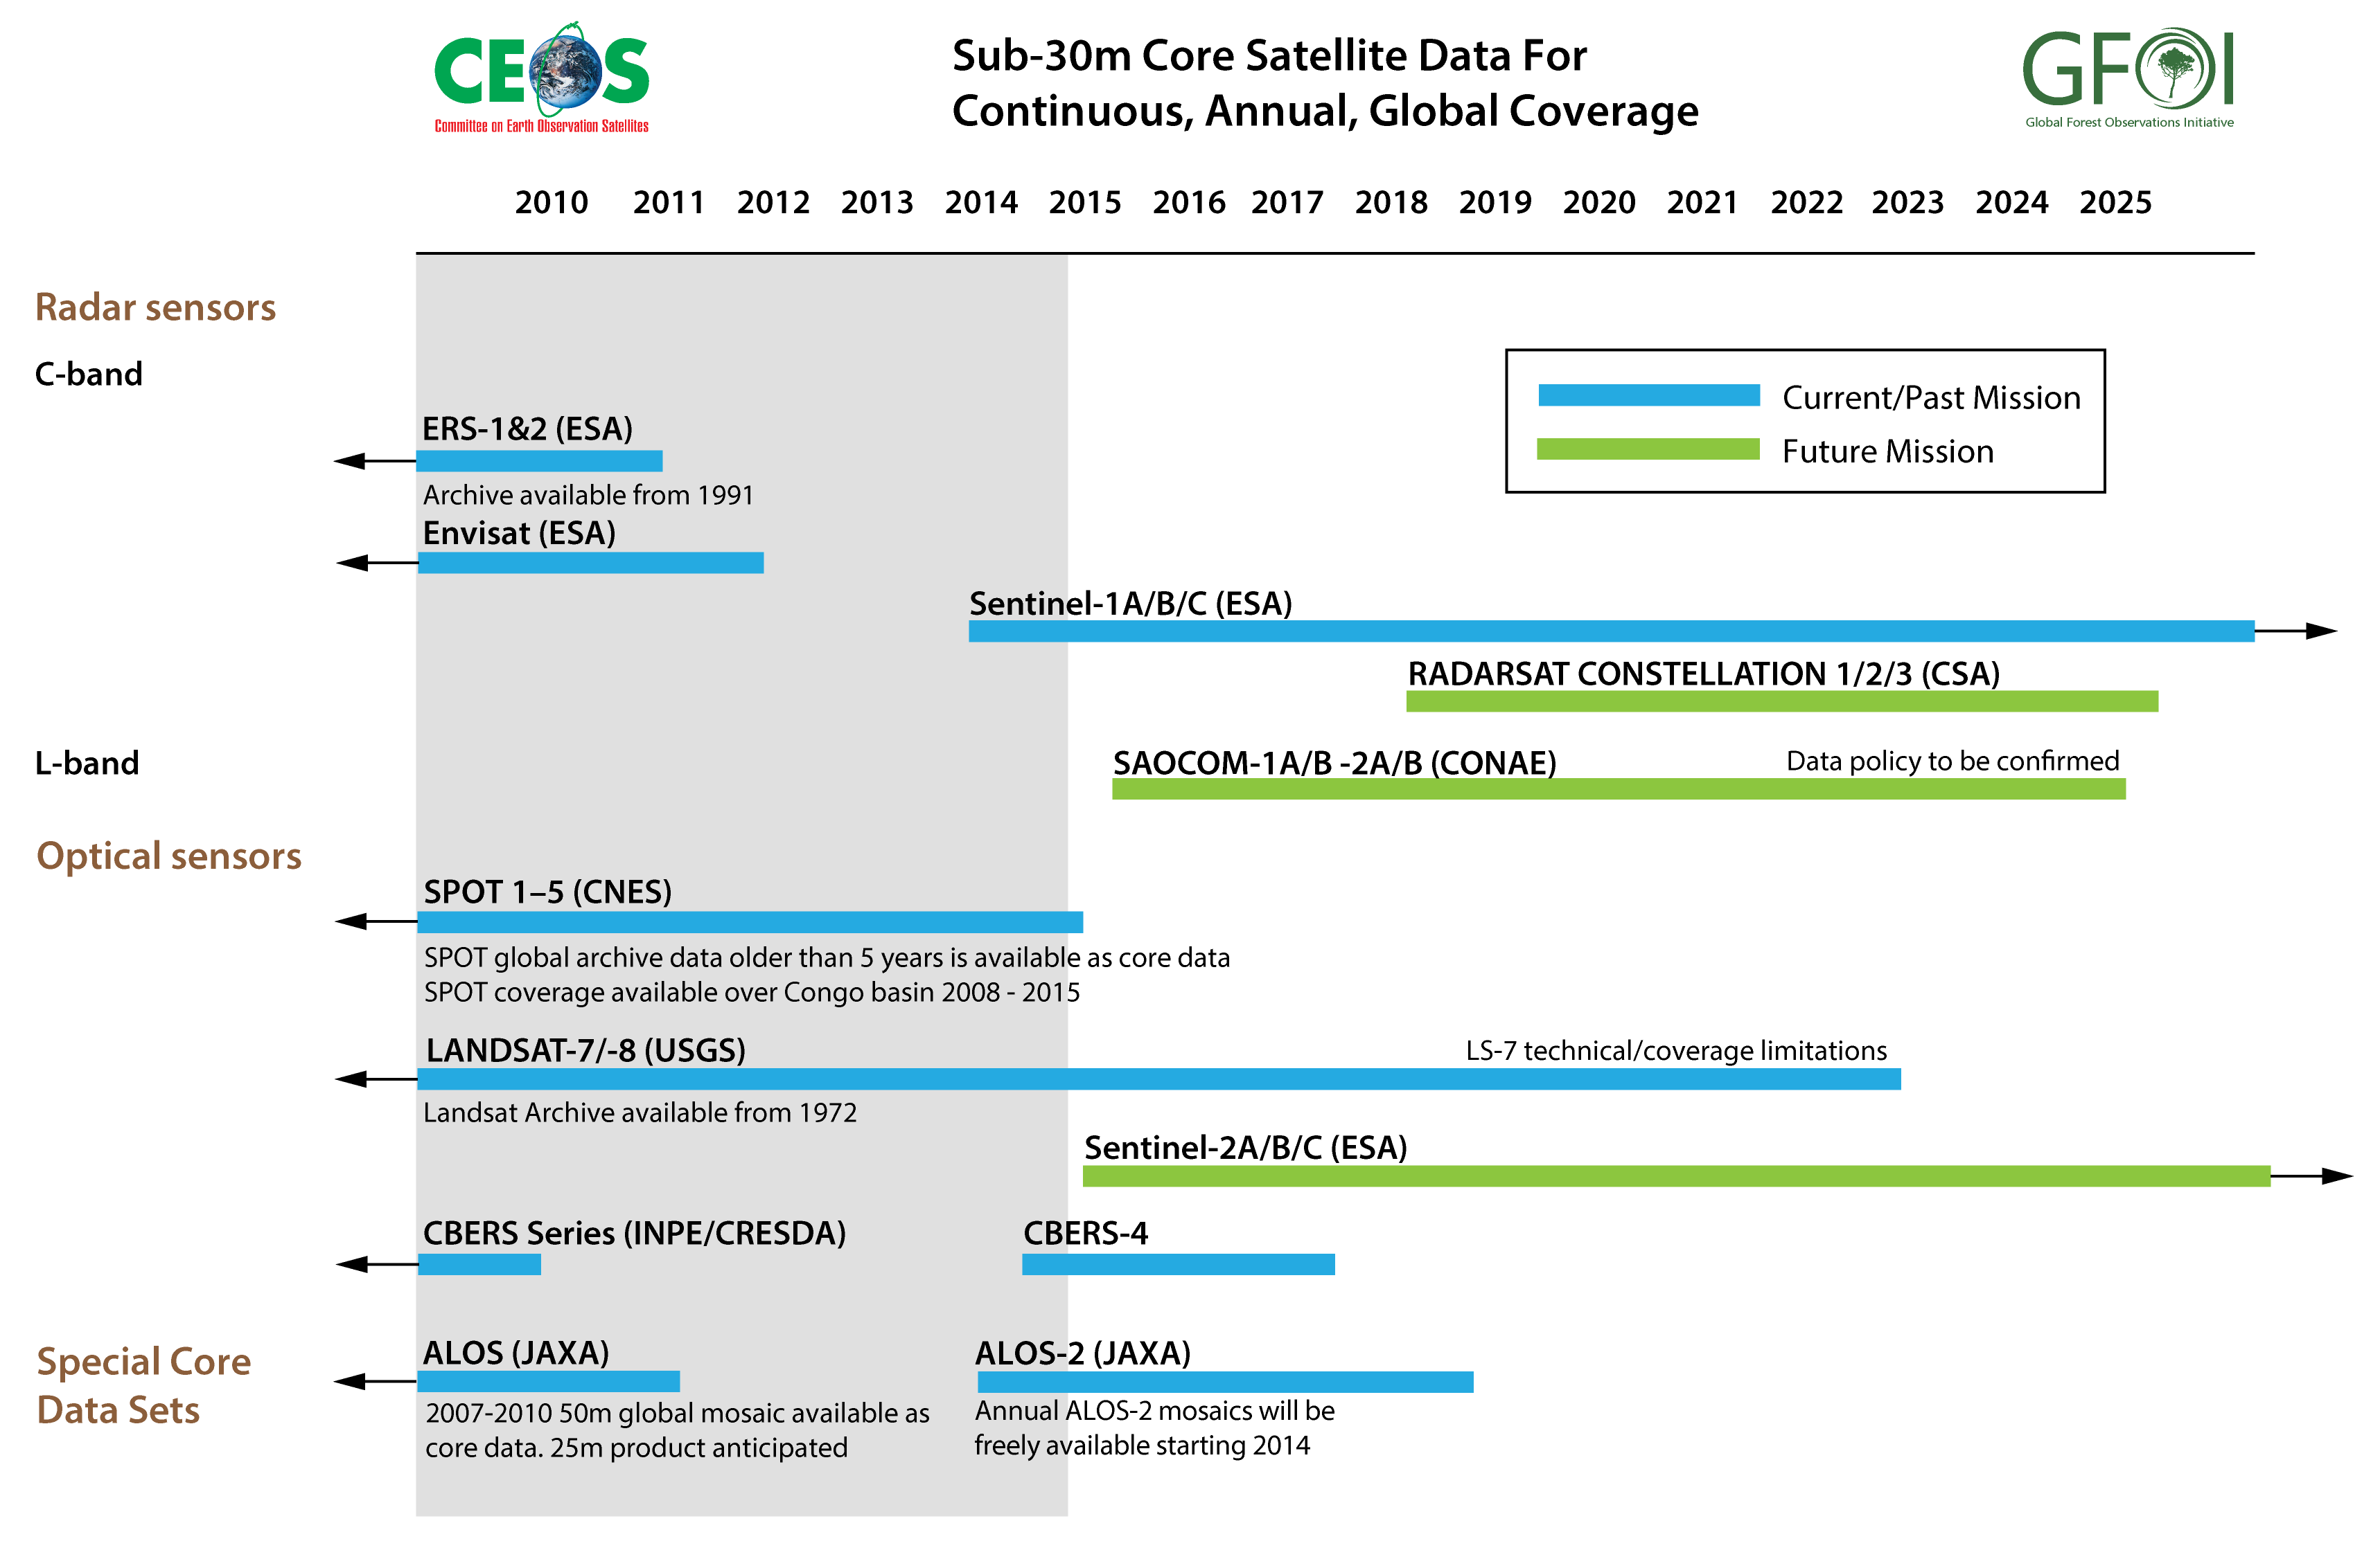
Global Baseline Core Satellite Data

Slide 13
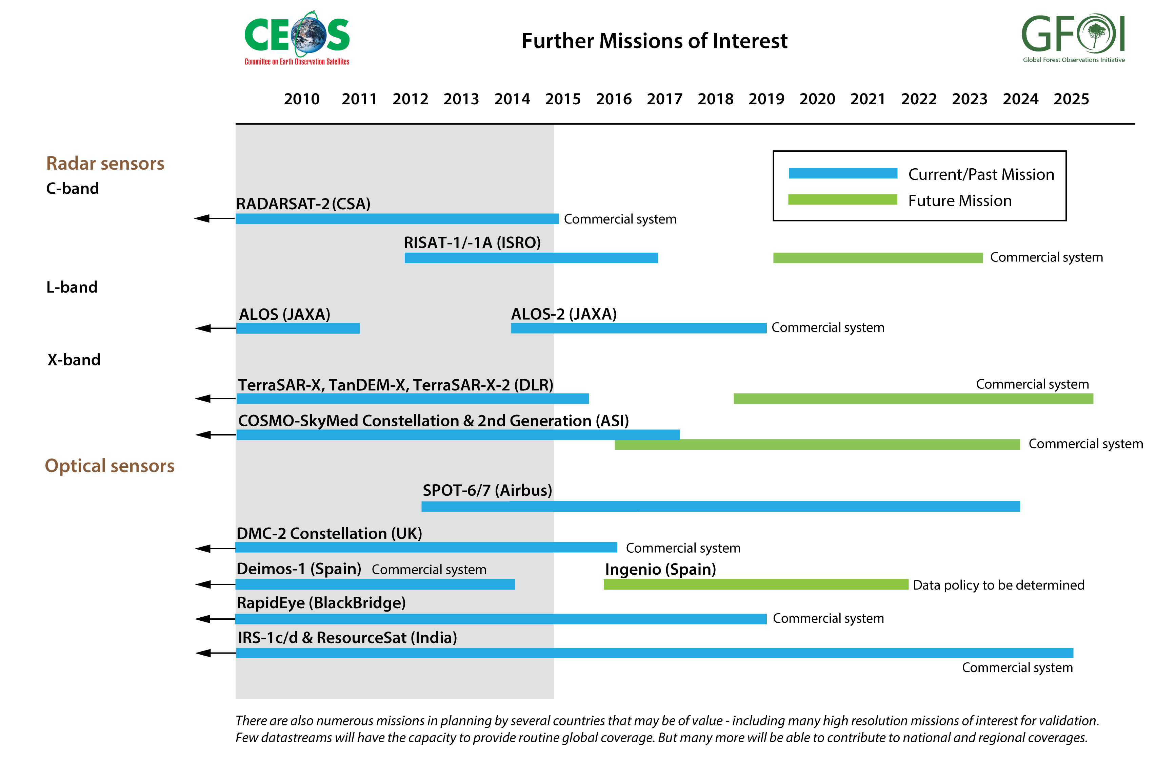
Global Baseline Contributing Satellite Data

Slide 14
Baseline Expansion Scenario
Year | Coverage added | No. countries* | Area* (Mkm²) | Total Area* (Mkm²)
2013 | GEO-FCT National Demonstrator Countries GFOI Participating Countries | 15 | 20.5 | 20.5
2014 | UN-REDD National Programme Countries WB-FCPF Participating Countries CD-REDD Project Countries (BMU) | 36 | 18.5 | 39.0
2015 | UN-REDD Partner Countries WB-FCPF Partner Countries Other Pan-Tropical Countries | 17 | 9.0 | 48.0
2016 | Global | 127 | 84.8 | 132.8

Slide 15
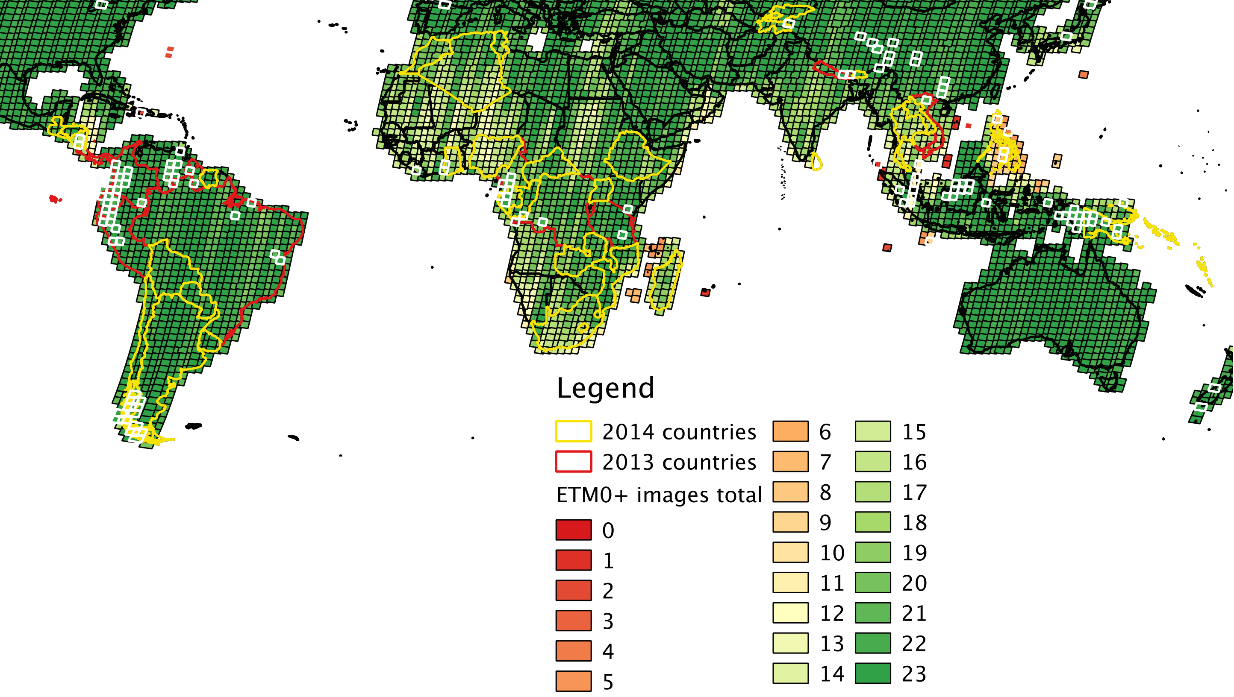
Landsat 7 status
2013
Median: 385 images/day
Max: 462 images/day
2014
Median: 444 images/day
Max: 525 images/day
Number of images
Scenes with best cloud cover greater than 20% in white
Notes:
Increased median acquisitions by Landsat 7: from 385 images//day in 2013 to 444 images//day in 2014
Only few forested areas with less than 10 images

Slide 16
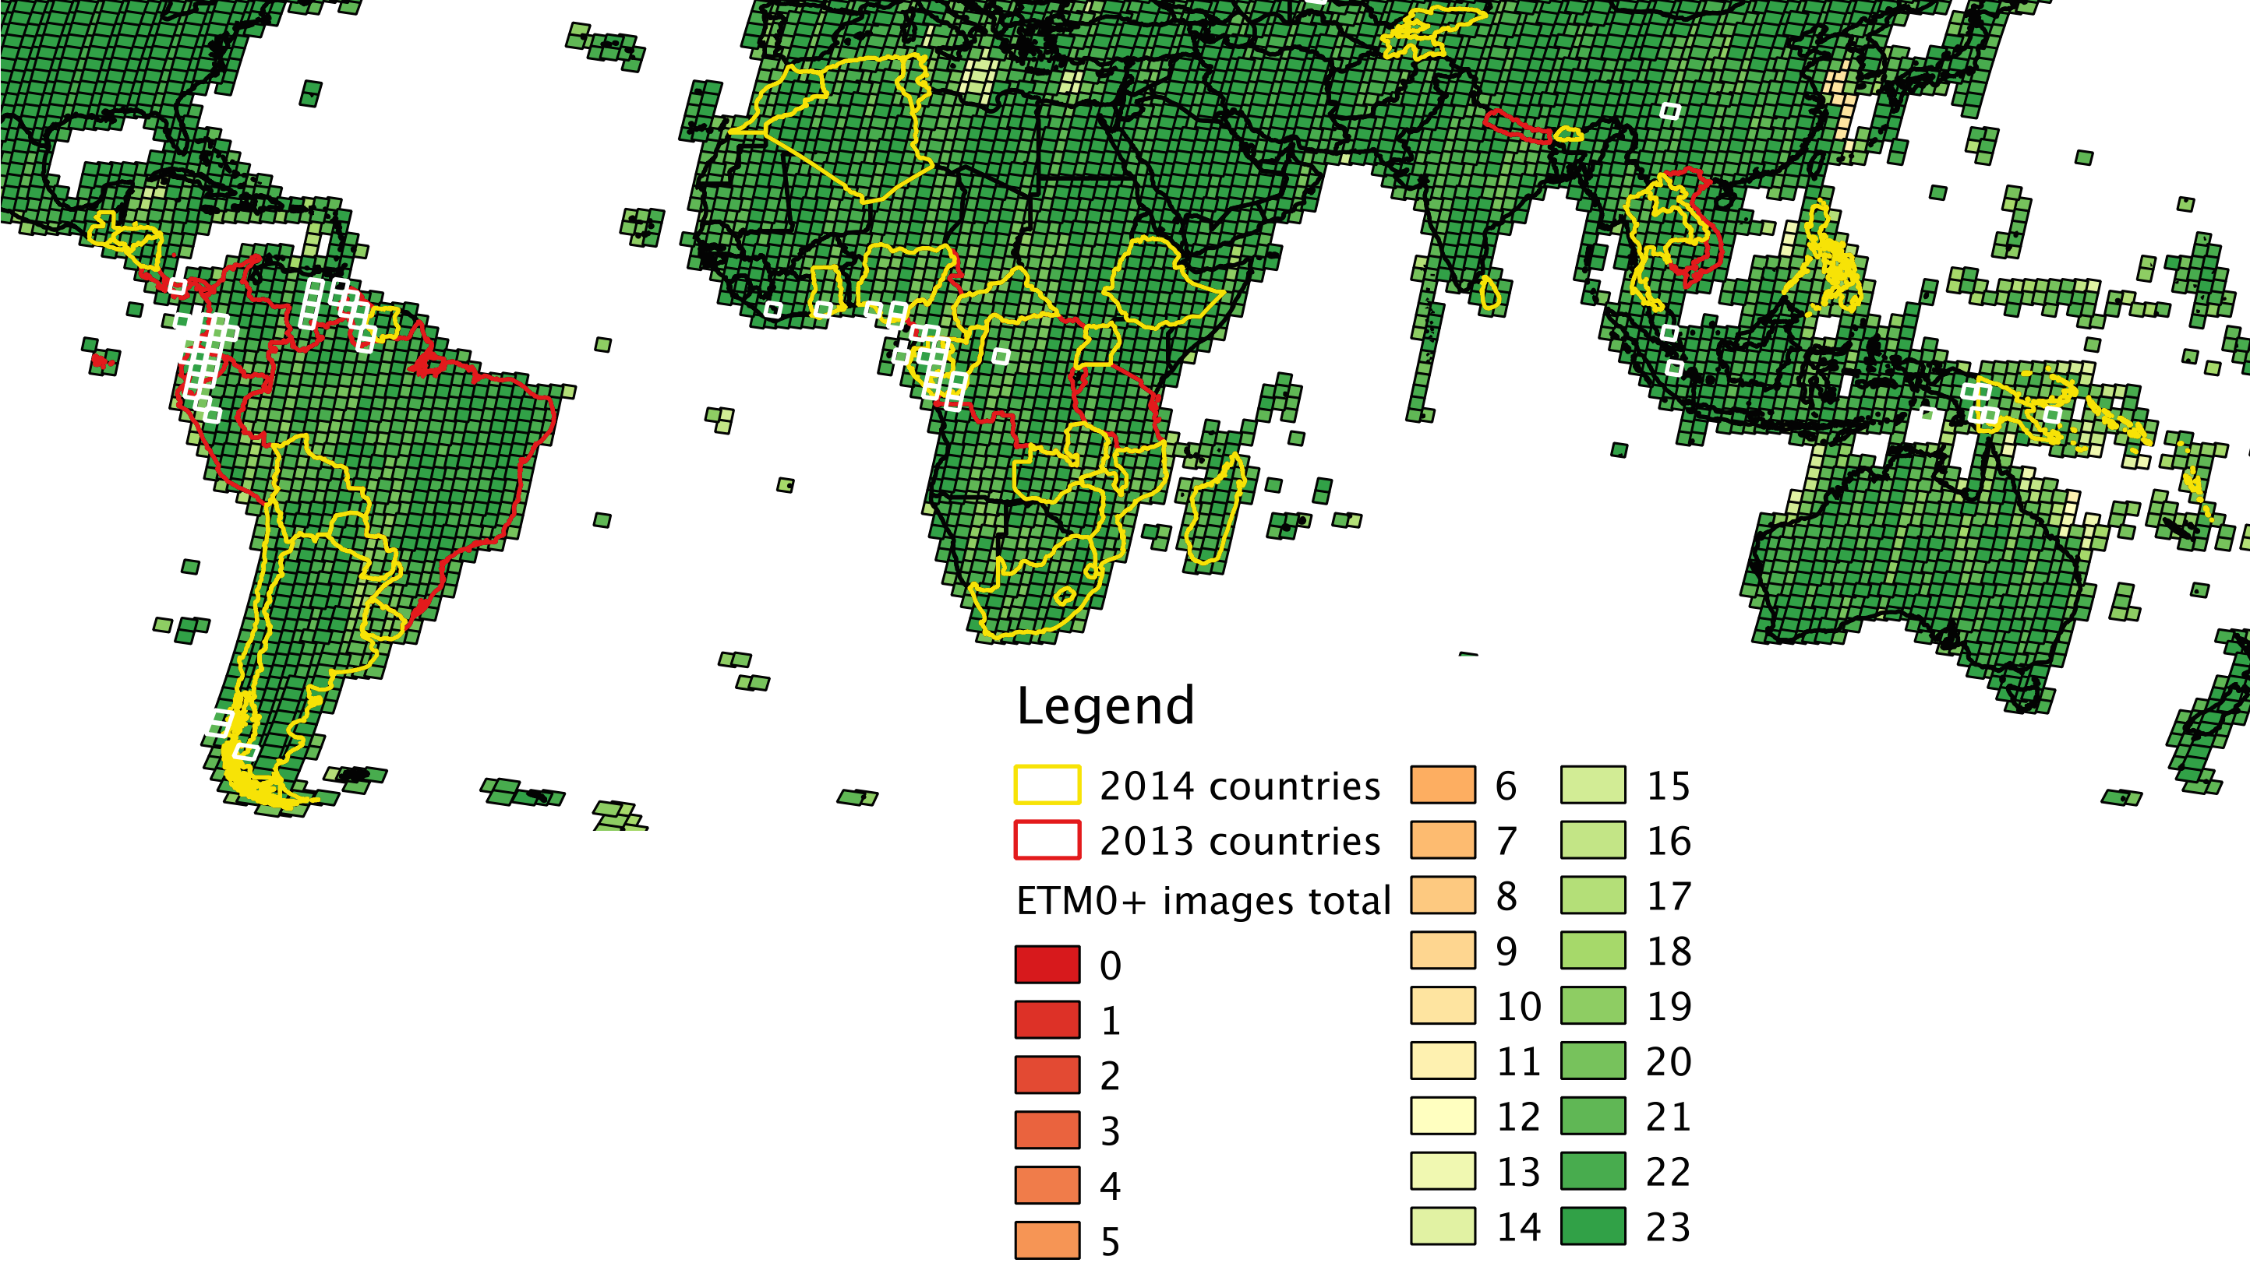
Landsat 8 status
2014 (before 7/26)
Median: 583 images/day
Max: 720 images/day
2014 (after 7/26)
Median: 732 images/day
Max: 764 images/day
Number of images
Scenes with minimum cloud cover greater than 20% in white
Since Dec 2014
Mid latitude (57°)
422 images/day
Reject 1 image/day
99.7%
High latitude
270 images/day
Reject 32 images/day
89.3%
More than 50% sidelap (less than 8-day revisit)
Notes:
Increased median acquisitions by Landsat 8: from 583 images/day in first half 2014 to 732 images/day in second half 2014
Only few forested areas with less than 10 images

Slide 17
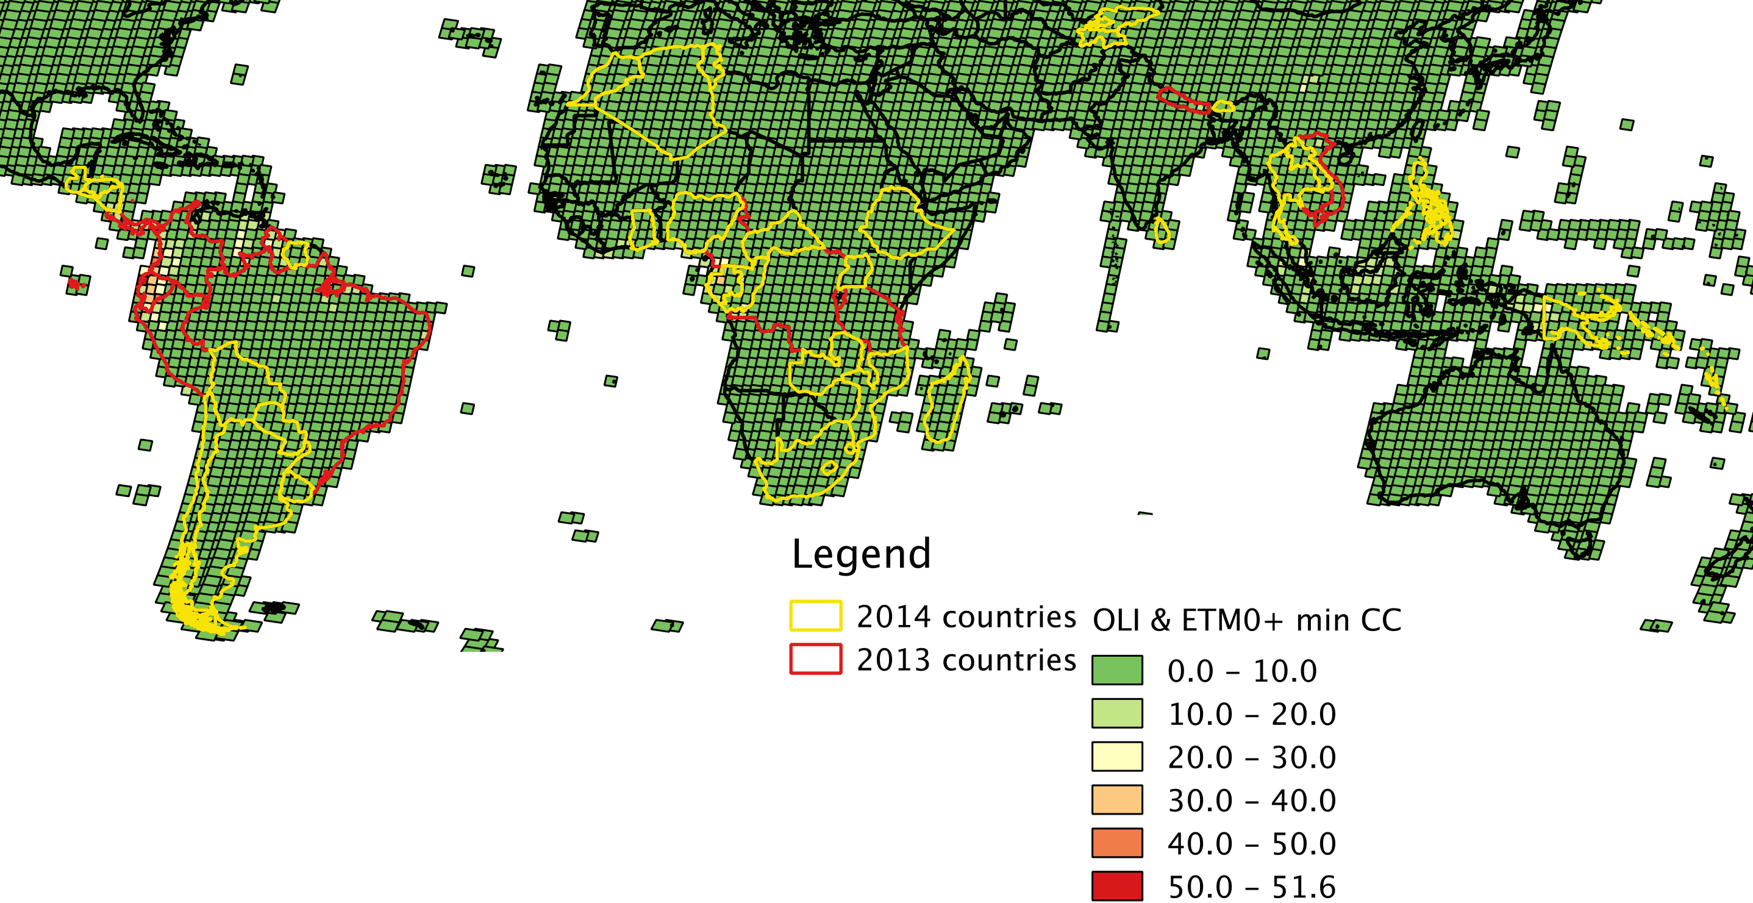
Baseline 2014: Landsat Coverage
Landsat 7 & 8 combined minimum cloud cover
Update Slide
Notes:
15 GFOI countries for 2014 are covered by 2216 Landsat scenes
Over 30 images are available for most path-row or on average one image every two weeks
40% of the best path-row images have close to zero clouds
70% of the best path-row images have cloud cover better than 3%
90% of the best path-row images have cloud cover better than 10%
But –
The “worst” best image (path 102; row 63) in Indonesia was 42.42% cloud covered
The next “worst” best image (path 10; row 5) in Panama/Colombia was 41.08% cloud covered

Slide 18
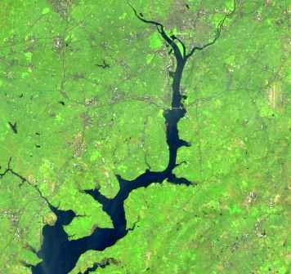
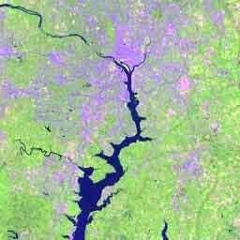
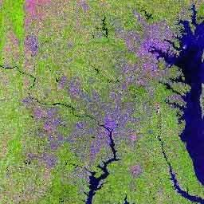
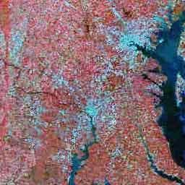
U.S. Landsat Archive Overview
OLI-TIRS: Landsat 8
385,345 scenes
average scene size 1813 MB
ETM+: Landsat 7
1,858,501 scenes
average scene size 487 MB
TM: Landsat 4 & Landsat 5
1,988,982 scenes
average scene size 263 MB
MSS: Landsat 1 through 5
1,299,626 scenes
average scene size 32 MB
Total:
5,532,454 scenes
All average scenes sizes are for uncompressed data Status 2 January 2015
Notes:
The end result is a vast archive of Landsat acquisitions covering 4 decades.
The 41 year Landsat archive contains over 5 million scenes covering an astounding 171 Billion squ. km.

Slide 19
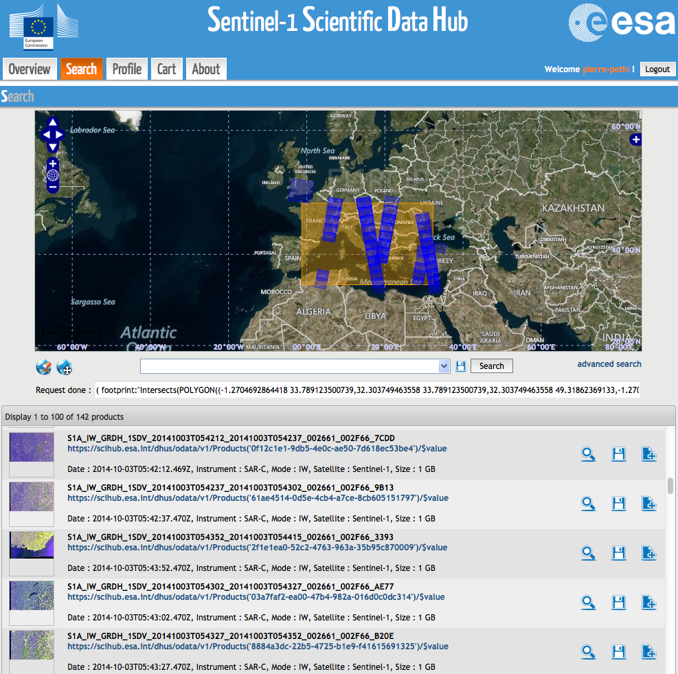
Sentinel-1A Data Flow Open to all users since 3 October 2014 at: https://scihub.esa.int
Sentinel-1 data available!
Today 5676 registered users
Max 2 concurrent downloads
Originally 2 months rolling archive, but no roll-out planned before October 2015
More than 60000 products available for download
Almost 600 TB downloaded
Gradual archive access planned from June 2015
Status 23 March 2015
Notes:
Screenshot of Sentinel-1 science hub
Open since 3 Oct 2014
New: roll-out of data starts only in October 2015
Access to archive also for non-COPERNICUS serviices from June 2015

Slide 20
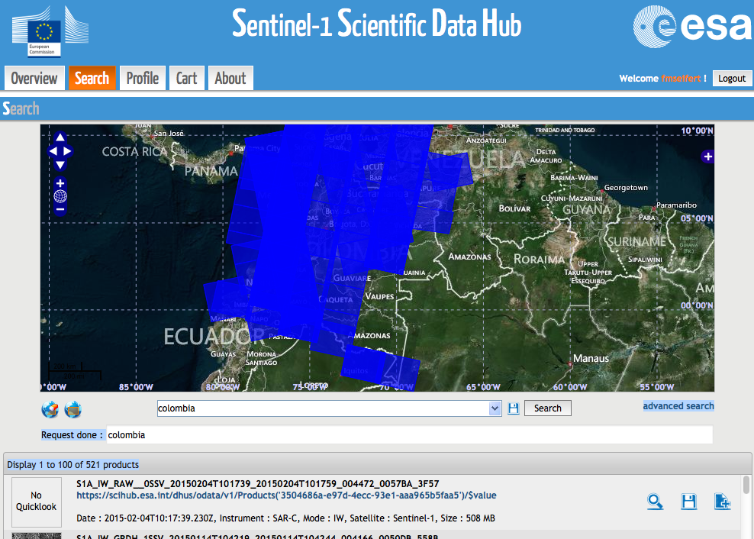
Sentinel-1 for GFOI
Several GFOI priority areas have been acquired during the Sentinel-1 ramp-up phase (overall / dual-pol scenes):
Colombia: 698 / 22
Ecuador: 340 / 0
Peru: 826 / 12
Tanzania: 684 / 61
Kenya: 369 / 34
Uganda: 316 / 30
Cameroon: 21 / 11
DRC: 290 / 36
Cambodia: 76 / 50
Viet-Nam: 371 / 142
Sumatra: 495 / 189
Status 19 March 2015
Notes:
Summary of Sentinel-1 data acquisitions requested over priority areas identified by GFOI

Slide 21
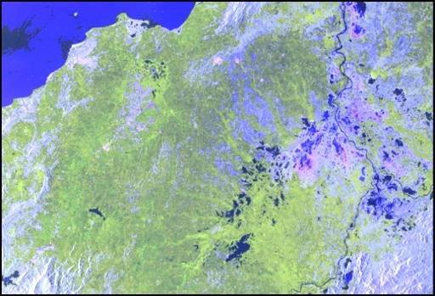
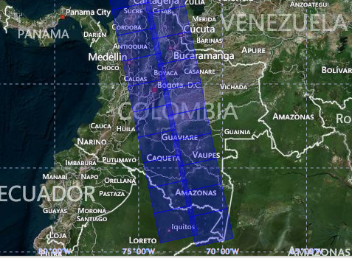
Sentinel-1 over Colombia
Colombia:
698 total
22 VV/VH
Notes:
S-1 VV/HV quick look image from Feb 2015 North coast of Colombia
Upper left corner: dual-pol coverage of Colombia

Slide 22
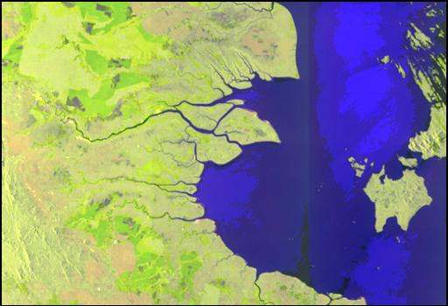
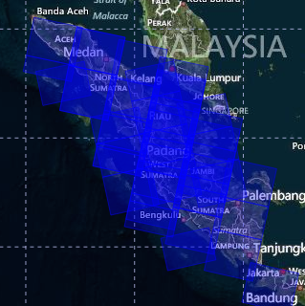
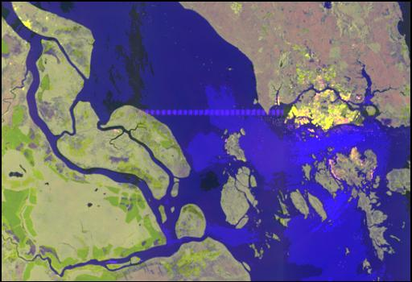
Sentinel-1 over Sumatra
Sumatra:
495 total
189 VV/VH
Notes:
S-1 VV/HV quick look image from Dec 2014 east coast central Sumatra
Upper left corner: dual-pol coverage of Sumatra

Slide 23
Baseline 2014: Coverage Summary
51 GFOI countries for 2014 are covered by 2215 Landsat scenes Over 45 images are available for most path-row or on average one image every 8 days
75% of the best path-row images have cloud cover better than 1%
88% of the best path-row images have cloud cover better than 5%
99% of the best path-row images have cloud cover better than 20%
➔ but in some areas e.g. Ecuador, Indonesia, Gabon, the “worst” best images were close to 50% cloud covered
Dedicated areas in 11 countries were covered by 4486 Sentinel-1 scenes during the ramp-up phase, out of that 587 in dual pol.
The Congo basin is only scarcely covered as it lies on the same orbits as Europe, which is the COPERNICUS priority area.
Relatively few dual pol acquisitions during ramp-up phase related to reduced workload of the system

Slide 24
Baseline 2014: Coverage Summary
Despite the high performance of Landsat, the 2014 requirement for cloud free data cannot be met solely with Landsat data
For all but a few path-rows, it should be possible to get cloud free estimates of the Earth’s surface using more than one image
i.e. cloud free mosaics
The inclusion of the Sentinel-2 and CBERS satellites should show a corresponding improvement, once data from these sensors becomes available in 2015
Even with more optical sensors, some persistently cloudy locations will exist where multiple dates of images in themselves will be not be sufficient to yield cloud free looks at the Earth
Other methodologies, such as SAR, will be required
Sentinel-1 acquires systematically over dedicated areas
ALOS-2 continues with free and open 25 m annual global mosaic

Slide 25
Endorsement of the Global Baseline Data Acquisition Strategy 2015 Update

Slide 26
Global Strategy: Context & Process
2011 CEOS Plenary endorsed the three-element CEOS Strategy for Space Data Coverage and Continuity in Support of GFOI and the establishment of the ad-hoc Space Data Coordination Group for GFOI
SIT-28 endorsed The Global Baseline Data Acquisition Strategy for GFOI (Element 1)
SDCG undertakes to report annually on the acquisitions results and to update the strategy to reflect latest requirements, mission status etc for SIT endorsement. At SIT-30 we seek endorsement of the 2015 update to the Global Baseline Data Acquisition Strategy.
Remove Slide to reduce overall number

Slide 27
Global Baseline Strategy: Core Data
Core data stream concept agreed in 2011 and prevails
provide data, at medium resolutions or finer, free-of-charge and openly shareable for GFOI purposes, consistent with being available in support of any country’s information requirements
sustained and long-term capacity in coverage, processing and distribution which is consistent with the large (global) scale data requirements of the GFOI.
Landsat-7, Landsat-8
Sentinel-1A/B
Sentinel-2A/B
CBERS-4
RCM
(SAOCOM-1 series)
not yet launched
NASA, USGS, ESA/EU, China, Brazil, Canada, (Argentina)
Notes:
Global coverage – Landsat-7/8 [2012+], Sentinel-1A/1B [2014+], Sentinel-2A/2B [2015+], RCM [2018+]
Regional Focus and Gap Filling – CBERS-4 [2015+] (South America, South and Southeast Asia, Africa), SAOCOM-1A/1B [2016+] (Pan-tropical)

Slide 28
Core Data Stream Roles
GLOBAL COVERAGE | REGIONAL FOCUS AND GAP FILLING
Landsat-7/-8 [2012+] Sentinel-1A/-1B [2014+] Sentinel-2A/-2B [2015+] RCM [2018+] | CBERS-4 [2015+] (South America, South- and Southeast Asia, Africa) SAOCOM-1A/-1B [2016+] (Pan-tropical)
Remove Slide to reduce overall number

Slide 29
Contributing Data Stream Roles
RapidEye, SPOT, RADARSAT-2, ALOS-2, TerraSAR-X/TanDEM-X, CosmoSkyMED - all have important capabilities and are relevant to national-level coverage and gap-filling as data supply allows.
Coordination under Space Data Services Strategy for GFOI (nationally focused Element 2 Strategy, more shortly)
ALOS 25 m annual global mosaics recently made available free and open, and represent an important “special core data set”
ALOS/ALOS-2 BOS ensures sustained annual global coverage
SPOT 1-5 archived data >5 years old available free and open. Special access to recent data over the Congo Basin.

Slide 30
Phasing
Year | Coverage added | No. countries* | Area* (Mkm²) | Total Area* (Mkm²)
2013 | GEO-FCT National Demonstrator Countries GFOI Participating Countries | 15 | 20.5 | 20.5
2014 | UN-REDD National Programme Countries WB-FCPF Participating Countries CD-REDD Project Countries (BMU) | 36 | 18.5 | 39.0
2015 | UN-REDD Partner Countries WB-FCPF Partner Countries Other Pan-Tropical Countries | 17 | 9.0 | 48.0
2016 | Global | 127 | 84.8 | 132.8
Notes:
BMU stands for German Ministry of Environment

Slide 31
Global Baseline: Main Updates for 2015
Adjustments based on mission status and launch date
Landsat-8; CBERS-4, Sentinel-1A, and ALOS-2 in orbit
Sentinel-2A launch in June 2015
ALOS mosaic and SPOT archive availability
Landsat operations increased to a median of 732 images per day, which is close to an acquire always over land surface strategy!
Increase Sentinel-1 acquisitions in dual-pol over dedicated areas
Insert priority countries in the Sentinel-2 ramp-up phase
References and linkages to the Space Data Services Strategy where appropriate
Summary of 2014 implementation, and detailing of 2015 implementation plans
Scoping of 2016 implementation plan and beyond

Slide 32
Global Baseline Data Acquisition Strategy
Global Baseline Strategy implementation commenced successfully in 2014
Strategy updated with revised implementation plan for 2015
Communicable & defensible
Provides ongoing community confidence that the organisational and technical capacity will exist to support reporting of all countries
Core data stream (& contributing data stream) agencies have been engaged throughout the process and subscribe
➔ Seeking endorsement of CEOS SIT (@ SIT-30) for the updated Strategy

Slide 33
Endorsement of SDCG 3-Year Work Plan

Slide 34
3-year Work Plan - Purpose
Why a 3-Year Plan for an Ad-hoc Group?
Intended to take the Space Data Component through the next phase of GFOI in a well-structured and managed way
Support effective internal and external communication as to the outputs of the Space Data Component of GFOI – process helped characterise and categorise our effort
Highlight obstacles to success for attention of Leads

Slide 35
3-year Work Plan - Approach
Describes a 3-year vision as the ideal outcome for the Plan
Outcome driven (17 outcomes over 3 years)
Document ‘lite’
Leadership of Threads consistent with roles & expertise
Thread leaders responsible for further development & definition
Propose to structure telecons and meetings around their progress reports
Baseline Global Observations
Space Data Services
Support to R&D
Component Coordination and Country Engagement

Slide 36
Features of the 3-year Vision
Consistent with the Strategic Plan for GFOI developed by the GFOI Leads
Easily communicated both internally and externally including to CEOS and its agencies, GFOI stakeholders and countries
Provides linkages and improves the integration with the other components of GFOI
Ensures an efficient and effective engagement with countries including by leveraging the in-country efforts of FAO, World Bank, and SilvaCarbon
Can provide the necessary direction and resources for the definition and execution of the activities and tasks required to realise the outcomes;
Informs and supports the discussion required among the GFOI Leads regarding the coordination necessary for realisation of the outcomes, in particular regarding the country engagement through FAO, World Bank and SilvaCarbon

Slide 37
3-year Vision 1/2
Streamlined and efficient processes for maintaining and adjusting the annual global coverage by the core data streams
Leveraging the programs of the core data stream providers to facilitate the necessary supply of data to the GFOI end-users
SDCG’s Space Data Services, alongside the GFOI Methods and Guidance, will be mainstreamed with the REDD+ activities of the major sponsors and in-country programs of FAO, World Bank, and others
Development of scalable tools and sustained capabilities (including cloud-based storage, interactive processing, and delivery) for the Space Data Services, based on the prototypes and pilots that SDCG has been exploring
Incorporation of GFOI Space Data Services and Methods and Guidance in one or more operational national MRV programmes

Slide 38
3-year Vision 2/2
Effective & professional engagement of the most relevant countries, based on the priorities of FAO and World Bank, and leveraging the activities of SilvaCarbon – resulting in wide-spread awareness of GFOI products and services among these countries
Implementation of a plan for acquisition and provision of satellite data in support of GFOI R&D activities; and
Implementation of a private sector cooperation strategy, especially in the area of GFOI Space Data Services, validation, and space data for R&D activities
Vision will benefit greatly from the increased engagement with the FAO following the collocation of the GFOI office in early 2015, as well as with the relevant programs and capacities of the core data stream providers, and recognition of GFOI as an integral part of REDD+ by the major donors and funded accordingly

Slide 39
Status
Significant and multiple reviews undertaken by SDCG Members and Exec – 9 month process
Several outcomes (esp. related to country engagement) require coordinated effort from GFOI – directed by the Leads
Trial run in Sydney meetings was extremely successful
➔ Seeking endorsement of CEOS SIT (@ SIT-30) for the Work Plan

Slide 40
Endorsement of SDCG Element-3 (R&D) Acquisition Strategy

Slide 41
SDCG Element-3: CEOS support to GFOI R&D
SDCG Element 3: Satellite Data in support of GFOI Research & Development (R&D) Activities
R&D focus provides a means also for CEOS agencies with commercial missions to actively contribute to GFOI objectives
Contributing agencies:
- ASI: COSMO-SkyMed
- CNES: Pléiades, SPOT 1-5
- CSA: RADARSAT-1 and RADARSAT-2
- DLR: TerraSAR-X and TanDEM-X
- JAXA: ALOS and ALOS-2
and in addition, “Core Mission” agencies ESA, INPE and USGS.

Slide 42
SDCG Element-3: CEOS support to GFOI R&D
Element-3 developed in parallel with the GFOI R&D Component Plan
GFOI R&D Plan provides
- Coordination of R&D towards GFOI priority topics
- Mechanism for integration of new methods in GFOI MGD
- Management of research groups
- Reporting and feed-back to space agencies and GFOI
- Organisation of R&D Expert workshops and science meetings
Element-3 provides
- Satellite data support to GFOI R&D Plan

Slide 43
SDCG Element-3:
CEOS support to GFOI R&D
The Element 3 strategy outlines different means for CEOS space agencies to support the GFOI R&D component:
• Provision of satellite data over GFOI R&D Study Sites
- New data acquisitions (satellite tasking)
- Historical (archive) data
• Coordinated Research Announcements (RA) and solicitations
- RAs targeted at selected GFOI priority R&D topics
- Coordinated open calls targeted at GFOI support
- Funding opportunities
- Others

Slide 44
SDCG Element-3:
CEOS support to GFOI R&D
R&D topics - Collection of country priority R&D requirements
GFOI R&D Expert workshops
- Sensor interoperability (Boston, USA, June 2014)
- Forest degradation (Wageningen, NL, Oct 2014)
- Vegetation Biomass (Brisbane, Australia, Feb 2015)
Country consultations
- SDCG-4 (Pasadena); SDCG-5 (Rome), SDCG-6 (Oslo), SDCG-7 (Sydney)
- GFOI/SilvaCarbon workshops (Thailand, Indonesia, Brazil)
Experiences from GEO-FCT National Demonstrator R&D prog.
- GEO-FCT Science Summits (USA 2010, Italy 2011, Tanzania 2012, Australia 2013)
- GEO-FCT PD team annual Technical Reports to CEOS (2010, 2011, 2012)
Priority R&D topics
Forest degradation; Above-ground Biomass; Sensor interoperability/complementarity; Activity Data for REDD; Time-series analysis

Slide 45
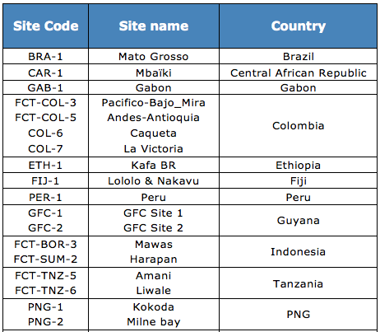
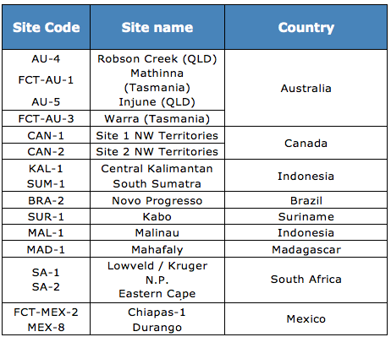
SDCG Element-3: CEOS support to GFOI R&D
GFOI R&D Study Sites & R&D teams
Multi-disciplinary sites, addressing several GFOI Priority R&D topics
Including study sites in former GEO-FCT National Demonstrator countries
13 R&D teams from GFOI countries and int’l research organisations

Slide 46
SDCG Element-3:
CEOS support to GFOI R&D
Complement to the Global Baseline Data Acquisition Strategy (Element-1) and National Space Data Services Strategy (Element-2)
Developed in consultation with countries, contributing CEOS agencies, GFOI Leads and leading R&D institutions
Provides GFOI engagement of both Core Mission and Contributing Mission agencies
3-year duration proposed. Implementation plan for 2015 ready for execution; plans for 2016-2017 scoped
Satellite acquisitions and data provision proposed to commence in April 2015
➔ Seeking endorsement of CEOS SIT (@ SIT-30) for the SDCG Element-3 Strategy

Slide 47
2015 Outlook

Slide 48
2015 Outlook: Global Baseline
Continuing ramp-up towards global coverage by 2016
L-7 & -8, Sentinel-1A and CBERS-4 all operational
Sentinel-2A launched
67 countries coverage in the bank
Action specified for SDCG Exec to scope a Global data flows study – to report within a year: short and strategic discussion paper which describes a GFO scenario and projects the data transmission, storage and processing volumes and costs – versus an alternative analysis-ready data near source scenario (such as Data Cubes)
SDCG believes this can change the world of EO – CEOS should investigate

Slide 49
2015 Implementation: Space Data Services
Await MGD portal as the sharp end of country engagement – will add space data links
SDCG-8 in conjunction with German aid ministries and countries
COVE Coverage Analyzer now includes Landsat 7/8, SPOT 1-6, Pleaides-1A/1B, Radarsat-2, ALOS-1. 2015 - adding Envisat, ERS-1/2, TerraSAR-X, RapidEye, and Sentinel-1A/2A in 2015 – e.a. “one-stop” location to perform coverage assessments and “discover” datasets
Data delivery moving online only

Slide 50
SDMS Pilot Projects
Significant work programme underway
Data Cube a strong focus
Kenya (Clinton, Australia) and Mexico (ESA) Pilots

Slide 51
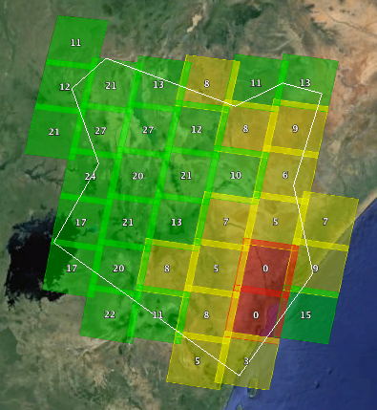
GFOI Data Services
FAO – Contract between KSAT (Norway) and AMA (SEO contractor) resulted in a Space Data Management System (SDMS) delivered on November 5, 2014. This was a scene-based system for Landsat data storage and forest cover analysis. FAO plans to utilize the system in Ecuador, Guyana, Tanzania and Uganda.
Colombia – SEO developed a proposal for TanDEM-X data and delivered an SDMS for storage and processing on December 3, 2014. The SEO has also provided training for Colombia researchers and performed detailed coverage assessments.
Kenya – SEO completed a detailed Landsat and SPOT coverage assessment back to 2000. SEO will order 6300+ Landsat scenes (analysis-ready data products) and will deliver them to Kenya in April 2015. These same scenes will be used for the Data Cube project.
Coverage Assessments – The SEO has completed 22 Coverage analysis reports since 2012 using COVE tools.
Cloud Computing

Slide 52
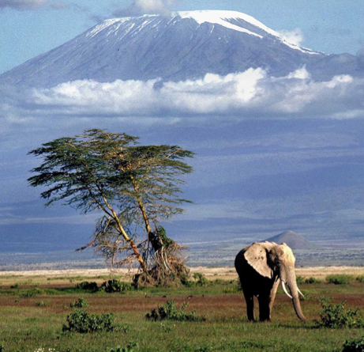
Kenya Data Cube Project
Data Cubes have the potential to revolutionize the use of satellite data. The Kenya Data Cube project will demonstrate this concept.
Scene-based data is inefficient and poses severe problems for developing countries. A multi-dimensional pixel-based Data Cube, pioneered by Geoscience Australia (GA), can “shift the paradigm” for data usage.
A team met at GA on March 9-11 to develop a vision, architecture and task plan for the project. The team includes CSIRO, GA, Australia Dept. of the Environment, NASA-SEO, Clinton Climate Initiative (SLEEK Project). Future involvement from USGS and ESA is desired.
Phase 1: Initial Kenya Data Cube to be presented at UNFCCC COP-21 (Dec 2015). Demo FAO land classification algorithm, temporal change detection algorithm, and data analysis tools.
Future Phases: More countries, more data layers, more analysis tools and more application tools.

Slide 53
SDMS Pilot Project Plan
United Nations FAO (Food and Agriculture Organization) Forestry Department, KSAT (Kongsberg Satellite Services), NASA’s CEOS Systems Engineering Office (SEO), and AMA (Analytical Mechanics and Associates, Inc.) are partnering to develop and demonstrate a prototype Space Data Management System (SDMS).
The 8-month effort (Dec 2013 through July 2014) has developed an operational prototype SDMS focused on 3 pilot countries: Ecuador, Tanzania and Uganda.
Successfull completion of this pilot project lead to a 3-year development project under the lead of FAO supporting up to 16 REDD+ countries.

Slide 54
2015 R&D
R&D Component needs leadership and financial support
SDCG developing a clearinghouse mechanism to better coordinate requests for space data in support of forest monitoring – including data for R&D & commercial data

Slide 55
2015 Country engagement
Remains SDCG’s biggest concern
Dedication of FAO and World Bank to be proven
Move of GFOI office to FAO should reveal intentions

Slide 56
Future of the ad hoc SDCG for GFOI

Slide 57
SDCG Next Steps
Continued implementation of the CEOS Strategy for Space Data Coverage and Continuity in Support of GFOI
If all goes to plan, coverage will soon not be the main issue
Next generation data architectures emerging through GFOI
GFOI takes CEOS & GEO a step closer to delivering to individual government needs
Relationship with GEOGLAM still TBD
SDCG will seek renewal of its mandate at CEOS Plenary

Slide 58
SDCG
Thanks for your attention!
Dr Seuss, 1971

