Slide 1
CEOS-CGMS Working Group on Climate
Committee on Earth Observation Satellites
John Bates, NOAA
SIT-30 Agenda Item #11
Climate Monitoring, Research, and Services
30th CEOS SIT Meeting
CNES Headquarters, Paris, France
31st March – 1st April 2015

Slide 2
Notable WGClimate Activities Since SIT-29
Report to and feedback from the UN Framework Convention on Climate Change (UNFCCC) Committee of the Parties (COP-20) Subsidiary Body on Scientific and Technological Advice (SBSTA-41)
“The SBSTA expressed its appreciation to CEOS and CGMS for their updated report on the progress made by space agencies providing global observations in their coordinated response to relevant needs of the Convention. It noted the importance of continuing and sustaining satellite observations on a long-term basis and welcomed the efforts to develop an architecture for climate monitoring from space. It invited CEOS to report on progress made at SBSTA 43, and at subsequent sessions, as appropriate.”
Significant progress on the ECV inventory including version control, reference assessment and compliance against GCOS guidelines, and reference gap analysis proposed.
Significant progress in case studies linking CDRs to societal applications and informed policy decisions and significant interactions with Climate Services, Mitigation, and Adaptation communitiesNomination of incoming Vice Chair of WGClimate – Jörg Schulz, EUMETSAT

Slide 3
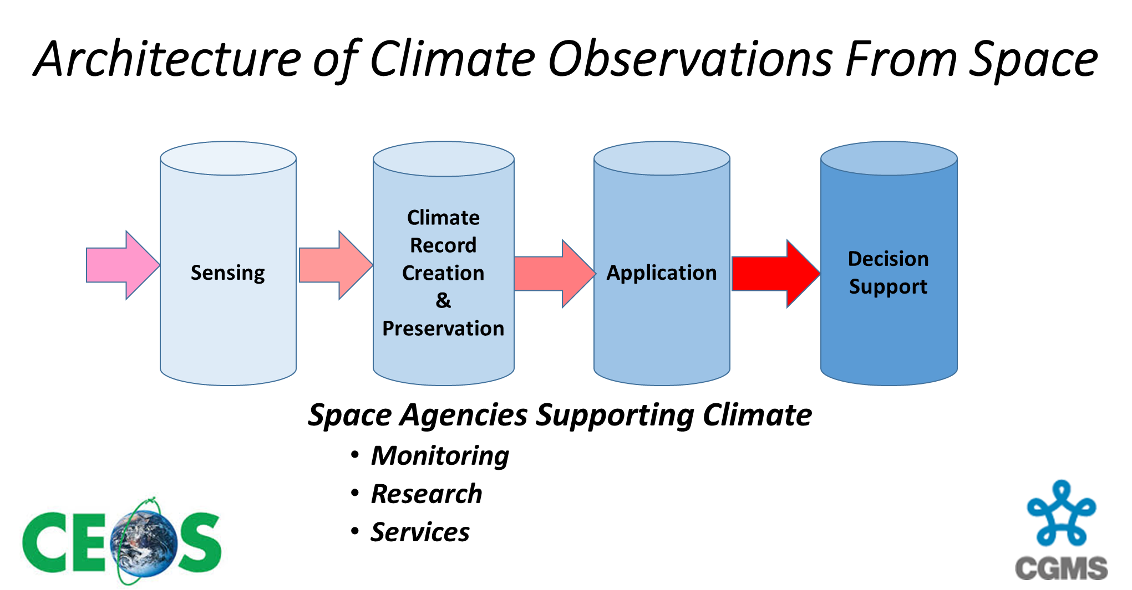
Notable WGClimate Activities Since SIT-29 – Architecture ‘Branding’

Slide 4
WGClimate – Importance of Space Agency Participation
The Working Group on Climate is working issues unique to Space Agency coordination and so does require a commitment. Agencies’ commitment has been uneven; some have made significant commitments, others less.
Participation is good and good for you. The ECV inventory will be the premier, trusted source of satellite climate products. Connections made in WGClimate have led to new and improved science and stewardship.
The Working Group on Climate is seeking the renewed commitment of Agencies and individuals to work on priority areas:
ECV inventory – WGClimate will provide a record-by-record assessment of compliance of input against GCOS climate data set guidelines. Help in improving compliance is requested
Participate - Participate in the annual meeting, task team activities, or other contributions (most Agencies support science and stewardship activities that could contribute to WGClimate)
ECV inventory – first cycle will be done as a proof of concept applied to a sample of the most complete records (insufficient records for complete gap analysis)

Slide 5
WGClimate Work Plan Elements Update
CMRS-2: Gap analysis – Define reference process for gap analysis and necessary tools to support this -
Status - WGClimate Action Groups formed and activities ongoing (Due Q2 2015)
ECV Assessment Action Group – Assessment criteria identified and applied to all records – Feedback on compliance will be with Pillar 2 will be provided to all Agencies. Select records will be assessed against all Pillars
ECV Gap Definition Action Group – Gap Definition Criteria identified and formalized. Analysis will be applied to a select sample of records
CMRS-3: Action plan – Identify actions Space Agencies can take to mitigate any gaps –
Status – Following CMRS-2 ongoing will be applied to sample of records (Due Q3 2015)
CMRS-9: Update of ECV inventory, gap analysis and action plan (version 2) – The above sequence forms the basis for an ongoing analysis cycle, in agreement with the new GCOS plans
CMRS-11: Analysis report on implications of UNFCCC treaty (and related GCOS update on ECV inventory)

Slide 6
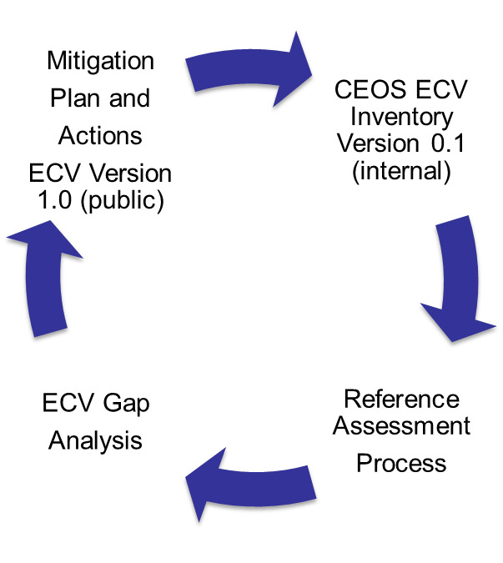
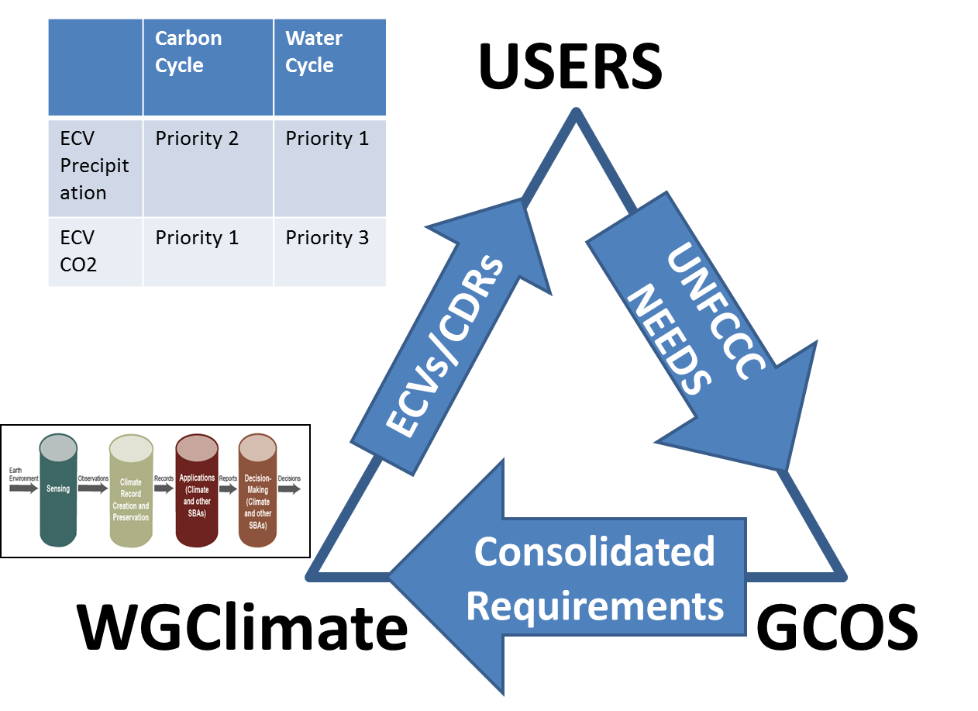
The ECV inventory assessment process
The set of CMRS actions 2, 3, 9, and 11 form an iterative cycle

Slide 7
WGClimate Work Plan Elements Update
CMRS-4: Case studies linking CDRs to societal applications and informed policy decisions – Identify examples from current work and map it to the Climate Monitoring Architecture
Status – On Schedule for Q1 2015 – A draft report edited by Mark Dowell and Stephan Bojinski was presented and approved at WGClimate meeting

Slide 8
WGClimate Work Plan Elements Update
CMRS-7: CEOS Response to the GCOS IP and Satellite Supplement for submission to GCOS (note change requested in consultation with GCOS)
44 potential actions were identified in the CEOS response
Draft update nearly complete; 23 responses received, several items determined not applicable, the remainder being addressed
Plan is simply to add new content to appropriate section of the original response document and provide updated executive summary
Need SIT help to conduct review and dispose of comments

Slide 9
WGClimate Work Plan Elements Update
CMRS-10 - CEOS-CGMS Report on Progress to SBSTA-43
Status – Ongoing – Approach is to have this report include 2 aspects of WGClimate work: 1) ECV inventory reference assessment, gap analysis, and recommendations and 2) summary of Climate Monitoring Architecture Climate Services Case Studies.
Timeline – Due to UNFCCC in early October. Draft to CEOS for review and comment by mid-July
SIT help requested for logistics of review, comment, and approval process

Slide 10
WGClimate Work Plan Elements Update
CMRS-8 - Incorporation of in situ data holdings within the ECV inventory
Status – Ongoing – This involves only the re-use of the ECV questionaire for use by the in situ community so as to allow common elements to be searched across all ECVs in the future. The actual surveying of the in situ community, and quality and version control of the in situ inventory results will be led by the WCRP Data Advisory Council (WDAC) in collaboration with GCOS panels

Slide 11
WGClimate Work Plan Elements Update
CMRS-9: Update of ECV inventory, gap analysis and action plan (Version 2)
Status – The ECV inventory is an ongoing cyclical process central to the WGClimate goals. The intent is to request additional input and provide an updated assessment, gap analysis, and report to CEOS and CGMS once every 2 years coinciding with the WGClimate Chair term.
CEOS ECV Inventory
V1.1
Reference Assessment
Process
ECV Gap
Analysis
Mitigation
Plan and
Actions V2.0

Slide 12
WGClimate – Other Business (cont.)
The Working group has received a letter of nomination and support from EUMETSAT for Jörg Schulz to be incoming Vice Chair. The WGClimate has approved this nomination and Jörg will become Vice Chair following approval at CGMS Plenary in June and the CEOS Plenary this Fall.
WGClimate appreciates and supports a European effort to provide additional resources for the further development of the ECV Inventory

