Slide 1

WGISS
Committee on Earth Observation Satellites
CNES
SIT-30 Agenda Item 10
CEOS Action / Work Plan Reference
30th CEOS SIT Meeting
CNES Headquarters, Paris, France
31st March – 1st April 2015

Slide 2
Summary
Technology Exploration Interest Group
Recovery Observation Infrastructure Project
Interoperability Interest Group
  Opensearch
  CWIC
  FedEO
  IDN
Data Stewardship Interest Group
Water portal
Next meeting

Slide 3
Technology Exploration
Around the CEOS Plenary in November 2015, WGISS held a side meeting on the theme of “Emerging technologies”
  Big data
  Cloud technologies
Current topics of exploration:
Australian Geoscience Data Cube (AGDC) - The AGDC (data cube) is a common analytical framework composed of a series of data structures and tools which facilitate the organisation and analysis of large gridded data collections.
  A dedicated session will be held during next WGISS meeting
  Intentions are to start activities after WGISS meeting
  Several CEOS agencies are interested
  Work will be done in cooperation with SEO

Slide 4
Technology Exploration
  Fundamentals of Managing Data - New activities on data management plans and on lessons learned. This will help with the 2015 action item on GFOI and GEOGLAM
Open Sourcing – Methods open sourcing software such that it can be freely used, changed, and shared (in modified or unmodified form)
Data Access via OPeNDAP – The Open Source Project for a Network Data Access Protocol (OPeNDAP) provides a mechanism for directly accessing earth science data and metadata via a web accessible API

Slide 5
Recovery Observatory
Version 2 has been delivered
  Coupling of EO data access tool and Drupal CMS for allowing collaborative work on EO data
  Implements KalHaiti functionalities
  Is installed on KalHaiti infrastructure and is under test
  URL for demo is available at http://dotcloud.akka.eu/drupal
  URL for development is at : http://dotcloud.akka.eu/drupal_dev
    Version 3 is foreseen for end of June
  Will implement all functionalities of the recovery observatory
  We are open for comments, contributions or new ideas
  A dedicated workshop will be held in May during next meeting in Japan (Tsukuba)

Slide 6
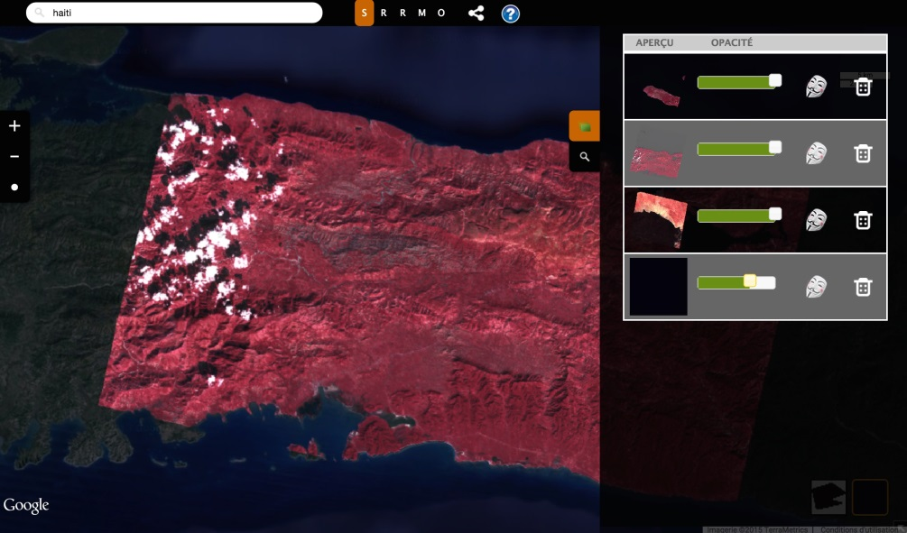
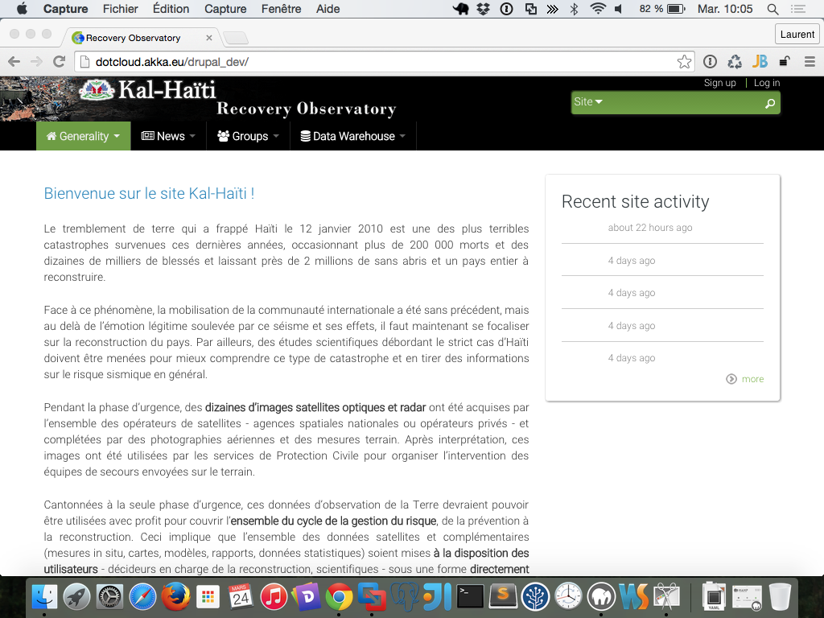
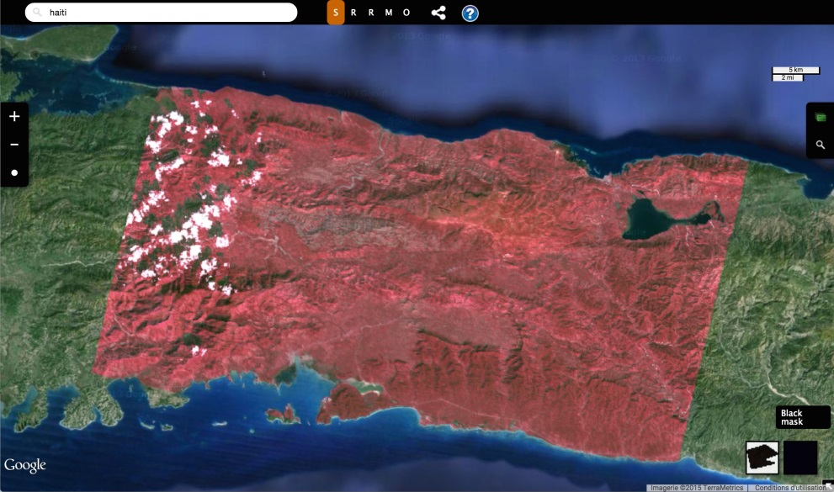
Recovery Observatory
Home page & Drupal
EO data access tool

Slide 7
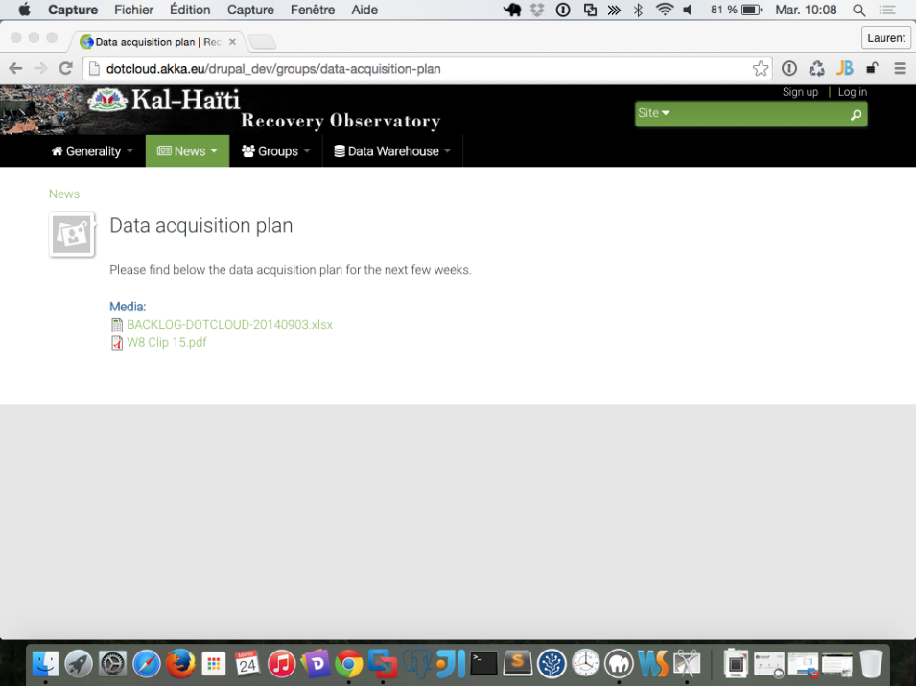
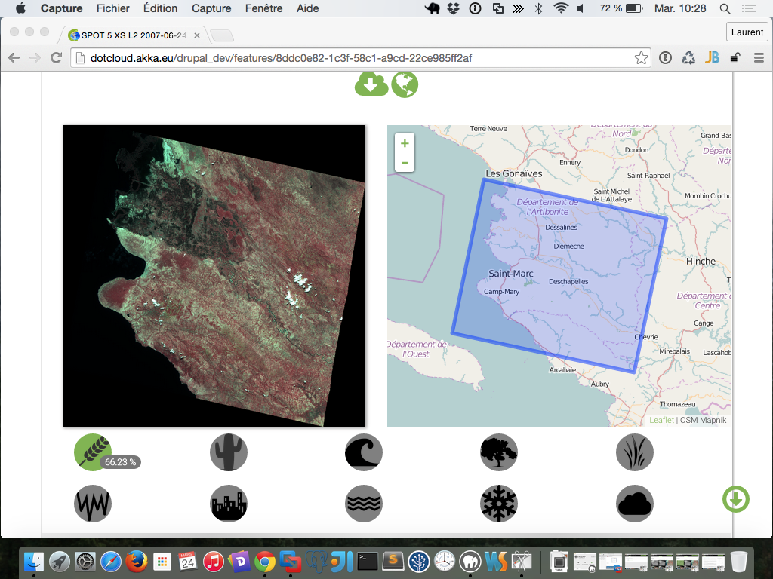
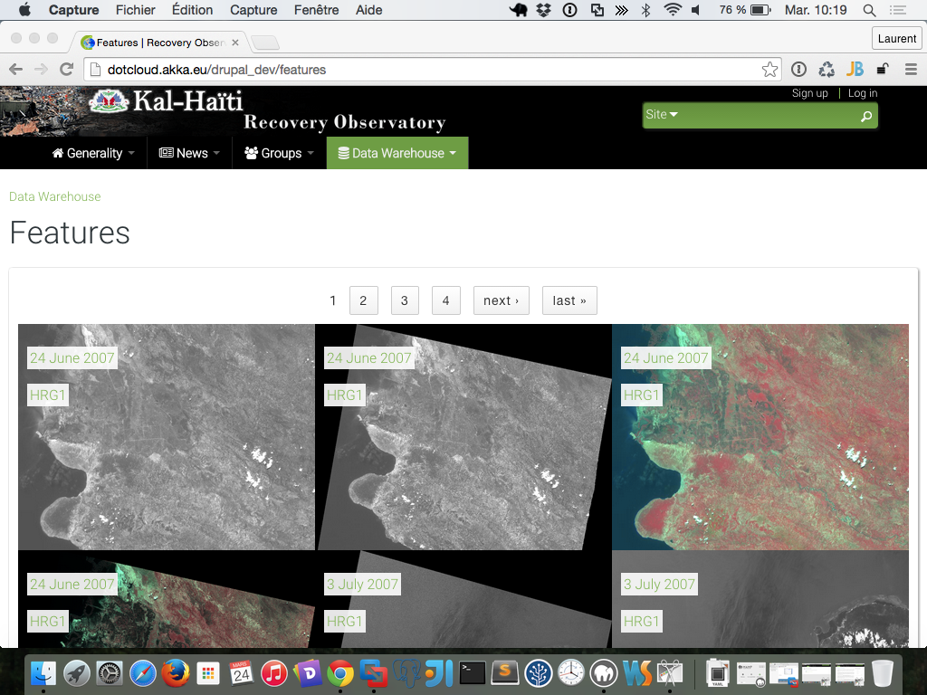
Recovery Observatory
Data acquisition plan
Feature, ie
EO data in Drupal CMS

Slide 8
Interoperability
OpenSearch
CEOS OpenSearch Best Practice document
  Comment period for the document is over
  Comments have been taken into account
  Document is published
CEOS OpenSearch Developer’s Guide document
  Explains key details on how to implement OpenSearch
  Undergoing final review, will be published in April 2015
Most of CEOS agencies data are accessible through OpenSearch
  CWIC federation
  FedEO federation
  IDN
  Other agencies have directly implemented OpenSearch (Canada, France, Japan, …)

Slide 9
Interoperability
CWIC
Annual CWIC Developers meeting held in Feb 2015. Discussed details of improving searching, additional monitoring metrics needed for CWIC components, and support for client and data partners.
Current operational CWIC data partners include: NASA, USGS/LSI, GHRSST/NOAA, INPE, CCMEO, EUMETSAT
Future CWIC data partners status
  ISRO expected to become operational very soon
  AOE and ROSCOSMOS making good progress
CWIC providing search and access to ~70 million granules of satellite data at the operational data partners to CWIC and GEO clients.

Slide 10
18,676 descriptions of data collections) offered to CEOS and GEO communities
IDN working on improving search results relevance
CEOS Agencies – simple process to register your data collections at the IDN available at
    http://ceos.org/document_management/Working_Groups/WGISS/Projects/CWIC/IDN-GCMD/CWIC_IDN-GCMD_DIF-Guide.pdf

Slide 11
Data Stewardship
Three documents produced in the frame of the Long Term Documentation Process (LTDP) working group. Review phase complete and the documents are now being published as Best Practices.
Preservation Workflow
Generic EO Dataset consolidation Process
Persistent Identifiers Best Practices
Updated Purge Alert Procedure in accordance with the discussions had during the last WGISS meeting. Finalising the procedure during the next WGISS

Slide 12
Water Portal
The enhancement to the portal has been completed.
The new architecture will be presented at next WGISS-39.
The portal uses several protocols including OpenSearch and OpeNDAP.
The portal has 286 registered users (as of Mar.23), and is achieving synergy with other domestic systems (DIAS) (single sign-on, etc).
The new data partners (NOAA/NCDC, GEODAB) can be accessed via the portal.

Slide 13
Next Meeting
  WGISS - 39 will be held in Tsukuba, Japan, May 11-15, 2015. The meeting will be hosted by JAXA
  WGISS – 40 will be held in Oxfordshire, UK, September 28 – October 2. The meeting will be hosted by the UK Space Agency.

