Slide 1
OSVW-VC Update
Committee on Earth Observation Satellites
Co-leads: Julia Figa Saldaña - EUMETSAT
B.S. Gohil – ISRO
Paul Chang - NOAA
30th CEOS SIT Meeting
CNES Headquarters, Paris, France
31st March – 1st April 2015

Slide 2
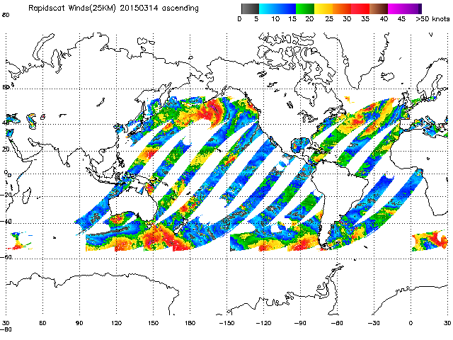
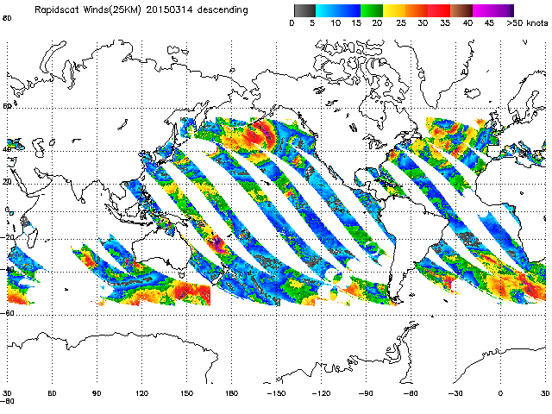
Highlight news: Successful launch of NASA/JPL RapidScat mission on September 20, 2014
Timely and open data access being provided by JPL
Ascending
Descending
Images from http://manati.star.nesdis.noaa.gov/rapidscat
Notes:
NRT Data are available operationally to EUMETSAT users through OSI SAF from JPL since mid-March (routine availability since February)

Slide 3
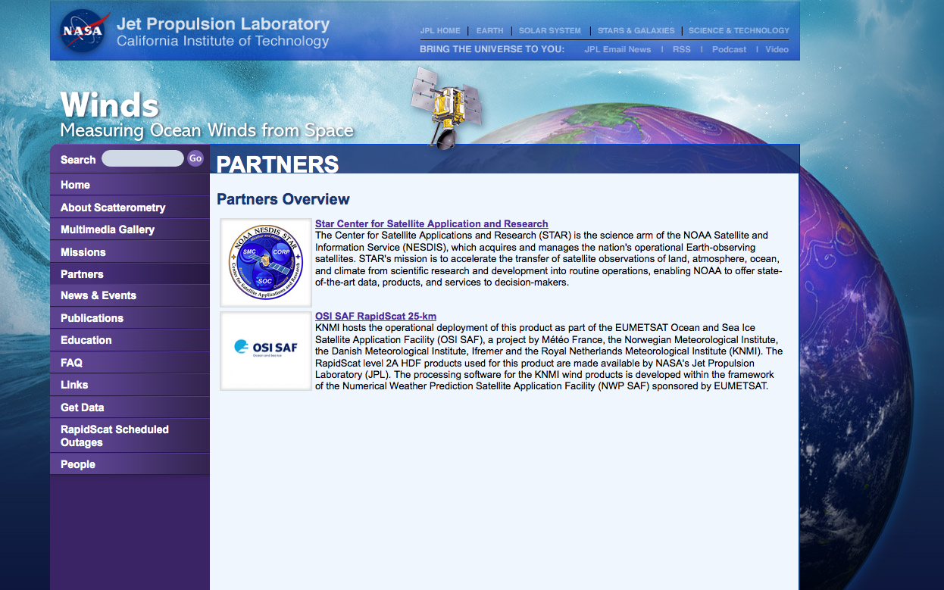
NRT Data are available operationally to EUMETSAT users
through OSI SAF from JPL since mid-March

Slide 4
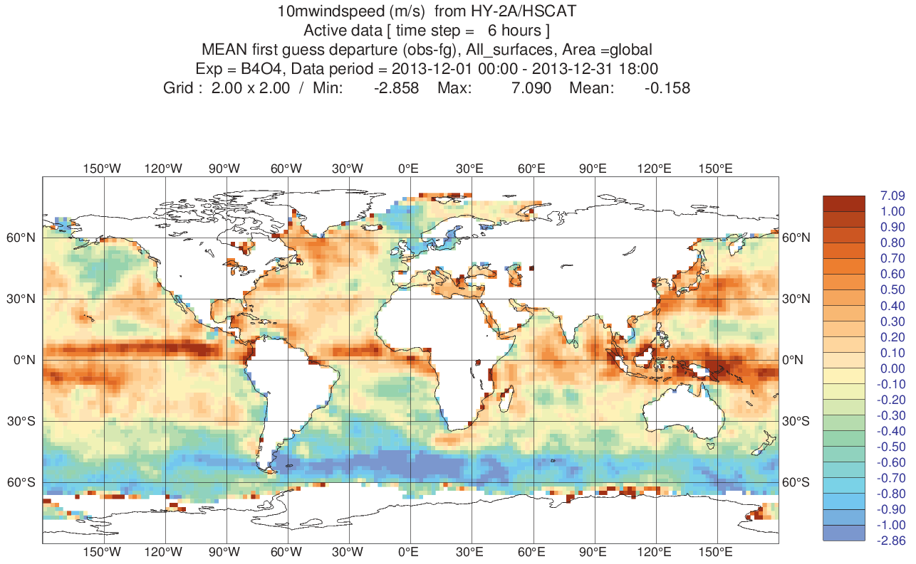
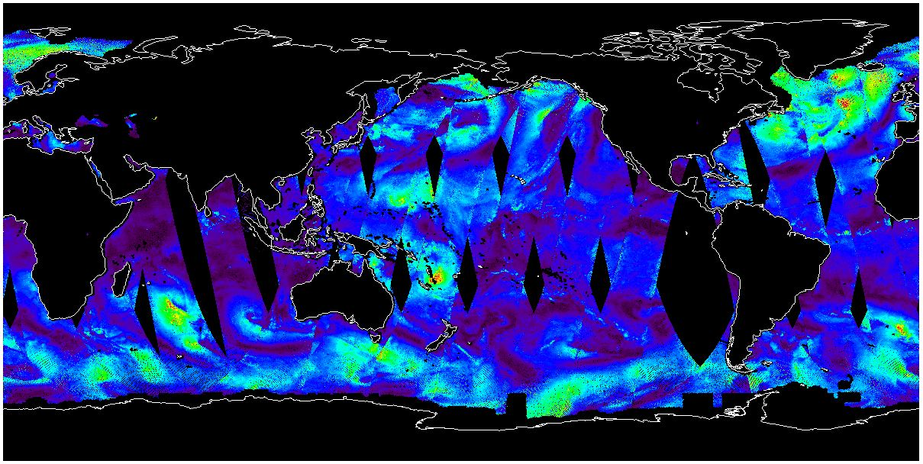
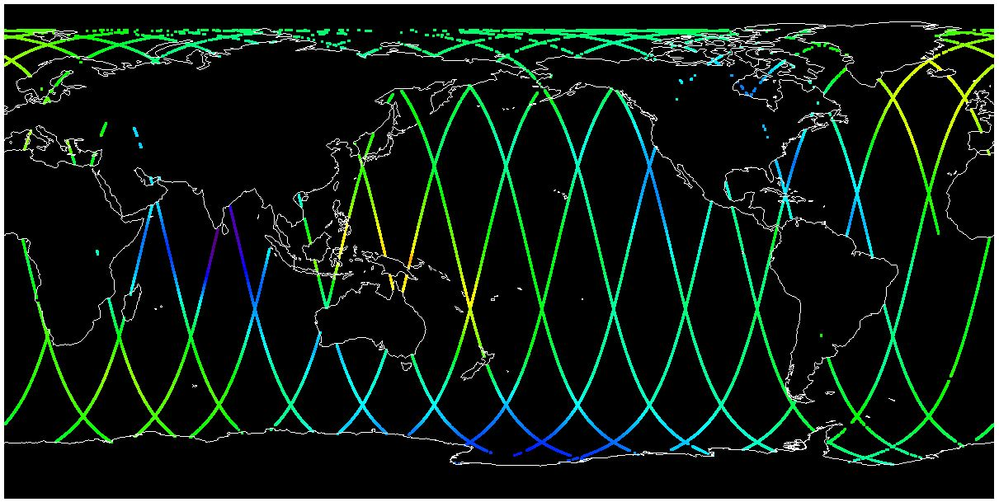
Third Party Data Services: HY2-A data services

Slide 5
Also coming up soon: ISRO planning launch of ScatSat late 2015
ISRO has confirmed their commitment to provide timely and open ScatSat data as it did with OSCAT
Other progress and on-going activities:
CEOS OSVW-VC web page updated
CEOS IDN updates
Currently updating for ASCAT data sets
OSVW-VC meeting planned during IOWVST meeting the week of May 18th, 2015
Follow-up forecaster training course with the South African Weather Service in late 2015 being discussed
Notes:
System similar to Oceansat-2 for SCAT. Cooperation with EUMETSAT on NRT service – follow-up of Oceansat-2
IDN = International Directory Network
IOWVST : International Ocean Wind Vector Science Team
SAWS : NOAA + EUMETSAT Support

