Slide 1
Update on IOCCG/OCR-VC Meeting Outcomes
Committee on Earth Observation Satellites
Paul M. DiGiacomo (NOAA), Peter Regner (ESA), Paula Bontempi (NASA)
SIT-30 Agenda Item #8
CEOS Action / Work Plan Reference
30th CEOS SIT Meeting
CNES Headquarters, Paris, France
31st March – 1st April 2015

Slide 2
Information:
Review progress with respect to OCR-VC action items in the Work Plan 2014-2016 & 2015-2017
VC-1 – Updated (on ongoing basis) on IOCCG web site: ioccg.org
VC-6 – Continued discussion with IOCCG; see esp. reports: 12, 13, 14
VC-7 – Agency mapping exercise complete
VC-8 – Update and plan provided
VC-9 – moving forward w/modular implementation, NASA, ESA, NOAA Update
VC-10 – Update and plans provided

Slide 3
Information
VC-1: List of Relevant Datasets from VCs Q4 2014
Current information is on the IOCCG website at http://www.ioccg.org/data/sensors.html

Slide 4
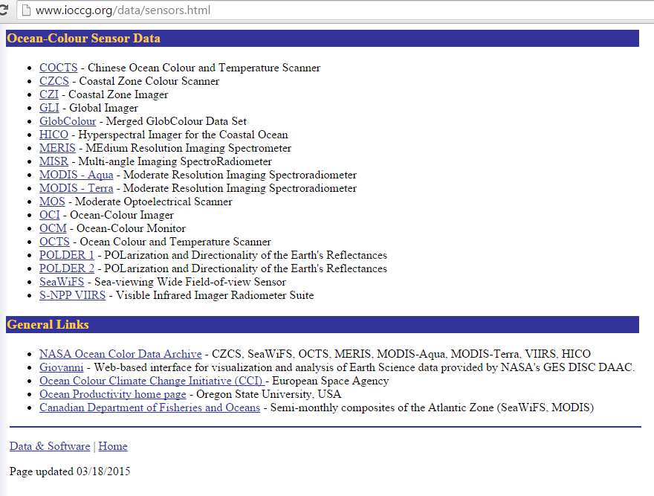

Slide 5
Information
VC-6: Vision and plan for an essential OCR-Virtual Constellation
space segment (Polar and GEO) Q4 2016
IOCCG to update the listing, specs, and details of current and planned ocean colour sensors.
A listing of current and planned ocean color sensors (Polar and GEO) can be found here:
Current - http://www.ioccg.org/sensors/current.html
Planned - http://www.ioccg.org/sensors/scheduled.html

Slide 6
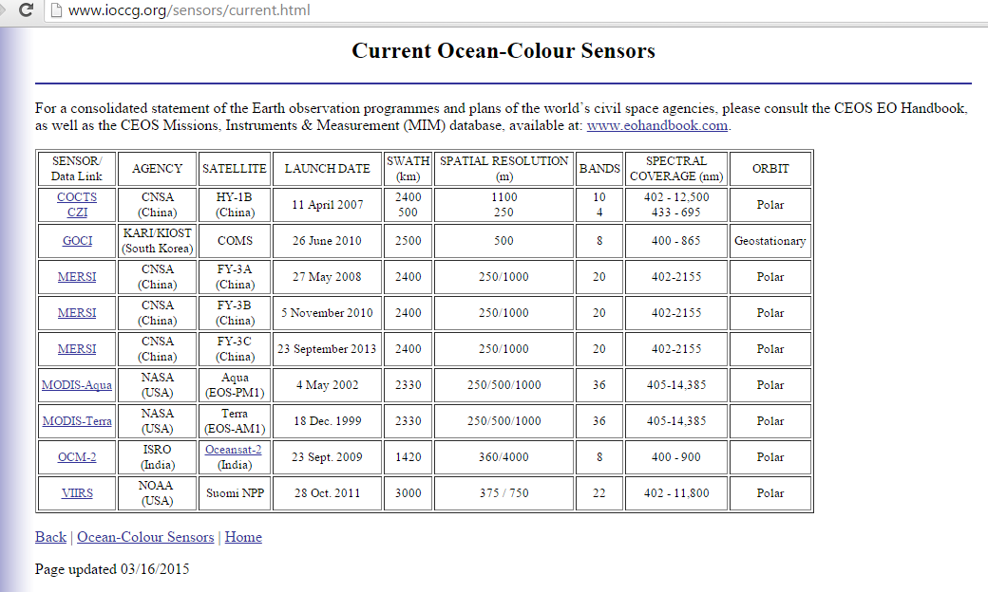

Slide 8
Information
VC-7: Catalog of Cal/Val infrastructure and activities Q2 2015
In 2014, IOCCG undertook a relevant "agency mapping" exercise that included consideration of available, and planned, international agency assets and resources for OCR cal/val.
As a first step towards implementation of the International Network for Sensor Inter-comparison and Uncertainty assessment for Ocean Colour Radiometry (INSITU-OCR) by IOCCG member agencies, the IOCCG asked that each agency indicate on the spreadsheet their potential area of contribution to INSITU-OCR implementation.
At the 3-5 March 2015 IOCCG meeting, IOCCG asked the member agencies to provide an agency-based list of infrastructure and assets.
IOCCG/OCR-VC is considering in situ protocols and data handling as well, such as described in the recent Sentinel-3 Validation Team meeting in December 2014.
Note: Ewa Kwiatkowska (EUMETSAT) will attend the upcoming WG-Cal/Val Meeting on behalf of the OCR-VC/IOCCG

Slide 9
Information
VC-8: Action Plan for GEO Blue Planet Components Q3 2015
The components to the GEO Blue Planet task are drawn from the new Blue Planet structure as per the GEO Work Plan: http://www.earthobservations.org/docshow.php?id=129 that calls out:
C1: Sustained Ocean Observations;
C2: Sustained Ecosystems and Food Security;
C3: Ocean Forecasting;
C4: Services for the Coastal Zone;
C5: Climate and Carbon;
C6: Developing Capacity and Societal Awareness.
IOCCG/OCR-VC agencies are and will continue to make significant contributions to all of the above components.
OCR-VC agencies are fully in support of the GEO Blue Planet Components, and the nature of the contributions vary according to the mission of each agency (e.g., research and development contributions from ESA and NASA; enabling applications and services from EUMETSAT and NOAA).
OCR-VC members serve in active leadership roles for several of the above components (e.g., C3 & C4/NOAA and C5/JRC), and will broadly contribute to the Blue Planet Symposium to be held in Cairns, Australia in May 2015 (hosted by CSIRO)

Slide 10
Information
VC-9: Implementation of the International Network for Sensor
InTercomparison and Uncertainty Assessment for Ocean Colour Radiometry (INSITU-OCR) Q4 2015
IOCCG Executive Committee meeting in October 2014- most agencies had completed the mapping exercise
- identify agencies that had resources to put into INSITU-OCR
- identify gaps in infrastructure that agencies could collectively address.
Noted that not enough examples of inter-agency collaboration.
Noted that not all agencies had included their long-term plans on the spreadsheet. ACTIONS from IOCCG EC Meeting - Agencies were requested to submit to the IOCCG Chair a short list of actual gaps for existing/upcoming missions, a list of priorities from their perspective, as well as areas where they need help, e.g., a need for more validation sites.
Once the OCR-VC has this updated information compiled, it will be conveyed to CEOS-SIT via the OCR-VC Chairs

Slide 11
Information (as an update - continued)
VC-9: Implementation of the International Network for Sensor InTercomparison and Uncertainty Assessment for Ocean Colour Radiometry (INSITU-OCR) Q4 2015
Sustaining current operational activities and in particular establishing new efforts (e.g., pilot investments and projects) to move the OCR-VC and INSITU-OCR forward is a very high priority.
(new) NASA has released and selected the vicarious calibration instrumentation competition for PACE, as a contribution to INSITU-OCR, and,
(new) ESA is planning to launch an open tender action this spring addressing the need for improved OCR in-situ instrumentation and community consensus protocols for instrument calibration and vicarious adjustments as well as establishing traceability to metrological institutes, and,
(existing) NOAA continues to fund and sustain MOBY operations (including an on-going system refresh), supporting present and upcoming (operational) missions
iv) all agencies could contribute towards the “protocols activity” (e.g., small committee to catalogue and share information regarding in situ instrumentation (for calibration and validation) protocols. The IOCCG will host a website to disseminate all relevant lists and information (prototype being developed by NASA at: oceancolor.gsfc.nasa.gov/cms/ioccg_proto_main).
Goal: enable communication about the refinement of in situ measurement protocols and to reduce redundancy in efforts, fill in gaps, and better target opportunities and key players. This is an early contribution to INSITU-OCR, and this multi-agency collaboration will advance its implementation.

Slide 12
Information
VC-10: Recommend the creation of a GEO Water Quality of Practice Q2 2015
There will be a GEO Water Quality Summit held April 2015 in Geneva at WMO.
The Summit Goal is to define specific requirements of the water quality observing system components and develop a plan to implement an integrated, global end-to-end water quality monitoring and forecasting service.
The Summit Deliverables will be: Development of a) Strategic implementation and b) A phased action plan including baseline (goal, ample funding)funding constrained) service build-outs, with both a short-term (0-5 year) build-out plan for pilot/prototype regional service(s) and a long-term (6-10 year plan for a global-scale water quality monitoring and forecasting service, and,
Formation of a GEO Water Quality (GEO-WaQ) Community of Practice bringing together relevant data providers and users who will work collaboratively to implement, utilize, maintain and enhance the regional (initially) and (ultimately) global water quality monitoring and forecasting service.

Slide 13
IOCCG-20 Actions
Note: Unofficial (TBC)
Action | Brief description | Status
20/1 | Vittorio Brando and Susanne Craig to submit a proposal for a WG with the mandate of revisiting parts of IOCCG Reports 3 and 5, and specifically incorporating the multi-water algorithm concept (due date: 1 June 2015). | Open
20/2 | IOCCG to send an additional supporting letter to Philippe Brunet and Kurt Vandenberghe endorsing the letter sent by Rosalia Santoleri on behalf of the S3VT scientists (S. Bernard, V. Stuart). | Open
20/3 | Send invitation letter to Craig Donlon inviting him to chair a panel discussion at IOCS-2015 (S. Bernard, V. Stuart). | Closed
20/4 | OCR-VC to provide a redaction of where IOCCG fits into GOOS and also to correct their description of the framework for ocean observing (P. DiGiacomo, S. Bernard) | Open
20/5 | Stephanie Dutkiewicz to attend the GOV MEAP-TT workshop in Halifax to represent the ocean colour modelling community. | On-going
20/6 | Stephanie Dutkiewicz to prepare a proposal and draft Terms of Reference for a new IOCCG working group on “Ocean Colour Applications for Biogeochemical and Climate Modelling” by June 2015. | Open
20/7 | EUMETSAT to investigate development of a Sentinel-3 multi-water demonstration product (E. Kwiatkowska). | Open
20/8 | IOCCG Agencies to provide new links to publically available ocean colour data sets, or update the links currently available on the IOCCG website (Venetia Stuart to coordinate). | On-going
20/9 | All IOCCG agencies to provide information to Venetia Stuart to update the timelines and specifications for the current and planned lists of ocean colour sensors on the IOCCG website. P. Bontempi, P. Regner and P. DiGiacomo to provide information to CEOS. | On-going
20/10 | Paul DiGiacomo to attend the SIT-30 meeting in Paris (31 March – 1 April 2015). | Closed
20/11 | Confirm new co-chairs of ECV Task Force (B. Franz, D. Antoine). | Open
20/12 | Jim Yoder’s ECV presentation to be included on IOCCG website (V. Stuart). | Closed
20/13 | Stewart Bernard and Giuseppe Zibordi to draft requirements for a community AOP/IOP processor for in situ data. | Open
20/14 | IOCCG to send a letter to KIOST/KARI expressing appreciation for GOCI data and for the rapid development of the missions (D. Antoine, S. Bernard, V. Stuart). | Open
20/15 | Ewa Kwiatkowska to consult with trainers at EUMETSAT to see how they can support IOCCG capacity building efforts. | Open
20/16 | IOCCG to prepare a summary of ocean colour training opportunities, including online courses (H. Dierssen, C. Wilson, E. Kwiatkowska, S. Bernard, V. Stuart, with input from Committee members). | Open
20/17 | Heidi Dierssen to prepare a brief on IOCCG-20 meeting for EOS. | On-going
20/18 | Paula Bontempi to finalize dates and venue for IOCCG-21 in 2016. | Open

Slide 15
Discussion
Requested distribution of ocean color radiometry satellite Level 0 or Level 1A data (as noted in IOCCG report #13); how can CEOS-SIT facilitate access to these data sets?
Importance of validation across all agencies and why validation (as well as calibration) should be built into all ocean color radiometry missions – how do we raise visibility and sustained implementation of these crucial capabilities in support of OCR?

