Slide 1

3rd UN World Conference on
Disaster Risk Reduction
Ivan PETITEVILLE, ESA
Chu ISHIDA, JAXA
SIT-30 Agenda Item # 6
CEOS Action DIS-7
30th CEOS SIT Meeting
CNES Headquarters, Paris, France
31st March – 1st April 2015

Slide 2
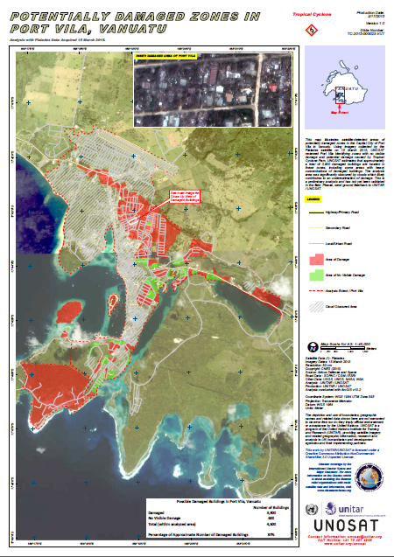
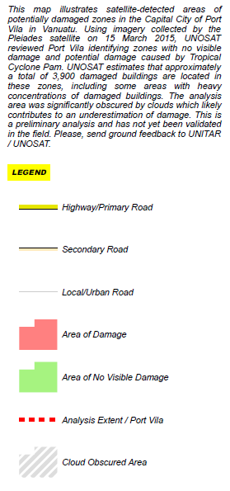
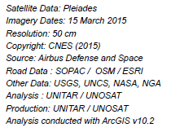

Slide 3
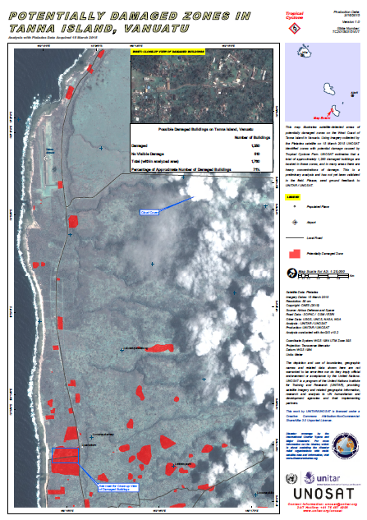
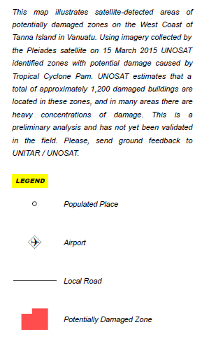

Slide 4
Plan
Outcomes from WCDRR
Next steps for CEOS in Disaster Risk Reduction
Lessons learned in preparation of a major UN conference
Outcomes from WCDRR
Next steps for CEOS in Disaster Risk Reduction
Lessons learned in preparation of a major UN conference

Slide 5
Some Figures
Over 6,500 delegates attended the intergovernmental and multi-stakeholder events.
  Over 143,000 over five days attended the public forum;
187 States officially represented;
  over 25 Heads of State, Vice Presidents, and Heads of Government as well as 100 participants at ministerial level.

Slide 6

Some Political Declarations
Japan Premier Abe pledged $US 4 billion over four years for implementation of post-2015 framework.
incl. Technologies for disaster observation, prediction and warning (incl. ICT, earth observation from space and geospatial information) and
Sentinel Asia

Slide 7
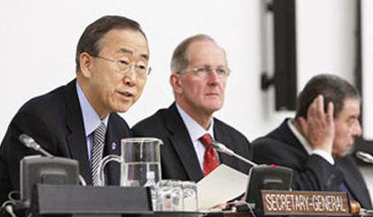
Some Political Declarations
French Foreign Minister Fabius (incoming President of COP21) called for creation of worldwide Climate Disaster Warning system
  “It is necessary to tackle these problems together and not separately.”
UN Secretary General recalled that “Six billion dollars allocated each year can result in savings of up to US$360 billion by 2030”
Notes:
Fabius : “70% of disasters are now linked to climate change, double the number of twenty years ago. ”

Slide 8
Outcomes for Space Agencies
Overall very positive unlike previous WCDRR (Kobe, 2005)
Political and institutional support:
  Several Decision Makers and Directors of key organisations cited satellite EO as one critical data source.
Post-2015 Framework for DRR contains:
  3 explicit references to satellite EO and several articles relying on the use of remote sensing data e.g. to produce regular up-to-date risk maps.

Slide 9
Outcomes for Space Agencies
Good platform to advertise usefulness of satellite EO and added value of coordination through CEOS.
  Two public presentations and several informal ones during side meetings with key stakeholders.
  Active participation to 3 Working Sessions (out of 30).
  Two CEOS booths (brochures, poster) kindly hosted by JAXA
  ~ 1500 copies of CEOS EO Handbook distributed
  E-course (video) with UNITAR

Slide 10



Slide 11
Plan
Outcomes from WCDRR
Next steps for CEOS in Disaster Risk Reduction
Lessons learned in preparation of a major UN conference
Outcomes from WCDRR
Next steps for CEOS in Disaster Risk Reduction
Lessons learned in preparation of a major UN conference

Slide 12
Next Steps for CEOS
  CEOS can play a key role in implementing the post-2015 framework.
Following presentations of CEOS disaster-related activities, some key partners have expressed strong interest in collaborating with CEOS on way forward:
World Bank GFDRR (Global Facility for Disaster Risk Reduction), UNESCAP, Copernicus/EMS

Slide 13
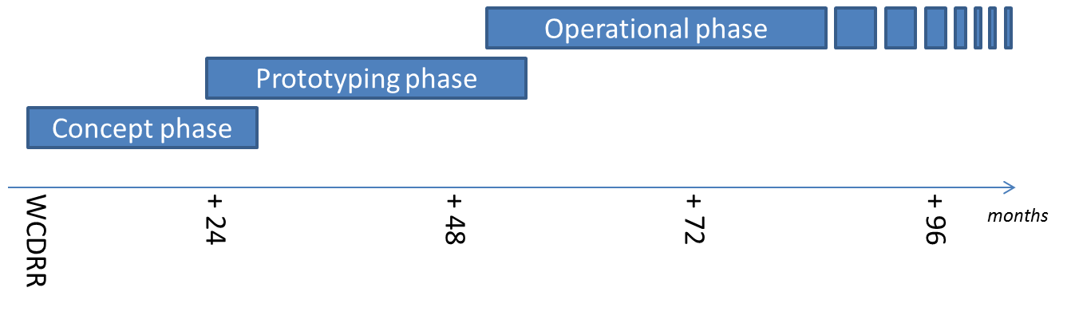
Next Steps for CEOS (cont’)
Intention: form a partnership with key stakeholders to define a strategy addressing high priorities of post-2015 framework with resources available, on a best effort basis, adopting a phased approach
if extra resources and funding
identified

Slide 14
Plan
Outcomes from WCDRR
Next steps for CEOS in Disaster Risk Reduction
Lessons learned in preparation of a major UN conference
Outcomes from WCDRR
Next steps for CEOS in Disaster Risk Reduction
Lessons learned in preparation of a major UN conference

Slide 15
Lessons Learned
  Enormous work over more than 2 years.
  Lots of lobbying with national governments and key stakeholders.
  Absolutely necessary for a highly political event
  Importance of establishing personal contacts
  Close cooperation with other organisations gives much more weight to our actions
  GEO and UN Agencies (UNITAR ; UNISDR)
More flexibility would be needed for the Head of Delegation to provide last minute statement without prior CEOS approval
  Statement to be in line with declarations & texts previously shared with CEOS.
  Statement to be shared with Delegation before and with CEOS asap.

Slide 16
Personal Thanks to…
  … CEOS Agencies and CEOS Principals,
  WG Disasters members, Symbios; ESA EO Graphic Bureau, SEO, and ….
  Special thanks to JAXA for their dedication and precious help before and during the Conference.

Slide 17
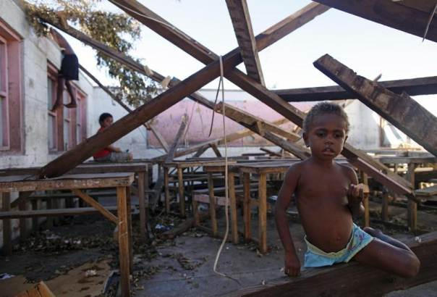
QUESTIONS ?
THANK YOU …
Children play in a destroyed school classroom in Tanna, Vanuatu, March 18, 2015. REUTERS/Edgar Su

