Slide 1
Group on Earth Observations (GEO) Developments CEOS SIT-30 Paris Agenda Item 5 Barbara Ryan 30 March 2015

Slide 2
GEO Vision
To realize a future wherein decisions and actions, for the benefit of humankind, are informed by coordinated, comprehensive and sustained Earth observations and information.

Slide 3
Secretariat Priorities for 2015
Prepare GEO for 2nd Decade; Support IPWG
Support Ministerial and Advance Communication/Outreach to Stakeholders
Re-engage Core Members/POs – Fill Gaps New Members
Refine Participation in Global Environmental Governance Mechanisms
Increase External Resources

Slide 4
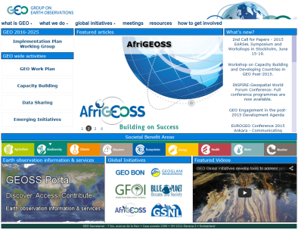
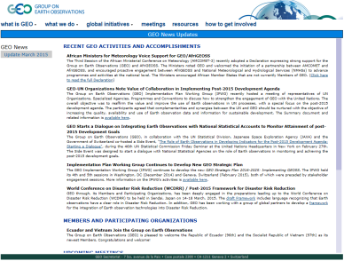
Communication/Outreach Initiatives

Slide 5
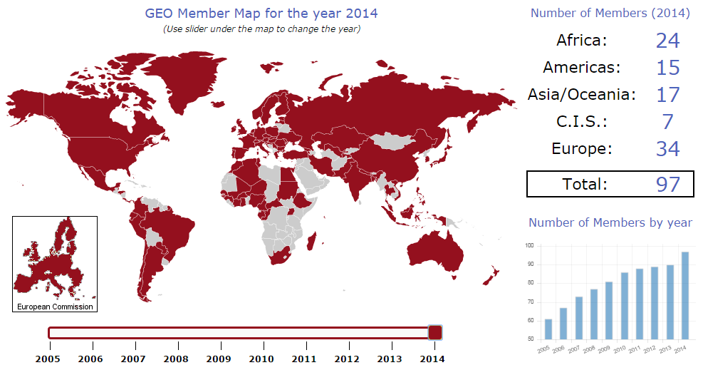
GEO Membership

Slide 6
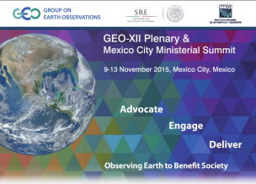
Filling the Gaps
Latin America
Africa
Middle East
Asia

Slide 7
87 Participating Organizations

Slide 8
Intergovernmental Organizations
Value Proposition: Leverage existing expertise, capacity, and coordination/representation of selected communities and provide additional data, tools and services.

Slide 9
UN Agencies, Programmes and Conventions
Value Proposition: Leverage existing monitoring efforts, systematically incorporate Earth observations into monitoring international treaties and conventions, and increase political support/recognition of Earth observations and GEO.

Slide 10
International Scientific Organizations
Value Proposition: Leverage existing expertise, capacity and coordination/representation of selected communities, and increase visibility for importance of sustained observing systems.

Slide 11
Emerging Partnerships or New Communities

Slide 12
International Development Banks
Value Proposition: Leverage assets in GCI to select, monitor and evaluate investments/loans, ensure new data is open, available and shared (in situ opportunities extensive), build capacity and potential funding for GEO projects.

Slide 13
Commercial Sector/Associations
Value Proposition: Bridge gaps between data and information by developing products, tools and services, potential funding for GCI.

Slide 14
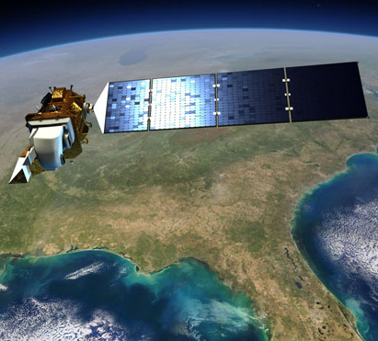
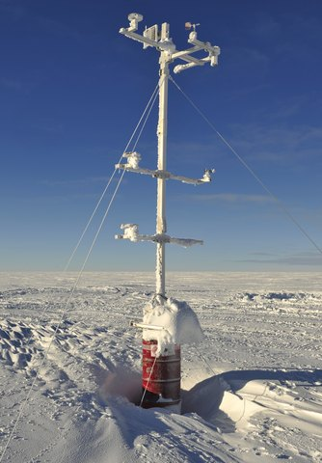
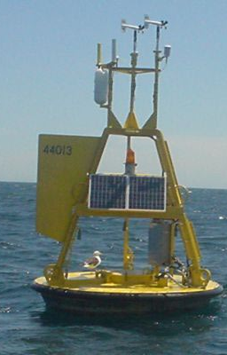
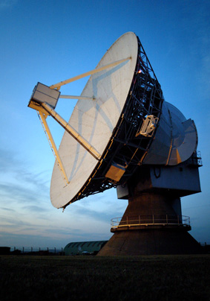
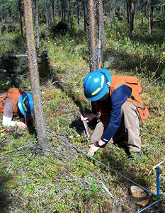
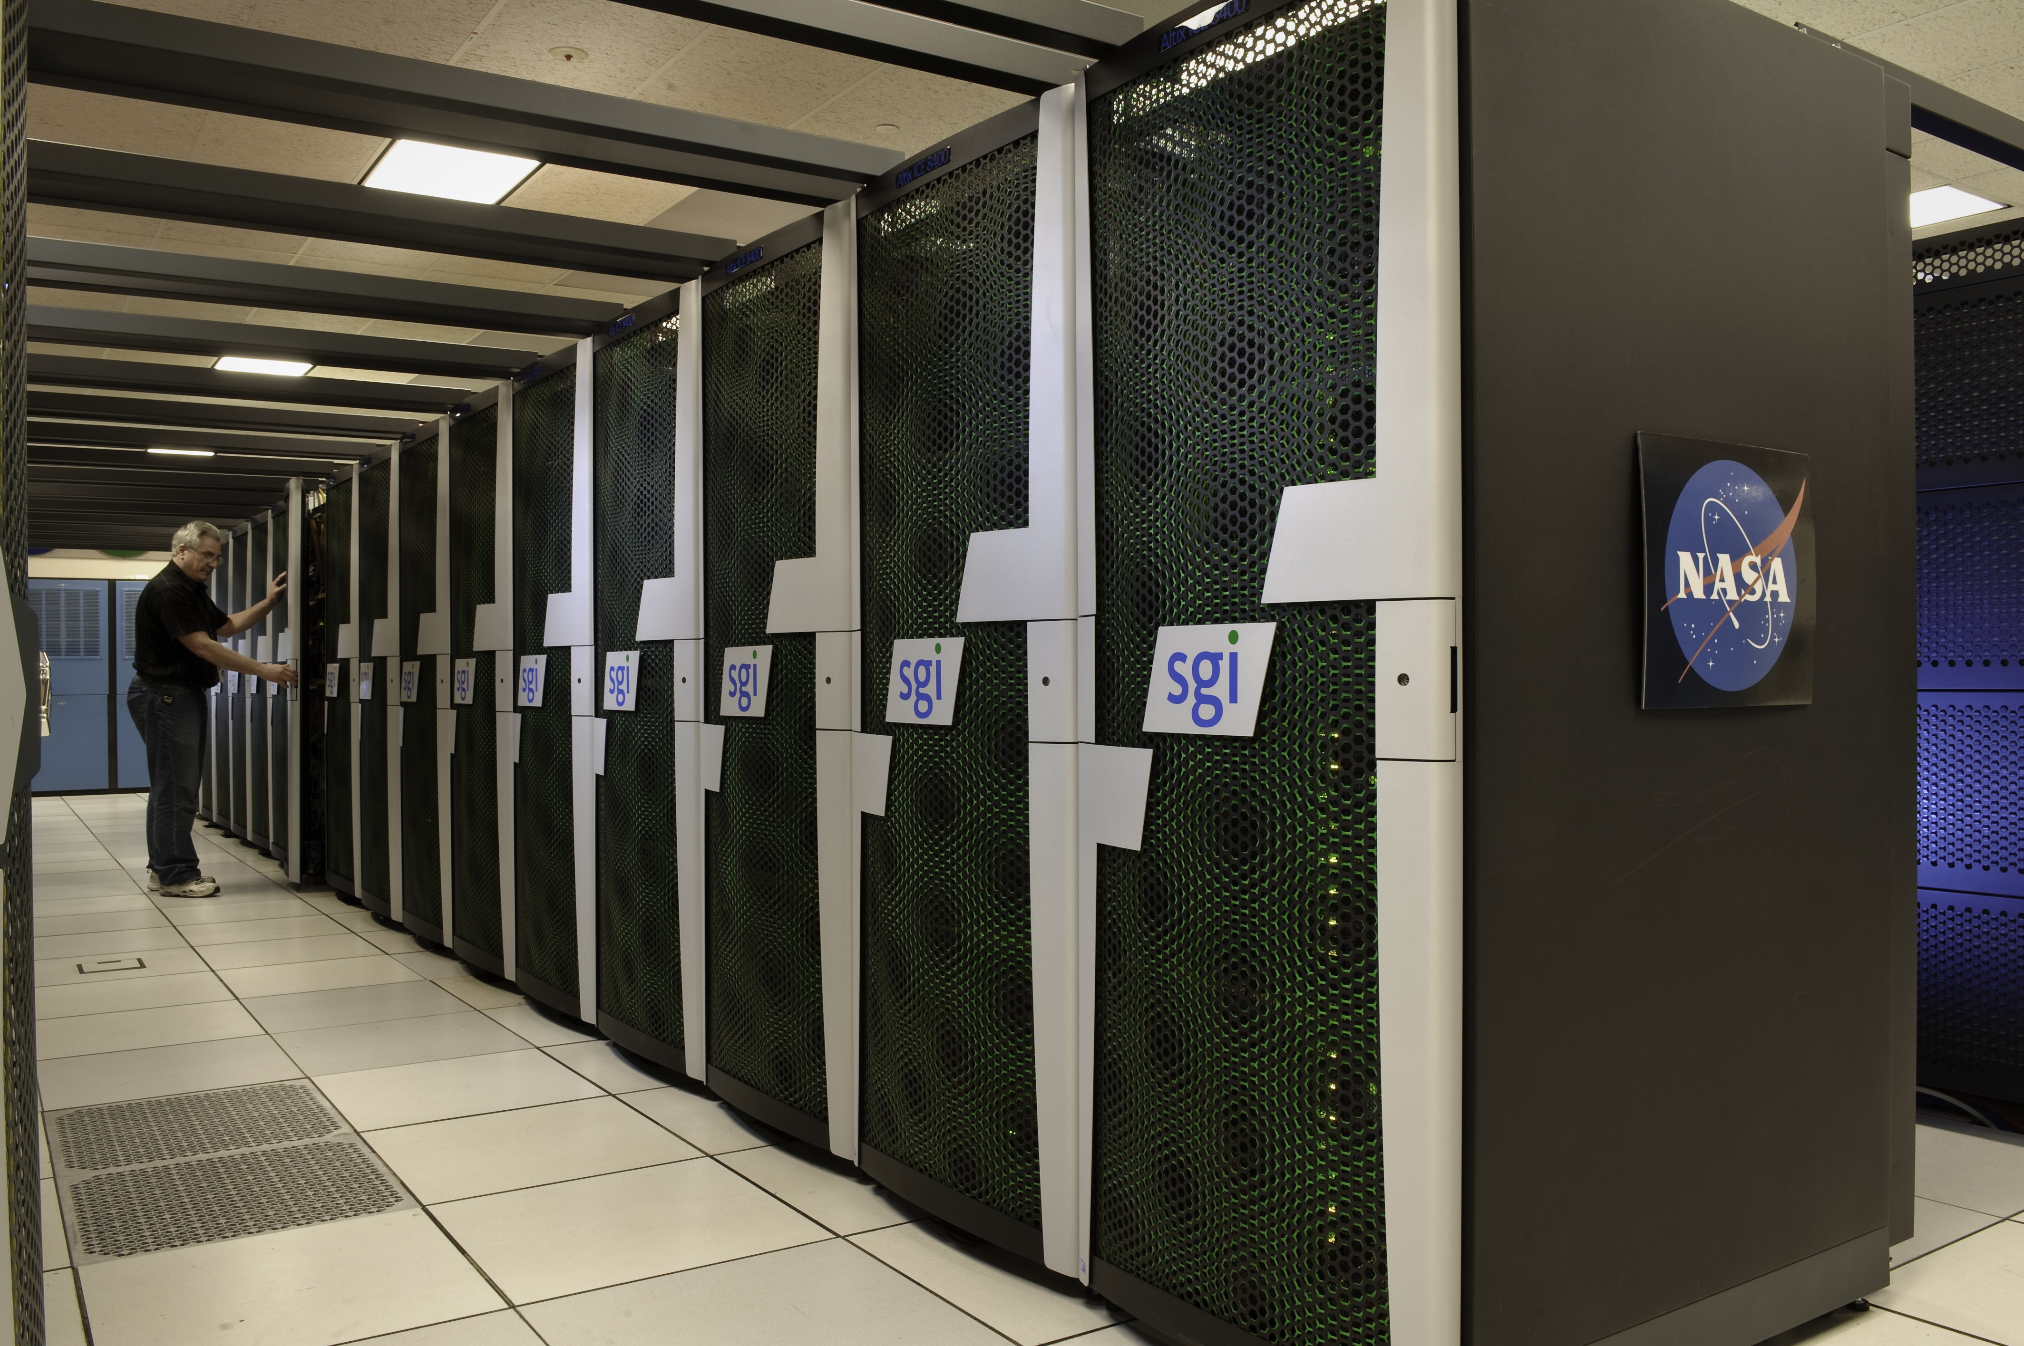
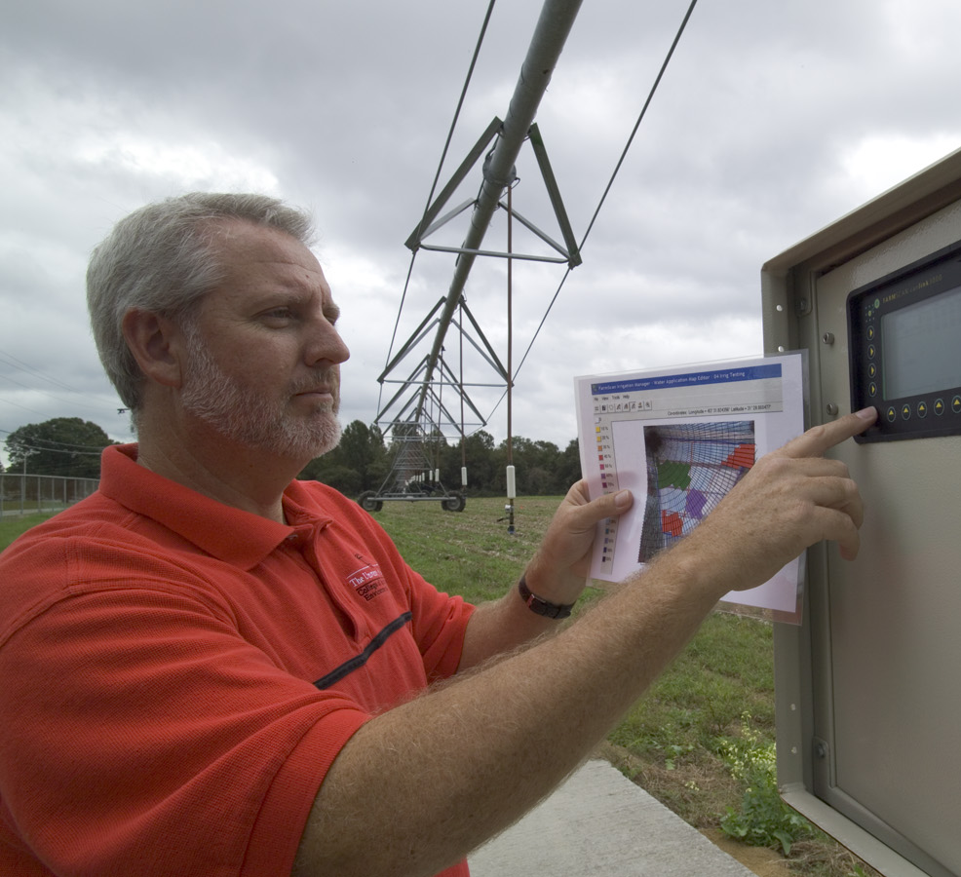
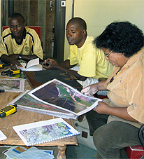
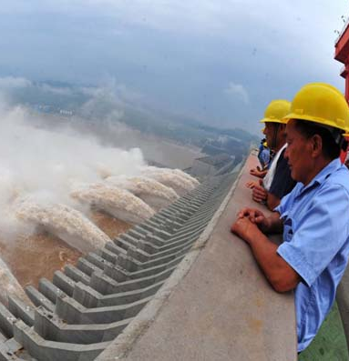
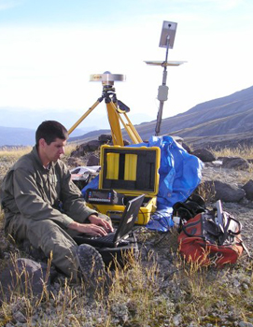
Commercial Sector Spans information Value Chain
Data
providers
Value-Added providers
Downstream
users

Slide 15
Participation in Global Environmental
Governance Mechanisms

Slide 16
Rio+20 -- The future we want
recognizes “… the importance of space-technology-based data, in situ monitoring and reliable geospatial information for sustainable development policymaking, programming and project operations. In this context, we note the relevance of global mapping and recognize the efforts in developing global environmental observing systems, including by the Eye on Earth Network and through the Global Earth Observation System of Systems. We recognize the need to support developing countries in their efforts to collect environmental data.”

Slide 17
Priority International Engagements

Slide 18
Infrastructure Partnerships

Slide 19
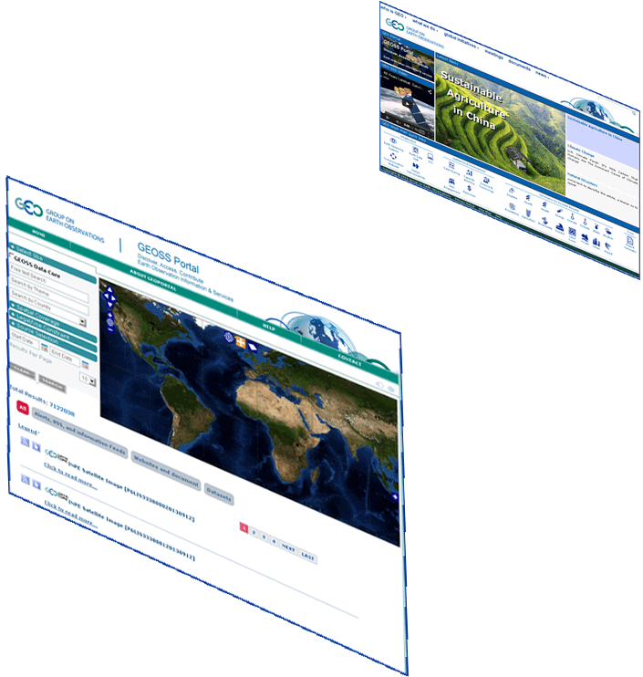
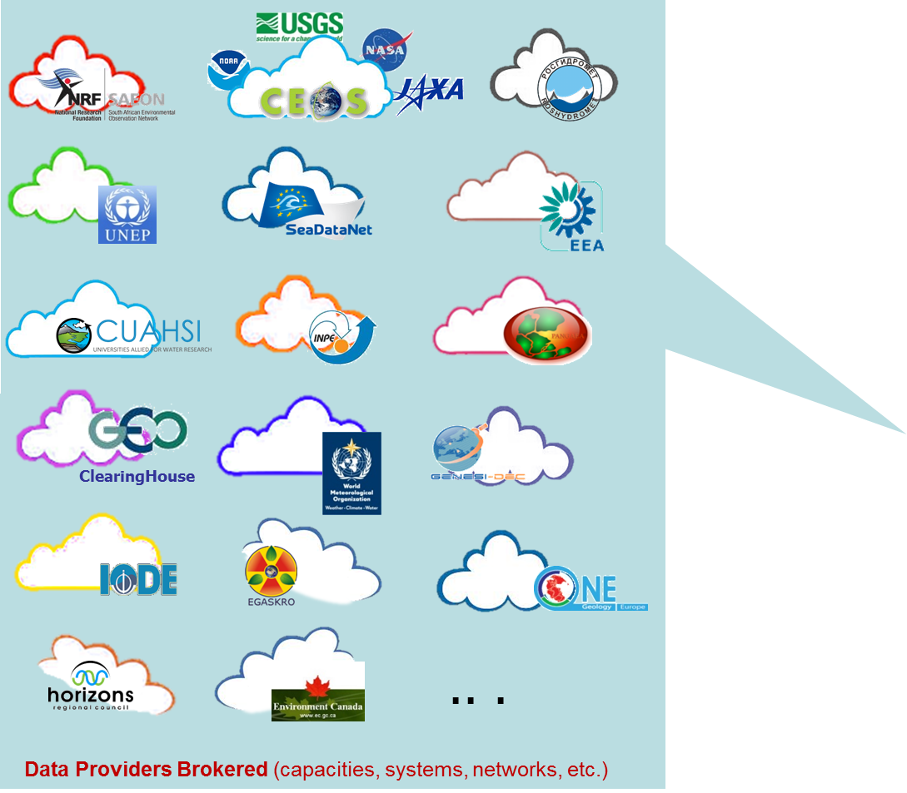
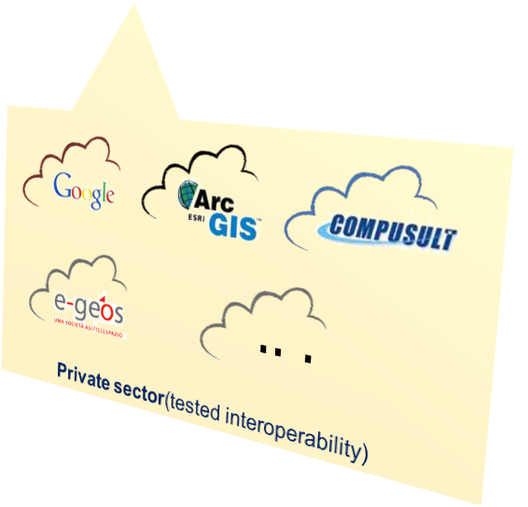
Home Page
GEOSS Portal
GEO DAB
Discovery & Access Broker
Notes:
Added GEOSS Clearinghouse, IDN, and CWIC, moved NOAA, added JAXA
19

Slide 20
Introduction of the Brokering approach

Slide 21
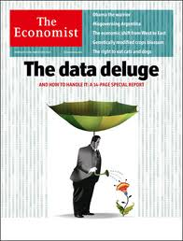
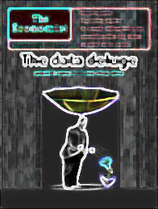
Terminology Tracking & Reporting
About 35 brokered data providers
.. .
Publish
More than 14 Million accessible resources (mix of data collections and datasets)
.. .
Contain
.. .
More than 82 Million assets
(mix of satellite scenes, raingage, streamgage records, etc.)
Resources
Notes:
It will be important to demonstrate the accuracy of these numbers. We have had difficulty tracking the source of large reported numbers in the past and verifying that they were actually accessible. The phrase “potentially Discoverable” should be defended in the demo.
21

Slide 22
GCI Assets
 | Brokered Data Providers | Collection | DataCORE | Granules
1 | CEOS WGISS CWIC (EO satellite) | 1796 | 50000000 | 50000000
2 | HIS Central US | 11835969 | - | 11835969
3 | FedEO/ESA | 2030 | - | 6856755
4 | SeaDataNet | 394 | - | 1300000
5 | INPE | 831710 | 831710 | 831710
6 | PANGEA | 349718 | 349718 | 349718
7 | ArcGIS online ESRI | 185000 | - | 185000
8 | WMO Information System | 153604 | 331 | 153604
9 | US Data Gov | 75968 | - | 75968
10 | GEOSS Clearinghouse | 44163 | 482 | 44163
11 | NASA GCMD | 24424 | 9484 | 24424
12 | SAEON | 7530 | 898 | 7530
13 | IODE | 7449 | - | 7449
14 | NOAA Unified Access Catalog | 5935 | - | 5935
15 | GRDC/GEOWOW | 3825 | 3825 | 3825
16 | New Zealand Government geodata Network | 2012 | - | 2012
17 | New Zealand Government data catalog | 1875 | - | 1875
18 | Webservice Energy Catalog | 1010 | 33 | 1010
19 | Canadian Monitoring Network | 829 | - | 829
20 | GMOS Database | 745 | - | 745

Slide 23
GCI Assets, cont.
 | Data Providers | Collection | DataCORE | Granules
21 | Knossos | 536 | - | 536
22 | EEA SDI | 412 | 412 | 412
23 | EGASKRO | 402 | 402 | 402
24 | OneGeology | 389 | 389 | 389
25 | BYU World Water Catalog | 267 | - | 267
26 | HIS Central Italy | 245 | - | 245
27 | ISPRA Monitoring network | 245 | - | 245
28 | DIAS/Japan | 202 | - | 202
29 | NIWA Data Catalog | 161 | - | 161
30 | RASAQM | 121 | 121 | 121
31 | MEDINA SDI | 58 | - | 58
32 | New Zealand Monitoring Network | 32 | - | 32
33 | Chile Road Network and Admin | 22 | - | 22
34 | Red Vial – Chile | 17 | - | 17
35 | Limites – Chile | 5 | - | 5

Slide 24
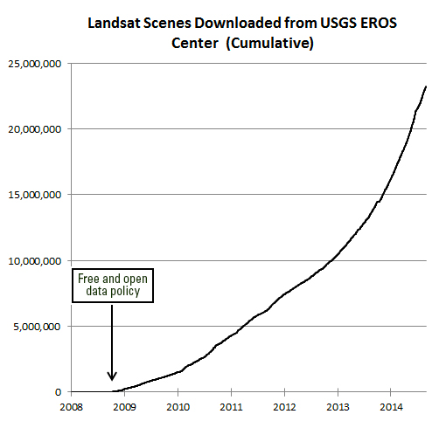
Economic Benefit 2011
USA $1.70 B
International $400 M
Global Total $2.1 B
.

Slide 25
Canada’s Experience
Radarsat-2

Slide 26
Mexico Ministerial and GEO-XII
GEO Week
9-13 November 2015
Mexico City
bryan@geosec.org
oochiai@geosec.org
www.earthobservations.org

